Slide 1
South Carolina Birth Outcomes Initiative
Postpartum LARC Experience
Amy H. Crockett, MD, MSPH
Clinical Lead, South Carolina Birth Outcomes Initiative
Maternal Fetal Medicine, Department of OB/GYN
Greenville Health System
acrockett@ghs.org

Slide 2
Disclosures
Grant/research support
  SC Department of Health and Human Services
  SC Chapter of the March of Dimes
  National Institutes of Health (R01 HD082311)
South Carolina Birth Outcomes Clinical Lead, position funded by the South Carolina Chapter of the March of Dimes
Vice Chair, South Carolina Section of ACOG

Slide 3
Objectives
To understand the biggest successes and the most significant challenges of the South Carolina experience with inpatient post-partum LARC
To describe elements necessary to implement inpatient postpartum LARC protocols in your hospital setting

Slide 4
Long Acting Reversible Contraception
Image downloaded 12.12.17 from: http://health.heraldtribune.com/2015/11/03/brody-most-reliable-birth-control-is-least-understood/

Slide 5
Contraceptive CHOICE Project
ACOG supports immediate postpartum LARC insertion (ie, before hospital discharge) as a best practice, recognizing its role in preventing rapid repeat and unintended pregnancy.
ACOG Practice Bulletin #186 November 2017
Women overwhelmingly chose LARC (>75%)
LARC methods associated with:
  higher continuation (85% vs 55% at 12 mos)
  more satisfaction (82% vs 54% at 12 mos)
  lower rates of unintended pregnancy (RR 20)
    <1% for LARC methods and Depo Provera
    9% for pills, ring and patch
http://www.choiceproject.wustl.edu/#STUDIES

Slide 6


Slide 7



South Carolina
2016 Birth Statistics
57,3337 Live Births
43 Birthing Hospitals
55% of women Medicaid eligible
50% unintended
11.2% deliver preterm
Downloaded December 9, 2017: http://www.scdhec.gov/VitalRecords/Statistics/

Slide 8
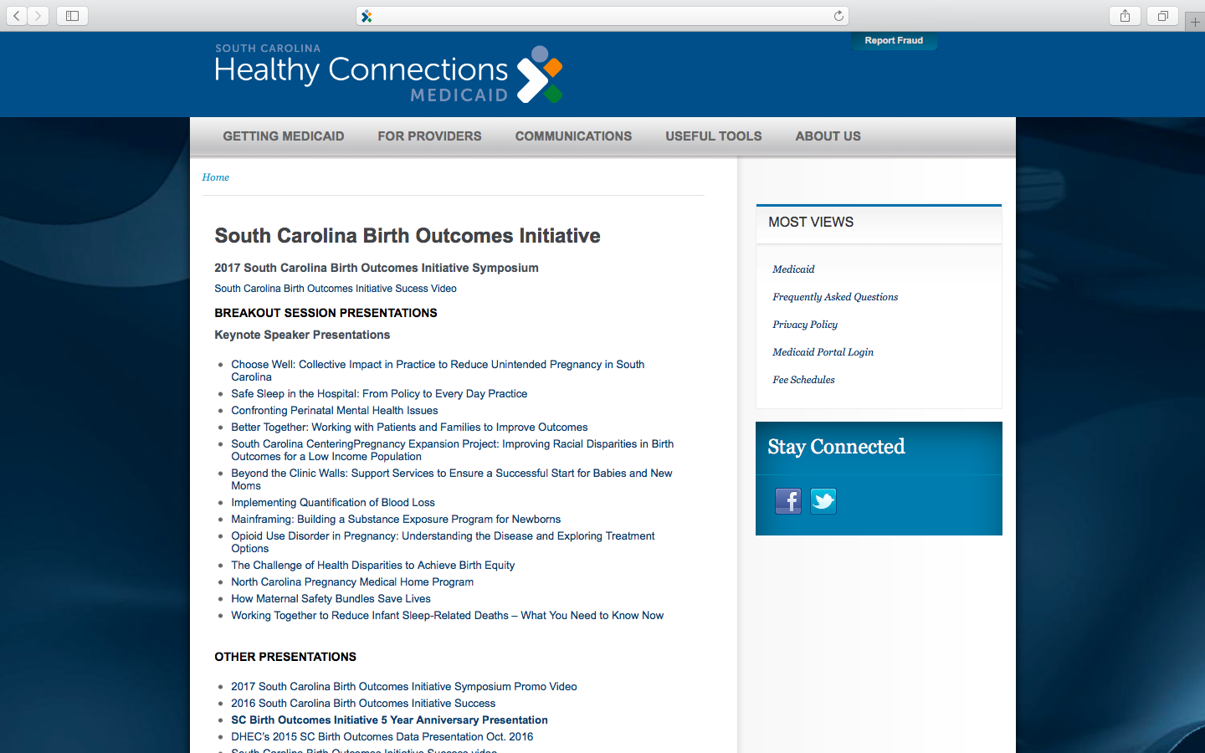

Slide 9
South Carolina Birth Outcomes Initiative established in 2011
Birth Outcomes Initiative
Quality and Safety
Disparities
BabyFriendly
Behavioral Health
Data
Care Coordination

Slide 11
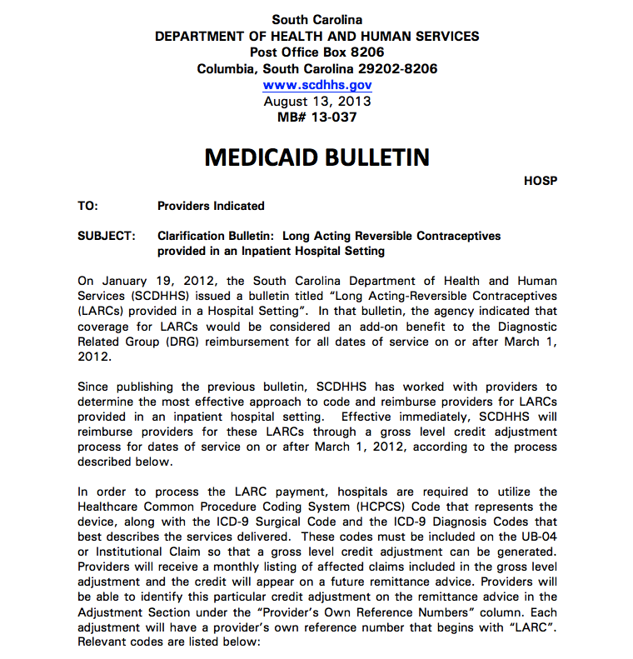
As of January 2017, 6 clarification- or reimbursement- related bulletins have been released by SC DHHS related to LARCs

Slide 12
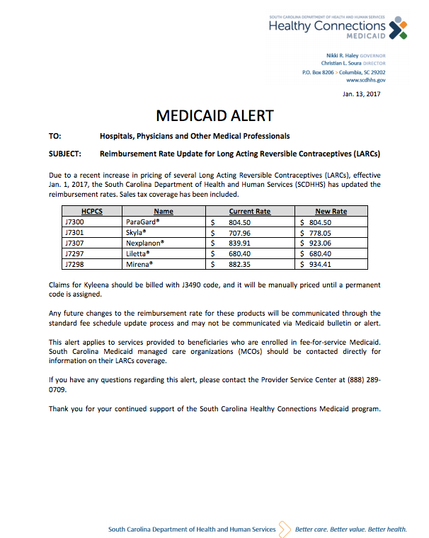

Slide 13
Review of 26 State Medicaid Inpatient LARC Policies

Slide 14
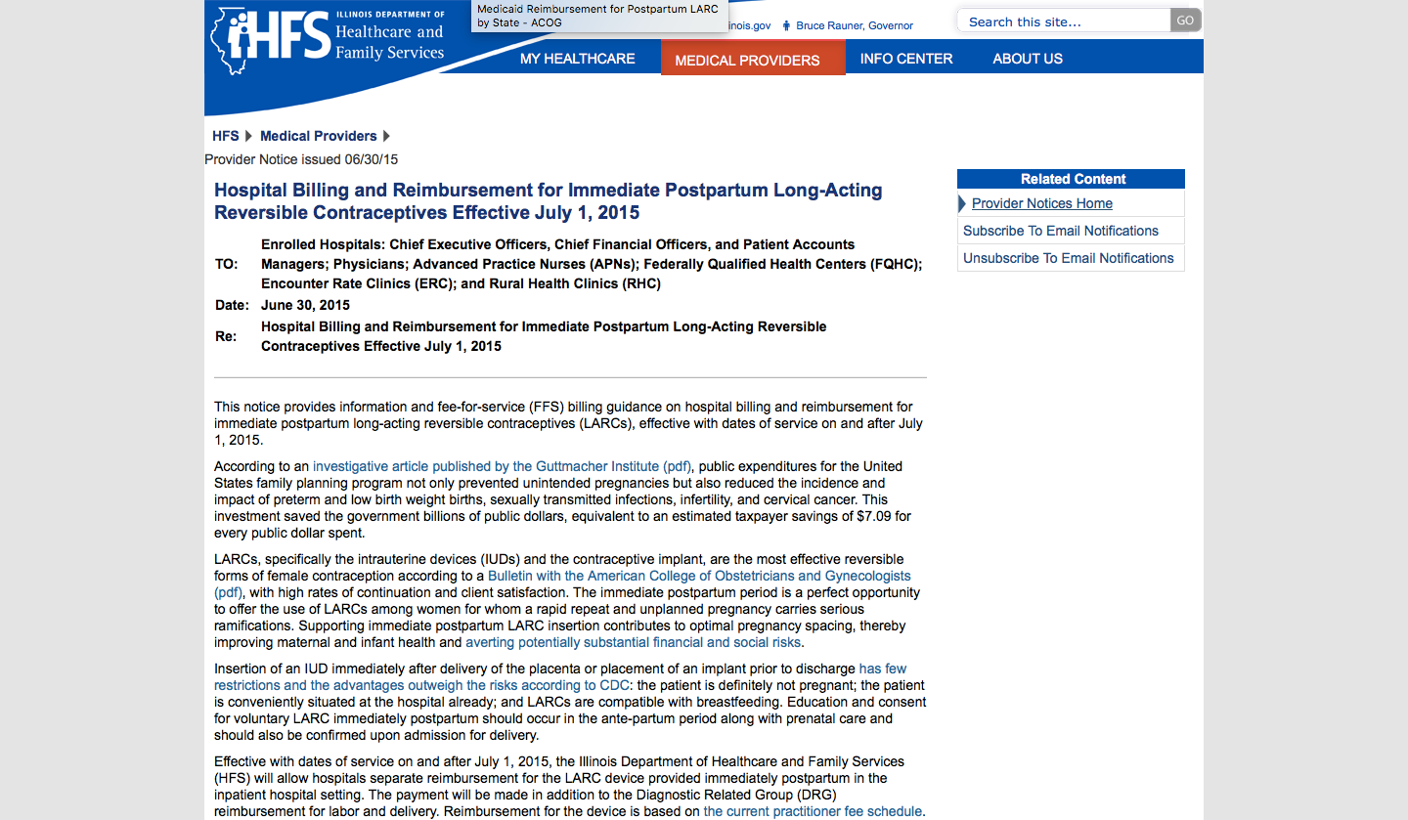
Billing Instructions
A practitioner must order the device and document the insertion procedure in the hospital’s medical record as well as the practitioner’s medical record
The hospital must use its fee-for-service NPI to bill the appropriate device or implant on the HFS 2360 paper claim form or electronically via the 837P claim transaction
The hospital must identify the NDC for the specific device or implant following the guidelines posted in Chapter A-200, Handbook for Practitioners Rendering Medical Services, Appendix A-6
The hospital must use the appropriate family planning ICD-10-CM on this claim
The place of service should be designated as Inpatient on the claim
https://www.illinois.gov/hfs/MedicalProviders/notices/Pages/prn150630a.aspx

Slide 15

Greenville health system

Slide 16
Nexplanon Insertion
http://youtu.be/ug7q_1RUMio
Request in-person training by calling Merck 877-467-5266
or online at http://www.nexplanon-usa.com

Slide 17
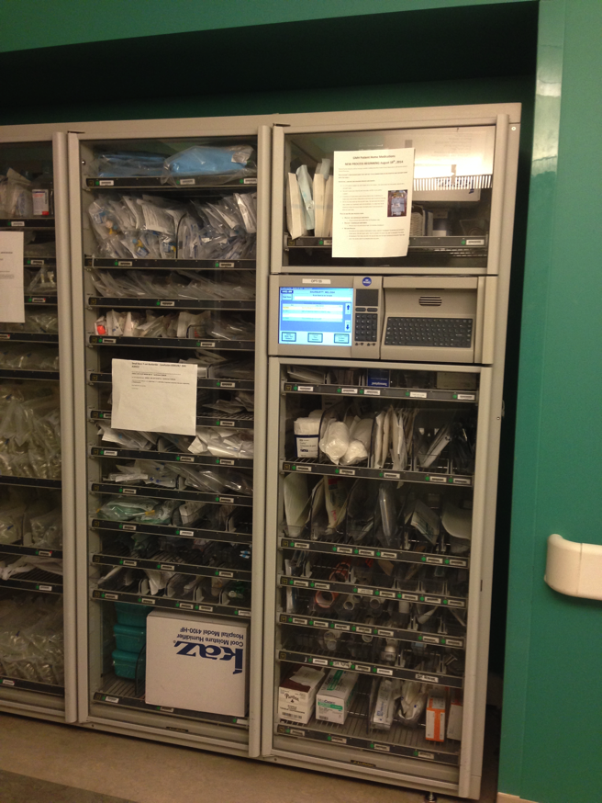
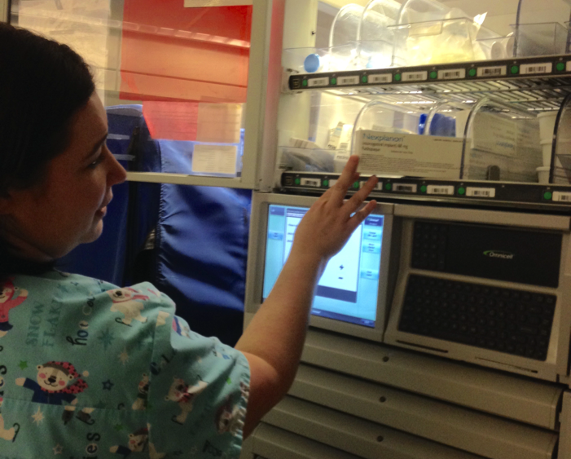
Supplies
Hospital Pyxis
Nexplanon device and local anesthetic

Slide 18
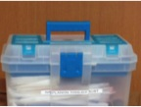
Supplies
Tackle Box
Sterile gloves
Sterile towels
Betadine swabs
Sterile marking pen
20 cc syringe
18 and 23 gauge needles
Band-aid
Dressing pads and wrap

Slide 20
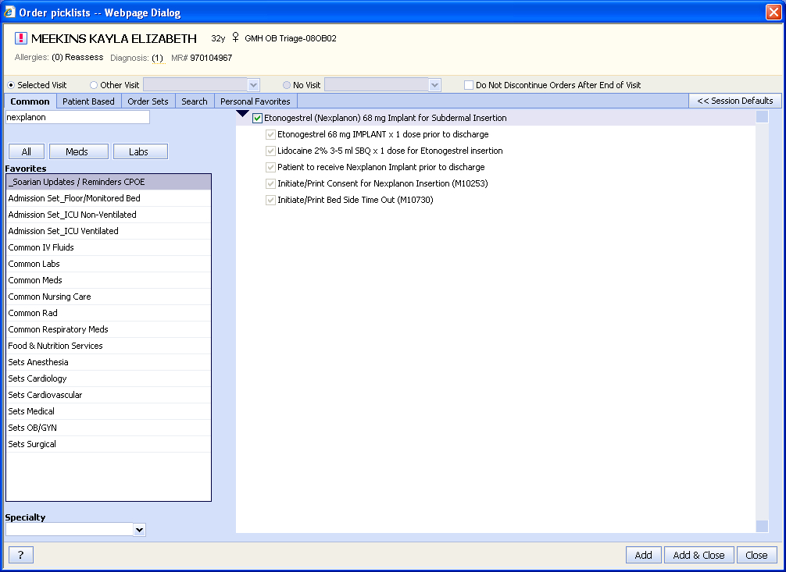
Order sets and patient consent

Slide 21


What about breastfeeding?
The implant can be inserted at any time following delivery. The advantages generally outweigh real or theoretical risks if placed <1 month post-partum, and there is no restriction if placed >1 month post-partum
USSPR for Contraceptive Use, August, 2016
https://www.cdc.gov/reproductivehealth/contraception/mmwr/spr/summary.html
Systematic review findings show that progestin-only contraceptives do not appear to adversely affect a woman’s ability to successfully initiate and continue breastfeeding, or an infant’s growth and development.
ACOG Practice Bulletin #186, Novmeber 2017
https://www.acog.org/-/media/Practice-Bulletins/Committee-on-Practice-Bulletins----Gynecology/Public/pb186.pdf?dmc=1&ts=20171031T1105492110

Slide 22
The risks of unintended pregnancy are much greater than the real or theoretic risks of progestin exposure in the
post-partum period
The advantage of Nexplanon over Depo Provera is that the implant can be removed in women who are struggling with lactation
An additional advantage of Nexplanon over Depo Provera is that it has a lower peak serum concentration.
  After Depo Provera injection , medroxyprogesterone acetate plasma concentrations peak at 7 ng/ml 3 weeks after injection
  After Nexplanon insertion, etonorgestrel plasma concentrations peak at 0.8 ng/ml 4 days after insertion

Slide 23
Do patients like PP Nexplanon? Insertion Rates

Slide 24
Do patients like PP Nexplanon? Continuation rates
Odds Ratio 0.43
95% CI 0.20, 0.97
p=0.041
13.7%
Odds Ratio 0.60
95% CI 0.27, 1.33
p=0.292
7.2%
5.1%
3.5%
P=0.29
P=0.04
*Chi square test
*Adjusted for age, previous live births (0-1, 2, or 3 or more previous live births), race (excluding “other” race), and body mass index
Crockett, Contraception 2017
Notes:
In other words, at 6 months, there was a 96.5% CONTINUATION rate if placed IN-patient vs 94.9% if placed OUT-patient
But this was not statistically significant
However, at 12 months, there was a 92.8% CONTINUATION rate for those placed IN-patient vs 86.3% if placed OUT-patient
0.43 Odds Ratio means 57% reduction in odds of early removal at <12 months if placed IN-patient vs OUT-pt
*Chi square test
*Adjusted for age, previous live births (0-1, 2, or 3 or more previous live births), race (excluding “other” race), and body mass index

Slide 25

Coercion

Slide 26
Do patients like PP Nexplanon?
LARC Use by Prenatal Contraception Plan
% of deliveries receiving LARC
Implant
IUD
Steroid
Contraception
Sterilization
Undecided
VanDeman ASRM oral presentation 2016

Slide 27
Post-partum IUD insertion
https://youtu.be/-xNlKUl5v_0?t=38s

Slide 28
Post-partum IUD insertion
Best practice is within 10 minutes of placental delivery
Ultrasound guidance is recommended

Slide 29
Postpartum Intrauterine Device Contraindications
Allergy to device components
Known or suspected cervical malignancy
Uterine cavity abnormality
Untreated STI
Placenta accreta or retained placenta requiring curretage
Chorioamnionitis or purulent cervical discharge
Genital trauma requiring urgent repair
http://www.obtsguidelines.org/postpartum-post-placement-iud-placement.html

Slide 30
Postpartum Intrauterine Device Expulsions
10% - 27% expulsion rate
  Higher after cesarean delivery
May need to trim strings at postpartum visit
Strings may not be visible at postpartum visit, necessitating ultrasound to check IUD position
ACOG Practice Bulletin #186 November 2017

Slide 31
Number of women with inpatient LARC insertion
1780
1490
1138
819
117% increase
250
7.1% of all deliveries
89

Slide 32
LARC insertion in any place of service and inpatient
16,699
16,084
13,958
11,515
11,988
10,508
1490
1780
819
1138
89
250

Slide 33
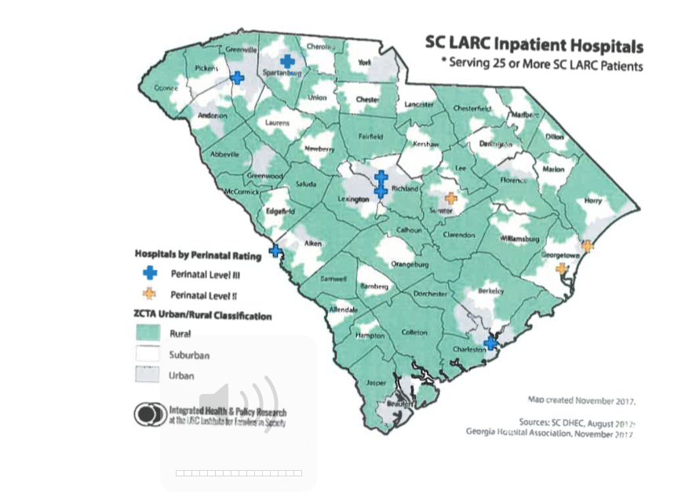
Characteristics of Participating Birthing Facilities

Slide 34

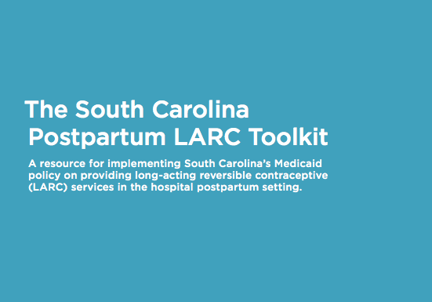
http://static.nichq.org/prevention-toolkit/resources/postpartum_larc_toolkit.pdf

Slide 35
Lessons Learned

Slide 36
Build administrative support and infrastructure
  Convene physician and nursing leadership with administrators from billing and pharmacy
  Build pathways for billing and coding, likely including new order sets for the EMR
  Develop procedures with the pharmacy for stocking LARC devices so they are easily accessible

Slide 37
Develop clinical pathways with physicians and nurses
Physicians need buy-in
Nursing and lactation consultants may have limited experience with LARC
Develop counseling, consent and insertion procedures

Slide 38
Train all clinical staff
Delivering physicians, including residents
Prenatal and postpartum care providers if different from delivering provider
Nursing
Lactation consultants

Slide 39
Make adjustments as needed
Collaboration with billing staff to ensure payments are being received for claims submitted
Monitor the proportion of women receiving LARC

Slide 40
Thank you!

Slide 41
Postpartum Visit Attendance
p = 0.024
% of deliveries attending PP visit

