Slide 1
Obstetric and Addiction Care for Women with Opioid Use Disorder: ACOG AIM Patient Safety Bundle
Ronald E Iverson, Jr, MD, MPH
Co-Chair, MA PNQIN
ILPQC 5th Annual Conference
December 19, 2017
Lombard, IL

Slide 2
Disclosure
I have no conflicts of interest with the information presented.

Slide 3

We created the opioid epidemic

Slide 4
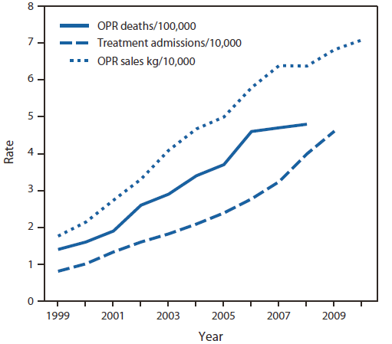
What caused our opioid crisis?
OPR: Opioid Pain Reliever
Notes:
Rates of opioid pain reliever (OPR) overdose death, OPR treatment admissions, and kilograms of OPR sold --- United States, 1999—2010
Sales of opioid pain relievers quadrupled 1999-2010
2010 Rx = enough to medicate every American adult 5mg hydrocodone (Vicodin) every 4 hours for a month
Rx opioids account for more treatment admissions than heroin

Slide 5
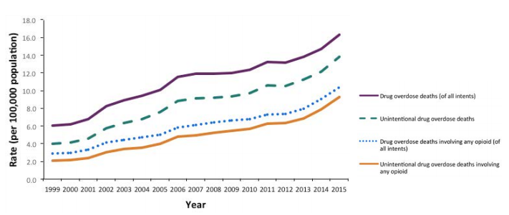
US opioid deaths continue to rise

Slide 6
Opioid-related deaths continue to rise in MA
https://www.mass.gov/files/documents/2017/08/31/data-brief-overdose-deaths-aug-2017.pdf

Slide 7
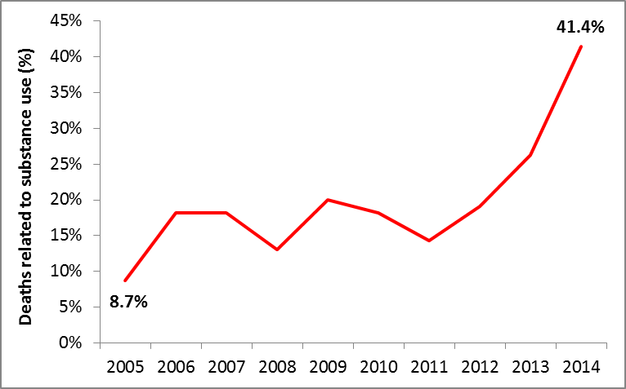
Substance use is increasingly involved in pregnancy mortality
Percent of Pregnancy-Associated Deaths Related to Substance Use by Year
Preliminary Data from Massachusetts DPH

Slide 8
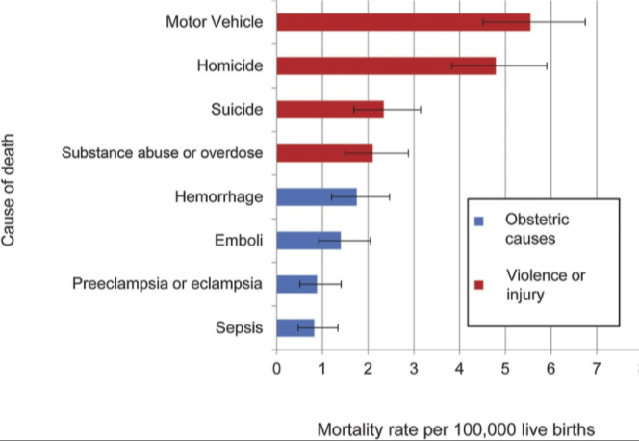
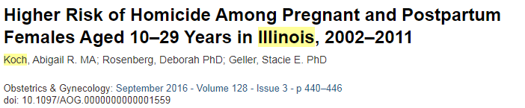
Substance use is involved in mortality more often than obstetric causes

Slide 9
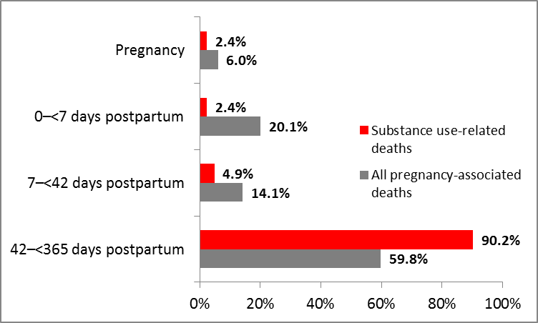
Most substance-use associated pregnancy mortality is after delivery
Percent of Pregnancy-Associated Deaths Related to Substance Use by Time Period
Preliminary Data from Massachusetts DPH

Slide 10
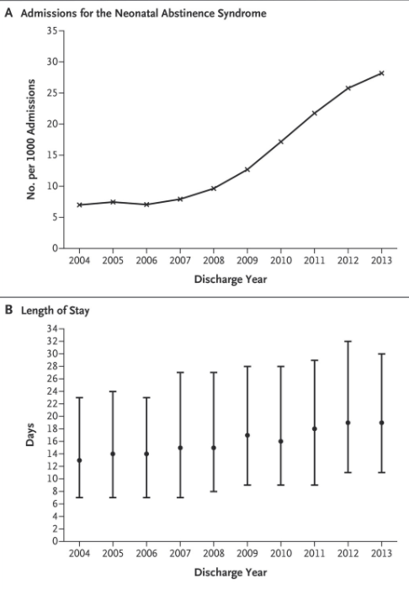
Neonatal Abstinence Syndrome is increasing
Over 3 fold increase in NAS admissions, from 7 to 27 per 1000 admissions from 2007 to 2013
Increasing Incidence of the Neonatal Abstinence Syndrome in U.S. Neonatal ICUs
Veeral N. Tolia, M.D., Stephen W. Patrick, M.D., M.P.H., Monica M. Bennett, Ph.D., et al
N Engl J Med 2015; 372:2118-2126May 28, 2015
Notes:
Over 3 fold increase in NAS admissions, from 7 to 27 from 2007 to 2013

Slide 11

Opioid use is increasingly the cause of child removal
Parental AOD as Reason for Removal in the US, 1999 - 2014
Note: Estimates based on all children in out of home care at some point during Fiscal Year
Source: AFCARS Data, 2014
AOD: Alcohol and Other drug use Disorder

Slide 12
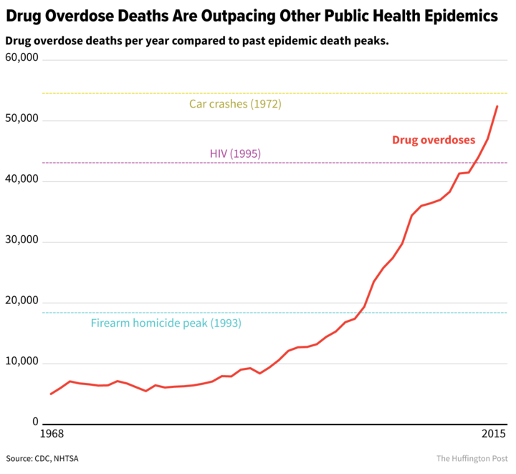
The Opioid Epidemic is overtaking other public health crises

Slide 13
Some progress is being made in prescribing
https://www.mass.gov/files/documents/2017/08/31/prescription-monitoring-program-data-aug-2017.pdf

Slide 14

How do we approach such a large problem?

Slide 15
Readiness
Reporting/ Systems learning
Recognition and Prevention
Response
Response

Slide 16
Addressing Opioid Use Across the Life Course
Family
Pregnancy
Newborn
Infant
Family

Slide 17

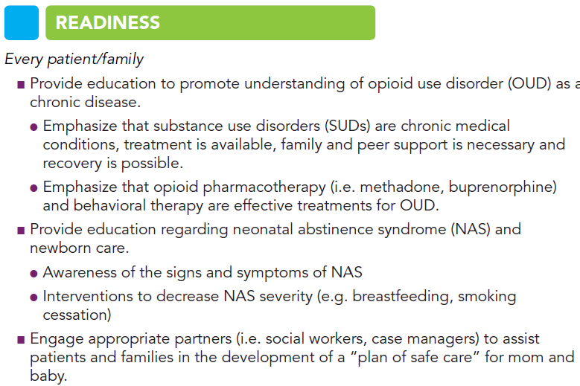

Slide 18
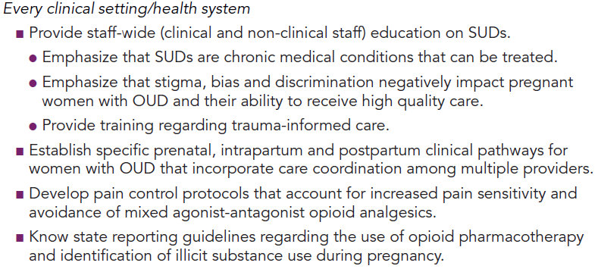
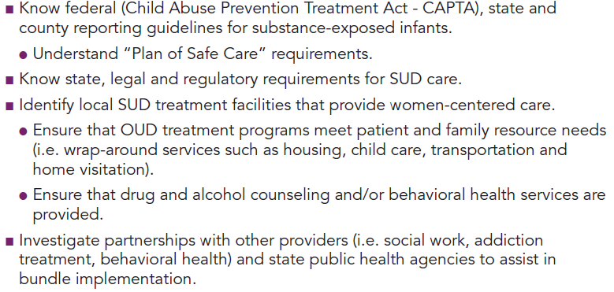

Slide 19
Readiness: Every patient/family
Provide education to promote understanding of opioid use disorder (OUD) as a chronic disease.
  substance use disorders (SUDs) are chronic medical conditions
  treatment is available
  family and peer support is necessary
  recovery is possible.
  Medication Assisted Therapy (MAT) and behavioral therapy are effective treatments for OUD.

Slide 20

Addiction
Primary chronic disease of brain reward, motivation, memory and related circuitry.
  Dysfunction in these circuits leads to psychological, social and spiritual manifestations.
Reflected in pathologically pursuing reward and/or relief by substance use and other behaviors.
Like other chronic diseases, addiction often involves cycles of relapse and remission.
Without treatment, addiction is progressive and can result in disability or death.

Slide 21
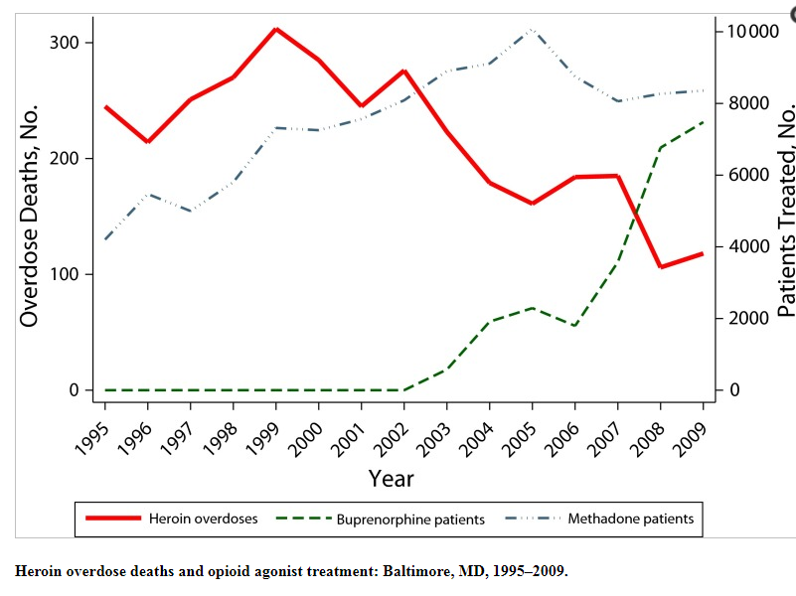
OUD treatment decreases overdose deaths
Opioid agonist treatments and heroin overdose deaths in Baltimore, Maryland, 1995-2009.
Schwartz RP¹, Gryczynski J, O'Grady KE et al, Am J Public Health. 2013 May;103(5):917-22.
doi: 10.2105/AJPH.2012.301049. Epub 2013 Mar 14.

Slide 22
MAT decreases maternal overdoses
MAT Received

Slide 23
Readiness: Every patient/family
Provide education regarding neonatal abstinence syndrome (NAS) and newborn care.
  Awareness of the signs and symptoms of NAS
  Interventions to decrease NAS severity (e.g. breastfeeding, smoking cessation)

Slide 24
Readiness: counseling patients
Neonatal consult pre-delivery
Plan for breastfeeding
Plan for rooming in
Explain Eat Sleep Console

Slide 25
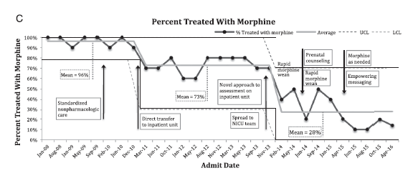
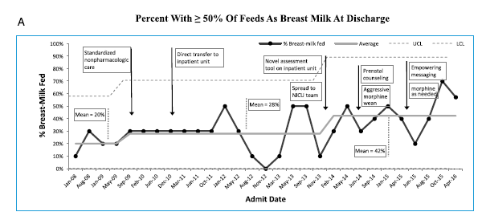
Eat, Sleep, Console
Grossman MR, Berkwitt AK, Osborn RR,et al. An Initiative to Improve the Quality of Care
of Infants With Neonatal Abstinence Syndrome. Pediatrics. 2017;139(6):e20163360

Slide 26
Readiness: Every patient/family
Engage appropriate partners (i.e. social workers, case managers) to assist patients and families in the development of a “plan of safe care” for mom and baby.

Slide 27
Readiness: Plan of Safe Care
Child Abuse Prevention and Treatment Act (CAPTA)
Ensure the safety and well-being of infants affected by substance use following release from health care providers
Address the health and substance use disorder treatment needs of the infant and family
Refer and deliver appropriate services to the infant and affected family or caregiver

Slide 28
Readiness: Every clinical setting/ health system
Provide staff-wide (clinical and non-clinical staff) education on SUDs.
  Emphasize that SUDs are chronic medical conditions that can be treated.
  Emphasize that stigma, bias and discrimination negatively impact pregnant women with OUD and their ability to receive high quality care.
  Provide training regarding trauma-informed care.

Slide 29
Readiness: Trauma-Informed Care
Understand the neurobiology of trauma
Recognize the signs and symptoms of trauma in patients and families
Screen for physical and sexual violence
Coordinate care with behavioral health/psychiatric care teams
Prevent re-traumatization

Slide 30
Readiness: Every clinical setting/ health system
Establish specific prenatal, intrapartum and postpartum clinical pathways for women with OUD that incorporate care coordination among multiple providers.
Patient
Obstetric care team
Primary care
Peer support
OUD specialist
Mental Health team
Case mgmt

Slide 31
Readiness: Every clinical setting/ health system
Develop pain control protocols that account for increased pain sensitivity and avoidance of mixed agonist-antagonist opioid analgesics.
  Order sets
  Remove agonist/antagonists from Pyxis

Slide 32
Readiness: Every clinical setting/ health system
Know state reporting guidelines regarding the use of opioid pharmacotherapy and identification of illicit substance use during pregnancy.
Know federal (Child Abuse Prevention Treatment Act - CAPTA), state and county reporting guidelines for substance-exposed infants.
  Understand “Plan of Safe Care” requirements.
Know state, legal and regulatory requirements for SUD care.

Slide 33
Readiness: Every Clinical Setting/ Health System
Identify local SUD treatment facilities that provide women-centered care.
  Ensure that OUD treatment programs meet patient and family resource needs (i.e. wrap-around services such as housing, child care, transportation and home visitation).
  Ensure that drug and alcohol counseling and/or behavioral health services are provided.

Slide 34
Readiness: Every Clinical Setting/ Health System
Investigate partnerships with other providers (i.e. social work, addiction treatment, behavioral health) and state public health agencies to assist in bundle implementation.

Slide 35
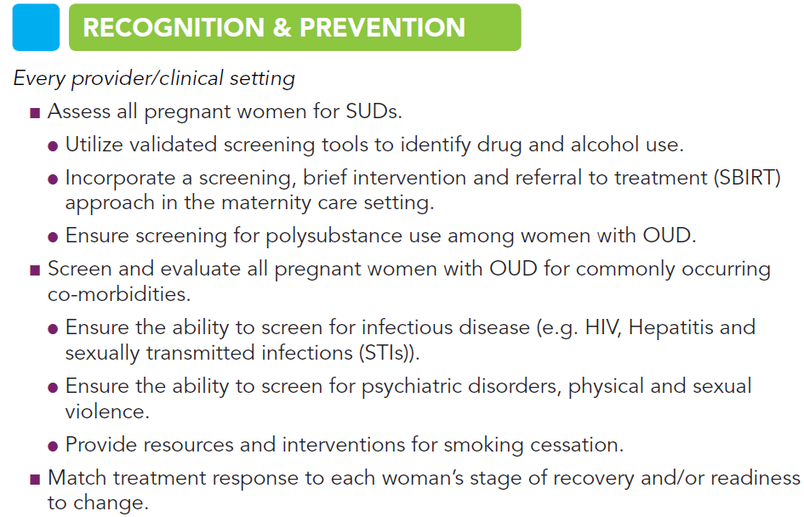

Slide 36
Recognition and Prevention: Every provider/clinical setting
Assess all pregnant women for SUDs.
  Utilize validated screening tools to identify drug and alcohol use.
  Incorporate a screening, brief intervention and referral to treatment (SBIRT) approach in the maternity care setting.
  Ensure screening for polysubstance use among women with OUD.

Slide 37
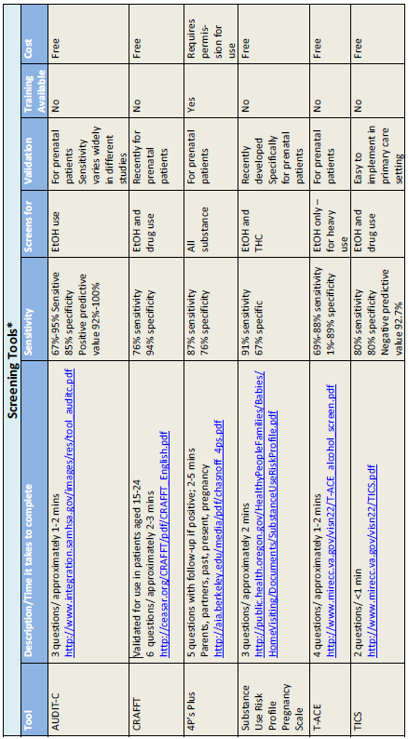
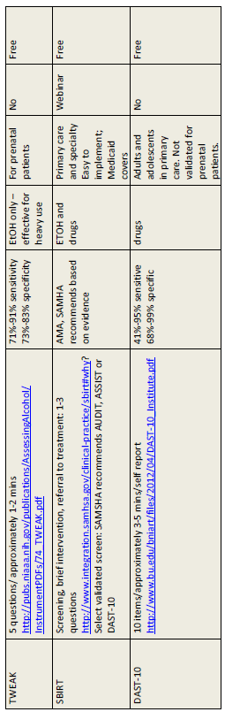
Screening tools
https://here.doh.wa.gov/portals/14/Materials/950-135-PregSubs-en-L.pdf

Slide 38
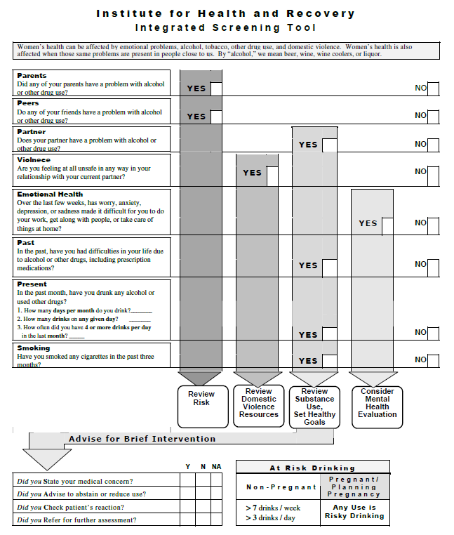
One screening tool, 5 Ps

Slide 39
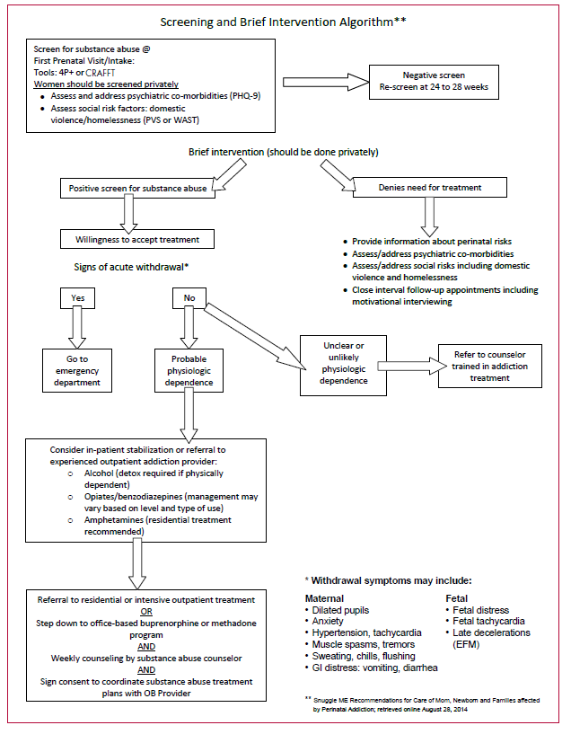
Screening, Brief Intervention, Refer to Treatment
https://here.doh.wa.gov/portals/14/Materials/950-135-PregSubs-en-L.pdf

Slide 40
Recognition and Prevention: Every provider/clinical setting
Screen and evaluate all pregnant women with OUD for commonly occurring co-morbidities.
  Ensure the ability to screen for infectious disease (e.g. HIV, Hepatitis and sexually transmitted infections (STIs)).
  Ensure the ability to screen for psychiatric disorders, physical and sexual violence.
  Provide resources and interventions for smoking cessation.

Slide 41
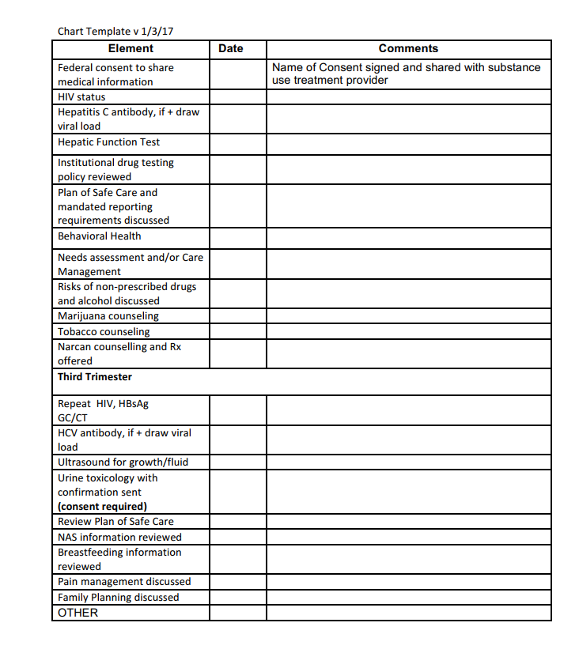
Complete evaluation checklist for OUD patient
http://www.nnepqin.org/wp-content/uploads/2017/08/ToolkitOUD_1_2_Checklist_Chart_Template.pdf

Slide 42
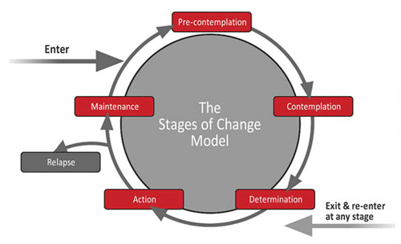
Recognition and Prevention: Every provider/clinical setting
Match treatment response to each woman’s stage of recovery and/or readiness to change.

Slide 43
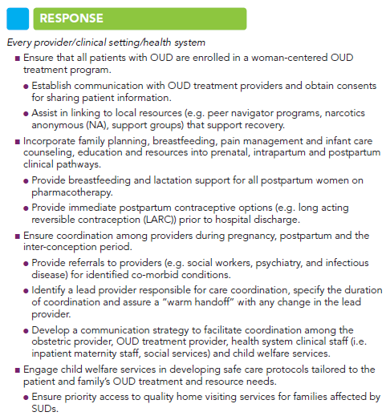

Slide 44

Medication Assisted Treatment (MAT)
For pregnant women with an opioid use disorder, opioid agonist pharmacotherapy is the recommended therapy and is preferable to medically supervised withdrawal because withdrawal is associated with high relapse rates, which lead to worse outcomes. More research is needed to assess the safety (particularly regarding maternal relapse), efficacy, and long-term outcomes of medically supervised withdrawal.

Slide 45
Response: Every provider/clinical setting/health system
Ensure that all patients with OUD are enrolled in a woman-centered OUD treatment program.
  Establish communication with OUD treatment providers and obtain consents for sharing patient information.
  Assist in linking to local resources (e.g. peer navigator programs, narcotics anonymous (NA), support groups) that support recovery.

Slide 46
Response: Every provider/clinical setting/health system
Incorporate family planning, breastfeeding, pain management and infant care counseling, education and resources into prenatal, intrapartum and postpartum clinical pathways.
  Provide breastfeeding and lactation support for all postpartum women on pharmacotherapy.
  Provide immediate postpartum contraceptive options (e.g. long acting reversible contraception (LARC)) prior to hospital discharge.

Slide 47
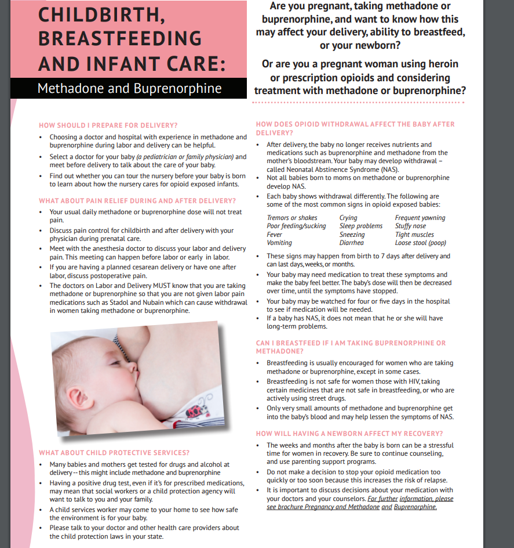
Breastfeeding education
http://pcssmat.org/wp-content/uploads/2013/10/ASAM-WAGBrochure-Opioid-Labor_Final.pdf

Slide 48
Response: Every provider/clinical setting/health system
Ensure coordination among providers during pregnancy, postpartum and the inter-conception period
  Provide referrals to providers (e.g. social workers, psychiatry, and infectious disease) for identified co-morbid conditions.
  Identify a lead provider responsible for care coordination, specify the duration of coordination and assure a “warm handoff” with any change in the lead provider.
  Develop a communication strategy to facilitate coordination among the obstetric provider, OUD treatment provider, health system clinical staff (i.e. inpatient maternity staff, social services) and child welfare services.

Slide 49
Response: Every provider/clinical setting/health system
Engage child welfare services in developing safe care protocols tailored to the patient and family’s OUD treatment and resource needs.
  Ensure priority access to quality home visiting services for families affected by SUDs.

Slide 50
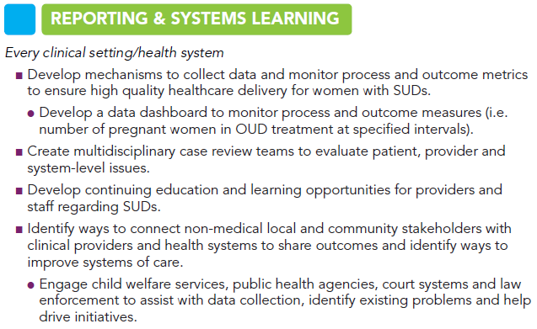

Slide 51

Reporting & Systems Learning: Every clinical setting/health system
Develop mechanisms to collect data and monitor process and outcome metrics to ensure high quality healthcare delivery for women with SUDs.
  Develop a data dashboard to monitor process and outcome measures (i.e. number of pregnant women in OUD treatment at specified intervals).

Slide 52
Reporting & Systems Learning: Every clinical setting/health system
Create multidisciplinary case review teams to evaluate patient, provider and system-level issues.
Develop continuing education and learning opportunities for providers and staff regarding SUDs.

Slide 53
Reporting & Systems Learning: Every clinical setting/health system
Identify ways to connect non-medical local and community stakeholders with clinical providers and health systems to share outcomes and identify ways to improve systems of care.
  Engage child welfare services, public health agencies, court systems and law enforcement to assist with data collection, identify existing problems and help drive initiatives.

Slide 54
2017 Improvement Initiative Goals: MA
Goal | Measure
Improve the care of women with perinatal opioid use | Increase the percent of mothers of infants at risk for NAS who are on MAT at time of delivery
Increase family engagement in care of infant at risk for NAS | Increase the percent of infants at risk for NAS who are receiving mother’s milk at time of hospital discharge
Improve follow-up of newborns and families impacted by perinatal opioid use | Increase the percent of infants with NAS enrolled in EI at 1 year of age

Slide 55
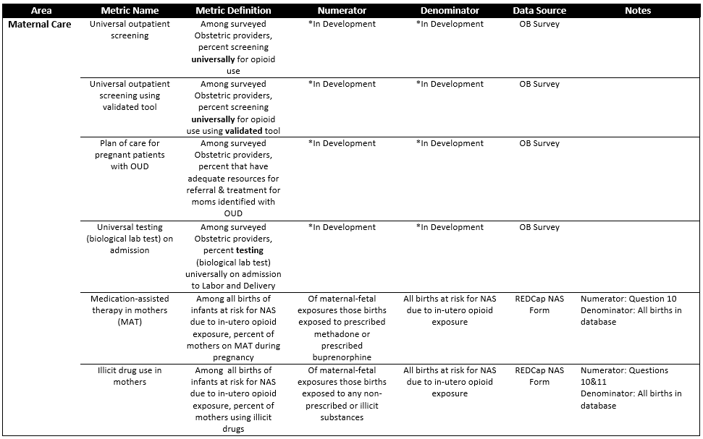
Process measures: Maternal

Slide 56
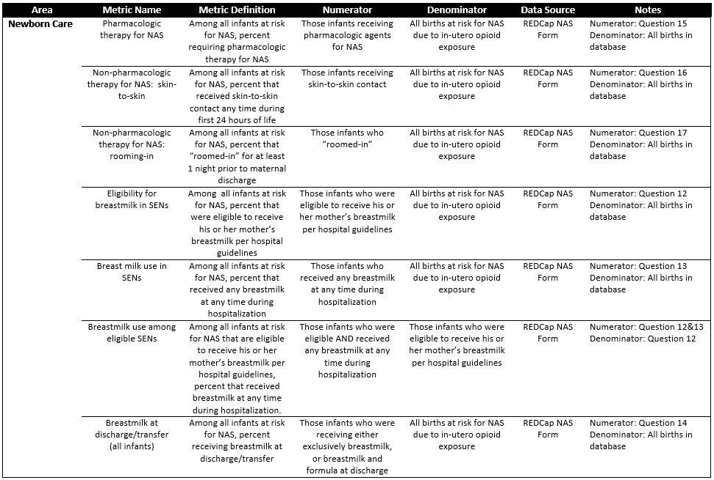
Process measures: Newborn

Slide 57
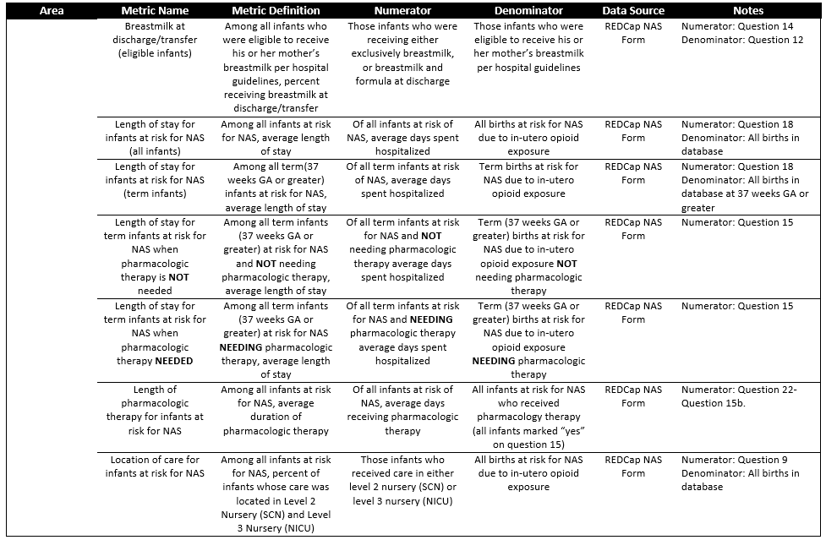
Process measures: Newborn

Slide 58
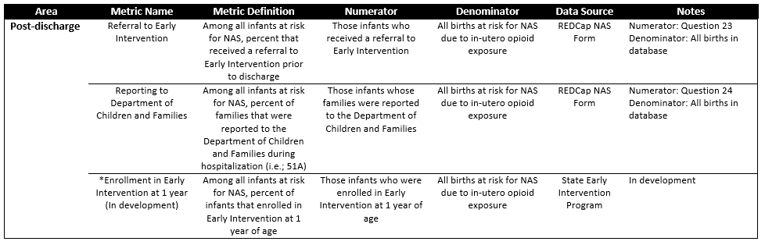
Process measures: Family

Slide 59
We can do this!
Readiness
Recognition and Prevention
Response
Reporting/Systems Learning

Slide 60

Thank you

