Slide 1
Straight Talk
“A Change Story”…
By Tamela Milan MPPA
Access Maternal and Child Health Outreach/Westside Healthy Start Community Action Co- Chair
AAP FPN Executive Committee
NHSA Former Board Member
Ever Thrive of IL Board of Directors
Health Connect One Board of Directors
Notes:
EDIT (throughout presentation): increase font and line spacing for easier readability

Slide 2
Where I Was
Opioid Use Disorder
Methadone Maintenance therapy
Family Intact Program through LCFS
Children with NAS
Failure to thrive
No prenatal care for 3 children
Needed Postpartum care
Under DCFS One child
Judgmental Providers
People think if you are on drugs you don’t love your kids
Scared they would take my kids
Dealing with children exposed to drug
Living in CHA housing “Projects”
Traumatizing Event

Slide 3
1997: Meet me where I am.
Children under DCFS Custody due to heroin abuse and neglect.
Parental support
Recovery
Engaged in Court System for Reunification
Married to Father of 5 Children, Heroin Addict, and Domestic Violence
5th & 6th Child Born with Methadone
Exposure
University of IL at Chicago Pediatrician
High risk infant enrolled in Early Childhood Research Program and Development (ECRIP @ UIC)

Slide 4
Daily struggle: Why me?
Limited programs for mothers on drugs
Constant partner violence
Isolation
Family and friends don’t visit the “projects”
The notion of feeing “crazy”
Perpetrator in constant need my information to hurt me and my immediate family members

Slide 5
Environmental changes: Where was I at?
Anger Management/ Methadone Maintenance Treatment
Henry Horner Public Housing Resident
Started degree at Robert Morris University
Started working with Healthy Start Chicago participating in groups
Notes:
Provided monitoring of parent & infant contact for DCFS
Enrolled in Associates Degree program
Participated in Parent groups to provide various skill set and self image building
Developed goals to reunify family
Introduced to Consortium
Health education to improve overall family health
Participated in focus groups to help develop action plans for other consumers

Slide 6
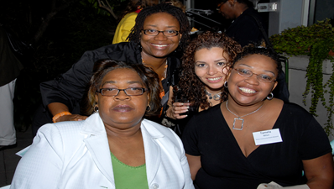
New Life: Working!
2000:
2002:
Family reunited
Transitioned from public housing into townhome
Completed AAS
Detoxed off of methadone
Working part-time
First “Real Job” with UIC ECRIP Program
Interim Consortia Chair for Chicago Healthy Start
Attended First National Healthy Start Conference
Notes:
EDIT: uncapitalized “public housing,” “townhome,” “methadone,” “part time;” added hyphen to “part time;” deleted extra space after “First” in first right bullet and after “Attended” in third right bullet; added colon after 2002
Provided monitoring of parent & infant contact for DCFS
Enrolled in Associates Degree program
Participated in Parent groups to provide various skill set and self image building
Developed goals to reunify family
Introduced to Consortium
Health education to improve overall family health
Participated in focus groups to help develop action plans for other consumers

Slide 7
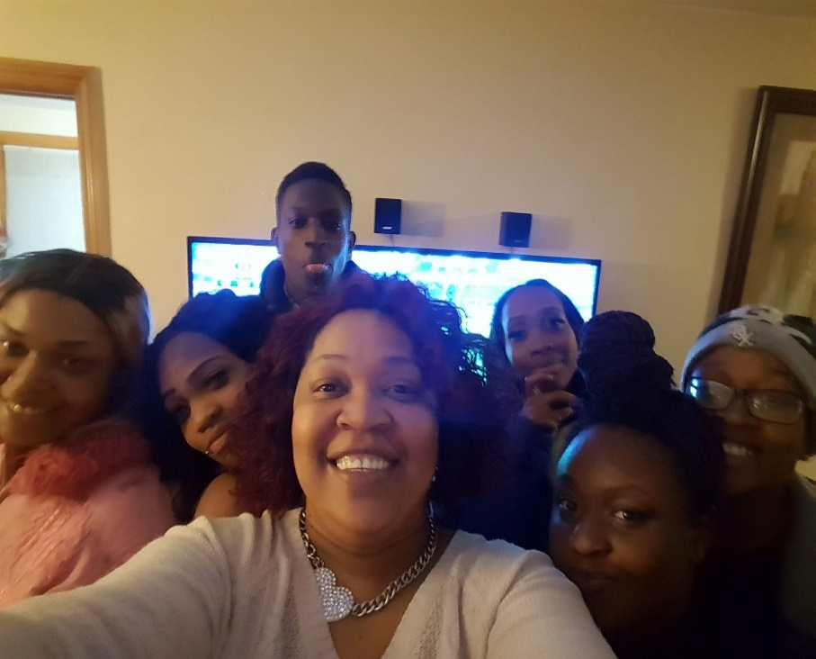
Transforming my life: Connection between health and community!
As a member of a community health center and a trusted member of the community I have served for 19 years now.
A link between health/social services and the community to help provide access to services and resources (The “Hook Up”).
It helps that I am knowledgeable of the care that is offered within the community.
Notes:
EDIT: removed extra spaces after “resources” in second bullet
QUESTION: there is a photo underneath the current photo, is that intentional?
The Westside Healthy Start (WHS) Program provides outreach, care management and coordination, health education, and support services to high-risk women, children, and their families on the Westside of Chicago.
Communities served:
North Lawndale
East/West Garfield
Austin
Community Partnership:
Lawndale Christian Health Center

Slide 8
How did I give back?
Providing inspirational testimony of others and how to tell their story.
Sharing the impact of Healthy Start and other services on the community.
The transition from a program participant to HS employee, as well as serving on Board of Directors (national and state agencies) has been humbling.
Outreach work keeps my nose to the ground.
Notes:
of success despite obstacles and circumstances.
Encourage participants, elected officials or any other stake holder to get involved, learn how to become an advocate for their family’s need and community needs. Motivate the person you are communicating with to get involved if they can.
Benefits of serving in other arenas. (Make connections, travel, exposure to opportunities, develop skills and etc.)

Slide 9
Reflection
I had an opportunity to speak on behalf of my efforts at Access with outreach to our regional counterparts and for the first time, I felt like I really was growing into my role fully as an advocate and a change agent in the most profound way.
I could tell you that I am just happy to work but that would not be true; fact of matter is that my work is my way of giving back to my community. One which have only seen a few people like myself make it and return to help enrich impoverished communities like the one I grew up and raised my children in.
I have availed myself to opportunities over the last decade or so of working in family and community engagement to develop strategies that can build up families so that they can become leaders in the community as well. This is where leadership begins…
Notes:
of success despite obstacles and circumstances.
Encourage participants, elected officials or any other stake holder to get involved, learn how to become an advocate for their family’s need and community needs. Motivate the person you are communicating with to get involved if they can.
Benefits of serving in other arenas. (Make connections, travel, exposure to opportunities, develop skills and etc.)

Slide 10
How can we all help?
What I have learned is that the best way to work together is to learn to respect the people that you work with, around and for.
We all can learn to tie our shoe strings but we don’t all learn how to save and buy those shoes.
I have been on both sides of the fence now and I see the difficulty that exists in trying to co-exist when there can be a lack of understanding in how everyone plays a role in the process especially the patients.
Learning what my implicit bias was and how others bias can change my actions.
Hire within those communities when you can!!!!

Slide 11
Positive Results
CHWs like myself have changed the landscape because we do more than just educate the people we have in our community. We educate those outside of our community as well to inform them of the hazards of the communities we serve.
Advocacy of our elected officials through testimonials and collaboration expands our influence on policy and actions that can broaden the reach of the services that can be provided.
Notes:
EDIT: removed “3,5” at end of second bullet (typo?), split first sentence into two to avoid run-on
Educating health care providers and administrators alike about the community’s health needs and the cultural relevancy by providing input on interventions helping those providers and the managers of health care systems to build their cultural competence and strengthen communication skills with the community.

Slide 12
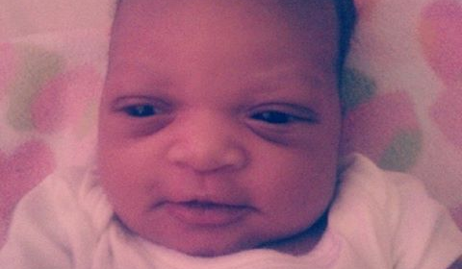
Integrating
My passion for community is what drives my efforts today. It is not just enough to go back to school for the academia portion but to get an experience that can challenge and impart the necessary tools to work within health systems to help change the culture of only doctors know best. We have to collaborate with patients and providers if we want to change for the better.
How I interact with my colleagues have changed for the better because I have been on both sides of the table. I am facilitating, advocating and representing Access Westside Healthy Start in a myriad of ways, which has opened up so many possibilities in my current and future work.
That’s why I am here…….

Slide 13
Information
Tamela D. Milan-Alexander, MPPA
MCH Partnership & Outreach Worker
Westside Healthy Start CAN Co-Chair
Access Warren Family Health Center
2409 W. Warren
Chicago, IL 60612
O: 312-733-8752
C: 773-634-0100
F: 312-733-9136
tamela.milan@achn.net
http://twitter.com/ACCESSHealth

