Slide 1

Leveraging QI Success in Other States:
Leaders from State Perinatal Quality Collaboratives Discuss Key Initiatives
ILPQC Fifth Annual Conference
December 19th, 2017

Slide 2
Overview
Moderator: Ann Borders, MD, MSc, MPH
Panelists:
  Carole Lannon, MD, MPH, Senior Faculty Lead, Learning Networks Program, Ohio Perinatal Quality Collaborative
  Julie Z. DeCesare, MD, Clinical Co-Lead for PROVIDE Florida Perinatal Quality Collaborative
  Brenda Barker, MEd, MBA, Executive Director and Improvement Advisor, Tennessee Initiative for Perinatal Quality Care

Slide 3
Ohio Perinatal Quality Collaborative Initiatives
Carole Lannon, MD, MPH, Senior Faculty Lead, Learning Networks Program, Ohio Perinatal Quality Collaborative

Slide 4


Slide 5





Ohio Perinatal Quality Collaborative
through the collaborative use of improvement science, to reduce preterm births and improve maternal and birth outcomes across Ohio as quickly as possible.

Slide 6
The Ohio Perinatal Quality Collaborative
ANCS for women at risk for preterm birth
(24^{0/7} - 33 ^{6/7})
Neonatal
39-Week Scheduled Deliveries w/o medical indication
Obstetrics
Increase Birth Data Accuracy & Online modules
Spread to all maternity hospitals in Ohio
BSI: High reliability maintenance bundle
Human milk in infants 22-29 wk GA
Progesterone for Preterm Birth Risk
Neonatal Abstinence Syndrome
LARC
NAS + MOMS
NICU Grads Project
Notes:
Hospital based projects

Slide 7
~2013 State partners:
Help us address key perinatal issues in Ohio:
Infant mortality
Opioid epidemic

Slide 8
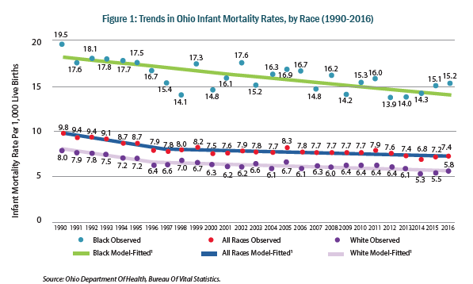
Ohio Infant Mortality 1990 – 2016 by
Maternal Race: Black 15.2 – White 5.8

Slide 9

NAS Statewide Rate per 1,000 Live Births
1.4
Year
Source: Ohio Hospital Association

Slide 10
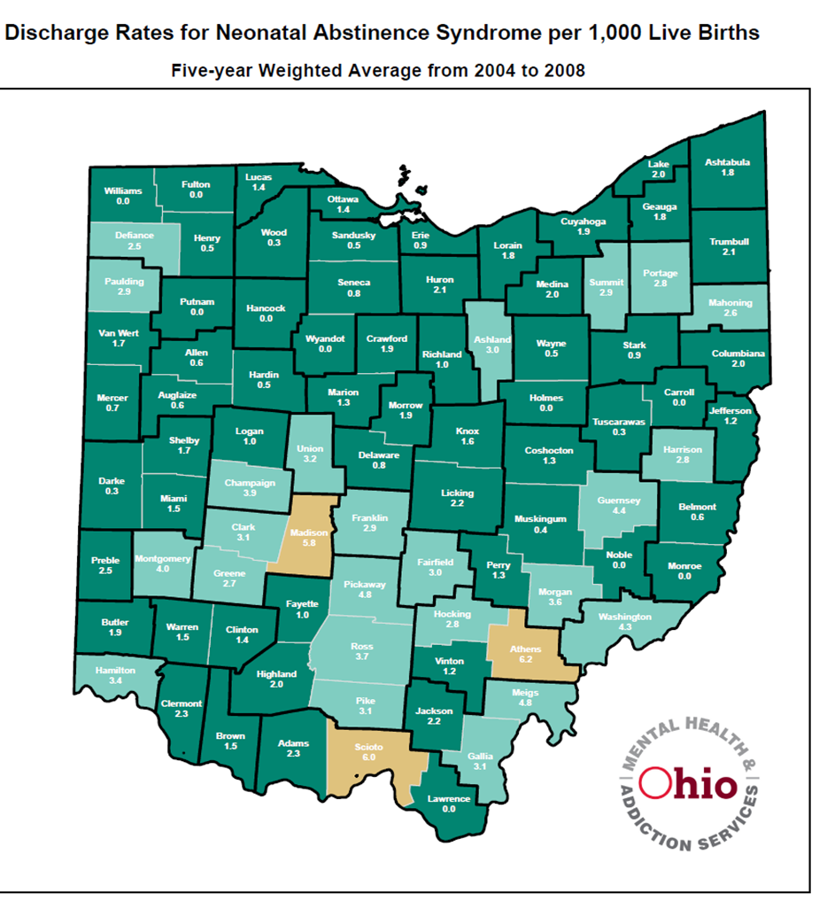
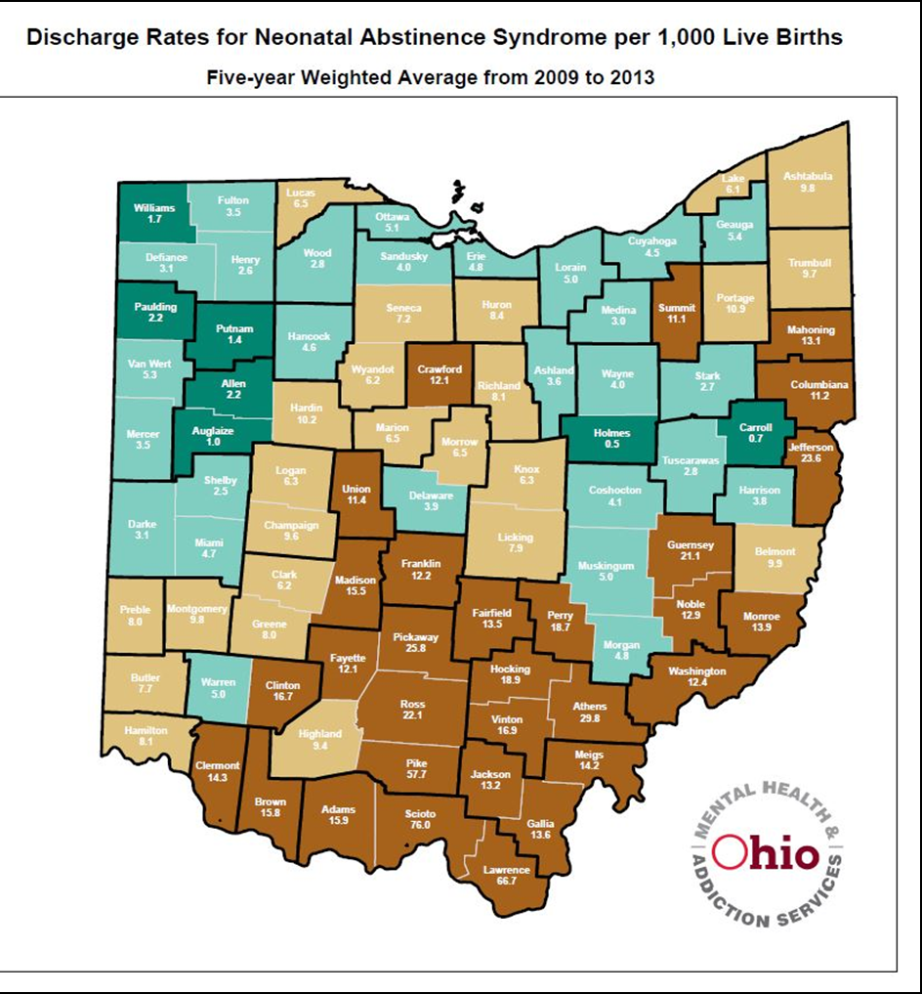
What a difference 5 years makes…
2004-2008
2009-2013

Slide 11
How OPQC AND TEAMs do this work…
OPQC employs a modified version of the Institute for Healthcare Improvement’s (IHI) Breakthrough Series Model (BTS). This was designed to accelerate translation of evidence into practice by engaging multiple teams to learn from each other and from recognized experts to make improvements in a specific topic area.
Specifically, the BTS promotes use of rapid Plan-Do-Study-Act (PDSA) cycles, in which teams are taught to address problems as they arise by testing interventions and subsequent modifications in small steps to achieve desired change.
OPQC uses monthly action period calls & face-to-face sessions with teams to review individual and aggregate data, learn from teams that have been successful at making changes and achieving improved outcomes, and with expert guidance, apply the Model for Improvement to test specific strategies.
All OPQC projects involve data collection.
OPQC analyzes and aggregates data collected by participating teams and then provides monthly data feedback to teams. This rapid-turnaround facilitates data-driven improvement.
Participating sites and OPQC sign data sharing agreements that specify that all patient data will be de-identified and that hospitals will not be identified without their permission.
Data is an integral part of improving care for Ohio’s mothers and babies.

Slide 12
Infant Mortality
THE PROGESTERONE PROJECT
THE INFANT VITALITY PROJECT (LARC)

Slide 13
THE PROGRESTERONE PROJECT

Slide 14
INTERVENTIONS
PROGESTERONE PROJECT KEY DRIVER DIAGRAM
Screen women for OB history of preterm birth
Align and communicate with EDs, WIC, CHW, MCPs, etc. to screen and refer when history of preterm birth
Facilitate rapid new OB appointments
Postpartum counseling on progesterone for those eligible in next pregnancy
DRIVERS
SMART AIM
Early access to prenatal care
BY July 1, 2016, DECREASE THE RATE OF PREMATURE BIRTHS in Ohio less than 37 weeks by 10%, and less than 32 weeks by 10%
Work with Medicaid and Medicaid Plans to identify women at risk and reduce administrative barriers
Create a written protocol for identified candidates
Start progesterone as soon as possible (according to ACOG and SMFM guidelines) after identification of eligible woman
Consistent and early recognition of prior preterm birth
Adopt a cervical length ultrasound screening protocol
Expedite progesterone supplementation
Use sonographers trained in cervical length measurement
Develop a practice protocol to selectively or universally screen cervical length (consider population risk)
GLOBAL AIM
IMPROVE NEWBORN OUTCOMES BY REDUCING PREMATURE BIRTHS
Customize patient care to start and maintain women on progesterone
Educate on benefits of progesterone and use evidence-based counseling methods
Involve key support individuals
Connect women to insurance, home care, social services, etc. to ensure progesterone available & administered
Notes:
Original KDD for Progesterone project
Tells the story of “what we have done”- review of project background

Slide 15
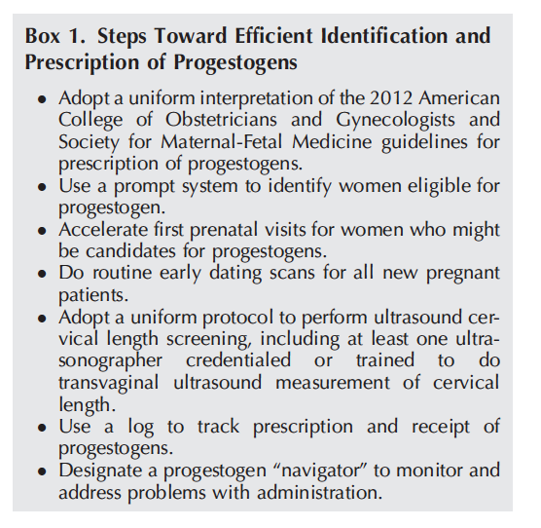
How Did We Do It?
Standard Protocols
  P Rx & Cx US
  Be Flexible
Quick Screen for PTB
  Go to Head of Line
Log ALL P-Eligible
  Track Rx, Delivery, Receipt, & Maintain. Trust No One
Designate P-Navigator
  Who Knows the System & the People
Communication
  Systems Issues ePRAF2.0
Obstet Gynecol 2017;Feb;129:337–46.
Notes:
Prior authorization, dropping women off rolls

Slide 16
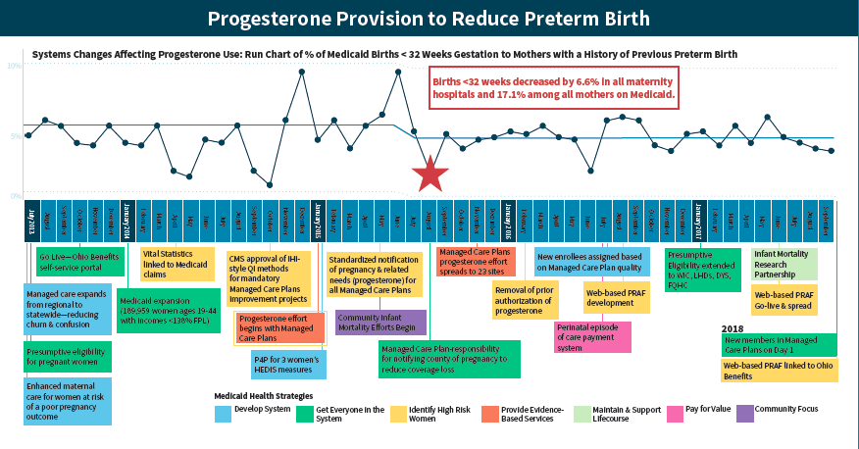

Slide 17
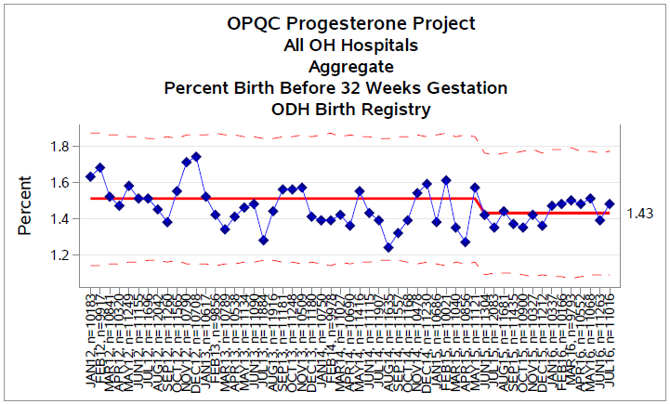
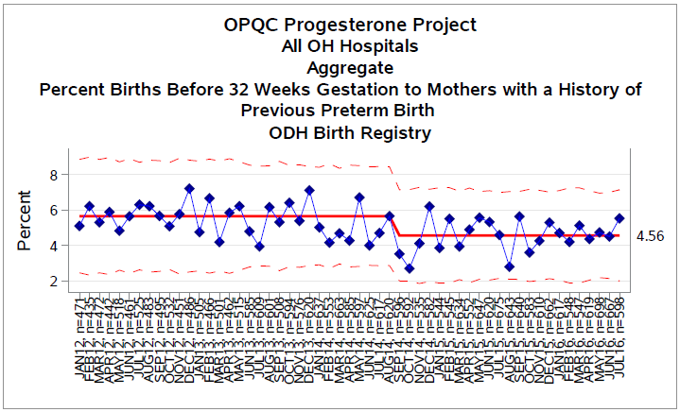
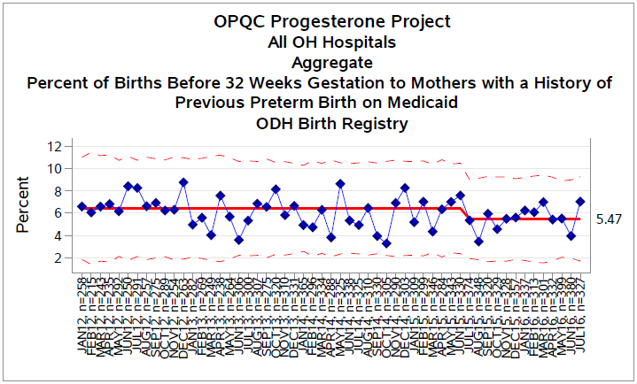
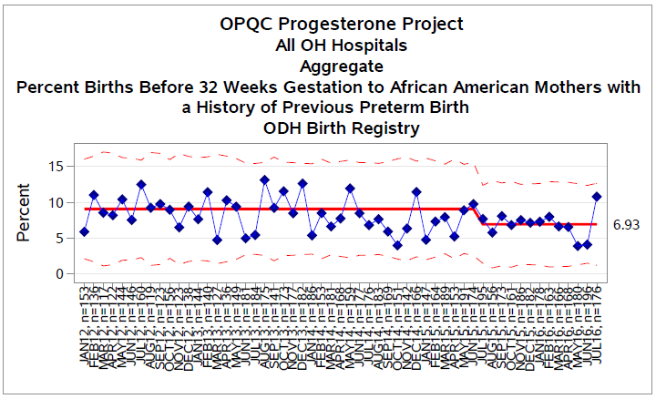
1. ALL OHIO BIRTHS BEFORE 32 WEEKS
2. ALL OHIO BIRTHS < 32 WKS w/ HX PTB
6.6%
20.5%
ALL OHIO BIRTHS <32 WEEKS
w/ HX PTB on MEDICAID
ALL OHIO BIRTHS <32 WEEKS TO
AFRICAN AMERICAN WOMEN w/ HX PTB
17.1%
20.3%
Notes:
Original target on KDD was reduce all births <32 weeks by 10%- showing 6.6% here, would capturing the other 3.4% for a total of 10% in spread be appropriate goal?

Slide 18
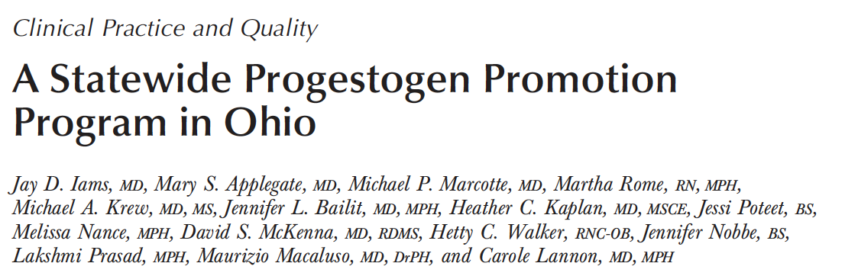
Outcomes
Obstet Gynecol 2017;Feb;129:337–46.

Slide 19

The
OPQC
Progesterone
Change
Package
A Step by Step
Pathway to Find
& Treat Women
Eligible for 17P
Notes:
We’ve developed a Change Package that we will spread through the 9 OEI Communities

Slide 20
e-PRAF
Notes:
An electronic Pregnancy Risk Assessment Form was developed from this project which will allow practitioners to provide information on each pregnancy to the MCPs AND (page 2) prescribe progesterone, order progesterone and alert pharmacy and home health agency

Slide 21
Future Focus for The Progesterone Project:
9 Ohio Equity Institute Counties
(counties with highest disparities in Infant Mortality in Ohio)

Slide 22
Opioid epidemic
NEONATAL ABSTINENCE SYNDROME (NAS)
MATERNAL OPIATE MEDICAL SUPPORTS (MOMS)

Slide 23


Projects:
OCHA & OPQC
OCHA: Ohio Children’s
Hospital Association Pilot
OPQC: Ohio Perinatal Quality Collaborative Statewide Spread
September 2012 – September 2014
Six children’s hospitals and their affiliates
(20 total hospitals)
994 infants in database
Included only infants that required pharmacological treatment for NAS
Funded by Office of Governor John Kasich
January 2014-December 2016
54 sites:
  25 Level III NICU’s
  26 Level II Special Care Nurseries
  3 Normal Newborn Nurseries
6,819 infants in database
Includes infants that were treated non-pharmacologically as well as those pharmacologically treated
Funded by Ohio Dept. of Medicaid

Slide 24
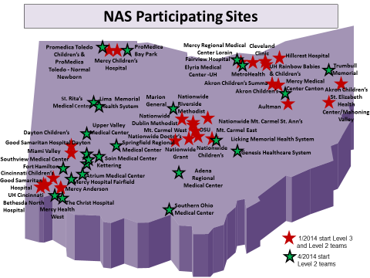

OPQC NAS
52/54 Level 3 NICU & Level 2 Special Care Nurseries
Notes:
All Level 2 and 3 Ohio NICUs and their affiliated level 1 units were eligible.
26 (100%) Level 3 NICUs
26 of 28 (93%) Level 2 NICUs
2 Level 1 units participated

Slide 25
Key Driver Diagram
Project Name: OPQC Neonatal NAS
KEY DRIVERS
INTERVENTIONS
GLOBAL AIM
Prenatal Identification of Mom
Implement Optimal Med Rx Program
All MD and RN staff to view “Nurture the Mother- Nurture the Child” Vermont Oxford Network’s DVD
Monthly education on addiction care.
To reduce the number of moms and babies with narcotic exposure, and reduce the need for treatment of NAS.
Improve recognition and non-judgmental support for Narcotic addicted women and infants
Fulltime RN staff at Level 2 and 3 to complete D’Apolito NAS scoring training video and achieve 90% reliability.
Attain high reliability in NAS scoring by nursing staff
Swaddling, low stimulation.
Encourage kangaroo care.
Feed on demand- MBM if appropriate or lactose free, 22 cal formula
SMART AIM
By increasing identification of and compassionate withdrawal treatment for full-term infants born with Neonatal Abstinence Syndrome (NAS), we will reduce length of stay by 20% across participating sites by June 30, 2015.
Optimize Non-Pharmacologic
Rx Bundle
Initiate Rx If NAS score > 8 twice.
Stabilization/ Escalation Phase.
Wean when stable for 48 hrs by 10% daily.
Standardize NAS Treatment Protocol
Connect with outpatient support and treatment program prior to discharge
Establish agreement with outpatient program and/or Mental Health
Utilize Early Intervention Services
Partner with Families to Establish Safety Plan for Infant
Collaborate with DHS/ CPS to ensure infant safety.
Partner with other stakeholders to influence policy and primary prevention.
Engage families in Safety Planning.
Provide primary prevention materials to sites.
Notes:
Goals
standardize identification, non-pharmacologic and pharmacologic treatment in Level 2 and 3 NICUs in Ohio.
reduce the use of and length of treatment with opioids.
reduce hospital length of stay in pharmacologically treated newborns with NAS.

Slide 26
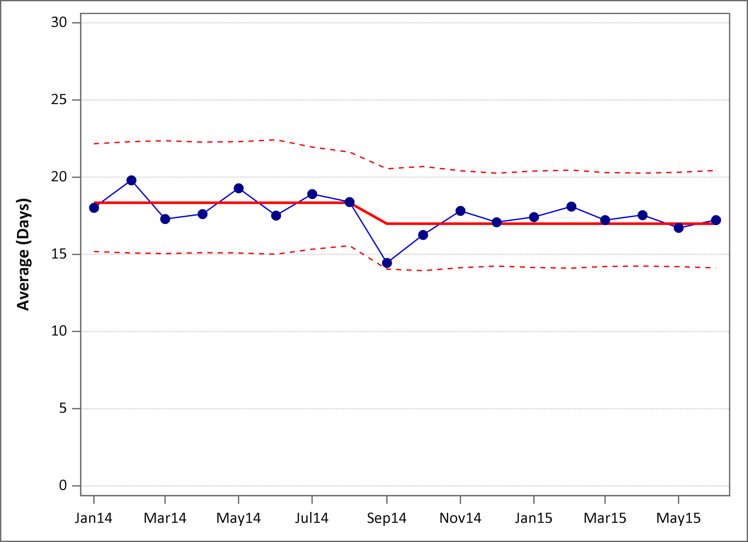
What OPQC Accomplished in Phase I…
January 2014 to June 2015
9% Decrease LOS
Standardized Finnegan scoring with reliability testing
Standardized approach to non-pharmacologic care based on best available evidence
Standardized treatment protocol based on best available evidence
Improved non-judgmental care
Better links with community resources
18.3 days
17 days
Notes:
From January 2014 to June 2015, OPQC conducted a QI initiative to reduce LOS in infants with NAS by standardizing care (Phase I). The geometric mean for length of stay showed a significant 9% decrease, the control chart showing special cause in early 2014, and a shift in the centerline from 18.3 days to 17.0 days
Approaches to standardization of non-pharmacologic care, were based on published expert opinion; therefore, variation across OPQC sites remained, particularly in use of LLF and 22 kcal feedings in formula-fed infants.

Slide 27


A Guide for Families

Slide 28

Improve recognition and non-judgmental support for Narcotic addicted women and infants
Addiction = Chronic Illness
  Addiction is a chronic and treatable disease
  Opioid maintenance therapy with methadone or buprenorphine may play an important role in treatment of pregnant women struggling with addiction
  Opioid maintenance therapy improves outcomes for both pregnant women and their infants
  Providing non-judgmental, compassionate care can be rewarding and beneficial for the patients and the providers
Attitude Measures Survey
This resource is focused on people’s attitudes towards alcohol and other drug use and is designed to encourage health professionals to explore and evaluate their attitudes towards drug users - particularly perceptions about a client’s or patient’s deservingness of medical care.

Slide 29
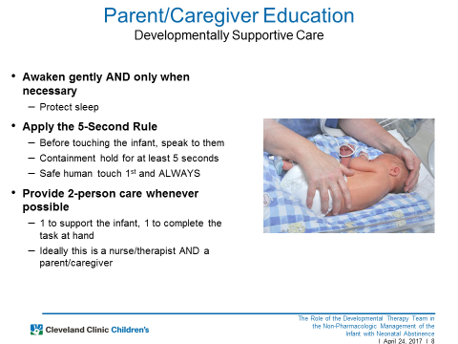

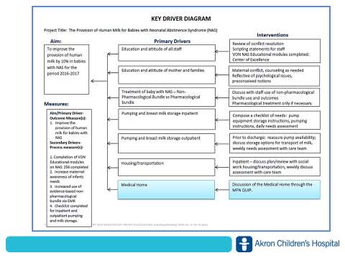
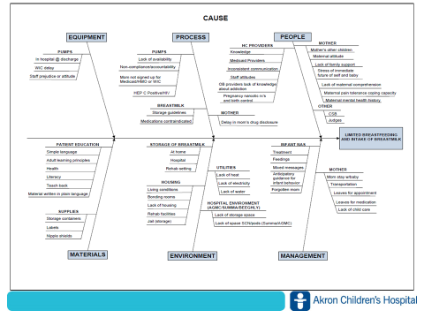

Slide 30
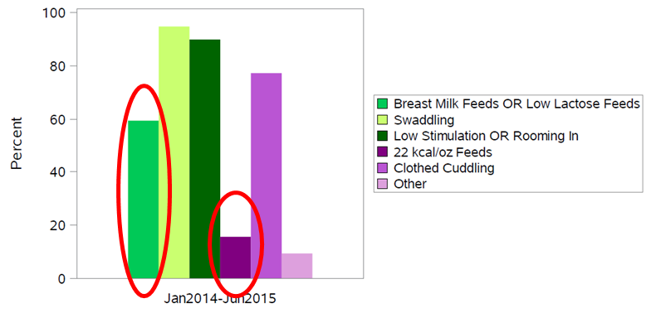
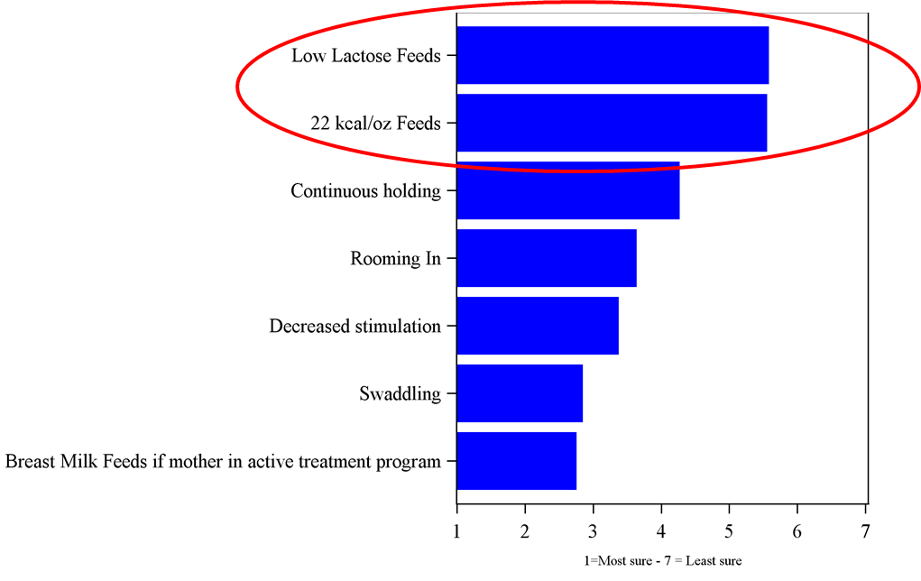
Variation and Uncertainty in Non-Pharmacologic Care

Slide 31

Phase 2 Orchestrated Testing
Is there a certain formula that is best for non-breastfeeding NAS infants?
Consistent benefit of 22 kcal/oz on weight loss, tx failure, and LOS
Notes:
Type of formula
Calorie content
Overall, the Orchestrated Testing data suggest that use of 22 kcal/oz could be a beneficial practice for NAS non-pharmacologic support
Consistent benefit of 22 kcal/oz feeds on weight loss, treatment failure, and length of stay
22 kcal/oz formula is associated with less treatment failure and shorter length of stay, though only explains a very small amount of the variation
Benefit of LLF is not consistent across outcome measures--possible synergistic effect with 22 kcal/oz on weight loss and length of stay, but not on treatment failure

Slide 32
Decrease % infants receiving pharmacologic treatment

Slide 33
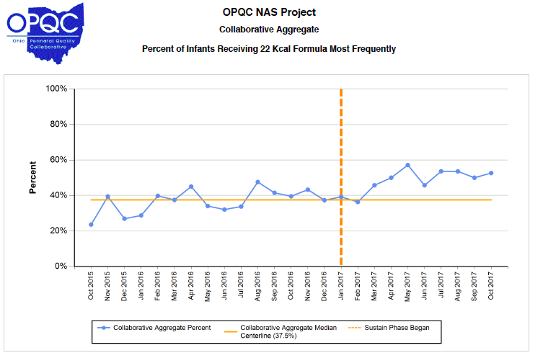
Diffusion through the network

Slide 34

Updated OPQC recommendations
Cohort of 6800 term infants with maternal narcotic exposure.
Notes:
The number of pharmacologically treated infants with NAS per hospital ranged from 2-495 in
Of the pharmacologically-treated infants,
17.9% were hospitalized in a Level 1 nursery
21.8% in a Level 2 nursery
60.3% in a Level 3 NICU
Thirty hospitals (56%) chose a standardized morphine protocol, 19 (35%) chose a standardized methadone protocol, while 5 (9%) used other protocols.
We identified 3266 opioid-exposed full term infants. All infants received treatment with the nonpharmacologic bundle.
1,570 (48.1%) infants required pharmacologic treatment for symptoms of NAS.

Slide 35
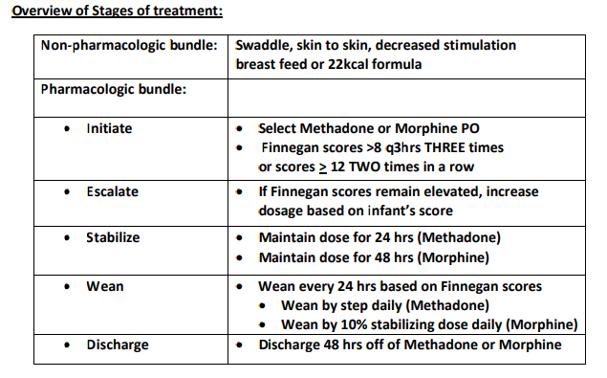
OPQC NAS Recommendations
Notes:
2. Non-Pharmacologic Treatments: All infants with NAS will be treated with a bundle of non-pharmacologic interventions including decreased stimulation, swaddling, continuous holding and frequent feeds.
2a. Each institution should develop a policy for the use of Mother’s Own Milk. Consideration of supporting breast feeding may be given if the mother is active in a treatment program and mother’s addiction specialist supports breast feeding.
2b. If MBM is not used, use of a term 22kcal/oz. formula to meet the exceptional caloric needs and combat the documented weight loss seen in NAS infants is recommended. Use of non-lactose containing formula is at the discretion of the individual unit. High calorie (22 kcal/oz.) formula may be discontinued when the infant completes pharmacologic treatment or if the infant has excessive weight gain.

Slide 36
Moving upstream
MATERNAL OPIATE MEDICAL SUPPORTS
MOMS (+NAS)

Slide 37
CLIENT-CENTERED CONTRACEPTIVE CARE
Ohio FQHC Infant Vitality Project

Slide 38


Slide 39
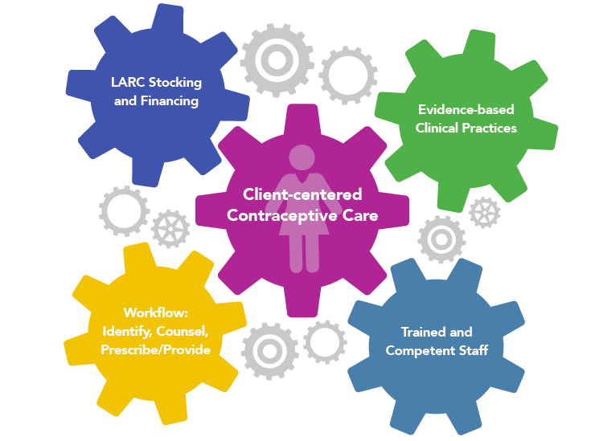

Slide 40
Ohio FQHC Infant Vitality Initiative Key Driver Diagram (KDD)
Project Leader(s): OPQC/CAI/OACHC
Revision Date: 7/31/2017
Global Aim
Key Drivers
Interventions
Social marketing campaign
Targeted communications to patients
Culturally appropriate messages
Improve infant vitality and maternal health by empowering women with information and services to optimize timing and spacing of their pregnancies.
Increased awareness of safe and effective contraception methods by clinicians and women
Realign workflow to identify, counsel & prescribe/provide contraception or preconception/interconception services
Employ a team based care model with all staff operating at top of their license
Remove requirements for unnecessary testing & FU visits
Provide same day contraception or a bridge method and f/u appointment if necessary
Train staff to provide client-centered contraceptive and preconception counseling
Train clinical staff to provide/prescribe all FDA approved contraceptive methods
Ensure skilled & competent providers in LARC insertion & removal available during every clinic session
Prepared, skilled proactive staff who can provide evidence informed counseling and contraception
SMART Aim
By Dec 2017, increase the % of women who desire and receive effective contraception in a timely manner from 55 to 70%.
Identification of women who desire contraceptive services
Use a standard tool or template in the EHR to identify women’s pregnancy intentions
Medication formulary includes all FDA-approved methods
Ensure IUDs, Implants, & Depo in-stock every day services provided
LARC exam room ready - materials for same day access (e.g. kits or carts)
Population
Access to all FDA approved/effective methods
Women of reproductive age (15-44) who are seen at FQHC
Leverage all sources of payment when providing contraceptive services
Ensure contracts with 3rd party payers include reimbursement for visit, insertion and cost of IUD/Implants
Optimize billing & coding to maximize reimbursement
Don’t deny services based on ability to pay
Ensure cost barriers for FQHC and Consumers are removed
Notes:
Logo edit
Left most arrows (have to be removed to make them useful) – do we have instructions that you should enter others?
Lines around the boxes the same width
Clean up syntax by providing examples
Make smart AIM box bigger
Blue arrow enter (new template) – make it black on entry
Add more interventions than key drivers
Add the A, B, C, D. And, 1-3 for interventions (add check mark for done).

Slide 41
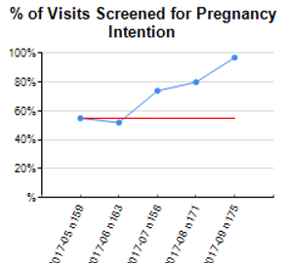
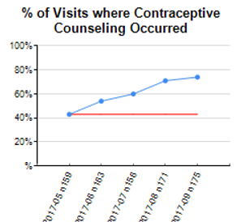
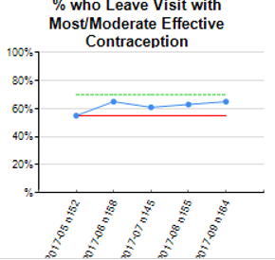
Measures
May-September 2017

Slide 42
Draft Change Package

Slide 43











It takes a village…

Slide 44
The Progesterone Project is funded by the Ohio Departments of Health and Medicaid through the Medicaid Technical Assistance and Policy Program (MEDTAPP), and administered by The Ohio Colleges of Medicine Government Resource Center.
The NAS Project is funded by the Ohio Department of Medicaid, through the Medicaid Technical Assistance and Policy Program (MEDTAPP) and administered by the Ohio Colleges of Medicine Government Resource Center.
The Infant Vitality Project is funded by the Ohio Association of Community Health Centers (OACHC), the Ohio Departments of Health and Medicaid, through the Medicaid Technical Assistance and Policy Program (MEDTAPP), and administered by The Ohio Colleges of Medicine
Government Resource Center.
The views expressed in these presentation are solely those of the authors and do not represent the views of state or federal Medicaid programs. This study includes data provided by the Ohio Department of Health which should not be considered an endorsement of this study or its conclusions.

Slide 45

Florida Perinatal Quality Collaborative: Recent Projects and Sustainability
Julie Z. DeCesare, MD
Clinical Co-Lead for PROVIDE
Florida Perinatal Quality Collaborative
Associate Professor
University of Florida College of Medicine

Slide 46

Vision
“All of Florida’s mothers and infants will have the best health outcomes possible through receiving high quality evidence-based perinatal care.”
Values
Voluntary
Population-Based
Data-Driven
Evidence-Based
Value Added

Slide 47











FPQC Partners & Funders

Slide 48
FPQC Organizational Structure
Steering Committee
FPQC Team
Program Staff
Medical Consultants
Nursing Consultants
Infant Health
Subcommittee
Data Indicator
User Group
Maternal Health
Subcommittee
Mothers Own Milk
QI Indicators
PROVIDE
NAS
BCI
Access LARC
QI Indicators
HIP Sustain.
QI Indicators

Slide 49
FPQC Initiatives
Data
Perinatal QI Indicators
Infant Health
Neonatal Catheter Infections
Mother’s Own Milk
Golden Hour
Hypertension in Pregnancy
Maternal Health
Early Elective Deliveries
OB Hemorrhage
Antenatal Steroids
2010
2011
2012
2013
2014
2015
2016
2017

Slide 50
Ongoing & New FPQC Initiatives
Perinatal QI Indicators
Data
Birth Certificate Accuracy
Infant Health
Mother’s Own Milk
Neonatal Abstinence
Maternal Health
Primary Vaginal Deliveries
Long-Acting Reversible Contraception
2017
2018
2019

Slide 51

Hypertension in Pregnancy (HIP) Initiative

Slide 52
Hypertension Safety Patient Bundle
Readiness
  Every unit
Recognition / Prevention
  Every patient
Response
  Every case of severe hypertension/preeclampsia
Reporting / Systems Learning
  Every unit

Slide 53

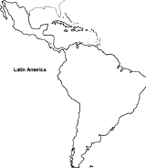
HIP Initiative Hospitals
32 Florida hospitals
1 Colombia hospital

Slide 54
Percent of Hospitals meeting
HIP Structural Measures
June 2017 (n=32)

Slide 55
Percent of All Reporting Hospitals that treated women with persistent new-onset severe HTN within 1 hour
Sustainability Phase began

Slide 56
Figure 8. Percent of All Reporting Hospitals where women had follow-up appointments scheduled in appropriate timing
Sustainability Phase began
Notes:
Numerator: Number of women who had follow-up appointments scheduled in appropriate timing
---------------------------------------------------------------------------------------------------------------------
Denominator: Number of charts reviewed

Slide 57
HIP Evaluation Results
Project had positive effect on hospital readiness, recognition, response, and reporting
  Improvements noted from pre- to post-implementation surveys:
    Standard protocol to manage HIP: 67% to 96%
    Medication box with required drugs: 9% to 100%
    Preparedness to handle HIP extremely well: 15% to 63%
Using IHI scale to assess improvement, 85% of hospitals reported significant or better improvement

Slide 58
HIP Lessons Learned
Collaboration is key and vital to hospital team participation
Understanding of QI science varies widely—building that capacity important for sustainability
Debriefing on hypertension events is challenging for hospitals

Slide 59
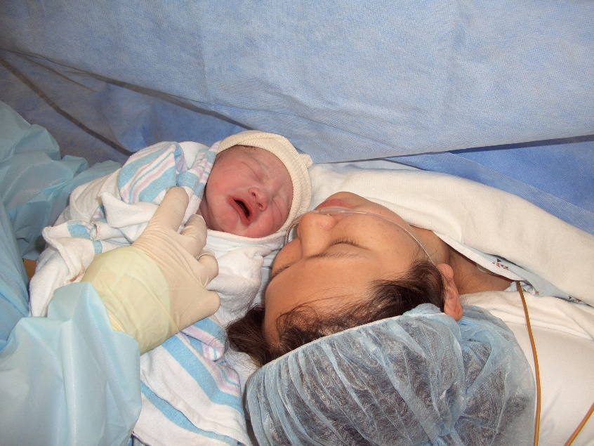
Promoting Primary Vaginal Deliveries (PROVIDE)
Reducing Low Risk Cesareans (NTSV)

Slide 60
The Florida Context
Delivery by cesarean section has been increasing in Florida
Low of 21.9% in 1996 to high of 38.1% in 2012
Variation in Florida hospital cesarean rates presents an opportunity for quality improvement and suggests other factors, including clinical practice patterns and patient preferences, may be affecting these rates
Notes:
Florida Context
Delivery by cesarean section has been increasing in Florida from a low of 21.9% in 1996 to a high of 38.1% in 2012; Florida’s provisional 2016 rate is 37.4%. Cesarean delivery of a woman’s first child, specifically among low-risk women with a term, singleton pregnancy with the fetus in vertex (head first) position are known as NTSV deliveries: nulliparous, term, singleton, vertex. It is likely NTSV cesareans are driving the increasing cesarean rate as virtually all subsequent births by NTSV women will be delivered by cesarean due to limited opportunity for vaginal delivery after cesarean (Martin et al 2011; Ecker & Frigoletto 2007; Hobbs et al 2016). In 2014, the national rate of primary cesareans was 26%; in Florida, it was 31%, the 2nd highest in the U.S (Rossen et al 2017).
A recent epidemiological study on individual and hospital level risk factors for cesarean delivery for low-risk first births in Florida (Sebastião et al, 2015) reports that after controlling for individual and hospital level factors (i.e., demographics, medical conditions, insurance status, day/time of delivery), the risk of such deliveries is greatest for women who deliver in hospitals located in the Miami-Dade area and for women in certain Hispanic subgroups (specifically Cuban and Puerto Rican). Variation in Florida hospital cesarean rates (which in 2012 ranged from 6.6% to 59.5%) presents an opportunity for quality improvement and suggests other factors, including clinical practice patterns and patient preferences, may be affecting these rates.

Slide 61
Low-Risk (Nulliparous Term Singleton Vertex) Cesarean Rate, 115 FL Hospitals
Range: 12.6—66.3%
Median: 30.0%
Mean: 30.8%
National Target =23.9%
17% of FL hospitals meet national target
Source: FL Vital Records, 2016
61
Notes:
Cesareans are the most common type of major surgery in the U.S. (32.8% of births) and Florida (38.1% of births) in 2012. Florida had the 4th highest rate among U.S. states.
Cesareans in Florida have been increasing from a low of 21.9% in 1996 to a high of 38.1% in 2012.
Primary cesareans are driving the increasing rate because virtually all subsequent births will be by cesareans because of few vaginal delivery after Cesarean.
A recent analysis of Florida birth certificates showed that across the 116 delivery hospitals in the state, the primary cesarean rate among low-risk first-birth deliveries ranged from 6.6% to 59.5%; roughly one-fifth of the hospitals (21%) meet the Healthy People 2020 national goal for such deliveries of 23.9% or less.

Slide 62
PROVIDE Goals
The PROVIDE Advisory Group proposes that PROVIDE initiative hospitals reduce their NTSV cesarean rates by at least 20% by the end of the 18-month initiative
The ultimate goal is for Florida’s rate to match if not surpass the U.S. rate in three years
Notes:
The California Maternal Quality Care Collaborative (CMQCC) was able to show reduction in hospital NTSV cesarean rates through a pilot project where hospitals received data measurement support, quality improvement mentoring from CMQCC, and payment reform. Three pilot hospitals saw an average of 22% reduction in their NTSV in less than a year with no change in the rate of unexpected newborn complications. Lessons learned from the pilot initiative, in addition to an expert task force, informed the creation of the CMQCC’s Toolkit to Support Vaginal Birth and Reduce Primary Cesareans (Smith et al 2016).
The FPQC PROVIDE Advisory Group decided to use the CMQCC’s Toolkit for the Florida PROVIDE Initiative. The Toolkit to Support Vaginal Birth and Reduce Primary Cesareans is a comprehensive, evidence-based guide based on the Council on Patient Safety in Women’s Health Care Patient Safety Bundle on Safe Reduction of Primary Cesarean Births and the American College of Obstetricians and Gynecologists and the Society for Maternal-Fetal Medicine (SMFM) Consensus on Safe Prevention of the Primary Cesarean Delivery. In addition to California’s toolkit, the advisory group is updating, modifying, amending, and adding tools for Florida care providers and hospitals to promote primary vaginal deliveries.

Slide 63
Planning and Support for this Project
Florida Department of Health
American College of Obstetricians and Gynecologists (ACOG) District XII
Florida Chapter of the Association of Women’s Health, Obstetric, and Neonatal Nurses (AWHONN)
Florida affiliate of the American College of Nurse Midwives (ACNM)
Alliance for Innovation in Maternal Health (AIM)
California Maternal Quality Care Collaborative (CMQCC)
Health Provider Representatives
Notes:
Needed to shorten the bullets to read. Who ever presents the slide needs to list all of the representatives: provider practice groups, hospitalists, health plans, hospital nurses and administration, public health professionals, childbirth educators, and doulas.

Slide 64
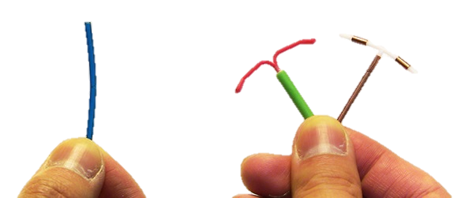
Access LARC
Immediate Postpartum Long-Acting Reversible Contraceptives (LARC)

Slide 65
LARC Background
In 2011, 45% of pregnancies in the U.S. were unintended; Florida’s rate was 59% in 2010
Women <30 years old account for the largest number of unintended pregnancies
Nearly 35% of pregnant teens experience another pregnancy in 2 years (rapid repeat)
Women with a repeat pregnancy in 5-17 months are at increased risk of poor pregnancy outcomes
Notes:
Encouraging the use of long acting reversible contraception is so important.
Unintended pregnancies, those pregnancies that are either unwanted or mistimed, have been an important public health issue for decades. Nationally, as many as 45% of pregnancies are either unwanted or mistimed. In Florida, the figure rises to 59% (Kost, 2015). Long Acting Reversible Contraceptives (LARCs), including Intrauterine devices (IUDs) and contraceptive implants are highly effective and can play a significant role in reducing unplanned pregnancies. Recent evidence has shown that providing LARC methods during the immediate postpartum period is safe and is supported by clinical evidence and guidelines.
1) and 2) Finer and Zolna, see comment
3) Baldwin, M. K., & Edelman, A. B. (2013). The effect of long-acting reversible contraception on rapid repeat pregnancy in adolescents: a review. Journal of Adolescent Health, 52(4), S47-S53.
4) Conde-Agudelo, A., Rosas-Bermúdez, A., & Kafury-Goeta, A. C. (2006). Birth spacing and risk of adverse perinatal outcomes: a meta-analysis. Jama, 295(15), 1809-1823.

Slide 66
Pregnancy Outcomes
Unintended / closely spaced pregnancies contribute to:
  Delayed initiation of prenatal care
  Higher risk of preterm birth & small for age
  Higher risk of maternal depression & child neglect
  Lower breastfeeding rates
LARC—intrauterine devices (IUD) & progesterone implants—are safe & highly effective prevention
Notes:
Interpregnancy intervals of shorter than 6 months are associated with an increased risk of preterm birth, low birthweight and small for gestational age compared to outcomes of births with interpregnancy intervals of 18-23 months. Short interpregnancy intervals impact breastfeeding rates, increase the risk for maternal depression and may have longer term health impacts on both parents. (Grundy and Kravdal; Do short birth intervals have long-term implications for parental health? Results from analyses of complete cohort Norwegian register data; J Epidemiol Community Health. 2014 Oct; 68(10): 958–964.
LARCs have been recognized by CDC, ACOG, AAP, the American Academy of Family Physicians and others as among the most highly effective family planning method.

Slide 67
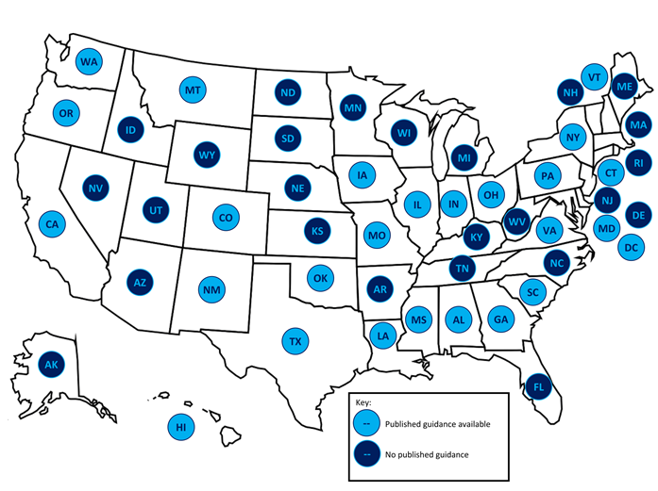
States with Medicaid Guidance for Immediate Postpartum LARC
Notes:
In March, 2012, South Carolina became the first state to change its Medicaid reimbursement policy to increase LARC placement immediately after delivery and prior to hospital discharge. As of 2016, 26 states have published guidance on providing immediate postpartum LARCs. We have relied heavily on documents from Georgia, South Carolina, West Virginia and Texas in writing Florida’s implementation toolkit for Access LARC.

Slide 68
Florida Medicaid
In 2016, Florida Medicaid joined other states in unbundling the cost of postpartum LARCs from the universal delivery charge (DRG), allowing hospitals to recover the cost of the devices, as well as provider and facility fees.
Individual Medicaid Managed Care Plans have the option of implementing this inpatient service.
Notes:
The Florida Medicaid Program on the advisory team for Access LARC and is developing materials for their managed care plans which closely parallel those developed for this FPQC initiative. We want to be sure the hospitals and the managed care plans are hearing the same guidance. The managed care plan’s role is pivotal in the successful implementation of the Access LARC quality initiative in clarifying and collaborating on policy, billing, and reimbursement at the hospital level.

Slide 69
Why immediate postpartum LARC?
Opportune Timing
Up to 40% of patients do not return for 6 week postpartum visit
Maximizing Patient interaction
Women are accessing healthcare
Capitalizing Patient Motivation
Women are motivated to obtain contraception

Slide 70
Project Goal
To increase access to immediate postpartum long-acting reversible contraception (LARC) as a contraceptive option in Florida hospitals.

Slide 71
Access LARC Initiative
Two Phases
Pre-Implementation Phase:
  Focuses on getting structural changes in place to allow for acquisition and billing of LARCs
Implementation Phase:
  Focuses on provision of new service
Notes:
Because this initiative is expected to take significant effort for hospital teams to get all the pieces in place for successful implementation, the initiative is divided into two phases: Pre-implementation and Implementation.
The Pre-implementation Phase focuses on creating and modifying hospital systems to enable acquisition and availability of and reimbursement for immediate postpartum LARC placement. Initial decisions regarding which LARC method (IUD or implant) as well as which hospital sites (L&D, postpartum, outpatient clinic) will be included in the initiative will guide the implementation process. The pharmacy will need to address formulary revisions, determine pharmacy costs (device, local anesthetic, stocking charge), inventory levels, stocking locations and order system revisions. Billing and collections department may need to create new billing codes (device, facility, provider), initiate contract amendments with managed care organizations, customize the claims process, and test billing revisions to assure reimbursement. Policies and procedures, guidelines and work flows for labor and delivery, obstetric operating rooms, and postpartum floors will also require creation or revision. Administration support at the highest level will be critical during this phase to assure the various departments work together and that, the initiative continues to make timely progress given other hospital priorities.
The Implementation Phase focuses on the delivery of this new service. It includes assuring that credentialed providers are available for immediate postpartum LARC insertion and that providers are trained in contraception choice counseling that includes the option of postpartum LARCs. This is the phase during which providers will actually begin offering and providing immediate postpartum LARC.This initiative will take some time for planning for successful implementation.

Slide 72
Planning and Support for this Project
Agency for Healthcare Administration (Medicaid)
Florida Department of Health
ACOG District XII
Florida Association of Healthy Start Coalitions
Aetna and United
AWHONN
Health Provider Representatives

Slide 73
Keys to FPQC Successes to Date
Support of organizational partners in promoting QI efforts with members
Funding from the Florida Dept. of Health and others
Committed nurses and physicians who develop and participate in projects
Building QI culture through trainings and monthly learning sessions
Our statewide partners are now seeing the FPQC as a natural extension of their organization and their work

Slide 74
New Initiatives
Neonatal Abstinence Syndrome (NAS) launching in Fall 2018

Slide 75




Questions?
Facebook.com/TheFPQC/
@TheFPQC
Join our mailing list at FPQC.org
E-mail: FPQC@health.usf.edu
Notes:
At FPQC.org you can find information about current and past projects and join our mailing list. We have a facebook page and twitter account as well. You can also email us at FPQC@health.usf.edu
http://health.usf.edu/publichealth/chiles/fpqc/provide is the specific site for PROVIDE

Slide 76

Illinois Perinatal Quality Collaborative
Brenda Barker, M Ed, MBA
Executive Director & Improvement Advisor

Slide 77

And How Are the Children?
Notes:
How Are the Children
Adapted by Pat Hoertdoerfer from an excerpt of a speech by Rev. Dr. Patrick T. O'Neill
Among the most accomplished and fabled tribes of Africa, no tribe was considered to have warriors more fearsome or more intelligent than the mighty Masai. It is perhaps surprising, then, to learn the traditional greeting that passed between Masai warriors:"Kasserian Ingera," one would always say to another. It means, "And how are the children?"
It is still the traditional greeting among the Masai, acknowledging the high value that the Masai always place on their children's well-being. Even warriors with no children of their own would always give the traditional answer, "All the children are well." Meaning, of course, that peace and safety prevail, that the priorities of protecting the young, the powerless, are in place. That Masai society has not forgotten its reason for being, its proper functions and responsibilities. "All the children are well" means that life is good. It means that the daily struggles for existence do not preclude proper caring for their young.
http://archive.uua.org/re/reach/teaching/masai.html

Slide 78
Disclosures
I have no financial relationships to disclose.
I will not be discussing off-label applications of devices or pharmaceuticals.
I do however have 11 children
I am a new NICU grandmother
And sometimes …

Slide 79

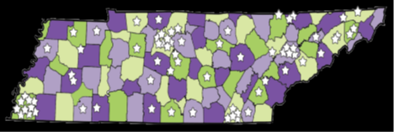
TIPQC in 2017
Statewide engagement
Annual meeting
  ~300 attendees
  Multidisciplinary
Leadership Transition Model
Celebrating 9 years
Recognized, trusted partner
Funding
  State Medicaid (TennCare) budget (matched state/federal funds)
  Intra-governmental transfer to Tennessee Department of Health
  Additional funding for VON antimicrobial stewardship project
Statewide engagement
Annual meeting
  ~300 attendees
  Multidisciplinary
Notes:
Established in 2008 by the TN Governor’s Office.
Physical Location is Vanderbilt University Medical Center, with data housed at TDH.
Focus is Maternal and Infant Population.
Participants: Open to all 65 birthing hospitals and OB clinics, and all 26 NICUs.

Slide 80


TIPQC in 2017
Developing Projects
for 2018
PPLARC
AIM-Opioid UD
Late Preterm Infant
NICU Nutrition & Growth
VON--Antibiotic Stewardship
CURRENT PROJECTS
2016-2018
2016-2018
Breastfeeding, 1.0, 2.0, 3.0
2010-16
NICU HAI
2014-16
Maternal Hemorrhage
2016-2017
NICU Follow Up
2012-13
Hypothermia
2009-10
Antenatal
Steroids
2013-14
CLABSI
2010-12
Neonatal Abstinence Syndrome 1.0, 2.0. 3.0
2012-2015
Human Milk
for NICU
2009-13
Undetected CCHD
2011-12
EED Before
39 Weeks
2009-15
Golden
Hour
2012-2015
PROJECTS IN SUSTAINMENT
Source: TIPQC Website, available at: https://tipqc.org/projects/

Slide 81

The Premature Birth Report Card compares the 2016 preterm birth rate to the March of Dimes goal of 8.1 percent by 2020. The Report Card highlights priority areas for action with county and racial/ethnic disparities data including a disparity ratio. Report Cards are intended to spur action to improve equity and reduce preterm birth, with the goal of giving every mother and baby a fair chance for a healthy pregnancy and birth.
In Tennessee, the racial disparity of the preterm birth rate among Black women is 43% higher than the rate for other women.

Slide 82
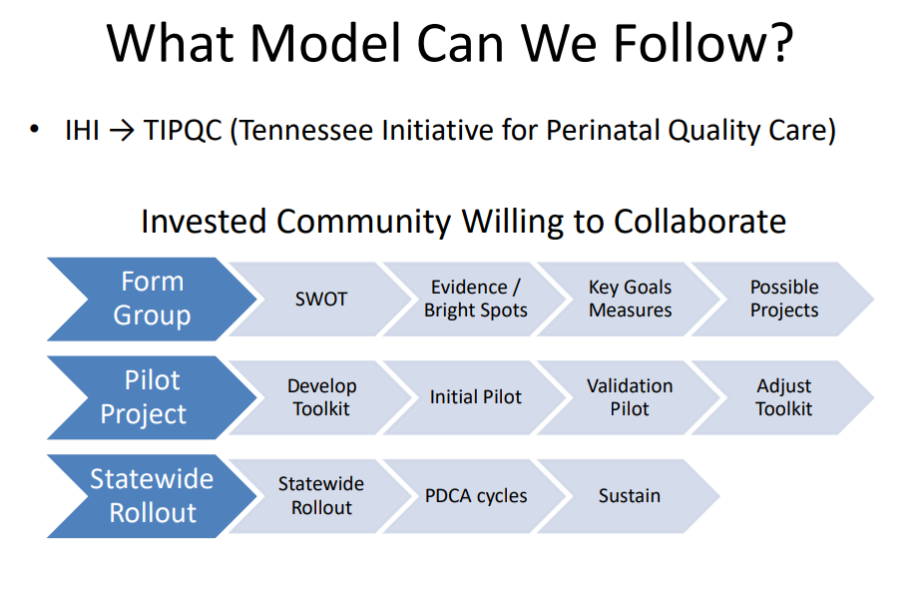

Slide 83
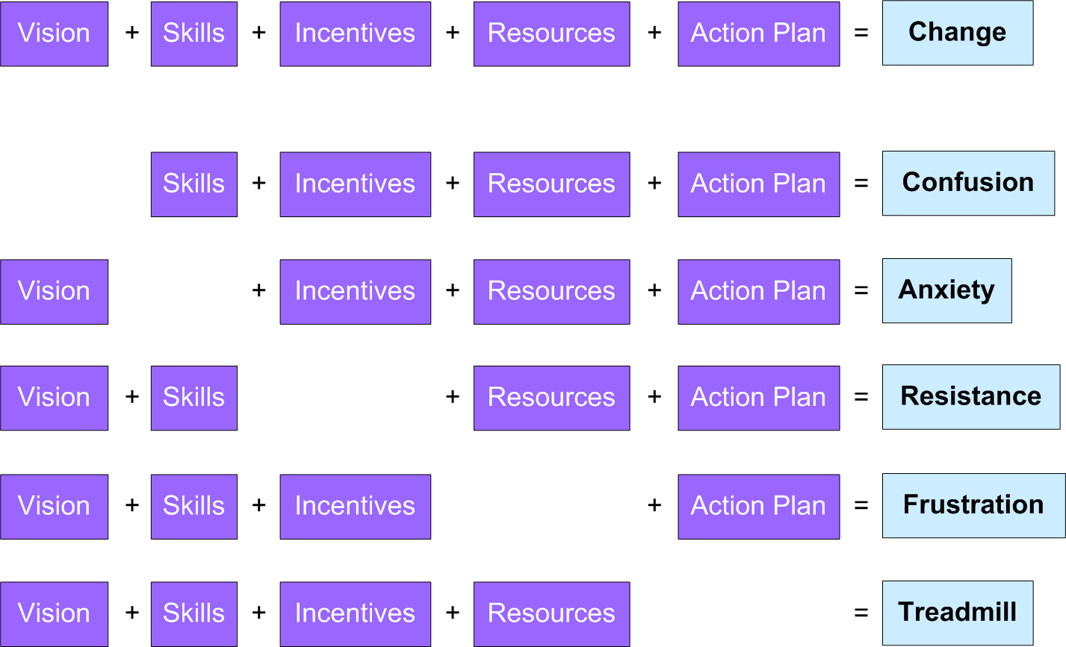

Components of
Successful Change Management
Knoster, T., Villa R., & Thousand, J. (2000) A framework for thinking about systems change.

Slide 84

Antibiotic Stewardship
2016-2018

Slide 85




Components of Successful Change Management
Vision
+
Skills
+
Incentives
Resources
+
Action Plan
=
Change
+
VON Call to Action
TDH
THA
TIPQC
+
VON
CME, CNE, MOC, VON recognition
TDH/ TIPQC Paid VON hospital fee
2016, 2017 & 2018 VON iNICQ
Confusion
=
Maximize CMS payments
=
Anxiety
CDC
=
Resistance
ACOG/ AAP Guidelines
Joint Commission
Hospital Resources
=
Frustration
QI Coaching
2018 State Collaboration
2018 TIPQC
2018 State Project
=
Movement

Slide 86
Developing 2018
Weekly point estimates of antibiotic use
Vancomycin Usage for babies on antibiotics
Adherence to unit guidelines for the use of antibiotics
Adherence to the standard of drawing blood cultures prior to starting antibiotics
Parent involvement/knowledge of their baby being started on antibiotics and the plan for discontinuing those antibiotics
Notes:
We had 9 NICUs participate in the November 2017 audit. The information we learned from this latest audit includes:
13% of NICU babies were on antibiotics on the day of the audit
most of the babies receiving antibiotics were < 1500 grams
more babies receive antibiotics for suspected late-onset sepsis
the top three antibiotics being used are aminoglycosides, ampicillin and vancomycin
our vancomycin use has decreased to 13.6%
all of our antibiotic stewardship teams have physician and pharmacist leadership
8 of 9 of the participating facilities have a multidisciplinary team dedicated to antibiotic stewardship
67% of the participating facilities have automatic stops in place
44% of the participating facilities have moved to using the early onset sepsis calculator
only 33% of the participating facilities include the 3 key components in their documentation
only 22% of the participating facilities monitor and report prescriber adherence to treatment recommendations
only 1 of the 9 participating facilities share NICU specific reports on antibiotic use with families

Slide 87
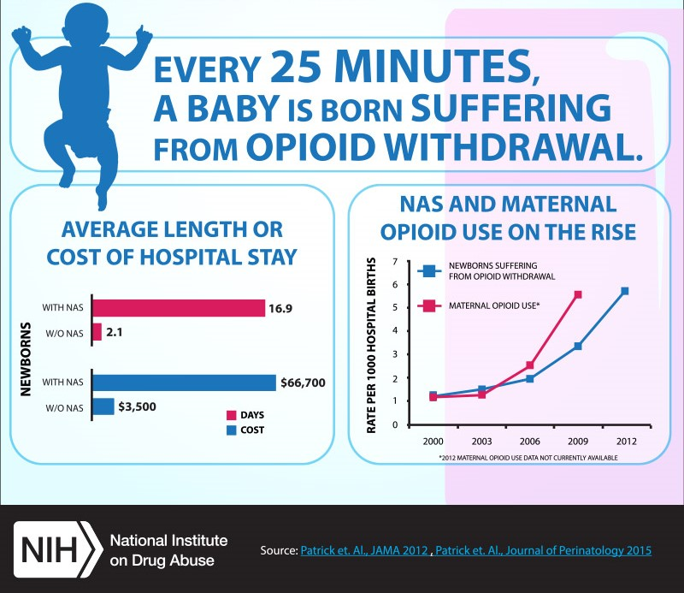
NAS
Opioid Use Disorder
NICU NAS 1.0 & 2.0, 2012-2015
NICU NAS Multistate Collaborative 2015-16
2018 AIM
Notes:
There was a five-fold increase in the proportion of babies born with NAS from 2000 to 2012, when an estimated 21,732 infants were born with NAS —equivalent to one baby suffering from opiate withdrawal born every 25 minutes. Newborns with NAS were more likely than other babies to also have low birthweight and respiratory complications. The number of delivering mothers using or dependent on opiates rose nearly five-fold from 2000 to 2009, to an estimated 23,009. In 2012, newborns with NAS stayed in the hospital an average of 16.9 days (compared to 2.1. days for other newborns), costing hospitals an estimated $1.5 billion; the majority of these charges (81%) were paid by state Medicaid programs, reflecting the greater tendency of opiate-abusing mothers to be from lower-income communities. The rising frequency (and costs) of drug withdrawal in newborns points to the need for measures to reduce antenatal exposure to opiates.
Top Graph: Every 25 minutes, 1 baby is born suffering from opiate withdrawal.
Bottom Left Graph: Average length or cost of hospital stay graph. Newborns with NAS stayed in the hospital for an average of 16.9 days compared to 2.1 days for those without NAS. The hospital costs for newborns with NAS were $66,700 on average compared to $3,500 for those without NAS.
Bottom Right Graph: NAS and maternal opiate use on the rise graph.

Slide 88
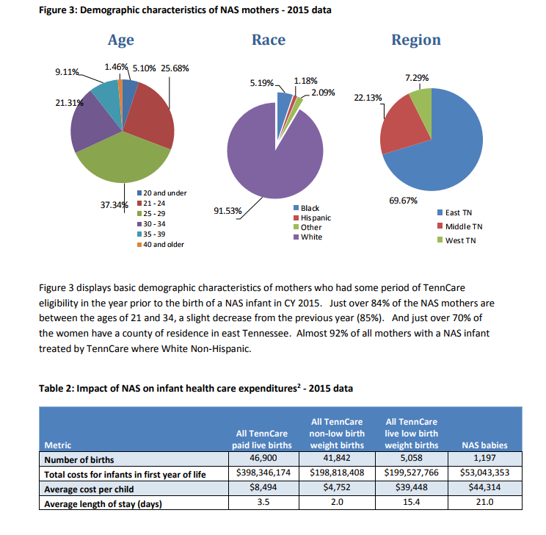
https://www.tn.gov/assets/entities/tenncare/attachments/TennCareNASData2015.pdf, May 2017

Slide 89
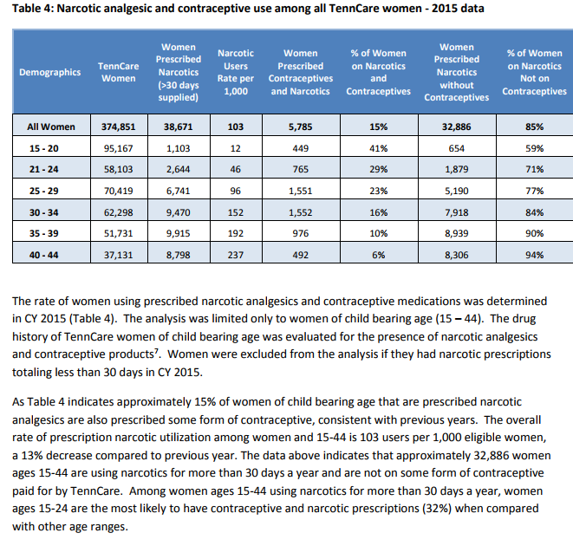
https://www.tn.gov/assets/entities/tenncare/attachments/TennCareNASData2015.pdf, May 2017
Women of Childbearing Age
50% of all pregnancies are unplanned
https://www.tn.gov/assets/entities/health/attachments/July_2017__NAS_Monthly_Update.pdf

Slide 90
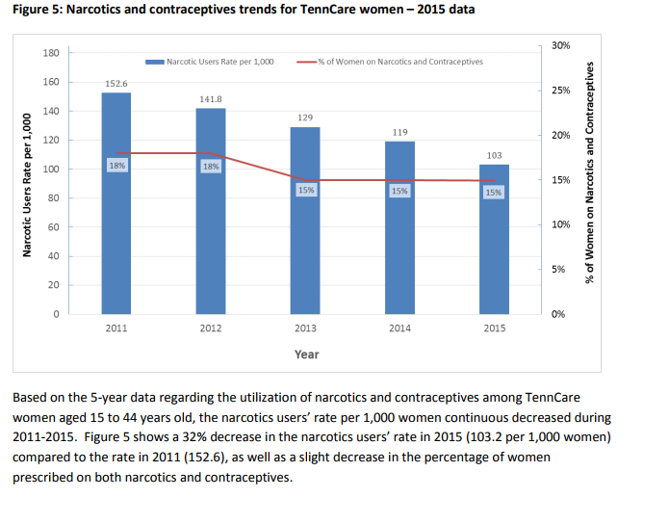
Figure 5: Narcotics and contraceptives trends for TennCare women – 2015 data
https://www.tn.gov/assets/entities/tenncare/attachments/TennCareNASData2015.pdf, May 2017

Slide 91
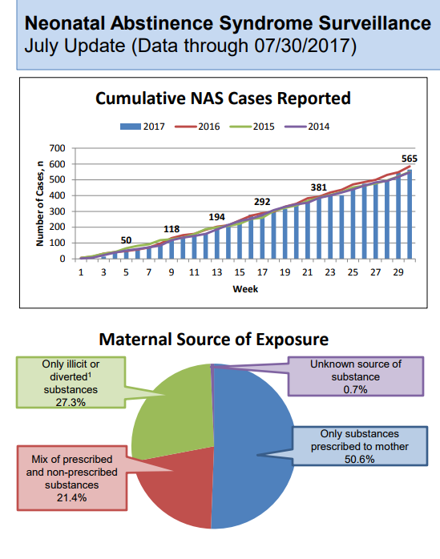
Notes 1. “Illicit” means drugs which are illegal or prohibited. “Diverted” means using legal/prescribed drugs for illegal purposes. For example, using a prescription drug purchased from someone else or using a prescription drug that was prescribed for someone else. 2. Multiple maternal substances may be reported; therefore the total number of cases in this table may not match the total number of cases reported. More information on Neonatal Abstinence Syndrome in Tennessee can be found here: http://tn.gov/health/topic/nas
https://www.tn.gov/assets/entities/health/attachments/July_2017__NAS_Monthly_Update.pdf

Slide 92
Notes:
QI & state plan for engagement, teams, processes, etc.

Slide 93



Components of Successful Change Management
Vision
+
Skills
+
Incentives
Resources
+
Action Plan
=
Change
+
+
ID & Early Scoring
BIG Problem!
TIPQC tool kit
Multi-State
Data
Research
AIM
TN Opioid Collaborative
TN work
=
Confusion
TDH
TIPQC
AIM
Multi-States
Payer Grants
=
Anxiety
Non-pharma
AIM
=
Resistance
Care of staff
Better care /management
TN Leaders
=
Frustration
OUD Treatment
Dropped Legal Action
Hospital & Treatment Resources
=
Treadmill

Slide 94

Nutrition & Growth for the VLBW
2016-2018

Slide 95
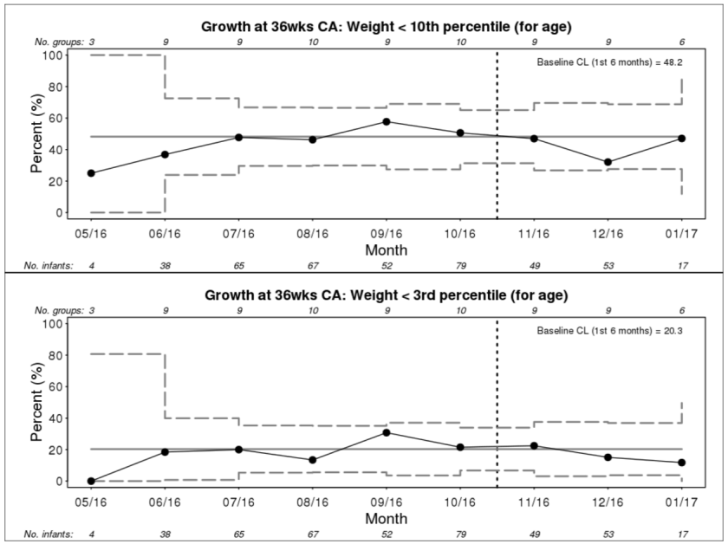
Nutrition for VLBW
From TIPQC Annual Report 2016 & Website
Notes:
Improvement of Process measures
Tightening—esp drop babies died from 7 days
Birth—starting well
More born at growth failure and severe growth failure

Slide 96
Components of Successful Change Management
Vision
+
Skills
+
Incentives
Resources
+
Action Plan
=
Change
+
+
Z-scoring
Long-term infant development
TIPQC Tool kit
Change in weight z-score greater than 0
=
Confusion
TIPQC Leadership
VON Data
“Do no harm”
TIPQC/ VON Data
Keep in same growth class
Anxiety
=
Best Practices
Monthly Huddles
Decrease feeding stops & gaps
=
Resistance
Feeding
CME & MOC
Amino Acid Shortages
Maximize Weekly Growth
=
Frustration
Nutrition Rounding
State Leadership
=
Treadmill

Slide 97

Golden Hour
NICU Golden Hour, 2012-2015

Slide 98

Golden Hour: By the Minute
Because Our Deliveries Should Run Like Clockwork!
Birth to 3 Min
Quality Improvement Tools
45 Min to 60 Min
Place oximeter
3 Min to 15 Min
CXR
Blood glucose
Vitamin K and Erythromycin
Begin glucose solution infusion
Administer ABX within 2 hours (ASAP)
Communication with parents
NRP!
Titrate FiO₂ to O₂ sats
5 min temp, FiO₂, and SaO₂
Prophylactic surfactant
Transport to NICU
Weigh
Admit temp
Call pharmacy to request IV fluids
Obtain IV access
Use clear drape for line
placement, if possible
Recheck infant temp PRN
Blood Pressure
Lab work
Scan antibiotic
orders STAT
30 Min to 45 Min
15 Min to 30 Min
St Thomas Midtown
Notes:
QI is critical….process, management, spread

Slide 99

Components of Successful Change Management
Vision
+
Skills
+
Incentives
Resources
+
Action Plan
=
Change
+
+
QI Skills
Improved Outcomes
TIPQC Tool kit
System Improvements
=
Confusion
TIPQC Leadership
VON Data
Improved Care
TIPQC/ VON Data
Communication
=
Anxiety
Systems Analysis/
Mapping
Hospital
Shared commitment across institutions
=
Resistance
CME & MOC
Improve high reliability of processes
=
Frustration
TIPQC Huddles
=
Treadmill

Slide 100

(4) Hub colonization

Slide 101
Patient & Family Advisor Contributions
Storytelling
Education
Safety
Rounding
Facility Design
Literature Review
System Input
Quality & Performance Improvement Teams
Patient Communication & Transparency
Adapted from Dutton, K. (2014). Strategic Storytelling: A creative approach to Achieving Quality. NAHQ 2014 Annual Meeting.

Slide 102

“The names of the patients whose lives we save can never be known. Our contribution will be what did not happen to them. And, though they are unknown, we will know that mothers and fathers are at graduations and weddings they would have missed, and that grandchildren will know grandparents they might never have known, and holidays will be taken, and work completed, and books read, and symphonies heard, and gardens tended that, without our work, would never have been.” Donald M. Berwick, MD

Slide 103
Hospital/
Clinic Change
Network/
Regional Spread
State-level improvement

Slide 104
TIPQC Results
12%
increase in breastfeeding at discharge
20%
increase in human milk for first feed
>90% reliability for Golden Hour use of checklists
>90% reliability for Golden Hour surfactant use
10%
increase in breastfeeding at discharge
BASELINE
66% decrease in NICU CLABSIs
83% decrease in elective deliveries before 39 weeks
37% decrease in NEC
26→24 days
length of stay for NAS infants
23→20 days
length of rx tx for NAS infants
24→22 days
length of stay for NAS infants
20→17 days
length of rx tx for NAS infants
Source: TIPQC Annual Report, 2013. Available at: https://www.etsu.edu/cph/pdam/documents/tipqc_ar_2013.pdf. Last accessed 11/27/2016. And communication with Dr. Peter Grubb, TIPQC Medical Director, 11/27/2016.

Slide 105
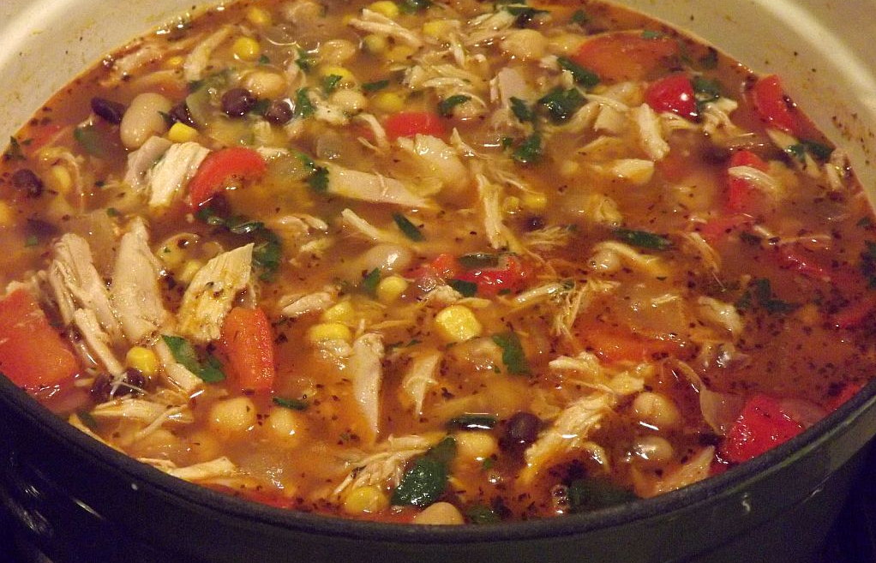
Ingredients for Success
Robust statewide network
Built data system utilizing REDCap™
SPC Reporting on demand
Recent move of data to TDH
Governance through key State Leaders including TDH, TennCare, all MCOs, and THA
15 projects showed improvement upon completion
Documented savings to Tennessee supporting efforts for continued funding
Recent change in leadership with succession plan for continued sustainment
LIVES SAVED AND FUTURES CHANGED!

Slide 106

What Can You Do
By Next Tuesday?

Slide 107


Brenda.Barker@TIPQC.org

Slide 108



