Slide 1
Neonatal Abstinence Syndrome:
Rethinking Our Approach
Matthew Grossman, M.D.
Assistant Professor of Pediatrics
Yale School of Medicine
Quality and Safety Officer
Yale-New Haven Children’s Hospital

Slide 2
Incidence of NAS in the US, 2000-2012
Patrick SW, et. al. Neonatal Abstinence Syndrome and Associated Healthcare Expenditures – United States, 2000-2009. JAMA. 2012 May 9;307(18):1934-40.
Patrick SW, Davis MM, Lehman CU, Cooper WO. Increasing incidence and geographic distribution of neonatal abstinence syndrome: United States 2009 to 2012. J Perinatol. Apr 30 2015.

Slide 3
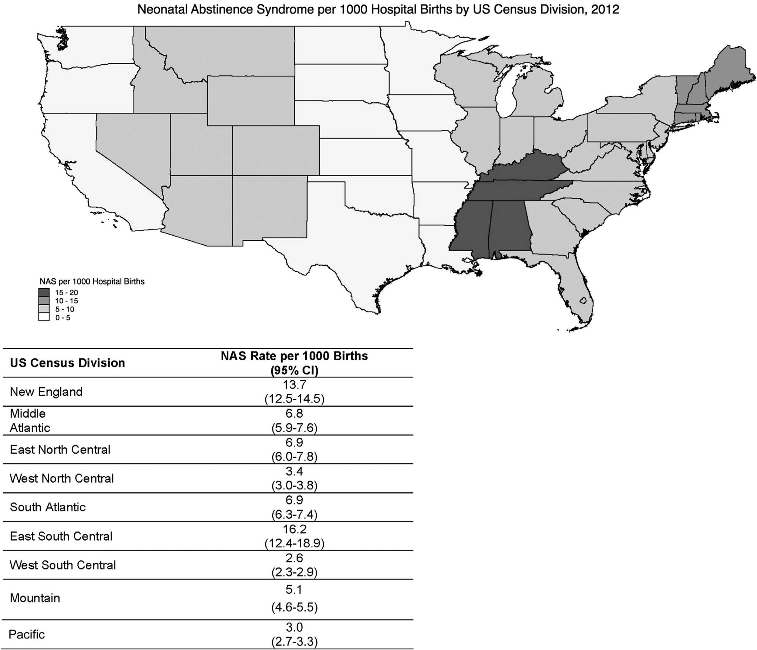
Patrick, et al Journal of Perinatology, 2015
Notes:
It is important to note that today, and this was just published last month, the distribution of NAS covers the nation, with higher incidences in the Northeast and Mid-Atlantic regions as well as the Mountain States. Those very dark states in the south are seeing 15-20 per 1000 babies treated in the hospital for NAS. Probably at least double that number are at-risk but escape prolonged hospitalization as not every baby exposed to opiates in utero will experience withdrawal. This is an expensive problem and currently the incidence is still rising.

Slide 5
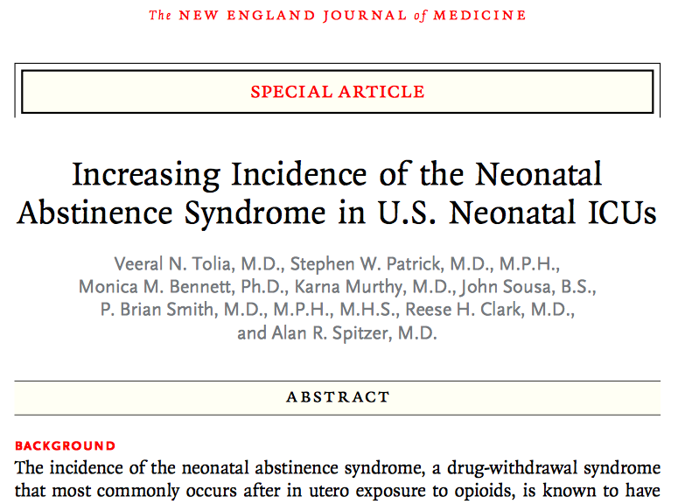

Slide 6

Source: Grossman Family Album
Notes:
What happens to the infant

Slide 7
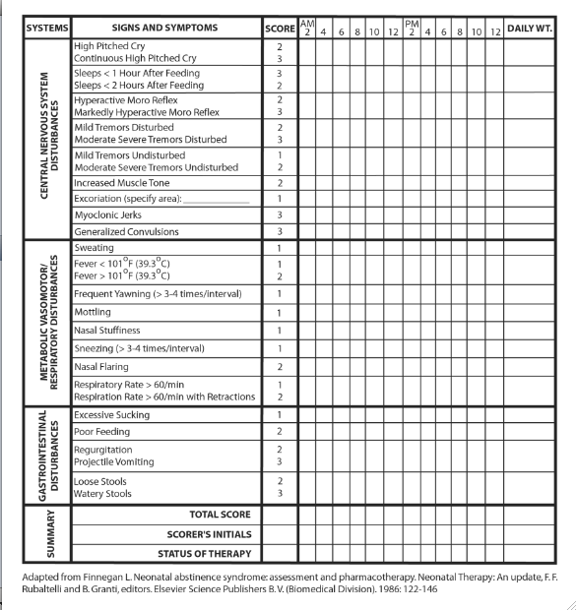

Slide 8
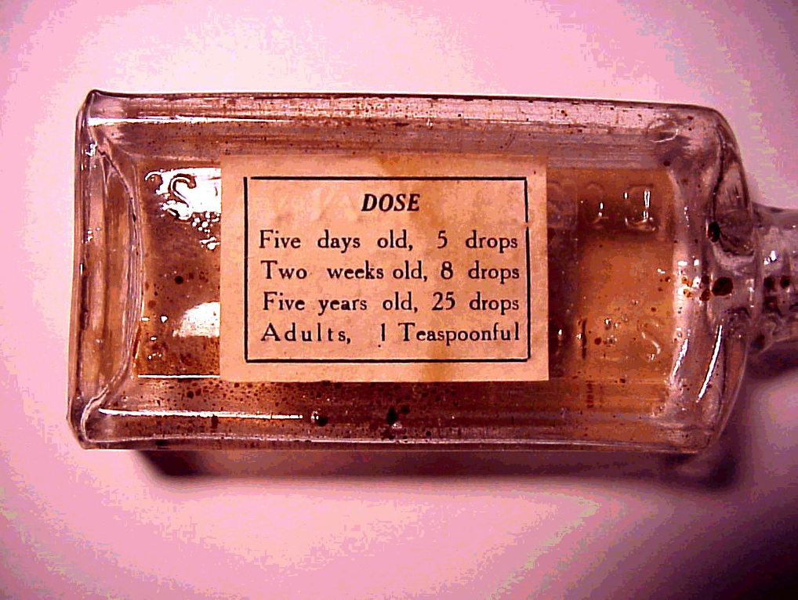
Source: http://wings.buffalo.edu/aru/preprohibition.htm
Langenfeld, et al. Drug and Alcohol Dependence 2005;77:31–6.

Slide 9
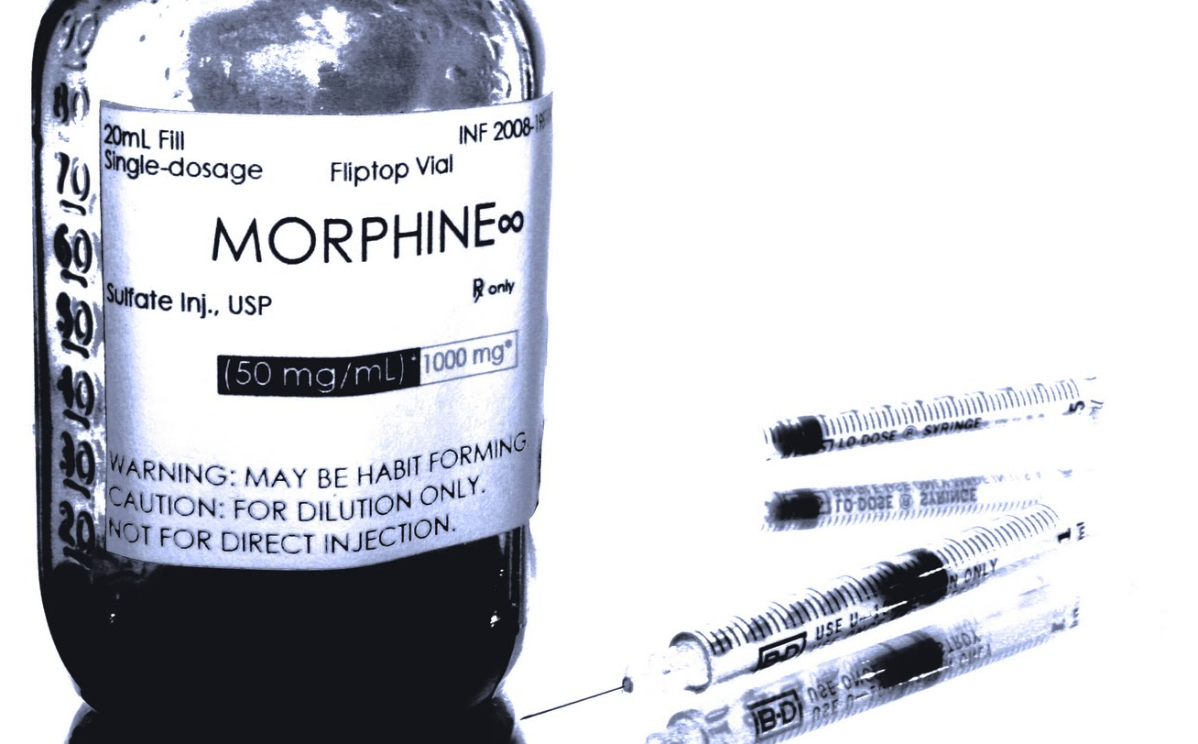
Source: http://olivier-dogot.blogspot.com
Jackson L, et al. Archives of Disease in Childhood 2004;89: F300–4.
Notes:
Compared morphine to phenobarb 12 days of treatment to 8 days of treatment

Slide 10
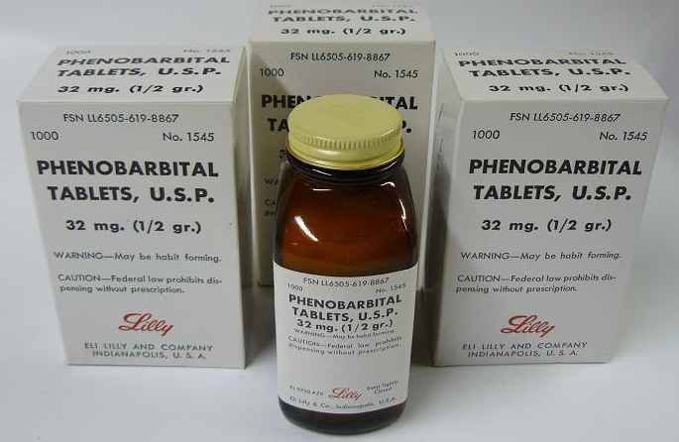
Source: http://www.bad-drug.net
Coyle MG. Journal of Pediatrics 2002;140:561–4
Notes:
DTO vs. DTO plus phenobarb = 79-38 days

Slide 11
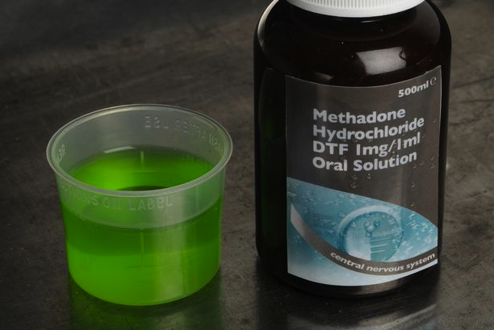
Source: http://www.projectknow.com
MS Brown et al. Journal of Perinatology 2014; (1-6)

Slide 12
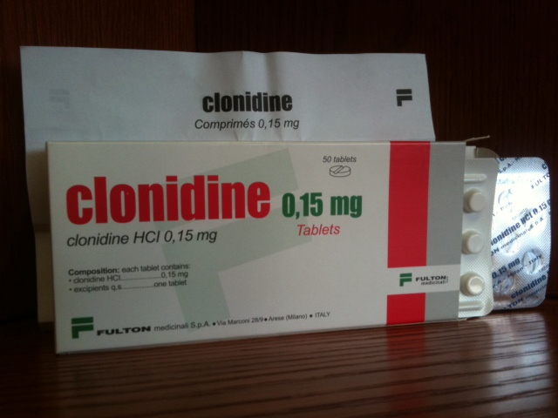
Source: http://www.recovery.org
Agthe, et al. Pediatrics 2009;123:e849–56.

Slide 13

Standard Approach
Medications
NICU
Finnegan Scores
Medication Dosing
Staff cares for the baby

Slide 14


Slide 15
Medication Studies
DTO vs. DTO plus clonidine: 17 days vs. 12 days
Morphine vs. Phenobarbitone: 8 days vs. 12 days
Morphine vs. DTO 30 days vs. 27 days
DTO vs. DTO plus Phenobarbitone 79 days vs. 38days
Methadone vs. Morphine 17 days vs. 24 days
DTO vs. DTO plus clonidine: 17 days vs. 12 days
Morphine vs. Phenobarbitone: 8 days vs. 12 days
Morphine vs. DTO 30 days vs. 27 days
DTO vs. DTO plus Phenobarbitone 79 days vs. 38days
Methadone vs. Morphine 17 days vs. 24 days
DTO vs. DTO plus clonidine: 17 days vs. 12 days
Morphine vs. Phenobarbitone: 8 days vs. 12 days
Morphine vs. DTO 30 days vs. 27 days
DTO vs. DTO plus Phenobarbitone 79 days vs. 38days
Methadone vs. Morphine 17 days vs. 24 days

Slide 16
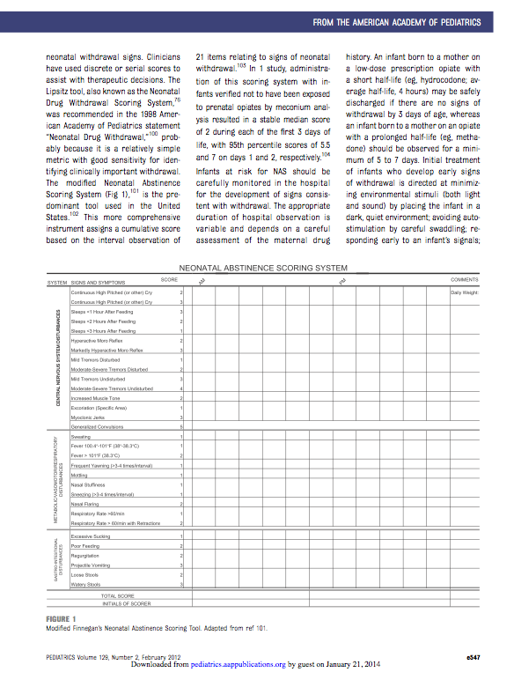
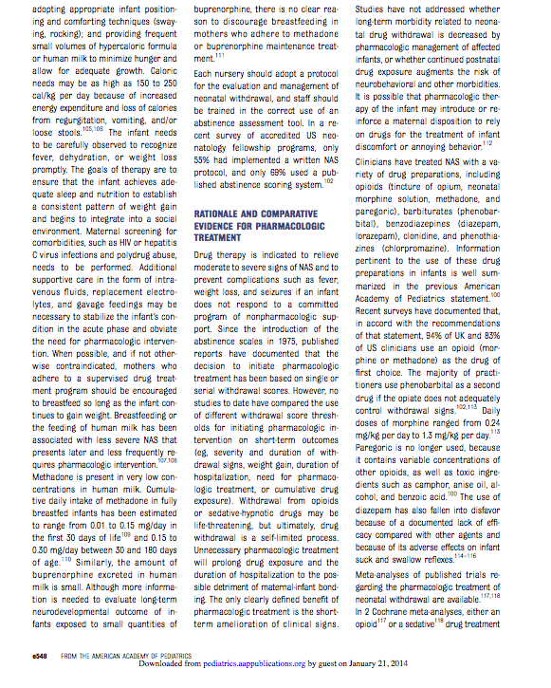

Slide 17
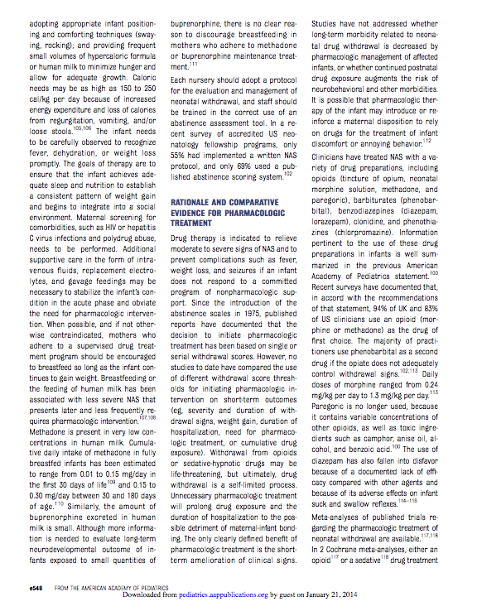
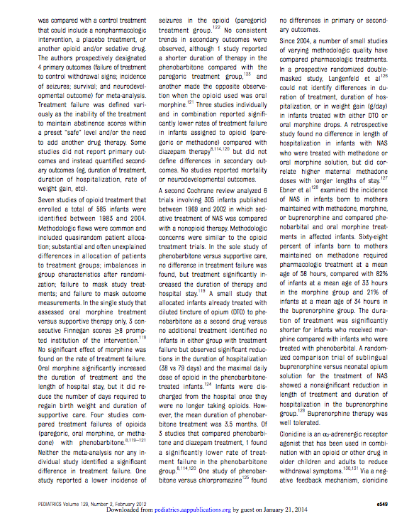

Slide 18
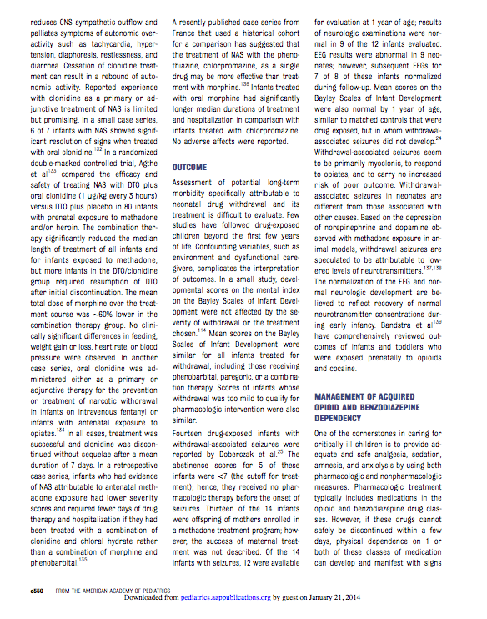
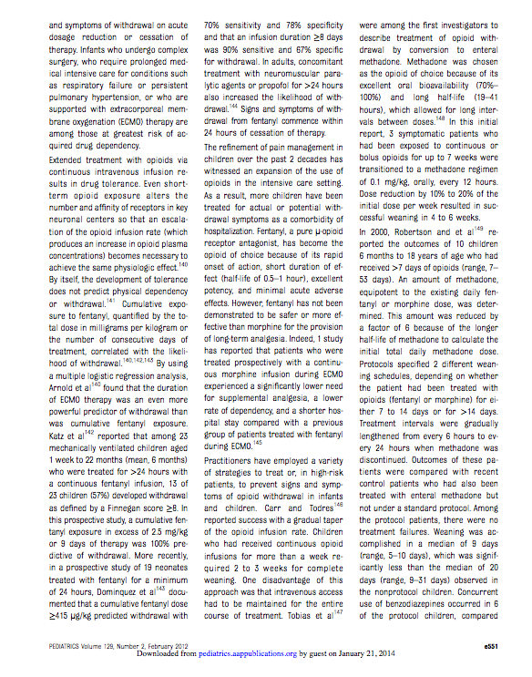

Slide 20
Length of Stay: Methadone exposed infants

Slide 21
The standard approach: why?
Medications

Slide 22
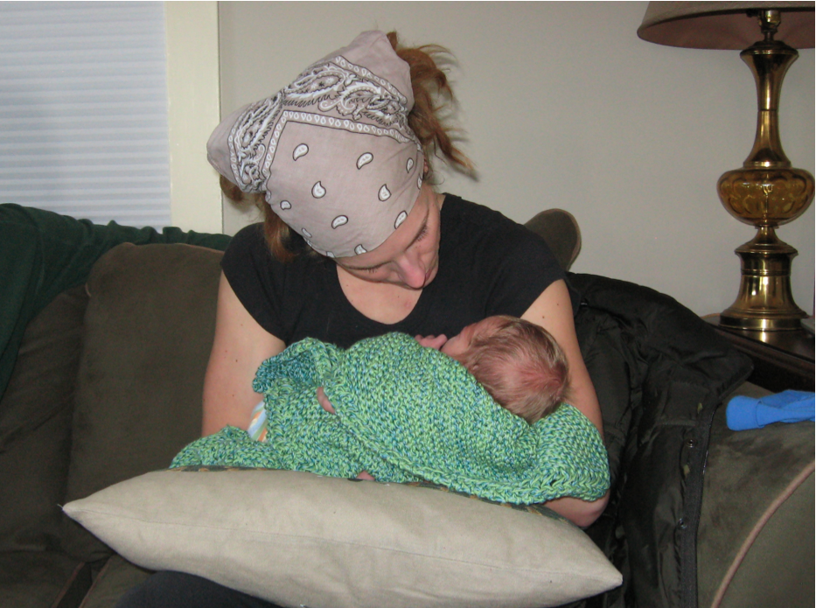
Source: Grossman Family Album
Abraham, et al. J Obstet Gynaecol Can 2010;32(9):866–871

Slide 23
Intervention 1
Focus on non-pharmacologic care

Slide 24
Length of Stay: Methadone exposed infants
Standardized non-pharm care
Mean=22.5
Mean=13.2

Slide 25
The standard approach: why?
Medications
NICU

Slide 26

Source: http://medicine.yale.edu

Slide 27
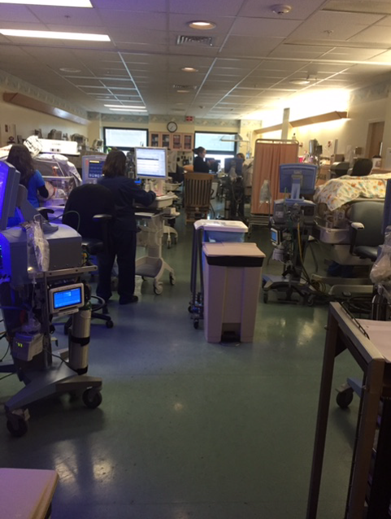

Slide 28

Source: http://adamandsarahcoats.blogspot.com

Slide 29
Intervention 2
Direct transfer to the general inpatient unit

Slide 30
Length of Stay: Methadone exposed infants
Standardized non-pharm care
Mean=22.5
Mean=13.2

Slide 31
The standard approach: why?
Medications
NICU
Finnegan Scores

Slide 32
Notes:
Diagnoses withdrawal
Disturb infant
Not responsive
Sneezing?

Slide 33
“The infant with a score of “7” or less was not treated with drugs for the abstinence syndrome because, in our experience, he would recover rapidly with swaddling and demand feedings. Infants whose score was “8” or above were treated pharmacologically”
Finnegan LP, et al. Assessment and treatment of abstinence in the infant of the drug- dependent mother. Int Clin Pharmacol Biopharm. 1975;12(1–2):19–32

Slide 34
Problems with the Finnegan
Long lengths of stay and lots of meds
Purpose of treatment is to get the scores below threshold
Must disturb the infant and exacerbate signs of withdrawal
Can be slow to respond
Powerful and potentially harmful meds to give to treat a sneeze or a yawn

Slide 35
Intervention 3
Discontinuation of the Finnegan Scoring tool and adoption of a functional scoring approach

Slide 36
Can the baby eat?
Can the baby sleep?
Can the baby be consoled?

Slide 37
ESC Study
Analyzed 50 consecutive NAS babies admitted to our general inpatient unit from March 2014 to August 2015
Assessed every 2-6 hours using the FNASS, but did not guide management
Management decisions based on ESC

Slide 38
Outcomes
Proportion of infants treated with morphine vs. proportion predicted to be treated with morphine using the FNASS approach
Days the two approaches disagreed
FNASS scores the day after the two approaches disagreed

Slide 39
Results
p<.001

Slide 40
Results
On 78 days (26.4%) the ESC Led to LESS Morphine than Predicted by The Finnegan
  The following day, the average Finnegan score decreased by 0.9 points, and decreased in 69% of cases.
On 2 days (0.7%) the ESC Led to MORE Morphine than Predicted by The Finnegan
  In both cases the average Finnegan score increased by 1.7 Points the next day

Slide 41
Results
No readmissions
No seizures
No ICU transfers

Slide 42
Source: http://www.mdnews.com
Notes:
Talk about protocol
Whalen quote

Slide 43
The standard approach: why?
Medications
NICU
Finnegan Scores
Medication Dosing

Slide 45
Intervention 5
Decrease in morphine up to 3 times per day

Slide 46
Intervention 6
PRN Dosing

Slide 47
Length of Stay: Methadone exposed infants
Standardized non-pharm care
Novel assessment
tool on inpatient unit
Spread to
NICU team
Prenatal
counseling
Mean=22.5
Rapid med
weaning
Mean=13.2

Slide 48
The standard approach: why?
Medications
NICU
Finnegan Scores
Medication Dosing
Staff cares for the baby

Slide 49

Cleveland, et al., JOGNN;43(3): 318-329

Slide 50
How do moms feel?
Addiction is misunderstood
Guilty
Judged
Mistrusting of nurses

Slide 51
“…because we’re gonna leave and he’s gonna cry and they’re gonna leave him crying because they’re gonna be like, ‘you know what? His parents are jerks!’”

Slide 52
“His nurse was like ‘his muscles are locking up because of his junkie mom’. I didn’t want to visit, I would call before and if that nurse was there, I wouldn’t even go.

Slide 53
Intervention 7
Empowering messaging

Slide 54

Source: http://potomachospital.blogspot.com

Slide 55

Source: http://potomachospital.blogspot.com

Slide 56
Old Protocol New Protocol
Goal: suppress withdrawal signs
NICU: Mom visits
Finnegan Scores: treat the number
“supportive care”
“feed on demand”
Morphine
Surprise!
Staff takes care of infant
Goal: have infant function as a normal neonate
Mother and child together
Eat/Sleep/Console: treat the infant
SUPPORTIVE CARE
No feeding schedule
Meds on page 3
Prenatal preparation
Staff coaches parents

Slide 57
Length of Stay: Methadone exposed infants

Slide 58
Average Length of Stay - Methadone Exposed Infants
Focus on supportive
management
Transfers directly from
WBN to Floor
NICU included
in effort
Protocol Change:
More aggressive weans
Discontinued Finnegan
Scoring
More aggressive
weans

Slide 64
p < .001

Slide 65
Boston Medical Center
Had been using FNASS approach
Finnegan prioritization from June-November 2016
Developed ESC approach as a scoring tool
Piloting since December 2016

Slide 66
Boston Medical Center – Results
Use of morphine decreased from 82% to 40%
Length of stay decreased from 18 days to 10 days
No readmissions

Slide 67
Additional Spread

Slide 68
Long-Term Outcomes
?

Slide 69

Conclusions
Hugs before drugs
  Empower families
  Rooming-in
  Non-Pharmacologic care as 1st line treatment
  ESC approach
  PRN meds
Ask why
Source: Grossman Family Album

Slide 70
Acknowledgements
David Hersh, MD
Adam Berkwitt, MD
Erin Nozetz, MD
Marcelle Applewaite, RN
Kim Carter, RN
Liz O’Mara, RN
Matt Bizzarro, MD
Yogangi Malhotra, MD
Jonathan Miller, MD
Camisha Taylor, RN
Rachel Osborn, MD

