Slide 2

ILPQC: Welcome
ILPQC Fifth Annual Conference
December 19, 2017

Slide 3

Happy 4th Birthday ILPQC!
Thank you to all who have contributed to building a successful state perinatal quality collaborative for IL
  Sponsors
  Stakeholders
  Advisory Workgroups
  Leadership / Data teams
  Perinatal Network Administrator & Educators
  Hospital Teams
  Patients & Families
  Volunteers

Slide 4
Conference Objectives
Describe benefits of working together on quality improvement in a perinatal quality collaborative;
Identify successful past/present initiatives in Illinois and other states to reduce adverse perinatal outcomes;
Plan, implement, and sustain a perinatal quality improvement project based on one’s expertise;
Identify smart aim and objectives of the ILPQC quality improvement initiatives starting in 2018.

Slide 5
ONA Approval Statement
This activity will provide 8.1 contact hours.
This continuing nursing education activity was approved by the Ohio Nurses Association, an accredited approver by the American Nurses Credentialing Center’s Commission on Accreditation (OBN-001-91).
Approval valid through (11/27/2019).
ONA #: 21258

Slide 6
Criteria for Successful
Completion
Prior to the learning activities there are no required items to complete.
To obtain full contact hours for CNEs, you need to complete the entire conference (8.1 contact hours) and an evaluation. No partial credit will be awarded.
CEU certificates will be distributed at the end of the conference after the evaluation is turned in.

Slide 7
Disclosures
The planners and faculty have declared no conflict of interest.
Commercial support for this conference was provided by Blue Cross Blue Shield of Illinois.

Slide 8
Agenda
8:00-8:45 | Welcome: Shannon Lightner, MSW, MPA ILPQC Stronger Together: 2017 Review and Onward to 2018 Ann Borders, MD, MSc, MPH; Leslie Caldarelli, MD; Justin Josephsen, MD
8:45-9:30 | Keynote: Neonatal Abstinence Syndrome: Rethinking our Approach Matthew Grossman, MD
9:30-9:45 | Break
9:45-11:15 | Leveraging QI Success in Other States: Leaders from State Perinatal Quality Collaboratives Discuss Key Initiatives Carole Lannon, MD, MPH (OH); Julie Zemaitis DeCesare, MD (FL); Brenda Barker, MEd, MBA (TN)
11:15-12:00 | Reaching Mothers with Opioid Dependency in Respectful and Collaborative Ways Tamela Milan, MPPA
12:00-12:30 12:30-1:30 | Networking Lunch Poster Session
1:30-2:15 | Obstetric and Addiction Care for Women with Opioid Use Disorder Ron Iverson, MD
2:15-3:00 | South Carolina Birth Outcomes Initiative: Action and Results for LARCs Immediate Postpartum Amy Crockett, MD, MSPH

Slide 9
Agenda
3:00-3:15 | Break
3:15 – 5:00 | Hot Topics in Obstetrics QI: Discussion of Sustaining Current Severe Maternal Hypertension Initiative and Launching 2018 Initiatives: Mothers and Newborns affected by Opioids and Immediate Postpartum LARC Ann Borders, MD, MSc, MPH; Julie Zemaitis DeCesare, MD; Amy Crockett, MD, MSPH; Ron Iverson, MD
 | Hot Topics in Neonatal QI: Discussion of Sustaining Current Golden Hour Initiative and Launching 2018 Initiative: Mothers and Newborns affected by Opioids Leslie Caldarelli, MD; Justin Josephsen, MD; Matthew Grossman, MD; Carole Lannon, MD, MPH; Brenda Barker, Med, MBA; Jeanne Silvestri, MD; Ann Downey, MD, MSc
 | Engaging Patients and Families in Quality Improvement Terry Griffin, MS, APN, NNP-BC; Tamela Milan, MPPA
5:00 – 5:15 | Wrap-up & Evaluation

Slide 10

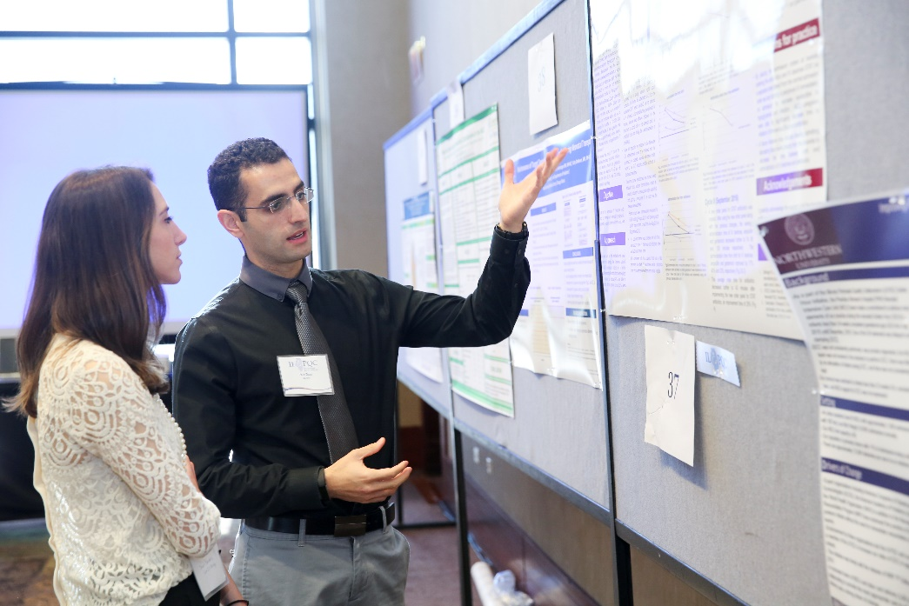
Poster Session
In addition to looking at all of our great posters, check out the poster awards of excellence (look for the white ribbon with the ILPQC logo)
Congrats!

Slide 11
ILPQC Welcome:
Shannon Lightner, MSW, MPA
Deputy Director, Office of Women’s Health, Illinois Department of Public Health
ILPQC Fifth Annual Conference
December 19, 2017

Slide 12
ILPQC Stronger Together:
2017 Review & Onward to 2018
ILPQC Fifth Annual Conference
December 19, 2017

Slide 13
Overview
ILPQC goals & accomplishments for 2017
  Sustain and develop state-wide participation
  Offer responsive QI services to hospital teams
  Engage patients/families in QI work
  Celebrate Hypertension and Golden Hour Initiative success
Launching New 2018 Initiatives
  Mothers and Newborns affected by Opioids
  Immediate Postpartum LARC
  ILPQC Goals for 2018
  Roll out successful statewide initiatives
  Support strong hospital QI teams and expand QI capacity
  Ensure QI sustainability and compliance monitoring
  Expand Patient/Family Engagement

Slide 14


Vision
A statewide perinatal quality collaborative that involves all perinatal stakeholders; utilizes data-driven, evidence-based practices; improves perinatal quality resulting in improved birth outcomes, improved health for women and infants, and decreased costs; builds on Illinois’ existing state-mandated Regionalized Perinatal System, and operates with long-term sustainable funding.

Slide 15
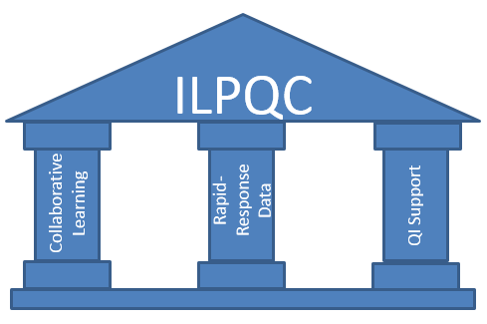
Three Pillars Support
Quality Improvement Success

Slide 16
ILPQC Milestones
2012
IL Perinatal Advisory Committee Prematurity Task Force Report
2015
Launch Golden Hour Initiative
2016
Launch Maternal Hypertension Initiative
2017
Maternal Hypertension and Golden Hour Initiatives Ongoing
2014
ILPQC Data System Launched
CDC Award with IDPH
Launch EED and Neonatal Nutrition Initiatives
2013
Consultation with Perinatal Quality Leaders (OH, CA, NC, FL)
Stakeholder Meetings Begin
Website Launch
ILPQC Kick-Off, 1st Annual Conference
Launch Birth Certificate Initiative
Started yearly spring Face to Face Meetings for OB and Neo Teams
IDPH Funding
Golden Hour Initiative Ongoing
CDC Funding for MNO Initiative
Pritzker Grant Award for IP LARC Initiative
Start Up Funding: CHIPRA / HFS

Slide 17
Goal 1: Sustain and Develop
State-wide Participation
112 hospitals participating in ILPQC initiatives
101 OB hospital teams and 31 Neonatal teams participated in ILPQC Face to Face meetings in 2017
Monthly calls with Perinatal Network Administrators to discuss strategies to engage and support teams
Quarterly updates to State Quality Council
Strong ILPQC advisory group participation
  OB Advisory Group – 74 members representing 30 hospitals with 25-30 participants on each monthly call
  Neonatal Advisory Group – 29 members representing 19 hospitals

Slide 18

ILPQC: Working with
IL Hospitals Across the State
112/120 IL birthing hospitals participating in one or more ILPQC Initiative
110 hospitals in OB Initiative
  99% of IL births covered by ILPQC
26 hospitals in Neonatal
Initiative
  91% of IL NICU beds covered by ILPQC

Slide 19
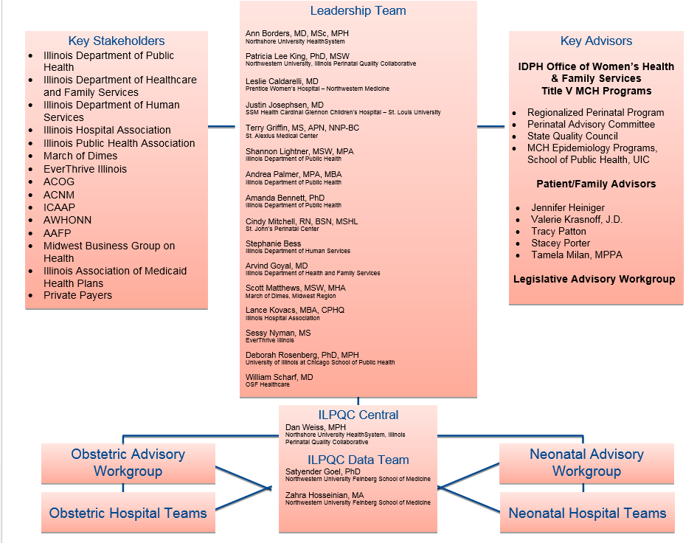
ILPQC Infrastructure
We will welcome new team members to ILPQC Central in 2018 to meet the growing needs of the collaborative

Slide 20
OB Advisory Group
Andrea Palmer
Amanda Bennett
Angela Rodriguez
Angie Bowen
April Caruso
Carol Andrychowski
Carol Burke*
Chelsea Rogers
Cindy Mitchell
Deb Landacre
Deb Rosenburg
Debbie Miller
Debbie Schy
Debra Kamradt
Denise Massey
Dr. Angelique Rettig*
Dr. Ann Borders*
*Hypertension Clinical Leads
Dr. Barbara M. Scavone
Dr. Bill Grobman
Dr. Bridgette Blazek
Dr. Emmet Hirsch
Dr. Heather Stanley-Christian
Dr. Howard Strassner
Dr. Jean Goodman
Dr. Jim Keller*
Dr. Jodee Brandon
Dr. Jude Duval
Dr. Latasha Nelson
Dr. Maura Quinlan
Dr. Mayank Shah
Dr. Michael Leonardi
Dr. Michael Socol
Dr. Patricia Heywood

Slide 21
OB Advisory Group (cont.)
Dr. Phil Higgins
Dr. Sarosh Rana
Dr. Rahmat Na'Allah
Dr. Ralph Kehl
Dr. Regina Gomez
Dr. Rob Abrams
Dr. Sherry Jones
Dr. Soti Markuly
Dr. Tina Wheat
Emanuel Vlastos
Felicia Feifer
Jean Mahoney
Jennifer Hofer
Jennifer Woo
Jessica Bimm Rosati
Kai Tao
Katie Warren
Kim Armour
Kisha Semenuk
Kristin Salyards
Lisa Sullivan
Lori Andriakos
Mahmoud Ismail
Margaret Villareal
Maripat Zeschke*
Mary Jean Handrigan
Melissa Claudio
Miranda Scott
Mona LeGrand
Myra Sabini
Pam Wolfe
Pat Joschko
Robbin Uchison
Roma Allen
Samantha Schoenfelder
Sheila Rhodes
Sue Hesse
Susan Fulara
Trish O'Malley
Trishna Harris
*Hypertension Clinical Leads

Slide 22
Neonatal Advisory Group
Aarti Raghavan
Akihiko Noguchi
Alok Rastogi
Anthony Bell
Colleen Mallory
Elaine Shafer
Jean Silvestri
Joel Fisher
Joseph Hageman
Justin Josephsen*
Kamlesh Macwan
Leslie Caldarelli*
Maliha Shareef
Marc Weiss
Matthew Derrick
Patricia Ittmann
Preetha Prezad
Radley Hein
Robert Covert
Sachin Amin
Syd Foreman
Venkata Majjiga
Vibhan Thaker
William Stratton

Slide 23
Goal 2: Offer Responsive QI
Services to Hospital Teams
  36 monthly OB & Neonatal team calls with Team Talks for collaborative learning over course of initiatives
  15 QI topic calls with about 80 hospitals and topic champions sharing strategies
  20 QI support calls per quarter with hospital teams working towards goals and perinatal network administrators providing additional support
  Facilitated twice-monthly e-newsletters to teams
  Monthly updates of key resources on ilpqc.org
  ILPQC rapid-response data system has real-time reports for teams to compare data across time and other hospitals

Slide 24

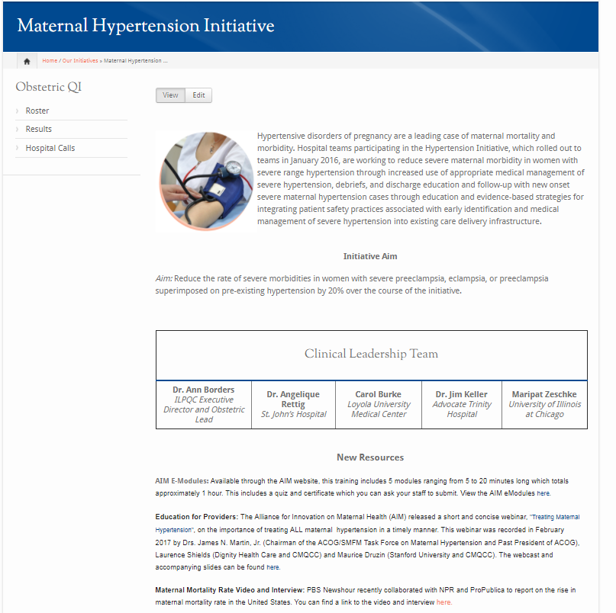
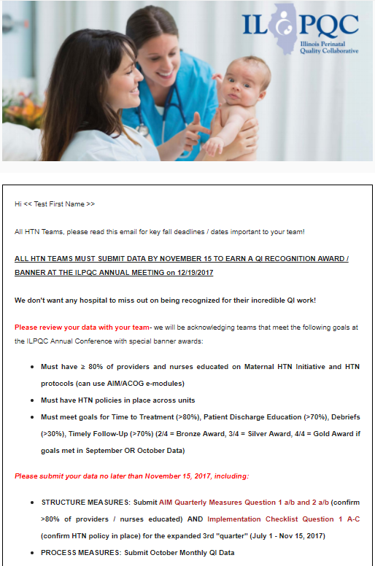
www.ilpqc.org
Bi-Weekly OB & Neo Newsletters
Up-to-date resources
Connecting with our teams through regular communication

Slide 25
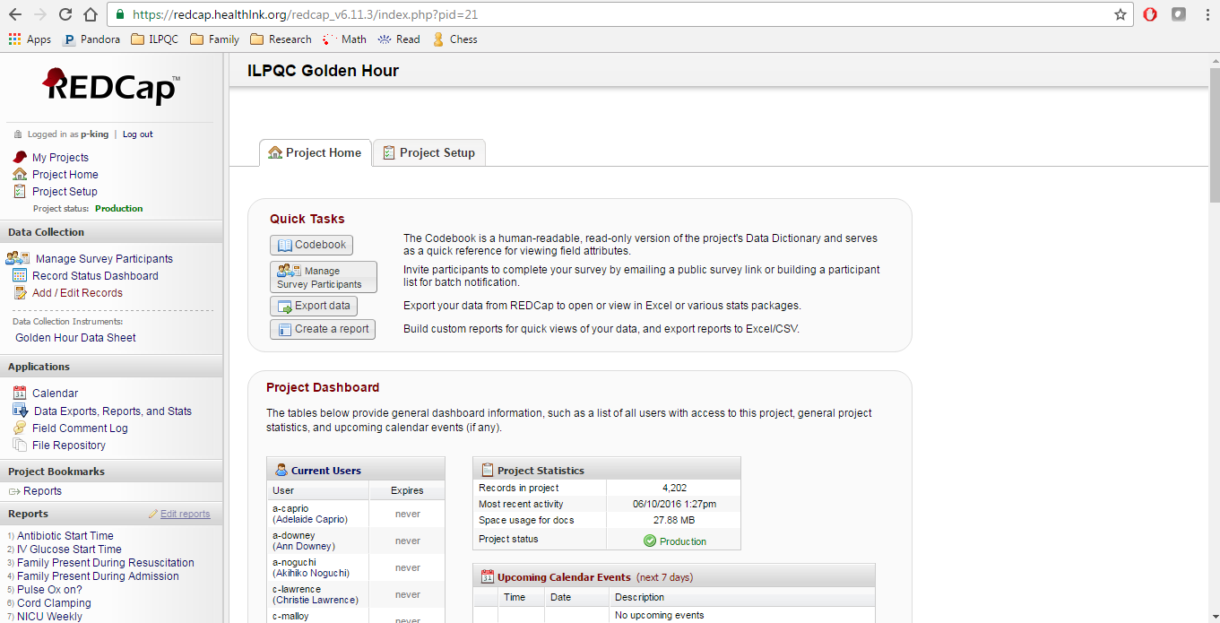
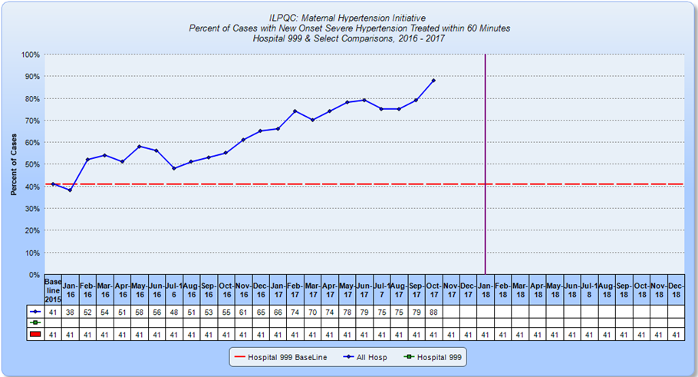
ILPQC Data System
Leveraging initiative reports for sustainability / compliance reports so teams can continue to monitor their compliance to sustain their gains
More teams then ever are reviewing their Rapid Response reports on outcome, process, and balancing measures to compare data across time and across hospitals

Slide 26
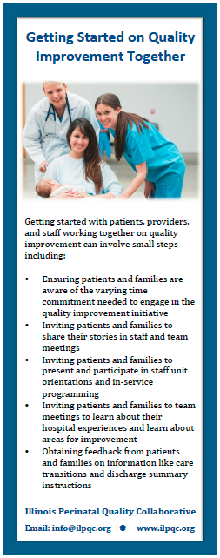
Goal 3: Engage Patients &
Families in QI Work
Patient /Family Advisors:
  Share personal stories and provide feedback
  Review process flow and identify opportunities for improvement
  Develop, review, and test content of materials
  Discuss quality improvement findings
Statewide: 5 Patient /Family Advisors now serve on ILPQC OB &Neonatal Advisory Groups
Hospital Teams: ILPQC has provided
  Resources to teams to engage patients and families in QI
  Pilot program to link team with March of Dimes and Preeclampsia foundation identified 10 patient/family volunteers who want to work with hospital teams on QI
Goal of Patient/Family Breakout today is to identify 2-3 key actions ILPQC can be involved in to help hospitals engage patients in their QI!

Slide 27
Patient/Family Team Members
Currently, only 6% of teams have a patient/family team member

Slide 28

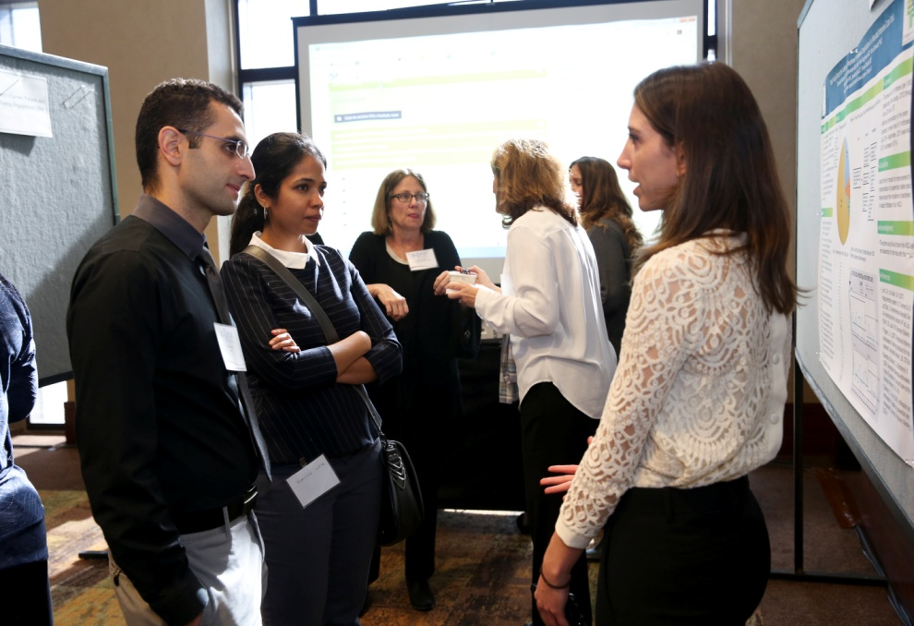
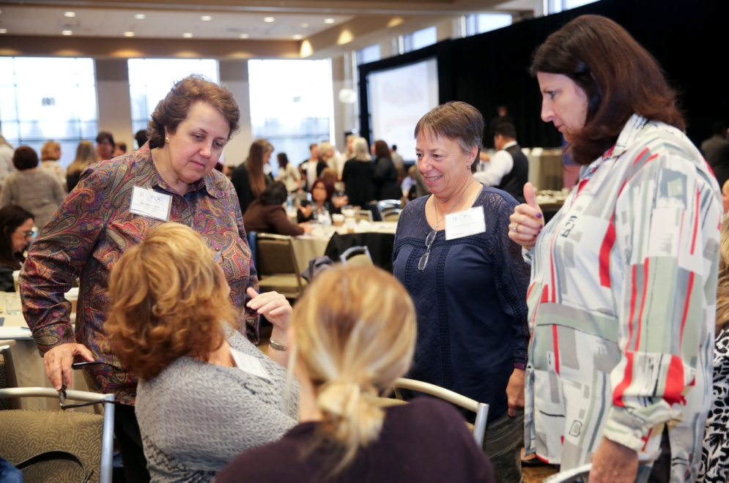

Goal 4: Working Together on
State-wide Initiatives

Slide 29


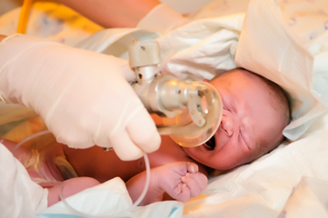
Celebrate HTN and Golden Hour Initiative Success

Slide 30
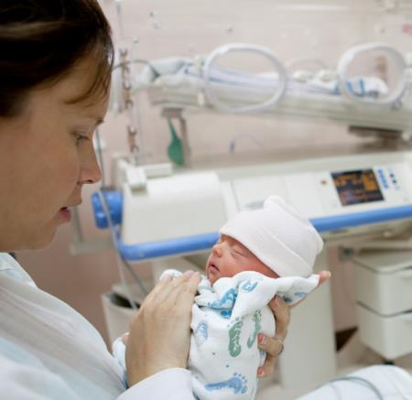
Neonatal Golden Hour
Initiative
Aim: Implement checklist of evidence-based practices in 80% of high-risk deliveries to improve short and long term outcomes for infants by December 2017
Approach: Established workgroup, identified hospital teams, developed toolkit, launched with 23 teams in spring 2015
26 Level II, II+, & III NICUs participated
Data collected on 8,019 infants undergoing resuscitation in ILPQC Data System as of November 2017
Kick off spring 2015, Face-to-Face meetings spring 2016, 2017
18 Monthly one-hour collaborative webinars since 2016

Slide 31
Golden Hour Toolkit Team
Mohamad Al-Hosni
Margaret Behm
Leslie Caldarelli
Kim Carmignani
Matthew Derrick
Rhonda Gale
Terry Griffin
Jodi Hoskins
Justin Josephsen
Venkata Majjiga
Lisa Maloney
Tonya Mangiaguerra
Aaron Muller
Akihiko Noguchi
Steven B. Powell
Katherine Robbins
Beverly Robin
Korina Sanchez
Maliha Shareef

Slide 32
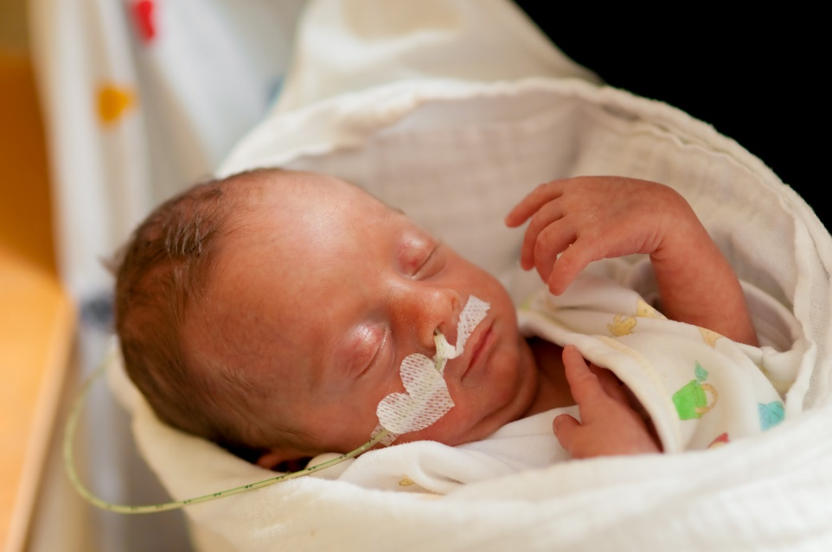
Golden Hour Goals
Increase use of evidence-based practices in:
  Delivery room team communication (brief, debrief, checklist)
  Delivery room management (CPAP, surfactant, delayed/timed cord clamping)
  Family engagement (family contact pre-delivery, family present at resuscitation and NICU admission)
  NICU admission (intravenous glucose and antibiotics, admission temperature)

Slide 33
Neonatal Golden Hour:
Communication Practices
91%
77%
88%
77
51%
77
79%
29%

Slide 34
Neonatal Golden Hour:
Delivery Room Practices
94%
78%
91%
56%

Slide 35
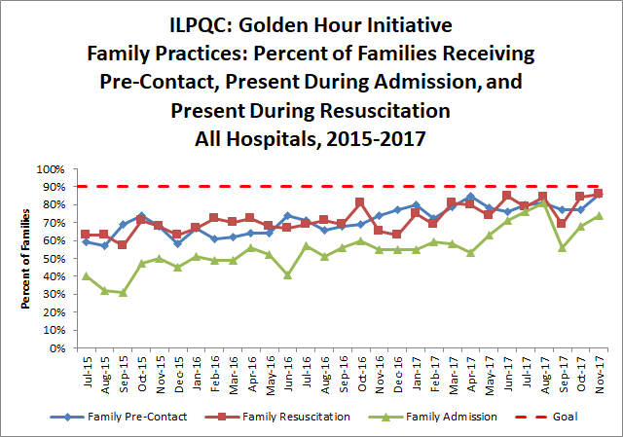
Neonatal Golden Hour:
Family Engagement
86%
63%

Slide 36
Survey Findings:
GH Measures as a Primary Focus
Temperature between 36.5-37.5 °C (97.7-99.5 °F) upon NICU admission
Delayed cord clamping
Post-resuscitation debrief
Pre-brief
Pulse-oximetry
Non-invasive respiratory support
Checklist
Family Engagement prior to delivery
Antibiotics and IV access within 1 hour of NICU admission
Family engagement in delivery room and during NICU admission
Surfactant
75% or more of teams
60-74% of teams
under 60% of teams

Slide 37
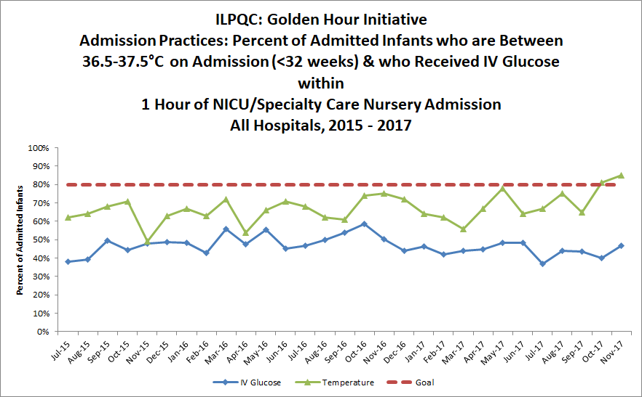
Neonatal Golden Hour: Admission
Practices – Temperature and IV Glucose
83%
61%
39%
44%

Slide 38

Achieving and Sustaining
GH Goals for ALL TEAMS
Compliance monitoring of key measures to sustain the gains
Teams focus on key measures to complete goals
ILPQC QI support to teams in need of additional assistance and will hold quarterly GH team calls

Slide 39

ILPQC Maternal
Hypertension Initiative
Aim: Reduce the rate of severe morbidities in women with severe preeclampsia, eclampsia, or preeclampsia superimposed on pre-existing hypertension by 20% by December 2017
Approach: Established workgroup, identified hospital teams, implemented evidence-based practices / protocols / AIM HTN Bundle
  110 hospital teams - 23 Wave 1 (Jan 2016), 87 Wave 2 teams (May 2016)
  106 Hospitals submitted data for over 13,000 women who experienced severe maternal HTN across the initiative
  HTN Kick-off Call – April 2016, 284 participants from 97 hospitals
  HTN Face-to-Face – May 2016, Springfield, 288 attendees, 101 hospitals
  HTN Face-to-Face – May 2017, Springfield, with 256 attendees 101 hospitals

Slide 40
Why we do this work
Severe Maternal Hypertension
Preeclampsia:
4-10% US pregnancies
9% of maternal deaths in the United States
1/3 of severe obstetric complications
IUGR,
oligohydramnios, placental abruption, NICU admission, stillbirth, neonatal death
6% of preterm births, and 19% of medically- indicated induced preterm births
Notes:
Preeclampsia is a relatively common condition in pregnancy,
affecting an estimated 2% to 8% of pregnancies worldwide.4,7,8
Approximately 9% of maternal deaths in the United States are directly
attributed to preeclampsia and eclampsia,4,19 and more than
one-third of severe obstetric complications are associated with
preeclampsia.4,20 Maternal complications include cerebrovascular
bleeding, retinal detachment, and HELLP (hemolysis, elevated liver
enzyme levels, and low platelet counts) syndrome. Approximately
1% to 2% of preeclampsia cases lead to eclampsia, a severe manifestation
of the syndrome characterized by seizures and complications
such as brain damage, aspiration pneumonia, pulmonary
edema, placental abruption, disseminated coagulopathy, acute renal
failure, cardiopulmonary arrest, and coma.4,8
Fetal and neonatal complications of preeclampsia include intrauterinegrowthrestriction,
oligohydramnios,placentalabruption,neonatal
intensive care unit admission, stillbirth, and neonatal death.
Delivery of the fetus is the definitive treatment of preeclampsia; as
a result, preeclampsia is a leading cause of medically indicated induced
preterm birth and low birth weight in the United States.4,21
Infants born to mothers with preeclampsia account for 6% of pretermbirthsand19%
of medically indicatedinducedpretermbirths.4,21
Most cases of preeclampsia occur after 34 weeks of gestation.
Preterm infants (ie, those born before 37weeks of gestation) are at
increased risk of morbidity and mortality; the risk of poor outcomes
increases with earlier delivery.4,22

Slide 41
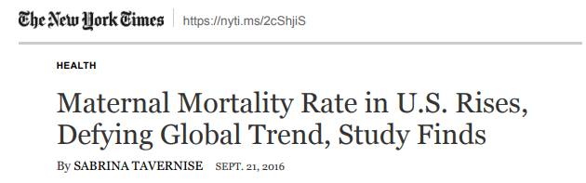
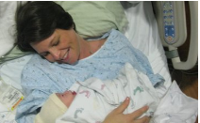
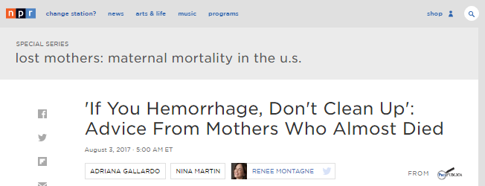
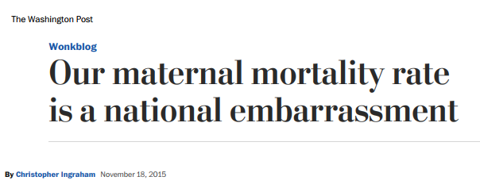

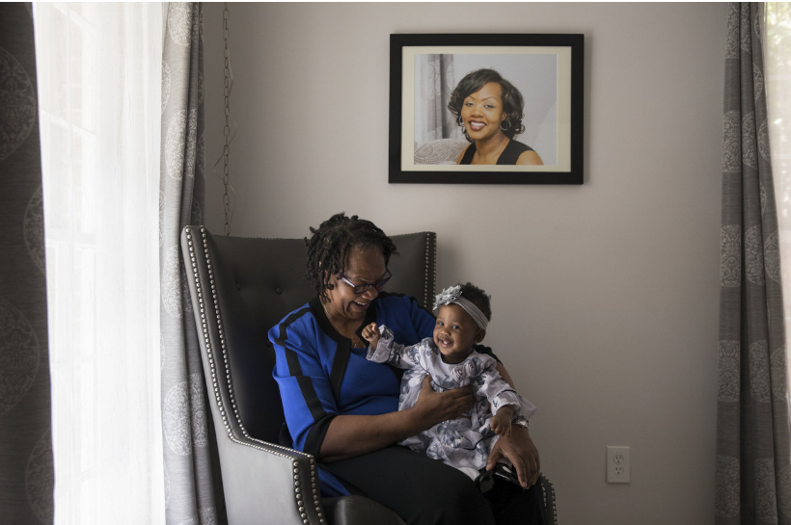
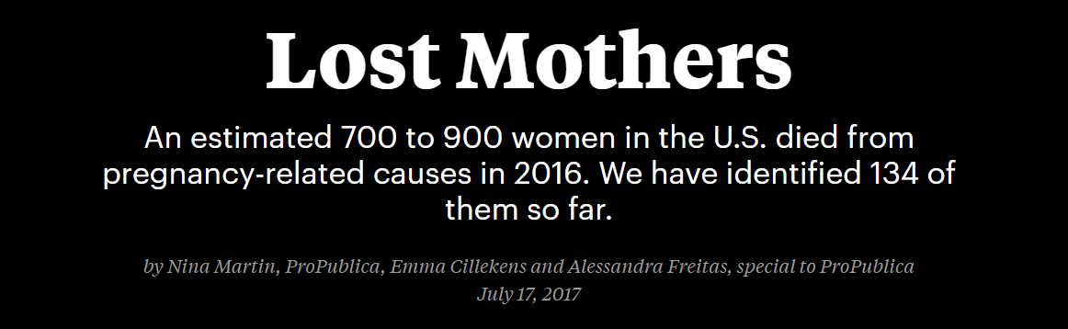
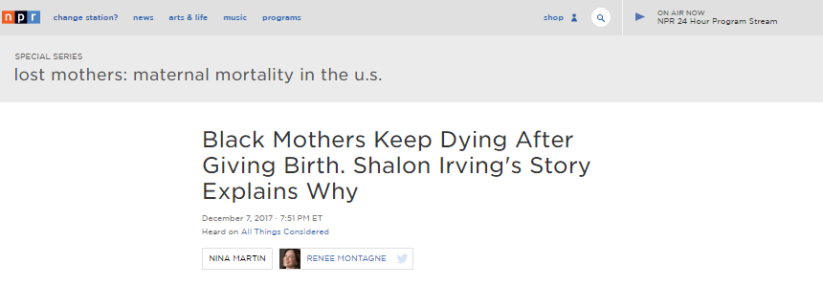
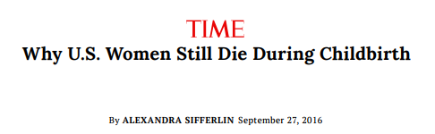
Why we do this work

Slide 42
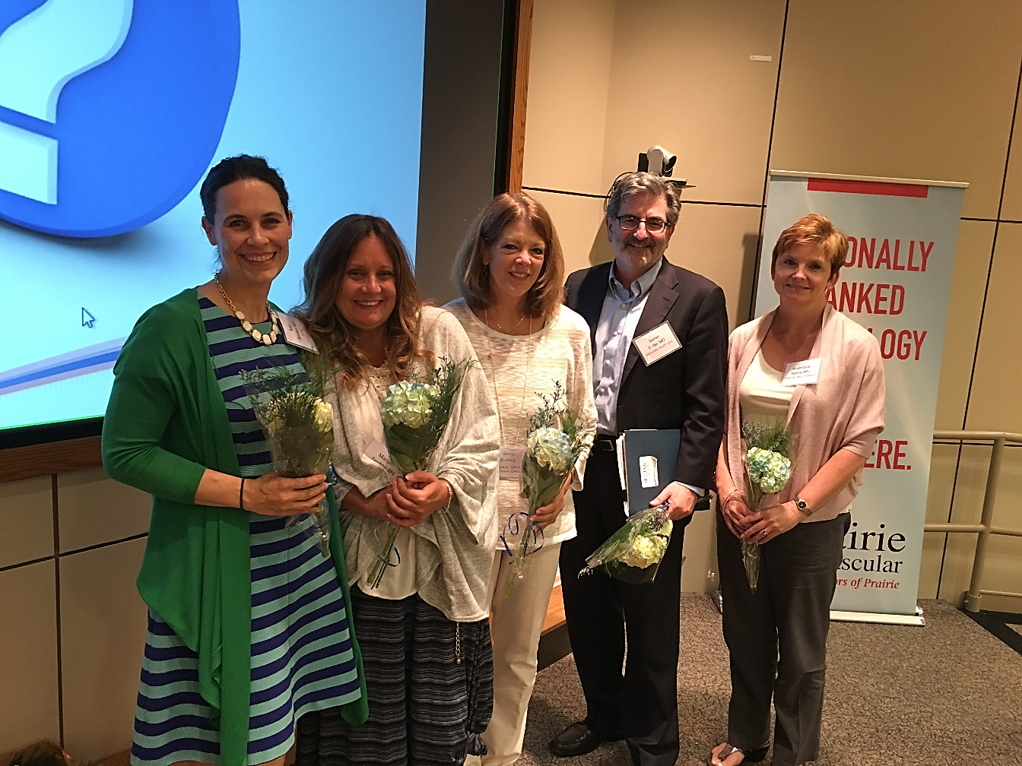
Maternal Hypertension
Leadership Team
Ann Borders
Maripat Zeshke
Carol Burke
Jim Keller
Angelique Rettig

Slide 43
Severe Maternal Hypertension Successes
Between Baseline (2015) and October 2017, teams have increased:
Women with sustained new onset severe range HTN receiving medication within 60 minutes:
42% to 84%
Women receiving preeclampsia discharge education materials:
37% to 83%
Women with new onset severe hypertension with a follow-up appointment scheduled within 3-10 days:
51% to 82%
Cases with new onset severe hypertension where a provider/nurse debrief was completed:
2% to 67%

Slide 44
Maternal Hypertension Data:
Time to Treatment

Slide 45
Maternal Hypertension Data:
Time to Treatment

Slide 46
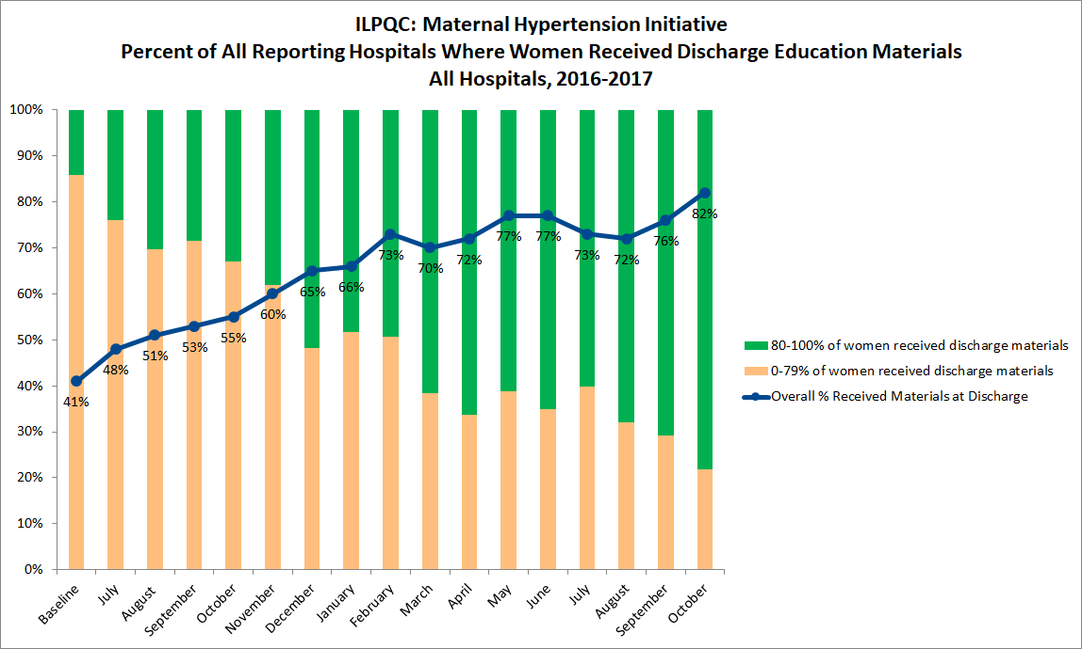
Maternal Hypertension Data:
Patient Education
UPDATING
Will be ready tomorrow morning 12/16

Slide 47
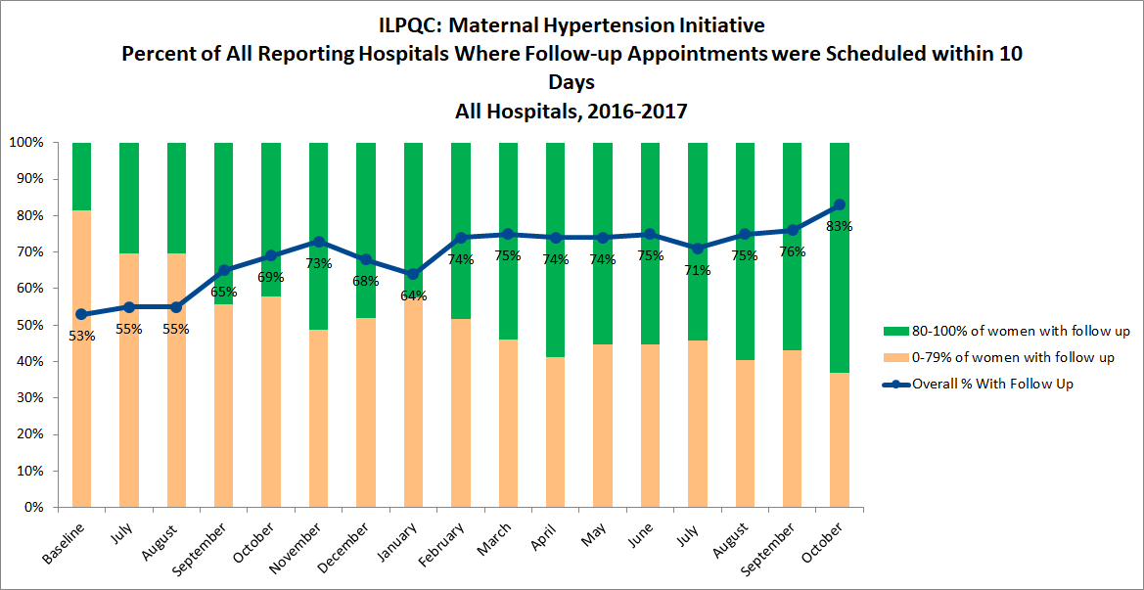
Maternal Hypertension Data:
Patient Follow-up
UPDATING
Will be ready tomorrow morning 12/16

Slide 48
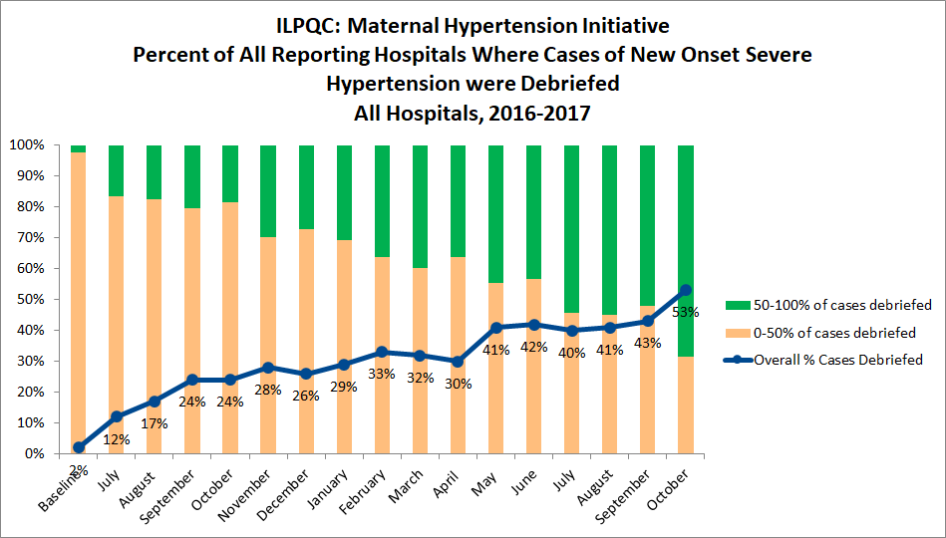
Maternal Hypertension Data:
Debrief
UPDATING
Will be ready tomorrow morning 12/16

Slide 49
Maternal Hypertension Outcome Data:
Severe Maternal Morbidity
Severe Maternal Morbidity Diagnoses:
Intracranial Hemorrhage or Ischemic event (stroke)
Eclampsia
Pulmonary Edema
HELLP Syndrome
Oliguria
DIC
Renal Failure
Liver Failure
Ventilation
Placental Abruption
OB Hemorrhage
ICU Admission
15%
9%
40% Change!
13,263 patients included

Slide 50
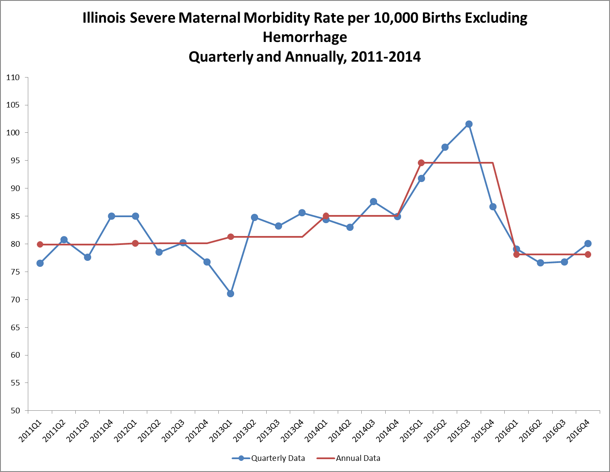
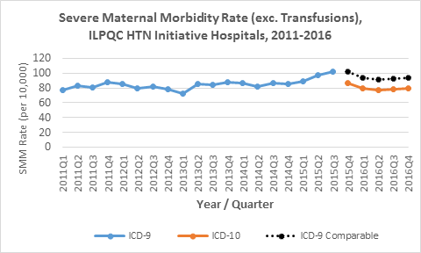
IL State SMM Data:
Excluding Hemorrhage
Switch from
ICD9 to ICD10

Slide 51
Achieving Time to Treatment
For ALL TEAMS
Perinatal Network Administrators outreach to teams not yet at 80% and discuss at network meetings
All teams complete provider / staff education using AIM e-modules
ILPQC QI support calls to teams in need of additional support and will hold at least quarterly HTN team check in calls

Slide 52

All Teams Develop their
Sustainability Plan
Sustainability Plan
Compliance Monitoring
New Hire Education
Ongoing Staff/Provider Education
Notes:
All teams should meet and develop Maternal HTN Sustainability Plan:
HTN compliance monitoring – 4 key questions
HTN education for new hires – AIM e-modules
Incorporate HTN education into ongoing unit education for providers and staff: drills / simulations / e-modules and continue to protocols, active “debrief” = “how did we do on Time to Treatment?”

Slide 53

Launch 2018 Initiatives
Mothers and Newborns affected by Opioids Initiative
  OB and Neonatal Teams making a difference together for opioid exposed moms and babies
Immediate Postpartum LARC Initiative
  OB Teams improving moms access to LARC

Slide 54
Overview of Statewide
Quality Initiatives in 2018
Statewide QI Initiative | Now | Jan 2018 | Feb | Mar | Apr | May
MNO | Recruit Wave 1 teams | Monthly calls start for Wave 1 | Letter of support from IDPH | Recruit Wave 2 teams | Initiative Launch Webinar with all teams | Face to Face Meetings
IPLARC |  | Recruit Wave 1 teams |  | Monthly calls start for Wave 1

Slide 55
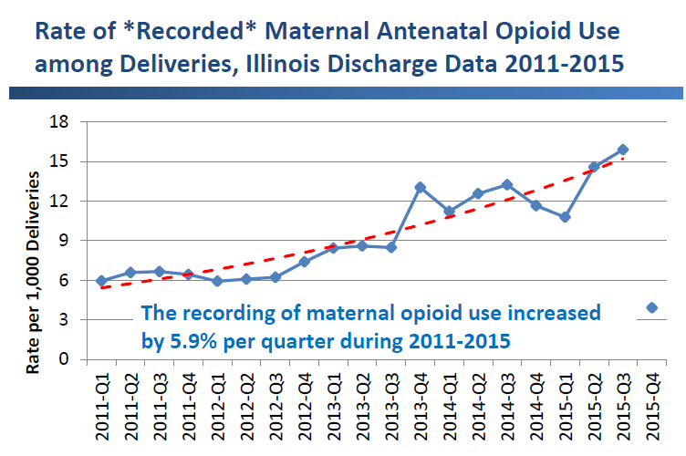
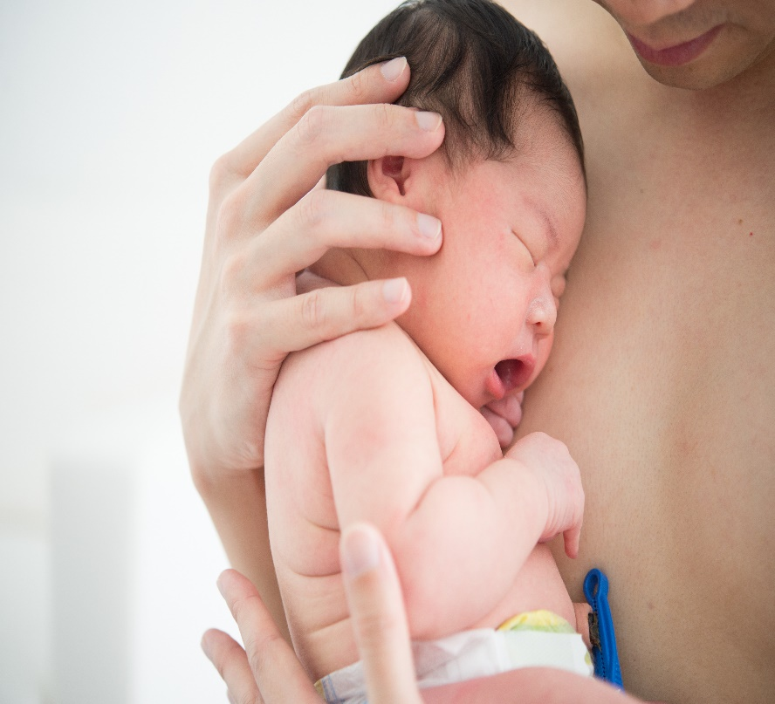
Mothers Affected by Opioids
in IL: Scope of the problem
Pregnancy is a window of opportunity to identify women with OUD and link to treatment

Slide 56

ILPQC Mothers and Newborns affected by Opioids (MNO)
Proposed Aims:
Increase pregnant women affected by opioids linked to care prenatally and receiving Medication Assisted Treatment (MAT) for opioid disorder at delivery
Decrease pharmacological therapy in substance exposed neonates
Increase mothers and newborns affected by opioids breastfeeding at neonatal discharge
Increase neonates exposed to chronic maternal opioid use who can be discharged to maternal care
Approach: Establish workgroup, identify hospital teams, implement ACOG AIM Maternal Opioid Bundle & neonatal change package using QI strategies, data, & collaboration.
First ever ILPQC “dyad” initiative with OB and Neonatal teams partnering to prepare providers, nurses, and families to improve outcomes for mothers and infants affected by opioids.

Slide 57
MNO Focus for Improvement Goals
Prevention
Screening and Linking to Care
Optimizing Care for Mom/Baby

Slide 58

ILPQC Immediate Postpartum
LARC Initiative
Aims: Empower women with information and improved access to effective contraception before discharge home after delivery
to reduce short interval and unintended pregnancies linked with adverse MCH outcomes
Approach: Establish expert panel, identify teams, support birthing hospitals implementation of IPLARC using best practice protocols, QI strategies, data and collaboration

Slide 59
Consequences of Unplanned Births and Short Interval Pregnancy
Consequences of Unplanned Pregnancies
Poor pregnancy outcomes
Delayed initiation of prenatal care
Lower breastfeeding rates
Higher risk of maternal depression and potential future child maltreatment
Unintended
Intended
Consequences of Short Interpregnancy Interval
Higher risk of poor maternal and infant outcomes: Preterm birth, low birthweight, preeclampsia
50% of IL births covered by Medicaid
Notes:
Chicago Metropolitan Agency for Planning definition of Cook and the counties immediately surrounding it: DuPage, Kane, Kendall, Lake, McHenry, and Will counties
In 2014 there were 158,522 births in Illinois with 69,526 (44%) in Cook county and 106,204 (67%) in the Chicago Metro area (Chicago Metropolitan Agency for Planning definition of Cook and the counties immediately surrounding it: DuPage, Kane, Kendall, Lake, McHenry, and Will counties).^{4a} Approximately 66,579 (42%) of Illinois births resulted from unintended pregnancies.^{4b} Approximately 9,684 births in Illinois are to teens 19 and under.^{4a} For babies with moms 21 years old or younger, it was at least the 2nd birth for 29% and at least the 2nd pregnancy for 39% (Personal Conversation with A. Bennett, 8/2017).
Intrauterine Devices (IUDs) and contraceptive implants, known as long acting reversible contraception (LARC) are safe and effective for most women and adolescents.⁵ They are demonstrated effective in reducing unintended pregnancies.⁶ LARC effectiveness could be increased when placed in the immediate postpartum (IPLARC) before hospital discharge after delivery given that approximately 40 to 60% of women have unprotected intercourse prior to the 6 week postpartum visit and fewer than half of women return to the doctor for their 6 week postpartum visit^{7,8,9}. Women counselled on all contraceptive methods and provided their choice of contraception for free chose LARC at a rate of 75%. Additionally, 86% of women were using LARC 12 months later – higher than the continuation rate for other short-acting reversible contraception – and reported high satisfaction with LARC.¹⁰
IPLARC is a strategy to empower women of childbearing age with information and services to optimize the timing and spacing of their pregnancies in order to reduce unintended pregnancies linked with adverse maternal and child health outcomes.¹¹ In 2014, 79,261 (50%) of Illinois births were covered by Medicaid.¹² In July 2015, the IL Department of HealthCare and Family Services (HFS) allowed hospitals to reimburse for LARC devices provided immediately postpartum before discharge from the hospital, in addition to the Diagnostic Related Group (DRG) reimbursement for labor and delivery.¹⁴ In addition, the American College of Obstetricians and Gynecologists (ACOG) released national guidelines in their Committee Opinion #670, authored by Ann Borders and Alison Stuebe, in August 2016.

Slide 60
ILPQC IP LARC Initiative
Goals
Increase access to IP LARC
Educate Patients on contraceptive options
Educate Providers counseling and placement
Simplify IPLARC Billing
Stock LARC in Pharmacy
Implement IP LARC Protocol
Systems Changes to OB Care Process Flow

Slide 61


OB & Neo Breakout Sessions
We will be discussing draft measures, goals, timelines, and next steps for MNO for both OB and Neo Teams and Immediate Postpartum LARC!

Slide 62

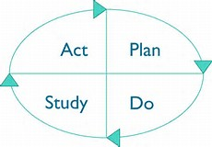


Our Goals for 2018
Roll out successful statewide initiatives
Support strong hospital QI teams and expand QI capacity
Ensure QI sustainability and compliance monitoring
Expand Patient/Family Engagement

Slide 63
Looking Ahead
2018 Call to Action
Teams create and implement sustainability plans and compliance monitoring for Severe Maternal Hypertension and Golden Hour Initiatives
Launch Statewide Initiatives
  Mothers and Newborns affected by Opioids (OB & Neo)
  Immediate Postpartum Long Acting Reversible Contraception (IP LARC)
ILPQC will continue to engage stakeholders, patients/families, and hospital teams from across the state to provide: opportunities for collaborative learning, rapid response data and QI support

Slide 64
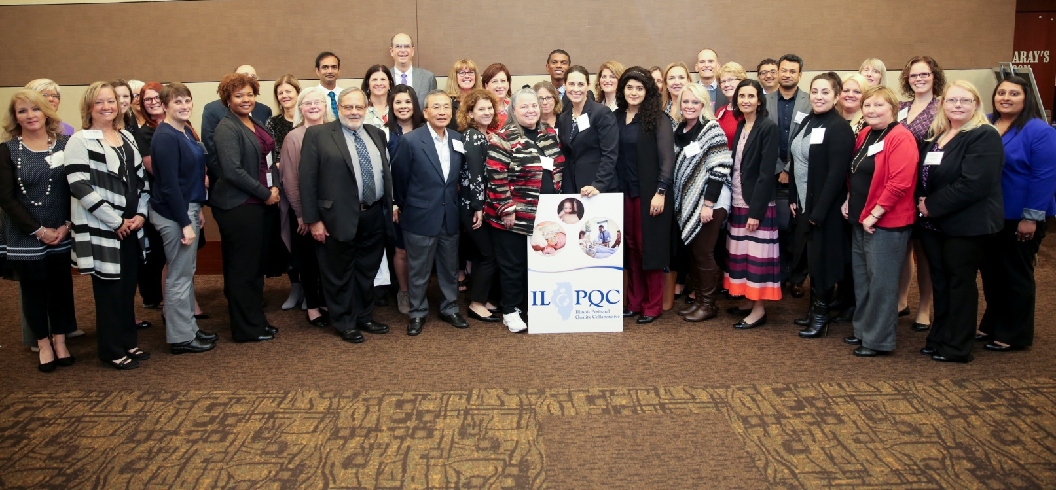
Improving Together
ILPQC is a collaborative of physicians, nurses, hospital teams, public health and other stakeholders working together for healthier moms and babies in Illinois
Thank you all – we look forward to continuing our work together

