Slide 1

Illinois Perinatal Quality Collaborative: Next Steps and Wrap Up
ILPQC Fifth Annual Conference
December 19, 2017

Slide 2
Wrap up from Breakouts:
Obstetric
Neonatal
Patient / Family Engagement

Slide 3
Looking Ahead
2018 Call to Action
Teams create and implement sustainability plans and compliance monitoring for Severe Maternal Hypertension and Golden Hour Initiatives
Launch Statewide Initiatives
  Mothers and Newborns affected by Opioids (OB & Neo)
  Immediate Postpartum Long Acting Reversible Contraception (IP LARC)
ILPQC will continue to engage stakeholders, patients/families, and hospital teams from across the state to provide: opportunities for collaborative learning, rapid response data and QI support
Notes:
UPDATED_DW_12.12.2017

Slide 4
Prepare your team for
2018 ILPQC QI Initiatives
MNO team rosters:
  Wave 1 by mid January, Wave 2 by mid April
IPLARC team rosters:
  Wave 1 by mid March, Wave 2 late 2018/early 2019
Contact info@ilpqc.org for more information on our initiatives starting in 2018
  Mothers and Newborns affected by Opioids (MNO)
  Immediate Postpartum LARC

Slide 5
To Participate in an
Advisory Workgroup
Neonatal and Obstetric Advisory Workgroups meet regularly to provide guidance for ILPQC initiatives
Representation across state, perinatal levels, and professions (MDs, RNs, QI, public health)
Contact info@ilpqc.org to participate or for more information

Slide 6

Happy 4th Birthday ILPQC!
Thank you to all who have contributed to building a successful state perinatal quality collaborative for IL
  Sponsors
  Stakeholders
  Advisory Workgroups
  Leadership / Data teams
  Perinatal Network Administrator & Educators
  Hospital Teams
  Patients & Families
  Volunteers
Notes:
UPDATED_DW_12.12.2017

Slide 7


Thank you ILPQC team!
ILPQC 5th Annual Conference Planning Committee
  Christine Emmons, MSN-CNL, MPH, RNC-NIC,
  Lisa Festle, MSN, RNC-NIC, APRN/CNS,
  Felicia Fitzgerald, BSN, RNC-OB, C-EFM, CLNC,
  Ana Flores, RNC-OB- BSN, CLC,
  Lori Folken, RNC-BSN, C-EFM,
  Barbara Hering, MSN, RNC-NIC, APRN/CNS,
  Deb Kamradt, MSN, RNC-OB, C-EFM,
  Patricia Lee King, PhD, MSW,
  Angela Rodriguez, RNC-OB, BSN, CCRC,
  Cecilia Lopez, BSN,
  Deborah Miller, MPH, BSN, RN, CPHQ,
  Dan Weiss, MPH
  Leslie Caldarelli, MD
  Justin Josephsen, MD
  Ann Borders, MD

Slide 8
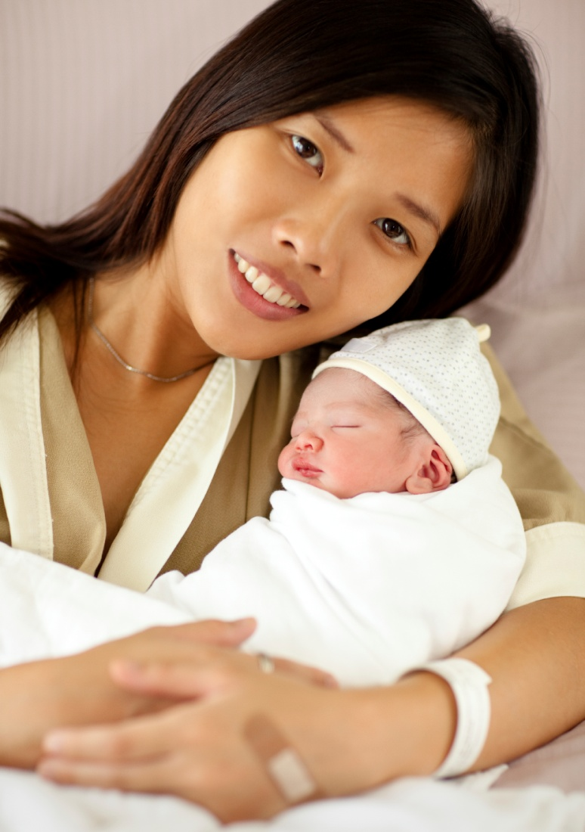
ILPQC Central Team
Ann Borders
ILPQC Executive Director, OB Lead
Leslie Caldarelli,
Justin Josephsen
Neonatal Leads
Patricia Lee King
State Project Director
Daniel Weiss
Project Coordinator
info@ilpqc.org OR www.ilpqc.org

Slide 9
Notes:
ADD SPONSORS SIGN
UPDATED_DW_12.13.2017

