Slide 1
Illinois Perinatal Quality Collaborate
ILPQC
Thursday, November 3, 2016
The Westin Lombard Yorktown Center
Lombard, IL

Slide 2

Maurice L. Druzin, MD
Professor and Vice-Chair
Department of Obstetrics and Gynecology
Associate Program Director
Obstetrics and Gynecology Residency Program
Stanford University School of Medicine
Stanford, California

Slide 4
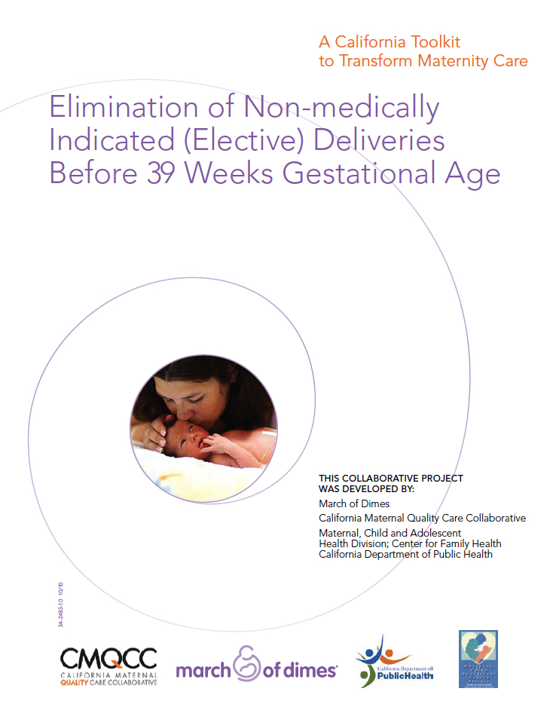
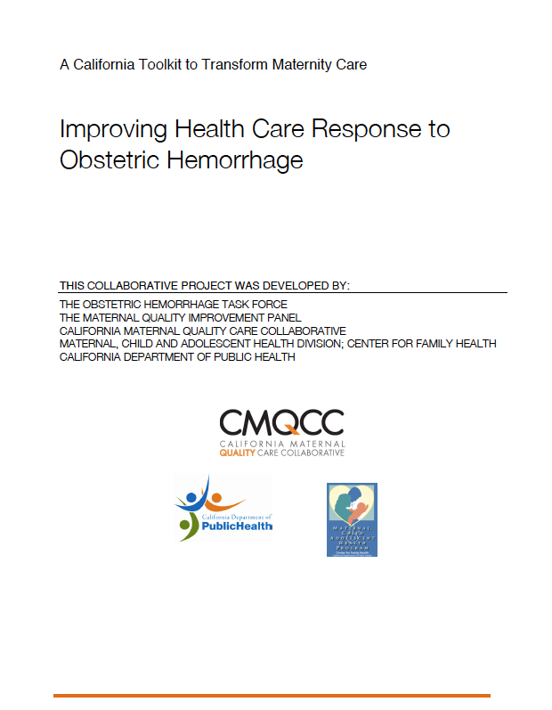
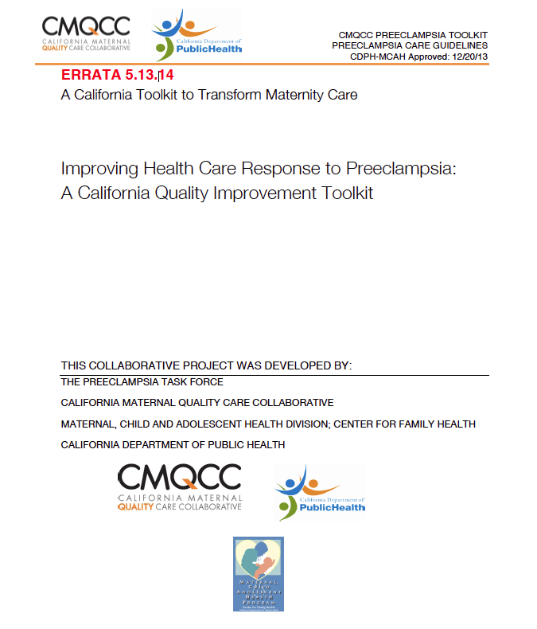
California Maternal Quality Care Collaborative
Leader for Maternity QI Projects
Statewide multi-disciplinary Taskforces that develop QI toolkits and implementation guides
Large-scale quality collaboratives in California
Widespread adoption by other states and national
Elimination of Early Elective Delivery (2010)
Response to OB Hemorrhage
(2010; 2nd Ed 2015)
Response to Preeclampsia
(2013)
4

Slide 5
Who are CMQCC’s Key Partners
State Agencies
CA Department of Public Health, MCAH
Regional Perinatal Programs of California (RPPC)
DHCS: Medi-Cal
Office of Vital Records
Office of Statewide Health Planning and Development (OSHPD)
Covered California
Membership Associations
Hospital Quality Institute (HQI)/California Hospital Association (CHA)
Pacific Business Group on Health (PBGH)
Integrated Healthcare Association (IHA)
Public and Consumer Groups
California Hospital Accountability and Reporting Taskforce (CHART)
California HealthCare Foundation (CHCF)
March of Dimes (MOD)
Professional Groups (California sections of national organizations)
American College of Obstetrics and Gynecology (ACOG)
Association of Women’s Health, Obstetric and Neonatal Nurses (AWHONN)
American College of Nurse Midwives (ACNM),
American Academy of Family Physicians (AAFP)
Key Medical and Nursing Leaders
UC, Kaisers, Sutter, Sharp, Dignity Health, Scripps, Providence, Public hospitals
5
5

Slide 6

CMQCC Maternal Data Center
CMQCC Maternal Data Center
Discharge Diagnosis Files
Birth Certificate Data
Individual Hospital QI Measures
Rapid-cycle Data
(45 days)

Slide 7
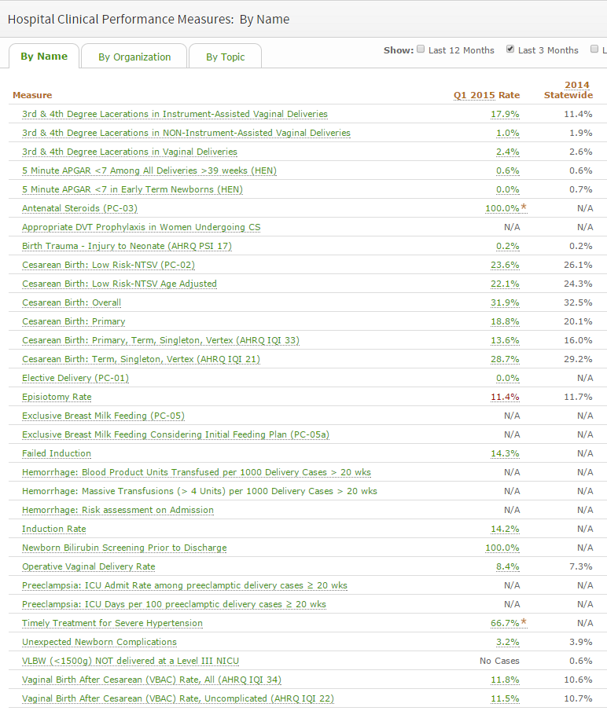
32 Nationally Recognized Hospital Clinical Quality Measures
Focus on:
NTSV C-Section

Slide 8
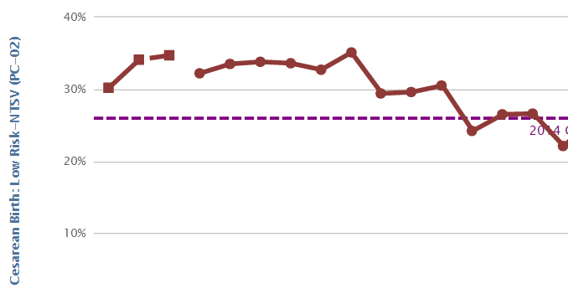
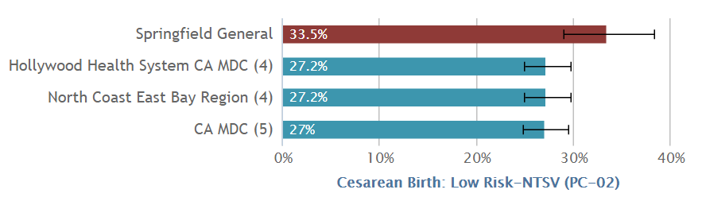

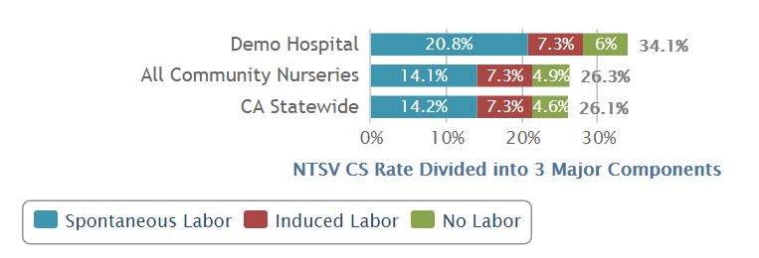
Utilize the CMQCC Maternal Data Center to:
Monitor hospital rates—in real time
Make peer comparisons
Assess provider variation
Identify QI opportunities
(and lots more!)
8

Slide 9
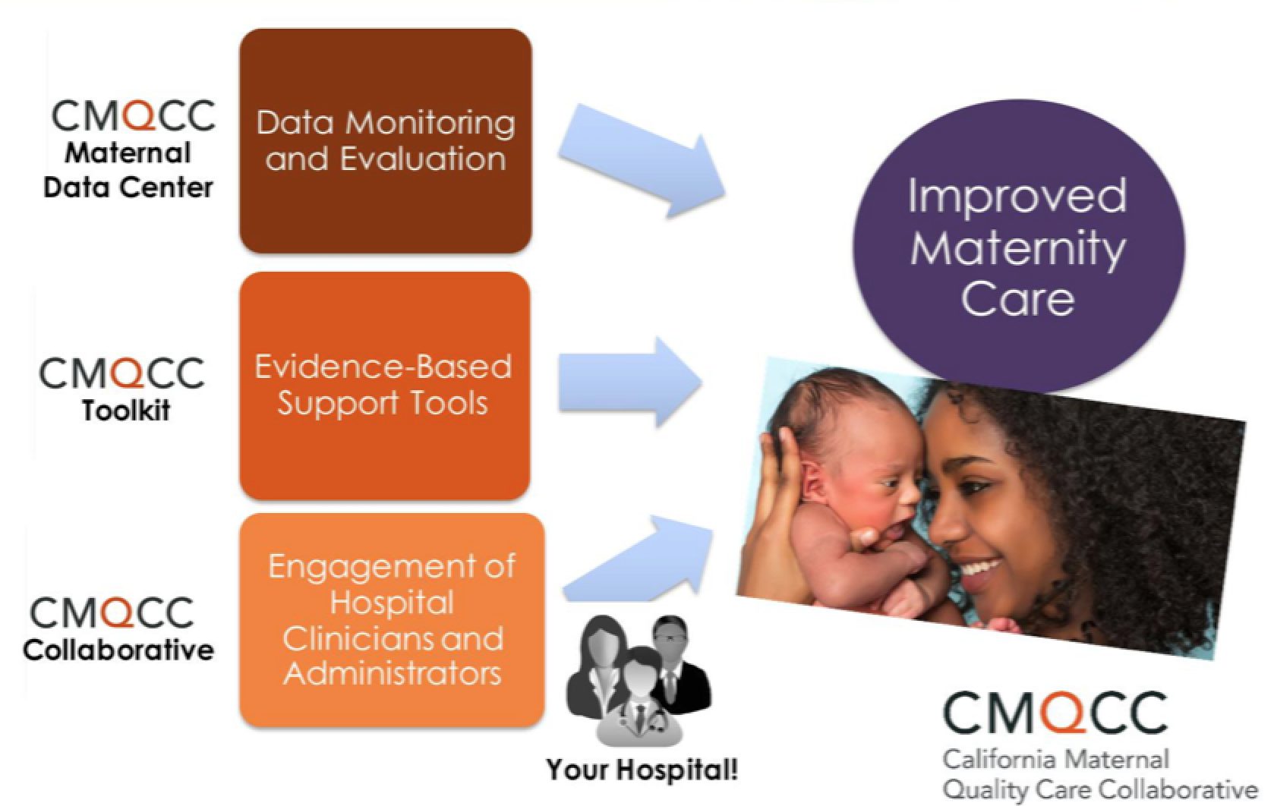

Slide 10

Severe Maternal Morbidity
Pre- and Post-Preeclampsia Toolkit Implementation
Percent of Patients
(n=817)
AJOG 2015;212:S69.

Slide 11
MEWT Pilot
Preeclampsia Toolkit
Toolkit
Compliance Monitoring
PREECLAMPSIA
Success!
Data Source: Midas+ Perinatal Quality Profile, 2011 – July 2016

Slide 12
Preeclampsia Bundle Compliance
PREECLAMPSIA
Jul14-Mar15

Slide 13


California and National Efforts to Support Vaginal Birth and
Reduce Primary Cesareans
Funding for the development of this toolkit was provided by the California Health Care Foundation
Notes:
13

Slide 14
Usage Terms
Please use the CMQCC template for any slide you use from the slide deck
Please do not use the CMQCC logo if you modify a slide – feel free to use your own logo in these situations
Slides with copyright material that we do not yet have copyright permission to use should not be shared with others (these slides are marked)
If you add slides to the slide set please do not use the CMQCC logo
Please provide us feedback and recommendations for improving the slide set

Slide 15
California Maternal Quality Care Collaborative (CMQCC)
Multi-stakeholder organization established in 2006: providers, state agencies, public groups with focus on Maternal Care
Hosts California Maternal Mortality Review Committee
Sister organization with CPQCC (neonatal care)
Developer of QI toolkits: Early Elective Delivery, OB Hemorrhage, Preeclampsia, CVD in Pregnancy, and First Cesarean Prevention
Leads multiple QI Collaboratives (Hemorrhage, HTN)
Established Maternal Data Center in 2011
15
Notes:
CMQCC and CPQCC are operated as research and quality improvement programs under the umbrella of Stanford University. Our mission is improving care for moms and newborns.
CMQCC started off as a partner to the California Department of Public Health (looking at maternal quality of care issues) , and has used that expertise to develop QI toolkits, including partnering with the MOD and CDPH to develop the Early Elective Delivery Toolkit used nationally by the MoD.
Our sister organization, CPQCC may be more familiar to hospitals, as they have operated a perinatal data center for over 15 years. Virtually all hospitals with NICUs participate in the Perinatal Data Center, which is focused on babies < 1500 grams.. The CMQCC Maternal Data Center is modeled on the CPQCC data center, but its scope will include ALL births in California.

Slide 16
CMQCC’s Key Stakeholders/ Partners
State Agencies
CA Department of Public Health, MCAH
Regional Perinatal Programs of California (RPPC)
DHCS: Medi-Cal
Office of Vital Records
Office of Statewide Health Planning and Development (OSHPD)
Covered California
Membership Associations
Hospital Quality Institute (HQI)/
California Hospital Association (CHA)
Pacific Business Group on Health (PBGH)
Integrated Healthcare Association (IHA)
Key Medical and Nursing Leaders
UC, Kaisers, Sutter, Sharp, Dignity Health, Scripps, Providence, Public hospitals
Professional Groups (California sections of national organizations)
American College of Obstetricians and Gynecologists (ACOG)
Association of Women’s Health, Obstetric and Neonatal Nurses (AWHONN)
American College of Nurse Midwives (ACNM),
American Academy of Family Physicians (AAFP)
Public and Consumer Groups
March of Dimes (MOD)
California HealthCare Foundation (CHCF)
California Hospital Accountability and Reporting Taskforce (CHART)
16
Notes:
CMQCC has engaged as many stakeholders in maternity care that we can think of—to make change we need everone to be pulling the oars in the same direction!

Slide 17
Today’s Discussion
Discuss the side variation in risk adjusted CS rates
Identify multiple reasons as to why should we care about CS rates
Discuss various state and national efforts to reduce primary CS rates
Summarize key parts of The Toolkit: Readiness, Recognition, Response, Reporting—barriers, strategies and tools
Recognize success strategies from hospitals with low rates
Recall pilot hospital success stories
Identify areas to prioritize: What do we do first? Implementation guide
17

Slide 18
“Let’s Begin with a Test” (NYT):
You are about to give birth. Pregnancy has gone smoothly. The birth seems as if it will, too. It’s one baby, in the right position, full term, and you’ve never had a cesarean section — in other words, you’re at low risk for complications.
What’s likely to be the biggest influence on whether you will have a C-section?
(A) Your personal wishes.
(B) Your choice of hospital.
(C) Your baby’s weight.
(D) Your baby’s heart rate in labor.
(E) The progress of your labor.
Rosenberg T, NYT, Jan 19 2016
18

Slide 19
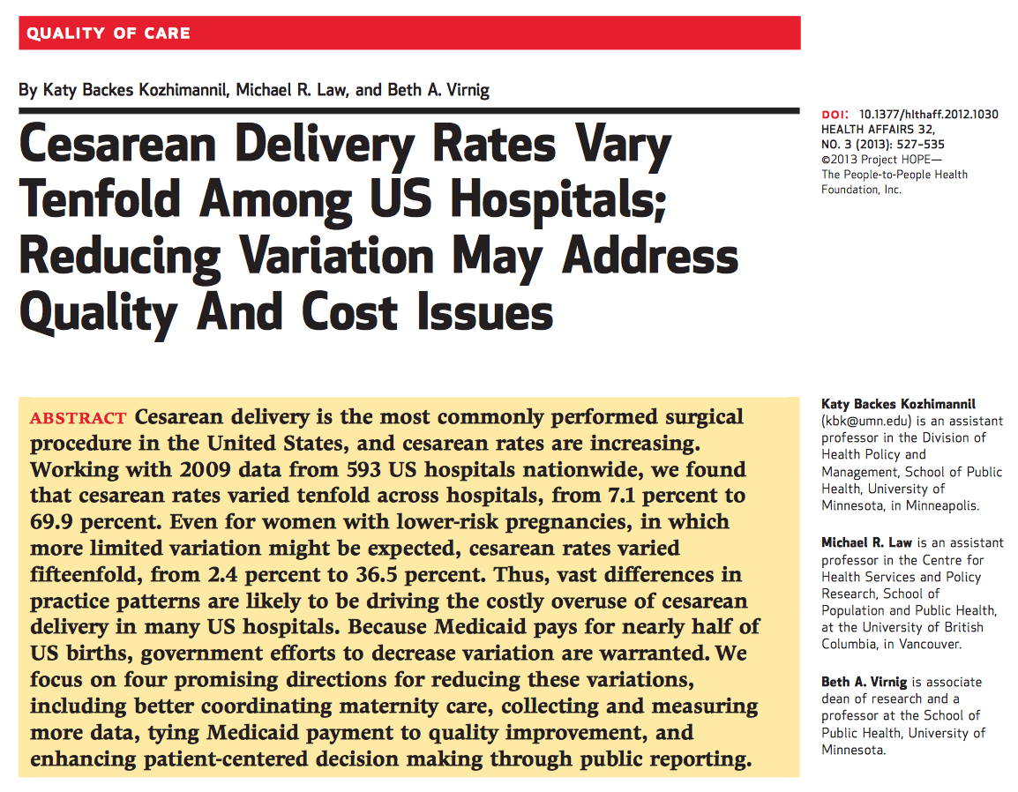
19
Notes:
This study looked at total CS rates and then drilled down to the AHRQ metric-term singleton vertex moms and found even greater variation

Slide 20
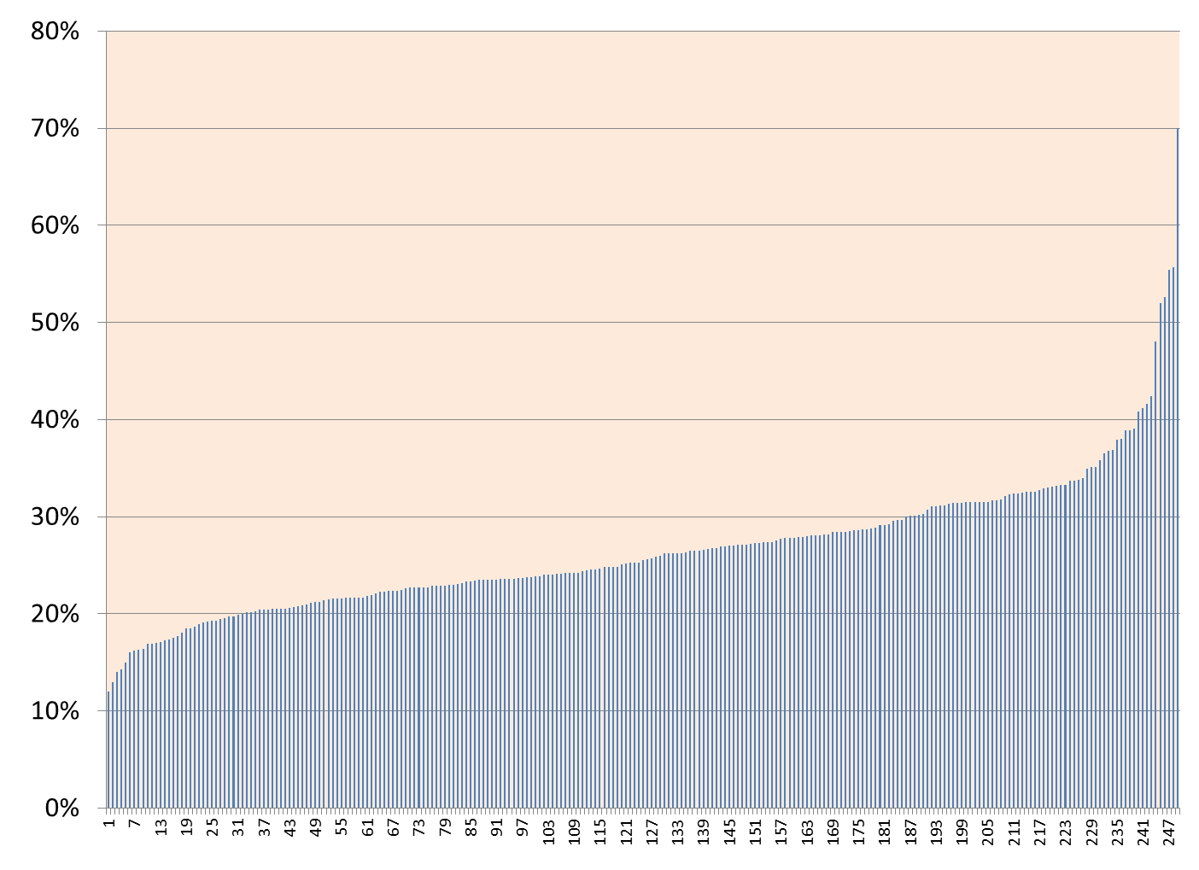
NTSV CS Rate Among CA Hospitals: 2014
(Nulliparous Term Singleton Vertex)
Risk Adjustment did not reduce the variation
Range: 12%—70%
Median: 25.3%
Mean: 26.2%
National Target =23.9%
40% of CA hospitals meet national target
Large Variation =
Improvement Opportunity
Hospitals
20
Notes:
Each column represents a single California maternity hospital

Slide 21
Why focus on Nulliparous Term Singleton Vertex Cesarean Section?
Notes:
It is a standard population that presents the most favorable set of conditions for vaginal birth – women with a full-term, single baby in the head-down position (vertex), but is also the group that has the most labor complications – women having a first birth

Slide 22

Importance of the First Birth
If a woman has a Cesarean birth in the first labor, over 90% of ALL subsequent births will be Cesarean births
A classic example of
path dependency
If a woman has a vaginal birth in the first labor,
over 90% of ALL subsequent births will be vaginal births
22
Notes:
The first birth is a true fork in the road for a woman’s reproductive life. The consequences of multiple cesarean births are significant.

Slide 23
What Indications Have Driven the RISE in CS?
 | Percent of the Increase in Primary Cesarean Rate Attributable to this Indication
Cesarean Indication | Yale (2003 v. 2009) (Total: 26% to 36.5%) Focus: all primary Cesareans | Kaiser SoCal (1991 v. 2008) (Primary: 12.5% to 20%) Focus: all primary singleton Cesareans
Labor progress complications (CPD/FTP) | 28% | ~38%
Fetal Intolerance of Labor | 32% | ~24%
Breech/Malpresentation | <1% | <1%
Multiple Gestation | 16% | Not available
Various Obstetric and Medical Conditions (Placenta Abnormalities, Hypertension, Herpes, etc.) | 6% | 20% (Did not separate preeclampsia from other complications)
Preeclampsia | 10%
“Elective” (variously defined) | 8% (Scheduled without “medical indication”) | 18% (Those “without a charted indication”)
60%!
23
Notes:
Increased diagnosis of Labor complications is the main reason for the rise in CS rates in the last 15 years. It is not more breeches or more previas. Even elective deliveries make a small contribution.
A main focus of educational efforts within your hospital should involve a variety of topics around labor management. These should include areas for both nursing and physician/providers. CMQCC is sponsoring regoinal labor support workshops to refresh labor support skills in a train the trainer format. For more information contact Jluie Vasher at CMQCC.

Slide 24
What Indications Drive the VARIATION in CS?
CS Indication | Proportion of Overall CS Rate | Proportion of Primary CS Rate | CS Rate for this Indication
Repeat (prior) | 30-35% | --- | 90+%
“Abnormal Labor” (CPD/FTP) | 25-30% | 35-45% | Highly variable
Fetal Intolerance of labor | 10-15% | 15-20% | Highly variable
Breech/Transverse | 10% | 15-20% | 98%
Multiple Gestation | 5-9% | 10-15% | 60-80%
Other: Placenta Previa, Herpes, etc | ~5% | ~10% | 90%
60%!
24
Notes:
Likewise the diagnoses of labor complications account for the great majority of differences in CS rates between hospitals

Slide 25
“But My Patients are Higher Risk…”
NTSV CS measure is already risk stratified
The only race that impacts is African-American
Age and BMI clearly impact an individual’s CS risk
Formal risk-adjustment analysis using both age and BMI shows that over 2/3 hospitals realize less than 2% change
Age and BMI effects may be provider dependent (more patience for obese women’s labor)
Notes:
NTSV CS measure is already risk stratified
Removes common high risk conditions that vary among hospitals. The only race that impacts is African-American (but remember that until 20 years ago, Af AM women always had lower CS rates than whites
Af AM rates very greatly from hospital to hospital
It is important o understand the difference between risks for an individual patient and the accumulated risk for a hospital
Age and BMI clearly impact an individual’s CS risk
Hospital populations of nulliparous women tend to be either older and thinner OR younger and heavier. Adjusting with logistic analysis for both together leads to minimal change in the adjusted NTSV CS rate at the hospital level. +/-<2% points in most. Only 6/251 hospitals moved form higher than 23.9% to below, and they were all <26% to start.
The CMQCC Maternal Data Center now shows both unadjusted and adjusted rates for those who are interested.
In addition, both age and BMI effects vary greatly from hospital to hospital (and even physician to physician) suggesting that there is an important part of the risk that is provider driven rather than inherent in the patient factor.

Slide 26

Effects of Maternal Age and BMI on Hospital NTSV CS Rates:
Green = Hospitals with NTSV CS Rate <25%
RED = Hospitals with NTSV CS Rate >35%
Every “red dot” (high NTSV CS rate hospital) has multiple “green dots” (low NTSV CS rate hospitals) directly adjacent with similar proportions of high maternal age and high BMI.
CMCQQ data presented at PCOGS 2014
(pre-pregnancy BMI used)
Notes:
Lets explain this graphically.
This slide shows the relationship seen among hospitals for their proportion of obesity (BMI>30) on the x-axis and the proportion of older moms (Maternal Age >35) on the Y axis.
Note that there are no hospitals with both high rates of high maternal age and high rates of high BMI.
Conversely, there is only one hospital that has low BMI and low rates of high maternal age. We would all love to practice there!!
Hospitals with high NTSV rates (>35%) are shown in red dots and hospitals with lower rates (<25%) are shown with green dots.
Note that there are red dots among all ratios of High Age and High BMI.
But also note that for every red dot there are several adjacent green dots that have the same ratio of high Age and High BMI, strongly indicating that it is NOT the age and BMI that is driving the high CS rate.

Slide 27
Nulliparous, Term, Singleton, Vertex (NTSV) Cesarean Section Rate:
Performance Measure
Risk Stratified (“standard population of nullips”)
Focus on labor management
Widely Adopted Nationally
  ACOG: Task Force on Cesarean Section rates (2000)
  HHS: Healthy Person 2010 and 2020
  NQF endorsed: Joint Commission Perinatal Core Measure (PC-02), LeapFrog, CMS
Further risk adjustment adds little (more to come later)
>15 years experience
Can be calculated at all levels: national, state, hospital,
and provider
27
Notes:
So to summarize, NTSV CS is the most accepted nationally vetted measure for cesarean birth

Slide 28
Cesarean: Neonatal Risks
Increased neonatal morbidity
  Impaired neonatal respiratory function
  Increased NICU admissions
  Affects maternal-newborn interactions including breastfeeding
Unrealized benefits
  Cerebral Palsy rates,
  neonatal seizure rates
  unchanged since 1980
28
Notes:
With the exception of fetuses in breech presentation, neonates have reaped few benefits with the rising rate of cesarean birth. Cerebral palsy rates have remained unchanged in the past 15 years, and recent evidence indicates that significant health consequences, including higher rates of serious respiratory complications, higher admission to the NICU, and development of childhood asthma requiring hospitalization and inhaler use are more likely in babies born by cesarean. Furthermore, cesarean birth remains a barrier to early breastfeeding support, delays the first feeding, and delays or completely interferes with early
skin-to-skin contact, all of which adversely affect the ability to exclusively breastfeed

Slide 29
Cesarean: Maternal Risks
Acute
Long Term &
Subsequent Births
Common:
Longer hospital stay
Increased pain and fatigue
Postpartum hemorrhage (transfusions ~2%)
Slower return to normal activity and productivity
Delayed or difficult breastfeeding
1/100 to 1/1000
Anesthesia complications
Wound infection
Deep vein thrombosis
1/100 to 1/1000
Abnormal placentation (previas and accretas)
Uterine rupture
Surgical adhesions
Bladder surgical injury
Bowel surgical injury
Bowel obstruction
We perform over 160,000 Cesareans every year in California
29
Notes:
Many of the serious complications are uncommon , <1% but we do over 160,000 cesarean sections EVERY year in California so they do add up quickly.
This is particularly true now that we are seeing women with multiple prior CS where the risks do increase significantly.

Slide 30
Maternal Psychological Risks
ACUTE
Delayed and/or ineffective bonding with neonate
Maternal anxiety
LONGER TERM
Post traumatic stress disorder (PTSD)
Postpartum anxiety and depression
30
Notes:
Psychological stress, anxiety, and post-traumatic stress disorder (PTSD) have been identified as potential risks of cesarean. A good point to mention shared decision making during prenatal, intrapartum care. We can decrease the loss of control and anxiety women may associate with the cesarean through effective communication.

Slide 31
Summary of Issues
Extreme variation among hospitals
Rapid rise of rates without neonatal or maternal benefits (indeed can have complications)
Significant consequences for future pregnancies
But, Cesarean births can also be life-saving and they have an absolute role in Obstetrics—
making the message to patients:
“They shouldn’t be taken lightly”
31

Slide 32
Multiple California and National Projects to Support Vaginal Birth
Reduce Primary Cesareans
32

Slide 33
California and National Projects
California
CMQCC QI Toolkit
Joint ACOG/AWHONN Speakers Bureau
Multi-hospital QI Collaboratives
Public release of hospital NTSV CS rates (TJC PC-02)
Multi-stakeholder engagement
National
National Safety Bundle
ACOG (National) Letter of Support for CMQCC Toolkit
Maternal Child Health Bureau support for Stare projects
CMS/Medicaid support for state Medicaid projects
33
Notes:
This project is one of many currently underway in California and the US to provide greater support for women in labor and increase their chance for a vaginal birth.

Slide 34

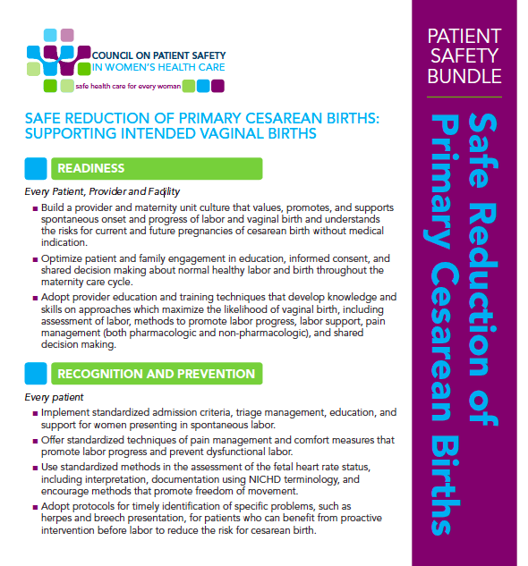
Key Foundation Materials
New National Guidelines for Defining Labor Abnormalities and Management Options
34
Notes:
These key ACOG documents form the Foundation for this project.
The new (2014) ACOG guidelines for defining labor abnormalities and recommendations for treatment are key.
Likewise, the 2016 national patient safety bundle for supporting vaginal birth and reducing primary cesarean births that is focused on practical approaches serves as the base for the CMQCC Toolkit
Lets look at some of the KEY FINDINGS

Slide 35
Patience
Greater clinical patience is the main focus of many of the recommendations in the ACOG/SMFM Obstetric Care Consensus on Safe Prevention of the
Primary Cesarean Delivery
patience
35
Notes:
One of the most important parts are the new guidelines on length of all stages of labor.
Patience is a clear virtue.
Of course, all such guidelines are Dependent on maternal and fetal status and professional expert opinion.

Slide 36
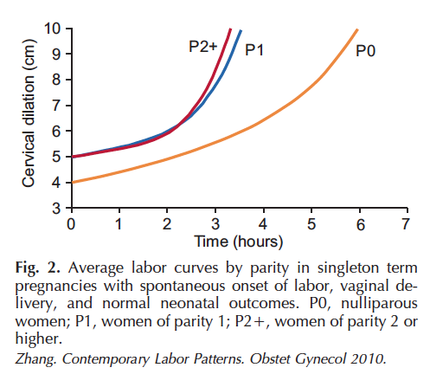
Active Labor: “6 is the new 4”
36
Notes:
For active phase labor, the timing of the onset is the most important change

Slide 37
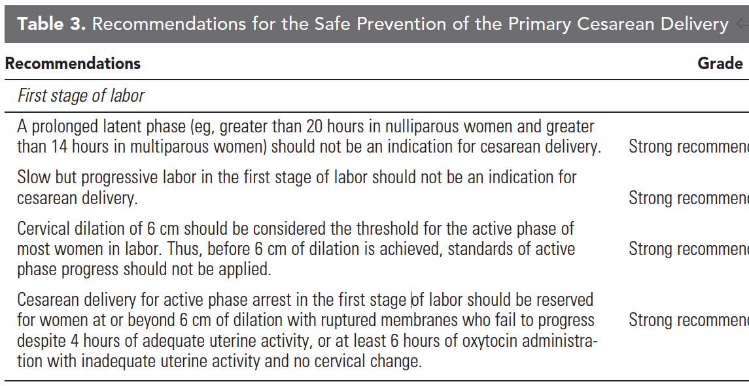
Revised ACOG Labor Guidelines
Safe prevention of the primary cesarean delivery. Obstetric Care Consensus No. 1.
American College of Obstetricians and Gynecologists. Obstet Gynecol 2014;123:693–711.
Notes:
This in turn leads directly to the new recommendations for labor dystocia/failure to progress.
Note that these are considered “strong recommendations”

Slide 38

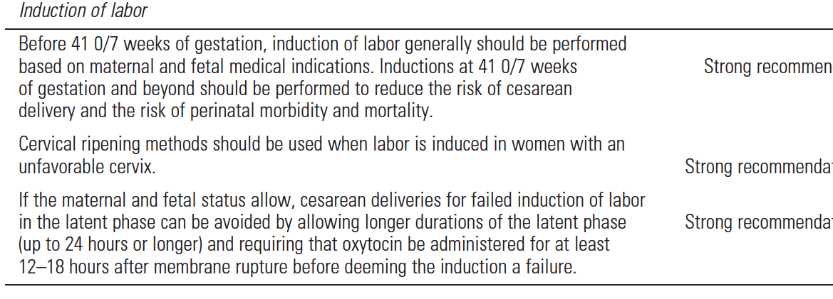
Revised ACOG Labor Guidelines
Safe prevention of the primary cesarean delivery. Obstetric Care Consensus No. 1.
American College of Obstetricians and Gynecologists. Obstet Gynecol 2014;123:693–711.
Notes:
For the first time, we have national ACOG guidelines for determining when a labor induction has “failed”.
Again, they are considered strong recommendations
Also, again note that they apply if fetal and maternal status allow.

Slide 39
Safe Reduction of Primary Cesarean Births: Supporting Intended Vaginal Births
National Safety Bundle / Multi-disciplinary QI Outline
Senior leaders from ACOG, AWHONN, ACNM, SMFM, AAFP, SOAP, ASA, ABOG and others
Bundle has 4 Domains:
  Readiness (every patient, provider and facility)
  Recognition and Prevention (every patient)
  Response (to every labor challenge)
  Reporting/System Learning (every birthing facility)
www.Safehealthcareforeverywoman.org
Direct links also found on the ACOG homepage
39
Notes:
From the Council on Patient Safety in Women’s Healthcare

Slide 40
OB Quality Improvement and Safety Efforts Help to Decrease Liability
Utilize evidence-based best practice protocols that follow national consensus
(e.g. oxytocin)
Utilize expert-vetted standardized approaches
for labor and fetal heart rate abnormalities
Communication techniques which engage the patient in “shared decision making” creates a strong deterrence to lawsuits
Reducing primary cesareans, protects against
post-cesarean complications and poor outcomes during future care
40
Notes:
We have been working with the major liability carriers who stress these principles.
The release of ACOG guidelines are very helpful in this matter.

Slide 41
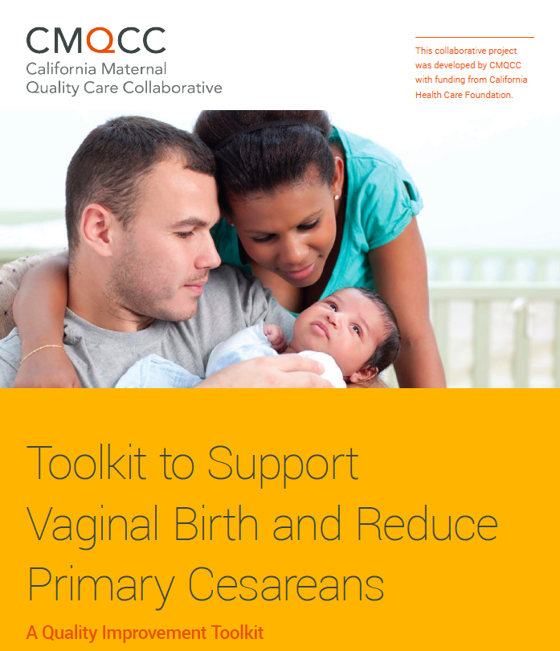
Public Release:
April 28, 2016
Download from:
www.CMQCC.org
Multi-disciplinary Collaboration,
Aligned with key ACOG, AWHONN, ACNM documents
Supplemental Materials:
Implementation Guide
Hospital self-assessments
More to come…
41
Notes:
Lets look at the Toolkit.
It is Open source for anyone to download and use.

Slide 42
CMQCC Supporting Vaginal Birth Taskforce
Writing Group
Obstetricians
MFMs
Certified Nurse Midwives
Registered Nurses
Educators
Doulas
Hospital Leaders
Public Health
Review Group
ACOG leaders
AWHONN leaders
ACNM leaders
SOAP (Society of Obstetric Anesthesia Providers) leaders
California Hospital Association
Medical Liability providers
Several Hospital Systems
Over 50 Contributors
42
Notes:
Multidisciplinary group for writing and reviewing.
We wanted all who are caring for laboring women to participate!

Slide 43
Toolkit: Table of Contents
Executive Summary
The Case for Improvement in Cesarean Birth Rates
Part I: Readiness:
  Improving the culture of care, awareness and education
Part II: Recognition and Prevention
  Supporting intended vaginal birth
Part III: Response
  Management of labor abnormalities
Part IV: Reporting and System Learning
  Using data to drive improvement
Part V: Success Stories
  Lessons learned form California hospitals
Appendices: specific QI tool examples and links
43
Notes:
Organized to approximate the safety bundles – around the four R’s.
79 pages in 5 parts
Followed by:
20 appendices
(graphics, flow charts), and
338 references

Slide 44
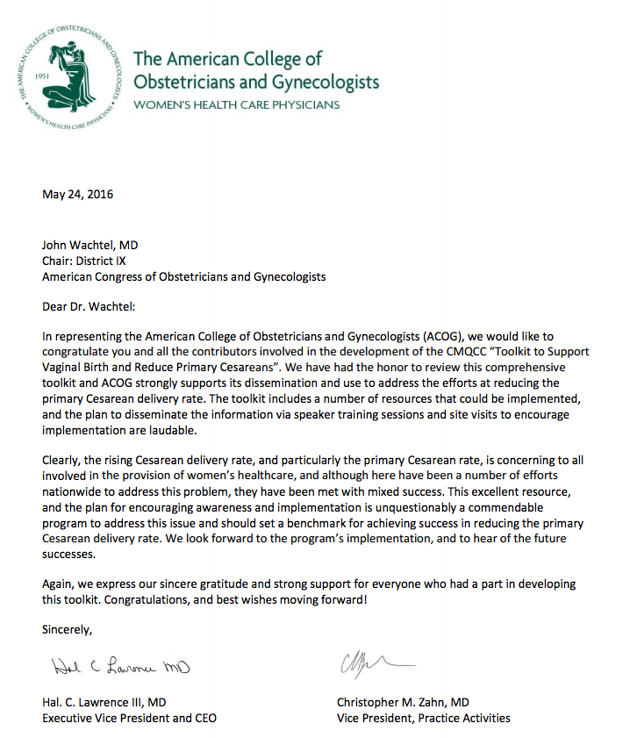
44
Notes:
Pleased to have support from our professional organizations. Letter of support from ACOG National is shown here.
Note the highlighted sentences. [CLICK TO BLOW-UP THE HIGHLIGHTED SENTENCES].

Slide 45
We have had the honor to review this comprehensive toolkit and ACOG strongly supports its dissemination and use to address the efforts at reducing the primary Cesarean delivery rate.
This excellent resource, and the plan for encouraging awareness and implementation is unquestionably a commendable program to address this issue and should set a benchmark for achieving success in reducing the primary Cesarean delivery rate.
45
Notes:
This is truly exceptional as they almost never support materials not internally created

Slide 46
READINESS
Developing a maternity culture that values, and supports intended vaginal birth
46
Notes:
Lets go thru some of the highlights of the toolkit

Slide 47
Strategies
Readiness
Create a unit culture to support intended vaginal birth
Improve access and quality to modern childbirth education
Improved shared decision making at critical points
Bridge provider knowledge and skills gap
47
Notes:
What is the culture of your unit?
CMQCC is creating a survey to measure attitudes/beliefs of the nursing physician staff. This will be used in two fold manner – to help hospitals determine what areas of their culture need attention to support intended vaginal birth as well as an overall assessment of the relationship between unit personnel attitudes and beliefs in relation to their NTSV rate.
Since a decreasing number of hospitals are directly involved with their childbirth education classes, it is important to meet often with community led classes to ensure information is current in relation to your facility and evidence.
The toolkit outlines several critical times for communication with the woman and creates the opportunity for shared decision making. Some of these key points include:
Choice of provider and/or facility for prenatal care and care at time of birth
Timing of admission to hospital (admission to labor and delivery while still in the latent/early phase is associated with an increased risk of cesarean)
Choice of fetal monitoring method (continuous monitoring is associated with an increased risk of cesarean)
Whether to have continuous labor support by a trained caregiver like a doula (continuous labor support improves chances of having a vaginal birth)
Induction of labor without medical indication (depending on the provider and facility)

Slide 48
Examples
Readiness
Sources of best childbirth education tools
Tools/policies/concepts of “mother friendly” hospital
Approaches to shared decision making and training aspects
Establish a team to create excitement and communications for implementation of the Toolkit
48

Slide 49
Sharing in decision making:
The SHARE Model
S
Seek
Readiness
Seek the patient’s participation
H
Help
Help her explore each option and
the corresponding risks and benefits
A
Assess
Assess what matters most to her
R
Reach
Reach a decision together and arrange
for a follow up conversation
E
Evaluate
Evaluate her decision (revisit the decision and assess whether it has been implemented as planned)
The SHARE approach. Agency for Healthcare Research and Quality Website. http://www.ahrq.gov/professionals/education/curriculum-tools/shareddecisionmaking/index.html. Accessed December 1, 2015.
49
Notes:
Shared decision making is a collaborative process between the provider and patient that “takes into account the best available
scientific evidence, as well as the individual’s values and preferences, to determine the right course of care.” By identifying the major decision points that most impact the risk for cesarean birth, providers can markedly improve the patient’s knowledge deficit and
decision making.

Slide 50



What about women who request a Primary Cesarean Birth?
It is important to communicate early and often during the prenatal period to alleviate any fears related to incomplete information
Fear of pain is a common concern. Work with her to identify good labor support personnel
Provider guidance is critical. Different approaches and attitudes reflect different rates
Incidence is less than 1%
Notes:
While a very small portion of women may desire a pre-labor cesarean, data from this survey do not support the suggestion that
maternal requests for cesareans contribute significantly to the high cesarean rate. To the contrary, the evidence indicates that women prefer vaginal birth — less than 1% of women reported choosing a non-medically indicated cesarean for their first birth.

Slide 51
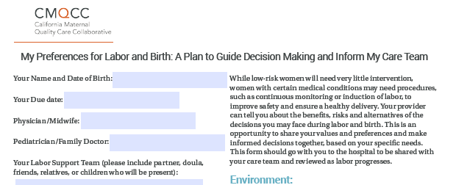
Birth Preferences Worksheet
Readiness
Collaborate with healthcare provider to determine birth preferences
Tailor choices to what is available at each facility
Example available in the toolkit
51
Notes:
It is not uncommon to hear how a woman’s Birth Plan is a “sure ticket to the operating room”. On the contrary, a collaboratively developed Birth Plan can offer a unique opportunity for providers to engage women in shared decision making early in the prenatal period and to discuss expectations, fears, gaps in knowledge, and specific decision points that may impact a woman’s risk of cesarean.
Hospitals can create positive communication regarding maternal preferences in labor by tailoring a birth preferences worksheet to what their facility can provide. This form can be placed on the hospital's website for download with their own logo on it. Not only does the hospital ownership help the patients identify their ability to make informed decisions with the particular hospital, the logo can help improve hospital staff buy in. Sure beats downloading a birth plan from an unknown source!

Slide 52
RECOGNITION AND PREVENTION
Key Strategies for Supporting
Intended Vaginal Birth
52

Slide 53
Strategies
Recog/Prevent
Implement institutional policies which support vaginal birth
Early labor management and supportive care
Labor support personnel (e.g. doulas)
Infrastructure/equipment
Best practices for regional anesthesia
Protocols for intermittent auscultation
Protocols for modifiable conditions like HSV and breech position
53

Slide 54
Examples
Recog/Prevent
Model policies for intermittent monitoring, freedom of movement, early labor support, etc.
Coping with labor algorithm
Guidelines for working with doulas
Patient education and decision guides
54
Notes:
Upcoming educational webinars through CMQCC collaborative – all are invited to view, refer to CMQCC website for details
Early labor support
Intermittent Auscultation and Intermittent Monitoring
Implementing the Coping with Labor Algorithm
How to build a relationship with doulas in your community and your hospital

Slide 55
Early admission support
Recog/Prevent
Admission policy or checklist for spontaneous labor
Latent labor support and therapeutic rest policies
Patient education materials to explain rationale for delayed admission, reduce anxiety and provide guidance on when to return to the labor and delivery unit
Material with specific guidance for partners and family members as to how to best support the woman in early labor
Setting expectations prior to labor is a critical step
55

Slide 56
Promoting mobility in labor/birth
Recog/Prevent
For both patients with and without regional anesthesia/analgesia
Know your labor beds and what they can do
Use of birthing balls and peanut balls
Posters in labor rooms of labor positions
Use of telemetry EFM
56
Notes:
We can still provide active nursing bedside labor support for women with regional anesthesia/analgesia
Call your birthing bed sales rep for an in house in-service on labor bed use – more than a lumbar support

Slide 57
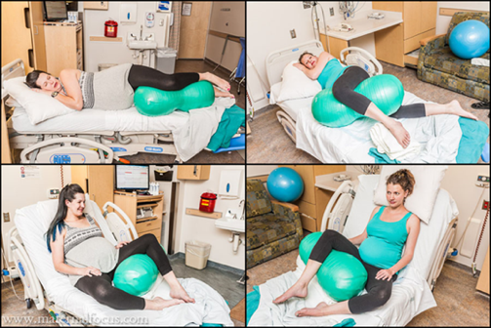
Peanut Ball
Recog/Prevent
Decreased length of labor
Decreased CS rate in patients
with epidurals
Tussey, C. M., Botsios, E., Gerkin, R. D., Kelly, L. A., Gamez, J., & Mensik, J. (2015). Reducing length of labor and cesarean surgery rate using a peanut ball for women laboring with an epidural. The Journal of Perinatal Education, 24(1), 16-24. http://dx.doi.org/10.1891/1058-1243.24.L16
57
Notes:
Peanut Balls are not commonly used in many sites with particular value among women with epidurals to help prevent/treat OP presentations

Slide 58
Non-Pharmacologic Approaches Are Relevant To Every Laboring Woman
Recognition
Continuous labor support
Breathing and relaxation techniques
Touch techniques and massage
Positions to promote comfort
Heat and cold therapy
Hydrotherapy
Sterile water injections
Transcutaneous electric nerve stimulation
58
Notes:
Non-pharmacologic methods can improve and augment coping for all women, especially those with regional analgesia (epidural) or narcotics
who are unable to reach an effective level of relief, women who desire to avoid pharmacologic methods until well into active labor, and women in facilities where 24-hour in-house anesthesia coverage is not available
Changing the culture of supportive care within a facility, to increase the use of non-pharmacological coping methods, may take several combined approaches.
The tools provided in this toolkit can assist in developing these skills and in providing care that supports intended vaginal birth,
safely reduces routine intervention, and provides a satisfying patient experience

Slide 59
RESPONSE
Management of Labor Abnormalities
59

Slide 60
Strategies
Response
Create highly reliable teams and improve interdisciplinary communication
Adopt standard definitions and approaches for labor and FHR abnormalities
Utilize operative vaginal deliveries in appropriate cases
Identify malposition and perform manual rotation
60

Slide 61
Examples
Spontaneous labor algorithms/dystocia checklists
Induction algorithms/checklists/policies for timing, scheduling, proper selection
Algorithms for standard intervention for FHR changes
Model policies for oxytocin
Tools for effective communication
Response
61
Notes:
Consider starting safety huddles on your unit that discusses cesareans during the shift with indication and potential areas that could have avoided the low risk CS. Communication? Slevel of support? No shame and blame – just learning.
Induction scheduling resources from one of our pilot hospitals available on CMQCC website under Collaborative resources.

Slide 62
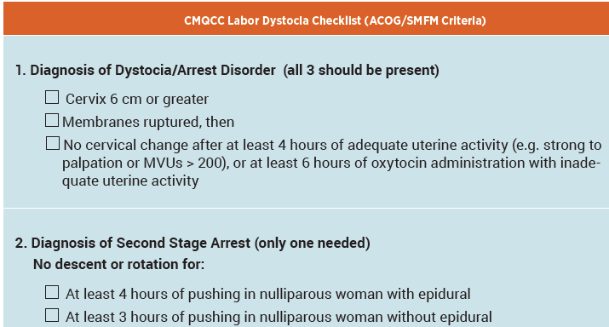
Example of ACOG/SMFM Labor Dystocia Checklist in toolkit
Response
62
Notes:
The ACOG Guidelines can be easily reduced to case review checklist.
This checklist would also be a good way to begin to evaluate your NTSV cases prior to any QI implementation efforts. A form to assist your hospital in this audit is available on the CMQCC website – and additional support is built into the CMQCC Maternal Data center.
instructions for completion are in the Implementation Guide (also available on the CMQCC website)

Slide 63
REPORTING/SYSTEMS
Using Data to Drive Improvement
63
Notes:
A key strategy for successful quality improvement (QI) projects is the use of rapid-cycle data to help drive change

Slide 64
Internal Strategies
Provide timely feedback in persuasive manner
Use comparative data which conveys a sense of urgency
Present data for both hospital and providers
Set achievable goals
Tie descriptive “cold” data with patient stories and other successes
Reporting
64
Notes:
Many hospitals have used group and provider level data to examine the large variation seen among providers.
Provider level data is not perfect for many reasons but they provide the ability to give feedback and comparisons within your department.
Attribution comes from the provider named on the Birth Certificate.
We are not supporting public release of these data

Slide 65
External Strategies
Reporting
Engage women, employers and the general public in the improvement project
Public release of selected hospital-level measures that have been well-vetted
Provide a lay explanation of the measures
Widely distribute these measures through multiple media channels to capture the greatest attention
65
Notes:
Currently, hospital level NTSV CS rates are being publically released using state-wide data sources.
Many stakeholders are very interested in these data!

Slide 66
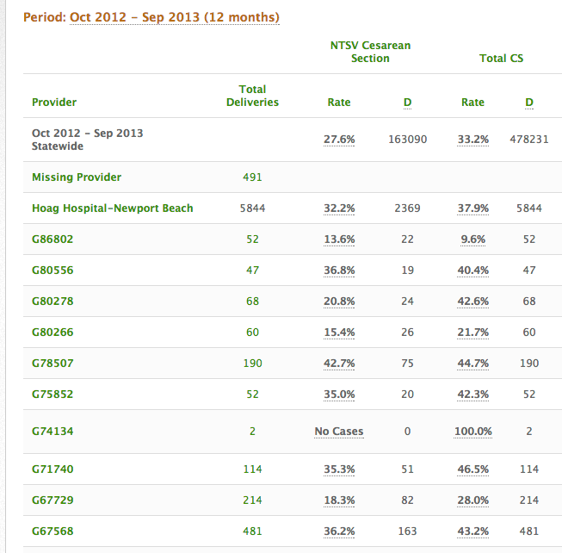
Provider-Level Cesarean Rates
Screen Shot from the CMQCC Maternal Data Center
Sample Medical Center
G7xxxx
G6xxxx
G5xxxx
Note the two busiest providers had widely different rates
G8xxxx
A8xxxx
A6xxxx
A5xxxx
A4xxxx
A8xxxx
A9xxxx
Notes:
Here is a screen shot form the data center highlighting the variation among providers with a single department.
Note the two busiest providers at the bottom. One has an NTSV rate of 18% and the other 36%! Others in the same department have 13% and 42% rates.
This underscores the variation hidden by the departmental average rate of 27%

Slide 67

In summary,
Cesarean deliveries can be
life-saving…
Just be sure she really needs it!
67

Slide 68

Thank You!
For more information or to download the toolkit, visit: www.CMQCC.org

Slide 69
Contact information
Collaborative:
  Julie Vasher, CMQCC – jvasher@stanford.edu
Toolkit
  Nancy Peterson, CMQCC – nursenp@stanford.edu
Labor Support Workshops:
  Julie Vasher, CMQCC – jvasher@stanford.edu
Maternal Data Center:
  Anne Castles – acastles@cmqcc.org
  Amanda Woods – awoods@stanford.edu
CMQCC Medical Director:
  Elliott Main, MD – main@cmqcc.org

Slide 70
Example Hospitals With
Sustained Success
70

Slide 71

John Muir – Walnut Creek
(Non-profit Private Practice Hospital with
~2,800 annual births)
NTSV Rate 17.4%
Turning point – embedded practices in the culture
  Patience with length of labor
  External Cephalic version
  Skilled attendants in singleton vaginal breech births
A safe oxytocin use policy
Non-medically indicated induction elimination
Intermittent monitoring for low-risk women
    With telemetry
    Delayed pushing in second stage
Delivery in OR not necessarily cesarean
    Be prepared, but not committed to cesarean
71
Notes:
Pick and choose some key elements to highlight

Slide 72

Kaiser Permanente – Roseville
(Staff-Model HMO Hospital with
~5,300 annual births)
NTSV Rate 16.9%
24/7 staffing with OB Hospitalist
Utilizes midwives
Adherence to quality improvement principles
Early adopters of Preventing the First Cesarean Delivery
Recognition of the team contribution – nurses are key
Data frequently shared
Tailored messaging to different disciplines
OB Medical Director
Challenges:
23% Obese/Morbidly Obese
(pre-pregnant)
19% over 35yrs of age
72
Notes:
Pick and choose some key elements to highlight

Slide 73
Is Change Possible?
We know there are some hospitals with low rates and others with high rates
But can we take hospitals with high rates and lower their rates significantly?
73

Slide 74

3 Pilot QI Projects Tested
Key Parts of the Toolkit
Hoag Hospital,
Newport Beach CA
Miller Children’s and Women’s Hospital,
Long Beach CA
Saddleback Memorial Medical Center,
Laguna Hills CA
74
Notes:
These sites were chosen due to:
High birth rates
Higher than state average NTSV cesarean rates
Strong leadership
Readiness to engage in the project
Employer concerns about potentially unnecessary cesareans for the large number of employees receiving care at those particular facilities

Slide 75
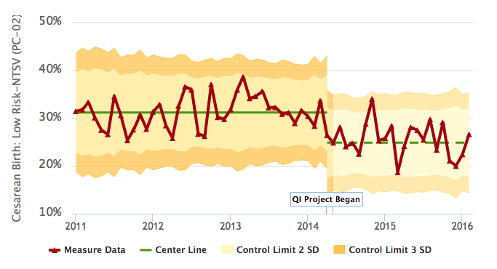
Monthly QI Control Chart:
NTSV CS Pilot Project
Baseline: 31.5%
New Baseline: 23.8%
75
Notes:
This is a simple run chart showing the long baseline period with a baseline rate of 31.5%.
Within months of starting a combined program of
1. Nursing renewal of labor support techniques
2. Provider education of ACOG guidelines and recurrent departmental sharing of provider rates
3. Physician, nursing, and hospital leadership and support
Change happened quickly and was sustained. A new baseline of 23.8% was established within several months and ahs continued for two years.
Note that there is month to month variability.

Slide 76

Impressive Results: within 6 months
24.2 % Reduction
22.1% Reduction
19.5% Reduction
Baseline – 32.6%
After QI – 24.7%
Baseline – 31.2
After QI – 24.3%
Baseline – 27.2%
After QI – 21.9%
76
Notes:
The same approach has now been undertaken by 3 Southern California hospitals all with outstanding results
Even the hospital with the lowest baseline rate (27.2%) lowered it by 20%.
In all 3 facilities, balancing measures were followed to monitor for unintended consequences of the QI project.
There were no changes in neonatal outcomes, in fact 2 hospitals showed an improvement.
Likewise, even with more vaginal births there was no increase in 3rd and 4th degree lacerations.

Slide 77
Lessons from the Pilot Hospitals
Power of provider-level data
Key role of nurses for labor support
Need a reason to change
(payment changes, transparency)
Medical and Nursing leadership important
National guidelines very helpful
Needs “constant gardening”
77
Notes:
Even pilot hospitals with a great degree of success continue to actively participate in efforts to reduce and sustain.

Slide 78
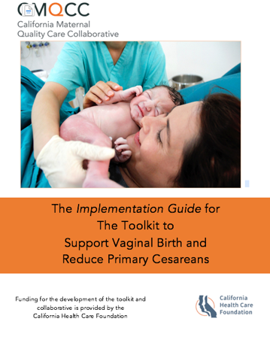
Implementation Guide
“How To Guide”
  Translating recommendations from the toolkit into practical advice for implementation
Provides methodology to identify:
  Key focus areas
  Strategies
  Process design for sustainability
  Key QI principles
78
Notes:
Available on the CMQCC website.

