Slide 1

Data for Quality Improvement:
Tools You Should Be Using Now
  Munish Gupta, MD MMSc
  ILPQC Fourth Annual Conference
  November 3, 2016

Slide 2
Disclosure Statements
I have no relevant financial relationships related to this CME presentation.
I do not intent to discuss an unapproved or investigative use of a commercial product.
I am a huge fan of state collaboratives.
I tend to talk a bit fast, and I have a fair amount of stuff I’d like to cover.

Slide 3
Goals
Remind you that measurement and data are critical to improvement
Review several data tools that are fairly central to quality improvement
Show you at least one new tool that you can start using now (or at least very soon)

Slide 4
Outline
Why data for QI is important
Data tools for QI in general
Data tools for QI collaboratives in particular
(examples from human milk along the way)

Slide 5
Outline
Why data for QI is important
Data tools for QI in general
Data tools for QI collaboratives in particular
(examples from human milk along the way)

Slide 6
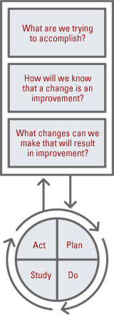
The Model for Improvement
AIMS
MEASURES
Data!
CHANGES
Testing Changes
Figure from Institute for Healthcare Improvement (www.ihi.org)

Slide 7

Deming’s Profound Knowledge
Appreciation
of a System
Theory of
Knowledge
Psychology
Understanding
Variation
Data!

Slide 8
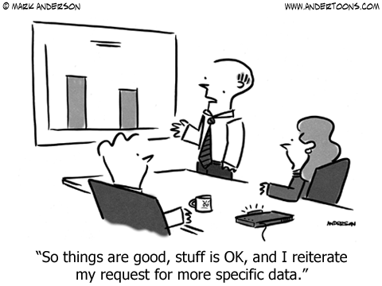

Slide 9
Take Home Points
Measurement is critical for improvement.

Slide 10
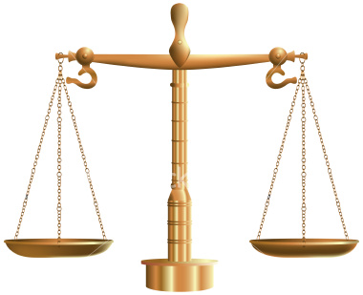
Types of Measures
Outcome measures – what patient experiences
Process measures – what we do
Balancing measures

Slide 11
A (Real) NICU Example
You would like to increase the use of human milk in your NICU.
You identify a SMART aim and think about appropriate measures.
You decide to use a key driver diagram to organize your efforts.

Slide 12
Key Driver Diagram
SMART Aims
Primary Drivers
Secondary Drivers/Interventions
Antenatal consultations
Education of families
More moms pumping
Increase % of VLBW infants receiving HM at discharge
Human Milk Initiation
Mom’s pumping earlier
Outcome measure: % of VLBW infants receiving HM at discharge
Donor milk use
Human Milk Continuation
Skin-to-skin care
Staff buy-in
Standardized advancement

Slide 13
What’s good about this approach?
What’s missing?

Slide 14
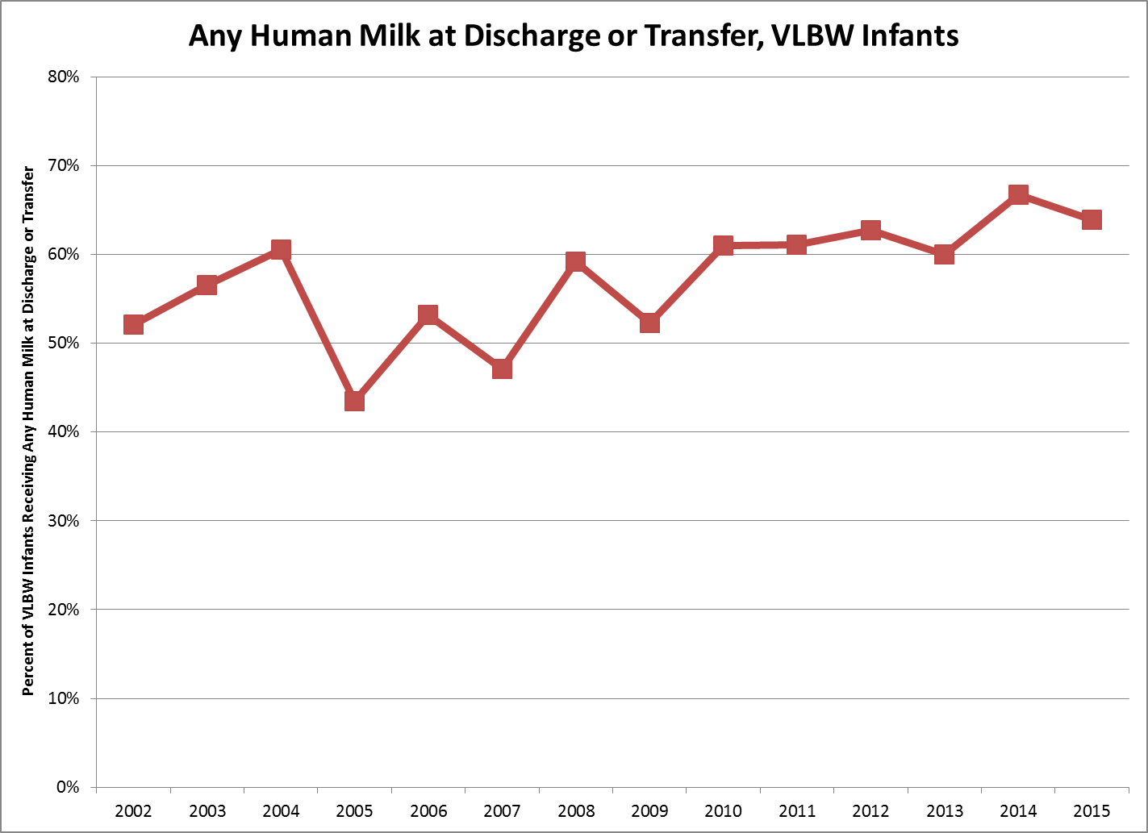

Slide 15
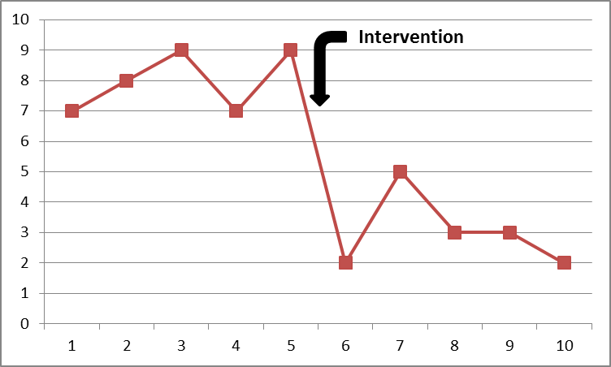
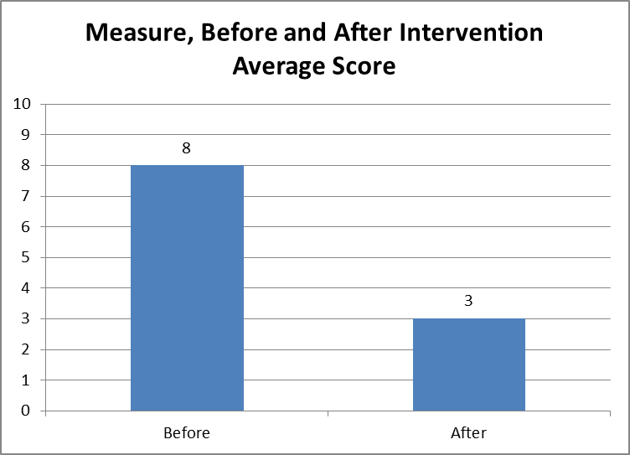
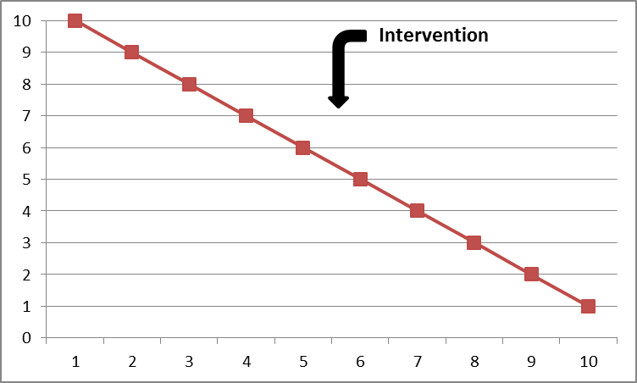
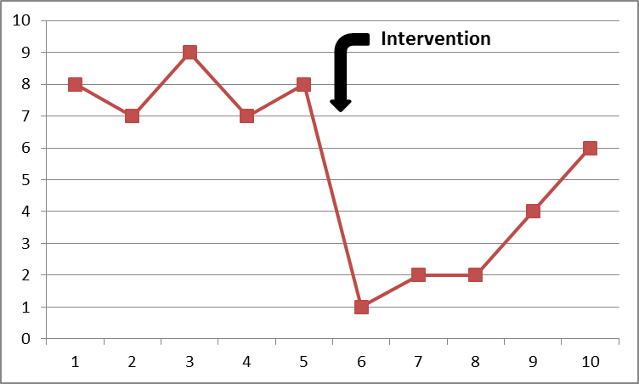
Why Important

Slide 16
Take Home Points
Measurement is critical for improvement.
Measurement over time is even better.

Slide 17
Key Driver Diagram
SMART Aims
Primary Drivers
Secondary Drivers/Interventions
Antenatal consultations
Education of families
More moms pumping
Process Measure: % of VLBW infants w/ first feeding of HM
Increase % of VLBW infants receiving HM at discharge
Human Milk Initiation
Mom’s pumping earlier
Process Measure: time to first use of HM for oral care
Outcome measure: % of VLBW infants receiving HM at discharge
Donor milk use
Human Milk Continuation
Skin-to-skin care
Process Measure: # of days held skin-to-skin in first month
Staff buy-in
Standardized advancement

Slide 18
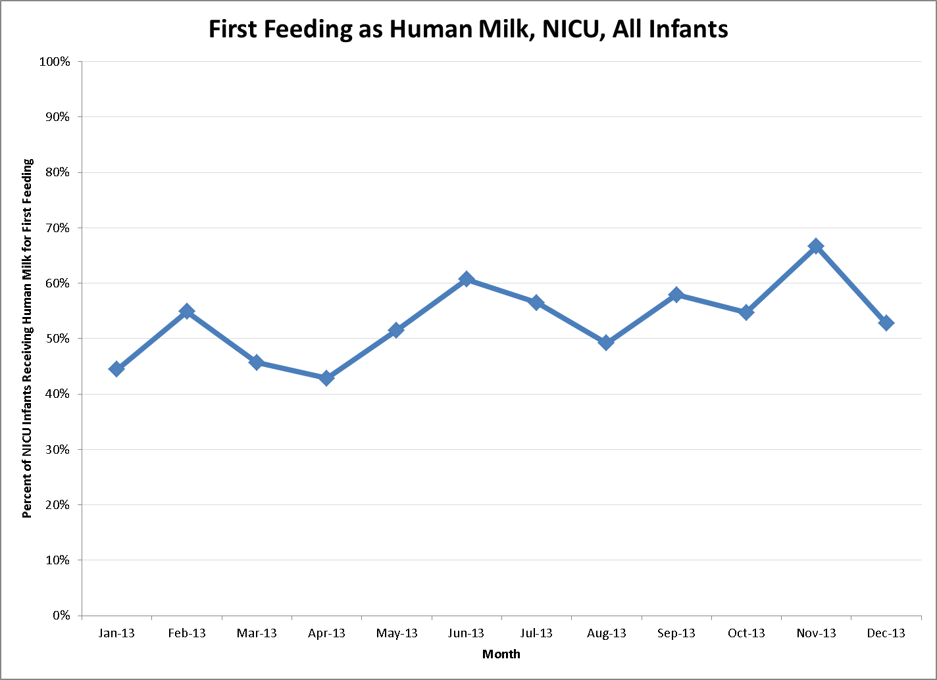
What’s good about this approach?
What’s missing?

Slide 19
Outline
Why data for QI is important
Data tools for QI in general
Data tools for QI collaboratives in particular
(examples from human milk along the way)

Slide 20
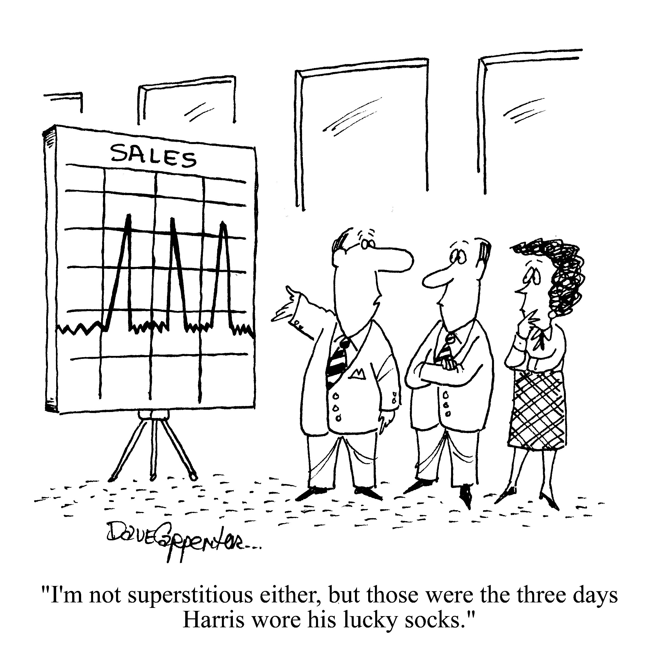
Statistical Process Control Theory

Slide 21
Statistical Process Control (SPC) and QI
Measurement over time critical for QI
But all things vary
Understand variation
Detect true change fast
SPC: tools to help interpret variation

Slide 22
Definitions
Common Cause Variation: Causes inherent as part of usual process (good or bad).
Special Cause Variation: Specific causes not part of usual process (good or bad).
Stable Process: Predictable variation within natural common cause bounds.
Unstable Process: Both special and common cause variation, variation unpredictable.
Notes:
Include examples – flipping a coin, time to get to work.

Slide 24
Special cause variation
Common cause variation

Slide 25
Why is this Important
Type of variation → type improvement action
Reduce unnatural variation
Establish stable work process
Special cause
Type of variation
Improve basic process
Improve overall outcomes
Common cause

Slide 26
SPC Tools for Measurement
Run charts – minimal standard
Control charts
Keys:
Plot and evaluate over time
Interpret visually and statistically

Slide 27
Run Charts

Slide 28
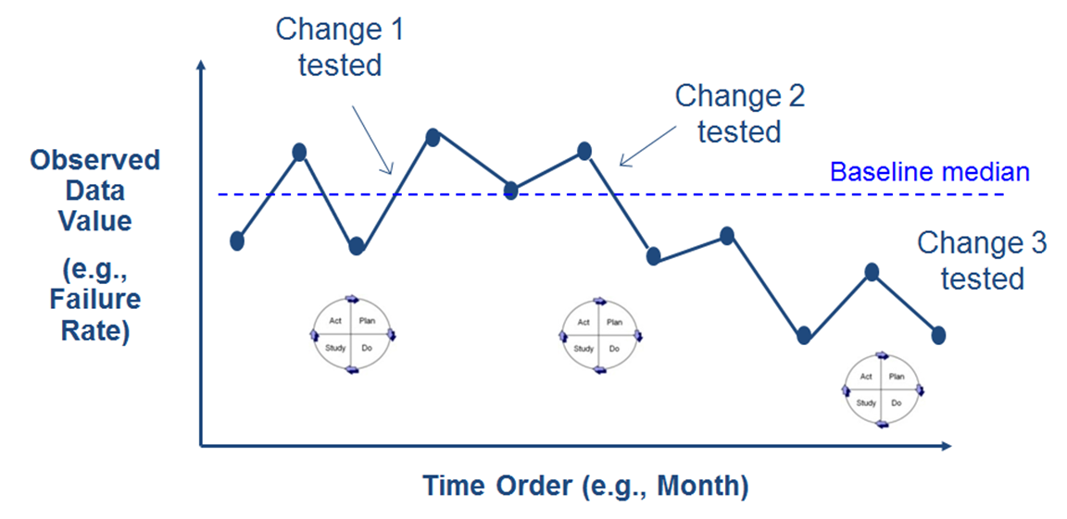
Run Charts
Visual display of data over time
Center line: median of data
Can include annotations

Slide 29
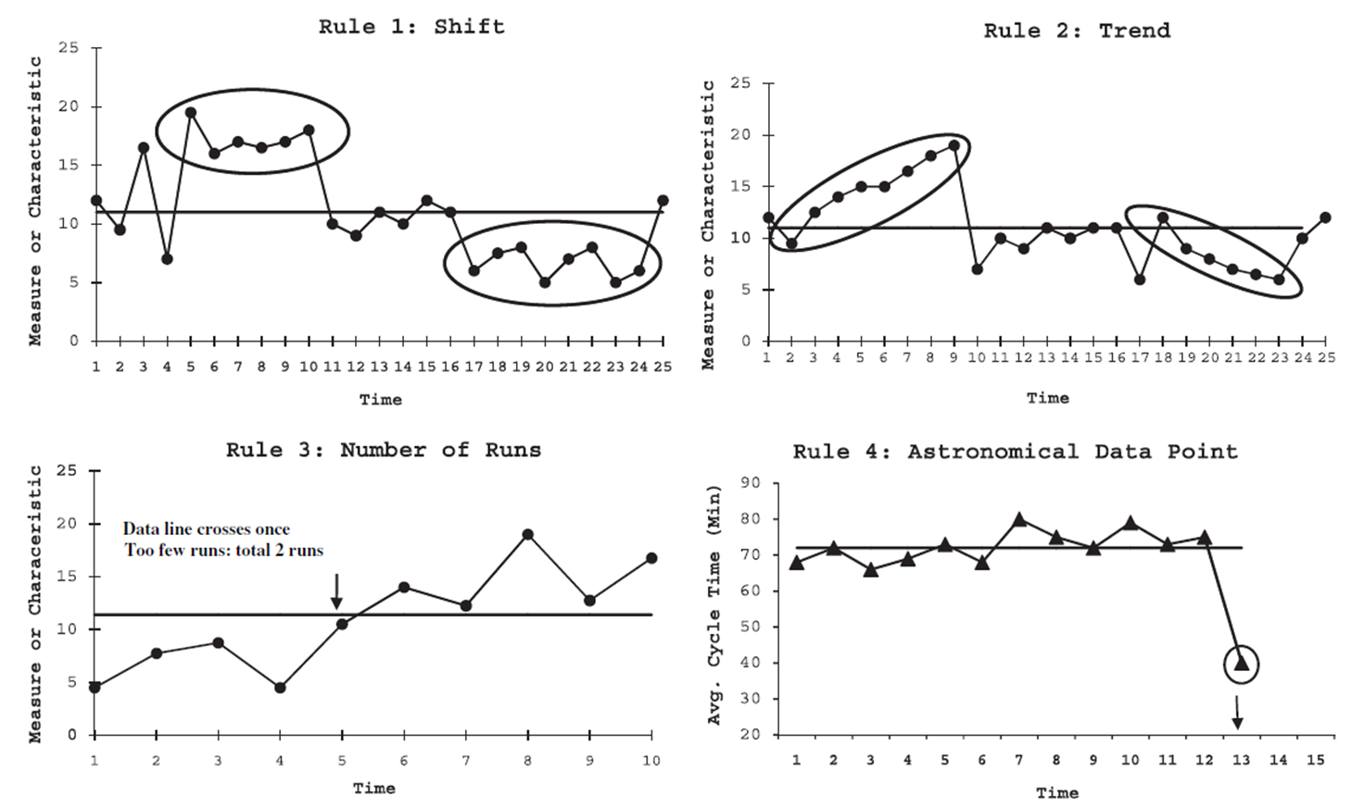
Interpreting Run Charts
≥ 6 points
≥ 5 points
Too many or too few
Perla et al, BMJ Qual Saf 2011; 20:46-51

Slide 30
Key Driver Diagram
SMART Aims
Primary Drivers
Secondary Drivers/Interventions
Antenatal consultations
Education of families
More moms pumping
Process Measure: % of VLBW infants w/ first feeding of HM
Increase % of VLBW infants receiving HM at discharge
Human Milk Initiation
Mom’s pumping earlier
Process Measure: time to first use of HM for oral care
Outcome measure: NEC rate per 100 VLBW days
Donor milk use
Human Milk Continuation
Skin-to-skin care
Process Measure: # of days held skin-to-skin in first month
Staff buy-in
Standardized advancement

Slide 32
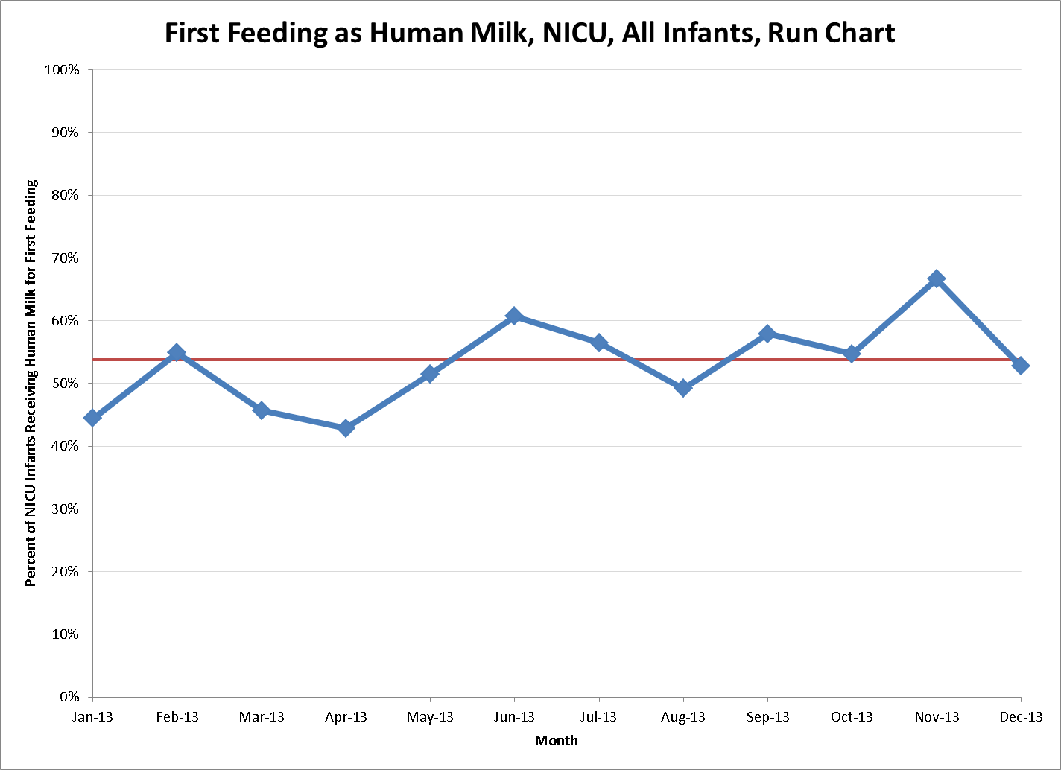

Slide 33
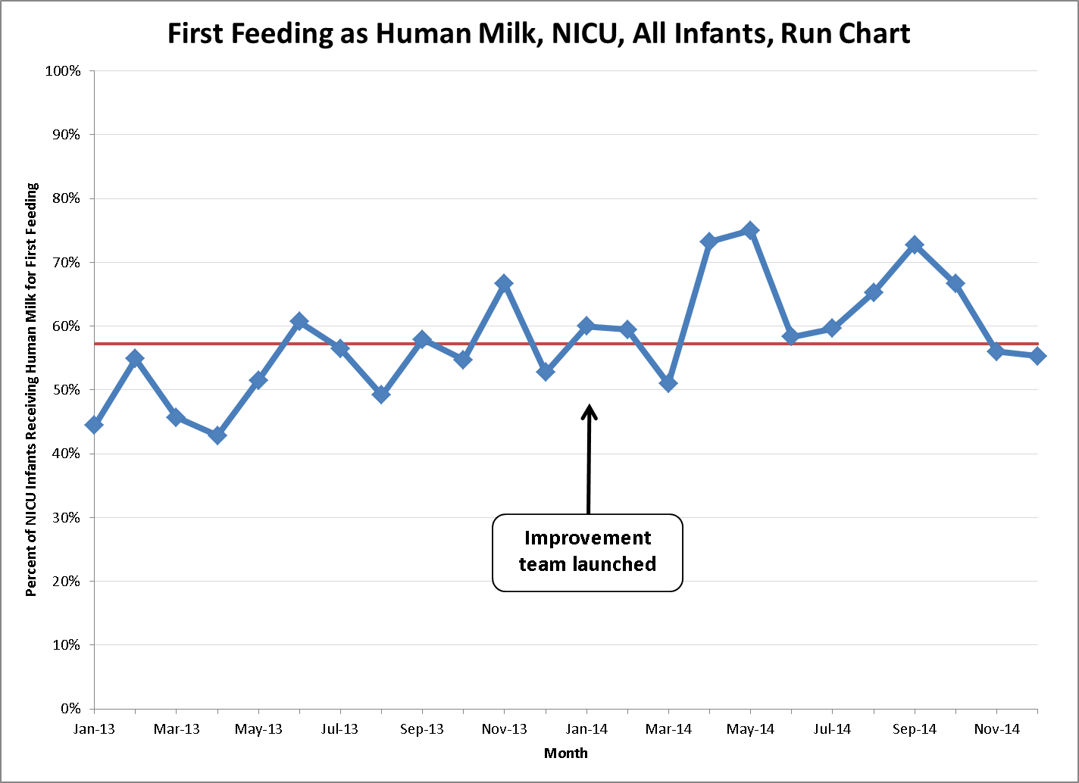

Slide 34
Run Charts
“Minimum standard” for QI project data
Can start with first few data points!
Need at least 10 data points to use ‘rules’
Simple to create (no software needed)
Can be used with all types of data
But… not as powerful as a control chart

Slide 35
Take Home Points
Measurement is critical for improvement.
Measurement over time is even better.
Minimum standard: run charts (annotated).

Slide 36
Control Charts

Slide 37

Control Charts
The Shewhart chart (a.k.a. control chart) is a statistical tool used to distinguish between common cause and special cause variation
Provost, LP and Murray S. The Health Care Data Guide. 2011

Slide 38
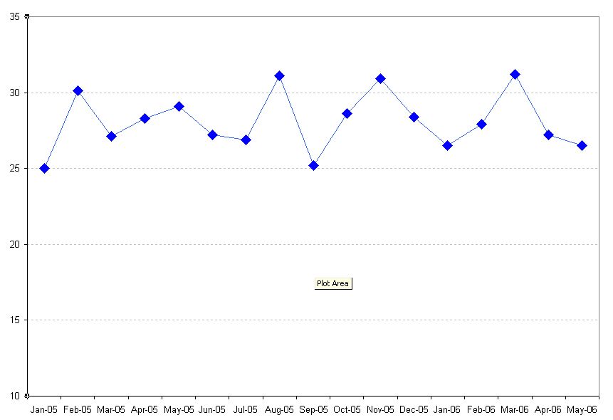
From Run Charts to Control Charts
A control chart is a run chart with some differences.
Upper Control Limit (UCL)
Run chart: Center line is the median.
Mean
Control chart: Center line is often the mean.
Value of Result
Lower Control Limit (LCL)
“Control limits” that reflect inherent variability in data – need to be calculated, but key to effectiveness
Unit of Time
(e.g. days, weeks, months, quarters)
Slides Courtesy of Yiscah Bracha, PhD. CCHMC

Slide 39
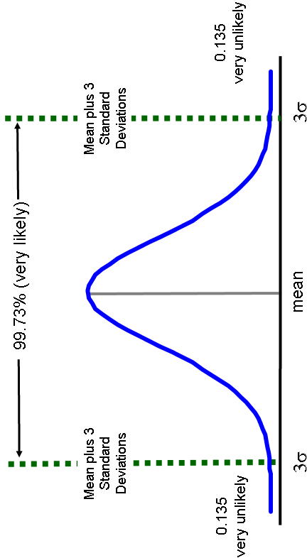
Relationship to Probability Theory

Slide 40
Constructing Control Charts
Type of data
Sample Size
Type of Chart
Math
(software)
Discrete (Integer) Data
Classification: Presence or not of an attribute
Count: How many attributes occur in sample
Continuous Data
Numerical value for each unit in a group

Slide 41
Types of Data & Control Charts
Type of Data | Example | Distribution | Control Chart
Discrete Classification | Any late infection | Binomial | P-chart
Discrete Count | Number of times skin-to-skin | Poisson | U-chart or C-chart
Continuous | Time to first pump | Normal | X-MR chart or Xbar-S chart

Slide 42
P-chart Calculations
Centerline = p-bar = Average of the Statistic
UCL = CL + 3 σ_{s}
LCL = CL - 3 σ_{s}
σ_{s} from the binomial distribution
Provost, LP and Murray S. The Health Care Data Guide. Slide courtesy of Terri Byczkowski, PhD, CCHMC

Slide 43
Which Control Chart To Use
Type of Data
Discrete / Attribute
(data is counted or classified)
Continuous / Variable
(data is measured on a scale)
Count
(events/errors are counted; numerator can be greater than denominator)
Classification
(each item is classified; numerator cannot be greater than denominator)
Subgroup size = 1
(each subgroup is single observation)
Subgroup size > 1
(each subgroup has multiple observations)
Equal or fixed area of opportunity
Unequal or variable area of opportunity
Equal or unequal subgroup size
X and MR charts
Individual measures and moving range
X-bar and S charts
Average and standard deviation
C chart
Count of events
U chart
Events per unit
P chart
Percent classified
Adapted from Provost & Murray, The Health Care Data Guide, 2011, and Carey, Improving Healthcare with Control Charts, 2003.

Slide 44
How to Interpret a Control Chart
Similar to run charts
Probability-based rules
Goal to detect non-random patterns
Rules designed to balance Type I and Type II errors

Slide 45
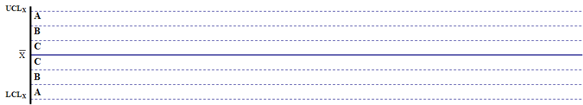
“Rules” for Detecting Special Cause
TEST 1:
1 point outside outer control limit
TEST 3:
4 out of 5 points more than 1 SD from center line
TEST 2:
2 out of 3 points more than 2 SD from center line
TEST 4:
Run of 8 points in a row on one side of center line
Notes:
Munish
Western Electric Run Rules
Talk about the rules in moderate detail
Key point – based on probability

Slide 46
“Rules” for Detecting Special Cause (2)
TEST 5:
Trend of 6 points in a row increasing or decreasing
TEST 6:
14 points in a row alternating up and down
Notes:
More Run Rules

Slide 47
Key Driver Diagram
SMART Aims
Primary Drivers
Secondary Drivers/Interventions
Antenatal consultations
Education of families
More moms pumping
Process Measure: % of VLBW infants w/ first feeding of HM
Increase % of VLBW infants receiving HM at discharge
Human Milk Initiation
Mom’s pumping earlier
Process Measure: time to first use of HM for oral care
Outcome measure: NEC rate per 100 VLBW days
Donor milk use
Human Milk Continuation
Skin-to-skin care
Process Measure: # of days held skin-to-skin in first month
Staff buy-in
Standardized advancement

Slide 49
Which Control Chart To Use
Measure: first feeding is human milk, yes or no
Type of Data
Discrete / Attribute
(data is counted or classified)
Continuous / Variable
(data is measured on a scale)
Count
(events/errors are counted; numerator can be greater than denominator)
Classification
(each item is classified; numerator cannot be greater than denominator)
Subgroup size = 1
(each subgroup is single observation)
Subgroup size > 1
(each subgroup has multiple observations)
Equal or fixed area of opportunity
Unequal or variable area of opportunity
Equal or unequal subgroup size
X and MR charts
Individual measures and moving range
X-bar and S charts
Average and standard deviation
C chart
Count of events
U chart
Events per unit
P chart
Percent classified
Adapted from Provost & Murray, The Health Care Data Guide, 2011, and Carey, Improving Healthcare with Control Charts, 2003.

Slide 50
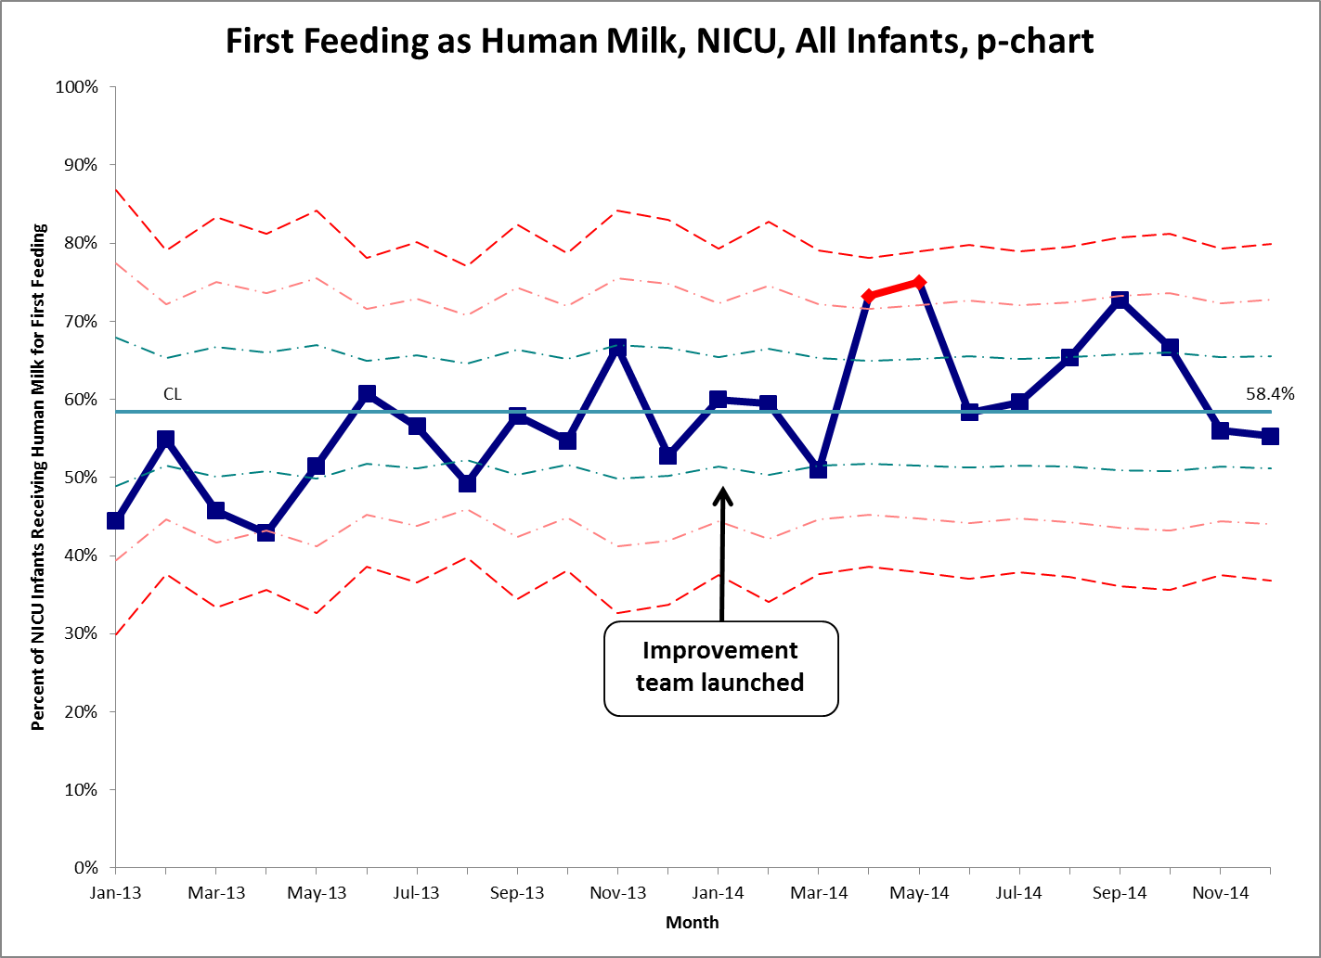

Slide 51
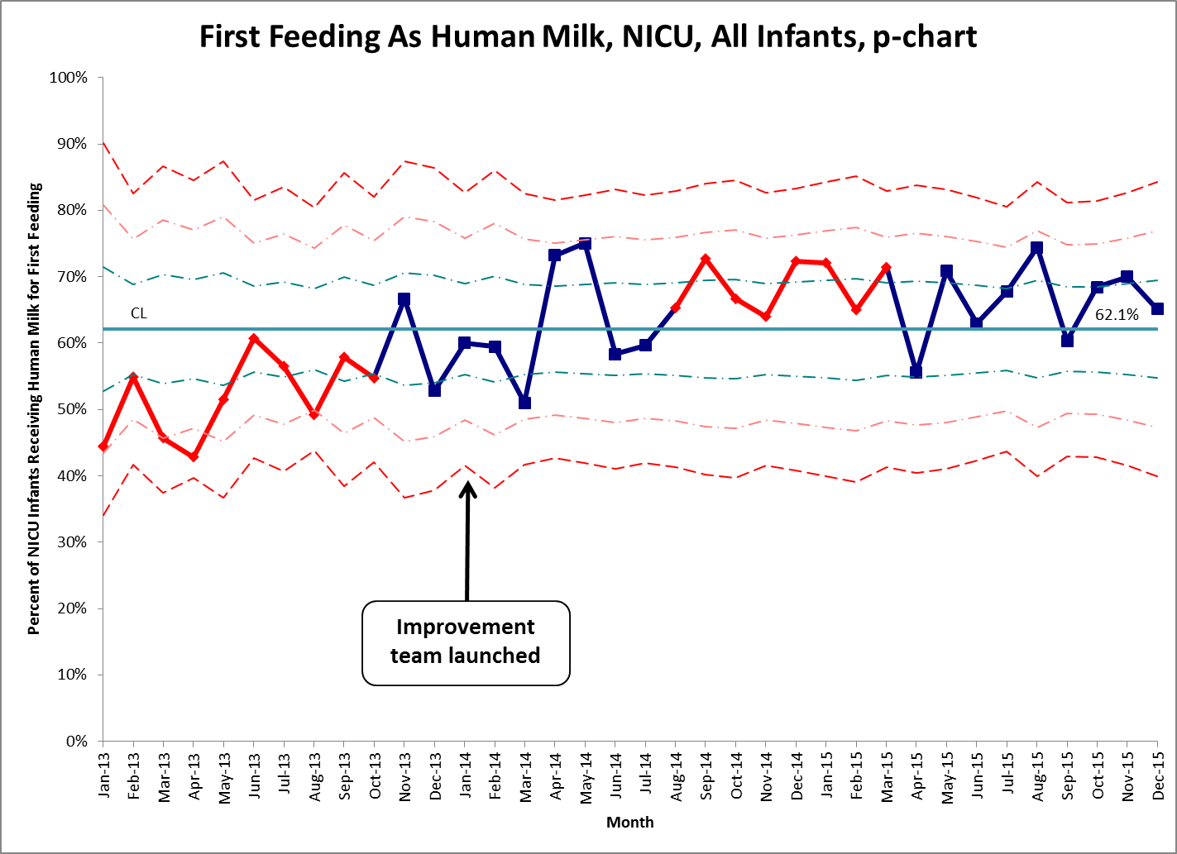

Slide 52
Why Control Charts Over Run Charts?
More sensitive / more powerful for detecting special cause
Estimate capability of a stable process → more accurately predict performance
But… more difficult to generate

Slide 53
The Goal: Standardize then Improve
Smaller is better
1
2
3
Unstable
process
Standard
process
Improved process
c/o J. Benneyan

Slide 54
Take Home Points
Measurement is critical for improvement.
Measurement over time is even better.
Minimum standard: run charts (annotated).
Control charts ideal, not easy but not hard.

Slide 55

Outline
Why data for QI is important
Data tools for QI in general
Data tools for QI collaboratives in particular
(examples from human milk along the way)

Slide 56

Benchmarking

Slide 58
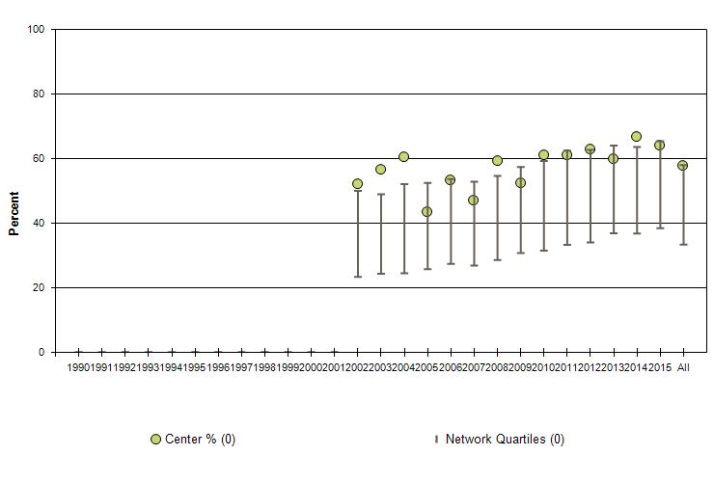
Any HM at Discharge or Transfer, VLBW Infants
Center Compared to VON Network

Slide 60
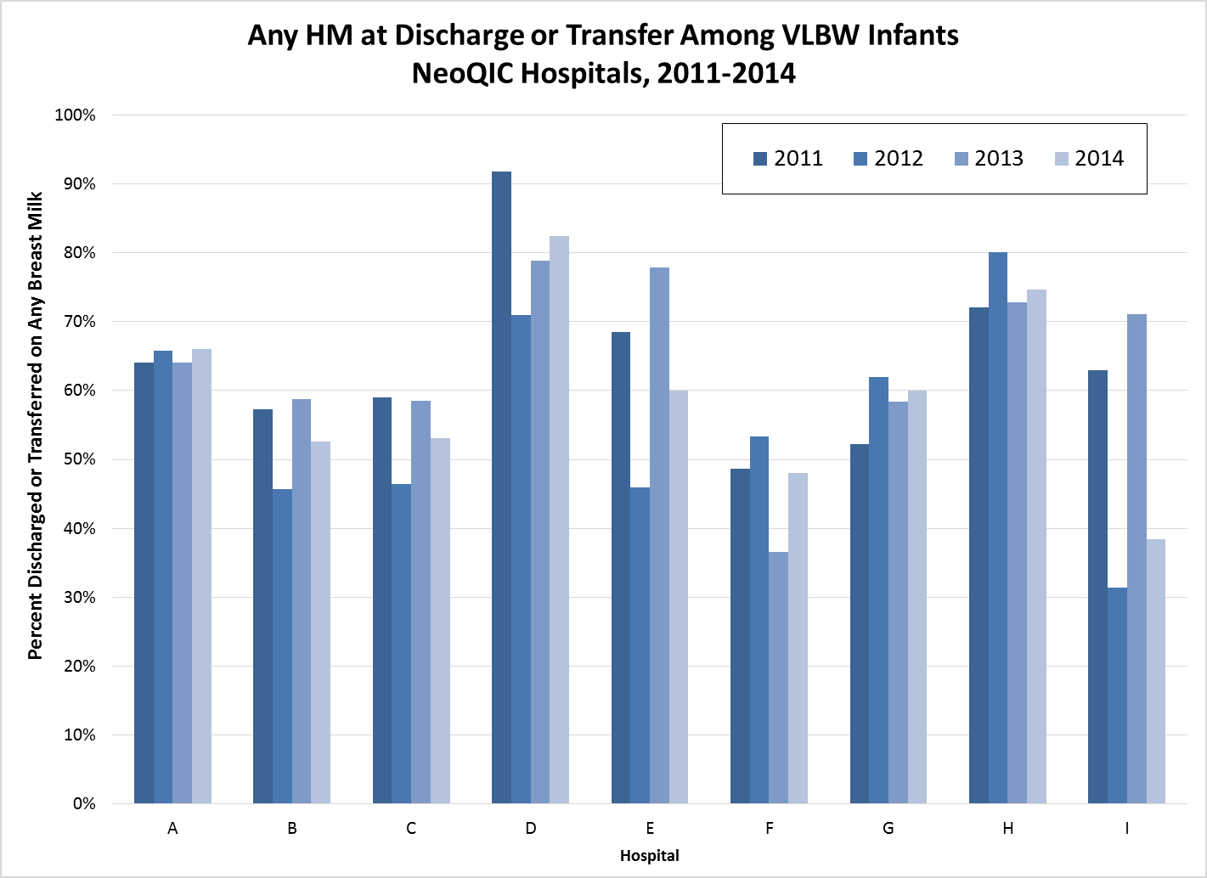

Slide 61
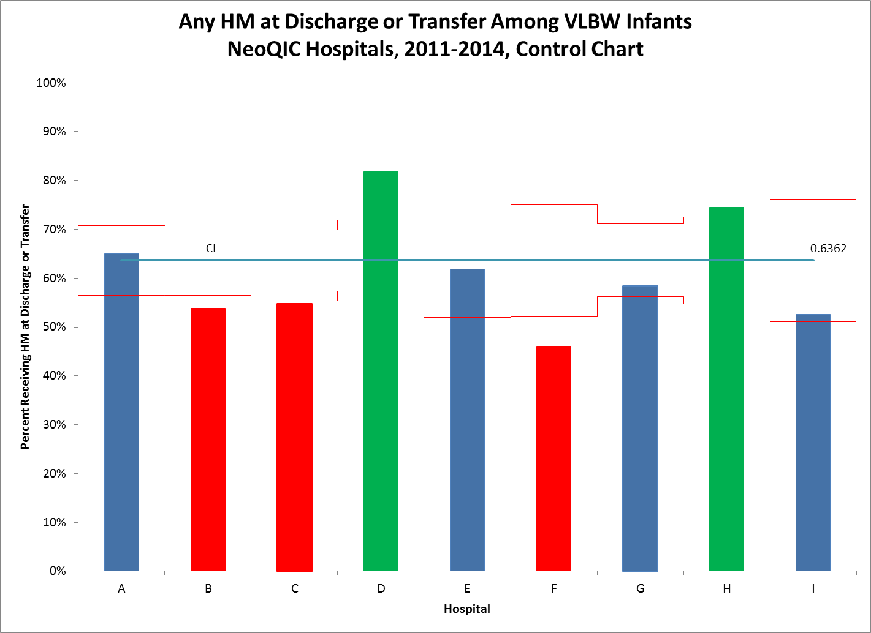

Slide 62
NeoQIC: Benchmarking
Use comparative data to:
Identify differences in outcomes and practices
Stimulate group discussion
Drive local improvement
Comparative, not competitive
Transparent

Slide 63
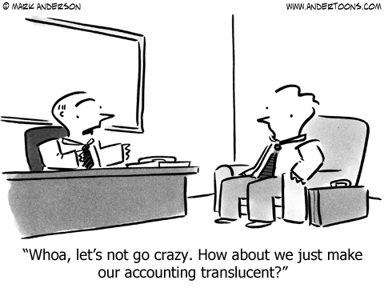

Slide 64
Benchmarking
My opinion:
Comparing yourself to national benchmarks is a great start, and important.
Comparing yourself to your state peers is much more compelling.

Slide 65
Take Home Points
Measurement is critical for improvement.
Measurement over time is even better.
Minimum standard: run charts (annotated).
Control charts ideal, not easy but not hard.
Comparative data can be super-effective.

Slide 66

Control Charts for Collaboratives

Slide 68
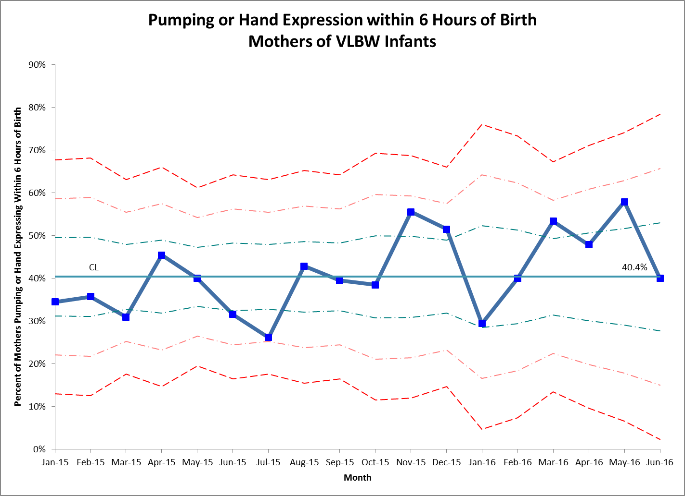

Slide 69
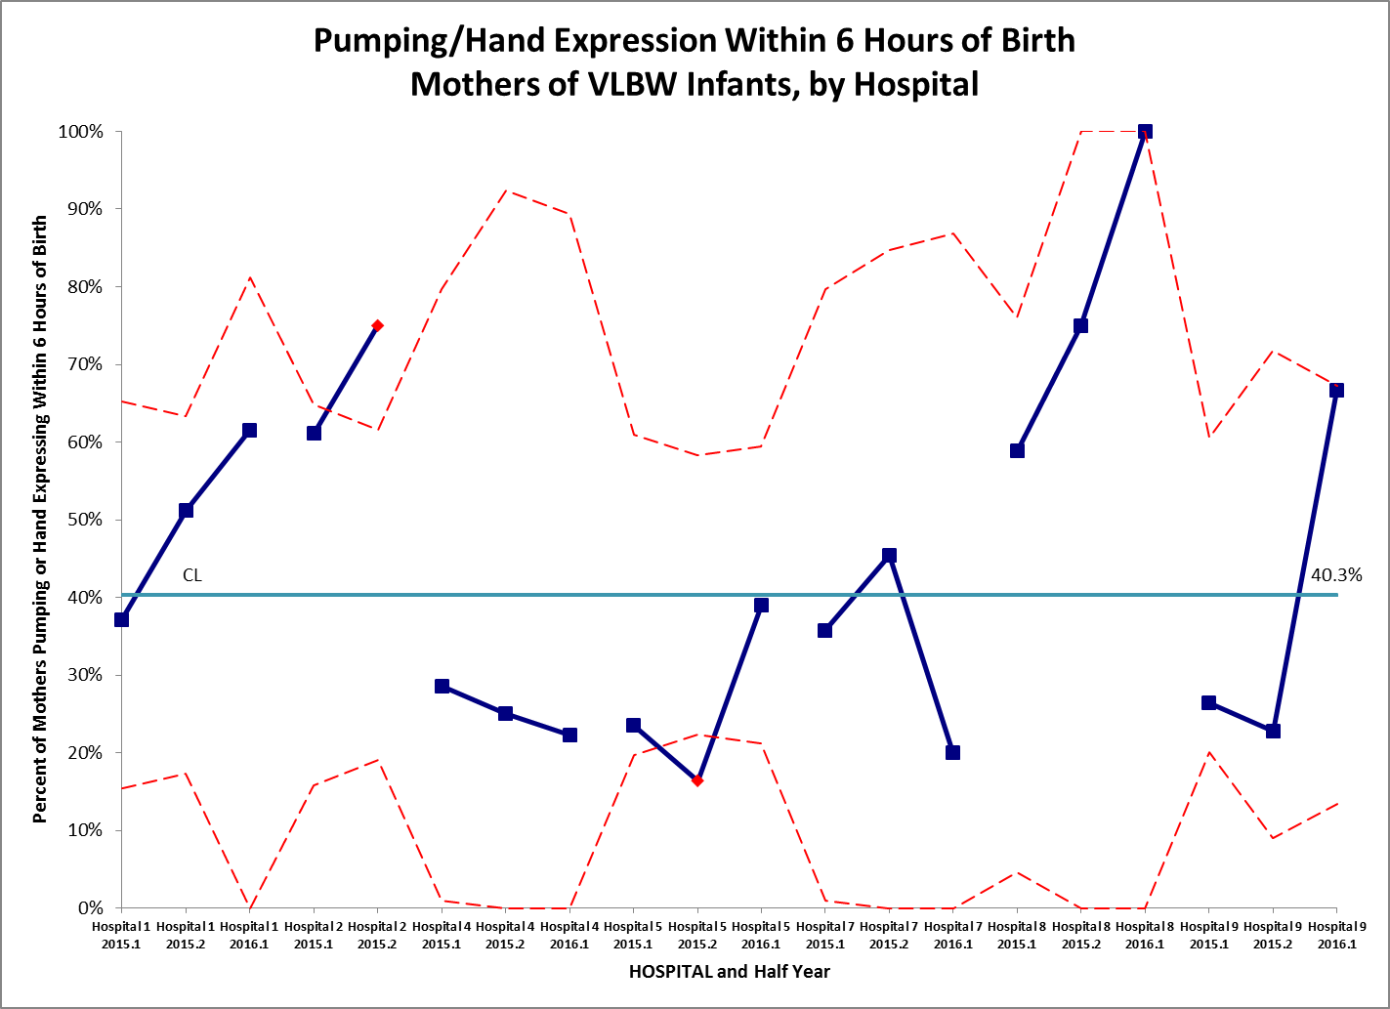
Hosp 1
Hosp 2
Hosp 4
Hosp 5
Hosp 7
Hosp 8
Hosp 9

Slide 70
Take Home Points
Measurement is critical for improvement.
Measurement over time is even better.
Minimum standard: run charts (annotated).
Control charts ideal, not easy but not hard.
Comparative data can be super-effective.
Can use stratified control charts for collaboratives!

Slide 71
Some Summary Thoughts
Data and measurement are at core of
quality improvement.
Use rigorous tools for data analysis (now).
Collaborative QI is really, really effective
(and kind of fun).
Try to feel comfortable sharing data, and
share it transparently.

Slide 72
Why This is Important

Slide 73

Why This is Important

Slide 74

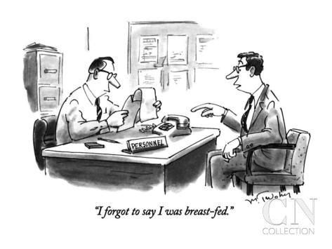
Thanks!

Slide 75
References
For more information on this topic, see the following publications:
Benneyan, J.C., R.C. Lloyd, and P.E. Plsek, Statistical process control as a tool for research and healthcare improvement. Qual Saf Health Care, 2003. 12(6): p. 458-64.
Benneyan, J.C., The design, selection, and performance of statistical control charts for healthcare process improvement. Int J Six Sigma and Competitive Advantage, 2008. 4(3):p.209-239.
Carey, R.G., Improving healthcare with control charts : basic and advanced SPC methods and case studies. 2003, Milwaukee, WI: ASQ Quality Press. xxiv, 194 p.
Langley, G.J., R.D. Moen, K.M. Nolan, T.W. Nolan, C.L. Normal, and L.P. Provost, The Improvement Guide. 2nd ed. 2009, San Francisco, CA: Jossey-Bass. 490 p.
Lee, K. and C. McGreevey, Using control charts to assess performance measurement data. Jt Comm J Qual Improv, 2002. 28(2): p. 90-101.
Lee, K.Y. and C. McGreevey, Using comparison charts to assess performance measurement data. Jt Comm J Qual Improv, 2002. 28(3): p. 129-38.
Perla, R.J., L.P. Provost, and S.K. Murray, The run chart: a simple analytical tool for learning from variation in healthcare processes. BMJ Qual Saf, 2011. 20(1): p. 46-51.
Provost, L.P. and S.K. Murray, The health care data guide : learning from data for improvement. 1st ed. 2011, San Francisco, CA: Jossey-Bass. 445 p.

Slide 76
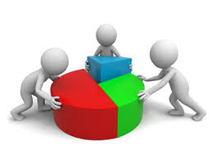
Supplemental Slides

Slide 77
Key Driver Diagram
SMART Aims
Primary Drivers
Secondary Drivers/Interventions
Antenatal consultations
Education of families
More moms pumping
Process Measure: % of VLBW infants w/ first feeding of HM
Increase % of VLBW infants receiving HM at discharge
Human Milk Initiation
Mom’s pumping earlier
Process Measure: time to first use of HM for oral care
Outcome measure: NEC rate per 100 VLBW days
Donor milk use
Human Milk Continuation
Skin-to-skin care
Process Measure: # of days held skin-to-skin in first month
Staff buy-in
Standardized advancement

Slide 78
Measure: Time to Oral Care with HM

Slide 79
Which Control Chart To Use
Measure: time to first use of human milk
Type of Data
Discrete / Attribute
(data is counted or classified)
Continuous / Variable
(data is measured on a scale)
Count
(events/errors are counted; numerator can be greater than denominator)
Classification
(each item is classified; numerator cannot be greater than denominator)
Subgroup size = 1
(each subgroup is single observation)
Subgroup size > 1
(each subgroup has multiple observations)
Equal or fixed area of opportunity
Unequal or variable area of opportunity
Equal or unequal subgroup size
X and MR charts
Individual measures and moving range
X-bar and S charts
Average and standard deviation
C chart
Count of events
U chart
Events per unit
P chart
Percent classified
Adapted from Provost & Murray, The Health Care Data Guide, 2011, and Carey, Improving Healthcare with Control Charts, 2003.

Slide 80
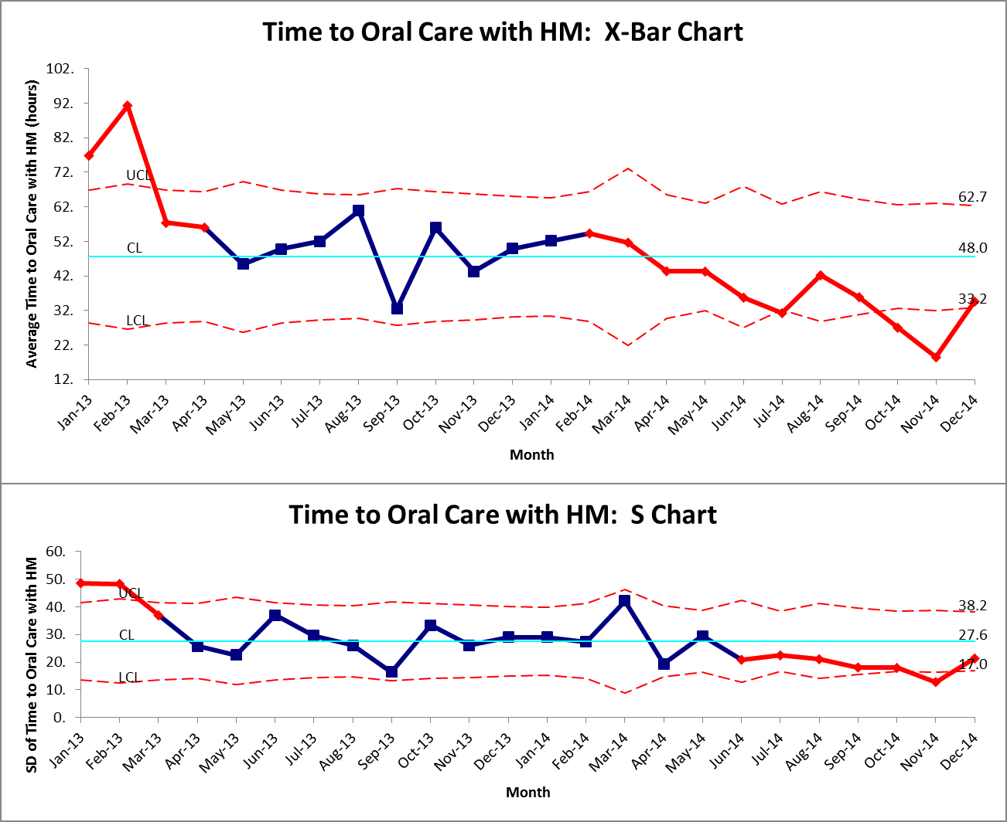

Slide 81
Why two charts (Xbar & S)?
2 types of possible process changes (unnatural variation)
Mean or standard deviation
Either can change without the other
One chart to detect each type of change
Change in mean
Change in SD
Notes:
I like this…we should add to the AAP presentation

Slide 83
Data Sharing
Data sharing → core of collaborative QI
Transparency ideal, when possible
Sharing summary data – e.g., annual rates – has value, and is fairly easy
Sharing more detailed, patient level data, will likely be necessary, and is a bit more complex

Slide 84
Patient-level Data Sharing
IRB issues
Data protection
Vehicles for data sharing -- REDCap

Slide 85
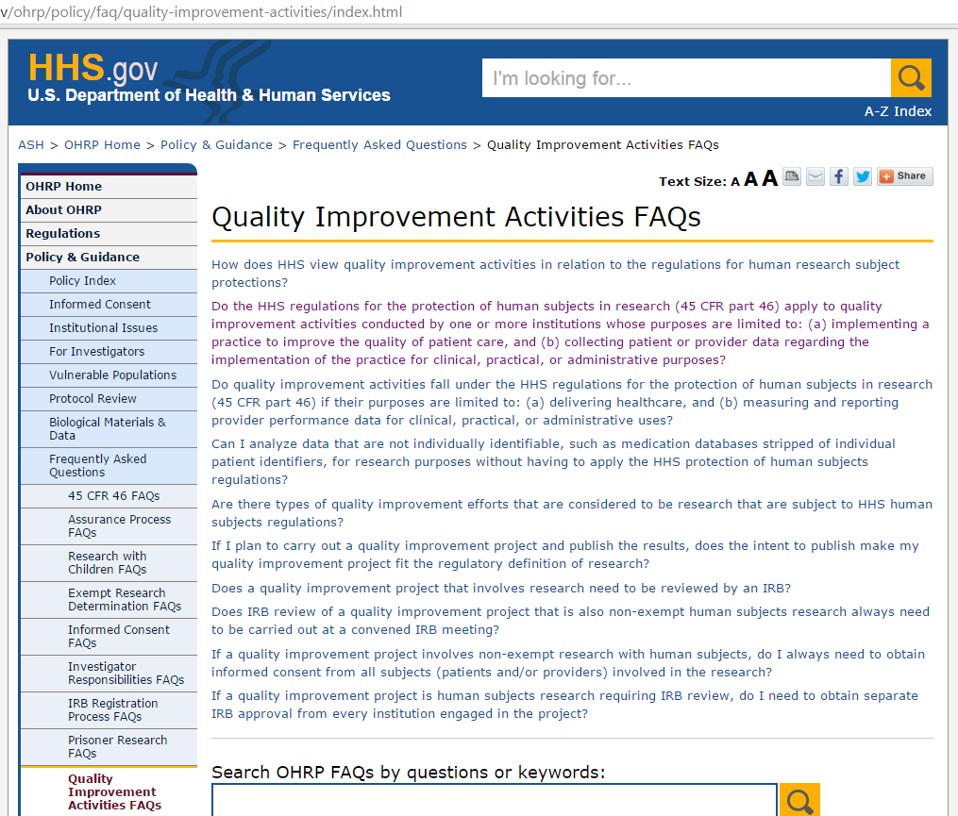
IRB Issues
http://www.hhs.gov/ohrp/policy/faq/quality-improvement-activities/index.html

Slide 86
Do the HHS regulations for the protection of human subjects in research (45 CFR part 46) apply to quality improvement activities conducted by one or more institutions whose purposes are limited to: (a) implementing a practice to improve the quality of patient care, and (b) collecting patient or provider data regarding the implementation of the practice for clinical, practical, or administrative purposes?
No, such activities do not satisfy the definition of “research” under 45 CFR 46.102(d), which is “…a systematic investigation, including research development, testing and evaluation, designed to develop or contribute to generalizable knowledge…” Therefore the HHS regulations for the protection of human subjects do not apply to such quality improvement activities, and there is no requirement under these regulations for such activities to undergo review by an IRB, or for these activities to be conducted with provider or patient informed consent.

Slide 87
IRB Issues
For quality improvement projects, IRB review is technically not needed. This includes collaborative QI.
Intending to publish does not make QI into research (and therefore does not mandate IRB review).
That being said, most centers feel most comfortable having their IRB be aware of collaborative QI projects, particularly when data sharing is involved.
Typically, projects are found to be exempt (or expedited review).

Slide 88
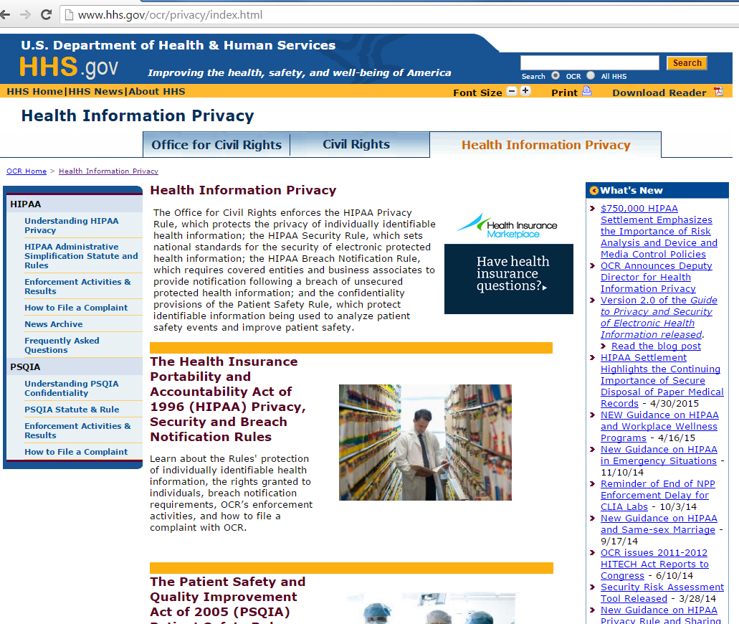
Data Sharing
http://www.hhs.gov/ocr/privacy/index.html

Slide 89
Data Sharing
Sharing of completely de-identified data technically allowable for health care operations.
Sharing of identified data requires a Business Associates Agreement, which is fairly complex.
Sharing of a limited data set requires a Data Use Agreement, which is generally more straightforward and follows standard language.
Limited data set: can include dates, ages, zip codes.
Data use agreement generally drafted by compliance or legal department of receiving institution, and reviewed by submitting institution.

Slide 90
If the only protected health information a business associate receives is a limited data set, does the HIPAA Privacy Rule require the covered entity to enter into both a business associate agreement and data use agreement with the business associate?
No. Where a covered entity discloses only a limited data set to a business associate for the business associate to carry out a health care operations function, the covered entity satisfies the Rule’s requirements that it obtain satisfactory assurances from its business associate with the data use agreement.
For example, where a State hospital association receives only limited data sets of protected health information from its member hospitals for the purposes of conducting and sharing comparative quality analyses with these hospitals, the member hospitals need only have data use agreements in place with the State hospital association.

