Slide 1
Safe Motherhood Initiative:
Standardizing Care for Mothers in New York and Beyond
Mary E. D’Alton, M.D.
Willard C. Rappleye Professor and Chair,
Department of Obstetrics & Gynecology
Columbia University College of Physicians & Surgeons

Slide 2
Disclosure
Dr. D’Alton is a member of the advisory board of Merck for Mothers.

Slide 3
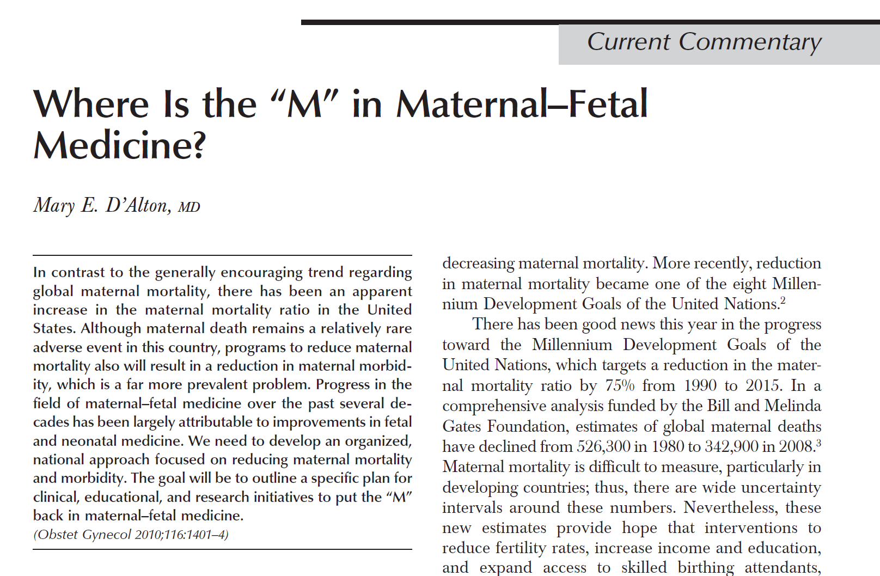
A Call to Action

Slide 4
Personal Case Presentation
34 yo G3P0020 at 33 weeks with Preterm PROM (2012)
  No significant medical or surgical history
  BP 126/78, HR 87, SpO2 99%, BMI 22
  Benign physical exam
    SSE visually 1cm dilated
  Betamethasone, latency antibiotics
  Hospital day 3, spontaneous preterm labor
  Arrest of dilation at 5cm
    Face presentation
  Primary LTCD without complication
    Intrapartum compression devices
    Male infant, Apgars 8/9
    EBL 800cc

Slide 5
Personal Case Presentation
Postoperative
  BP 110s-120s/60s-80s
  HR 70s-90s
  RR 15-18
  SpO2 97-99%
Postoperative DVT prophylaxis
  Sequential compression devices (SCDs)
  Early ambulation

Slide 6
Personal Case Presentation
Post-operative Day (POD) #1
  0800, Ambulating around the room
    HR 118/88, HR 93, RR 19, SpO2 97%
  0900, Acute chest pain, shortness of breath
  Patient unresponsive, without palpable pulse
  Medical response team called
    MFM, Cardiology, anesthesia at bedside
  CPR was performed, sinus rhythm was restored
  Transferred intubated to CCU
  Right heart failure on echo
  Patient never regained consciousness
  Cerebral edema, pupils fixed
On POD #9, support was removed

Slide 7
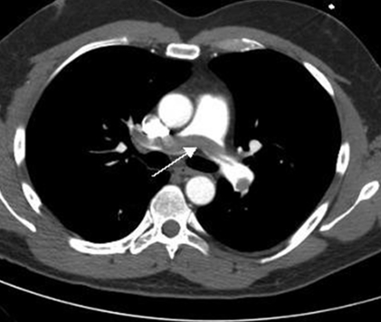
CT Angiogram

Slide 8
Personal Case Presentation
Was the standard of care met?
Current ACOG Guidelines:
  Perioperative mechanical thromboprophylaxis for all patients
  Pharmacological prophylaxis for:
    high-risk thrombophilias
    any prior VTE event
    family history of VTE and a thrombophilia
ACOG Practice Bulletin No. 123 (2011, Reaffirmed 2014)

Slide 9
ACOG Guidelines Rationale
Overall risk of postpartum VTE is very low (2.3 per 1,000)
Studies are small and underpowered to show a decreased risk of DVT or PE with anticoagulation
Risk of HIT, bleeding and wound infections
SCDs cost effective if incidence of post-cesarean VTE in the population was ≥6.8 per 1,000
Llindqvist et al. Obst Gynecol 1999; Gates et al AJOG 2004;
Burrows et al. BJOG 2001; Quinones et al. Obstet Gynecol 2005
Casele, Grobman. Obstet Gynecol 2006; Ferres et al. Obstet Gynecol 2011

Slide 10
Success in the UK
Guidance from RCOG supports broad, risk-factor based assessments for both antepartum and postpartum patients
Under RCOG criteria, women who have undergone cesarean birth and have any additional risk factors are likely to receive pharmacologic prophylaxis
Results of implementation:
  2003-2005: 1.94 deaths per 100,000 births
  2006-2008: 0.79 deaths per 100,000 births
  2011-2013: 1.01 deaths per 100,000 births
    Lower than any of the seven periods from 1985 to 2005

Slide 11
NewYork-Presbyterian/CUMC VTE Guidelines
October 2012, NYP issued new guidelines
Apply pneumatic compression devices prior to surgery
  Maintain until ambulatory
Anticoagulation
  Unfractionated Heparin
    5000 Units, subcutaneously, every 12 hours
    May be administered at any time interval after epidural catheter removal or spinal needle placement
    First dose given in PACU
  Low Molecular Weight Heparin
    First dose 6 hours post op
    Weight-based dosing
Promote early ambulation

Slide 12
What are we doing to reduce maternal mortality
and morbidity in a maternal population with an
increasing incidence of
chronic disease?

Slide 13
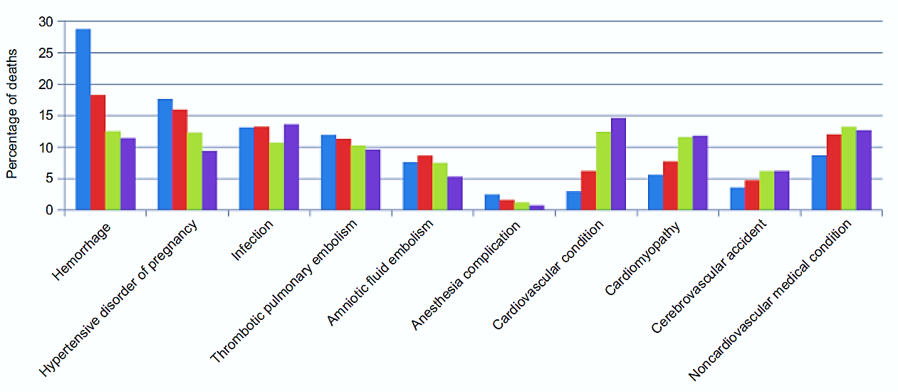

Pregnancy-related Mortality U.S. 1987-2010
Creanga AA, et al. Obstet Gynecol 2015;125:5–12.

Slide 14

The Burden of Maternal Morbidity
Reviewed Nationwide Inpatient Sample (ICD-9) for 1998-2009
Severe morbidity 12.9 per 1000 deliveries
  Increased by 75% and 114% for delivery and postpartum from 1998/99 to 2008/09
  Increase in shock, ARF, PE, RDS, Acute MI, blood transfusion, aneurysm, cardiac surgery
Overall mortality in postpartum period increased by 66%
Impacts >50,000 women each year
  Callaghan WM et al. Obstet Gynecol. 2012 Nov;120(5):1029-36.

Slide 15
Factors Increasing Maternal Mortality & Morbidity
Maternal age
Obesity
Cesarean delivery
More pregnancies in women with significant chronic medical conditions
  Hypertension
  Pregestational diabetes
  Congenital heart disease
  Organ transplant

Slide 16
Advances in Fetal and Neonatal Medicine
Prenatal diagnosis and screening programs
  Genetic disorders and congenital anomalies
Near eradication of Rh disease
Therapies for women at high risk for PTB
  steroids, antibiotics for PPROM, magnesium
Progesterone to decrease recurrent PTB
Reduction of stillbirth
Fetal therapy
  TTTS, NAIT, myelomeningocele

Slide 17
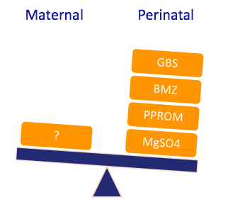
What are the protocols for maternal health?
ACOG Committee Opinion No. 485: Prevention of Early Onset Group B Streptococcal Disease in Newborns
ACOG Committee Opinion No. 475: Antenatal corticosteroid therapy for fetal maturation
ACOG Practice Bulletin No. 80: Premature rupture of membranes. Clinical management guidelines for obstetrician-gynecologists
ACOG Practice Bulletin No. 455: Magnesium Sulfate Before Anticipated Preterm Birth for Neuroprotection

Slide 18
Changes in Modern Obstetrical Practice
Significant decrease in rate of operative vaginal deliveries
Near-extinction of vaginal breech deliveries
Generalists and laborists managing labor and delivery
Increased reliance on medical subspecialists to manage chronic disease in pregnancy
Increased utilization of GYN oncologists to assist in complicated obstetrical surgery
13 MFMs currently certified in critical care

Slide 19
Lessons Learned from Reviews
Hemorrhagic death
  93% of all deaths were potentially preventable
  Lack of appropriate attention to clinical signs of hemorrhage
  Failure to restore blood volume, to act decisively with life saving interventions
Severe Hypertension
  60% of maternal deaths were potentially preventable
  Failure to control blood pressure, to recognize HELLP syndrome, to diagnosis and treat pulmonary edema
Pulmonary Embolism
  “single cause of death most amenable to reduction by systematic change in practice”
  Failure to use adequate prophylaxis
Berg CJ, et al. Obstet Gynecol 2005;106:1228-34
Cantwell R, et al. BJOG 2011 Mar;118 Suppl 1:1-203
Clark, SL. Semin Perinatol 2012;36(1):42-7

Slide 20
Narrative v. Evidence-based Medicine: And, Not Or
“Facts and figures are essential, but insufficient, to translate data and promote the acceptance of evidence-based practices and policies...”
Stories, when compared with statistical evidence, can have more impact and help to make sense of population-based evidence
Guideline developers must recognize the value of stories to explain the science of guidelines to:
  patients and families
  health care professionals
  policy makers
Meisel ZF, et al. JAMA 2011 Nov;306(18).

Slide 21
SMFM Meeting February 2012: Objectives
Organized, national approach to decrease maternal mortality and morbidity in the US
  Enhance the training in maternal care for residents and fellows
  Improve medical care and management of pregnant women
  Address the critical research gaps in maternal medicine
Putting the “M” back in maternal-fetal medicine. Am J Obstet Gynecol. 2013 Jun;208(6):442-8.

Slide 22
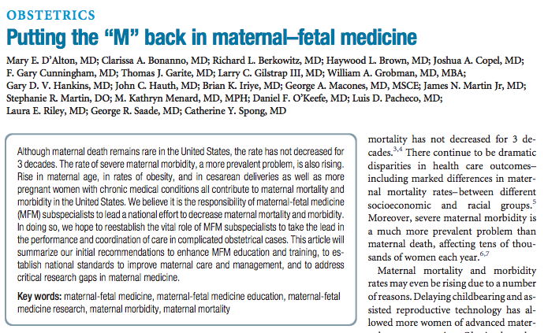
Setting the Course

Slide 23
Education Recommendations
Recommendation | Status
1. Modifications to MFM Fellowship Requirements Increase time requirements for clinical rotations during fellowship Include formal rotations on L&D/inpatient service Include formal rotations in intensive care unit | Complete
2. Encourage use of simulation and case-based learning in MFM fellowship | Complete
3. Require active certification in ACLS for MFM fellows
4. Develop in-service examination for MFM fellows
5. Expand leadership training for MFM fellows | In progress

Slide 24
Critical Care in Obstetrics:
An innovative and integrative learning model
Increase in simulation and case-based learning methodologies
- D’Alton ME, et al. Am J Obstet Gynecol. 2013 Jun;208(6):442-8.
SMFM Planning Committee
Mike Foley, Director | Shad Deering, Co-Director
Helen Feltovich, Co-Director | Bill Goodnight, Co-Director
Loralei Thornburg, Content Co-Chair | Deirdre Lyell, Content Co-Chair
Suneet Chauhan, Testing Chair | Mary D’Alton
Daniel O’Keeffe | Andrew Satin
Barbara Shaw

Slide 25
Clinical Care Recommendations
Recommendation | Status
1. Establish national, stratified system for levels of maternal care | Complete
2. Develop specific, prospective guidelines on complications associated with highest maternal morbidity and mortality | Complete
3. Increase departmental and divisional support for MFM subspecialists with maternal focus | In progress
4. Improve skills in coding and reimbursement for maternal care | In progress
5. Provide for academic advancement for MFM inpatient directorships | In progress
6. Develop models for comprehensive antenatal care for mothers with chronic or acute complications | In progress

Slide 26
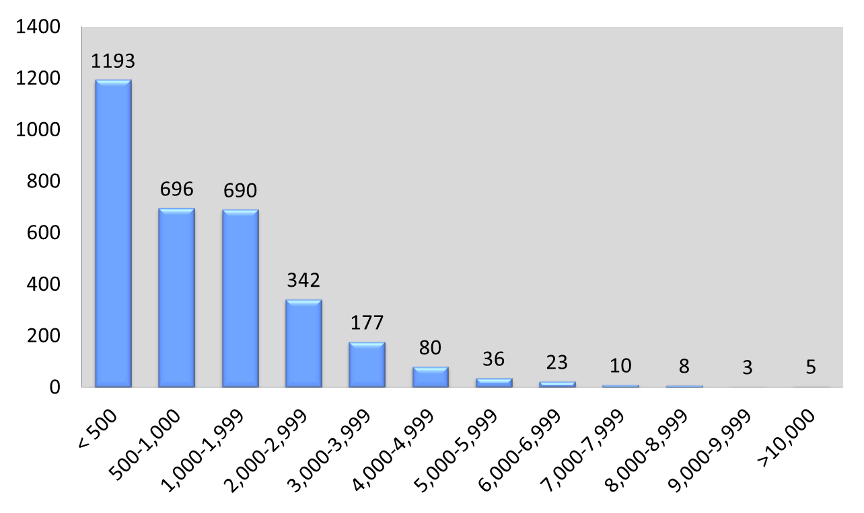
Annual Birth Volume in U.S. Hospitals, 2008
NUMBERS OF HOSPITALS
n = 3,265
Simpson KR, JOGNN 40, 2011.

Slide 27
Models of Care for the “M” in MFM
“Develop models for comprehensive, antenatal care for mothers with chronic or acute medical complications.”
- D’Alton, et al. Am J Obstet Gynecol. 2013; 208:442-8
Formally recognize the subspecialty of obstetric physicians. Train and increase their numbers.
- Nelson-Piercy C, et al. BMJ. Editorial 2011, V. 343
MFM subspecialists work with teams of expert physicians and midwives in multidisciplinary clinics at Tertiary centers.
-Kilby MD, Response to Editorial, BMJ 2011; 343:d4993
"Before calling for increased training we should look at the training already in place. There would appear to be plenty of room for improvement.”
- David R. Hogg GP, Response to Editorial, BMJ 2011; 43:d4993

Slide 28

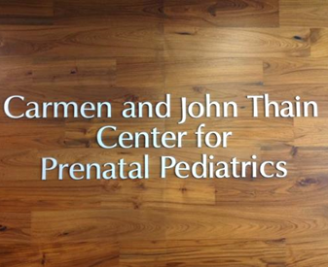
Center for Prenatal Pediatrics
January 2004 - Established virtual center
January 2011 - Carmen and John Thain Center opened
Program dedicated to the care of pregnant women and their families after a significant birth defect is identified
Multidisciplinary integration of all services with close collaboration between prenatal and pediatric specialists
6072 cases referred
  27% for Congenital Heart Disease (CHD)

Slide 29
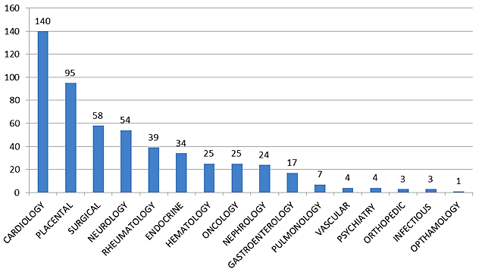

The Mothers Center
Provides comprehensive, multidisciplinary care to medically and surgically complicated pregnant women
Collaboration with cardiology, neurology, anesthesiology and others
Over 550 patients have been referred since October 2013
A center where the vision to put the “M” back in MFM is the top priority

Slide 30
Research Recommendations
Recommendation | Status
1. Developing standardized methods for national surveillance of maternal mortality and morbidity | In progress
2. Defining significant maternal morbidity and “near misses” | Complete
3. Prediction of patient’s risk of maternal mortality and severe morbidity | In progress
4. Determining optimal timing of delivery to balance maternal, fetal, and neonatal risks | In progress
5. Economic analyses to show benefit of maternal care, including interpregnancy and postdelivery care, as well as improvement in neonatal outcome
6. Effectiveness of various approaches to improve training in maternal medicine | In progress
7. Research on impact of adverse pregnancy outcomes on long-term maternal health | In progress

Slide 31
Severe Maternal Morbidity
Define significant maternal morbidity and “near misses”
All hospitals should identify women who:
  Are admitted to an ICU during pregnancy (3-4 per 1000 deliveries)
  Have been transfused with ≥4 units of blood (2 per 1000 deliveries)
Not meant to discourage an individual site to use additional clinical criteria to define morbidity
Cases of SMM should be reviewed for ongoing quality improvement
‘We believe they will serve as a good starting point’
You WB, et al. Am J Perinatol 2013;30:21-4
Wanderer JP, et al. Crit Care Med 2013;41:1844-52
Callaghan WM, et al. Obstet Gynecol. 2014 May;123(5):978-981
D’Alton ME, et al. Am J Obstet Gynecol. 2013 Jun;208(6):442-8

Slide 32
Progress since 2012
Title | Journal/Date
Putting the "M" back in maternal-fetal medicine | Am J Obstet Gynecol. 2013 Jun
The National Partnership for Maternal Safety | Obstet Gynecol. 2014 May
Facility-based identification of women with severe maternal morbidity: it is time to start | Obstet Gynecol. 2014 May
Standardized severe maternal morbidity review: rationale and process | Obstet Gynecol. 2014 Aug
The maternal early warning criteria: a proposal from the national partnership for maternal safety. | Obstet Gynecol. 2014 Oct
Center of excellence for placenta accreta | Am J Obstet Gynecol. 2014 Nov
Obstetric Care Consensus: Levels of Maternal Care | Am J Obstet Gynecol. 2015 Feb
National Partnership for Maternal Safety: Consensus Bundle on Obstetric Hemorrhage | Obstet Gynecol. 2016 July
New York’s Safe Motherhood Initiative: A Collaborative Effort | Semin Perinatol. 2016 Mar
National Partnership for Maternal Safety: Consensus Bundle on Venous Thromboembolism. | Obstet Gynecol. 2016 Oct

Slide 33
Maternal Mortality in New York State
Currently at 18.9 per 100,000 live births
  Ranks 46th among 50 states
  4 states with higher rates - Oklahoma, Mississippi, Michigan, Georgia
Peaked at 29.2 per 100,000 live births in 2008
Decreased to 22.4 per 100,000 live births in 2010
Decreased to 17.9 per 100,000 live births in 2013
Still over 1.5x higher than the Healthy People 2020 objective of 11.4 per 100,000 live births
*http://hrc.nwlc.org/status-indicators/maternal-mortality-rate-100000 (Accessed 10/10/2016)

Slide 34
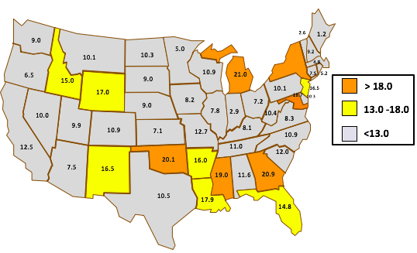
Maternal Mortality per 100,000 Liveborn Births
3.2
18.9
13.9
Source: NLWC from Center for Disease Control and Prevention, National Center for Health Statistics 1999-2006

Slide 35
Birth Volume NYS Hospitals, 2012
49 Level 1
26 Level 2
35 Level 3
18 RPCs

Slide 36


Reducing Maternal Mortality in NYS
Safe Motherhood Initiative (SMI)
  Support from Merck for Mothers
First working group met January 2013
Consensus driven and multidisciplinary
Implementation of standardized care management plans for 3 leading causes of maternal mortality & morbidity:
  Hemorrhage
  Severe hypertension
  Venous thromboembolism

Slide 37
Safe Motherhood Initiative Bundle Development
Working groups developed safety bundles for Hem, HTN, VTE
Bundles presented and revised during multiple phone calls and in-person meetings
Monthly data collection to assess process and outcomes
Support resources developed: SMI Website, Educational Videos and Print materials
Implementation site visits and grand rounds presentations from ACOG representatives

Slide 38
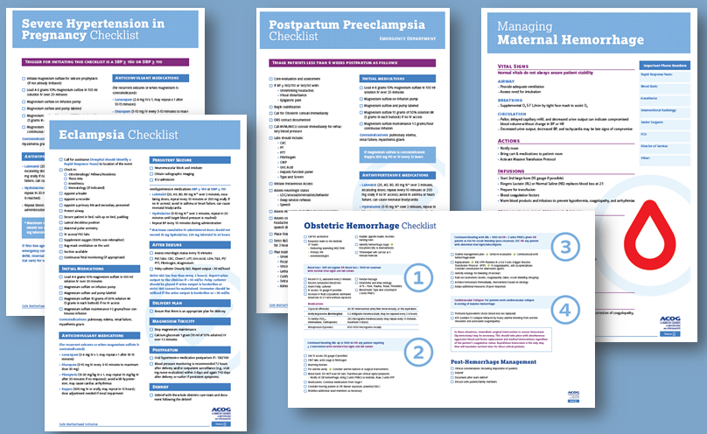
Obstetric Bundle Composition
PowerPoint slide decks w/ implementation guidance
Visual aids: posters, brochures
Checklists
Algorithms
Risk assessment tables
Medication dosing tables
Debriefing forms
http://www.acog.org/About_ACOG/ACOG_Districts/District_II/Safe_Motherhood_Initiative

Slide 39
The 4 R’s: Readiness, Recognition, Response, Reporting
Standardization
Multidisciplinary engagement
Culture assessment

Slide 40

Bundle Implementation Support
Online and print materials
Educational videos
Clinical simulations & assessment guides
Implementation visits
93% of NYS hospitals engaged in implementation
Grand Rounds
Quarterly meetings
Monthly conference calls
Updated FAQ
Notes:
Implementation is supported by monthly conf calls, site visits , exchange of “best practices” during our quarterly mtgs etc
Several resources were distributed and are available through the ACOG DII website to provide implementation support.
A clinical FAQ was just developed which consists of a compilation of questions and answers that have been submitted over the course of the project. The questions range from implementation inquires to specifics on data collection. The FAQ is meant to assist others who may have similar questions.
Additional print materials for all three bundles are available for purchase.
An educational video was developed and is posted on the District II website. The video walks through all three care management plans.

Slide 41

Quarterly Meetings
2016
October: Annual District Mtg in New York 115+
January: Maimonides Medical Center: 95+
2015
October: Annual District Mtg, New York 100+
July: Skidmore College 105+
April: Univ. at Buffalo, SUNY 65+
January: Harlem Hospital Center 120+
2014
Annual District Mtg in New York 115+
Albany Medical Center 95+
SUNY Upstate Medical Univ. 75+
Hofstra Univ. 65+
2013
Annual District Mtg, New York 60+
Malta, NY 50+
Montefiore Medical Ctr. 50+
Columbia University 45+
Notes:
Much of our work was completed during in-person quarterly mtgs
To date, we have conducted 10 in-person meetings since 2013 at various hospital sites across New York State . Attendance at each meeting continues to grow.
We also continue to host monthly conference calls with all participating facilities.
Monthly SMI conference call topics range from:
-strategies to reduce the 3 leading causes of maternal morbidity & mortality – hemorrhage, severe hypertension, and VTE;
-emerging challenges in implementing this initiative statewide;
-effective approaches to data collection; and,
-other relevant topics such as de-identified case presentations and opportunities to ask targeted clinical questions.

Slide 42
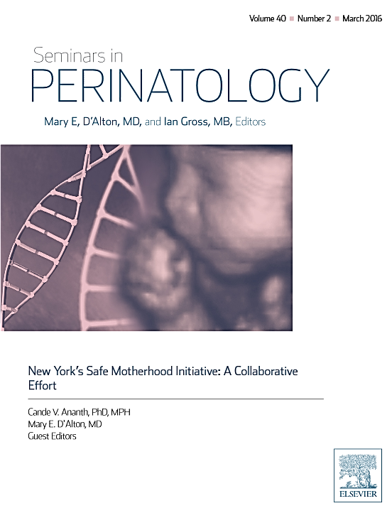
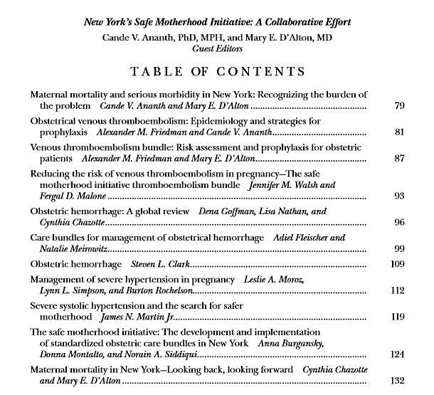

Slide 43
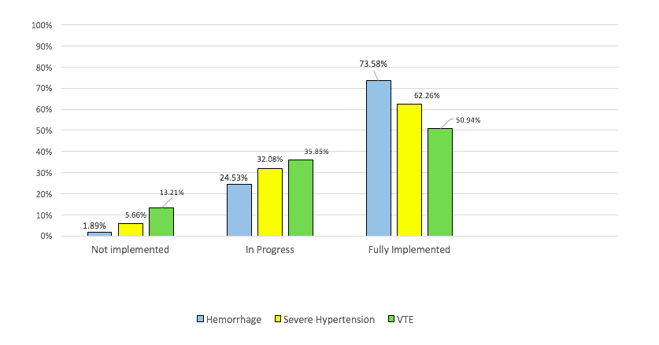
SMI Implementation Report (Phase 1) - 2016

Slide 44
Feedback from SMI Hospitals
“Better data”
“Better integration of EMRs”
“Revise checklists for ease of use”
“Change takes a long time”
“Would love to continue the networking”
“Quarterly meetings were tremendously valuable”
“Believe sharing lessons learned was invaluable”
“Have more site visits”
“I would continue until we are fully implemented and sustained”

Slide 45
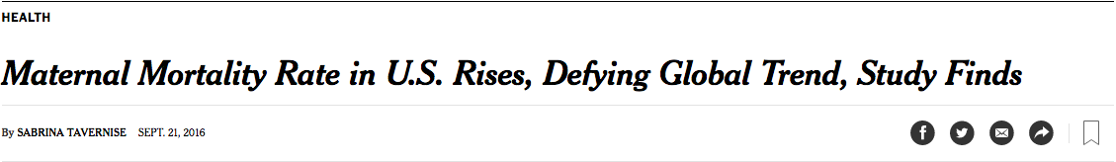



A National Conversation . . . Finally!

Slide 46
Reflections
Recognition took too long nationally, regionally and locally
Collaboration at all levels is key and rewarding
Enormous progress has been made in 4 years to keep mothers safe
Too many mothers still experience preventable harm and suboptimal outcomes
Reviews and a sense of narrative are an essential key to further reducing maternal mortality and morbidity
However…

Slide 47
Safe Motherhood Initiative:
Standardizing Care for Mothers in New York and Beyond
Mary E. D’Alton, M.D.
Willard C. Rappleye Professor and Chair,
Department of Obstetrics & Gynecology
Columbia University College of Physicians & Surgeons

