Slide 1
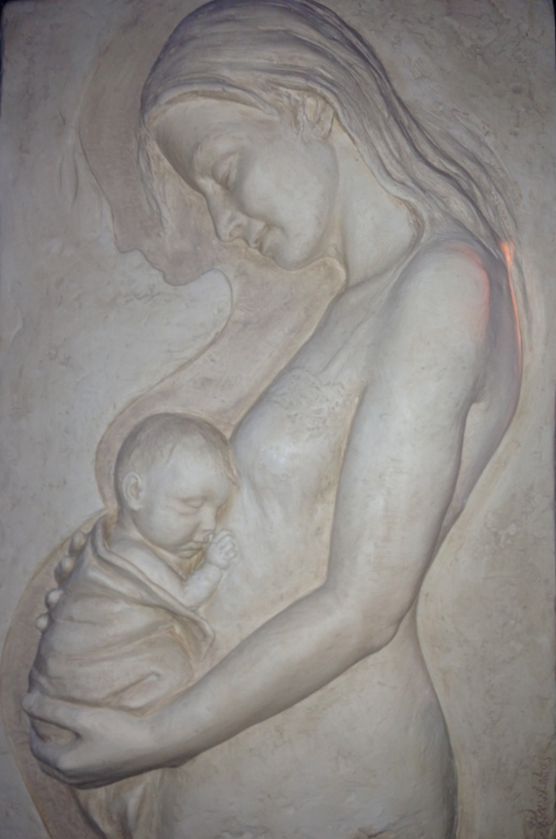



Surviving a Perinatal Crisis: The Patient Perspective
“Embracing Hope”
Artist: Ellen Pavlakos
@Eleni_Z_Tsigas
November 3, 2016
4th Annual Conference

Slide 2

Learning Objectives:
Incorporate education tools and methods that contribute to patients’ prenatal and postpartum understanding of preeclampsia symptoms
Recognize unmet mental health problems that patients with hypertensive disorders of pregnancy may experience and how to respond
Determine how and why patient engagement may inform quality measures and improve outcomes
Disclosures:
None

Slide 3
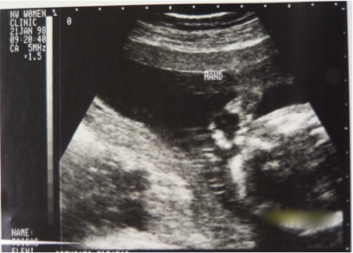
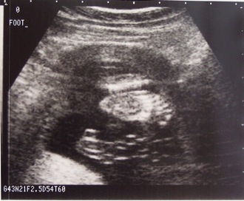
The thrill of the first look.

Slide 4
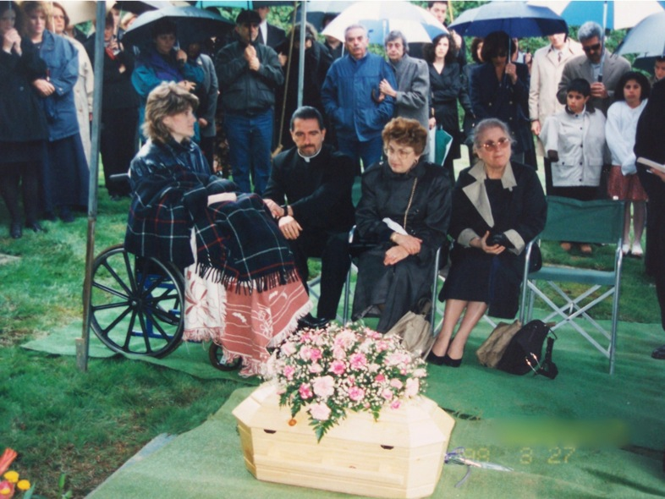
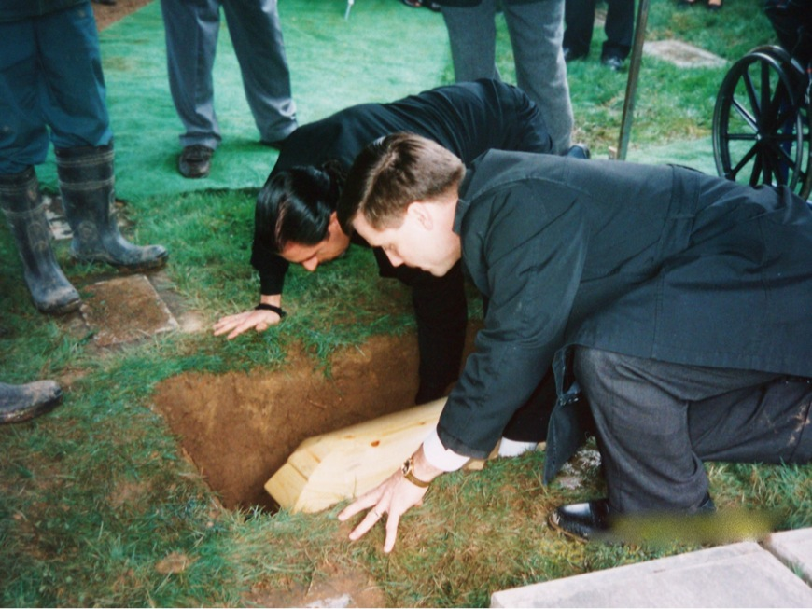
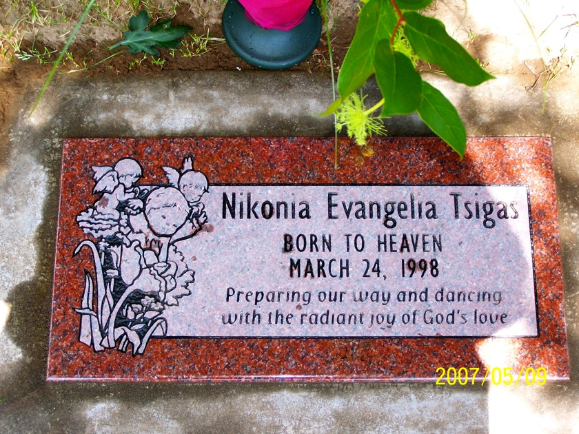
The horror of goodbye.

Slide 5

What if…?
My doctor had ever told me why my BP was being checked and I was peeing in a cup?
I knew that, for my usually low BP, 140/90 was reason enough to go directly to the hospital?
The nurse didn’t skip my urine dip on my last prenatal visit?
The nurse on the phone took a more cautious approach when I reported severe swelling and asked me to come in to be checked -- since I hadn’t been seen in 3 weeks?
I or others around me stopped to notice and comment on my puffy red face during my birthday dinner 3 weeks earlier?
I’d had an accurate and immediate diagnosis when I arrived at the hospital by a doctor who appreciated the acute dangers of a headache, nausea, and visual disturbances on top of an elevated BP and proteinuria, and acted with urgency?
I wasn’t left in the radiology department several floors away for two hours after the tech recorded a BPP of 2 – indicating a fetus in distress? There was U/S equipment in L&D?
Notes:
And possibly more importantly, this could very well be the BEST possible scenario. What could be happening to women with less access to good quality health care or without the health literacy skills that I supposedly had?

Slide 6
Prologue
Hopes & expectations
(family, pregnancy,
birth experience)
Patient’s health literacy
(pregnancy IQ, risk awareness)
Patient/provider relationship (trust, listening, history)
Clinical Readiness
(hospital/provider readiness/experience w/ preeclampsia, maternal health, prenatal care)
Prodromal symptoms
in that pregnancy
Social determinants
(inc. cultural & family influences)
Epilogue
Postpartum transition (discharge, follow up, medical home, acute and long-term health)
Emotional Recovery (impact on family, family planning decisions, trauma care, community support)
Patient/provider relationship (inc. trust in the healthcare system, future pregnancies)
Patient/family perspectives for case review
Employment & finances (self, spouse)
The HospitalEvent
© 2016 Preeclampsia Foundation

Slide 7
Prologue
Hopes & expectations
(family, pregnancy,
birth experience)
Patient’s health literacy
(pregnancy IQ, risk awareness)
Patient/provider relationship (trust, listening, history)
Clinical Readiness
(hospital/provider readiness/experience w/ preeclampsia, maternal health, prenatal care)
Prodromal symptoms
in that pregnancy
Social determinants
(inc. cultural & family influences)
Epilogue
Postpartum transition (discharge, follow up, medical home, acute and long-term health)
Emotional Recovery (impact on family, family planning decisions, trauma care, community support)
Patient/provider relationship (inc. trust in the healthcare system, future pregnancies)
Patient/family perspectives for case review
Employment & finances (self, spouse)
The HospitalEvent
© 2016 Preeclampsia Foundation

Slide 8



Where Are the Gaps in Care for HDP?
Community Factors in Maternal Mortality
FL-PAMR 2009-2013 CA-PAMR 2002-2004
Notes:
Factors contributing to Maternal Mortality in Hypertensive Disorders of Pregnancy.
California – delays in seeking care were a factor in 63% of MM from HDP and lack of knowledge were a factor in 56% of those deaths
Florida – 47% and 33%

Slide 9
Awareness of Preeclampsia
Q:
Have you ever heard of preeclampsia?
*Significant difference from prior wave
Source: BabyCenter Preeclampsia Survey, January 2014, Total (n=1,670); July 2015 (N=1,657)

Slide 10
Awareness by Demographic
Awareness is lower among lower income and less educated women
We saw a decline in awareness among stay at home moms
Have you ever heard of preeclampsia? - YES
Q:
Source: BabyCenter Preeclampsia Survey, January 2014, Total (n=1,670) July 2015 (N=1,657)

Slide 11
Did Provide Give Information?
Does Understanding Lead to Action?
N=754
317
Received the information
Understood it?
51%
Yes
25%
Didn’t Act
49%
No/Not Fully
94%
Didn’t Act
75%
Acted
6%
Acted
1:5 recalled information and understood it!
75% v.6% acted if they had symptoms
J Mat-Fet Neo Medicine 2013
Notes:
Of those 317 women, about half reported fully understanding the explanation. The education bias in this sample doesn’t bode well for the rest of the population that is not as well-educated or health literate.
Of THOSE women, who received it and understood it, 75% acted upon this knowledge – actions such as reporting symptoms, going to the hospital, or monitoring their own BP.
Of those who did NOT understand, only 6% acted upon their symptoms.
So in summary, 1 out of 5 recalled information and understood it; and 75% vs. 6% acted if they had symptoms.

Slide 12

Maternal Recognition Improves Outcomes
Symptoms of Preeclampsia
Patient seeks care, practices self-efficacy
Escalate care
MgS04
Antihypertensives
Steroids for Baby
Delivery
Improved Outcome
“The best way to diagnose preeclampsia is to listen to your patients.”
~ Dr. Baha Sibai
Notes:
Patient education of course does not prevent preeclampsia, but patient education improves recognition of symptoms, leading women to seek care and advocate for themselves, allowing for some interventions and closer surveillance, leading to improved outcomes.

Slide 13

66%

Slide 14
On “not being listened to”…
“I had good doctors, but I was not listened to about very intense and acute headaches that they called migraines. I would see black, throw up, and lose my ability to move certain parts of my body, as well as my ability to speak clearly.”
“My doctors needed to listen to me. I was in the hospital a day before my placenta abrupted for symptoms related to HELLP. I was never told I had HELLP, but I had all of the symptoms. I kept telling them that I felt like I was in labor, but not normal labor. It was like I had a monster contraction that never let up. The next day, I lost a crazy large amount of blood and found that my placenta had abrupted.”

Slide 15
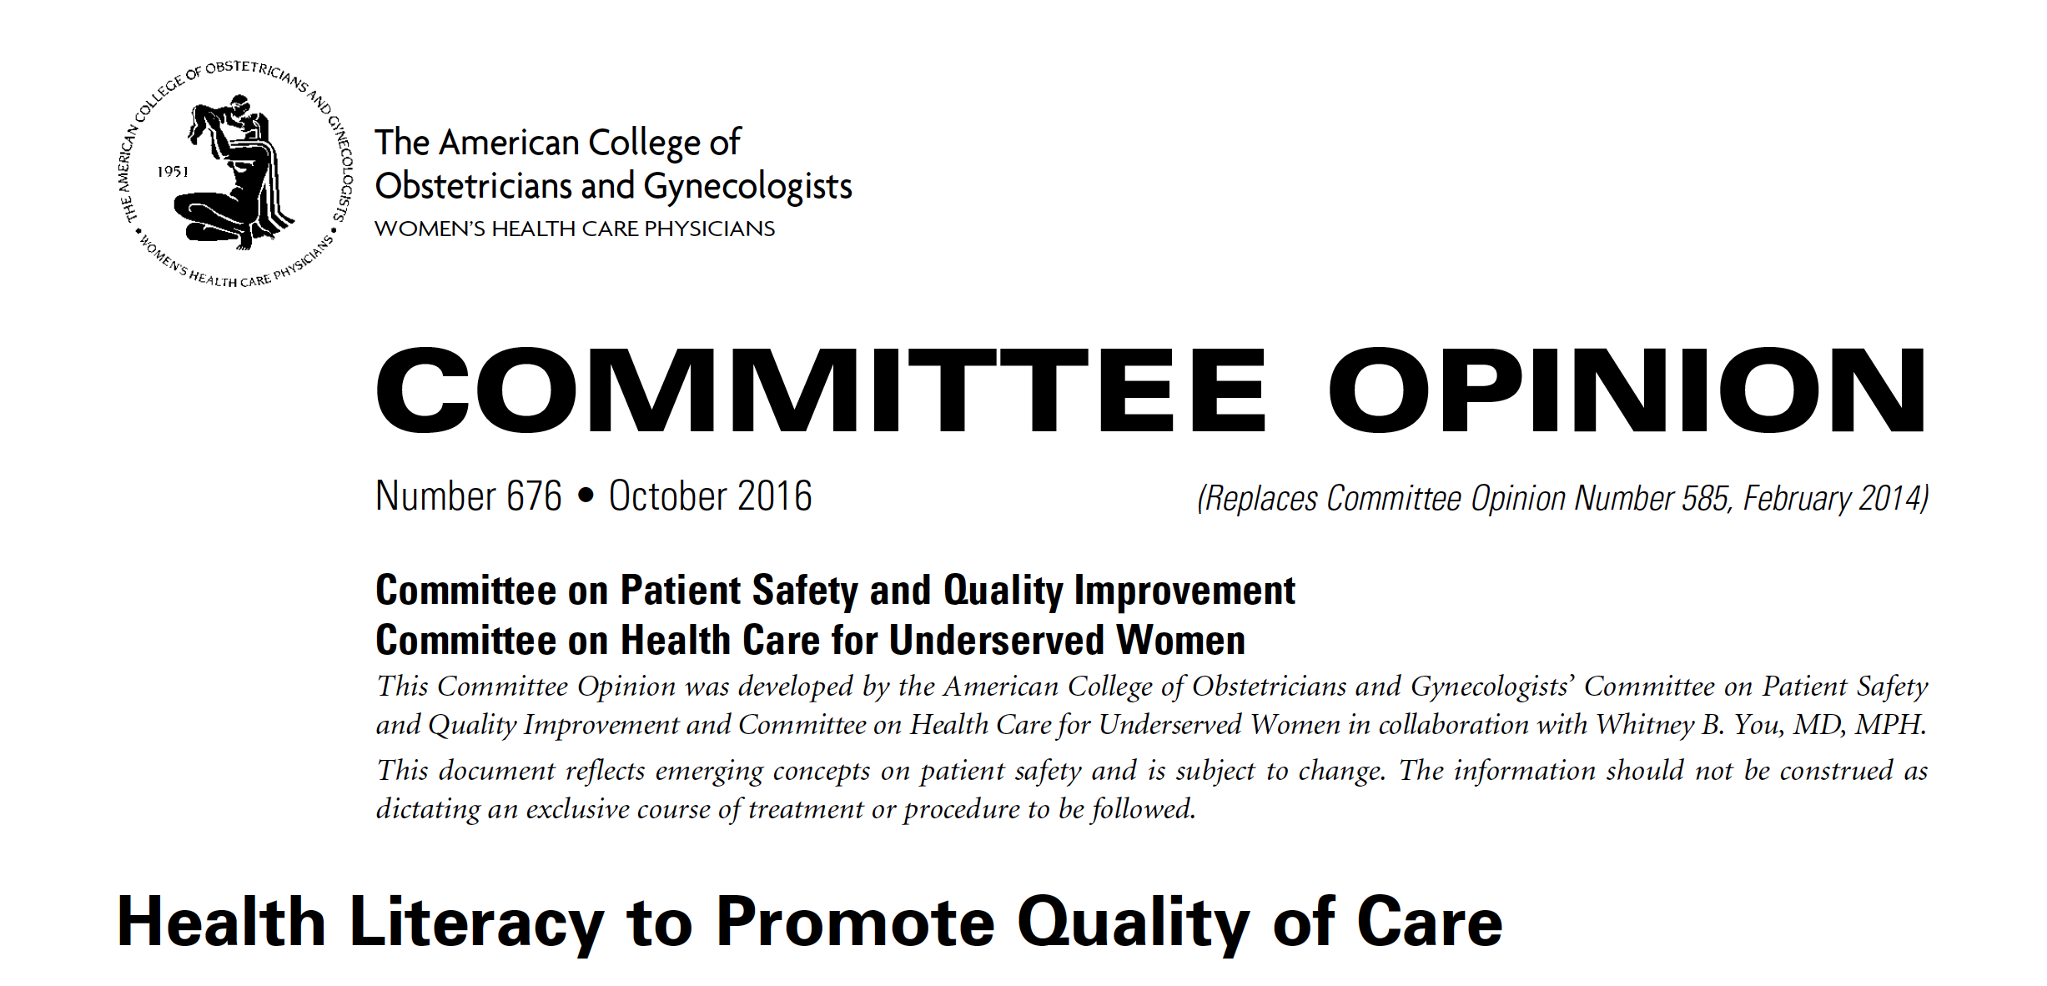
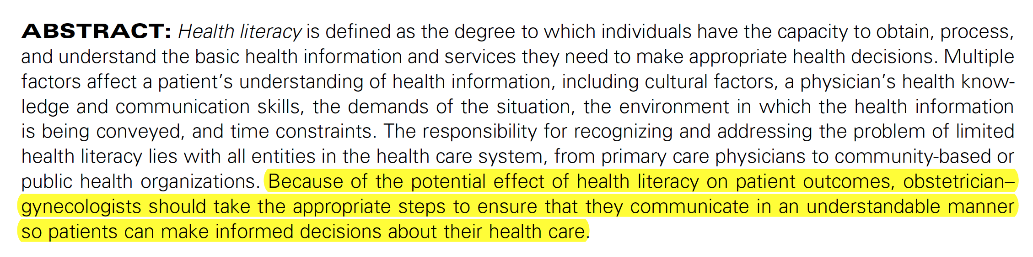

Slide 16


Key Strategies for Effective
Patient Communication
Use non-medical plain language
Organize information into 2 or 3 components (“chunk & check”)
Use “teach back” to confirm understanding with open-ended Q’s
Do not assume patients’ literacy levels or understanding by appearance
Stop, look, and listen to your patients!
Use proven tools that support consistent message
Messages must be repeated to be remembered
Use multiple teaching strategies to accommodate learning styles
ACOG Hypertension in Pregnancy guidelines (2013)
Notes:
Other strategies drawn from a number of health literacy experts include:
Use “plain language” to convey important information.
Chunk up the information into 2 or 3 components.
Teach back means after you’ve explained the symptoms and what you want her to do if she experiences any of them, you would ask your patient tell you what they understand using open-ended questions, not a yes-no “did you understand?” cuz I guarantee you, we’ll all say we understand. So you might say, “We’ve covered a lot of material today. What kind of symptoms might you experience that would cause you to call us?”
“proven tools” – it’s a good idea to validate their utility.
Research has shown that the best way to get your message across is repetition, providing the message at multiple office visits, phone calls and in triage. Therefore using several strategies is more likely to help learners to internalize the message. There is a YouTube video available that brings the information in another form that may also be used.

Slide 17
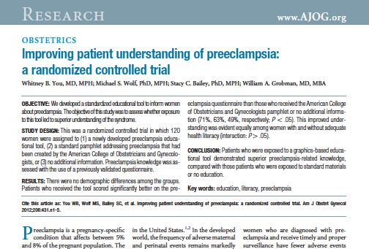
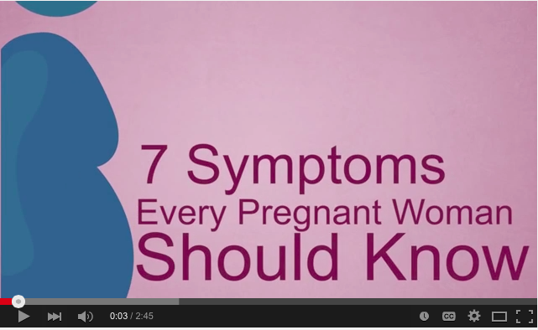
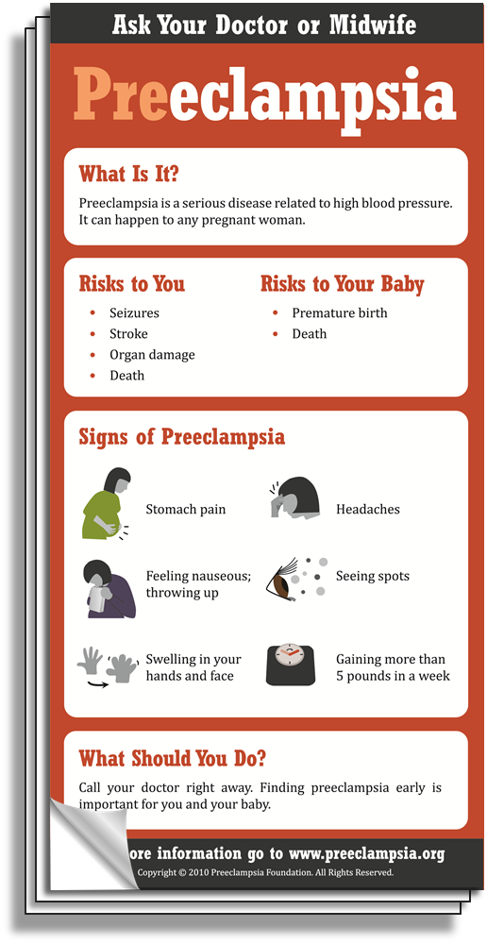
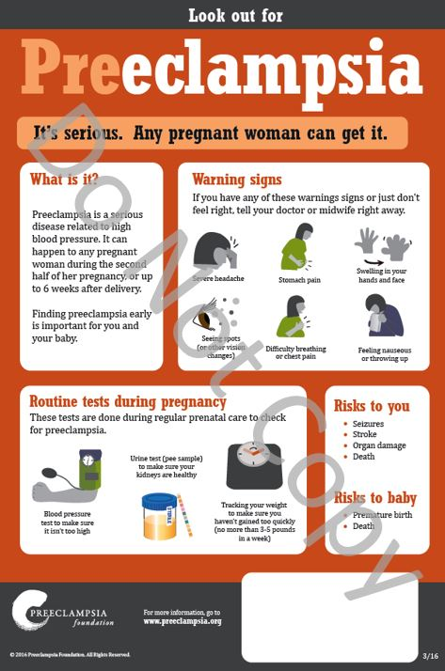

Your Patient Education Toolkit
Video available in English and Spanish on YouTube™ or for adding to your website
These and other patient education materials are available in multiple languages and can be ordered from www.preeclampsia.org/store
Notes:
Providers can order at preeclampsia.org/store
Tear pads and digital licenses available. E.g., Florida Hospital Orlando is using the 7 symptoms video via their Smart tv solution that enables us to send education to patients in their inpatient rooms.

Slide 18




Your Patient Education Toolkit
www.preeclampsia.org/store

Slide 19
The role of partners as advocates.

Slide 20


“…the cure for preeclampsia is delivery.”

Slide 21
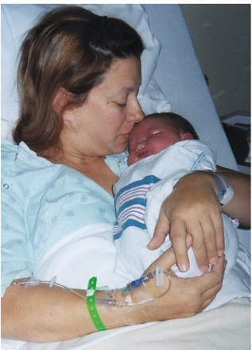
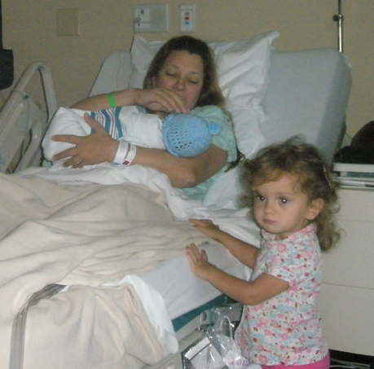
Joan, Max and Sophie
Joan and Max

Slide 22

Joan Donnelly
May 24, 1967 – August 6, 2010

Slide 23
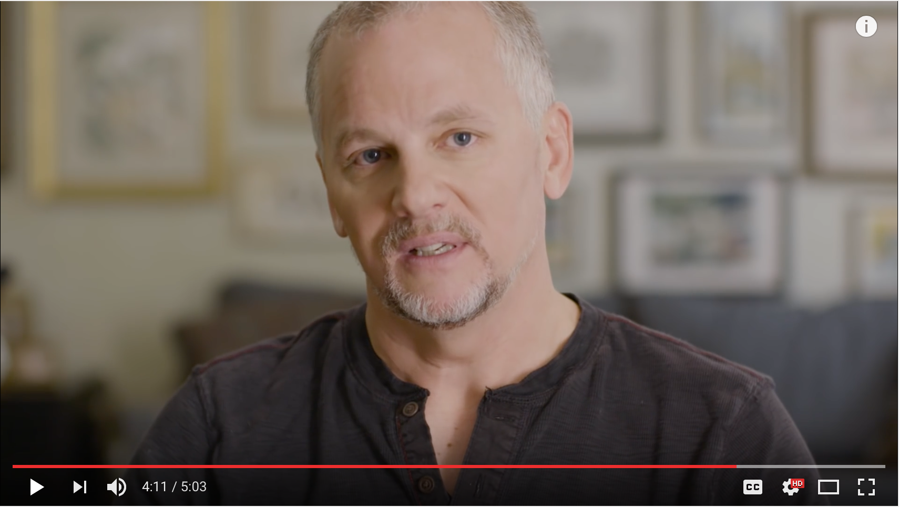

“I said ‘I’m sorry’ to her every single day.”

Slide 24

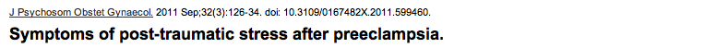
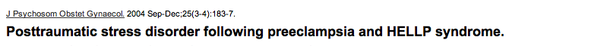
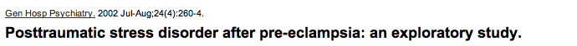
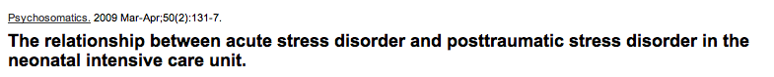
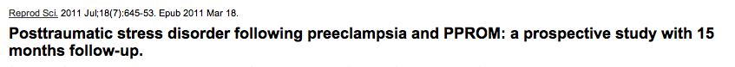
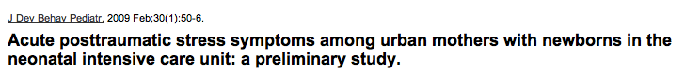

Slide 25
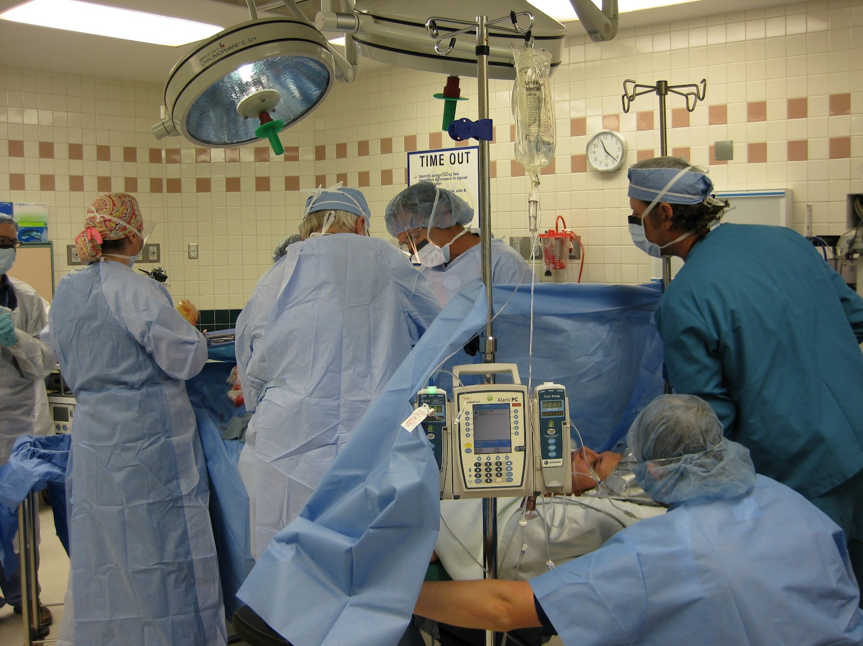

Slide 26


Slide 27
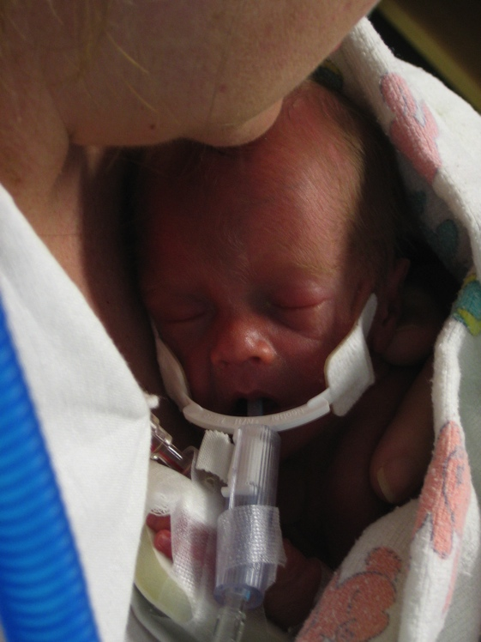
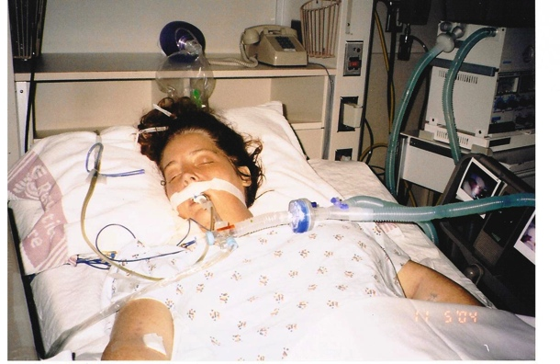
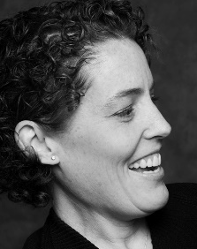
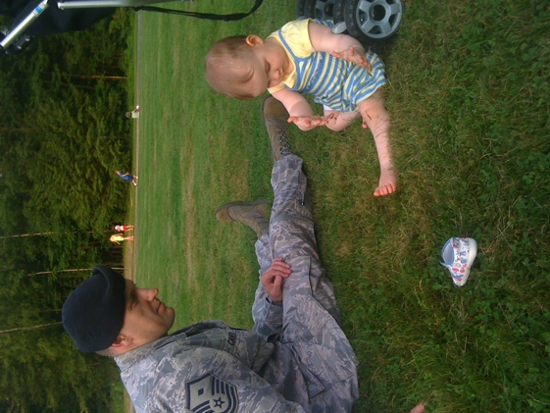
Birth trauma affects everybody.

Slide 28

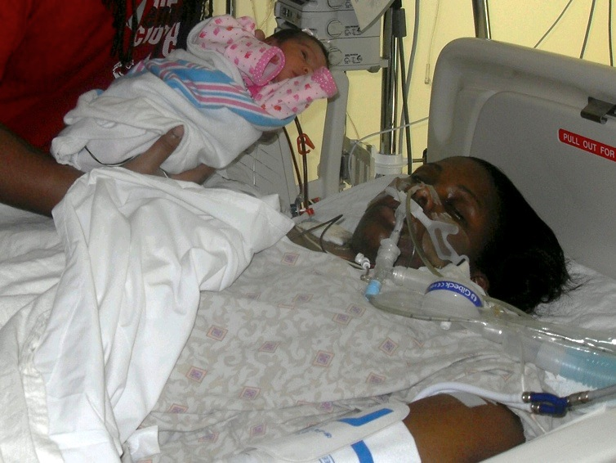
Regular dialysis or kidney transplant?
~ Fattiyah Doster, Miami, FL

Slide 29

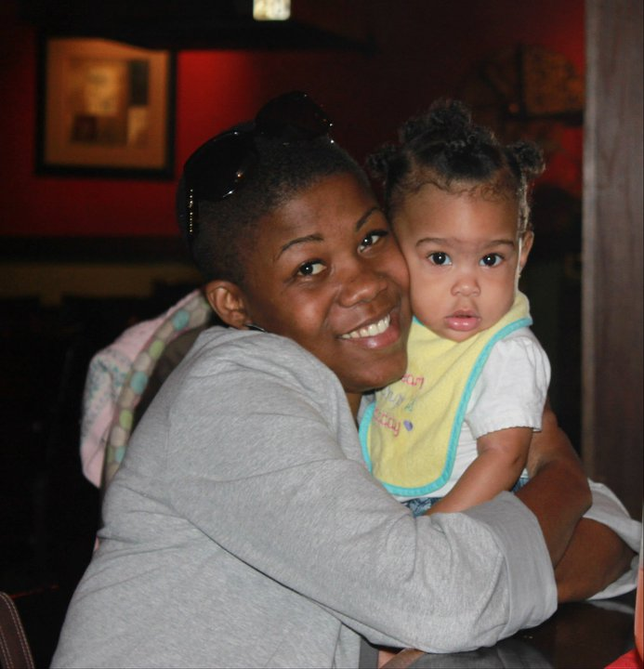

Slide 30

Hold for Tia Doster interview

Slide 31
Birth Trauma? Get Help!
Failure
Guilt
Anxiety
Anger
Depression
Psychological assessment & treatment
  Breslau Short Screening Scale (7 Qs) for PTSD* or Edinburgh Postnatal Depression Scale**
Chaplain or spiritual leader
Affirm them; patients want information
Local (e.g., The Promise Walk for Preeclampsia™) or online support groups (e.g., message boards, Facebook groups)
Grief counselor, specializing in perinatal loss
Ask for, and listen to, their story
* Breslau, N., Peterson, E.L., Kessler, R.C., Schultz, L.R. (1999). Short screening scale for DSM-IV post-traumatic stress disorder. American Journal of Psychiatry, 156, 908-11.
** https://psychology-tools.com/epds/
Notes:
Literature review findings are mixed but generally points to positive associations between various forms of psychopathology (anxiety, depression, post traumatic stress symptoms and PTSD) and previous PE/HELLP Syndrome. Women who had a birth trauma may need referral. Citations or links to the suggested screening scales are footnoted.
Review article: Delahauije D, et al. Anxiety and depression following preeclampsia or HELLP syndrome. A systematic review. Acta Obstet Gynecol Scand 2013; 92:746-761.

Slide 32
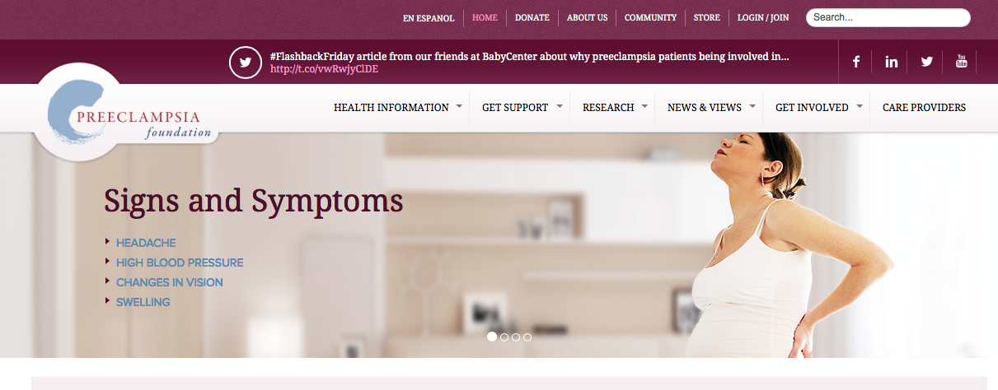


www.preeclampsia.org
A trusted resource for your patients
www.PreeclampsiaRegistry.org
A trusted resource for researchers;
Encourage your patients to enroll
Eleni Tsigas, Executive Director
eleni.tsigas@preeclampsia.org
@Eleni_Z_Tsigas

Slide 33
Emotional Impact of this Pregnancy
N=1,552

Slide 34
Steps Taken to Address Mental Health
N=1,346

Slide 35

Post Traumatic Stress Disorder (PTSD)
A mental health condition that’s triggered by a terrifying event – either experiencing it or witnessing it. Symptoms may include flashbacks, nightmares, and severe anxiety, as we as uncontrollable thoughts about the event.

