Slide 1

Leveraging QI Success in Other States:
Leaders from State Perinatal Quality Collaboratives Discuss Key Initiatives
ILPQC Fourth Annual Conference
November 3, 2016

Slide 2
Overview
Moderator: Ann Borders, MD, MSc, MPH
Panelists:
  William M. Sappenfield, MD, MPH, CPH, Director, Florida Perinatal Quality Collaborative
  Michael P. Marcotte, MD, Obstetric Faculty and Obstetric Project Clinician, Ohio Perinatal Quality Collaborative
  Munish Gupta, MD, MMSC, Chair, Neonatal Quality Improvement Collaborative of Massachusetts

Slide 3
Florida’s Perinatal Quality Improvement Efforts
William M. Sappenfield, MD, MPH, CPH
Director, Florida Perinatal Quality Collaborative
The Chiles Center at the College of Public Health
University of South Florida

Slide 4

Vision
“All of Florida’s mothers and infants will have the best health outcomes possible through receiving high quality evidence-based perinatal care.”
Values
Voluntary
Population-Based
Data-Driven
Evidence-Based
Value Added
Notes:
Blue looks fine!

Slide 5










FPQC Partners and Funders

Slide 6
FPQC Organizational Challenges
De-regionalized perinatal health care system
Highly competitive business environment
Minimize state government regulations
Underfunded state agencies
No one organization covers most health care providers
NICUs already participate in other QI efforts
Recruiting 118 delivery hospitals, 30 Level III NICUs, and multiple health care networks individually
Sustainable sufficient funding

Slide 7
The FPQC “Approach”
Steering Committee sets direction, hold accountability & promote sustainability
Health Committees direct efforts, select topics & recruits
Advisory Committees develop initiatives, project tools, training materials & recommendations
Participating hospitals: in-person meetings, monthly webinars, e-bulletins, QI trainings & site visits
Promote the practice of quality improvement sciences
Provide rapid data turn-around to guide efforts

Slide 8
FPQC Initiatives to Date
 | 2011 | 2012 | 2013 | 2014 | 2015 | 2016
Early Elective Delivery
Neonatal Catheter Infections
Obstetric Hemorrhage
Golden Hour
Antenatal Steroids
Hypertension in Pregnancy
Mothers Own Milk in NICU
Perinatal QI Indicators
Active Project Sustainability Phase

Slide 9
Maternal Health Projects
Obstetric Hemorrhage Initiative (OHI)
Hypertension in Pregnancy (HIP) Initiative

Slide 10

Obstetric Hemorrhage Initiative (OHI)

Slide 11
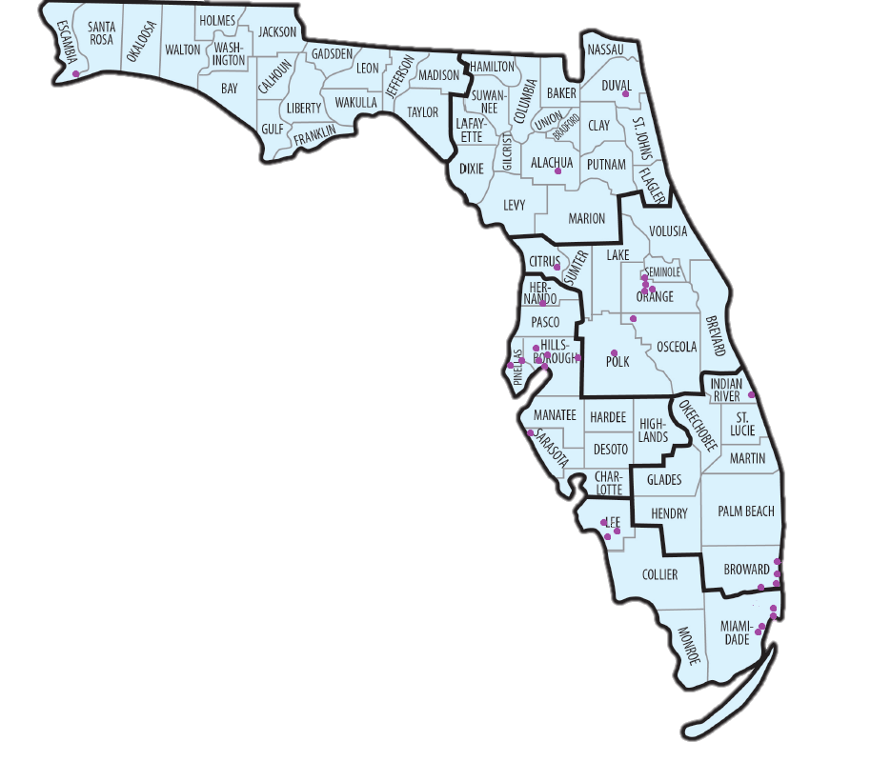
OHI
31 Florida & 4 North Carolina hospitals
Objective: Decrease short/long-term morbidity/mortality related to maternal hemorrhage.

Slide 12
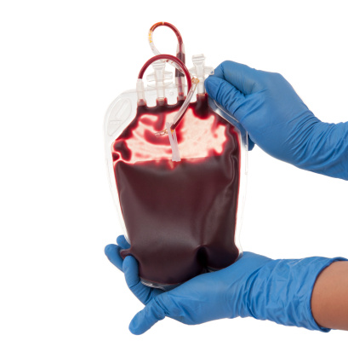
Key OHI QI Elements
Readiness
Develop an Obstetric Hemorrhage Protocol
Develop a Massive Transfusion Protocol
Construct an OB Hemorrhage Cart
Ensure Availability of Medications and Equipment
Recognition
Antepartum Risk Assessment
Quantification of Blood Loss
Active Management of the Third Stage of Labor
Response
Perform Interdisciplinary Hemorrhage Drills
Debrief after OB Hemorrhage Events

Slide 13
Florida OHI Hospitals
Risk Assessment on Admission
Percent of Hospitals Assessing for Risk of Obstetric Hemorrhage at Birth Admission and documenting score in clinical records
11%
34%
18%
75%
20%
70%
46%
17%
8%
Notes:
Drop simply do to number of slides.

Slide 14
Florida OHI Initiative Hospitals
Quantification of Blood Loss
Percent of Vaginal Deliveries where blood loss was quantified (chart audit)

Slide 15
Percent of women who were transfused with > 3 units of any blood product during birth admission

Slide 16

Hypertension in Pregnancy (HIP) Initiative

Slide 17


HIP
32 Florida & 1 Colombia hospitals
Objective: Decrease short/long-term morbidity/mortality related to acute onset hypertension.

Slide 18
Hypertension Safety Patient Bundle
Readiness
  Every unit
Recognition / Prevention
  Every patient
Response
  Every case of severe hypertension/preeclampsia
Reporting / Systems Learning
  Every unit

Slide 19
Florida HIP Hospitals
Treatment of New Onset Hypertension
Percent of All Reporting Hospitals that treated women with persistent new-onset severe HTN within 1 hour

Slide 20
Florida HIP Hospitals
Education of New Onset Hypertension
Percent of All Reporting Hospitals where women received discharge education materials

Slide 21
Florida HIP Hospitals
Follow-Up of New Onset Hypertension
ee
Percent of All Reporting Hospitals where women had follow-up appointments scheduled in appropriate timing
Notes:
Numerator: Number of women who had follow-up appointments scheduled in appropriate timing
---------------------------------------------------------------------------------------------------------------------
Denominator: Number of charts reviewed

Slide 22
Florida HIP Hospitals
Structural Measures
Percent of All Reporting Hospitals
Hypertension protocol
Electronic health record integrated
Patient, family, & staff support protocol
Multidisciplinary case-review
Hypertension discharge education policy

Slide 23
Infant health projects
Golden Hour: Delivery Room Management
Mother’s Own Milk (MOM) in the NICU Initiative

Slide 24
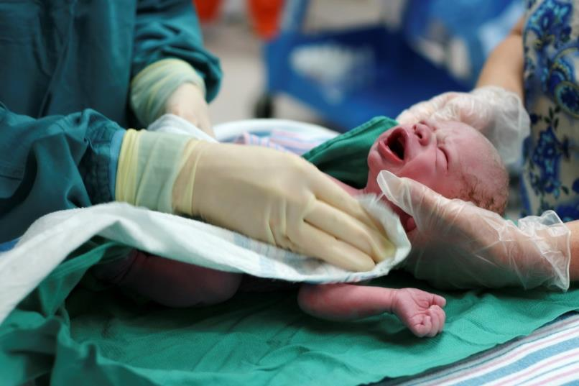
Golden Hour:
Delivery Room Management
Notes:
Our other neonatal focused project on the Golden Hour, demonstrates the power of teamwork. Interventions during the time period between fetal and neonatal life have been shown to have a great influence on a baby’s future morbidities. Optimizing delivery room management of newborns particularly through the assignment of team roles can improve outcomes.

Slide 25
Golden Hour:
Delivery Room Management
Objective: Improved outcomes in babies ≤30 6/7 weeks gestational age OR ≤1500g birth weight
Interventions in the first hour may affect:
  Short term morbidities—thermoregulation, hypoglycemia, plus.
  Long term morbidities—CLD, ROP, & IVH
  Mortality
Notes:
Go over slide
NICU teams focused on prepared teamwork, delayed cord clamping, oxygen regulation, and temperature regulation.

Slide 26
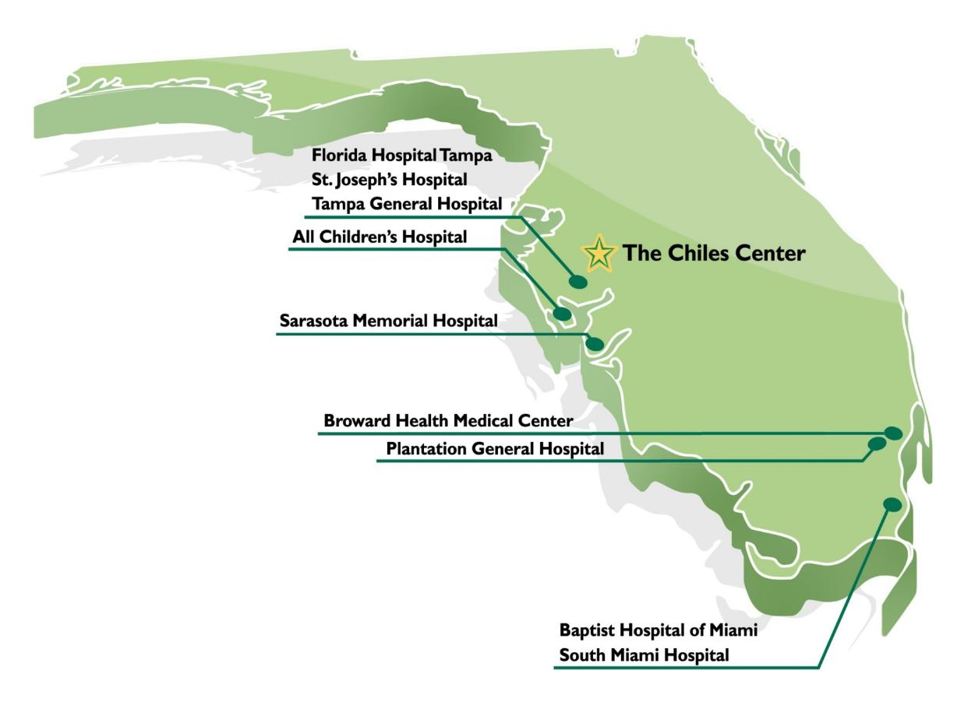
9 Golden Hour Pilot Hospitals
ACADEMIC
TGH/USF
ACH/Johns Hopkins
NON-ACADEMIC
St. Joseph’s Hospital
Baptist Hospital Miami
Florida Hospital Tampa
South Miami Hospital
Sarasota Memorial Hospital
Broward Health Medical Center
Plantation General Hospital
Notes:
The project was carried out by 9 NICUs shown here, again, scattered about the state. As with all of our QI projects, participating hospitals received monthly data reports on data they were collecting for the project, regular communication with the project lead via phone and email, and education via webinars and monthly newsletters. Teams were encouraged to share their best practices as they carried out the project.

Slide 27
Initiative-Wide Data
Delayed Umbilical Cord Clamping
86%
58%
76%
22%
11%
Notes:
During this 14 month project, delivery room teams increased the practice of delayed cord clamping (18% to 65%), resuscitation role assignments (50% to 82%), and team debriefing rates (33% to 84%).

Slide 28
Initiative-Wide Data
Relationship between Pre-Delivery “Preparedness Score” & Outcomes
Each data point represents the outcome related to pre-delivery preparedness score (0 – 7). Data are from October 2013-October 2014.
Notes:
This slide shows how being prepared as a team helped improve outcomes. NICUs were encouraged to complete 7 pre-delivery tasks to prepare for infants. The more of these tasks that were completed the better the outcomes for the infants in terms of delayed cord clamping and having appropriate temperature and oxygen ranges.
[Tasks were to assign roles to the delivery team (leader, airway, circulation, and scribe), conduct an equipment check, verify that the radiant warmer was turned on to 100%, and to hold a debriefing meeting within four hours of the delivery.]

Slide 29

Mother’s Own Milk (MOM)

Slide 30

MOM
25 Florida Level II & III NICUs
Objective: Increase % of VLBW babies receiving moms own milk.

Slide 31
American Academy of Pediatrics recommends exclusive human milk diet for premature infants.
In 2013, 45.7% of VLBW infants were receiving any human milk at discharge in FL NICU’s (VON)
Project Drivers:
  Mother’s Intent to Provide her own milk
  Establishing Supply
  Maintaining Supply
  Transition to the Breast

Slide 32
FPQC Initiative Challenges
Engaging physician champions
Staff turnover
Preventing hospital and provider QI fatigue/burnout
Understanding & use of QI practices vary widely
Balancing data needs with reducing data burden
Behaviors changes without having system changes
Observing measurable health outcome changes

Slide 33
Lessons Learned
Enthusiasm and commitment to improve outcomes collaboratively exists among virtually all stakeholders
Frequent communication and encouragement via multiple channels is essential
Becoming a successful, productive, visible, high-quality, full-service quality collaborative focused on the health of mothers and infant promotes momentum for change
QI project participants learn a lot from each other
Only what gets measured gets managed and measurement requires resources: time, $, admin, buy-in
Hospital ownership of addressing issues is key
Engaged hospital QI teams using QI sciences can make a substantial difference

Slide 34
Lessons Learned, continued
From OHI Implementation evaluation
  Adaptability of bundle elements facilitates implementation
  Complexity of bundle is challenging but can be ameliorated by supportive materials and assistance
From Golden Hour
  Promoting teamwork by increasing pre-delivery preparedness was associated with improved thermoregulation, SPO2 targeting, and DCC rates

Slide 35

Thank You!
www.fpqc.org
Email: fpqc@health.usf.edu

Slide 36
OPQC Current Projects
Preventing preterm births with Progesterone and standardized treatment of Neonatal Abstinence Syndrome
Michael P. Marcotte MD
OB Clinical Advisor, The Ohio Perinatal Quality Collaborative
Director of Quality and Safety for Women's Services,
TriHealth Good Samaritan Hospital
Cincinnati Ohio
Through collaborative use of improvement science methods, reduce preterm births & improve perinatal and preterm newborn outcomes in Ohio as quickly as possible.

Slide 37
Disclosures
Dr. Marcotte is employed by
Cincinnati Children’s Hospital’s
  Cradle Cincinnati
  James M. Anderson Center for Health Systems Excellence, with funds from the
Ohio Department of Health and the
Center for Disease Control and Prevention to be the
Clinical Advisor for the Ohio Perinatal Quality Collaborative.
Tri-Health
  Good Samaritan Hospital (tertiary) and Bethesda North Hospital (secondary)
  Tri-Health HOPE Program (substance use disorder in pregnancy program)
No other funding, contracts, stocks, consultancies
or advisory boards.

Slide 38

Ohio Perinatal Quality Collaborative
The Ohio Perinatal Quality Collaborative (OPQC), founded in 2008, has worked using improvement science methods, to reduce preterm births & improve perinatal and preterm newborn outcomes in Ohio as quickly as possible.

Slide 39
Who Is OPQC?
Start up $$ from CMS
ODJFS → OPQC
Ohio Department of Job & Family Services
Ohio Department of Health – Vital Statistics
Ohio Medicaid
Ohio AAP, ACOG, OHA, MoD
Peds + OB Content & Q.I. Leaders
“OPQC Central”
  Secure Central De-identified Data Processing
Staff at Ohio Maternity & Children’s Hospitals
Ohio Families Affected by Prematurity

Slide 40
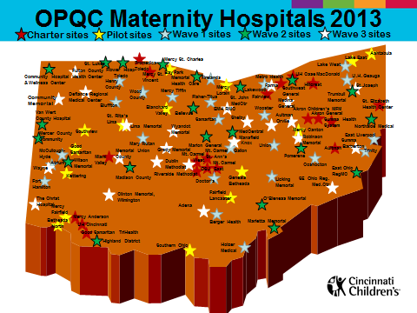
OPQC Sites
105 (of 107)
Maternity Hospitals
52 (of 54)
Level II & III NICUs
23 Outpatient OB Clinics
3 Federally Qualified Health Centers

Slide 41













It takes a village…

Slide 42
ANCS for women at risk for preterm birth
(24^{0/7} - 33 ^{6/7})
Neonatal
39-Week Scheduled Deliveries without medical indication
Obstetrics
Increase Birth Data Accuracy & Online modules
Spread to all maternity hospitals in Ohio
BSI:
High reliability of line maintenance bundle
Use of human milk in infants 22-29 weeks GA
Progesterone for Preterm Birth Risk
Neonatal Abstinence Syndrome
Ohio Perinatal Quality Collaborative
NICU Grads Project

Slide 43

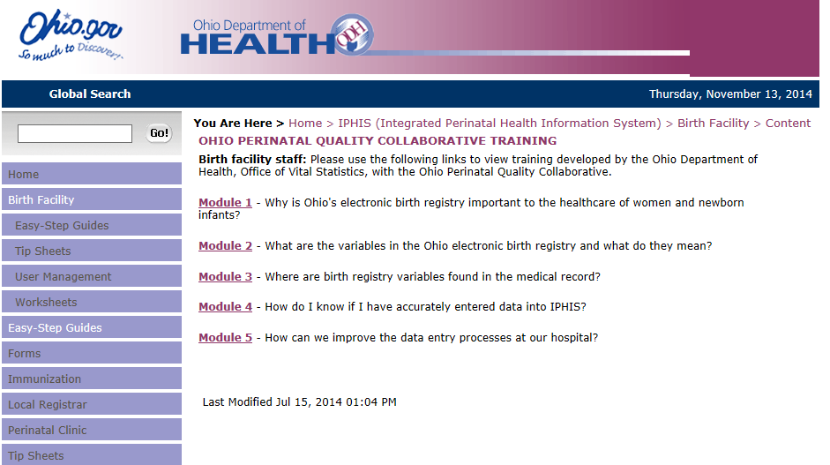
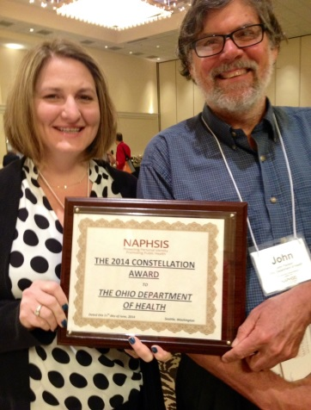
The Ohio Birth Certificate
Drives Quality Improvement
CDC Funding to Ohio Dept. Health & OPQC 2014-2017
Birth Data Accuracy in All Ohio Maternity Hospitals.
Site Visits & Online Education for Birth Registrars.
13 KEY Variables Identified & Expanded for QI Use.
Timely Reports from ODH Vital Stats to OPQC in 2 mo.

Slide 44
Progesterone
Obstetric

Slide 45

Progesterone
Population spread of identification of and preventative treatment with progesterone supplementation in pregnant women to reduce preterm births in OB practices.
23 OB outpatient clinics (affiliated with 20 largest maternity hospitals) and 3 Ohio Association of Community Health Centers FQHCs.
Designed and Tested Form to Assess Pregnancy Risk Factors and Link with MCPs for Care Coordination (With ODM, 5 MCPs and Practices)
Cost Analysis (GRC/Medicaid & Health Services Researcher)
Manuscript submitted for publication

Slide 46
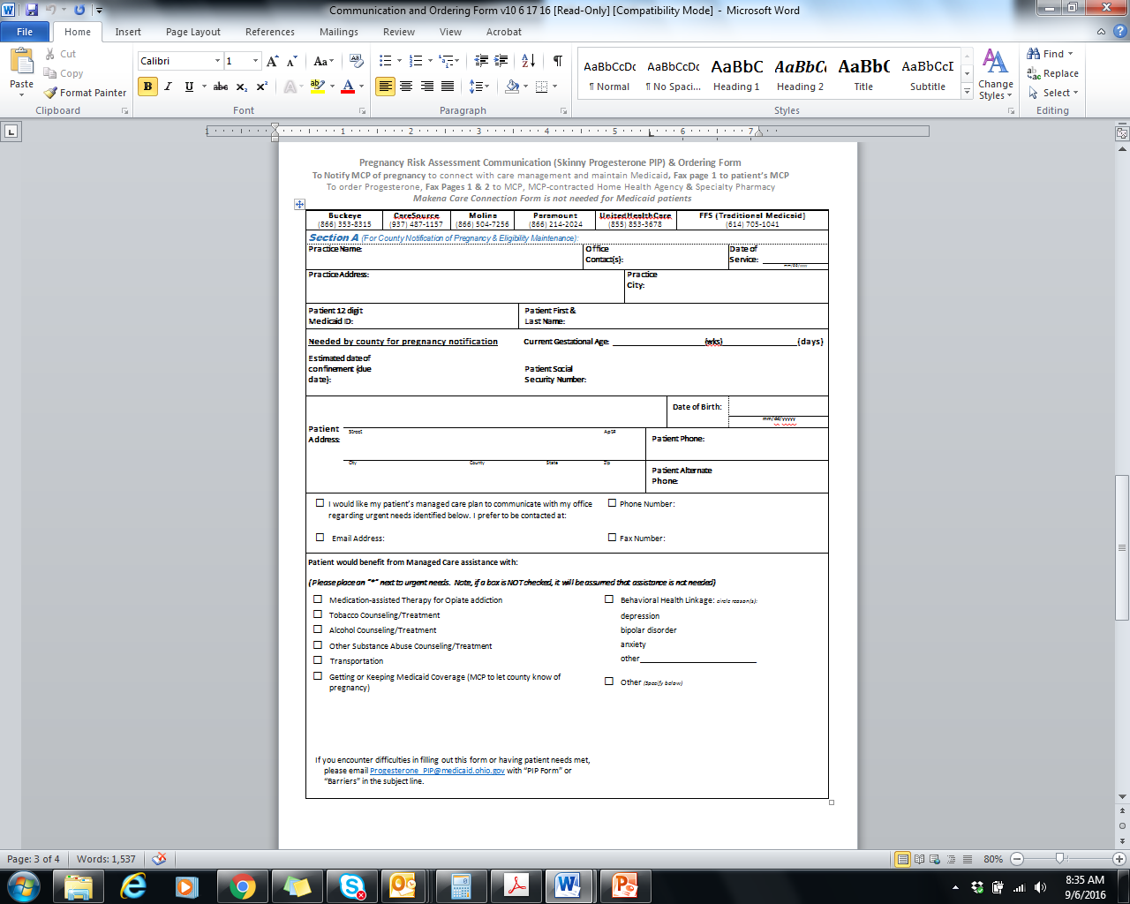
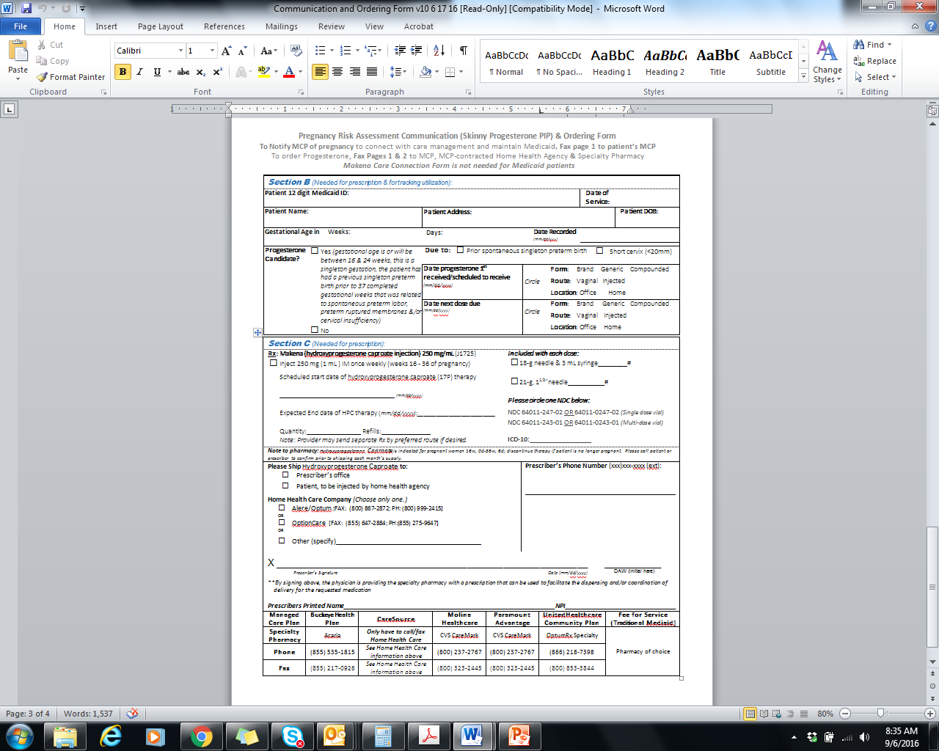
“Skinny” PIP Form
Identifying & Communicating to MCPs About Pregnant Women at Risk
For every pregnant woman on Medicaid, fill out A and B
Electronic version going live January 2017
A
B

Slide 47
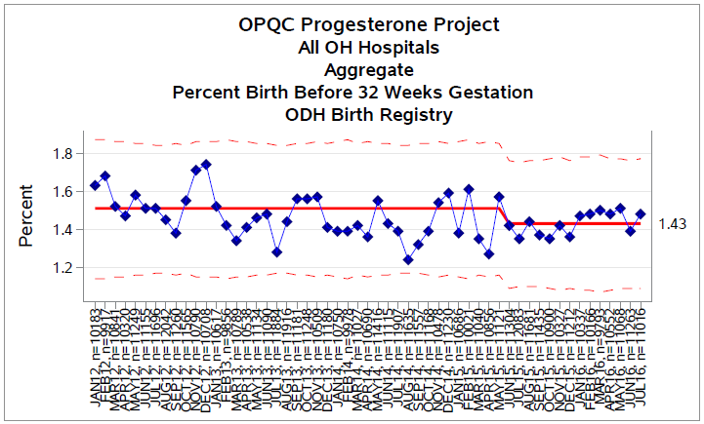
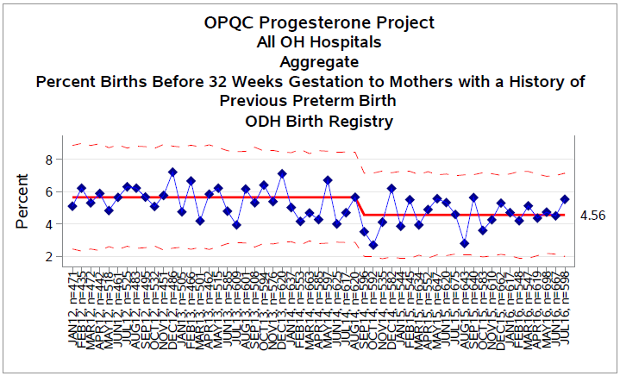
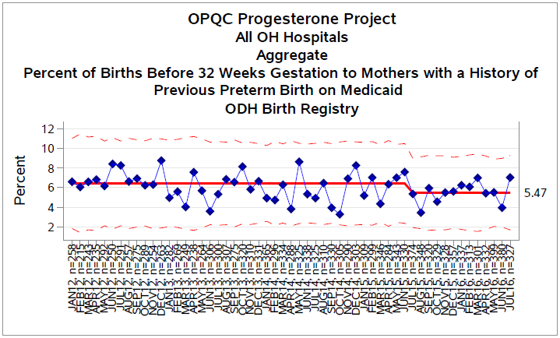
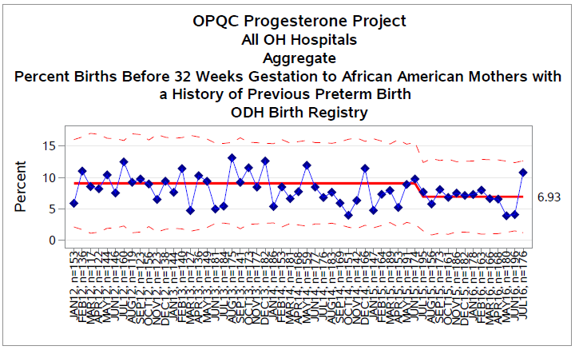
1. ALL OHIO BIRTHS BEFORE 32 WEEKS
2. ALL OHIO BIRTHS < 32 WKS w/ HX PTB
6.6%
20.5%
ALL OHIO BIRTHS <32 WEEKS
w/ HX PTB on MEDICAID
ALL OHIO BIRTHS <32 WEEKS TO
AFRICAN AMERICAN WOMEN w/ HX PTB
17.1%
20.3%

Slide 48
Progesterone Project 2014 →Present
Lessons Learned
Goal to Reduce All PTB in Ohio Not Achieved
  % PTB related to Hx SPTB is << expected
  % PTB related to Short Cx is << expected
But Significant Reductions in Births < 32 Weeks!
  Medicaid-insured and African American Women
System Barriers to 17-OHPC were >> expected
  Orphan Drug Pricing→ Multiple adverse effects *
Medicaid Partnership is Key to Progress
  Accurate Universal Communication
  System-Level Change
Principal Patient Barrier is Late Entry to Care
  Transportation and Child Care

Slide 49
Progesterone Project Plans
2016-2017
Develop a change package
  Test MCPs + FQHCs/Clinics + Community
Maternity Medical Home for High-Risk Women w/focus on Infant Mortality
  Previous PTB initial example
  Use PIP Skinny Form to identify risks and coordinate care with MCPs and county job and family service providers
Progesterone Spread

Slide 50
Neonatal Abstinence Syndrome
Neonatal

Slide 51
NAS
Standardization of protocols for assessment and treatment of neonatal abstinence syndrome (NAS) in neonatal ICUs and newborn nurseries.
52 Level 2 and 3 nurseries.
Evidenced-informed treatment protocols for >5700 infants with NAS since January 2014
Cost Analysis Underway (GRC/Medicaid & Health Services Researcher)
Orchestrated Testing of Non-Pharm Bundle
Move Into Sustain Phase January 2017

Slide 52
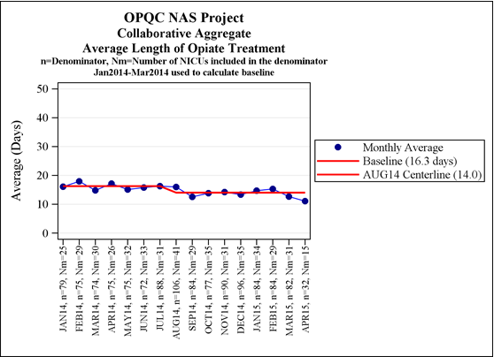
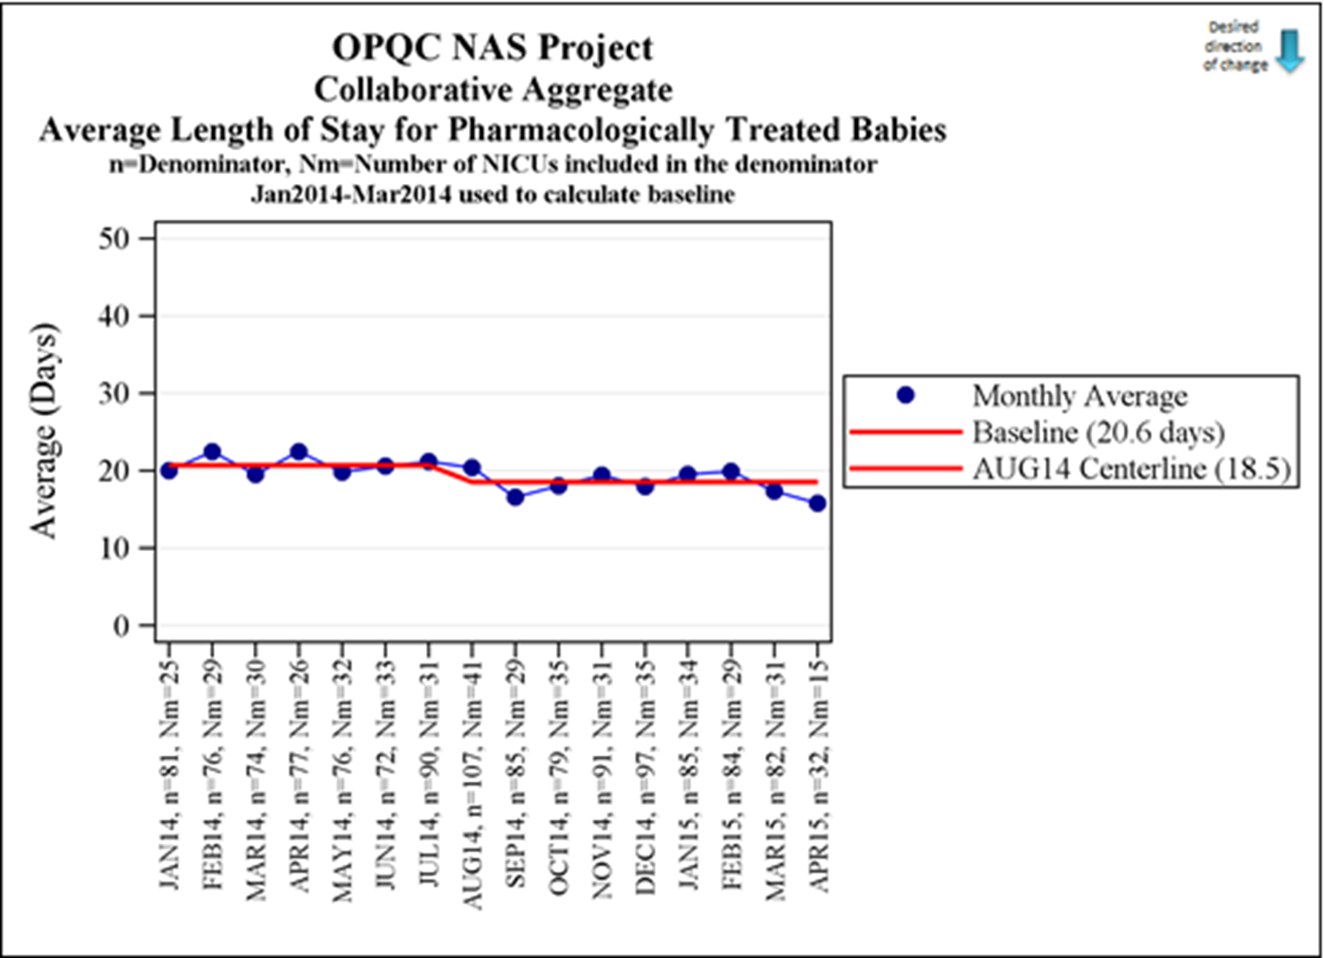
What Have We Accomplished…
Neonatal Abstinence Syndrome
Standardized
  identification of infants with NAS
  approach to non-pharmacologic care based on best available evidence
  treatment protocol based on best available evidence
Increased Compassionate Care *as measured by attitude survey
Significantly reduced Length of Treatment and Length of Stay
Length of Opiate Rx
16.3 days
14.8 days
Length of Stay
20.6 days
19.4 days

Slide 53
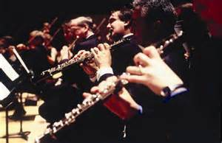



NAS: we are still learning…
Variation in non-pharmacologic bundle
Orchestrated Testing
Wind Section
Low Lactose or BM Standard
19 kcal/oz Standard
String Section
Low Lactose or BM Standard
22 kcal/oz Standard
Horn Section
Regular Formula or BM Standard
19 kcal/oz Standard
Percussion Section
Regular Formula or BM Standard
22 kcal/oz Standard

Slide 54
Nicu graduates
Neonatal

Slide 55
NICU Graduates
Transition from NICU to home for infants with complex medical needs
  Parent/caregiver preparation
  Care coordination w/MCPs, subspecialists and primary care
6 Children’s Hospitals’ NICU teams, including parent(s)
Develop evidence-informed guidelines for safely delivering care in home setting, including post-discharge assessment for milestones

Slide 56




Thank You!
Web: www.OPQC.net
Email: info@OPQC.net

Slide 57

Stronger Together:
The Massachusetts Experience with a State Perinatal Quality Collaborative
Munish Gupta, MD MMSc
ILPQC Annual Conference
November 3, 2016

Slide 58
Take Home Message
It seems that perinatal quality collaboratives, regardless of structure, have unique added value that helps hospitals and states take their perinatal improvement efforts to the next level.

Slide 59
Outline
A brief history of PQCs in Massachusetts
Some of our current projects
What I think we’ve learned from our experience
Caveat: this is mostly about our work on the neonatal side.

Slide 60



Current Situation: a bit of an alphabet soup

Slide 61

Timeline
First meetings to launch NeoQIC!
2002

Slide 62
What happened?
Initial efforts in 2002:
Respected leaders
All Massachusetts NICUs, level II SCNs
Department of Public Health
Outside consultants
Lots of time and energy
But….didn’t work

Slide 63
What happened?
Highly focused on STRUCTURE
  All partners at the table
  Multiple potential data sources
  Need for substantial funding
Why didn’t it work?
  Too daunting? Too risky?
  Not interesting? Not focused on projects?

Slide 64
NeoQIC Launch: 2006-2007
Renewed interest
Keep it simple, at least at first
Start with 10 level III NICUs
Start with available data
Start with clinical projects

Slide 65
Timeline
VON state report
Comparative data reports
Meeting of 10
level III NICUs
Infection, ROP
Review local and best practices
Basic agreements on goals, data
Twice-yearly meetings
QI education
2006 2007 2008
Twice-yearly meetings, transparent sharing of data and practices

Slide 66
NeoQIC Mission Statement
Use the open sharing of data and practices to support local and collaborative quality improvement efforts and improve newborn outcomes in Massachusetts

Slide 67
Timeline
VON State Collaboratives Group!!
Additional topics: nutrition, BPD, IVH
New England Neonatal Quality and Safety Forum (with March of Dimes)
Partnership with DPH:
CLABSI, EI, readmissions
NAS project
Massachusetts Perinatal Quality Collaborative
CDC grant with MPQC, DPH, and MOD
2009 2010 2011 2012 2013 2014 2015 2016
Twice-yearly meetings, transparent sharing of data and practices

Slide 68
What Can State-Based Collaboratives Do?
Improve Newborn Outcomes
QI Education
Support Local QI Efforts
Collaborative QI Projects
Bench-marking
Work at the Population Level

Slide 69
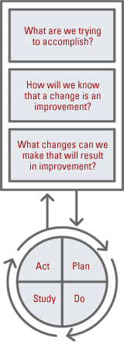
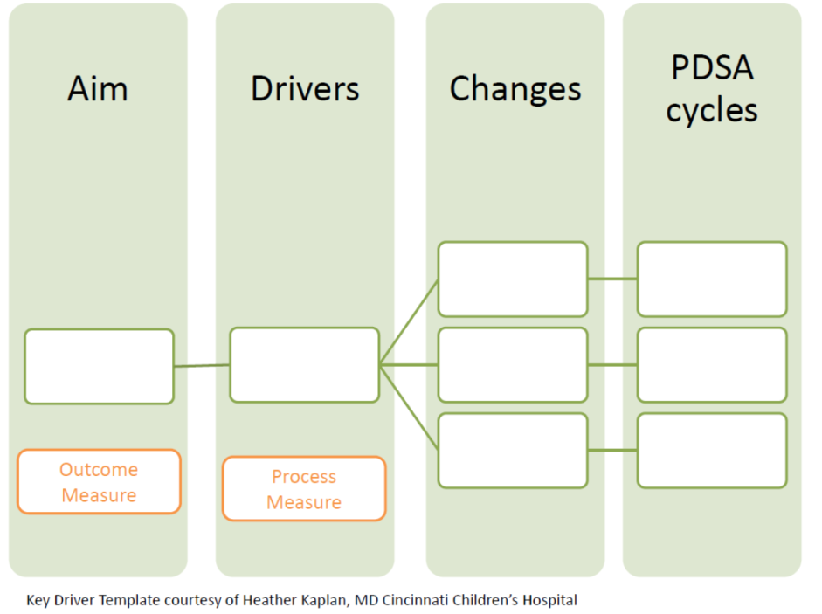
QI Education

Slide 70


Slide 71
What Can State-Based Collaboratives Do?
Improve Newborn Outcomes
QI Education
Support Local QI Efforts
Collaborative QI Projects
Bench-marking
Work at the Population Level

Slide 72
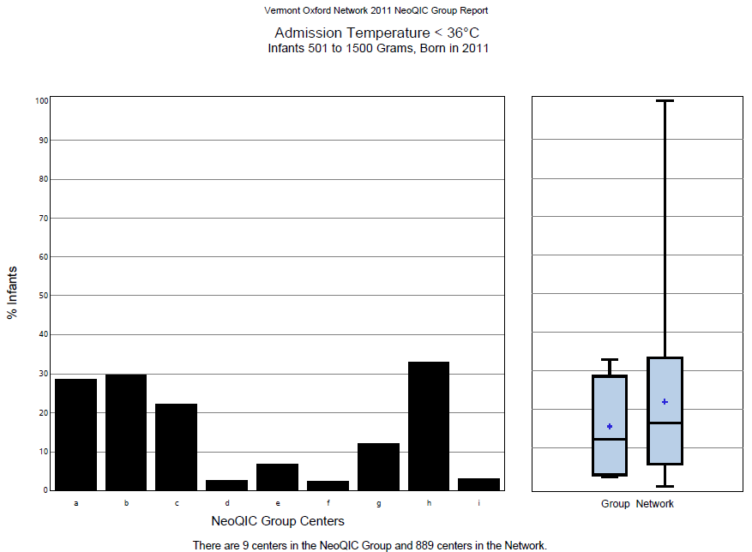

Slide 73
What Can State-Based Collaboratives Do?
Improve Newborn Outcomes
QI Education
Support Local QI Efforts
Collaborative QI Projects
Bench-marking
Work at the Population Level

Slide 74
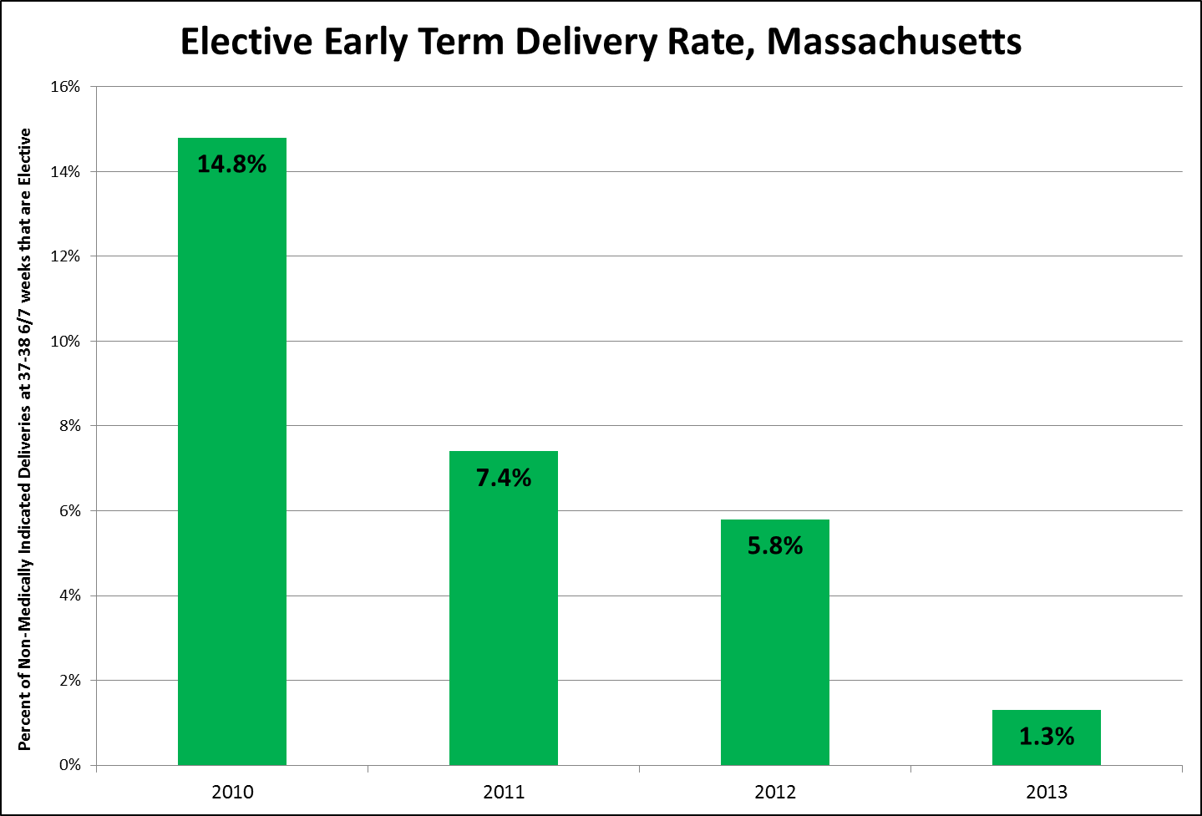
MPQC Projects

Slide 75
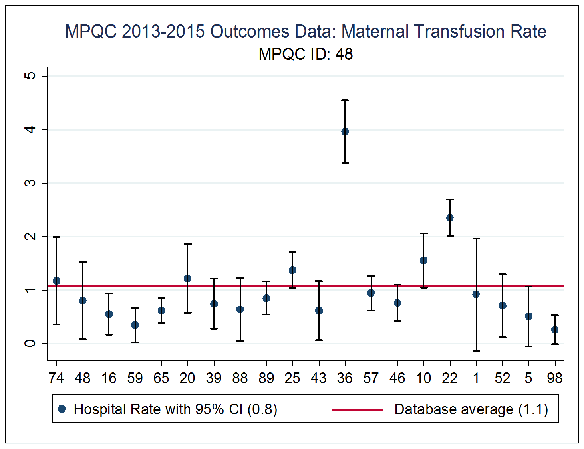
MPQC Projects

Slide 76
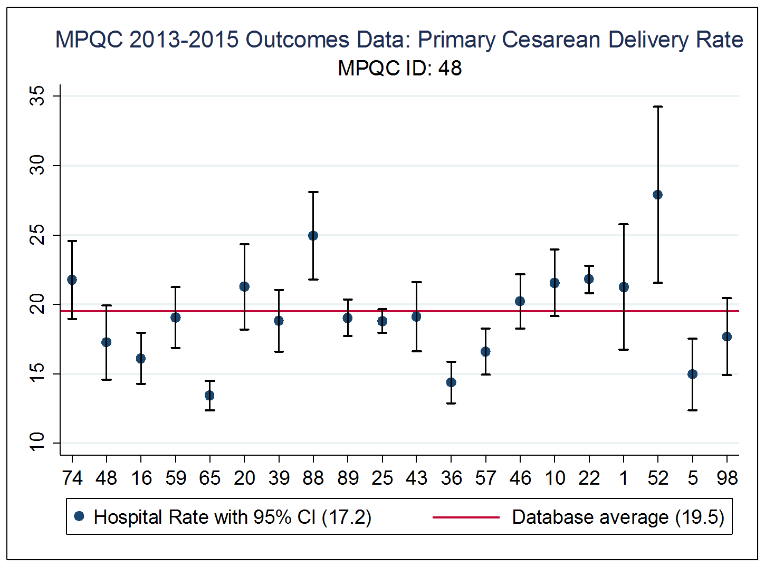
MPQC Projects

Slide 77
Severe Morbidity Project: Maternal Hypertension
Primary Aims
Primary Drivers
Secondary Drivers
Potential Change Concept
Overall Project Goal:
Decrease Rate of Severe Maternal Morbidity Associated with Hypertensive Disease In Pregnancy
Increase and improve participation of MA hospitals in improvement project
Increase number of hospitals that have active ACOG based hypertension protocols
Outreach to all MA hospitals
Development of local protocols
Database development and structured reporting development
Implement QI education at hospitals
Measure: % of MA birth Hospitals engaged in project
Measure: % of hospitals that have ACOG hypertension Protocols
Reduce Maternal ICU admission for maternal hypertension
Increase appropriate medical management of maternal severe hypertension
Improve Hospital Based Care of Maternal Severe Hypertension
Outreach to all MA hospitals
Development of local protocols
Implement standardized annual training programs for nurses and physicians
Measure: State and Hospital % for ICU admission for maternal hypertension
Measure: % of patients in whom severe range BPs were reported appropriately per ACOG standard
Measure: % of patients with appropriate medical treatment per ACOG recommendations
Reduction of the number of patients readmitted for postpartum hypertension
Increase the number of patients with appropriate post partum out patient follow-up
Measure: State and Hospital readmission rate for postpartum hypertension
Measure: % of patients with appropriate 7-10 day BP follow-up

Slide 78
NeoQIC: Current Projects
Safe Sleep
Human Milk
NAS
? CLABSI/
Antibiotics

Slide 79
Safe Sleep Positioning in NICU
Launched 2015
All 10 level III NICUs, expanding to level IIs
Project lead: Susan Hwang, Colorado (!)
2 summits/year, 2 webinars/year
Partnership with DPH, CoIIN
Weekly audits of eligibility and compliance
Standardizing eligibility criteria
Difficult populations (reflux, NAS, etc)?

Slide 80
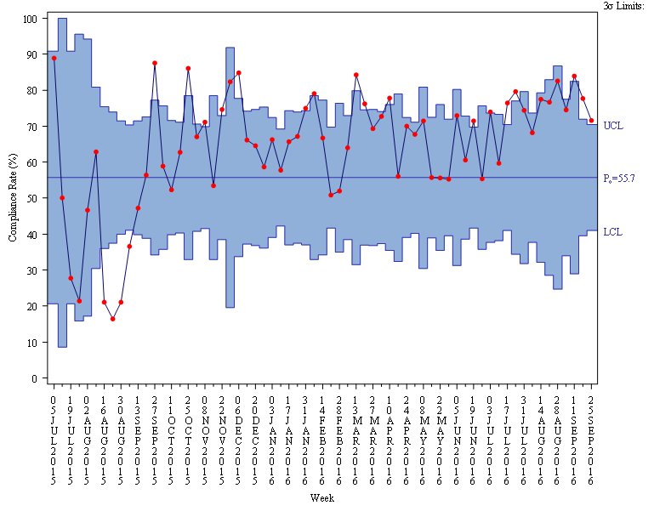
Compliance with Safe Sleep Positioning
center line= 2015 Baseline data

Slide 81
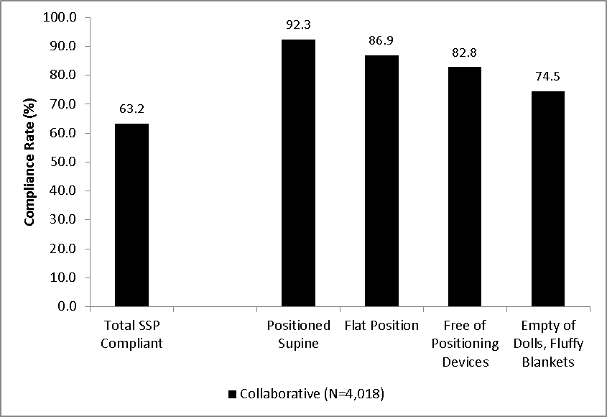
Compliance by Safe Sleep Practice

Slide 82
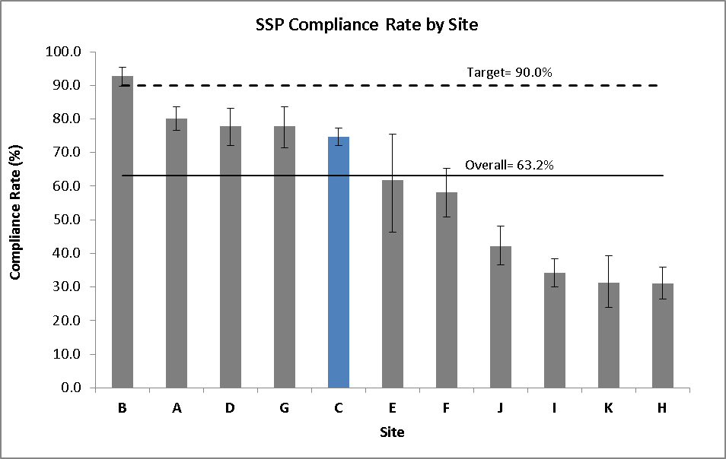
Compliance by Site

Slide 83
Mother’s Own Milk in VLBW Infants
Launched 2015
All 10 level III NICUs in MA
Lead: Meg Parker, Boston Medical Center
2 summits/year, 4 webinars/year, site visits
Extensive QI coaching
Partnership with DPH, WIC
Through September 2016: >700 VLBW infants

Slide 84
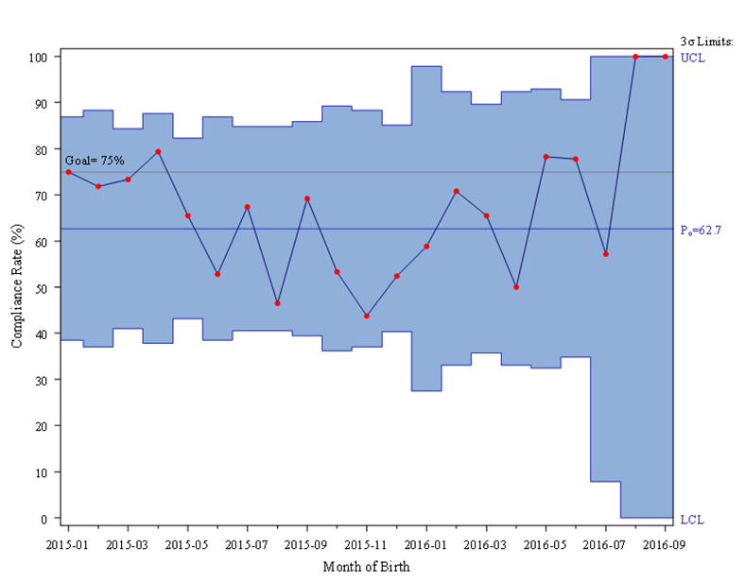
Mother’s Milk, Discharge/Transfer, VLBW

Slide 85
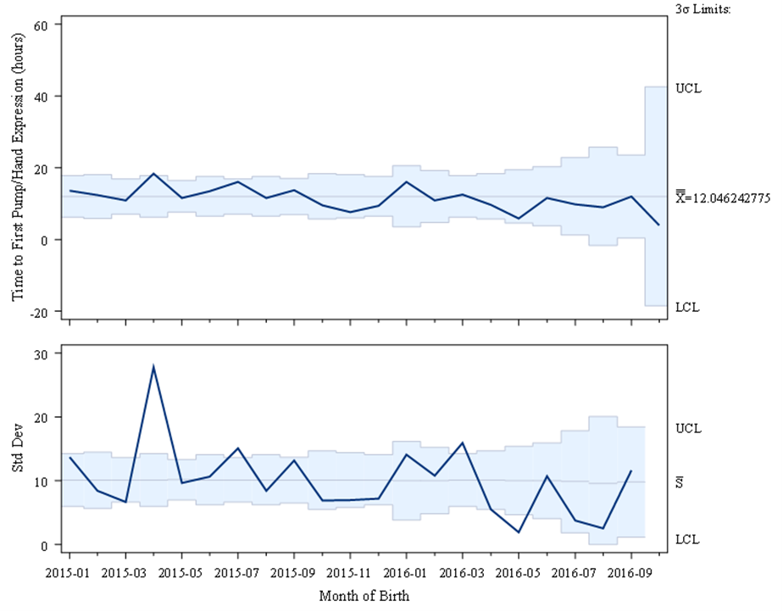
Average Time to First Pump

Slide 86
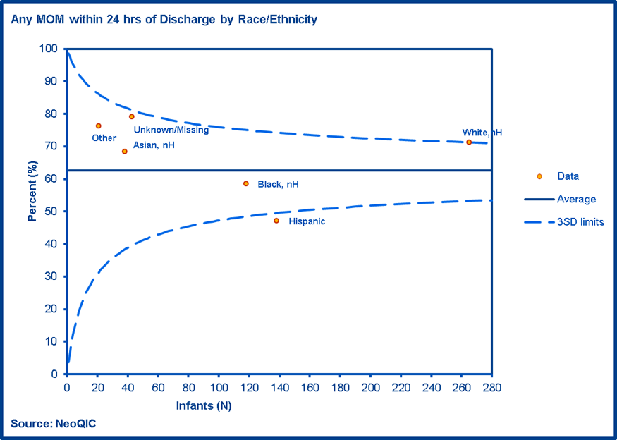
Mother’s Milk, Discharge/Transfer, by Race

Slide 87
NeoQIC NAS Initiative
Collaborative project since 2013
Hospital-based improvement teams
Education through VON webinar series
Twice yearly summits for sharing, learning
Practice surveys and data audits
Local improvements
Partnerships with many state agencies and groups

Slide 88

Participating Centers – NeoQIC NAS
Holy Family
Lawrence General
Health Alliance
Anna Jaques
Lowell General
Beverly
North Shore
Baystate Franklin
Heywood
Winchester
St. Vincent’s
Emerson
Tufts
Cooley Dickinson
MGH
BWH
Spaulding
Berkshire
Holyoke
UMass
Melrose-Wakefield
Metrowest
BIDMC
Baystate
St. Elizabeth’s
BMC
Newton-Wellesley
Mt. Auburn
Mercy
Harrington
Brockton
South Shore
Milford
Good Samaritan
Sturdy
Plymouth
Morton
Charlton
Cape Cod
St. Luke’s
Falmouth
Nantucket

Slide 89
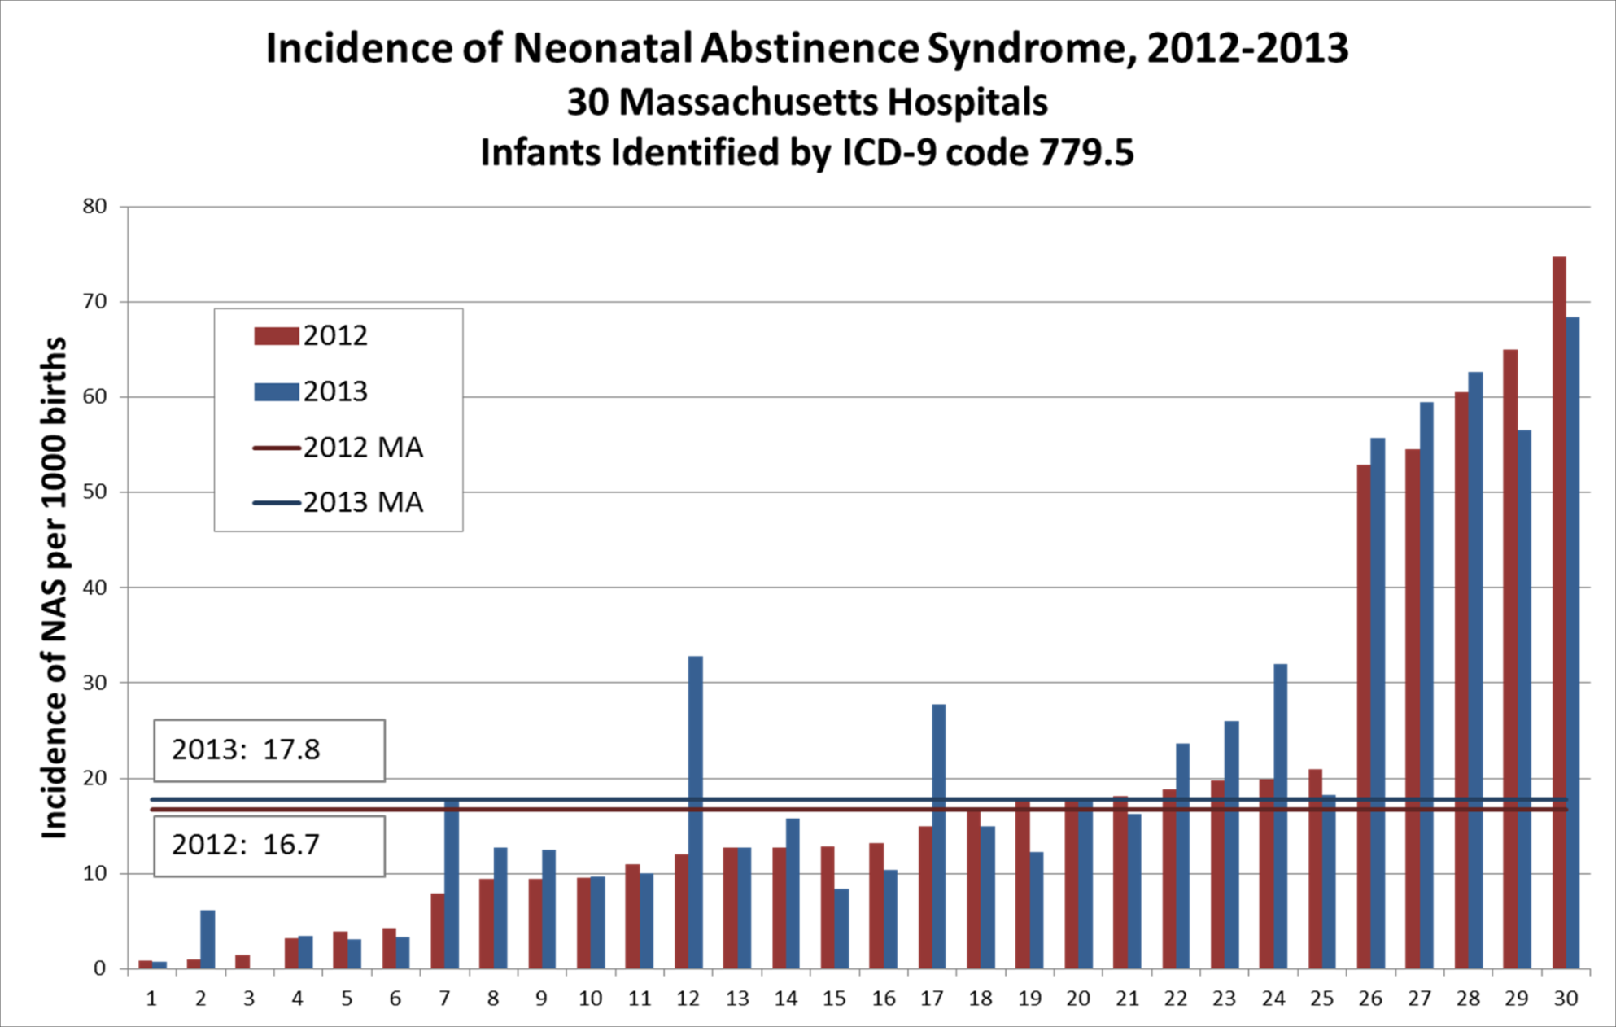

Slide 90
NAS Improvement - Newborn
Risk identification
NAS symptoms
Screening
Testing
Standardized scoring scales
Supportive care
Environment
Rooming-in
Breast-feeding
Pharmacologic management
Morphine
Phenobarbital
Clonidine
Family support
Partnership
Social work
DCF
Follow-up
Nutrition
Methadone
Areas of Improvement:
Standardization of practices
Increased focus on non-pharmacologic care
Increased involvement of families as partners
Improved coordination with community partners
Changing attitudes

Slide 91
SENs and their Families
Family
Pregnancy
Newborn
Infant
Family
BSAS, state agencies, community-based efforts
Hospital-based QI, clinical guidelines, toolkits
Care coordination, DCF, EI, community supports
Goals of Improvement Work Now and in the Future:
Continue, expand, and BETTER COORDINATE efforts throughout the state to improve care across this spectrum
Develop a rigorous, structured clinical quality improvement collaborative initiative to support hospitals across the state seeking to improve care during pregnancy and after delivery

Slide 92
CLABSI/Infections

Slide 93

What Have We Learned?

Slide 94

A Couple “Lessons” from Massachusetts
It’s fine to start simple. Don’t necessary need a fully defined process and structure to start doing collaborative improvement.

Slide 95

A Couple “Lessons” from Massachusetts
Sitting in a room together has a LOT of value.

Slide 96

A Couple “Lessons” from Massachusetts
Data is key. Transparency is really helpful.

Slide 97

A Couple “Lessons” from Massachusetts
Improvement really is local. Specific toolkits and change packages may not always be necessary, or even be helpful.

Slide 98

A Couple “Lessons” from Massachusetts
While it’s ok to separate OB and neonatal efforts, it’s not great either.

Slide 99

A Couple “Lessons” from Massachusetts
Can easily have too many projects.

Slide 100

A Couple “Lessons” from Massachusetts
We’re an IMPROVEMENT organization.
That’s different than other state-based perinatal health groups.

Slide 101

Thanks!
Many people and groups in Massachusetts
All of you, and other state-based PQCs

Slide 102

Q&A
Please come forward to one of the three microphones located in the front of the room to ask a question!

