Slide 1


Slide 2

ILPQC: Welcome
ILPQC Fourth Annual Conference
November 3, 2016

Slide 3

Fly the W!!

Slide 4

Happy 3rd Birthday ILPQC!
Thank you to all who have contributed to building a successful state perinatal quality collaborative for IL
  Sponsors
  Stakeholders
  Advisory Workgroups
  Leadership / Data teams
  Perinatal Network Administrator & Educators
  Hospital Teams
  Patients & Families

Slide 5
Conference Objectives
Select quality improvement tools and methods to improve perinatal outcomes;
Identify successful past/present initiatives in Illinois and other states to reduce adverse perinatal outcomes;
Plan, implement, and sustain a perinatal quality improvement project based on one's expertise;
Compare national, state, and local polices aimed to improve perinatal health.

Slide 6
ONA Approval Statement
This activity will provide 8.1 contact hours.
This continuing nursing education activity was approved by the Ohio Nurses Association, an accredited approver by the American Nurses Credentialing Center’s Commission on Accreditation (OBN-001-91).

Slide 7
Criteria for Successful
Completion
Prior to the learning activities there are no required items to complete.
To obtain full contact hours for CNEs, you need to complete the entire conference (8.1 contact hours) and an evaluation. No partial credit will be awarded.
CEU certificates will be distributed at the end of the conference after the evaluation is turned in.

Slide 8
Disclosures
The planners and faculty have declared no conflict of interest.
Commercial support for this conference was provided by Blue Cross Blue Shield of Illinois and Lupin Pharmaceuticals, Inc.

Slide 9
Agenda
8:00-8:45 | Welcome: Shannon Lightner, MSW, MPA ILPQC: A Year in Review Ann Borders, MD, MSc, MPH Akihiko Noguchi, MD, MPH Patricia Ittmann, DO
8:45-10:15 | Leveraging QI Success in Other States: Leaders from State Perinatal Quality Collaboratives Discuss Key Initiatives William M. Sappenfield, MD, MPH, CPH (Hypertension, Hemorrhage, Golden Hour, Mother’s Own Milk) Michael P. Marcotte, MD (17 OHP, Neonatal Abstinence Syndrome) Munish Gupta, MD, MMSC (Hypertension/Hemorrhage, Neonatal Abstinence Syndrome)
10:15-10:30 | Break
10:30-11:10 | Surviving a Perinatal Crisis: The Patient Perspective – Eleni Z. Tsigas
11:10-12:00 | Keynote: Safe Motherhood Initiative: Standardizing Care for Mothers in New York and Beyond – Mary E. D’Alton, MD
12:00-1:30 | Networking Lunch & Poster Session: Hospital teams from across Illinois share their quality improvement work
1:30-2:15 | Using Data and Measures for Quality Improvement: Tools You Should Be Using Now – Munish Gupta, MD, MMSC
2:15-3:00 | Reduction of Primary Cesarean Sections – The CMQCC Toolkit – Maurice Druzin, MD

Slide 10
Agenda
3:00-3:15 | Break
3:15 – 5:00 | Hot Topics in Obstetrics QI: Discussion of Current and Future Initiatives Ann Borders, MD, MSc, MPH Mary E. D’Alton, MD Maurice Druzin, MD Monty Robertson, MHA Micahel P. Marcotte, MD
 | Hot Topics in Neonatal QI: Discussion of Current and Future Initiatives Akihiko Noguchi, MD, MPH Patricia Ittmann, DO Denise Cornell, MSN, APN, NNP-BC Munish Gupta, MD, MMSC Justin Josephsen, MD Kamlesh Macwan, MD William M. Sappenfield, MD, MPH, CPH
 | Engaging Patients and Families in Quality Improvement Eleni Z. Tsigas Terry Griffin, MS, APN, NNP-BC
5:00 – 5:15 | Wrap-up & Evaluation

Slide 11
Agenda
Also during poster session:
  In addition to looking at all of our great posters, check out the poster awards of excellence (look for the white ribbon with the ILPQC logo)
  Terry Griffin is available to answer team patient/family engagement questions (see program for Terry’s location in poster area)
  Jazzmin Cooper will be available to answer your provider ABOG MOC Part IV Credit questions in the registration area

Slide 12
ILPQC Welcome:
Shannon Lightner, MSW, MPA
ILPQC Fourth Annual Conference
November 3, 2016

Slide 13
ILPQC:
A Year in Review
ILPQC Fourth Annual Conference
November 3, 2016

Slide 14
Overview
ILPQC accomplishments for 2016
  Sustain and develop state-wide participation
  Offer responsive QI services to hospital teams
  Celebrate Birth Certificate Initiative success 2015
  Engage patients/families in QI work
  Implement new/advance ongoing initiatives
Our current initiative highlights
  Golden Hour
  MOD Big 5 ACT
  Maternal Hypertension
  Plan future initiatives for 2017 and beyond

Slide 15


Vision
A statewide perinatal quality collaborative that involves all perinatal stakeholders; utilizes data-driven, evidence-based practices; improves perinatal quality resulting in improved birth outcomes, improved health for women and infants, and decreased costs; builds on Illinois’ existing state-mandated Regionalized Perinatal System, and operates with long-term sustainable funding.

Slide 16
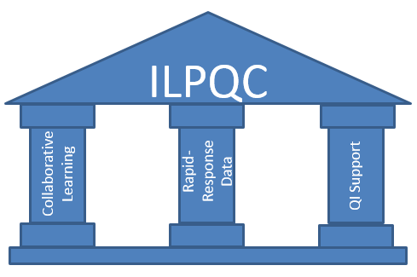
Three Pillars Support
Quality Improvement Success

Slide 17
ILPQC Timeline
IL Perinatal Advisory Committee Prematurity Task Force Report Released
Stakeholder Meetings Begin
Website Launch
2nd Annual ILPQC Conference
3nd Annual ILPQC Conference
4th Annual ILPQC Conference
Start Up Funding CHIPRA / HFS
ILPQC Kick-Off Conference
Consultation with Perinatal Quality Leaders
OH, CA, NC, FL
Launch EED and Neonatal Nutrition Initiatives
Launch Maternal Hypertension Initiative
Launch Birth Certificate Initiative
ILPQC Data System launched
Launch Golden Hour Initiative
IDPH Funding
CDC Award with IDPH
Nov.
2012
Sept.
2013
Nov.
2013
Jun.
2014
Sept.
2014
Nov.
2014
Dec.
2014
Apr.
2015
Nov.
2015
Jan.
2016
Nov.
2016

Slide 18
Goal 1: Sustain and Develop
State-wide Participation
112 hospitals participating in QI initiatives
71% participated in at least one activity (e.g. teams call, face-to-face meeting)
49% of Maternal Hypertension teams are from networks outside of the Chicagoland area
75% of the neonatal centers from networks outside of the Chicagoland area are participating in Golden Hour
Strong advisory group participation
  OB Advisory Group – 74 members representing 30 hospitals with 25-30 participants on each monthly call
  Neonatal Advisory – 22 members representing 18 hospitals

Slide 19

Hospital Engagement
112 hospitals participating in one or more ILPQC Initiative
110 hospitals in OB Initiatives
  Over 95% of IL births covered by ILPQC
26 hospitals in Neonatal
Initiative
  Over 85% of IL NICU beds covered by ILPQC

Slide 20
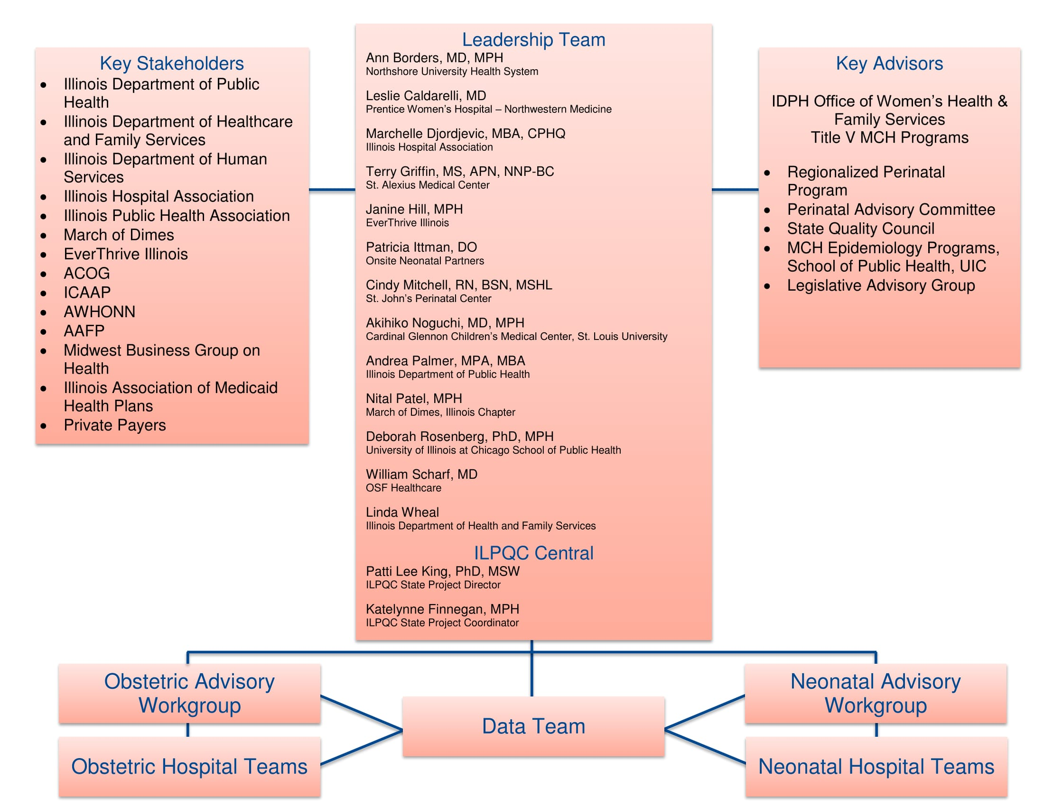
ILPQC Infrastructure

Slide 21
OB Advisory Group
Andrea Palmer
Amanda Bennett
Angela Rodriguez
Angie Bowen
April Caruso
Carol Andrychowski
Carol Burke*
Chelsea Rogers
Cindy Mitchell
Deb Landacre
Deb Rosenburg
Debbie Miller
Debbie Schy
Debra Kamradt
Denise Massey
Dr. Angelique Rettig*
Dr. Ann Borders*
*Hypertension Leadership Team
Dr. Barbara M. Scavone
Dr. Bill Grobman
Dr. Bridgette Blazek
Dr. Emmet Hirsch
Dr. Heather Stanley-Christian
Dr. Howard Strassner
Dr. Jean Goodman
Dr. Jim Keller
Dr. Jodee Brandon
Dr. Jude Duval
Dr. Latasha Nelson
Dr. Maura Quinlan
Dr. Mayank Shah
Dr. Michael Leonardi
Dr. Michael Socol
Dr. Patricia Heywood

Slide 22
OB Advisory Group (cont.)
Dr. Phil Higgins
Dr. Sarosh Rana
Dr. Rahmat Na'Allah
Dr. Ralph Kehl
Dr. Regina Gomez
Dr. Rob Abrams
Dr. Sherry Jones
Dr. Soti Markuly
Dr. Tina Wheat
Emanuel Vlastos
Felicia Feifer
Jean Mahoney
Jennifer Hofer
Jennifer Woo
Jessica Bimm Rosati
Kai Tao
Katie Warren
Kim Armour
Kisha Semenuk
Kristin Salyards
Lisa Sullivan
Lori Andriakos
Mahmoud Ismail
Margaret Villareal
Maripat Zeschke*
Mary Jean Handrigan
Melissa Claudio
Miranda Scott
Mona LeGrand
Myra Sabini
Pam Wolfe
Pat Joschko
Robbin Uchison
Roma Allen
Samantha Schoenfelder
Sheila Rhodes
Sue Hesse
Susan Fulara
Trish O'Malley
Trishna Harris
*Hypertension Leadership Team

Slide 23
Neonatal Advisory Group
Aarti Raghavan
Akihiko Noguchi
Alok Rastogi
Anthony Bell
Colleen Mallory
Elaine Shafer
Jean Silvestri
Joel Fisher
Joseph Hageman
Kamlesh Macwan
Leslie Caldarelli
Maliha Shareef
Marc Weiss
Matthew Derrick
Patricia Ittmann
Preetha Prezad
Radley Hein
Robert Covert
Syd Foreman
Venkata Majjiga
Vibhan Thaker
William Stratton

Slide 24
Goal 2: Offer Responsive QI
Services to Hospital Teams
  Monthly OB & Neonatal team calls with team talks
  May 2016, OB & Neonatal Face-to-face meetings with approximately 325 participants total
  4 Maternal Hypertension QI topic workshops with about 50 hospitals and topic champions sharing strategies
  Facilitated OB & Neonatal topic discussion boards in members’ only section
  Facilitated twice-monthly OB teams newsletter & Golden Hour Listserv
  Monthly updates of key resources on ilpqc.org
  Developed real-time reports to work with rapid-response data system for each initiative

Slide 25
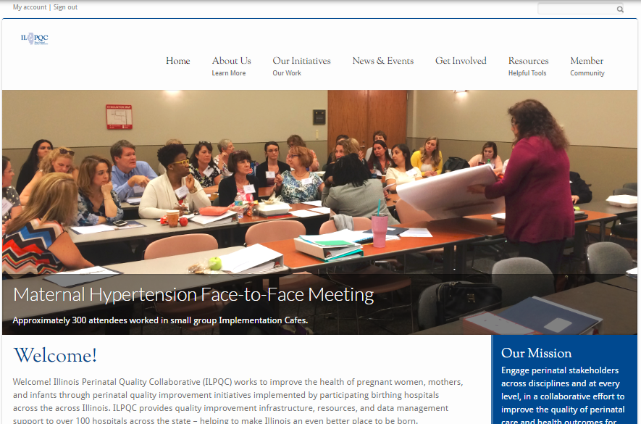
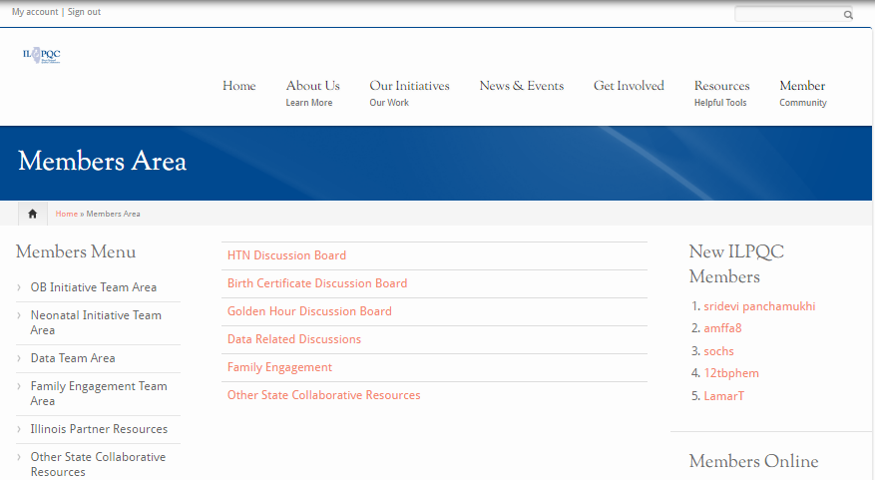
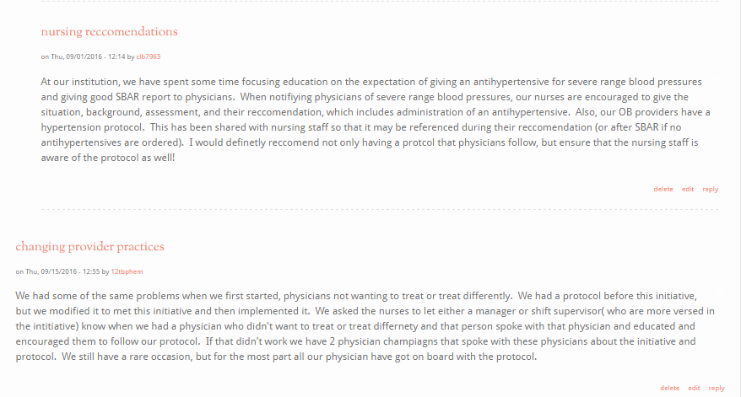
www.ilpqc.org
Team Sharing on Discussion Boards

Slide 26
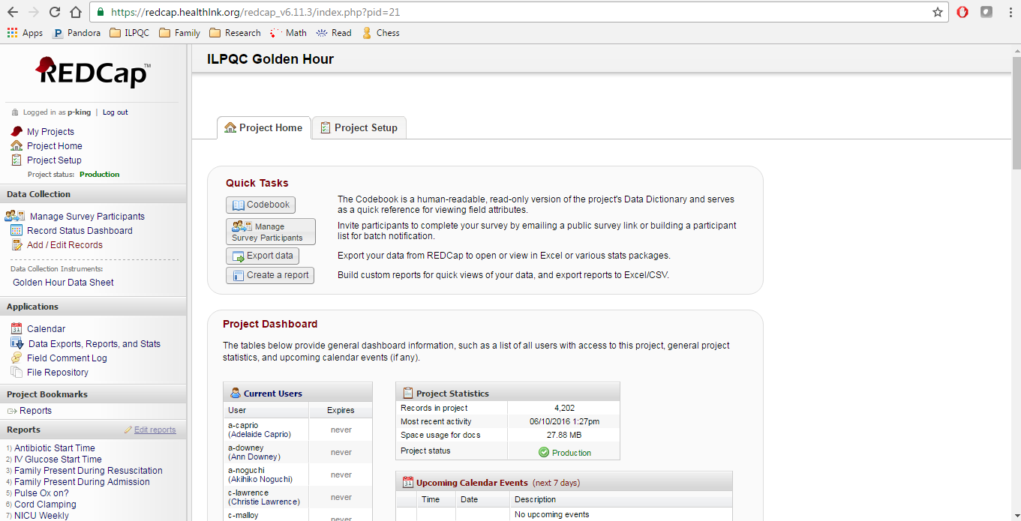
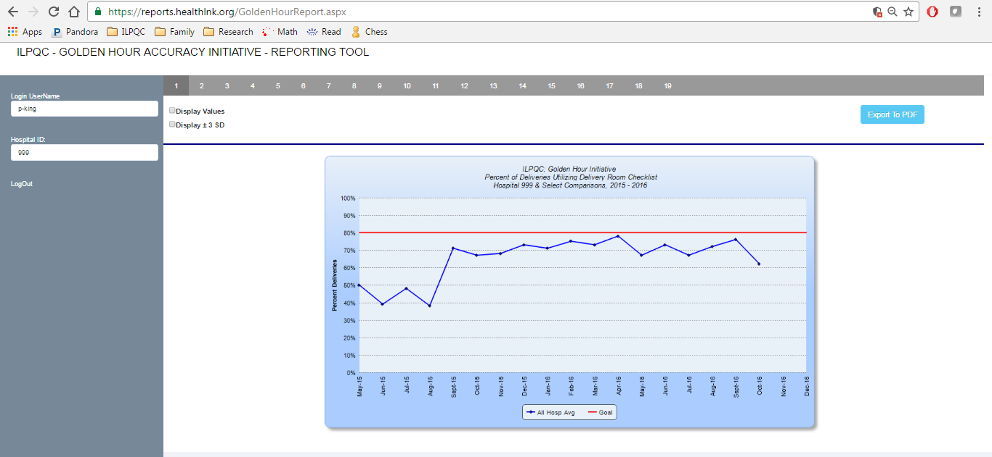
ILPQC Data System
Rapid Response reports on outcome, process, and balancing measures allows each hospital to compare data across time and across hospitals

Slide 27

Goal 3: Celebrate Birth
Certificate Accuracy Initiative Success
Aim: In partnership with IDPH and IHA, obtain at least 95% accuracy on 17 key birth certificate variables by December 2015
Results:
107 teams participated; 230 face to face attendees
Improved BC accuracy from 87% to 97% across 109 hospitals
Commended 81 (76%) hospitals reaching >95% accuracy for Oct, Nov, or Dec 2015
Accurate, rapid response data that provides comparison across time and across participating hospitals is crucial to identify opportunities for improvement, focus efforts, gauge progress and improve outcomes

Slide 28
BC Accuracy: Overall Accuracy of All Variables

Slide 29
BC Accuracy Improvement from Baseline to Date

Slide 30
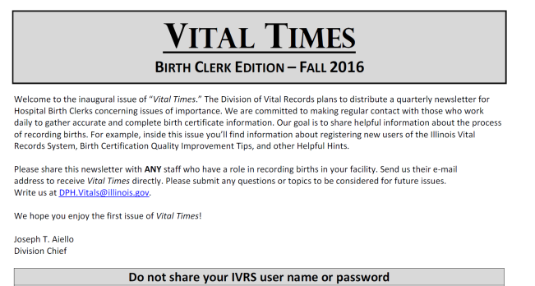
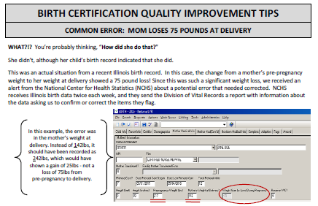
Birth Certificate Accuracy
Sustainability with Vital Records
Hospital Level
Quarterly audits to monitor accuracy levels
Monthly team meetings
New hire training
EMR integration
Support for Staff
Reestablish Quarterly Newsletters
In-Person Training
Yearly Conference
Maintain Current Reference Material
Avenues for Improved Communication

Slide 31

Goal 4: Engage Patients &
Families in QI Work
Golden Hour initiative included patient/family engagement measures
OB and Neonatal teams to identify a patient/family advisor for their QI team
Developed information sheet and patient/family advisor recruitment resources for hospital teams
Recruiting Patient/Family Advisor for ILPQC OB and Neonatal Advisory Groups

Slide 32
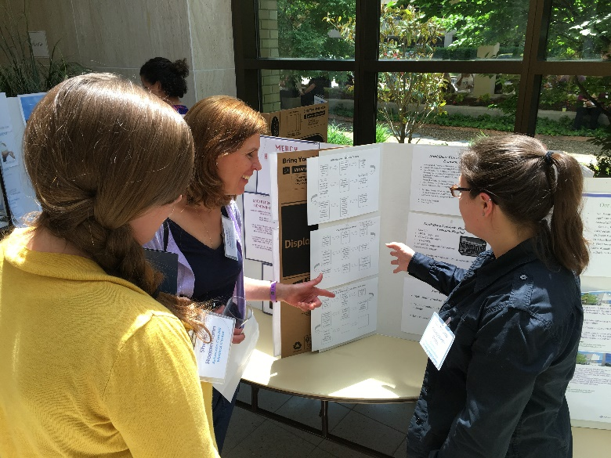
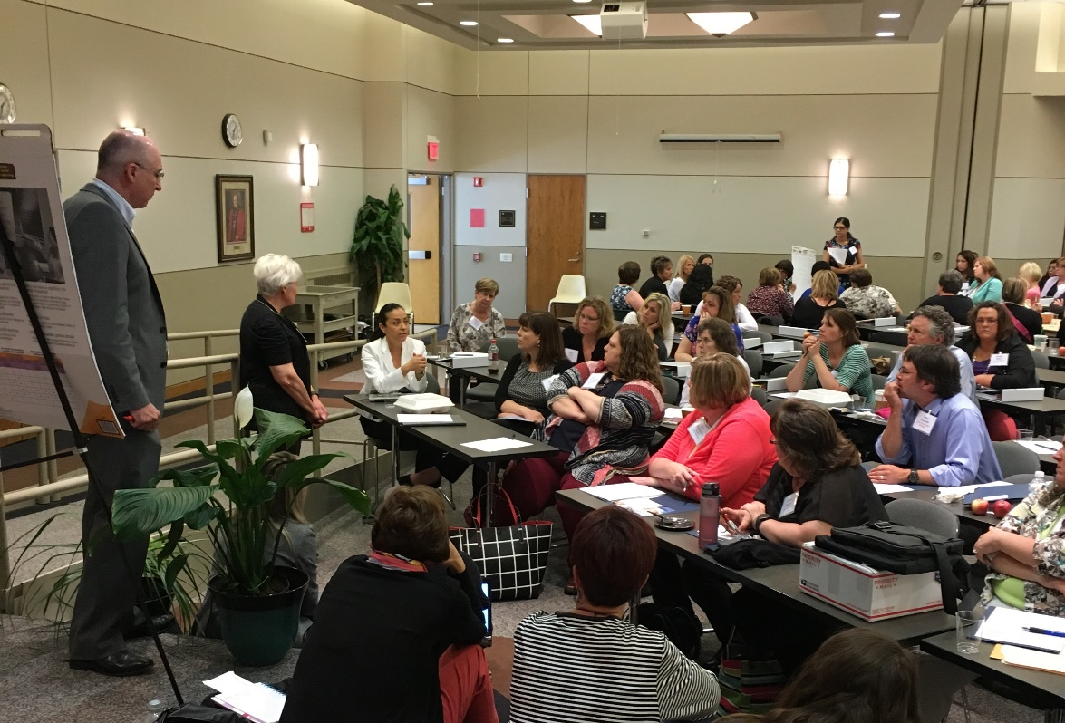


Goal 5: Working Together on
State-wide Initiatives

Slide 33
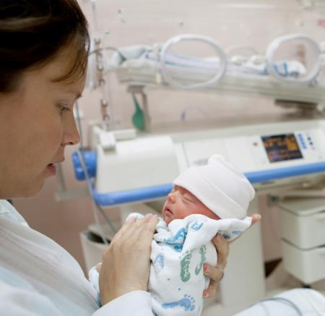
Neonatal Golden Hour
Initiative
Aim: Implement resuscitation checklist with brief and debrief of the OB and nursery team in 80% of high-risk deliveries by December 2017 to reduce the rate of infants with chronic lung disease, retinopothy of prematurity and intraventricular hemorrhage
Approach: Establish workgroup, identify hospital teams, implement toolkit with evidenced based practices for first hours of life
23 Level II, II+, & III NICUs participating
Data collection in progress with 4,215 infants entered in to ILPQC Data System as of 10/13/2106
Kick-off April 20, 2015, Face-to-Face May 13, 2016

Slide 34
Golden Hour Toolkit Team
Mohamad Al-Hosni
Margaret Behm
Leslie Caldarelli
Kim Carmignani
Matthew Derrick
Rhonda Gale
Terry Griffin
Jodi Hoskins
Justin Josephsen
Venkata Majjiga
Lisa Maloney
Tonya Mangiaguerra
Aaron Muller
Akihiko Noguchi
Steven B. Powell
Katherine Robbins
Beverly Robin
Korina Sanchez
Maliha Shareef

Slide 35
Golden Hour Goals
Increase use of evidence-based practices in:
  Delivery room team communication (brief, debrief, checklist)
  Delivery room clinical practices (CPAP, surfactant, timed cord clamping)
  Family engagement (family contact pre-delivery, family present at resuscitation and NICU admission)
  Neonatal intensive care unit (NICU) admission (standardize admission, intravenous glucose and antibiotics, admission temperature)
Potential Cost Savings: Based on current projections, reduction in chronic lung disease and intraventricular hemorrhage could result in over $10 million in savings

Slide 36
Neonatal Golden Hour:
Communication Practices

Slide 37
Neonatal Golden Hour:
Delivery Room Practices
Goals:
CPAP = 70%
TCC = 80%

Slide 38
Neonatal Golden Hour:
Family Practices

Slide 39
Neonatal Golden Hour:
Admission Practices
Goals:
IV Glucose & Antibiotics = 80%
Temp = 90%

Slide 40

March of Dimes Big 5 Antenatal
Corticosteroids (ACT) Initiative
Aim: To optimize ACT administration and documentation to >90% of eligible women who deliver between 23 ^{0/6} and 34 ^{6/7} weeks gestation by December 2016.
Approach: Establish workgroup, identify hospital teams, implement evidence-based practices for administration of antenatal corticosteroids to eligible mothers
11 Illinois hospitals are participating with CA, FL, NY and TX
IL Face-to-face meeting October 2015
  Monthly webinars and quality improvement work
  Baseline (May-July 2015) then monthly data collection (January-December 2016) in MOD data portal

Slide 41
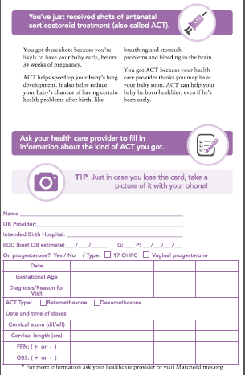
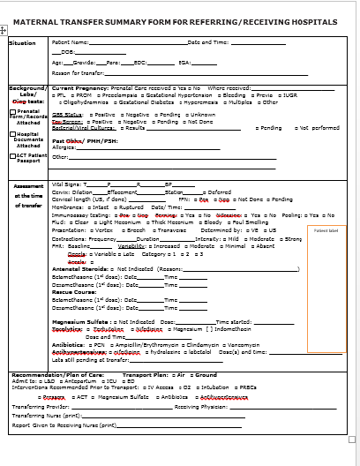
MOD Big 5 ACT Resources
Patient Passport
Maternal
Transport
Available on ILPQC Website to improve documentation of ACT administration

Slide 42
MOD ACT QI Work in IL
  Developing systems to alert providers about patients’ ACT status
  Training for medical records staff on how to identify and report ACT courses in patient charts
  Education resources for patients with signs and symptoms of preterm labor about the importance and benefits of ACT
  Documenting information on ACT administration for women whose preterm labor does not progress and are sent home

Slide 43
MOD ACT Data

Slide 44

ILPQC Maternal
Hypertension Initiative
Aim: Reduce the rate of severe morbidities in women with severe preeclampsia, eclampsia, or preeclampsia superimposed on pre-existing hypertension by 20% by Dec. 2017
Approach: Establish workgroup, identify hospital teams, implement evidence-based practices / protocols / AIM HTN Bundle
  Letter from IDPH Director distributed to all hospitals in the state
  110 hospital teams - 23 Wave 1 (Jan 2016), 87 Wave 2 teams (May 2016)
  HTN Kick-off Call – May 2 with 284 participants from 97 hospitals (88%)
  HTN Face-to-Face – May 23, Springfield, IL with 288 attendees from 101 hospitals (92%)

Slide 45
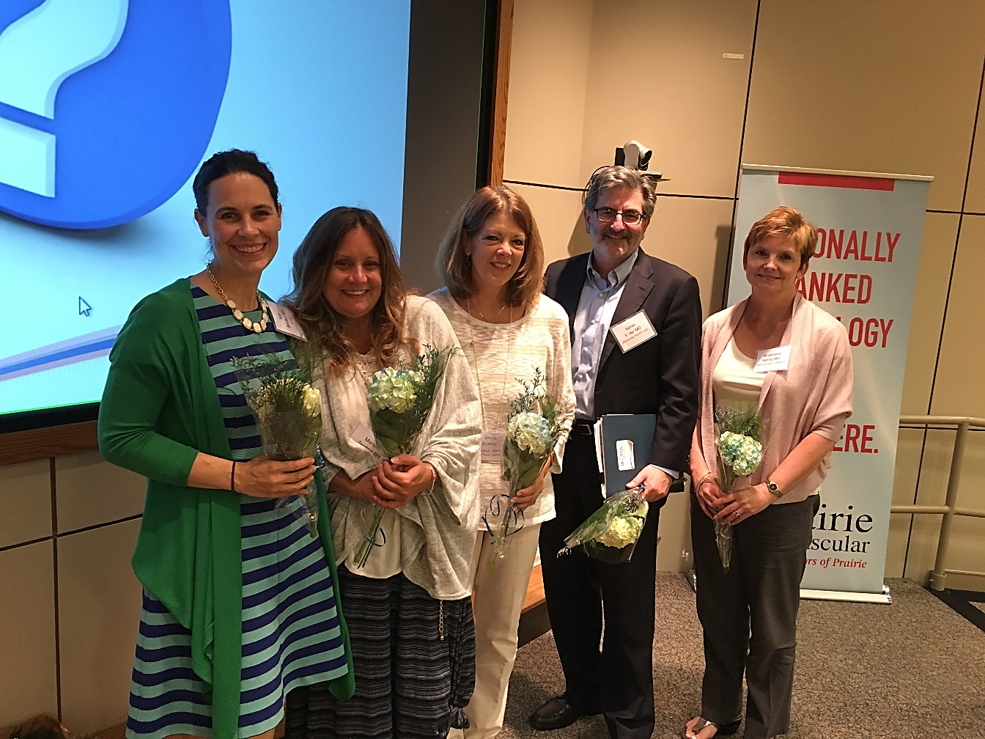
Maternal Hypertension
Leadership Team
Ann Borders
Carol Burke
Jim Keller
Angelique Rettig
Maripat Zeshke

Slide 46
Maternal Hypertension Goals
IL Measure | Type | Goal
Severe Maternal Morbidity (SMM) No. of women with severe maternal morbidities (e.g. Acute renal failure, ARDS, Pulmonary Edema, Puerperal CNS Disorder such as Seizure, DIC, Ventilation, Abruption) / No. pregnant & postpartum women with new onset severe range HTN | Outcome | 20% reduction
Appropriate Medical Management in under 60 minutes No. of women treated at different time points (30,60,90, >90 min) after elevated BP is confirmed / No. of women with new onset severe range HTN | Process | 100%
Debriefs on all new onset severe range HTN* cases | Process | 100%
Discharge education and follow-up within 10 days for all women with severe range HTN, 72 hours with all women with severe range HTN on medications | Process | 100%
$5-9 million in estimated potential savings in hospital medical care costs when SMM cases linked to preeclampsia are reduced by use of appropriate identification and treatment
Severe range HTN: ≥160 systolic / ≥110(105) diastolic per hospital standard
*New onset severe range HTN: first episode of persistent severe range HTN (lasting >15 minutes) in a hospitalization (ER, L&D, or other inpatient setting), can be chronic HTN, gestational HTN, preeclampsia and/or postpartum diagnosis.

Slide 47
REVISED - Key Driver Diagram: Maternal Hypertension Initiative
GOAL: To reduce preeclampsia maternal morbidity in Illinois hospitals
Key Drivers
Interventions
AIM: By December 2017, to reduce the rate of severe morbidities in women with preeclampsia, eclampsia, or preeclampsia superimposed on pre-existing hypertension by 20%
GET READY
IMPLEMENT STANDARD PROCESSES for optimal care of severe maternal hypertension in pregnancy
Develop standard order sets, protocols, and checklists for recognition and response to severe maternal hypertension and integrate into EHR
Ensure rapid access to IV and PO anti-hypertensive medications with guide for administration and dosage (e.g. standing orders, medication kits, rapid response team)
Educate OB, ED, and anesthesiology physicians, midwives, and nurses on recognition and response to severe maternal hypertension and apply in regular simulation drills
RECOGNIZE
IDENTIFY pregnant and postpartum women and ASSESS for severe maternal hypertension in pregnancy
Implement a system to identify pregnant and postpartum women in all hospital departments
Execute protocol for measurement, assessment, and monitoring of blood pressure and urine protein for all pregnant and postpartum women
Implement protocol for patient-centered education of women and their families on signs and symptoms of severe hypertension
RESPOND
TREAT in 30 to 60 minutes every pregnant or postpartum woman with new onset severe hypertension
Execute protocols for appropriate medical management in 30 to 60 minutes
Implement a system to provide patient-centered discharge education materials on severe maternal hypertension
Implement protocols to ensure patient follow-up within 10 days for all women with severe hypertension and 72 hours for all women on medications
CHANGE SYSTEMS
FOSTER A CULTURE OF SAFETY and improvement for care of women with new onset severe hypertension
Establish a system to perform regular debriefs after all new onset severe maternal hypertension cases
Establish a process in your hospital to perform multidisciplinary systems-level reviews on all severe maternal hypertension cases admitted to ICU
Incorporate severe maternal hypertension recognition and response protocols into ongoing education (e.g. orientations, annual competency assessments)

Slide 48
IL State SMM Data:
Excluding Hemorrhage

Slide 49
Maternal Hypertension Data

Slide 50
Looking Ahead
2017 Call to Action
Obstetric teams focus work towards goals on Maternal Hypertension Initiative
Neonatal teams focus work towards goals on Golden Hour Initiative
ILPQC will continue to engage stakeholders and hospital teams from across the state to provide opportunities for collaborative learning, rapid response data and QI support

Slide 51
Learning from other state's projects for possible future initiatives
Maternal opioid use/addiction and Neonatal Abstinence Syndrome*
Long-acting Reversible Contraception (LARC) at Delivery
Support vaginal birth and reduce primary cesareans
Progesterone therapy for recurrent preterm birth prevention
Breastfeeding and breastmilk in the NICU
Antenatal corticosteroids optimization
Continued work on maternal morbidity reduction (hypertension, hemorrhage, VTE)

Slide 52

Improving Together
ILPQC is a collaborative of physicians, nurses, hospital teams, public health and other stakeholders working together to succeed
Thank you all – we look forward to continuing our work together for healthier moms and babies in Illinois

