Slide 1

Illinois Perinatal Quality Collaborative: Next Steps and Wrap Up
ILPQC Fourth Annual Conference
November 3, 2016

Slide 2
Wrap up from Breakouts:
Obstetric
Neonatal
Patient / Family Engagement

Slide 3
Next Steps for ILPQC
Continue Obstetric Maternal Hypertension Initiative
  Focus on QI work and Key Driver Interventions; Engage providers and develop physician champions
Continue Neonatal Golden Hour Initiative
  Focus on key areas for improvement
Continue to provide valued QI services to hospital teams
Continue to engage stakeholders / key advisory groups
Ongoing focus on sustainable funding
Plan for 2018 and beyond
  Neonatal Abstinence Syndrome Initiative
  Future Obstetric Initiative

Slide 4
To Participate in an
ILPQC QI Initiative
Contact info@ilpqc.org for more information on our current initiatives
  Obstetric Maternal Hypertension (continuing from 2016)
  Neonatal Golden Hour (continuing from 2015)

Slide 5
To Participate in an
Advisory Workgroup
Neonatal, Obstetric, and Data Advisory Workgroups meet regularly to provide guidance for ILPQC initiatives
Representation across state, perinatal levels, and professions (MDs, RNs, QI, public health)
Contact info@ilpqc.org to participate or for more information

Slide 6

Happy 3rd Birthday ILPQC!
Thank you to all who have contributed to building a successful state perinatal quality collaborative for IL
  Sponsors
  Stakeholders
  Advisory Workgroups
  Leadership / Data teams
  Perinatal Network Administrator & Educators
  Hospital Teams
  Patients & Families

Slide 7
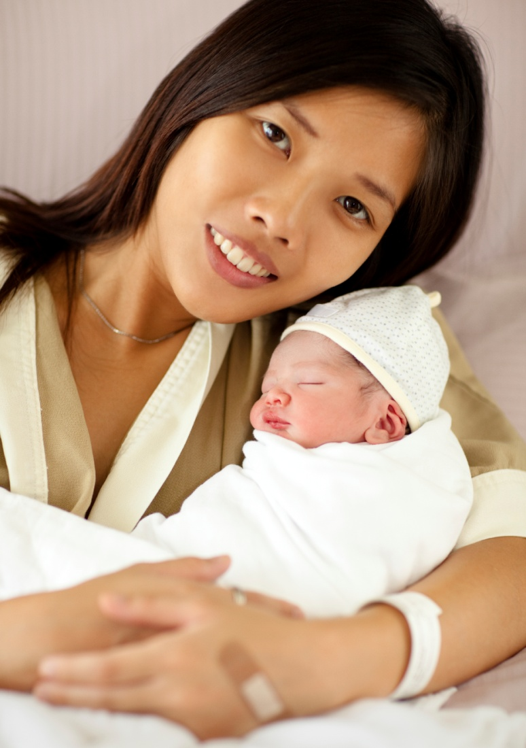
ILPQC Administrative Team
Ann Borders
ILPQC Executive Director, OB Lead
Aki Noguchi, Pat Ittmann,
Leslie Caldarelli
Neonatal Leads
Patricia Lee King
State Project Director
Kate Finnegan
Project Coordinator
info@ilpqc.org OR www.ilpqc.org

Slide 8


