Slide 1
ILPQC Neonatal Breakout Session
November 3rd 2016

Slide 2
Agenda
Welcome and introductions
Videos
Cardinal Glennon
CHOI
Golden Hour Data- a different look by Munish Gupta
NAS- Aki

Slide 3
Quality Improvement of Neonatal Resuscitation using Video Recordings
Justin Josephsen, MD
Laura Cerny, MD
ILPQC Conference
November 3, 2016

Slide 4
Disclosures
Dr. Josephsen and Dr. Cerny have no conflicts of interest to disclose

Slide 5
Objective
Project overview
Risk Management
Equipment
Committee and Process
Review Video
Practice Improvements

Slide 6
Project Overview
Goal of project:
  Improvement of neonatal resuscitation practices with video recordings and subsequent debriefings

Slide 7
Risk Management
Parent consent obtained upon admission to NICU
Videos automatically and permanently erased after 30 days
Retained videos require separate consent
Sign posted in DR informing of video recording in progress.

Slide 8
Room Layout and Equipment
Resuscitation room adjacent to delivery room
  Mother not in camera view
5 cameras with HD capabilities
Captures both video and audio
Automatic initiation of recording by motion detection
Recordings are stored on a secure server maintained by the IT department
Software access is individual password protected

Slide 9
Review Process
Review committee consisting of physicians, NNPs, L&D nurses, risk management, and nursing administration
Cases subject to review:
  Advanced resuscitation (chest compressions, meds, lines placed in DR)
  Unexpected outcomes
  Staff concerns
  Complex anomalies
  ELBW/<26 weeks gestation
  APGARS <5 at 5 minutes

Slide 10
A sample video
Confidentiality statement
Team building phrases only
The flag

Slide 11
Practice Improvements
Inadequate role assignment and compliance
Nurses did not always have a place at the bedside (teaching hospital)
Performance checklist compliance low
Lack of timely pressure increase per MR SOPA
Nursing education gap when giving emergency blood
Ventilation rate not per NRP recommendations (40-60)

Slide 12
Thank you
.

Slide 13
Golden Hour Management:
Neonatal Stabilization in the Delivery Room Including Delayed Cord Clamping
ILPQC Annual Meeting, Lombard, Illinois
November 3, 2016
Kamlesh Macwan MD
Clinical Associate Professor
University of Illinois College of Medicine, Peoria
Associate Director of NICU
Children Hospital of Illinois at OSF St. Francis Medical Center, Peoria, Illinois

Slide 14
Percentage of Survival

Slide 15
Outcome of VLBW (2014)

Slide 16
 | Participant (n) | GA | Follow up mean + SD | Moderate to severe NDI | CP (%) | IQ < 70 (%) | Blind (%) | Deaf (%)
Short term outcome | 5179 | < 27 wks | 27 + 5 months | 32 % | 15 % |  | 7 % | 6 %
Long term outcome | 3171 | < 27 wks | 7.3 + 2.6 years | 33 % | 13% | 19% | 4% | 2%
Neurodevelopmental Outcome After Extreme Prematurity: A Review of the Literature
Imad T. Jarjour MD*
Pediatric Neurology 52 (2015) 143e152

Slide 18
Driver Diagram: Family Integration
Increase visits and family to spend more time in the NICU with the baby
Identify and overcome the barriers
Involve the FAB, Parent Mentor Team and Family Support staff to increase support for family presence at the bedside
Educate the family about :
Skin to skin care
Involve in the care as a partner in the buddy system
Educate and implement the Developmental Care Map appropriately for gestational age for both families and staff
Increase Family involvement in the care of their neonates
Family support via telemedicine
Family/mother in postpartum at OSF
Family at referring hospital
Family at home
Develop and provide brochures for the follow up program
Increase follow up visit to RDFP and EIS
Follow up coordinator
Educate 100 % of the eligible families in the NICU
Follow up by phone calls and text
Collect the data of the outcome

Slide 19

Classical Conditioning (also known as Pavlovian): is a learning process in which an innate response to a potent stimulus comes to be elicited in response to a previously neutral stimulus; this is achieved by repeated pairings of the neutral stimulus with the potent stimulus
Operant Conditioning: behaviors are learning processes that are strengthened or weakened by their consequences (i.e., reward or punishment)
Conditioned reflexes are a function of the cerebral cortex

Slide 20
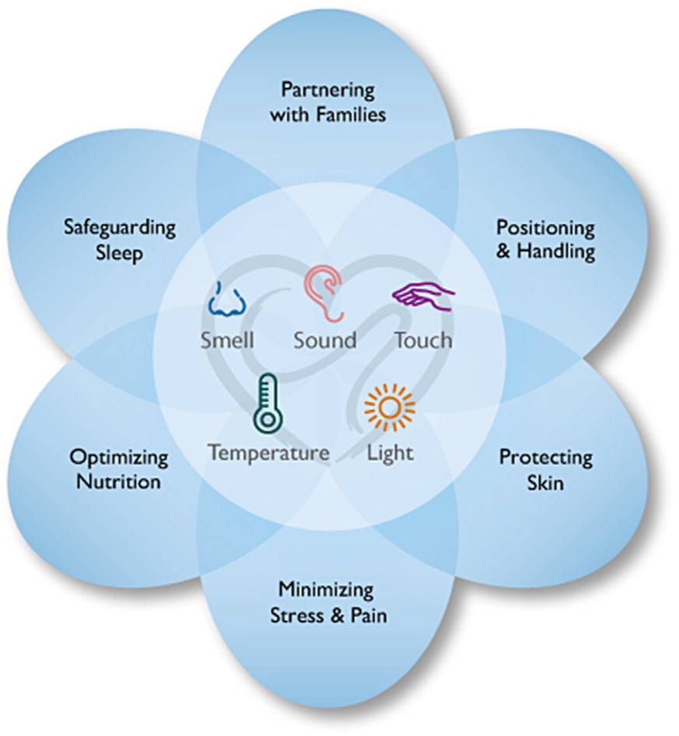

Slide 21

Golden Hour Management:
Neonatal Stabilization in the Delivery Room Including Delayed Cord Clamping

Slide 22

Improvement Work for Substance-Exposed Newborns in Massachusetts
Munish Gupta, MD MMSc
ILPQC Meeting, Neonatal Breakout
November 3, 2016

Slide 23
Long History of SEN Work at State Level
State (very incomplete list)
Increasing treatment availability, particularly for women, including mandatory insurance coverage
Improving DCF screening and monitoring protocols
Efforts to increase EI enrollment for SENs
Community-based support programs for SEN families
Increased investments for innovation around NAS
Many efforts to reduce opioid burden, including PMP
Widespread availability of Naloxone
Governor’s Task Force, legislation

Slide 24
NeoQIC NAS Improvement Project
Collaborative project since 2013
Hospital-based improvement teams
Education through VON webinar series
Twice yearly summits for sharing, learning
Practice surveys and data audits
Local improvements
Partnerships with many state agencies and groups

Slide 25
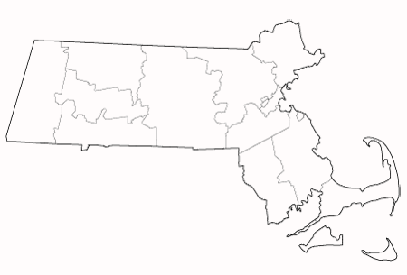
Participating Centers - NeoQIC
Holy Family
Lawrence General
Health Alliance
Anna Jaques
Lowell General
Beverly
North Shore
Baystate Franklin
Heywood
Winchester
St. Vincent’s
Emerson
Tufts
Cooley Dickinson
MGH
BWH
Spaulding
Berkshire
Holyoke
UMass
Melrose-Wakefield
Metrowest
BIDMC
Baystate
St. Elizabeth’s
BMC
Newton-Wellesley
Mt. Auburn
Mercy
Harrington
Brockton
South Shore
Milford
Good Samaritan
Sturdy
Plymouth
Morton
Charlton
Cape Cod
St. Luke’s
Falmouth
Nantucket

Slide 26
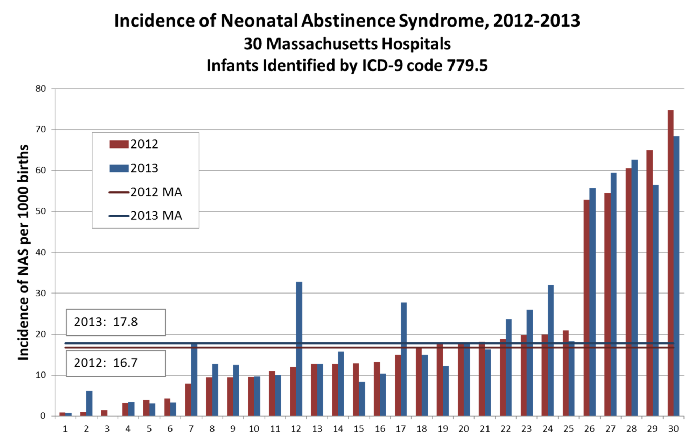
What have we learned?

Slide 27
NAS Improvement - Newborn
Risk identification
NAS symptoms
Screening
Testing
Standardized scoring scales
Supportive care
Environment
Rooming-in
Breast-feeding
Pharmacologic management
Morphine
Phenobarbital
Clonidine
Family support
Partnership
Social work
DCF
Follow-up
Nutrition
Methadone
Areas of Improvement:
Standardization of practices
Increased focus on non-pharmacologic care
Increased involvement of families as partners
Improved coordination with community partners
Changing attitudes

Slide 28
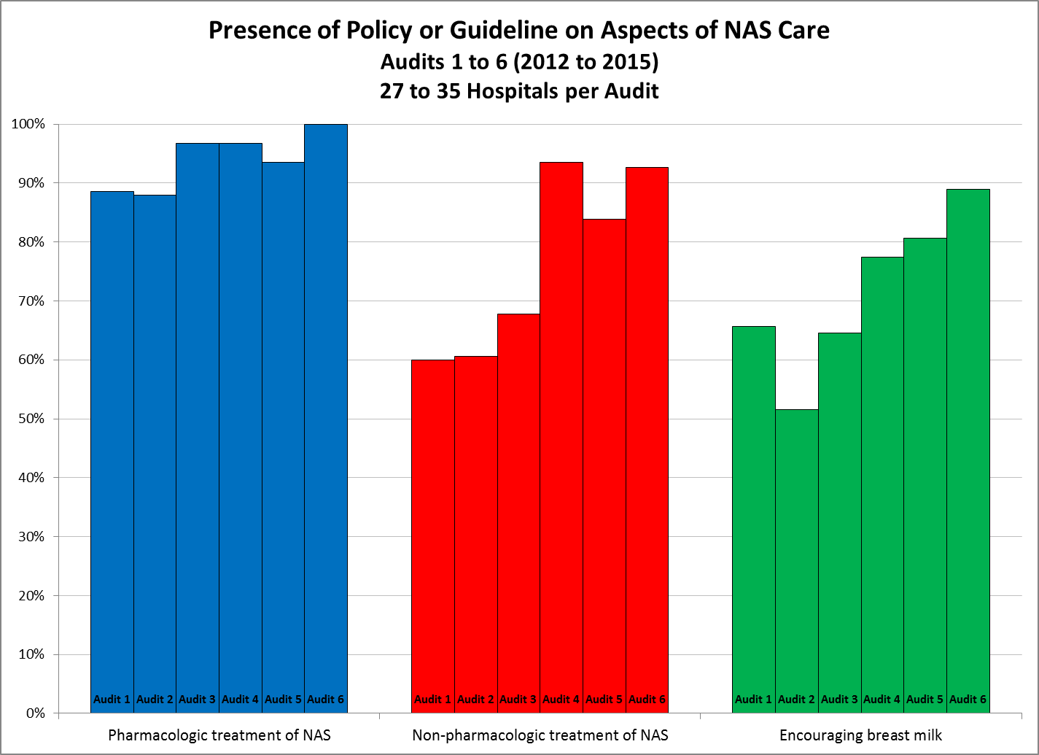

Slide 29
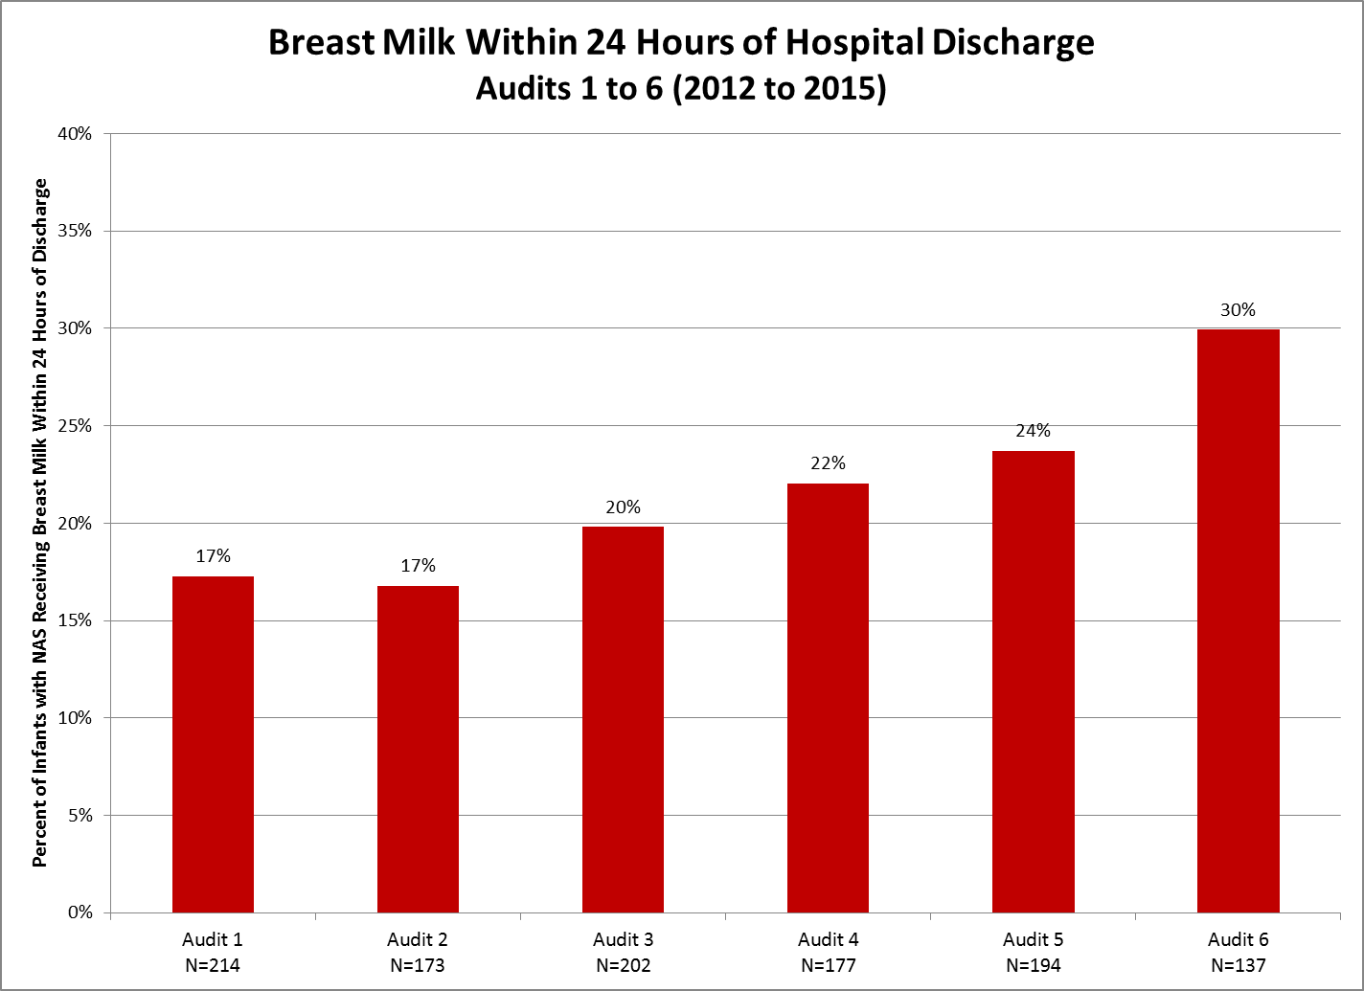

Slide 30
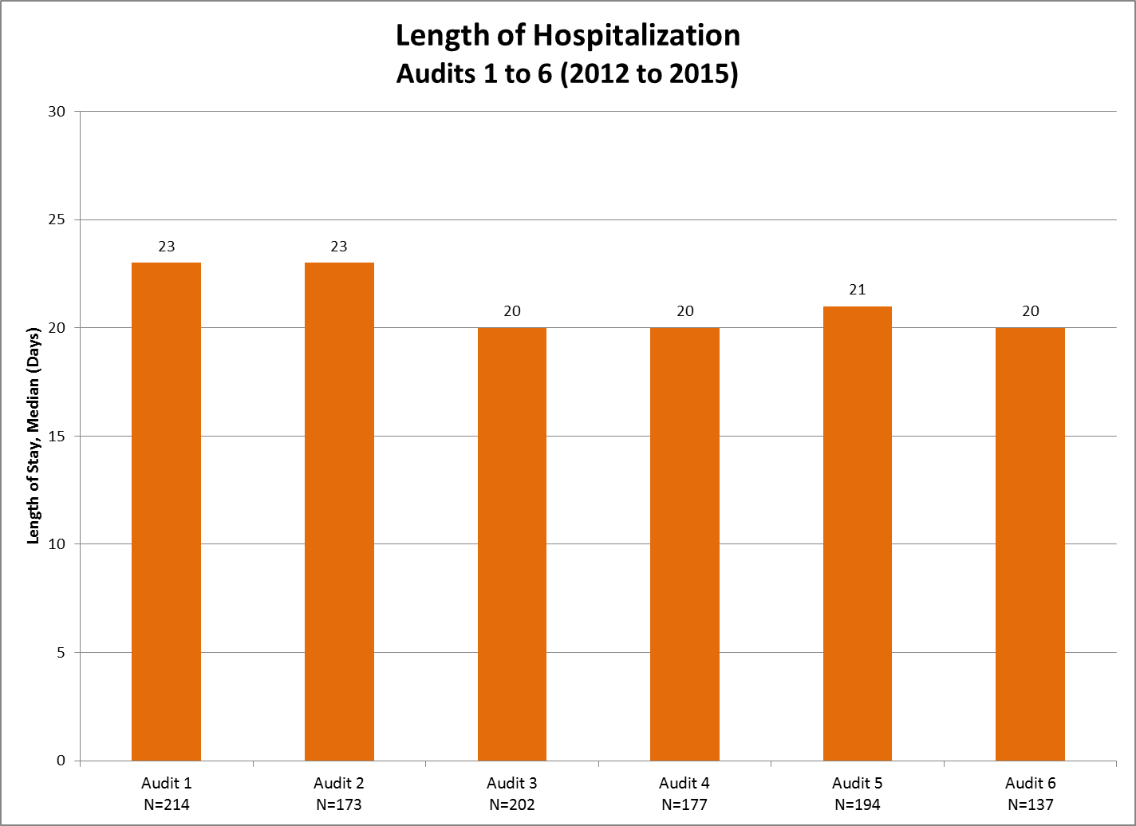

Slide 31
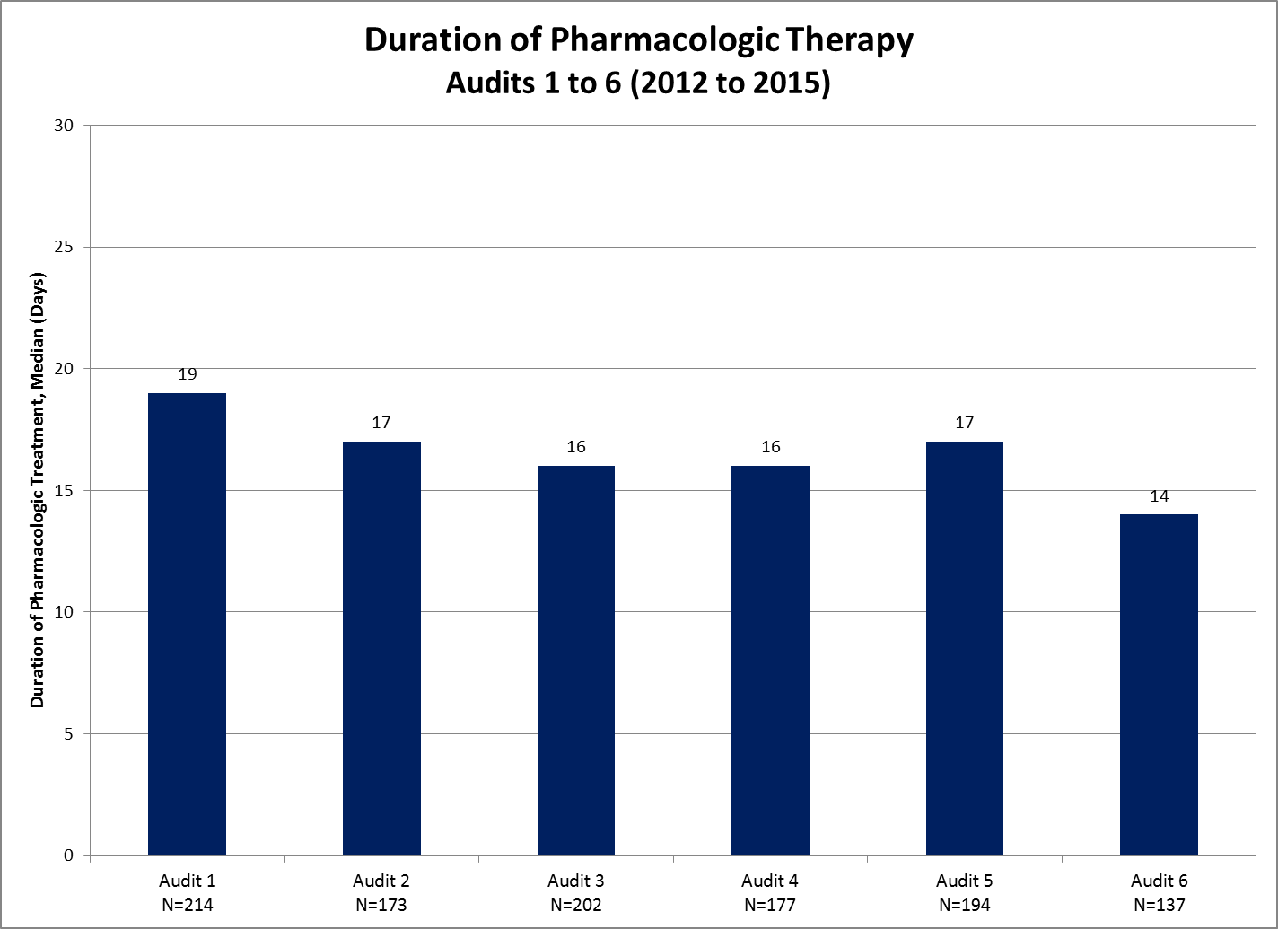

Slide 32
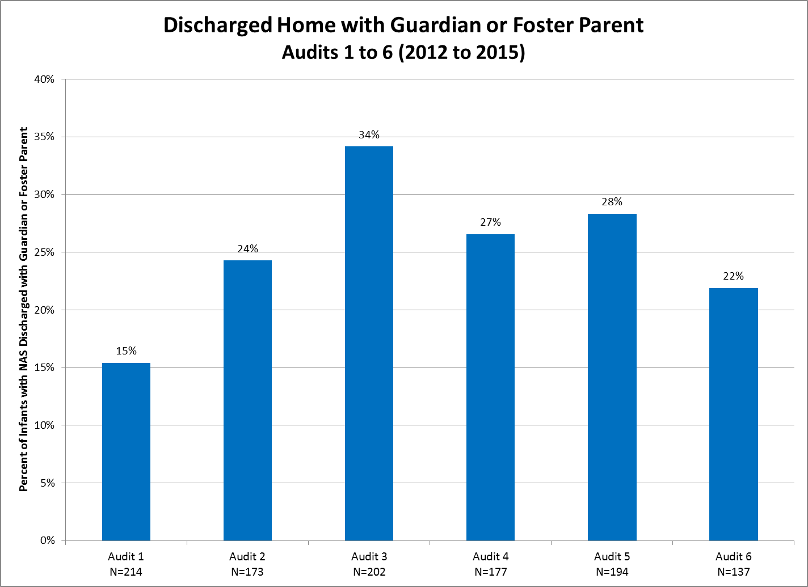

Slide 33
NeoQIC Toolkit!
NAS Inpatient Provider Toolkit:
Prenatal Consultation Template
Inpatient Monitoring Recommendations
Department of Children and Families (DCF)
Toxicology Screening
NAS Scoring and Assessment Tools
Non-Pharmacologic Care with sample parent handouts
Breastfeeding with sample guidelines
Pharmacologic Management with sample guidelines: Morphine, Methadone, Phenobarbital, Clonidine
Discharge Planning

Slide 34
Improving the Care of SENs and Families
Family
Pregnancy
Newborn
Infant
Family
BSAS, state agencies, community-based efforts
Hospital-based QI, clinical guidelines, toolkits
Care coordination, DCF, EI, community supports
Goals of Improvement Work Now and in the Future:
Continue, expand, and BETTER COORDINATE efforts throughout the state to improve care across this spectrum
Develop a rigorous, structured clinical quality improvement collaborative initiative to support hospitals across the state seeking to improve care during pregnancy and after delivery

Slide 35
Ongoing Statewide Efforts (Many)
Governor’s Opioid Working Group (2015)
New state perinatal task force
Title V renewal grant
Moms Do Care project at UMass, Cape Cod
Community Catalyst, Institute for Health Recovery
Early Intervention pilot program
Health Policy Commission innovation grants
Others….

Slide 36
NeoQIC Improvement Initiative (New)
Goal:
Develop a collaborative quality improvement initiative of Massachusetts hospitals that will use structured quality improvement methods and sharing of data and practices to further support hospital-based improvement efforts to achieve measurable improvements in the care of substance-exposed newborns and their families.

Slide 37
NeoQIC Improvement Initiative (New)
Components: “Breakthrough Series” approach
Hospital-based improvement teams
Quality improvement education
Toolkits of standard practices and resources
Structured QI: aims, measures, PDSA change cycles
Shared database with online data entry
Annual practice surveys
Quarterly state and hospital progress reports
Webinars and statewide summits
? VON on-line universal curriculum

Slide 38
NeoQIC Improvement Initiative (New)
“Standard Baby Metrics”
Percent of SENs requiring pharmacologic therapy
Percent of SENs receiving breast milk
Average length of stay for infants with NAS
Average length of pharmacologic therapy for infants with NAS
Other Potentially Interesting Metrics
Percent of mothers of SENs in medication-assisted treatment
Location of care for infant with NAS
Staff attitude assessments when caring for infants with NAS
Readmission rate for infants with NAS after discharge
Rate of enrollment in EI at 1 year of age for infants with NAS

Slide 40


Slide 41

Using Data in a QI Collaborative
  Munish Gupta, MD MMSc
  Neonatal Breakout, ILPQC Meeting

Slide 42
Fundamental ‘Truths’
Measurement is critical for improvement.
Measurement over time is even better.
Need to understand variation in data in order to know how to improve.

Slide 43
Understanding Variation
Common Cause Variation: Causes inherent as part of usual process (good or bad).
Special Cause Variation: Specific causes not part of usual process (good or bad).
Stable Process: Predictable variation within natural common cause bounds.
Unstable Process: Both special and common cause variation, variation unpredictable.
Notes:
Include examples – flipping a coin, time to get to work.

Slide 44
Why is this Important
Type of variation → type improvement action
Reduce unnatural variation
Establish stable work process
Special cause
Type of variation
Improve basic process
Improve overall outcomes
Common cause

Slide 45
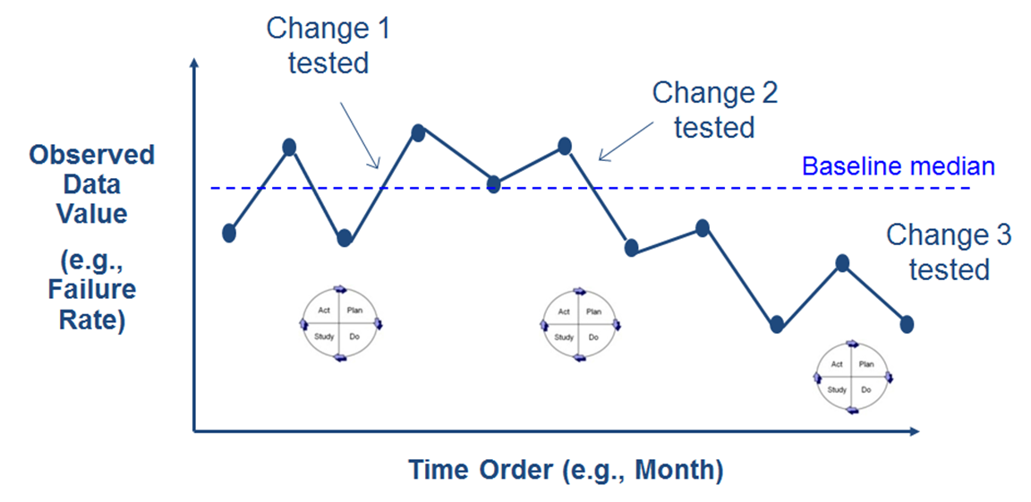
Run Charts
Visual display of data over time
Center line: median of data
Can include annotations

Slide 46
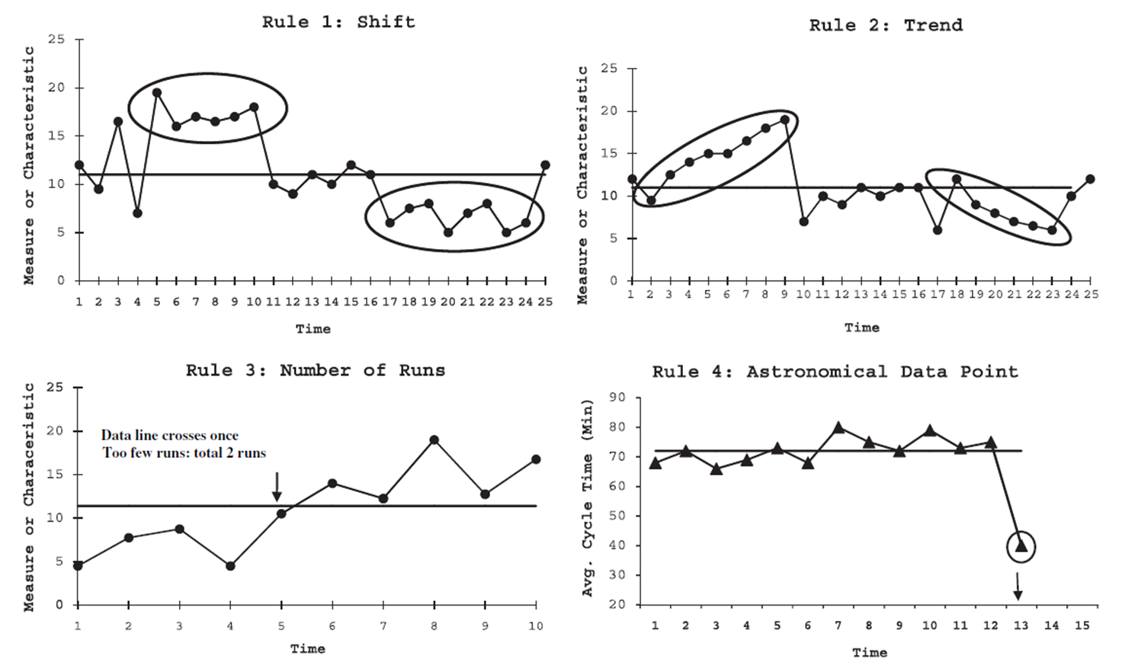
Interpreting Run Charts
≥ 6 points
≥ 5 points
Too many or too few
Perla et al, BMJ Qual Saf 2011; 20:46-51

Slide 47
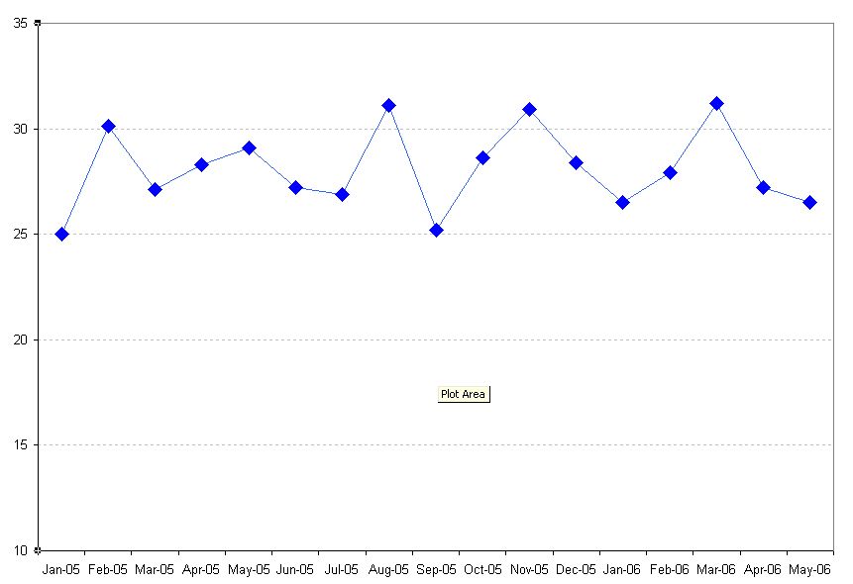
From Run Charts to Control Charts
A control chart is a run chart with some differences.
Upper Control Limit (UCL)
Run chart: Center line is the median.
Mean
Control chart: Center line is often the mean.
Value of Result
Lower Control Limit (LCL)
“Control limits” that reflect inherent variability in data – need to be calculated, but key to effectiveness
Unit of Time
(e.g. days, weeks, months, quarters)
Slides Courtesy of Yiscah Bracha, PhD. CCHMC

Slide 48
Types of Data & Control Charts
Type of Data | Example | Distribution | Control Chart
Discrete Classification | Any late infection | Binomial | P-chart
Discrete Count | Number of times skin-to-skin | Poisson | U-chart or C-chart
Continuous | Time to first pump | Normal | X-MR chart or Xbar-S chart

Slide 49
Which Control Chart To Use
Type of Data
Discrete / Attribute
(data is counted or classified)
Continuous / Variable
(data is measured on a scale)
Count
(events/errors are counted; numerator can be greater than denominator)
Classification
(each item is classified; numerator cannot be greater than denominator)
Subgroup size = 1
(each subgroup is single observation)
Subgroup size > 1
(each subgroup has multiple observations)
Equal or fixed area of opportunity
Unequal or variable area of opportunity
Equal or unequal subgroup size
X and MR charts
Individual measures and moving range
X-bar and S charts
Average and standard deviation
C chart
Count of events
U chart
Events per unit
P chart
Percent classified
Adapted from Provost & Murray, The Health Care Data Guide, 2011, and Carey, Improving Healthcare with Control Charts, 2003.

Slide 50
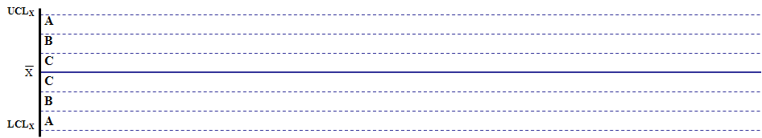
“Rules” for Detecting Special Cause
TEST 1:
1 point outside outer control limit
TEST 3:
4 out of 5 points more than 1 SD from center line
TEST 2:
2 out of 3 points more than 2 SD from center line
TEST 4:
Run of 8 points in a row on one side of center line
Notes:
Munish
Western Electric Run Rules
Talk about the rules in moderate detail
Key point – based on probability

Slide 51
“Rules” for Detecting Special Cause (2)
TEST 5:
Trend of 6 points in a row increasing or decreasing
TEST 6:
14 points in a row alternating up and down
Notes:
More Run Rules

Slide 52
Why Control Charts Over Run Charts?
More sensitive / more powerful for detecting special cause
Estimate capability of a stable process → more accurately predict performance
But… more difficult to generate

Slide 53
The Goal: Standardize then Improve
Smaller is better
1
2
3
Unstable
process
Standard
process
Improved process
c/o J. Benneyan

Slide 54

Some ILPQC Golden Hour Data!

Slide 55
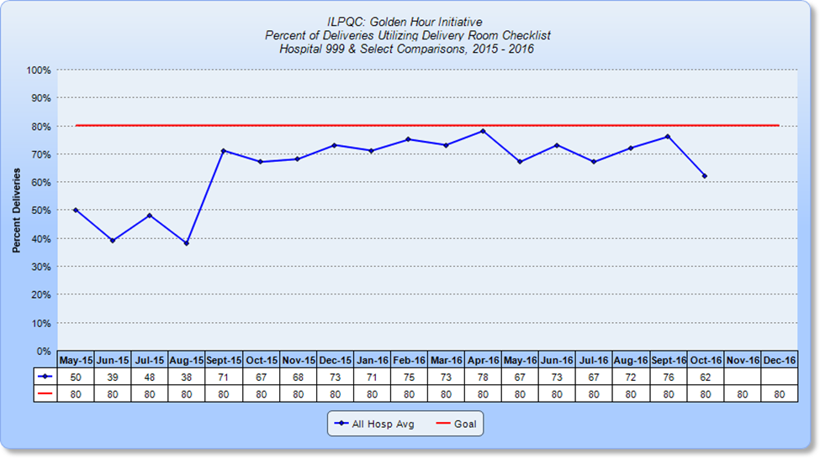

Slide 56
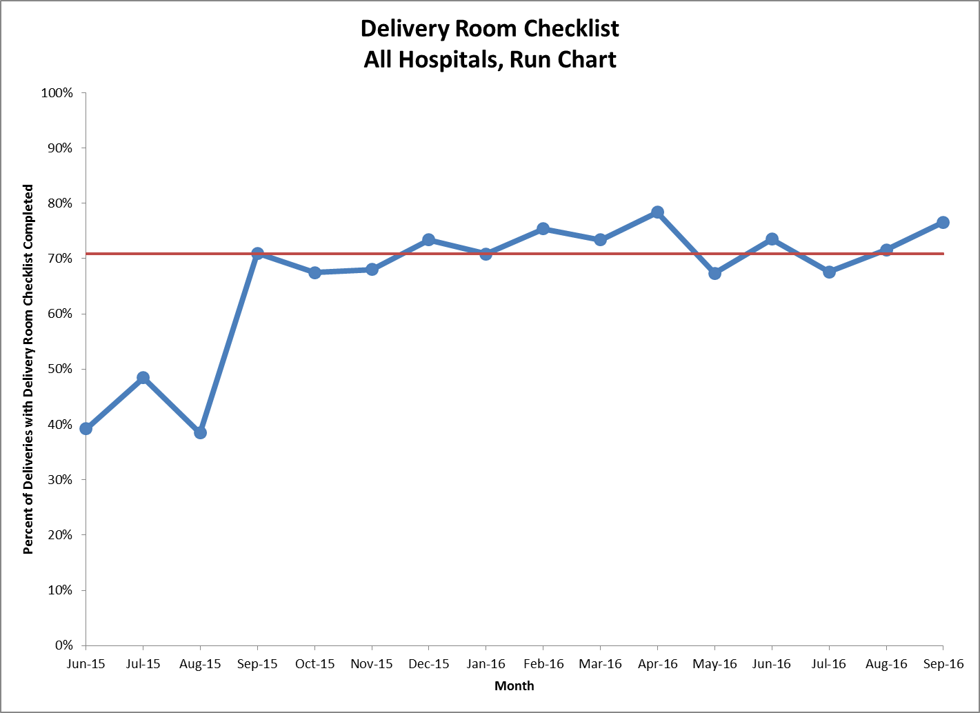

Slide 57
Interpreting Run Charts
≥ 6 points
≥ 5 points
Too many or too few
Perla et al, BMJ Qual Saf 2011; 20:46-51

Slide 58
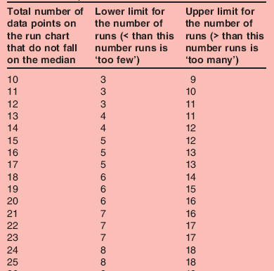
Too few, too many runs
Perla et al, BMJ Qual Saf 2011; 20:46-51

Slide 59
Which Control Chart To Use
Type of Data
Discrete / Attribute
(data is counted or classified)
Continuous / Variable
(data is measured on a scale)
Count
(events/errors are counted; numerator can be greater than denominator)
Classification
(each item is classified; numerator cannot be greater than denominator)
Subgroup size = 1
(each subgroup is single observation)
Subgroup size > 1
(each subgroup has multiple observations)
Equal or fixed area of opportunity
Unequal or variable area of opportunity
Equal or unequal subgroup size
X and MR charts
Individual measures and moving range
X-bar and S charts
Average and standard deviation
C chart
Count of events
U chart
Events per unit
P chart
Percent classified
Adapted from Provost & Murray, The Health Care Data Guide, 2011, and Carey, Improving Healthcare with Control Charts, 2003.

Slide 60
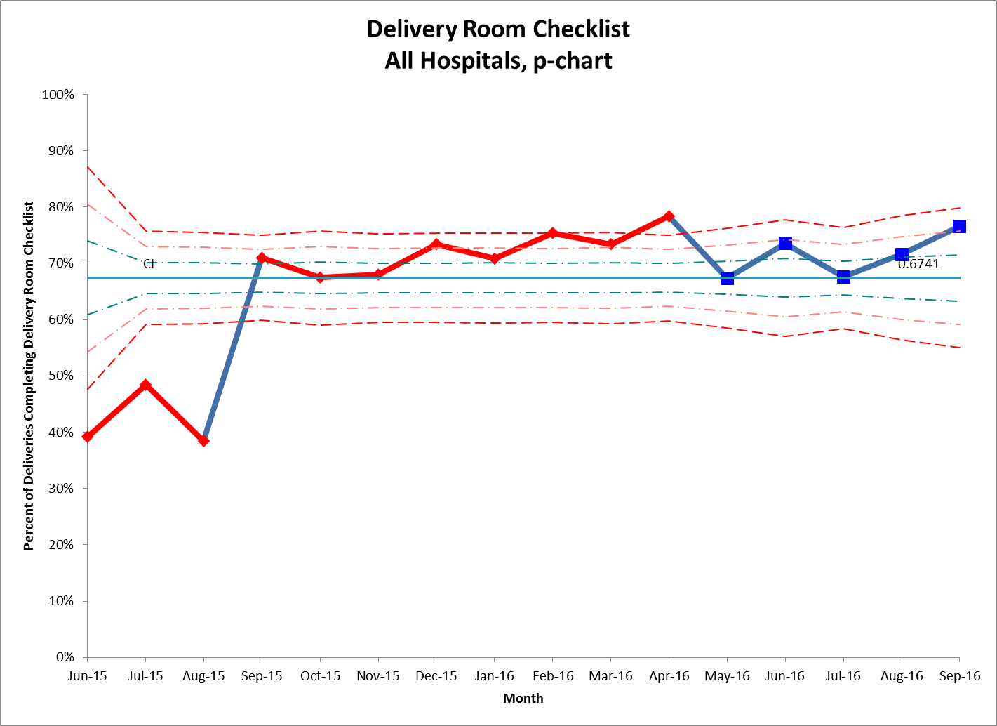

Slide 61
“Rules” for Detecting Special Cause
TEST 1:
1 point outside outer control limit
TEST 3:
4 out of 5 points more than 1 SD from center line
TEST 2:
2 out of 3 points more than 2 SD from center line
TEST 4:
Run of 8 points in a row on one side of center line
Notes:
Munish
Western Electric Run Rules
Talk about the rules in moderate detail
Key point – based on probability

Slide 62
“Rules” for Detecting Special Cause (2)
TEST 5:
Trend of 6 points in a row increasing or decreasing
TEST 6:
14 points in a row alternating up and down
Notes:
More Run Rules

Slide 63
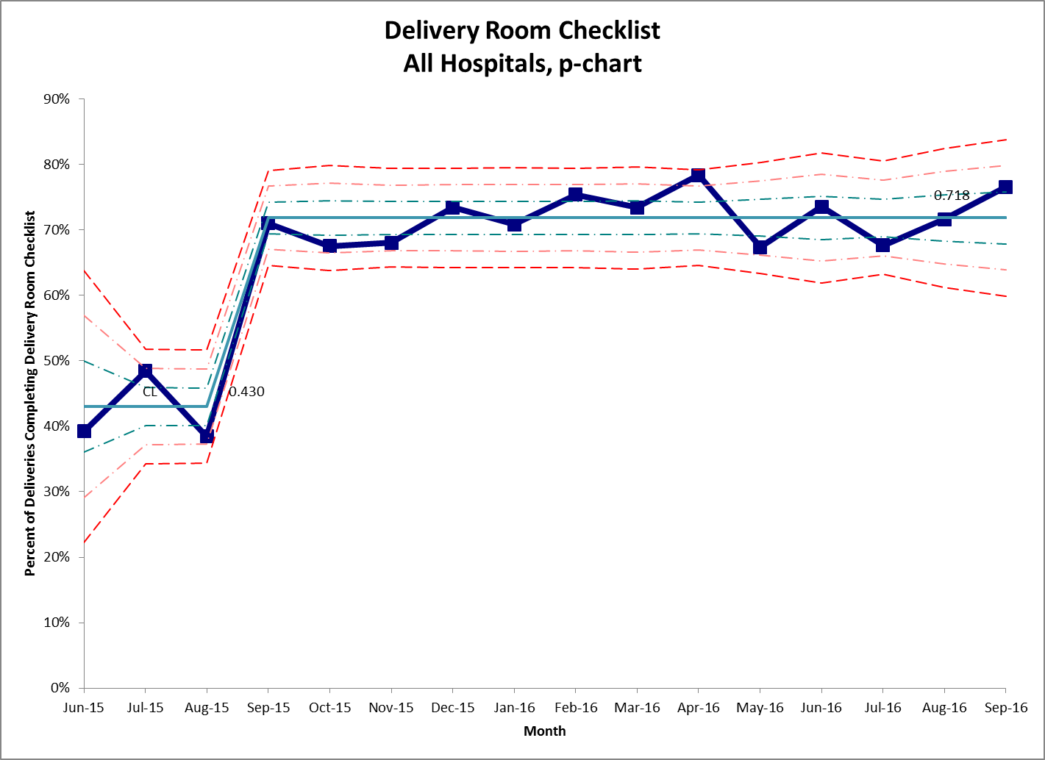

Slide 64
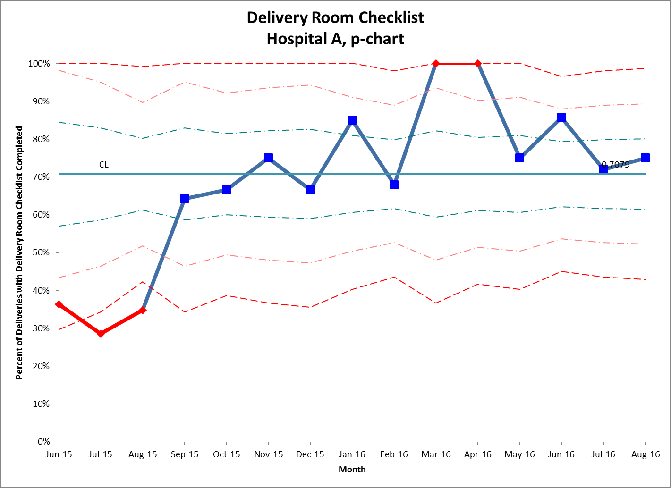

Slide 65
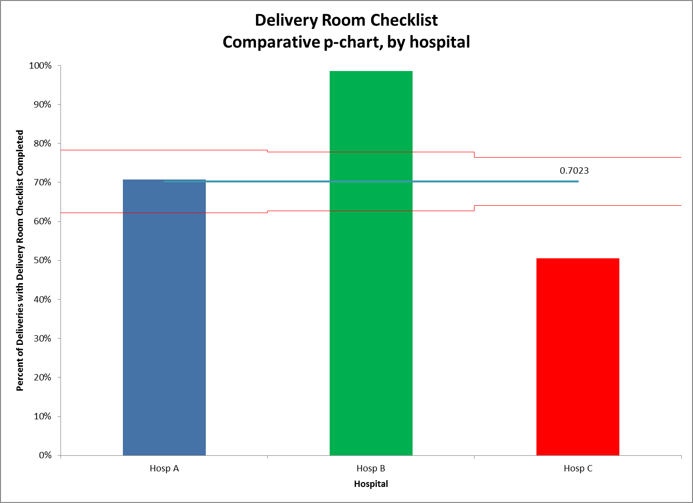

Slide 66
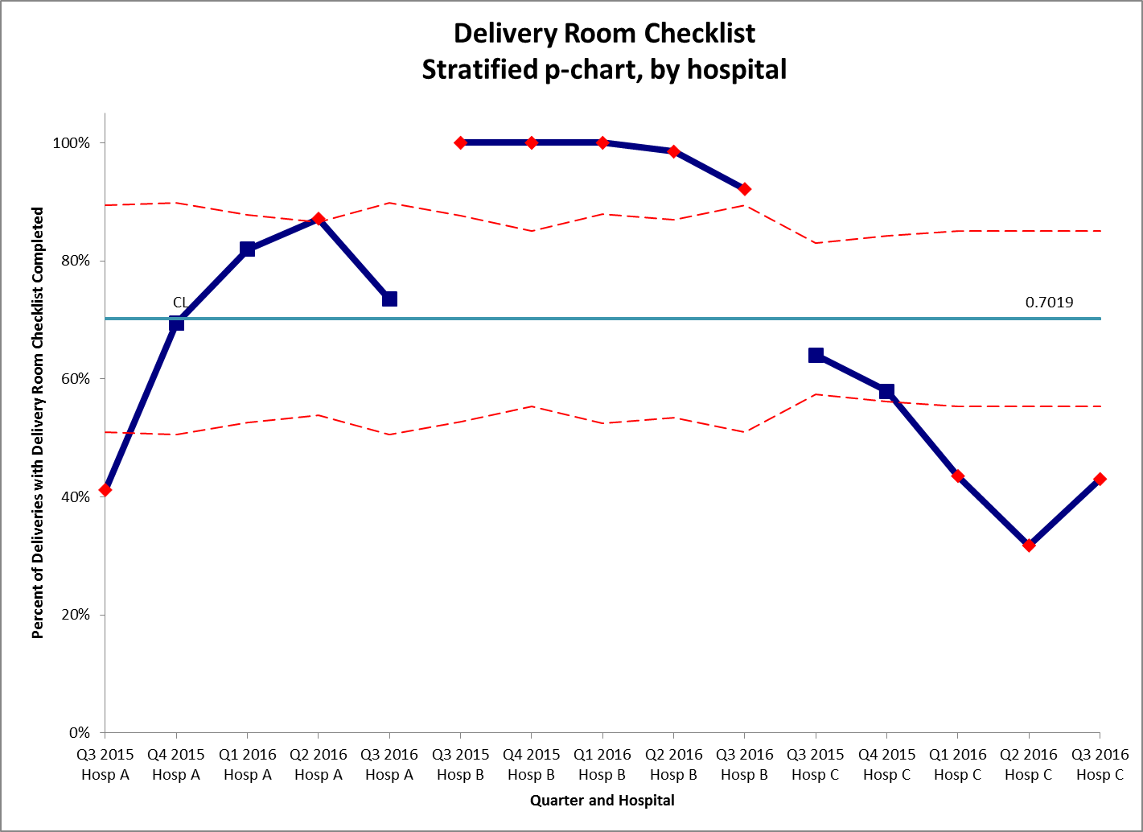

Slide 67
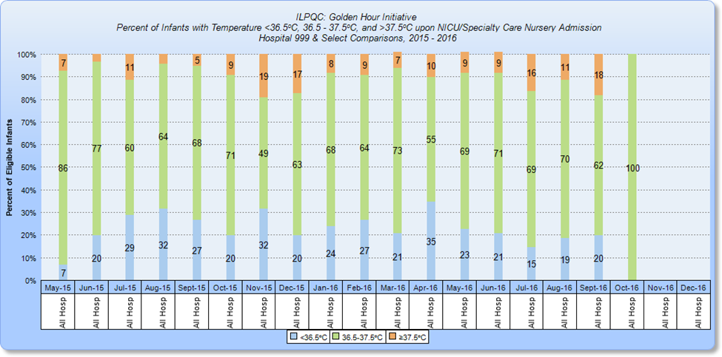

Slide 68
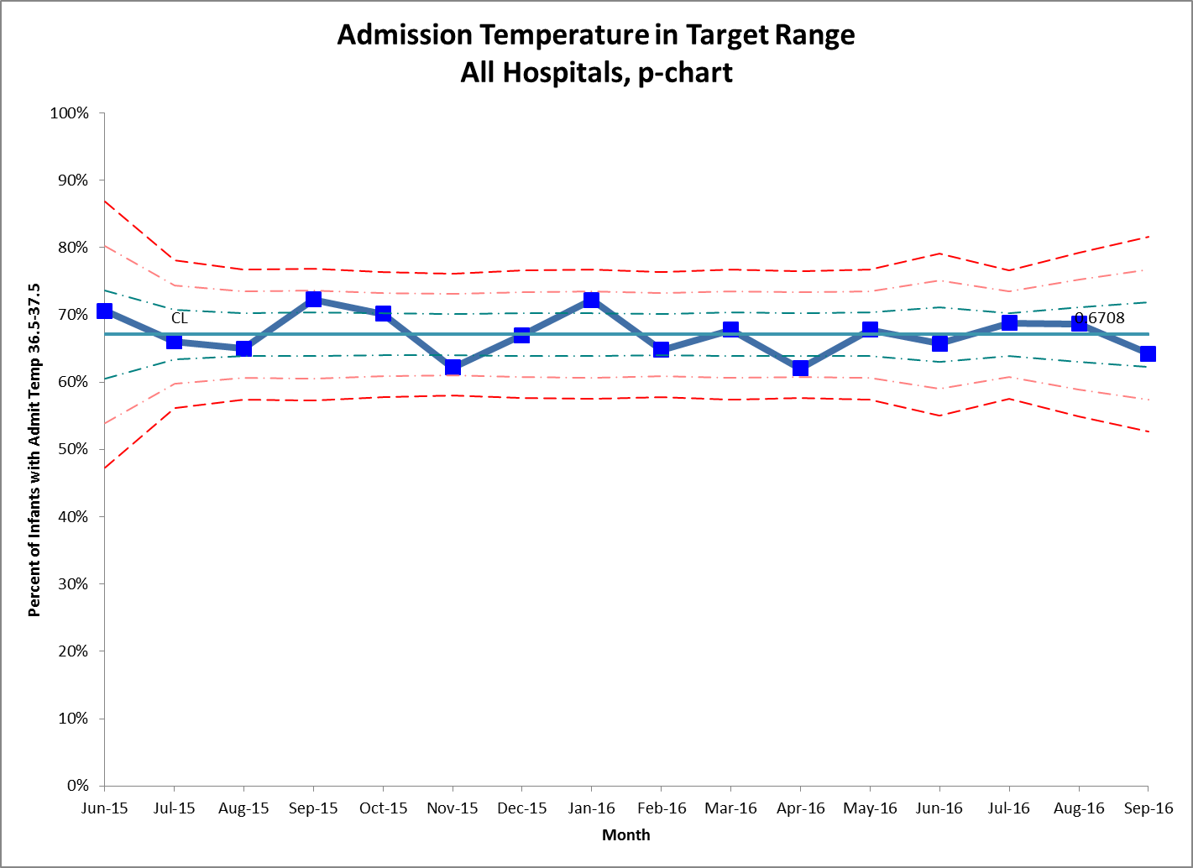

Slide 69
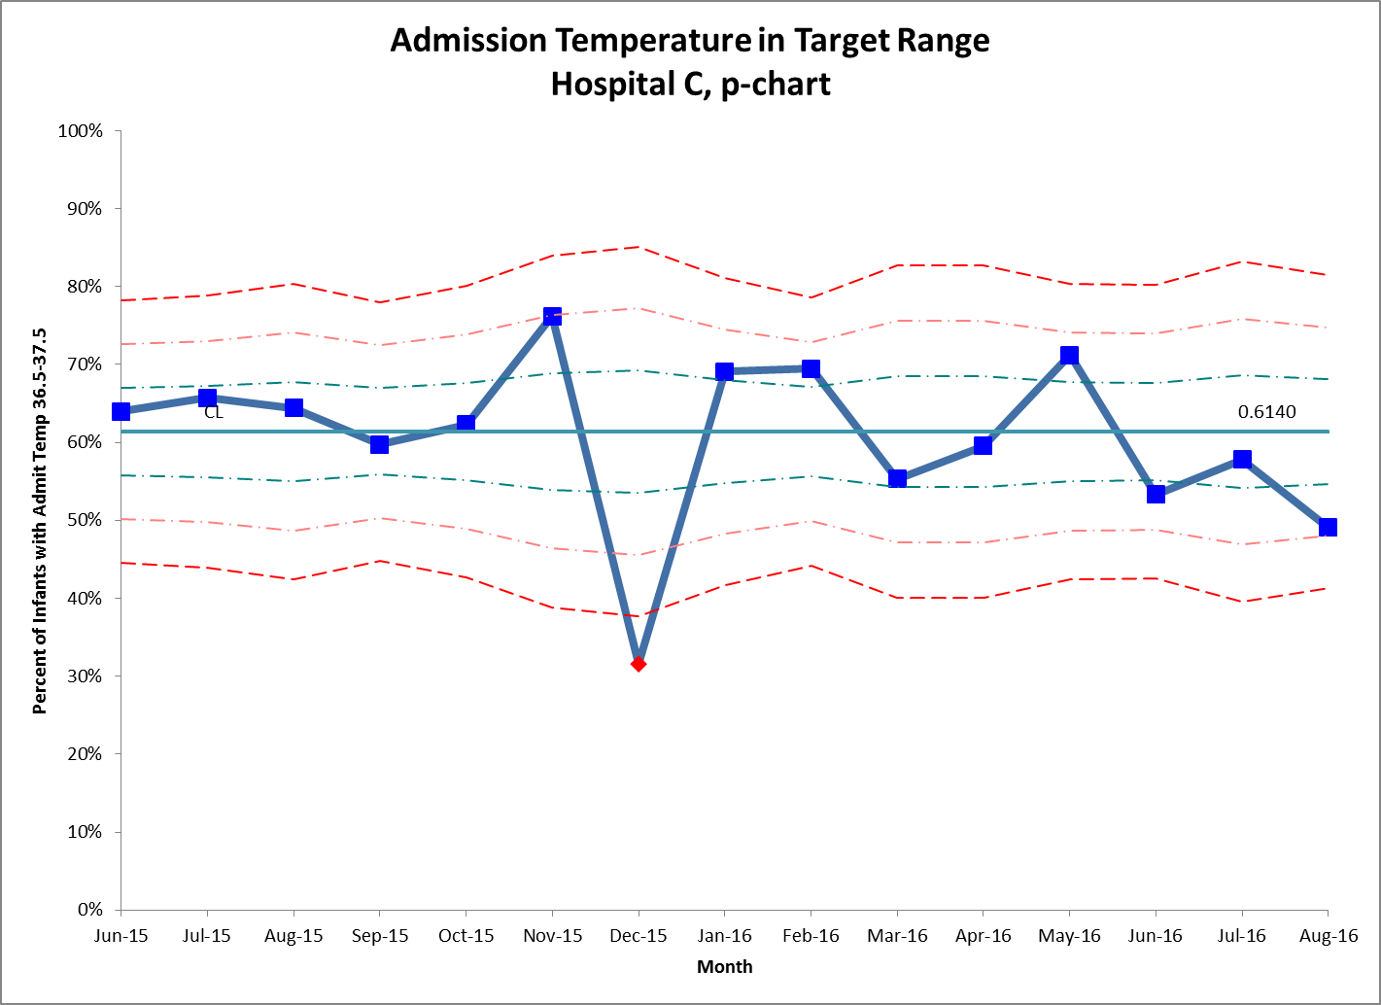

Slide 70
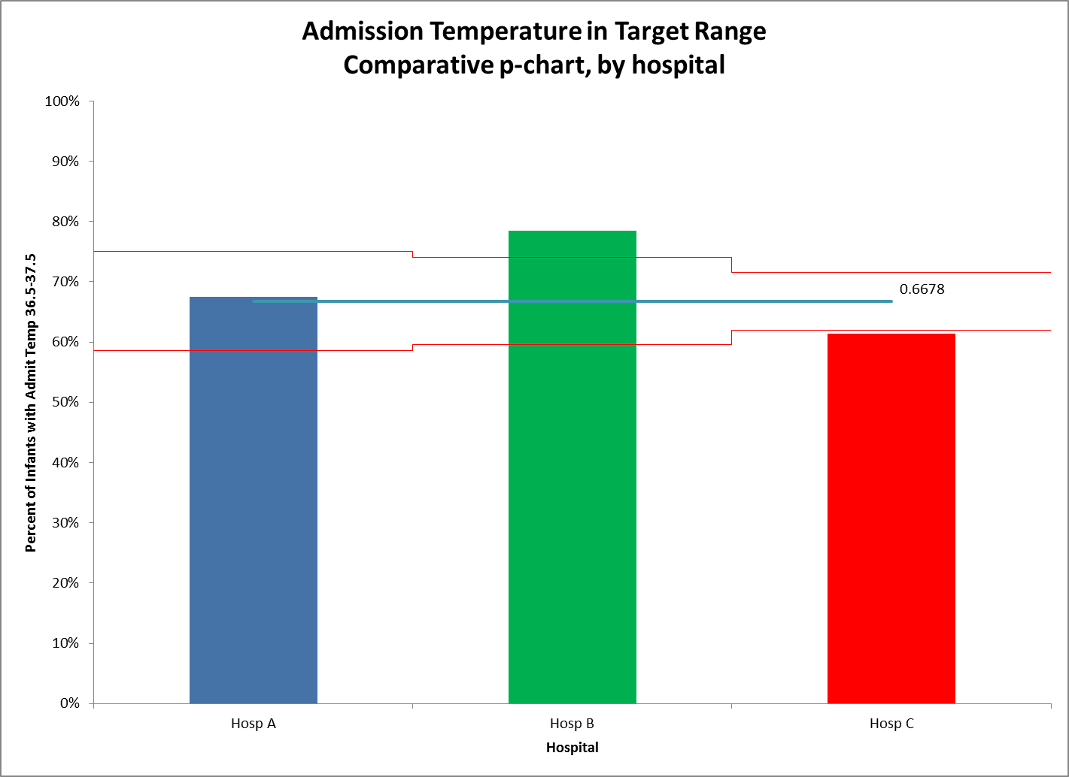

Slide 71
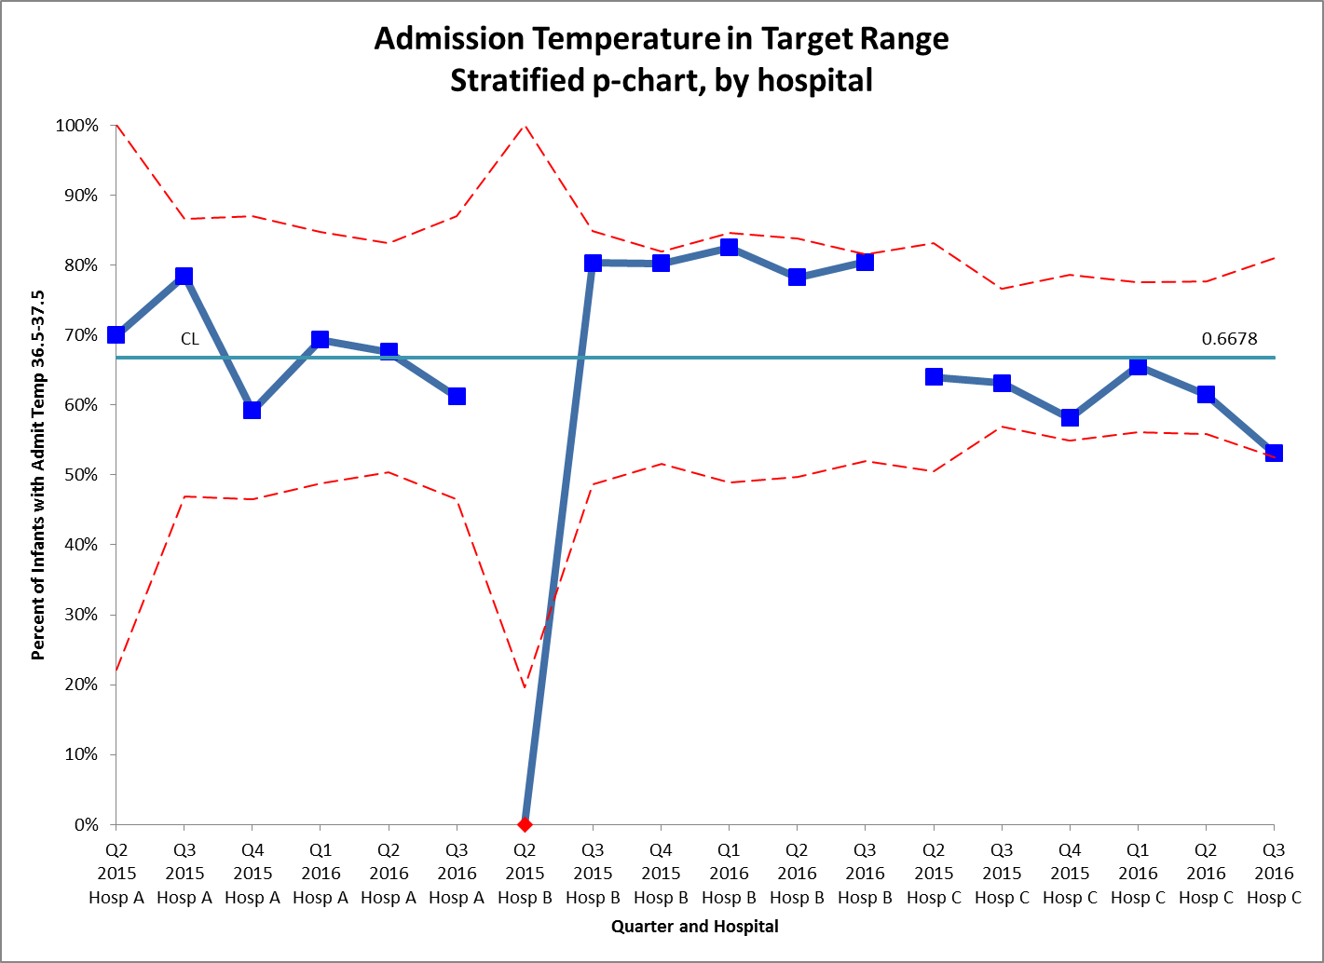

Slide 72
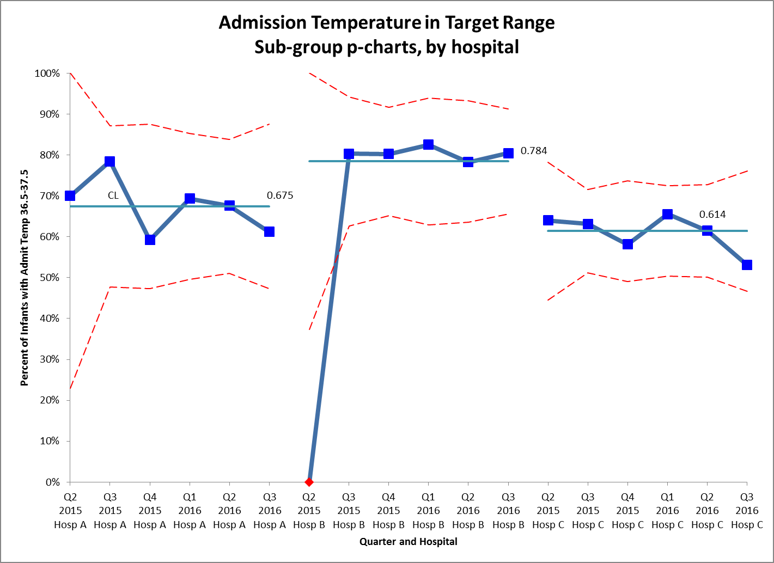

Slide 73
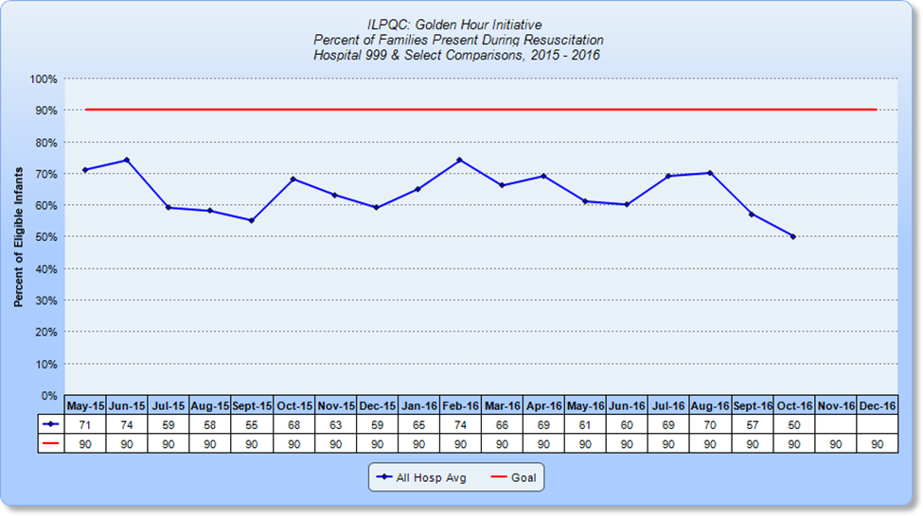

Slide 74
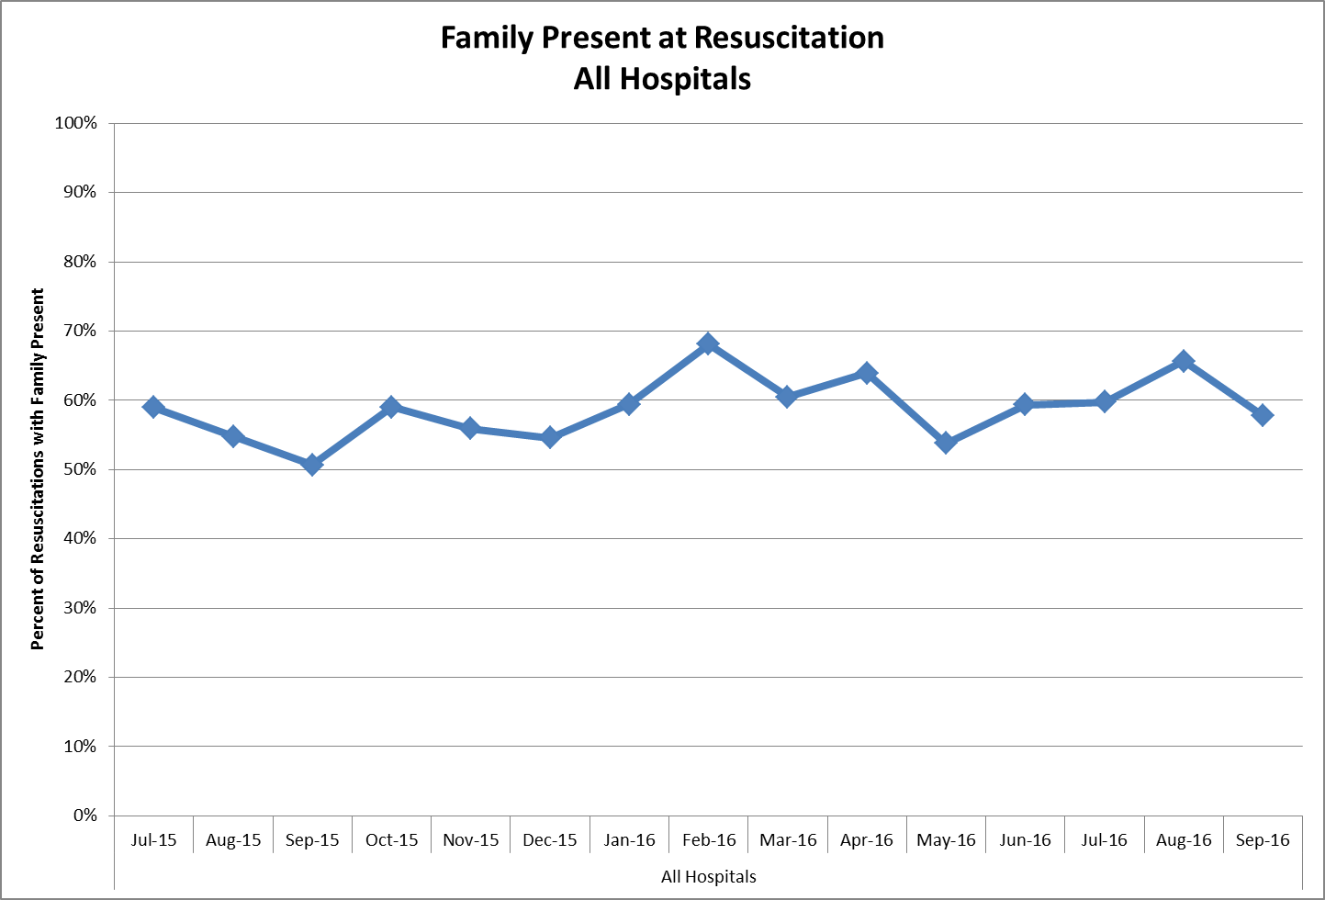

Slide 75
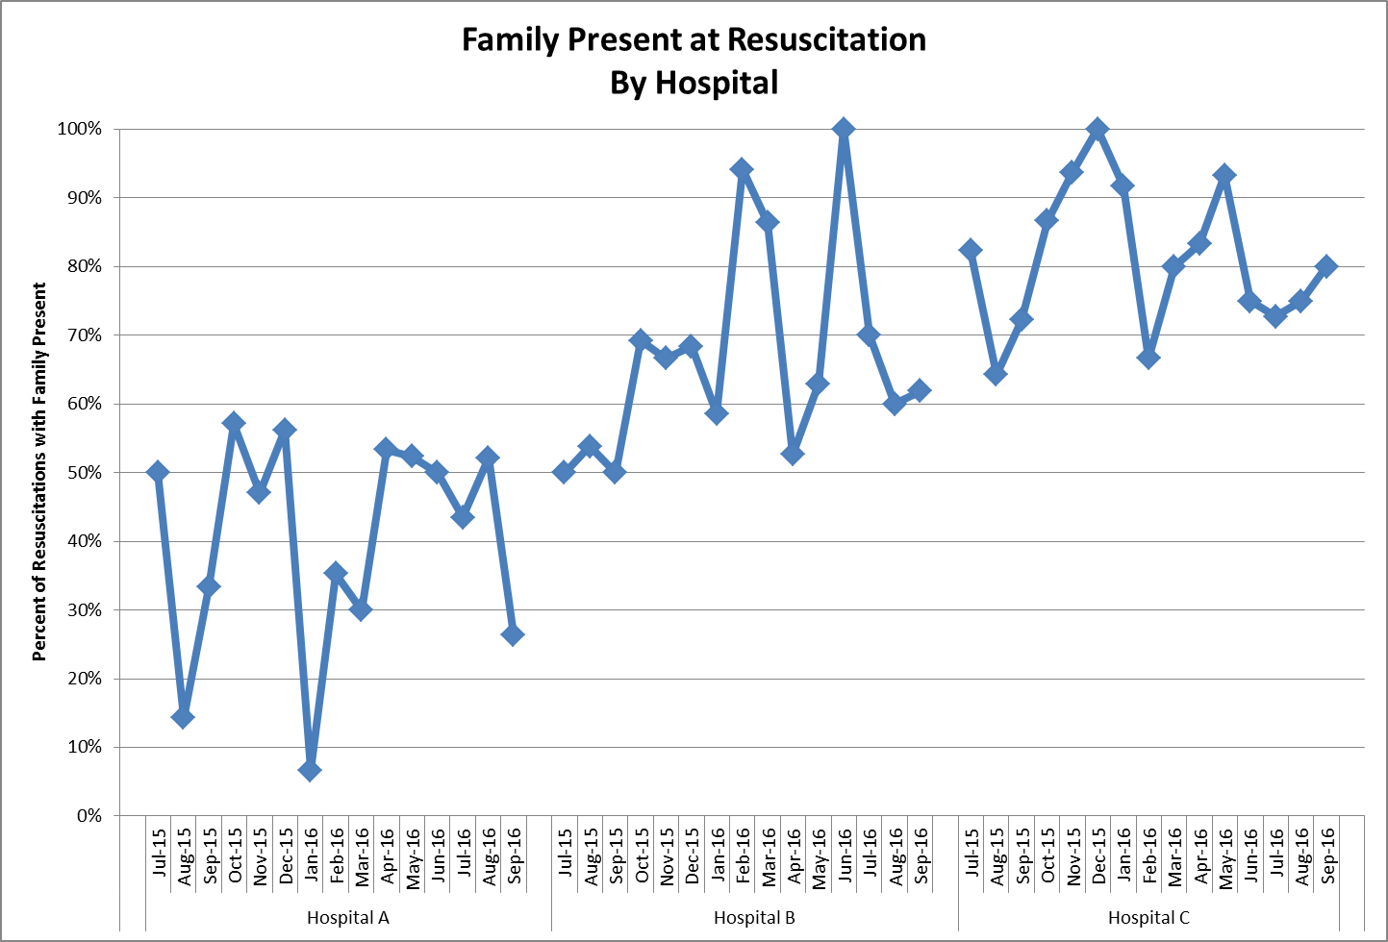

Slide 76
Data for Collaborative QI
Monitor progress over time, for collaborative and for each center.
There are many ways to compare centers, and almost always, comparisons are interesting!
Local comparisons, for whatever reason, seem more powerful than national comparisons.
Think about what transparency would add (probably quite a bit).

Slide 77
NAS in Illinois
IDPH NAS Committee started in Jan 2016
Collect accurate data and communicate timely
ILPQC
Implement procedures to improve outcomes

Slide 78
NAS in Illinois
Up to 2015
Focused on Level III centers.
2016 onwards
Involve Level I, II, III maternity centers.

Slide 79
How to proceed in ILPQC
Close collaboration with IDPH NAS Committee
Who will be in the project team?
What hospitals?
What data need to be collected?

Slide 80
NAS timeline and direction
Timeline | Content
Nov-Dec 2016 | Formulate Vision, Goals/Objectives Form ILPQC NAS Committee
Jan-Feb 2017 | Develop driver diagram Present to IDPH NAS Committee
Mar-April | Data sheet and data definition

Slide 81
Next Steps
Golden Hour 2017
NAS

Slide 82

Thanks to all our hard working teams
“Never doubt that a small group of thoughtful, committed citizens can change the world; indeed, it's the only thing that ever has.”
"Change is not a bolt of lightning that arrives with a zap. It is a bridge built brick by brick, every day, with sweat and humility and slips. It is hard work, and slow work, but it can be thrilling to watch it take shape." ~ Sarah Hepola

