Slide 1

Hot Topics in Obstetric QI: Discussion of Current and Future Initiatives
ILPQC Fourth Annual Conference
November 3, 2016

Slide 2
Overview
Review Maternal Hypertension Initiative goals, 2016 data, OB Teams October 2016 survey results (N = 42)
Identify barriers and discuss key strategies for the Maternal Hypertension Initiative 2017
Discussion of future OB teams initiatives
  Long acting reversible contraception - Monty Robertson, MHA
  Reducing primary cesareans - Maurice Druzin, MD
  17 Hydroxyprogesterone - Michael Marcotte, MD
  Maternal opioid use/addiction - Michael Marcotte, MD
  Hemorrhage 2.0 / VTE - Mary D’Alton, MD
Next steps

Slide 3
Identify barriers and discuss strategies for the Maternal Hypertension Initiative 2017
ILPQC Fourth Annual Conference
November 3, 2016

Slide 4
Overview
Review initiative AIM and Key Driver Diagram
Review hypertension data to date
Discuss barriers and strategies to decrease time to treatment and improve discharge education and follow-up
Outline plan to focus on QI and system change strategies on upcoming OB Teams Calls
Next steps for OB Teams

Slide 5
REVISED - Key Driver Diagram: Maternal Hypertension Initiative
GOAL: To reduce preeclampsia maternal morbidity in Illinois hospitals
Key Drivers
Interventions
AIM: By December 2017, to reduce the rate of severe morbidities in women with preeclampsia, eclampsia, or preeclampsia superimposed on pre-existing hypertension by 20%
GET READY
IMPLEMENT STANDARD PROCESSES for optimal care of severe maternal hypertension in pregnancy
Develop standard order sets, protocols, and checklists for recognition and response to severe maternal hypertension and integrate into EHR
Ensure rapid access to IV and PO anti-hypertensive medications with guide for administration and dosage (e.g. standing orders, medication kits, rapid response team)
Educate OB, ED, and anesthesiology physicians, midwives, and nurses on recognition and response to severe maternal hypertension and apply in regular simulation drills
RECOGNIZE
IDENTIFY pregnant and postpartum women and ASSESS for severe maternal hypertension in pregnancy
Implement a system to identify pregnant and postpartum women in all hospital departments
Execute protocol for measurement, assessment, and monitoring of blood pressure and urine protein for all pregnant and postpartum women
Implement protocol for patient-centered education of women and their families on signs and symptoms of severe hypertension
RESPOND
TREAT in 30 to 60 minutes every pregnant or postpartum woman with new onset severe hypertension
Execute protocols for appropriate medical management in 30 to 60 minutes
Implement a system to provide patient-centered discharge education materials on severe maternal hypertension
Implement protocols to ensure patient follow-up within 10 days for all women with severe hypertension and 72 hours for all women on medications
CHANGE SYSTEMS
FOSTER A CULTURE OF SAFETY and improvement for care of women with new onset severe hypertension
Establish a system to perform regular debriefs after all new onset severe maternal hypertension cases
Establish a process in your hospital to perform multidisciplinary systems-level reviews on all severe maternal hypertension cases admitted to ICU
Incorporate severe maternal hypertension recognition and response protocols into ongoing education (e.g. orientations, annual competency assessments)

Slide 6
Future OB Team Calls
Focus calls from Nov/Dec 2016 - June 2017 on system changes to implement Key Driver Diagram Interventions
20 minutes – Reviewing collaborative data relevant to monthly call topic, general initiative announcements
20 minutes – QI focused discussion of Key Driver Diagram Interventions
20 minutes – team talks recruited based on QI topic, identified from AIM data, surveys, etc.

Slide 7
Proposed Future Call Schedule and Topics
Call Date | Topics –Top 5 system level changes/interventions to decrease the time to treatment and improve discharge education and follow-up:
December 19, 2016 12:30 – 1:30 pm | Establish a system to perform regular debriefs after all new onset severe maternal hypertension cases
January 23, 2017 12:30 – 1:30 pm | Develop and implement standard order sets, protocols, and checklists for recognition and response to severe maternal hypertension and integrate into EHR
February 27, 2017 12:30 – 1:30 pm | Implement a system to identify pregnant and postpartum women in all hospital departments and execute protocol for measurement, assessment, and monitoring of blood pressure and urine protein for all pregnant and postpartum women
March 27*, 2017 12:30 – 1:30 pm | Ensure rapid access to IV and PO anti-hypertensive medications with guide for administration and dosage (e.g. standing orders, medication kits, rapid response team)
April 24, 2017 12:30 – 1:30 pm | Implement a system to provide patient-centered discharge education materials on severe maternal hypertension and implement protocols to ensure patient follow-up within 10 days for all women with severe hypertension and 72 hours for all women on medications
May | Anticipate Face –to – face meeting

Slide 8
Goal 1: reducing time to treatment

Slide 9
Maternal Hypertension Data:
Time to Treatment

Slide 10
Maternal Hypertension Data:
Rapid Access to Medication

Slide 11
Barriers to Reducing Time to
Treatment
Lack of provider, staff awareness of best practices for BP assessment and need to treat within 30-60 mins
Time to transport from triage to L & D
Connecting with provider when out of hospital
Time to notify provider/provider response and lack of IV access in postpartum unit
Difficulty starting IV
Patient dissatisfaction with frequent BP measurement during mother/baby bonding

Slide 12
Barriers to Implementing
ACOG Algorithms & Order Sets
Not all providers are utilizing 2013 diagnostic criteria & the ACOG algorithms and order sets
  Accomplishing buy in to updated standards of care across all providers
  “Treating” with Mag Sulfate instead of first line antihypertensives
  Provider delaying treatment to wait and see if BP comes down after confirmed elevated BP
  Perceived need for cardiac monitoring with IV antihypertensive treatment

Slide 13
Barriers to Implementing
ACOG Algorithms & Order Sets
Long multi department/multistep approval processes with meetings subject to cancellation
Delays/challenges in developing EMR solutions with ITS
Getting the right stakeholders at the table and reaching consensus

Slide 14
Strategies to Reduce Time to
Treatment
Partner with pharmacy for quicker access to IV HTN meds in all units using: standing orders, availability in PYXIS & override of antihypertensives
Changing policies on telemetry with IV meds, labetalol
Facilitate consistent and timely interdepartmental communication using: nurse champions to carry to all units; debriefs, huddles, daily rounds, individual feedback to discuss cases; share REDCap data with staff and providers
Adapt and implement protocols, checklists, and standard order sets across units

Slide 15
Strategies to Implement
ACOG Algorithms & Order Sets
Develop interdisciplinary committee to review algorithms and order sets for implementation using Plan/Do / Study / Act = small test of change = test 1 provider, 1 patient, 1 day or test 1 unit for 1 week
Integrate into EMR
Develop easily accessible printed algorithms & order sets (e.g. bedside clipboard, pocket card order sets)
Use key words in nurse provider communications: “your patient has severe range hypertension”, report BPs, “I would like to activate severe HTN protocol”
Post severe HTN time to treatment sign across units

Slide 16

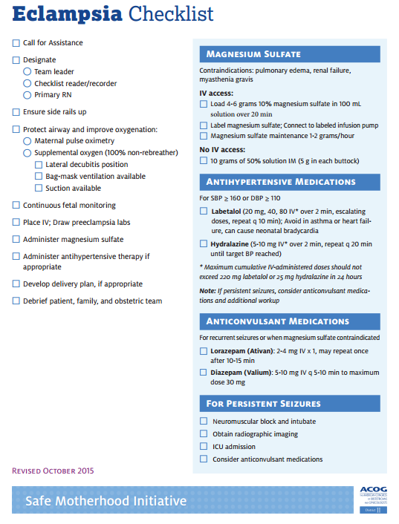
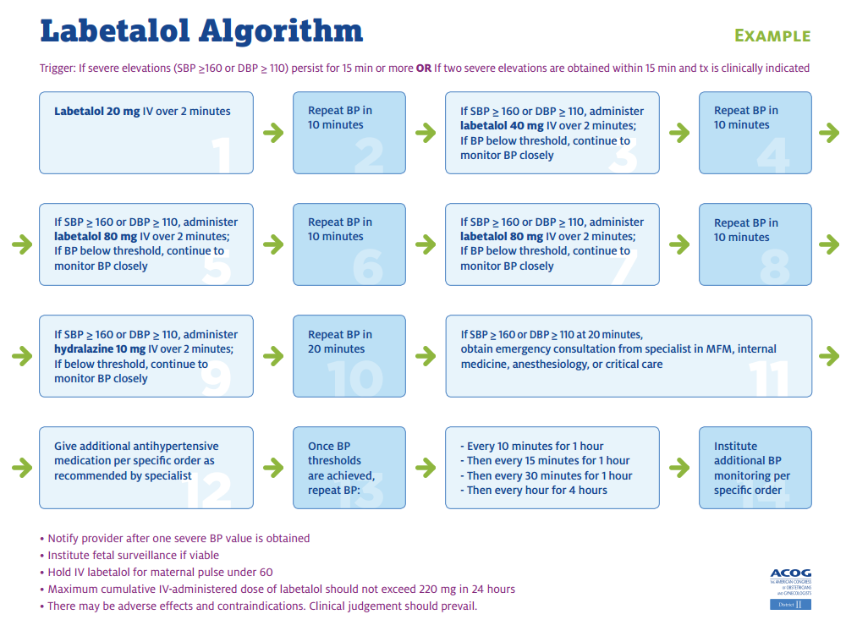
Tools to Implement ACOG
Algorithms & Order Sets
ACOG Pocket Order Sets | ACOG DII Checklists | ACOG DII Algorithms
Available to pick up at the table to the left of the stage! | Available on website or under Tab 5 in your binder | Available on website or under Tab 7 in your binder
All tools can be implemented in to EHR!

Slide 17
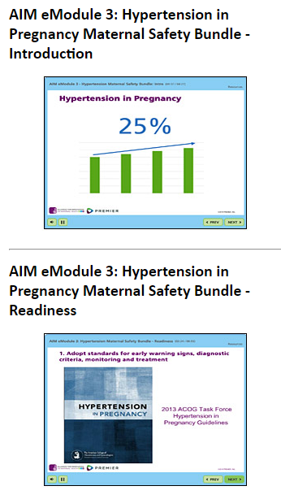
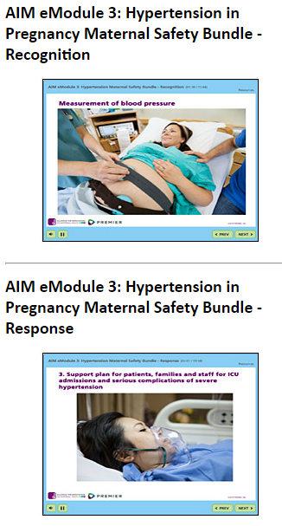

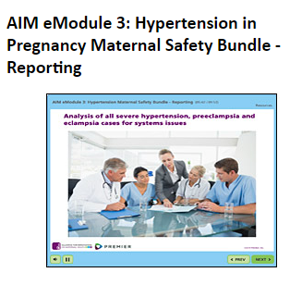
Tools to Implement ACOG
Algorithms & Order Sets – Physician Buy In
AIM eModules | Severe Maternal HTN Grand Rounds
Available on AIM website. Quiz at end with certificate - can ask providers/staff to submit certificate. View eModules here. | Available to download from ILPQC website (or click here). Speakers group available to provide Grand Rounds across the state. Email info@ilpqc.org for more information.

Slide 18
Goal 2: Implementing regular debriefs

Slide 19
Maternal Hypertension Data:
Debriefs

Slide 20
Maternal Hypertension Data:
Debriefs

Slide 21
Barriers to Implementing
Physician-Nurse Debriefs
Value not apparent among providers and nurses
Competing priorities for providers and nurses
Difficult to connect with physician in a timely manner following event, requires catching them before they leave unit or calling them
Nurse assertiveness needed to initiate
Lack of coordination with ED around severe HTN cases

Slide 22
Strategies for Implementing
Physician-Nurse Debriefs
Include hospital leadership in education and communications around implementing debriefs
Illustrate value of debriefs through case examples
Remind staff importance of debriefs during shift changes and check-in if not completed
Utilize role play examples to demonstrate debrief skills
Incorporate debrief into clinical care (eg. End of phone call to report med given or BP controlled, discuss time to treatment)
Add documentation field in electronic patient chart for debrief
Include paper debrief form at the end of the patient chart
QI team regularly review and have timely solution oriented response to issues raised on debriefs

Slide 23
Goal 3: Increasing Patient Discharge Education and follow-up

Slide 24
Maternal Hypertension Data:
Patient Discharge

Slide 25
Maternal Hypertension Data:
Patient Education

Slide 26
Barriers to Patient Discharge
Education & Follow-Up
Lack of awareness and buy in to the 72 hour follow-up appointments for patients discharged on medications
System barriers to change and use external education resources for discharge education
Difficulty scheduling follow-up appointment due to patient delays, weekend discharge
Availability of staff at clinics for follow-up BP checks
Lack of systematic way to identify patients with HTN at time of discharge to insure timely follow up appt

Slide 27
Strategies to Implement Patient
Discharge Education & Follow-Up
Develop discharge policy with education and follow-up appointment scheduled for all deliveries
Designate staff to call for patient’s follow-up appointment during office hours, including process for unassigned patients
Incorporate updated patient discharge education and physician follow-up appointment in 72 hours as favorite or “smart phrase” or add to patient education tab in EMR
Develop discharge booklet with hypertension signs & symptoms and need for follow-up or insert into all current printed discharge papers
Distribute paper Preeclampsia Foundation tear pads or purchase electronic tearpad license for EMR integration

Slide 28


ILPQC Resources for Patient
Discharge Education & Follow-Up
Pick yours up during the OB Break Out Today – 1 per team
Preeclampsia warning signs posters in English and Spanish
  Patient stories DVD

Slide 29
Goal 4: Increasing Provider buy in across units

Slide 30
Maternal Hypertension Data:
Physician/Nurse Education

Slide 31
Maternal Hypertension Data:
HTN Drills

Slide 32
Maternal Hypertension Data:
ED Practices

Slide 33
Barriers to Physician, ED, &
Pharmacy Engagement
Lack of awareness and understanding of the initiative
Lack of understanding of the importance of their role in the initiative
Limited experience/exposure to QI process and strategies
Unavailable to participate in trainings, ILPQC OB team meetings, hospital QI team meetings, etc.
Changes in department leadership and staff
Lack of awareness of ABOG MOC credit for physician champions

Slide 34
Strategies for Team Leads to
Encourage Physician Engagement
Require hypertension education for re-credentialing
Share hospital baseline data from ILPQC REDCap Data System to build a case for improvement
Provide CMEs for attendance at didactic and hands-on learning sessions
Provide incentives (i.e. lunch) to participate as a team on ILPQC and QI team meetings
Discuss and define providers roles & responsibilities on the QI team. (eg. engage in QI process, PDSA cycles, staff education, drills & simulations, protocol - check list - order set development)

Slide 35
Strategies for Physician
Champions to Engage Other Providers
Engage physician champions to provide individual feedback with providers resistant to standard treatment algorithms, protocols.
Present education and grand rounds, promote ACOG evidence-based information
Physician champion can discuss HTN initiative at key meetings including M & Ms, OB Department Meetings, One-on-One Provider talks, Grand Rounds

Slide 36
Tools for Physician Engagement
Invite physicians to participate on ILPQC OB Advisory Workgroup on the 2nd Monday of the month from 12:00 – 1:30 pm
  If interested in participating, please email info@ilpqc.org to be added to the group
Remind physicians about ABOG MOC Part IV credits (for 2016 participation, attestations due by December 1 via survey monkey here
Invite physicians to participate in the Grand Rounds Speakers Group

Slide 37
Strategies for ED & Pharmacy
Engagement
Engage ED physicians / nurses & pharmacy on importance of the HTN initiative
Identify opportunities to educate staff on HTN in Pregnancy & Postpartum diagnostic criteria and treatment algorithms
Work together to identify strategies to update protocols across units, identify pregnant/postpartum women and timely access of IV medications.
Frequent communication of initiative information via emails and invitation to participate in ILPQC meetings
Incorporating department leadership and staff as members of QI team

Slide 38
Goal 5: Implement hospital-wide standard protocols

Slide 39
Maternal Hypertension Data:
Standard Protocols

Slide 40
Barriers to Hospital Implementation of Standard Protocols & Procedures
Getting input and buy-in from everyone involved developing/updating hospital-specific protocols
Lengthy protocol review and approval process
Enforcing consistent adherence to established protocols and procedures by all staff
Monitoring awareness and utilization of updated protocols
Hospital infrastructure barriers including staff shortages and acquiring equipment (i.e. blood pressure machines & cuffs)

Slide 41
Strategies for Implementation of
Standard Protocols & Procedures
Develop a interdisciplinary protocol development workgroup to get buy-in and ownership
Use PDSA cycles to test new / updated protocol = test: 1 provider, 1 patient, 1 day
Share hypertension protocols with medical directors and hospital leadership after building the case for the need for a standard protocol
Raise awareness of protocols and procedures during existing educational/skills days
Monitor awareness and utilization of protocols across units and provide feedback

Slide 42
HTN Initiative Next Steps
Review your data entry for completeness to date
Note upcoming data due dates:
  Severe HTN Data Form - October data due November 15th
  AIM Quarterly Measures - 2016 Q4 (October – December) due January 15th
  Quarterly Implementation Checklist - 2016 Q4 (October – December) due January 15th
Continue monthly team meetings and review your ILPQC Data System web based reports monthly in REDCap
Attend the next OB Teams call is December 19th from 12:30 – 1:30 pm (merging November/December calls) with your team as we move towards system change and quality improvement strategies
Share ABOG Part IV MOC Credits information with physicians – team lead and physician must submit attestation survey via survey monkey by December 1

Slide 43
Discussion of future OB teams initiatives
ILPQC Fourth Annual Conference
November 3, 2016

Slide 44
Hospital team interest in potential future initiatives prior to discussion (n=39)

Slide 45
Discussion of potential future
OB teams initiatives
  Reducing primary cesarean - Maurice Druzin, MD
  17 Hydroxyprogesterone - Michael Marcotte, MD
  Maternal opioid use/addiction - Michael Marcotte, MD
  Hemorrhage 2.0/venous thromboembolism (VTE)- Mary D’Alton, MD
  Long acting reversible contraception (LARC) at delivery - Monty Robertson, MHA

Slide 46
Reducing Primary Cesarean
Problem: Cesareans are associated with increased adverse health outcomes for moms and babies
  National increase from 22% (1998) to 33% (2008) with variation in rates
  Vaginal births cost 40% less than cesarean births
Healthy People 2020 Objective of 23.9% (MICH 7.1)
Model QI program(s): California, AIM bundle on Safe Reduction of Primary Cesarean Births
Stakeholders: IDPH, DHFS, Insurers, Midwest Business Group on Health

Slide 47
17 Hydroxyprogesterone
Problem: Prematurity is the primary cause of neonatal morbidity and mortality
  Illinois prematurity rate: 10.1%
  National costs: $26.2 billion ($51,600/infant) in 2005
Model QI Program, OPQC: Screening, identification, and treatment of pregnant women at risk for preterm birth who will benefit from progesterone has been shown to reduce the rate of preterm birth
Stakeholders: IDPH, DHFS, Insurers, Midwest Business Group on Health

Slide 48
Maternal Opioid Use/Addiction
Problem: NAS is associated with adverse neonatal outcomes for infants
  5 fold increase in rate of NAS between 2000 and 2012 (National & Midwest)
  IL NAS infants hospital costs approx. $27.2 million (2013)
  Hospital costs for NAS $66,500 more than an uncomplicated term birth and infants with NAS are 150x more likely to be readmitted within 30 days
Model QI program(s): VON, Ohio, Tennessee, Florida, Massachusetts
Stakeholders: IDPH, DHFS, DHS, aligns with IL NAS Advisory Committee – identification, reporting, and recommendations to improve outcomes
ILPQC Neonatal Team planning an NAS initiative for 2017/2018

Slide 49
Hemorrhage 2.0/VTE
Problem: Hemorrhage and VTE are leading causes of severe maternal morbidity and mortality
Model QI program(s), ACOG DII SMI, FPQC, CMQCC: Implementation of standard protocols in a quality improvement collaborative have demonstrated reduction in associated severe maternal morbidity
AIM Patient Safety Bundles and Tools on Obstetric Hemorrhage and Maternal VTE Prevention available
Stakeholders: IDPH, builds off of hemorrhage education work in progress with hospitals through the Regionalized Perinatal Network Administrators

Slide 50
LARC at Delivery
Problem: High costs of unintended pregnancies and underutilization of immediate postpartum contraception
Illinois Medicaid policy enabling hospitals and providers to receive full reimbursement for LARC outside of global fee for delivery but there are system barriers to implementation
Model QI program(s): South Carolina
Stakeholders: IDPH, DHFS, CDPH, Insurers
Planning for 2017: CDPH and IDPH priority area with funding discussion in progress

Slide 51
How to Increase Access to LARCs:
A Roadmap to Implementing Immediate Postpartum LARCs
Monty Robertson, MHA
South Carolina Birth Outcomes Initiative
November 3, 2016

Slide 52


SCBOI Overview
Located at the South Carolina Medicaid agency, SCDHHS, and launched in July 2011
Collaborative effort of more than 125 stakeholders
Meet on a monthly basis

Slide 53
Why Immediate Postpartum?
55%
of women on Medicaid miss their six week postpartum visit

Slide 54
South Carolina Postpartum LARC Policy
In 2012, South Carolina, through SCDHHS, was the first state in the nation to institute a Medicaid policy enabling hospitals and providers to receive full reimbursement (outside the global fee for delivery) for the LARC device and the physician insertion procedure fee when women received a LARC postpartum, prior to being discharged from the hospital.
https://www.scdhhs.gov/sites/default/files/LARC.pdf

Slide 55

What Next?

Slide 56
Keys to Success
Use education in building relationships and knowledge
Must have clinical champions and administrative support and infrastructure in place
Document utilization of LARC- Use this data for proof of your quality improvement efforts

Slide 57
Education Efforts
LARC webinar March 2015
Breakout sessions at annual symposium
SC Postpartum LARC Toolkit
Outreach to hospitals to assist with implementation

Slide 58
Gaining Buy-in
Build clinical support for postpartum LARCs with peer to peer experience
Gain buy in from clinical champions in the hospitals
  Get private payers on board

Slide 59
Administrative support and infrastructure
  Convene clinical leadership and billing and pharmacy management
  Educate billing and pharmacy leadership on the importance of postpartum LARC services
  Convene clinical staff to develop counseling, consent, and insertion procedures

Slide 60
Billing Checklist
Assessing whether the billing system is adaptable to allow for automated line items outside the DRG
Working with your Medicaid AND Managed Care Program coordinator/manager
Submitting all required information exactly according to policy to avoid claims being denied/rejected

Slide 61
What are the results?

Slide 62
Increasing LARC utilization
From FY2012-2015, there was a 96% increase associated with inpatient postpartum insertion of LARCs for females below the age of 18
From FY2012-2015, there was a 74% increase associated with inpatient postpartum insertion of LARCs for females above the age of 19
In SC, inpatient LARC insertion now makes up 17% of total LARC use

Slide 63
Total Cost Savings To Date
Using the LARC insertion cost per payment over the course of the policy/initiative (1/2012-5/2016)….
The total savings to date (based on $439/patient is $1,742,391
Its important to note this is just the savings for subsequent births and that LARC expansion outside of IPI could have a much larger impact
Impact Analysis: Provided by USC Institute for Families in Society

Slide 64
Thank You
BZ Giese, SCBOI Director
GieseM@scdhhs.gov
803-898-2472
or
Monty Robertson, SCBOI Senior Consultant
Montrelle.Robertson@scdhhs.gov
803-898-3866

Slide 65

Discussion
Questions
Barriers and opportunities to implement these initiatives in Illinois
Next steps for consideration

