Slide 1
Antenatal Corticosteroid Administration:
Why are we still talking about this?
Bryan T. Oshiro, M.D.
Associate Professor,
Loma Linda University School of Public Health
Chief Medical Officer, Health Catalyst

Slide 2
Objectives
Review the science behind antenatal corticosteroids in clinical improvements in perinatal / neonatal care
Review the status of antenatal corticosteroid use in the U.S.
Review quality improvement strategies to improve antenatal corticosteroid use

Slide 3

Disclaimer:
No Financial Interests

Slide 4
Illinois Prematurity Statistics
155,528 births in 2013
Preterm birth rate 2014: 10.1%
15,708 preterm births
Cost: $810,532,800 ($51,600 / preterm infant-IOM)

Slide 5
Still waiting… ideas sometimes take a long time

Slide 7
Egypt 2750 B.C.
Thales of Miletus, 600 B.C.

Slide 8
How long does it take to for original research to become integrated into physician practice?
2 years
5 years
10 years
12 years
17 years

Slide 9
How long does it take to for original research to become integrated into physician practice?
2 years
5 years
10 years
12 years
17 years*
*Correct answer
Balas EA Pediatr Ann f1998;27:581-4

Slide 10
What about Antenatal Corticosteroids?

Slide 11

Graham “Mont” Liggins
1926-2010

Slide 12
When was the landmark human study on antenatal corticosteroids was published?
1957
1965
1972
1980
1990
Notes:
1957: Sputnik, Bogart Dies
1965: Medicare, Salma, Voting Rights Act
1972: Liggins
1980: First study on surfactant published
1990: Simpsons, Mandella, Invasion of Kuwait

Slide 13
When was the landmark human study on antenatal corticosteroids was published?
1957
1965
1972 *
1980
1990
*Correct answer
Notes:
1957: Sputnik, Bogart Dies
1965: Medicare, Salma, Voting Rights Act
1972: Liggins
1980: First study on surfactant published
1990: Simpsons, Mandella, Invasion of Kuwait

Slide 14
A Controlled Trial of Antepartum Glucocorticoid Treatment for Prevention of the Respiratory Distress Syndrome in Premature Infants
 | Placebo n=97 | Betamethasone n=122
RDS | 25.8% | 9. 0%
Neonatal mortality | 15.0% | 3.2%
Liggins and Howie Pediatrics 1972

Slide 15
Liggins’ Conclusions
RDS 1/3 less in babies who received ACT
Significant improvement after full course (>24 h)
No cases of neonatal death who had received ACT had hyaline membrane disease

Slide 16
20+ years later, ACT implementation in hospitals was up to
90%
75%
50%
40%
None of the above

Slide 17

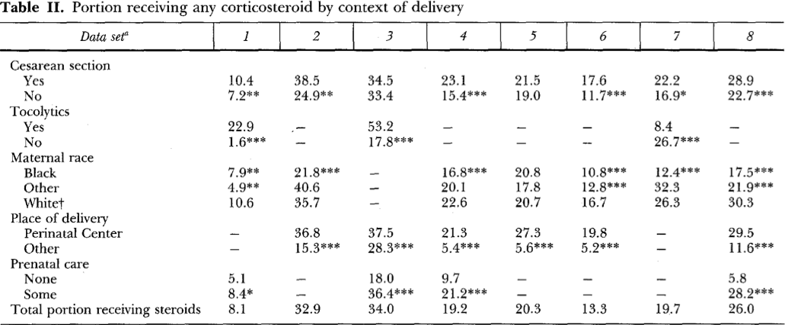
32.9%
AJOG 1995

Slide 18
Have we made progress over the next 20 years?
True
False
Is it enough?
True
False

Slide 19
Vermont Oxford Network U.S. Data
Notes:
This slide, using nationwide VON data, illustrates national rates of ACT from 2004- 2013.
Although rates of ACT administration are rising, nationwide we are missing 15% of infants who may have benefited from ACT.
Illustrates one of the many variations of reporting of ACT
Babies included in VON data:
Have received any ACT (regardless of how long before or at what gestational age or how many doses given)
reported by birthweight not by weeks gestational age at delivery. Included in the reporting are all eligible babies >401gms <1500gms. AND >22 0/7 wks GA <30wks GA
so this slide does not capture all of the babies who would qualify for steroids.
Precipitous deliveries who do not get steroids, count as a NO. There is no exception or explanation of why the baby did not get steroids.

Slide 20
Snapshot - ACT Utilization Rates
State | Year | Rates | Data Type
Florida | 2012 | 23% of eligible patients in did not receive ACT | FL VON reporting hospitals
New York | 2010-2012 | 31% of patients received | birth certificates
Notes:
This initiative aims to standardize and improve documentation.
Need year and citation
CA:
FL: Derived from Florida’s Vermont Oxford Network hospitals for 2012, a median of only 77% of premature infants received antenatal steroids. Unpublished VON data 2012
IL:
NY: Derived from birth certificate data. May be falsely lower due to inaccurate reporting by hospital coder and birth certificate secretaries
TX:
Following this slide is an opportunity for you to add a slide of local or state data of ACT rates if you have available data and choose to do so.

Slide 21
Cross-sectional analysis of 33 610 VLBW infants
120 hospitals in 11 California perinatal care regions
2005 to 2011.
Pediatrics 2015;135:2014-2177

Slide 22
Crude ACT Rates by Region
Pediatrics 2015;135:2014-2177
Notes:
From 2005 to 2011, mean ACU rates across California increased from 82% to 87.9%. Regional median (IQR) ACU rates ranged from 68.4% (24.3) to 92.9% (4.8). We found signiﬁcant variation in ACU rates among regions (P , .0001). Compared with Level IV NICUs, care in a lower level of care was a strongly signiﬁcant predictor of lower odds of receiving antenatal corticosteroids in a multilevel model (Level III, 0.65 [0.45–0.95]; Level II, 0.39[0.24–0.64]; P , .001). Regions with lower performance in ACU exhibited greater variability in performance.

Slide 23
Is the reason ACT usage is not higher is because there is unclear evidence as to the benefits?
True
False

Slide 24
Proven Benefits of Antenatal Corticosteroid Therapy (ACT)
Between 24 and 34 Weeks
ACT Administration Decreases:
Neonatal Death | ~ 30%
Respiratory Distress Syndrome | ~ 35%
Intraventricular Hemorrhage | ~ 50%
Necrotizing Enterocolitis | ~ 55%
NICU Admissions | ~ 20%
Early Systemic Infections | ~ 50%
Roberts D, Dalziel S. Cochrane Database of Systematic Reviews 2006; Issue 3
Notes:
SO why does this initiative matter?
We know that ACT use in appropriate patients significantly reduces prematurity-related mortality as well as every known major morbidity.(RDS, IVH, NEC, NICU admissions.)
The benefit of identifying and treating women at high risk of preterm delivery is clear, as demonstrated by this metaanalysis of 21 studies (3,885 women and 4,269 infants; published by the Cochrane Database). The data in this table illustrate significantly improved outcomes for babies whose mothers received ACT prior to delivery.
Based on well-established value, ACOG recommends antenatal corticosteriods between 24 weeks and 34 weeks gestation ??? when there is risk of preterm delivery within 7 days.
Standardized assessment and management of risk factors leading to preterm birth can improve identification of those women who are most likely to benefit from ACT.

Slide 25
Perhaps it’s due to the risks of ACT?
True
False

Slide 26
Crowley et. al. AJOG 1995;173:322
Maternal infection: no effect
No differences in gender, race, surfactant use
Long term neonatal outcome
  Physical growth and development: no effect
  IQ scores: no effect
  Neurological abnormalities: no effect
Cost
  Treated groups: $10,000 - $13,000
  Control groups: $19,000 - $28,000

Slide 27
Perhaps there is no financial benefit?

Slide 28
J Pediatr (Rio J). 2015. http://dx.doi.org/10.1016/j.jped.2015.03.004
Retrospective cohort analysis of premature infants with GA 26-32 weeks w/out birth defects, born between Jan 2006 and Dec 2009
170 newborns received at least one dose of antenatal corticosteroid vs 41 controls
24%-47% reduction of the components of the hospital services costs for the ACS group
In very-low birth weight infants, ACS promoted a 30%-50% reduction of all elements of the costs, with a 36% decrease in the total cost (p = 0.008).
The survivors with gestational age <30 weeks showed a decrease in the total cost of 38% (p = 0.008) and a 49% reduction of NICU length of stay (p = 0.011).

Slide 29
Are there areas of controversy?

Slide 30
Multiple courses are safe
True
False
Maybe

Slide 31
Multiple Dosing in Animal Studies
Effects on other organs
Sheep
  Growth restriction
  Glucose intolerance
  Delayed nervous system maturation
Mice
  No growth restriction
  Subtle changes in neurobehavioral development
Rabbits
  Growth restriction
  Adrenal Suppression

Slide 32
Neurotoxicity of Glucocorticoids
Enhance ischemic damage to brain neurons
  Sapolsky et al. Science 1985
Alter myelination
  Dunlop et al. J Matern Fetal Med 1997
Decrease brain weight
  Huang et al. Obstet Gynecol 1999
Glucocorticoid receptor autoregulation does not occur during organogenesis
  Ghosh et al. Toxicol Appl Pharmacol 2000

Slide 33
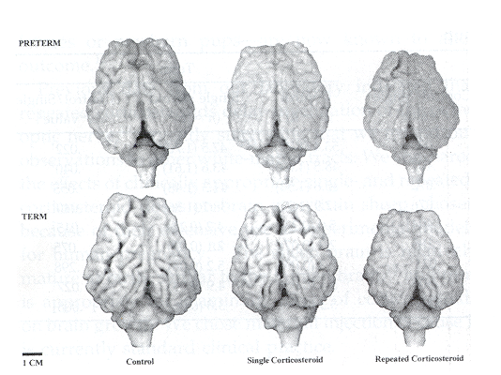
This is your brain on steroids.
PRETERM
TERM
1 CM
Control
Single Corticosteroid
Repeated Corticosteroid
Huang et Al. Obstet Gynecol 1999

Slide 34
Association of ACT with mortality and neuro-development outcomes among infants born at 22 to 25 weeks gestation
23 academic perinatal centers in the United States
Data collected prospective on infants born at 22 to 25 weeks
Follow-up exams on 4,924 babies born between 1993 and 2008 who survived to 18 to 22 months.
Compared health outcomes based upon ACT use
Examiners were blinded as to the steroid use.
Carlo et al., 2011
Notes:
Let’s discuss the use of ACT on pregnancies at risk for delivering before 25 weeks. This large, multiinstitutional study looked at the outcomes of babies delivered at 22 to 25 weeks who survived to 18 to 22 months. They then compared differences in outcomes based upon ACT use.

Slide 35
Outcomes by 18–22 Months Corrected Age of Infants 22 to 25 Wks by Antenatal Corticosteroid Treatment for 1993–2008 Births
Gest Age | 22 Weeks |  | 23 Weeks |  | 24 Weeks
 | ACT | No ACT | ACT | No ACT | ACT | No ACT
Death | 85/116 (73.3) | 220/267 (82.4) | 634/1072 (59.1) | 585/796 (73.5) | 1141/2768 (41.2) | 411/786 (52.3)
OR (95% CI) | 0.60 (0.34-1.07) |  | 0.50 (0.40-0.63) |  | 0.66 (0.55-0.79)
NDI | 16/27 (59.3) | 23/41 (56.1) | 204/371 (55.0) | 91/162 (56.2) | 570/1361 (41.9) | 148/285 (51.9)
OR (95% CI) | 1.14 (0.39-3.28) |  | 1.11 (0.72-1.71) |  | 0.8 (0.60-1.08)
MDI<70 | 14/21 (66.7) | 16/32 (50.0) | 159/295 ((53.9) | 67/134 (50.0) | 425/1008 (42.2) | 11/257 (45.9)
OR (95% CI) | 2.16 (0.36-13.1) |  | 1.27 (0.79-2.03) |  | 0.85 (0.62-1.16)
PDI<70 | 10/21 (47.6) | 13/34 (38.2) | 111/ 293 (37.9) | 55/136 (40.4) | 307/996 (30.8) | 87/254 (34.3)
OR (95% CI) | 1.47 (0.48-4.50) |  | 0.93 (0.58-1.50) |  | 0.69 (0.49-0.95)
Mod-Sev CP | 4/28 (14.3) | 7/44 (15.9) | 43/380 (11.3) | 31/167 (18.6) | 140/1432 (9.8) | 36/295 (12.2)
OR(95% CI) | 0.88 (0.23-3.34) |  | 0.50 (0.30-0.85) |  | 0.71 (0.47-1.08)
Carlo WA, McDonald SA, Fanaroff AA, et al. JAMA 2011; 306:2348
Notes:
This slide describes the outcomes for babies at 18-22 months corrected age who wee born between 22 to 25 weeks.

Slide 36
Outcomes by 18–22 Months Corrected Age of Infants 22 to 25 Weeks Gestation by Antenatal Corticosteroid Treatment for 1993–2008 Births
Gest Age | 22 Weeks |  | 23 Weeks |  | 24 Weeks
 | ACT | No ACT | ACT | No ACT | ACT | No ACT
Death | 85/116 (73.3) | 220/267 (82.4) | 634/1072 (59.1) | 585/796 (73.5) | 1141/2768 (41.2) | 411/786 (52.3)
OR (95% CI) | 0.60 (0.34-1.07) |  | 0.50 (0.40-0.63) |  | 0.66 (0.55-0.79)
NDI | 16/27 (59.3) | 23/41 (56.1) | 204/371 (55.0) | 91/162 (56.2) | 570/1361 (41.9) | 148/285 (51.9)
OR (95% CI) | 1.14 (0.39-3.28) |  | 1.11 (0.72-1.71) |  | 0.8 (0.60-1.08)
MDI<70 | 14/21 (66.7) | 16/32 (50.0) | 159/295 ((53.9) | 67/134 (50.0) | 425/1008 (42.2) | 11/257 (45.9)
OR (95% CI) | 2.16 (0.36-13.1) |  | 1.27 (0.79-2.03) |  | 0.85 (0.62-1.16)
PDI<70 | 10/21 (47.6) | 13/34 (38.2) | 111/ 293 (37.9) | 55/136 (40.4) | 307/996 (30.8) | 87/254 (34.3)
OR(95% CI) | 1.47 (0.48-4.50) |  | 0.93 (0.58-1.50) |  | 0.69 (0.49-0.95)
Mod-Sev CP | 4/28 (14.3) | 7/44 (15.9) | 43/380 (11.3) | 31/167 (18.6) | 140/1432 (9.8) | 36/295 (12.2)
OR(95% CI) | 0.88 (0.23-3.34) |  | 0.50 (0.30-0.85) |  | 0.71 (0.47-1.08)
Carlo WA, McDonald SA, Fanaroff AA, et al. JAMA 2011; 306:2348
Notes:
At 22 weeks gestation, there was no difference in death or severe morbidities whether ACT was given or not. Therefore, we are not recommending any ACT be given before 23 weeks.

Slide 37
Outcomes by 18–22 Months Corrected Age of Infants 22 to 25 Weeks Gestation by Antenatal Corticosteroid Treatment for 1993–2008 Births
Gest Age | 22 Weeks |  | 23 Weeks |  | 24 Weeks
 | ACT | No ACT | ACT | No ACT | ACT | No ACT
Death | 85/116 (73.3) | 220/267 (82.4) | 634/1072 (59.1) | 585/796 (73.5) | 1141/2768 (41.2) | 411/786 (52.3)
OR (95% CI) | 0.60 (0.34-1.07) |  | 0.50 (0.40-0.63) |  | 0.66 (0.55-0.79)
NDI | 16/27 (59.3) | 23/41 (56.1) | 204/371 (55.0) | 91/162 (56.2) | 570/1361 (41.9) | 148/285 (51.9)
OR (95% CI) | 1.14 (0.39-3.28) |  | 1.11 (0.72-1.71) |  | 0.8 (0.60-1.08)
MDI<70 | 14/21 (66.7) | 16/32 (50.0) | 159/295 ((53.9) | 67/134 (50.0) | 425/1008 (42.2) | 11/257 (45.9)
OR (95% CI) | 2.16 (0.36-13.1) |  | 1.27 (0.79-2.03) |  | 0.85 (0.62-1.16)
PDI<70 | 10/21 (47.6) | 13/34 (38.2) | 111/ 293 (37.9) | 55/136 (40.4) | 307/996 (30.8) | 87/254 (34.3)
OR(95% CI) | 1.47 (0.48-4.50) |  | 0.93 (0.58-1.50) |  | 0.69 (0.49-0.95)
Mod-Sev CP | 4/28 (14.3) | 7/44 (15.9) | 43/380 (11.3) | 31/167 (18.6) | 140/1432 (9.8) | 36/295 (12.2)
OR(95% CI) | 0.88 (0.23-3.34) |  | 0.50 (0.30-0.85) |  | 0.71 (0.47-1.08)
Carlo WA, McDonald SA, Fanaroff AA, et al. JAMA 2011; 306:2348
Notes:
At 23 weeks, there was a significant reduction in death, which is still around 60%, even with ACT. But, severe neurodevelopmental impairment was not improved with ACT. Therefore, the patient should be counseled by a multidisciplinary team comprised of the obstetrician, neonatologist and MFM before ACT is instituted in pregnancies at 23 weeks gestation.

Slide 38
General Guidance Regarding OB Interventions for Threatened and Imminent Periviable Birth by Best Estimate of Gestational Age (Modified from ACOG-SMFM Periviable Birth Obstetric Care Consensus)
Weeks Gestation | 20 0/7- 21 6/7 | 22 0/7- 22 6/7 | 23 0/7- 23 6/7 | 24 0/7- 24 6/7 | 25 0/7- 25 6/7
Neonatal assessment for resuscitation* | Not recommended | Consider | Consider | Recommended | Recommended
 | 1A | 28 | 28 | 18 | 18
Antenatal corticosteroids | Not recommended | Not recommended | Consider | Recommended | Recommended
 | 1A | 1A | 28 | 18 | 18
*Survival of infants born in the periviable period is dependent on resuscitation and support. There may be factors in addition to gestational age that will affect the potential for survival and the determination of viability. Importantly, some families, concordant with their values and preferences, may choose to forgo such resuscitation and support. Many of the other decisions on this table will be linked to decisions regarding resuscitation and support and should be considered in that context.
Obstetric Care Consensus Number 3, Periviable Birth. ACOG, SMFM. October, 2015
8
Obstetric Care Consensus No. 3
Notes:
The American College of Obstetricians and Gynecologists and Society for Maternal-Fetal Medicine recently published a consensus document to help guide clinical care around the time of periviability.
Periviable birth is defined by NICHD as delivery occurring between 20 0/7- 25 6/7 weeks.
There is a progressive increase in the rate of survival with progressive decrease in neurodevelopmental impairment as gestational age increases.
Antenatal corticosteroid administration is recommended at 24 weeks and beyond and not recommended before 23 weeks.
Corticosteroids can be considered during the 23rd week of gestation if intervention is planned.
Obstetric interventions should be undertaken only after multidisciplinary counselling, including the possibility of non-intervention and palliative care.

Slide 39
Can we do better?

Slide 40
ACT primary outcome goal
To assure that all eligible pregnancies* who are likely to deliver between 23^{0/7} and 33^{6/7} weeks gestation receive appropriate antenatal corticosteroid treatment to reduce perinatal morbidity and mortality
*Eligible pregnancies
No fetal or maternal contraindications to ACT
Planned resuscitation of the infant at delivery
Notes:
Because we can’t accurately predict when delivery will occur, our goal is to ensure we identify all eligible pregnant patients* between 23 0/7 and 33 6/7 weeks gestation who are likely to deliver that are at risk for delivery within the next 7 days and then immediately implement ACT.
*Eligible pregnancies
No fetal or maternal contraindications to ACT
Planned resuscitation of the infant at delivery

Slide 41
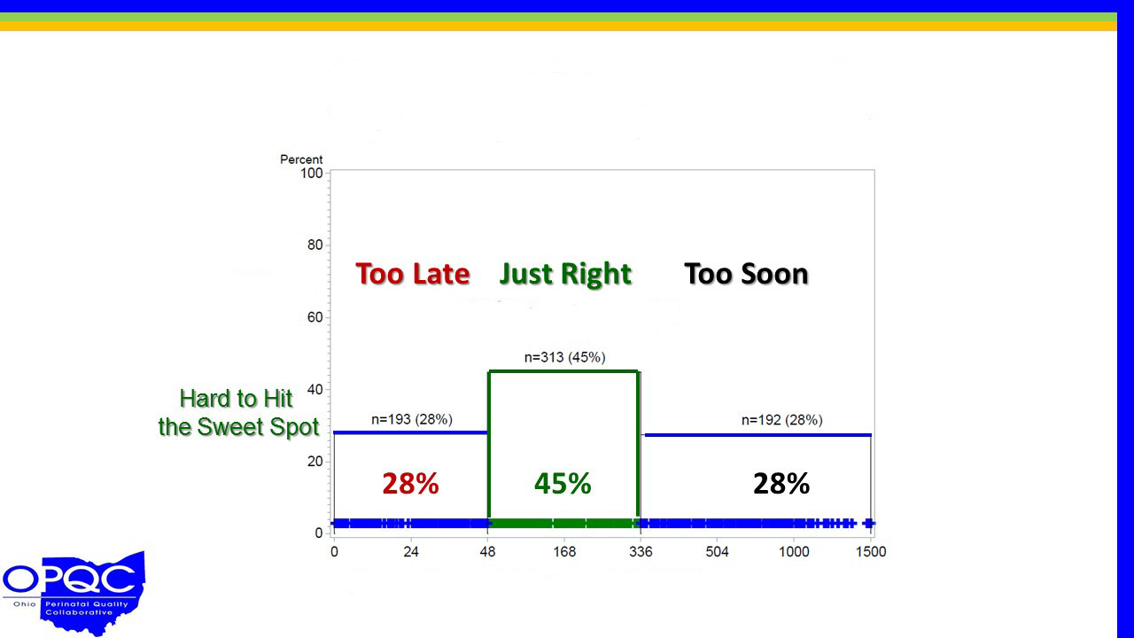
Achieving the Optimal ACT Interval
From ACT to Preterm Birth
< 2 Days
Optimal
> 14 Days
2 days – 14 days
dddd
Ohio Perinatal Collaborative Results
0 1 2 7 14 21 41 62.5
Days from First Dose of ACT → Delivery

Slide 42
Reliable implementation of evidence: a qualitative study of antenatal corticosteroid administration in Ohio hospitals
Six major themes supporting reliable implementation of ANCS at these hospitals emerged including:
presence of a high reliability culture
processes that emphasize high reliability
timely and efficient administration process
multiple disciplines are involved
evidence of benefit supports ANCS use
benefit is recognized at all levels of the care team
Kaplan et al. BMJ Qual Saf doi:10.1136/bmjqs-2015-003984

Slide 43
The power of a collaborative
Represents a “community of change”
Shares benchmark performance and approaches to overcoming obstacles
Individual hospitals positively influence outcomes for participating institutions.
Develops a high-quality, reliable database
Disseminates risk-adjusted, confidential reports
Supports the comparison of performance between hospitals
Supports perinatal providers
Sustainable, long-term improvement
Gould, 2010; Lee, Lyndon, Blumenfeld, Dudley & Gould, 2011
Notes:
A “community of change” includes hospital- and community-based health care systems that work on achieving shared benchmarks. Together, the community works to overcome obstacles, and the positive influences of the collaborative helps organize work at individual institutions.
Often a collaborative database is built to support the project, and confidential trend reports are distributed that allow member hospitals to compare their outcomes to hospitals operating in similar contexts and throughout the collaborative. Being able to compare outcomes can motivate member hospitals to improve care.
Additional benefits of a collaborative
Perinatal providers are supported in their work to improve perinatal care.
Outcomes and research reveal collaborative efforts have been successful in sustaining long-term improvement.

Slide 44
What is the March of Dimes Big 5 State Perinatal Collaborative?
California, Florida, Illinois, New York, Texas
Five States represent nearly 40 percent of births and 37 percent of preterm births in the United States.
In 2007, an initial meeting of perinatal leaders from the Big 5 States was held to establish a common vision to improve perinatal outcomes.
Today, key leaders continue to collaborate within and across the Big 5 States on mutually defined, data-driven, quality improvement (QI) initiatives.
Notes:
Five states represent nearly 40 percent of births and 37 percent of preterm births in the United States. In 2007, 50 perinatal leaders from California, Florida, Illinois, New York and Texas came together to share best practices and to identify how to work together to have a greater impact on maternal and child health in their states.
The initial meeting in 2007 was spearheaded by the March of Dimes. In 2012, the group named itself the March of Dimes Big 5 State Perinatal Collaborative and continues to work toward a shared vision.

Slide 45
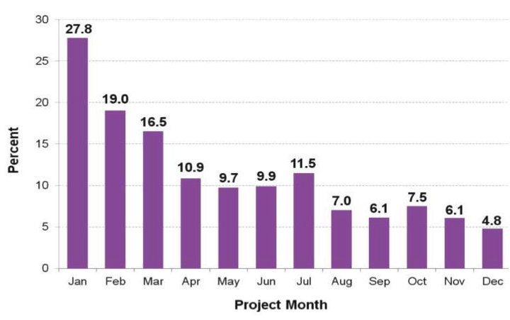
Big 5 State Perinatal Collaborative success
2010: Launched the first Big 5 State initiative: elimination of non-medically indicated deliveries <39 weeks gestational age
May 2013: Published work in Obstetrics and Gynecology, Vol. 121, No. 5, May 2013
Fall 2015: Kickoff the next Big 5 State initiative on ACT
A multistate quality improvement program to decrease elective deliveries before 39 weeks of gestation
Scheduled singleton early term (37 to 38 completed weeks gestation) non-medically indicated inductions and cesarean deliveries fell 83 percent during a one-year quality improvement program in 25 hospitals in CA, FL, IL, NY & TX in 2011, funded in part by the March of Dimes (Oshiro et al., 2013).
Notes:
In 2010, the March of Dimes Big 5 State Perinatal Collaborative spearheaded its first campaign: elimination of non-medically indicated deliveries <39 weeks gestational age. A multistate hospital collaborative was recruited, comprised of 25 hospitals from the five most populous states (California, Florida, Illinois, New York, and Texas) to validate the newly developed toolkit Elimination of elective deliveries <39 weeks gestational age. In 2011, the 25 hospitals within the collaborative went from a 27.8 percent to a 4.8 percent early-term elective delivery rate, an 83-percent reduction. These impressive results were published in Obstetrics and Gynecology in May 2013.
After the success of the elimination of the early-term elective deliveries initiative, the March of Dimes Big 5 State Perinatal Collaborative defined its next goal, improving the utilization of antenatal corticosteroids among 23- to 34-week patients. The next Big 5 state hospital collaborative will launch in the fall of 2015.

Slide 46
Implementation
Plan extensively, but
KEEP IT SIMPLE!

Slide 47
ACT process improvement goals
Develop a standardized pathway to identify patients for preterm delivery
Provide ACT in a timely fashion to 100 percent of eligible women if delivery is anticipated within 7 days
For planned preterm deliveries, consider delaying delivery to complete ACT, if patient conditions allow
Improve documentation of ACT administration
Notes:
Outlined on the slide are key process goals that should be implemented in order to reach and sustain the primary goal.
47

Slide 48

The ACT Bull's-eye
Determine: patient eligibility
Administer: ASAP as indicated
Repeat: after 14 days if preterm delivery risk persists
Target: patients at 23 0/7-
    33 6/7 weeks at increased risk of delivery in the next 7 days *
* eligible pregnancies with no contraindications to ACT and planned resuscitation at delivery
Notes:
Determine: patient eligibility
Determine gestational age
Determine if risk for PTL is within 7 days.
Council patients on infant survival less than 24 weeks. Consider infant compatibility with life
At gestational age 23-0/7 – 23 6/7 give ACT as soon as possible if neonatal resuscitation is desired after multidisciplinary counseling
If delivery is to be planned, consider delaying delivery until the optimal time frame of 24 hrs. to 7 days is reached.
The greatest beneficial effects are seen when ACT is administered within the time frame 24 hours to 7 days prior to delivery.
However, some neonatal benefit has been shown after ACT<24 hours, therefore, ACT should be administered IMMEDIATELY to any patient at risk for delivery within 7 days of diagnosis.

Slide 49
Antenatal Corticosteroids Draft Key Driver Diagram
Goal: Assure that all *eligible infants born between 23 ^{0/6} and 34 ^{6/7} week' gestation receive appropriate antenatal corticosteroid treatment to reduce perinatal morbidity and mortality. *Eligible: no contraindications to ACT, planned resuscitation at delivery, sufficient time prior to delivery to receive first dose of ACT
Interventions
Create an integrated system of recording ACT administration among prenatal care sites and delivery sites encompassing all levels of acuity of care
Improve documentation and reporting of ACT for maternal transport
Standardize birth certificate documentation of ACT administration
AIM: To optimize the percentage of *eligible infants born between 23-34 weeks gestation who receive ACT and have accurate ACT documentation to >95%, by December 2016.
Key Drivers
ACT documentation system
Identification of appropriate ACT candidate
Choose an ACT strategy or guideline for your site
Standardize protocols of preterm labor risk assessment
Educate providers / nurses on optimal timing of ACT administration
Educate providers / nurses on ACT repeat course
Identification of appropriate time of ACT administration
Ensure availability of ACT on L&D and ED/ER for Level I or 0 hospitals so steroids can be initiated prior to rerouting mom to the proper level of care hospital
Promote consistent use of common algorithm of ACT administration.
  Providers / Nurses
  Hospitals
    Link to maternal transfer / link to tocolysis
    Pharmacies
Optimal and efficient administration of ACT
Patient / Public awareness and benefits of risks
Promote public awareness of benefits of ACT
Education of patients & non-perinatal providers

Slide 50
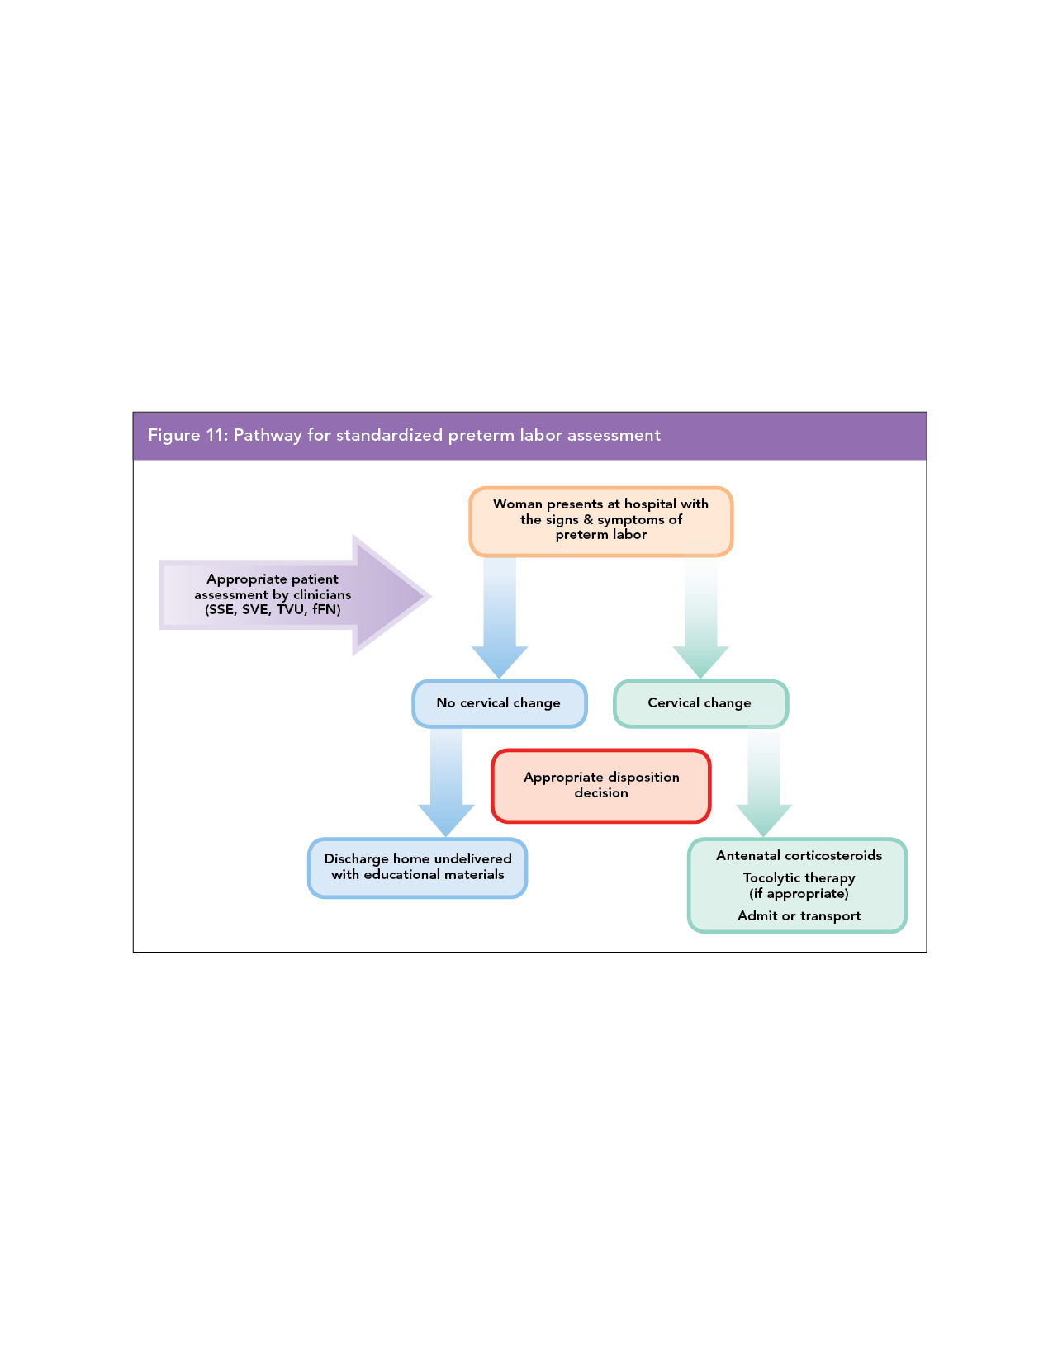
Standardized Pathway for Identifying Preterm Delivery
Notes:
March of Dimes Preterm Labor Assessment Toolkit (PLAT) aims to ensure that cervical changes are uniformly assessed in women presenting with signs and symptoms of preterm labor. Uniform practices lead to appropriate disposition decisions.
The algorithm, protocol and tools outlined in PLAT drive change in assessment behaviors (purple arrow), resulting in appropriate disposition decisions (red box). These, in turn, lead to improved outcomes.

Slide 51
Clinical Examples
A patient presenting with preterm labor or PPROM should be given ACT immediately upon diagnosis because of our inability to predict how soon she will deliver.
A patient presenting with IUGR or preeclampsia and whose delivery can be planned, may be able to remain undelivered until 24 hours after ACT administration.

Slide 52
Thank you!

