Slide 1

Panel: Teams Share Strategies for QI Success
ILPQC Third Annual Conference
November 18, 2015

Slide 2
Overview
Moderator: Barb Murphy, MSN, RN
Panelists:
  Ingalls Memorial Hospital
    Shanice Graham, BS & Glynis Adams, RNC, MS
    Using PDSA cycles for increased Birth Certificate accuracy
  Rockford Memorial Hospital
    Melissa A. Byars RNC-OB, BSN & Rhonda Gale, RNC-NIC
    NICU and L&D collaboration on the Golden Hour Initiative
  University of Illinois Health and Hospital System
    Adelaide B. Caprio, APN, CCNS, MSN & Aarti Raghavan, MD
    Use PDSA cycles for implementation of the Golden Hour Delivery Pack

Slide 3
Ingalls Memorial
Perinatal Unit,
OB Birth Certificate Accuracy

Slide 4
Challenges
Inaccurate information obtained from patient interview
  First prenatal visit
  WIC participation
  Date of last menses

Slide 5
Plan, Do, Act, Study!
Objective
    To improve accuracy through obtaining as much information as possible from patient’s prenatal record (part of patient’s chart)
Test
    Select 3 charts and replace patient interview with prenatal record review
  Prediction
    Better accuracy from established documentation

Slide 6
Plan, Do, Act, Study!
List tasks necessary to complete this test (what) | Person Responsible (who) | When | Where
1- Identify chart | Abstractor | While on unit | L&D
2 - Pull chart if available | Abstractor | While on unit | L&D
3 - Document needed information from chart if available | Abstractor | While on unit | L&D
4 - Interview patient from verification and missing items | Abstractor | While on unit | L&D
5 - Document experience | Abstractor | While on unit | L&D

Slide 7
Plan, Do, Act, Study!
Do
  The review of the prenatal record and documentation was carried out as planned
Study
  As a result, accurate information was pulled from the prenatal record (chart) and recorded on the Birth Certificate Worksheet
Act
  We decided to ADAPT this method in retrieving accurate patient information that’s verifiable via patient chart

Slide 8
Challenges
Patients with limited or no prenatal care
    Reverted back to interviewing patient
Missing prenatal records
    Interview nurse for possible documentation from previous visits
    Interview patient
Availability of patient chart
    Currently in the process of getting Birth Certificate Abstractors access to GE. A worksheet will be created and populated with all information needed to complete the Birth Certificate Worksheet accurately

Slide 9
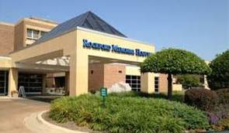
ILPQC NICU and L&D Collaboration
Rhonda Gale RNC-NIC, BSN
Melissa Byars RNC-OB, BSN
Rockford Memorial Hospital
ILPQC Annual Meeting QI Panel
November 18, 2015

Slide 10
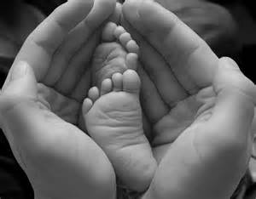
Roles
  Rhonda Gale, RNC, BSN NICU Educator, ILPQC Golden Hour Committee Champion, and Temperature Improvement PBP Task Force Champion.
  Melissa Byars, RNC, BSN L&D, Maternal Transport Nurse, Golden Hour Committee member and Teamwork PBP Task Force Champion.

Slide 11
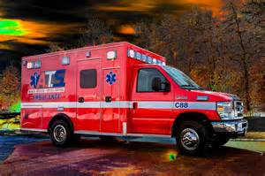
History of NICU and L&D Collaboration
NICU Transport Team and Maternal Transport Team
Both units have strong presence in Shared Governance
Clinical Shift Coordinators hold twice daily “huddles”
NICU and L&D staff complete NRP together

Slide 12
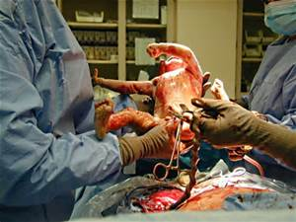
History of NICU and L&D Collaboration
NICU and L&D High Risk Delivery Simulations
Established Student Nurse Intern program
  Both units prefer to hire SNI applicants
L&D and NICU frequently work together during high stress events
  Emergency C/S
  High risk vaginal deliveries

Slide 13
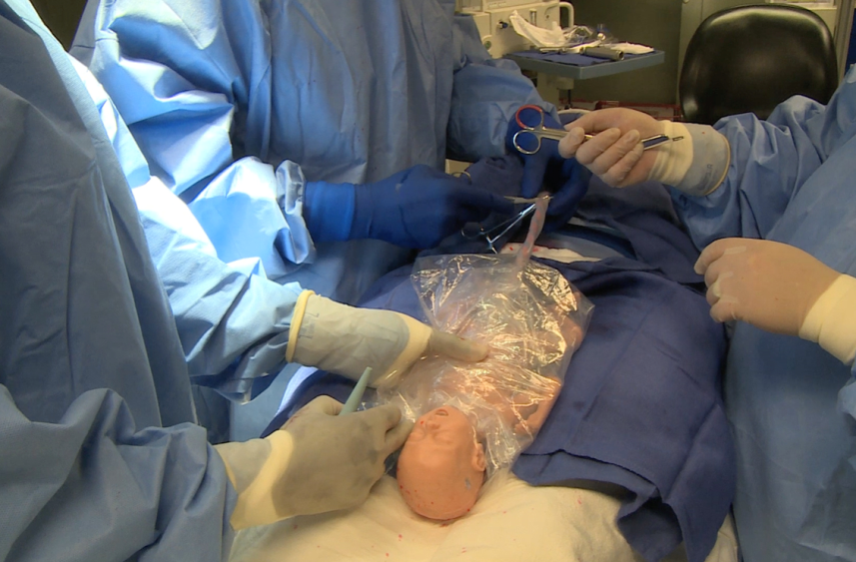
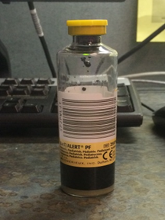
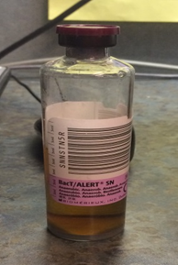
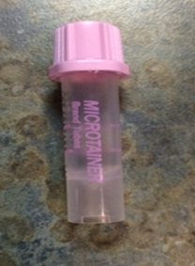
Recent Collaborative QI Endeavors
VON Micropremie
  Timed Cord Clamping
  Currently developing process to draw NICU admission labs from placenta

Slide 14
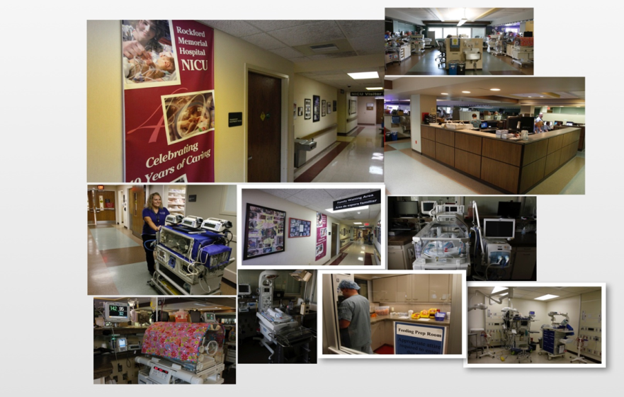
Recent Collaborative QI Endeavors
Golden Hour
        Temperature PBP
          Teamwork PBP
        Gimme 5
      Partnership with families PBP
      Consults and use of Virtual NICU Video Visit

Slide 15
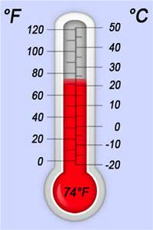
Process
  Developed interdisciplinary committee with strong interest in QI
Each committee member became a task force champion for the PBPs they chose to work on
Gathered pre-data on all inborn NICU admission temperatures
Brainstormed on ways to improve admission temperatures

Slide 16
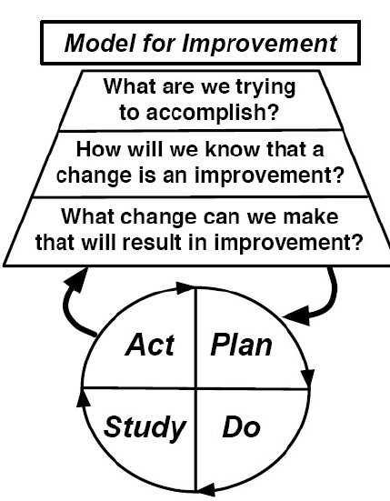
Tools
  ILPQC Toolkit
  PBPs
PDSA (Plan, Do, Study, Act)

Slide 17
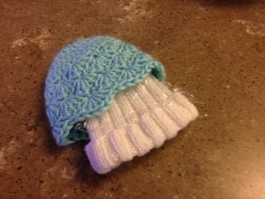
Small Tests of Change
    Admission Temp audit tool-August
    Added a heat lamp next to Panda beds in ORs-August
    K-pads on Panda beds for all <35 weeks vaginal and C/S deliveries-August
    Change to double knitted hats for <32 weeks-August
    OR temp log-September
    Slowly increased temperature in ORs-September
    Continue to collect data

Slide 18
Strategies
  Shared the pre-data with the OBs at the Perinatal Safety meeting to obtain buy-in for the need to improve in July.
  Informed both NICU & L&D staff of the pre-data and the need to improve.
  Educated both staff on the changes.
    Mutual respect between both units.
    Same goals-best outcomes for the mom and baby.
  Constant focus by the task force committee members.
  Incorporated the changes into Simulations to keep focus and buy-in.
  Continue to share with both departments where we are at since the changes were made.

Slide 19
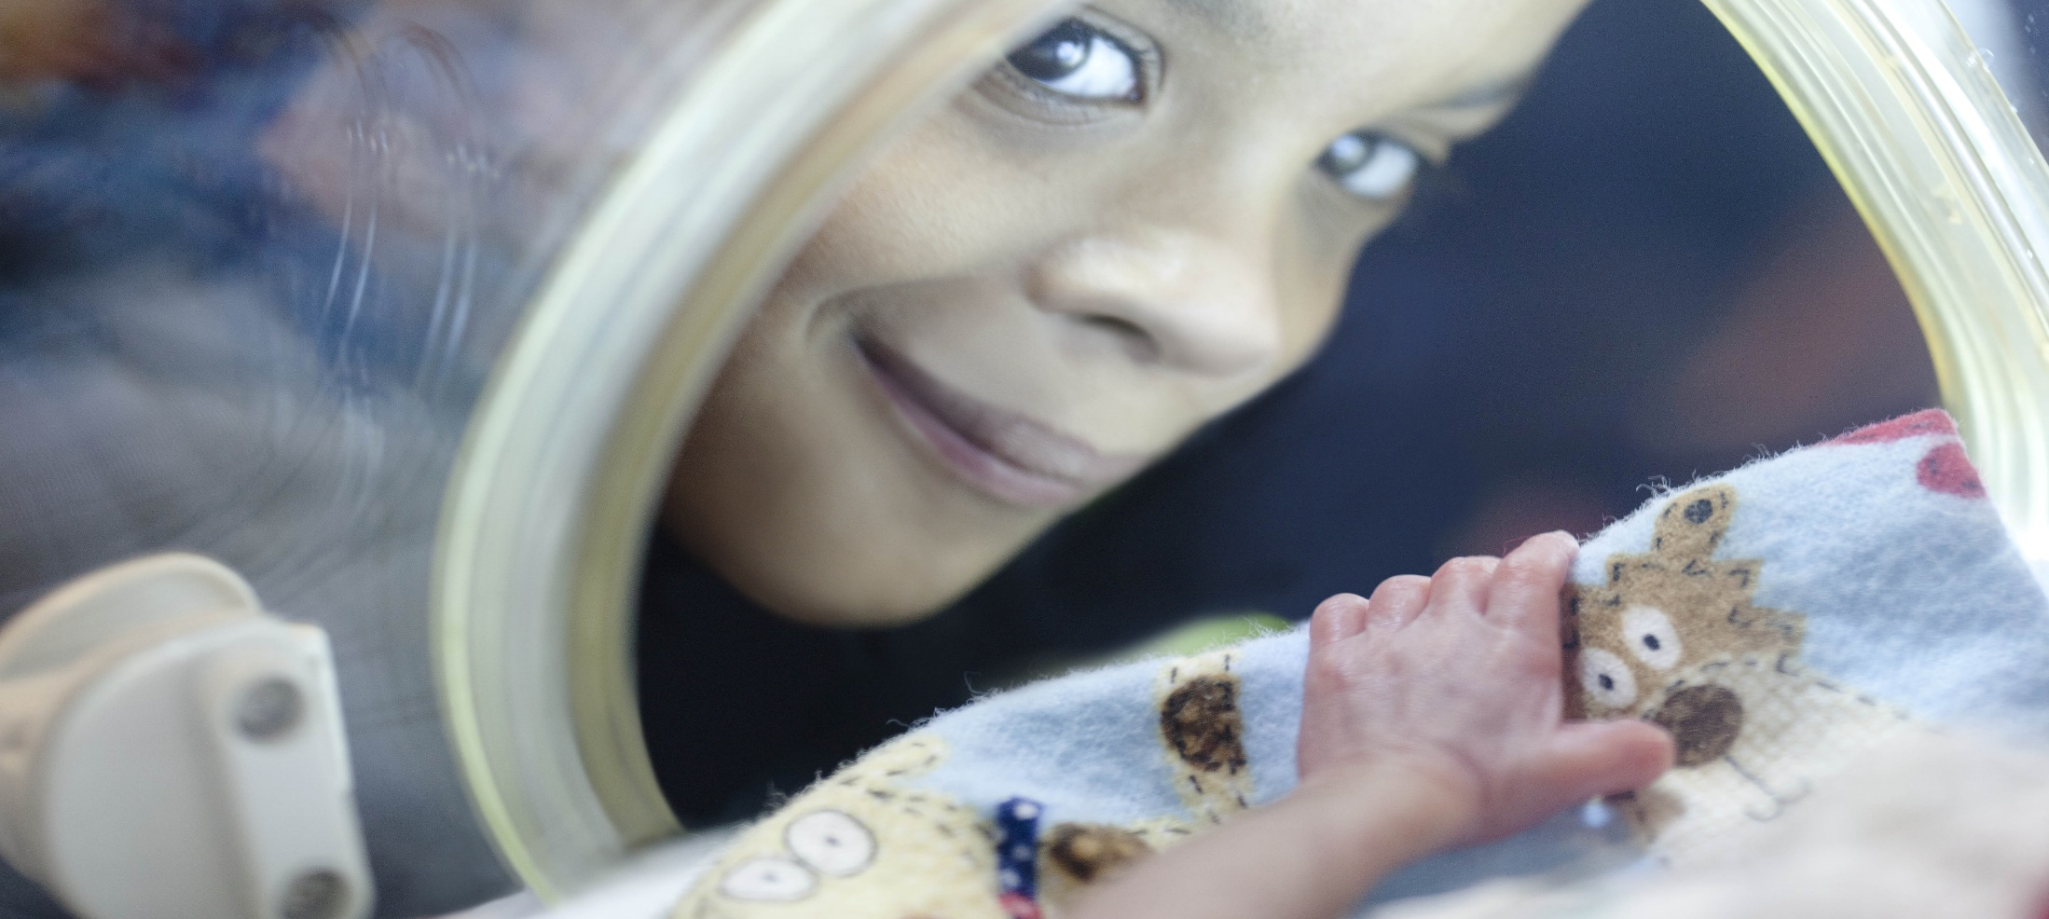

Implementation of the Golden Hour Delivery Pack at Children's Hospital University of Illinois
Adelaide Caprio, APN, MSN, CCNS, RNC-NIC
Aarti Raghavan, MD

Slide 20
Introductions
Adelaide Caprio, APN
Clinical Nurse Specialist - NICU
Aarti Raghavan, MD
Director : Quality Improvement – Pediatrics
Director: Neonatal Perinatal Fellowship Program
Division of Neonatology
Children’s Hospital University of Illinois (CHUI)
University of Illinois Hospital & Health Sciences System

Slide 21
Disclosure
We have no commercial interests and no conflicts of interest to disclose.

Slide 22

History OF PDSA CYCLES IN THE CHUI NICU
First encounter with PDSA cycles:
  OWL project: Deliver Oxygen With Love
  Established start/end times for each test of change
  Established need to uniquely identify patients participating in PDSA Cycles
  Developed feedback forms
Verbal feedback about tests of change obtained and incorporated.
Test of Change Symbol
Notes:
Picture of butterfly
Feedback form template
General pdsa packet content pics

Slide 23
Golden Hour Delivery Pack
Focus group created for Golden Hour Project
  Stake holders, End users, QI Experts
    Thermoregulation identified as initial project
      Need for “everything in one place” identified
  Staff focus groups brain stormed need & contents of a potential kit
    Initial kits created for first PDSA Cycle
Notes:
Talk about WHY thermoreg was chosen as the initial project.
(mattress was already in use, but sparingly and somewhat disorganized after implementaiton the prior year). Neowrap was available, but harder to find on the unit as it is a specialty item.

Slide 24
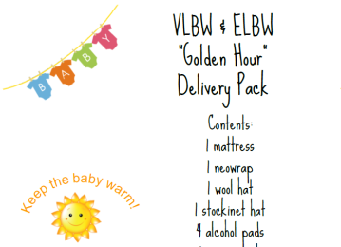
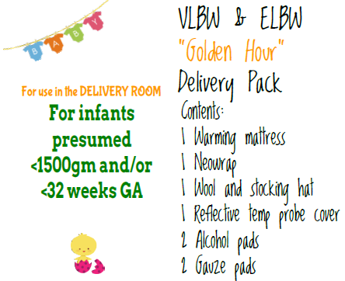
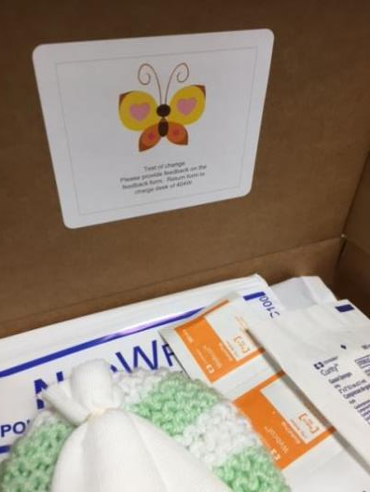
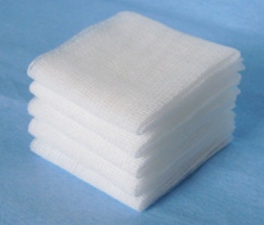
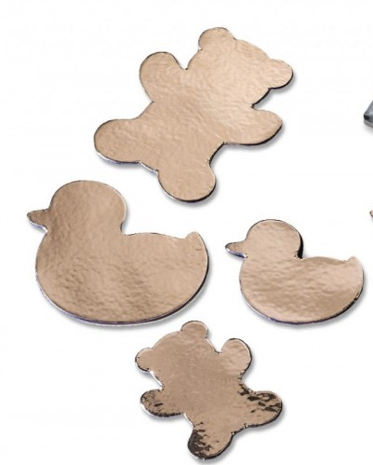
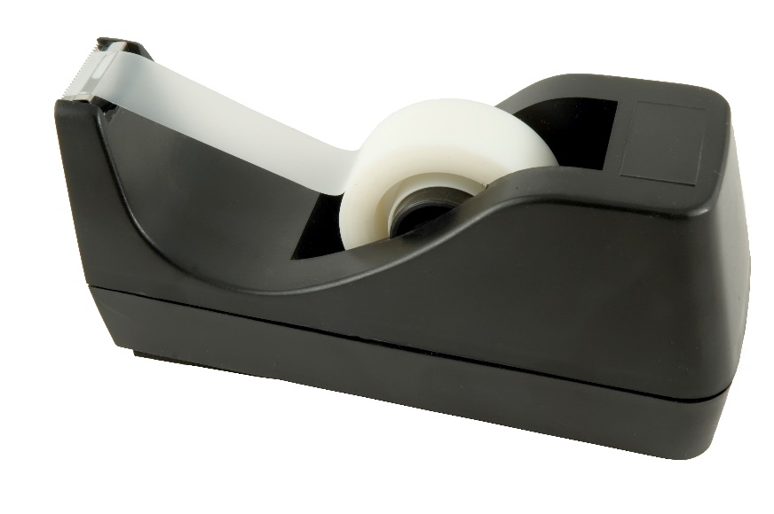
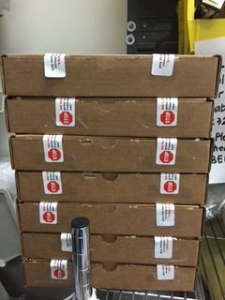
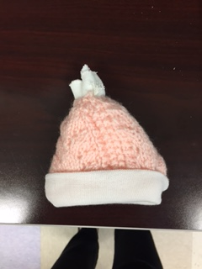
FIVE PDSA Cycles
AIM: To standardize equipment availability and use for thermoregulation in the DR and admission process.
To ensure compliance with best practices related to thermoregulation of the VLBW infant.
Original Label
New Label
Promote compliance with best practices
Cycle 3
Add reflective temp probes
Cycle 2
New labels, New hats
P
D
S
A
Cycle 5
Better seal with warning.
Education:
All boxes are created equal*
A
P
D
S
DATA
Cycle 5: Seal with better label,
educate staff contents are equal
S
A
D
D
Cycle 1
Test new kit
A
P
D
S
Cycle 4: Add more gauze, seal box
Cycle 4:
Add more gaze,
Seal with tape
P
D
S
A
Cycle 3: Add reflective temperature probe
Cycle 2: Clarify intended population and test new hats
Standardize equipment. Make it available
Cycle 1: Test the idea on two patients
Notes:
Add pictures flashing for each item that was tested
Cycle 5: Seal with better label, educate staff contents are equal (3 packs)
Cycle 4: Seal boxes, add more gauze (3 packs)
Cycle 3: Add reflective temperature probe (3 packs).
Cycle 2: Clarify intended population and test new hats (2 packs)
Cycle 1: Test the idea on two patients (2).

Slide 25
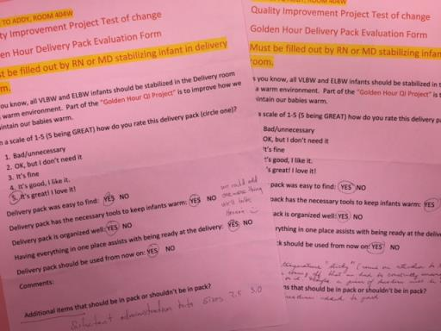
Results
Staff feedback regarding PDSA Cycles
  Verbal
  Written survey forms at the bedside
Compliance
  Data collection from 42 deliveries shows 92.7% compliance with use of the box.
    3 deliveries without included 2 deliveries of infants <32 weeks but >1500gm
Notes:
Can add pics of actual survey forms

Slide 26
Challenges: sustainability
Availability of hats
  Made by volunteers
Bundle creation
  Sustained by CNS and students
Purchase of kits in the future
  No company makes this…yet!

Slide 27
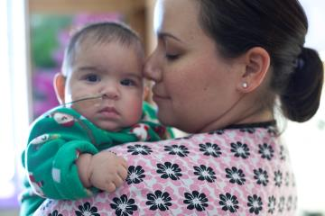

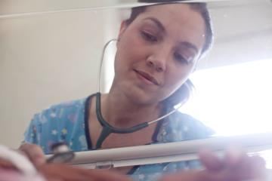
ACKNOWLEDGEMENTS
The CHUI NICU Nursing and Medical Staff for their patience and willingness to adopt change in order to provide the best care to our patients and families.

