Slide 1

Panel: Strategies for Family Engagement in QI
ILPQC Third Annual Conference
November 18, 2015

Slide 2
Overview
Moderator: Terry Griffin, MS, APN, NNP-BC
Panelists:
  St. Alexius Medical Center
    Maliha Shareef, MD, Director of Neonatology, maliha.shareef@alexian.net
    Korina Sanchez, MSN, RN, Director, NICU, korina.sanchez@alexian.net
    Licia Cirone, BSN, RN, Staff RN, licia.cirone@alexian.net
    Theresa Rekuc, Parent Advisor, trekuc@gmail.com
  Preeclampsia Foundation
    Stacey Porter, Preeclampsia Survivor and Preeclampsia Foundation Volunteer

Slide 3
Partnering with Families
A discussion with the team
Alexian Brothers Women and Children’s Hospital at
St Alexius Medical Center
Moderator: Terry Griffin, APN

Slide 4
Partnerships with Families

Slide 5
Families as Essential Partners
Families as essential partners in safe, quality and satisfying care

Slide 6
Challenges
Culture shift
Attitudes of providers
  Education
  Practice
Families were non-essential to their loved ones care and outcomes.

Slide 7
Golden Hour

Slide 8
Golden Hour
Clinical interventions for resuscitation and stabilization in the first 90 minutes of life affect infant outcomes.
Hospital teams participating in the Golden Hour Initiative work to improve outcomes of infants requiring resuscitation and stabilization by implementing evidenced-based practices for the first hours of life.

Slide 9
Golden Hour Tool Kit

Slide 10
Goal of Golden Hour Toolkit
Measurable Aim (s)
By December of 2016:
90% of resuscitation team leaders will have introduced themselves to the mother and/ or significant other prior to delivery
90% of fathers/ significant others will have experienced partnership the baby’s bedside in the delivery room, transport to NICU/ SCN, and during the admission process

Slide 11
Implementation
Nursing leadership and physician consensus and support for implementation
Assessment of environment and necessary modifications if possible

Slide 12
Implementation
Education of team including opportunities to share concerns and challenges of proposed practice change
  Language of partnership vs. power
  Understanding the difference between doing care “for” and “with” families
  Defining behavioral and process expectations
  Plan for follow-up and coaching
  Leadership support and reinforcement

Slide 13
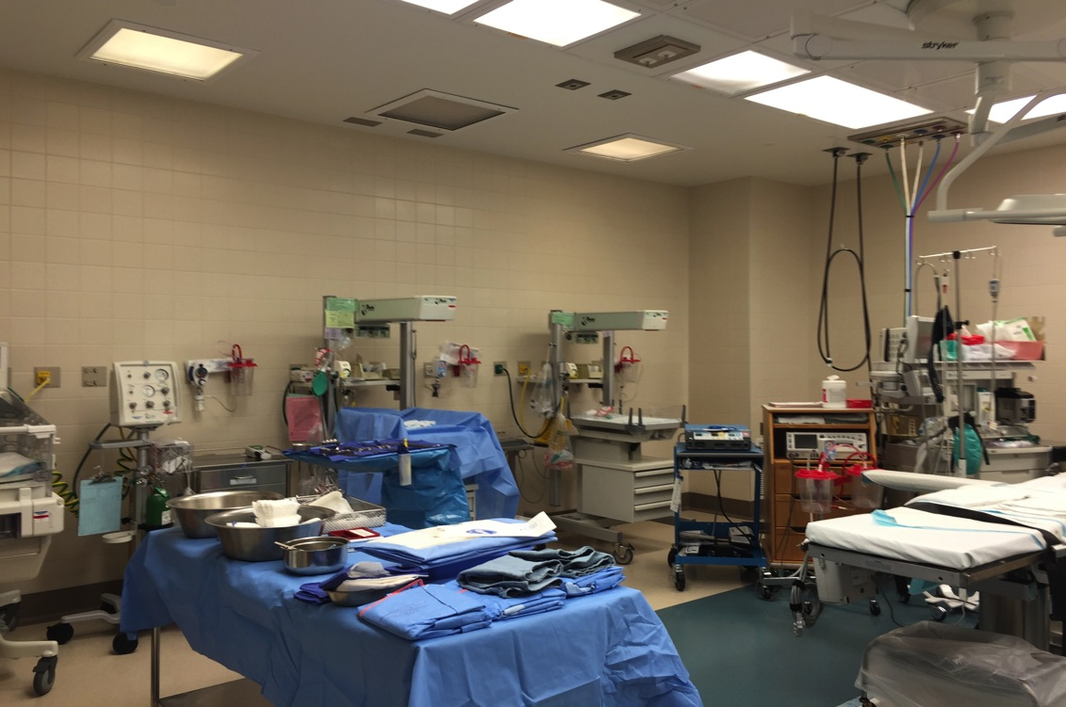
Operating Room

Slide 14
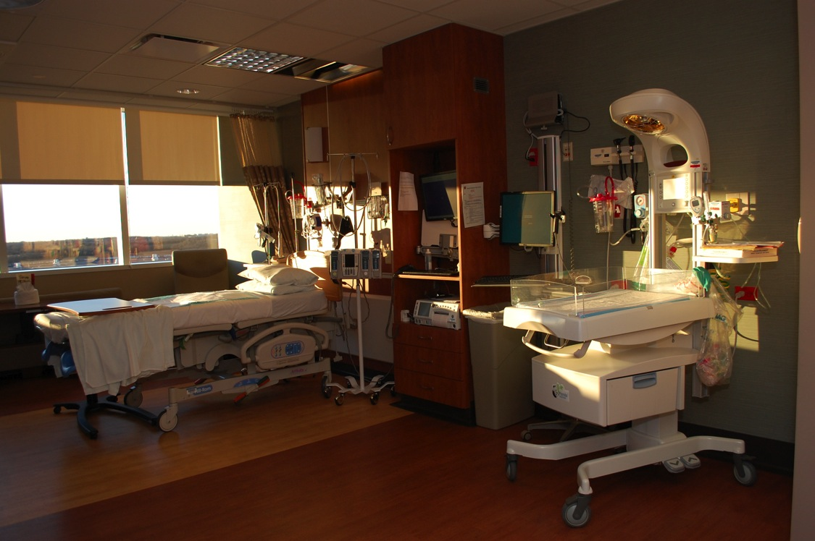
Labor and Delivery Room

Slide 15
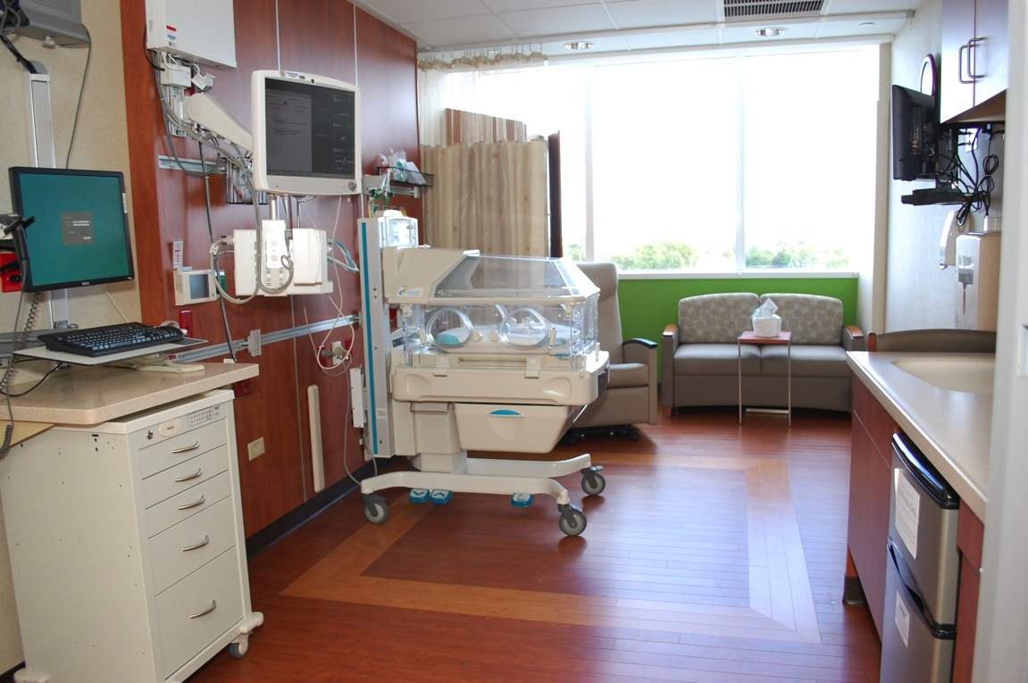
NICU Room

Slide 16
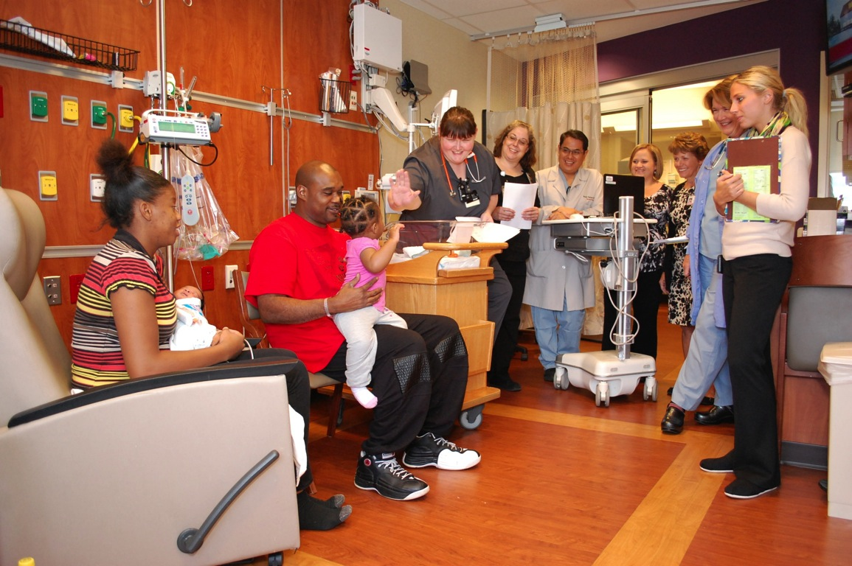
Medical Team Rounds

Slide 17
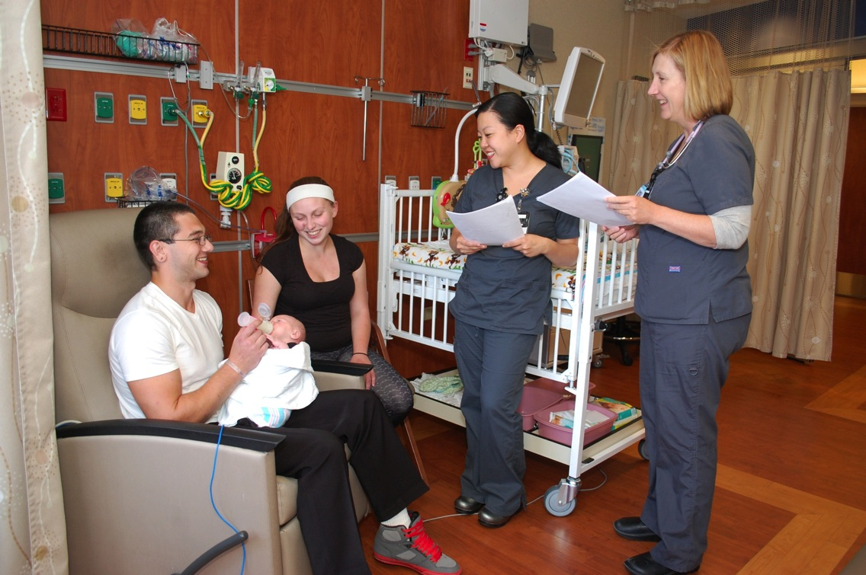
Nurse to Nurse Hand-Off

Slide 18
Patient & Family Engagement in preeclampsia
Stacey Porter
Preeclampsia Survivor, and Preeclampsia Foundation Volunteer

Slide 19
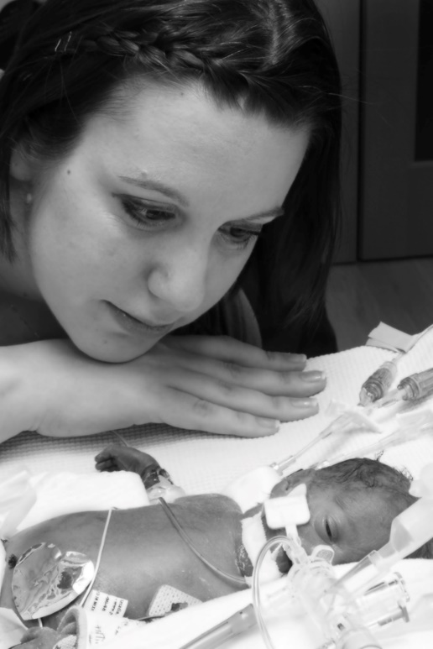

Stacey’s Story
The regular checkup and the catch that may have saved my life
The birth of Delilah Evangeline, and when hoping, praying and fighting just wasn’t enough
Preeclampsia Foundation Mission (www.preeclampsia.org)
  Awareness of signs and symptoms
  Disseminating the most accurate information about preeclampsia, HELLP Syndrome and other hypertensive
  disorders of pregnancy, and dispelling the myths of the past
  Improving healthcare practices
  Catalyzing research

Slide 20
Illinois Survey Results
Findings from Survey of 46 women who had at least one birth in Illinois and reported having some type of hypertensive disorder of pregnancy
While a large number of Illinois women with history of HDP (70%) expressed concerns or reported symptoms, only slightly more than half felt heard or received information they could understand.
87% of women did not receive any kind of support or resources for support, despite almost all of them reporting several resources they would have appreciated.
Women in Illinois are not for the most part (60%+) given a means of providing feedback to their care providers about their experience. And when they are, it is via a paper survey. 36% of those women do not consider that method adequate for conveying their point of view.
We can (and must) do better.

Slide 21
Awareness and advocacy, how to get families engaged
An engaged patient is informed, in partnership with her care providers, feels supported, and is invited into the debriefing process, recognizing that she brings a unique and valuable perspective.
  Listen to what patients are saying
  Provide the info and/or resources they need (before, during, after)
    Teach the signs and symptoms / What may not be normal
    Make sure significant others and/or family members are aware of what to look for
  Create an opportunity for them to debrief their experience after they have had time to process it; the information they share will contribute to your QI efforts.

Slide 22
Questions?

