Slide 1
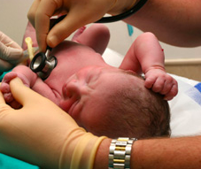
Building sustainable Quality Improvement in the hospital
Barbara Murphy, MSN, RN CMQCC/CPQCC

Slide 2

The CPQCC Experience:
Breast Milk Nutrition QI Collaborative
CPQCC led this QI Collaborative from October 2009 through September 2010.
IHI-style collaborative involving 11 NICUs from throughout California
Aim – increase the percentage of VLBW infants receiving breast milk at discharge
Multiple interventions recommended; participating sites implemented a self-selected combination of these interventions

Slide 3
CPQCC Breast Milk Nutrition QI Collaborative
Breast milk feeding rates were compared between baseline (54.6%), implementation (61.7%) and sustainability periods.
Secondary outcome measures included NEC rates (declined from 7% to 4.3%) and length of stay.
Review of post-collaborative data showed sustained improvement in the 6 months immediately following the collaborative.
Within 18 months, breast milk rates had returned to baseline.

Slide 4
CPQCC Breast Milk Nutrition QI Collaborative – What Happened?
CPQCC conducted a study 31 months after the end of the formal collaborative to assess the systems-level qualitative factors that promoted sustained improvement in sites that effectively sustained these improvements following participation.
11 NICUs invited to participate in site-specific, standardized scripted phone interviews with local teams; 8 participated.
Analysis conducted via qualitative research methodology to identify facilitators or barriers to sustainability.
Notes:
Qualitative research methodology allows the stakeholder mindsets and experiences impacting motivations for individual and team behaviors, along with underlying work culture.

Slide 5
CPQCC Breast Milk Nutrition QI Collaborative: Sustainability Study Findings
Facilitators:
  Incorporation in daily workflow leading to cultural change
  Advanced approach to staff education
  Multidisciplinary team involvement with an emphasis on physician involvement
  Data-driven feedback system (routine data collection, data review and data sharing with team members)
Formal involvement in structured collaborative contributed to initial success, but not sustainability.

Slide 6

DUH!!

Slide 7
Sustainability: “When new ways of working and improved outcomes become the norm.”*
**
Perceived value Monitoring and feedback Leadership Staff Shared Models Organizational infrastructure | Organizational fit Community fit Partners Spread Funding Government policies
*Sustainability: Model and Guide. National Health Service Institute for Innovation and Improvement. UK. 2007
**Thomas, S and Zahn, D. Sustaining Improved Outcomes: A Toolkit. NYS Health Foundation. 2010
(http://nyshealthfoundation.org/resources-and-reports/resource/sustaining-improved-outcomes-a-toolkit)

Slide 8
Sustainability: Key Factors*
Innovation: doing something different, rather than doing the same thing better
Measurement: to determine which changes demonstrate improvement and by how much
Human factors: optimizing the way individuals behave, teams work and organizations function
Culture: attitudes, beliefs, perceptions and values employees share
Change management: transitioning individuals, teams and organizations to a desired future state
*Jeffcott, S. Healthcare Improvement Scotland, 2014 for NHS Scotland Quality Improvement Hub (http://www.qihub.scot.nhs.uk/knowledge-centre/quality-improvement-topics/spread-and-sustainability.aspx

Slide 9
Sustainability: Key Factors*
Leadership: combining technical QI skills with effective interpersonal and relational skills
Knowledge into action: how to translate and embed best ideas and evidence into practice
Engagement: connection with people’s emotional, cognitive and behavioral styles
Evaluation: understanding why and how a change delivered improvement in a particular context
Empowerment: the degree of person-centeredness in a system
*Jeffcott, S. Healthcare Improvement Scotland, 2014 for NHS Scotland Quality Improvement Hub (http://www.qihub.scot.nhs.uk/knowledge-centre/quality-improvement-topics/spread-and-sustainability.aspx

Slide 10

“Quality improvement work can be a lot like dieting, in that lasting success requires behavior modification. As with weight loss, achieving and maintaining improvements can seem overwhelming at the start, as implementation often proves difficult and the initiative frequently may seem to be on the brink of failure. And, like weight loss, sustaining quality improvement requires adherence to disciplined routines, ongoing measurement and constant vigilance, even after the goal has been achieved.”*
*https://innovations.ahrq.gov/perspectives/sustaining-and-spreading-quality-improvement

Slide 11
Technical Knowledge vs. “Soft Issues”
“Technical ‘know-how’ related to quality improvement science is insufficient. Attention to ‘soft issues’ such as leadership development and change management are necessary to promote sustainability and spread”
(Julie Kliger, MPA, BSN – Director, Integrated Nurse Leadership Program, UCSF)
https://innovations.ahrq.gov/perspectives/sustaining-and-spreading-quality-improvement

Slide 12
Technical Knowledge vs. “Soft Issues”
Identified 4 pillars in which specific change management skills need to be developed:
“Individuals” pillar – self awareness and emotional intelligence; how one’s actions influence the group/work
“Team” pillar – how high-performance teams function, complete their work, communicate and ensure accountability
“Organizational” pillar – understanding power structure, strategic communication, stakeholder ID and forming allies
“Process” pillar – evidence based practice, QI indicators, data
https://innovations.ahrq.gov/perspectives/sustaining-and-spreading-quality-improvement

Slide 13
Critical Components
Data – rigorous use of data, consistently tracked at the unit level informs PDSA cycles
Teamwork – working as a team is the key to success; not working harder as an individual. Bring stakeholders in at the start to that solutions are valid and practical within the context of existing work processes
Training – build individual QI capacity to promote data driven, team driven process improvement
https://innovations.ahrq.gov/perspectives/sustaining-and-spreading-quality-improvement

Slide 14
Sustaining Healthcare Innovations
Ongoing processes to monitor performance
Senior leadership, re: clear direct communication and support
Recognition that frontline personnel - not senior leaders - are best positioned to lead change
Dedicated time for frontline personnel to create, monitor and improve care processes
Combination of core evidence-based requirements with flexibility
https://innovations.ahrq.gov/perspectives/sustaining-and-spreading-quality-improvement

Slide 15
Sustaining the Change: How to Prevent Your Efforts From Running Out of Gas
Make it personal Grab attention Embrace emotion Bring it to life Make it easy | Generate respect Promote the passion Keep it fresh Reinforce the messages Measure and refresh
http://www.mcdanielpartners.com/sustaining.html

Slide 16
“Making Change Happen, and Making It Stick”
“Understand and spell out the impact of the change on people.
Build an emotional and rational case for change.
Ensure that the entire leadership team is a role model for change.
Mobilize your people to “own” and accelerate the change.
Embed the change in the fabric of the organization.”
http://www.strategy-business.com/article/00057?pg=all

Slide 17

“5 Reasons Why a Change Management Strategy Matters”*
“Change is personal.
The soft stuff is really the hard stuff.
Successful change requires a change in mindsets and/or behaviors.
Change must be sustainable to be successful.
Make real impact.
*http://www.smartchangesolutions.com/5-reasons-why-a-change-management-strategy-matters/

Slide 18
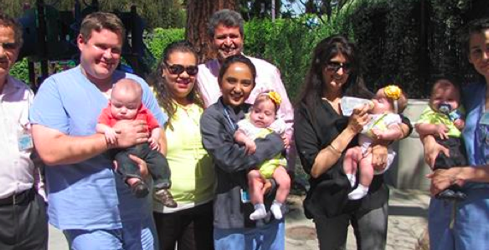
Building a QI Culture
“The culture of an organization is the embodiment of the core values, guiding principles, behaviors and attitudes that collectively contribute to its daily operation.” NACCHO, 2012*
*http://qiroadmap.org/resources/

Slide 19
Building the Foundation of a QI Culture: Leadership Commitment
Leadership commitment to transformational change:
  Endorsed and possibly led by senior management
  Dedicated human and financial resources
  Communication, re: progress (or lack thereof)
  Lasting support for QI efforts
Primary role for senior leadership – change management (i.e., the structured approach to transitioning from a current state to a desired future state)
*http://qiroadmap.org/resources/

Slide 20
Building the Foundation of a QI Culture: QI Infrastructure
The infrastructure required to ensure that QI efforts are aligned with the organization’s mission, vision and strategic plan and is linked to performance
Components of a strong QI infrastructure:
  Performance management system (data driven, cyclical)
  QI Council(oversees the implementation of the performance management system)
  QI Plan (provides direction and structure for QI efforts
*http://qiroadmap.org/resources/

Slide 21
Building the Foundation of a QI Culture: Employee Empowerment and Commitment
Empowering employees (training, granting authority, eliminating fear of consequences)
Identifying QI champions at all levels
Supporting QI as modus operandi; employees continuously consider how processes can be improved and innovation is the norm.
Viewing QI, not as just one more thing that has to be done, but as second nature and “the way we do things here”.
*http://qiroadmap.org/resources/

Slide 22

Building the Foundation of a QI Culture: Customer Focus
Customer service is a core tenet of quality.
Services must be customer-driven.
Customers are stakeholders, and need to be involved in the process.
*http://qiroadmap.org/resources/

Slide 23
Building the Foundation of a QI Culture: Teamwork and Collaboration
Recognize QI culture as an organization-wide effort that can only be achieved through teamwork and collaboration.
Teams need to be routinely formed to brainstorm, solve problems, implement QI projects and share lessons learned.
Collaborations among divisions and programs must exist to standardize processes and break silos.
*http://qiroadmap.org/resources/

Slide 24
Building the Foundation of a QI Culture: Continuous Process Improvement
Shoot for better, not perfection.
Never-ending quest to improve processes by identifying root causes of problems, making gradual improvements to reduce variation, improve the quality of services and increase customer satisfaction
*http://qiroadmap.org/resources/

Slide 25

CPQCC Breast Milk Nutrition QI Collaborative: Sustainability Facilitators: How?
Incorporation in daily workflow leading to cultural change

Slide 26

CPQCC Breast Milk Nutrition QI Collaborative: Sustainability Facilitators: How?
  Advanced approach to staff education

Slide 27

CPQCC Breast Milk Nutrition QI Collaborative: Sustainability Facilitators: How?
  Multidisciplinary team involvement with an emphasis on physician involvement

Slide 28

CPQCC Breast Milk Nutrition QI Collaborative: Sustainability Facilitators: How?
  Data-driven feedback system (routine data collection, data review and data sharing with team members)

Slide 29
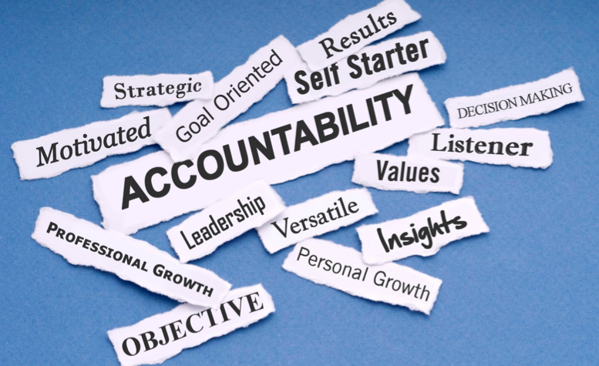
CPQCC Breast Milk Nutrition QI Collaborative: Sustainability Facilitators: How?
Accountability

Slide 30
Program Sustainability Framework and Domain Descriptions
Copyright 2013. The Program Sustainability Framework V2 is a copyrighted instrument of Washington University, St Louis, MO.
https://sustaintool.org

Slide 31
QI Sustainability Planning Form* Hospital:
Initiative:
Date:
*Shamelessly stolen, with gratitude, from the PQCNC, 2015

Slide 32

Questions?
Barbara Murphy, MSN, RN
Director, CPQCC/CMQCC
Director, Perinatal Programs
Division of Neonatal and Developmental Medicine
Stanford University
650-723-4822
barbar@stanford.edu

