Slide 1
Severe Maternal Morbidity:
Why and How To Review
Sarah J. Kilpatrick MD, PhD
Professor and Helping Hand of Los Angeles Endowed Chair
Chair Department of Obstetrics and Gynecology
Associate Dean for Faculty Development
Cedars-Sinai Medical Center

Slide 2
Disclosure of Faculty Financial Interests or
Relationships
I do not have any disclosures.

Slide 3
Objectives
This session will provide an overview of:
  The standard definition of severe maternal morbidity
  How to effectively identify cases of severe maternal morbidity
  How to use the Severe Maternal Morbidity Data Abstraction and Assessment Tool

Slide 4
25 YO G3P2 37 wks
Presented in labor, known fibroids
  Active phase arrest at 8 cm
  Taken for cesarean
    Difficulty getting into uterus due to fibroids
    EBL 1500 cc during delivery
    HR 120’s, BP 110/50
  In RR pt holding baby, became dizzy, hypotensive, tachycardic
  Taken back to OR; large hemoperitoneum; could not be resuscitated

Slide 5
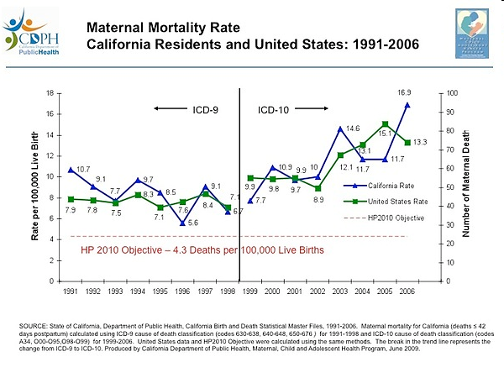
California Data: 1991-2006

Slide 6
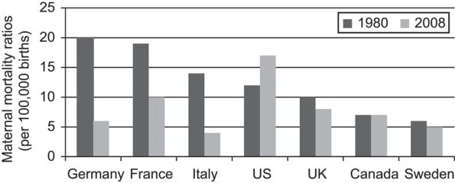
MMR 1980 vs. 2008
Hogan MC, Lancet 2010;375:1609-23.
Hankins. Levels of Maternity Care. Obstet Gynecol 2012.

Slide 7
Causes of Death Subtle Change
Berg OG 2010;116:1

Slide 8

Morbidity: The Problem
Maternal morbidity is difficult to define
  Broad range of complications and conditions
  Broad range of severity
Maternal morbidity cannot be captured by a defined set of metrics
Administrative vs. more local records
  We need to start somewhere
Healthy Mom
Death

Slide 9
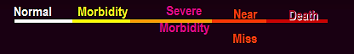
Why Evaluate Severe Maternal Morbidity?
Not enough maternal deaths per institution to study
1.7 million women/year have maternal morbidity (Danel, 2003)
If severe maternal morbidity cases are similar to deaths re disease diagnoses and preventable issues then we large number to study
Continuum of Morbidity

Slide 10
What is Below the Iceberg?
Severe maternal morbidity cases
    0.5% deliveries 1991-2003
        291,000 cases, 464 hospitals, national hospital discharge survey
    Based on ICD-9 codes most common: transfusion, eclampsia, hysterectomy (75%)
    50X more common than death
What if we studied these?
Callaghan ajog 2008;199:133

Slide 11
How to Define and Screen for SMM
National Surveillance
Facility Identification and Review

Slide 12
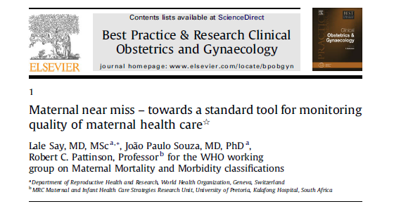
“A woman who nearly died but survived a complication that occurred during pregnancy, childbirth or within 42 days of termination of pregnancy.”

Slide 13
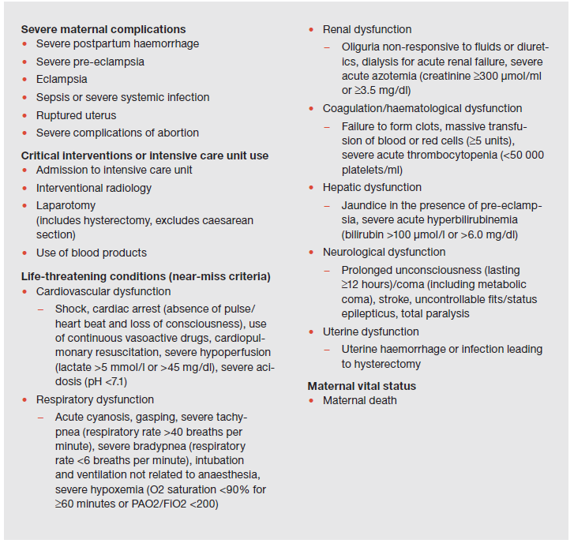
WHO Near-miss Approach
http://whqlibdoc.who.int/publications/2011/9789241502221_eng.pdf

Slide 14
Severe Maternal Morbidity: Near Miss
Life-threatening events at delivery hospitalization
  ‘‘a very ill pregnant or recently delivered woman who would have died had it not been but luck and good quality care was on her side’’
    Mantel et al. Br J Obstet Gynecol 1998;105:985-90.
  “a woman who nearly died but survived a complication that occurred during pregnancy, childbirth or within 42 days of termination of pregnancy”
    Say et al. Best Pract Res Clin Obstet Gynaecol 2009;23:287-96 doi: 10.1016/j.bpobgyn.2009.01.007
Variety of data sources to identify cases based on indicators
Near miss by expert opinion
Geller et al., JAMA, 2002

Slide 15
Severe Maternal Morbidity: Near Miss
5 factor scoring system identified women with “near miss” morbidity (Se 100%; Sp 93%)
    Organ system failure
    Extended intubation
    ICU admission
    Surgical intervention
    Transfusion ≥4 units
Geller et al., J Clin Epidemiol, 2004

Slide 16
Severe Maternal Morbidity: Near Miss
Overcomes the issue of severity
Requires multiple sources or a dedicated perinatal database for identification
  Most scoring system factors not available in administrative databases
  Less useful in smaller institutions
  Cumbersome for state-level and national surveillance
Organ system failure performs well by itself (Se 95%; Sp 88%)
  Indicators of such in administrative data are attractive candidates
Transfusion ≥4 units and/or ICU admission is nearly as sensitive as the 5-factor system (Se 100%; Sp 78%)
Geller et al. construct has been validated
(You et al., Am J Perinatol 2013;30:21-4)

Slide 17
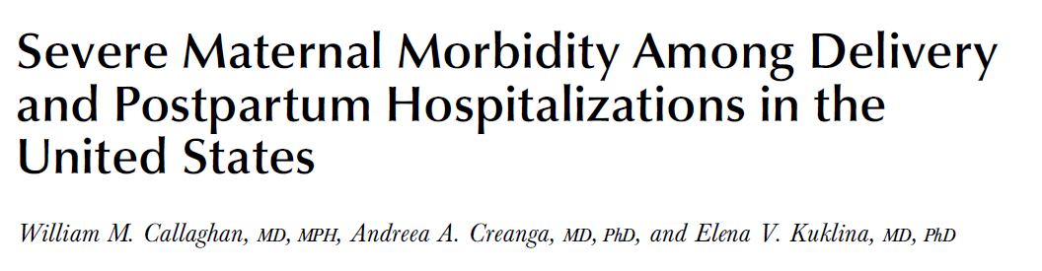
Nationwide Inpatient Sample database
Aim to capture indicators of organ system failure
Use mortality hospitalizations to identify morbidity not previously considered
  Length of stay >90th percentile for diagnosis-identified cases by mode of delivery
    >2 days vaginal
    >3 days repeat cesarean
    >4 days primary cesarean
  Include postpartum admissions
Callaghan et al. Obstet Gynecol 2012;120:1029-36

Slide 18
Maternal morbidity | ICD-9-CM
 | Codes | Diagnosis code | Procedure code
Acute renal failure | 584, 669.3 | x
Cardiac arrest/ventricular fibrillation | 427.41, 427.42, 427.5 | x
Heart failure during procedure or surgery | 669.4x, 997.1 | x
Shock | 669.1, 785.5x, 995.0, 995.4, 998.0 | x
Sepsis | 038.0-038.9, 995.91, 995.92 | x
Disseminated intravascular coagulation | 286.6, 286.9, 666.3 | x
Amniotic fluid embolism | 673.1 | x
Thrombotic embolism | 415.1x, 673.0, 673.2, 673.3, 673.8 | x
Puerperal cerebrovascular disorders | 430, 431, 432.x, 433.x, 434.x, 436, 437.x, 671.5, 674.0, 997.2, 999.2 | x
Severe anesthesia complications | 668.0, 668.1, 668.2 | x
Pulmonary edema | 428.1, 518.4 | x
Adult respiratory distress syndrome | 518.5, 518.81, 518.82, 518.84,799.1 | x
Acute myocardial infarction | 410.xx | x
Eclampsia | 642.6x | x
Blood transfusion | 99.00-99.09 |  | x
Hysterectomy | 68.3-68.9 |  | x
Ventilation | 93.90, 96.01-96.05, 96.7x |  | x
Sickle cell anemia with crisis | 282.62, 282.64, 282.69 | x
Intracranial injuries | 800.xx, 801.xx, 803.xx, 804.xx, 851.xx-854.xx | x
Internal injuries of thorax, abdomen, and pelvis | 860.xx—869.xx | x
Aneurysm | 441.x | x
Operations on heart and pericardium | 35.xx, 36.xx, 37.xx, 39.xx |  | x
Cardio monitoring | 89.6x |  | x
Temporary tracheostomy | 31.1 |  | x
Conversion of cardiac rhythm | 99.6x |  | x

Slide 19
Severe Morbidity
Between 1998-1999 and 2008-2009 severe morbidity during delivery hospitalization increased ~75% (7.4-12.9/1,000 deliveries).
Severe morbidity at postpartum hospitalizations more than doubled (1.4-2.9/1000 deliveries).
Large proportions of women who died in hospital had indicators for severe morbidity
  e.g. 1/3 had transfusion; nearly 2/3 had ventilation
Severe morbidity 100 times more common than mortality

Slide 20
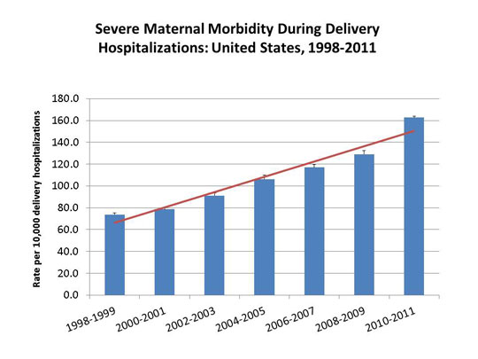
Population-based surveillance
Callaghan et al. Obstet Gynecol 2012;120:1029-36

Slide 21
36 YO G1 at 40 Weeks
Mild preeclampsia at 38 wks
Induction recommended; patient declined
Came in with “worst headache of life”
BP 220/110
  Hydralazine and magnesium started
Pt stated she was going to seize
BP 240/120
Pt stated she was going to arrest
Pt had left sided paralysis and became unarousable

Slide 22
Issues for Surveillance of Severe Morbidity
Standardization of terminology
  Near miss; severe morbidity; severe obstetric morbidity. etc.
Facility versus population
  Callaghan et al. construct is retrospective
  Real-time identification more important for facilities
  Availability of data systems
Considerations for quality improvement

Slide 23
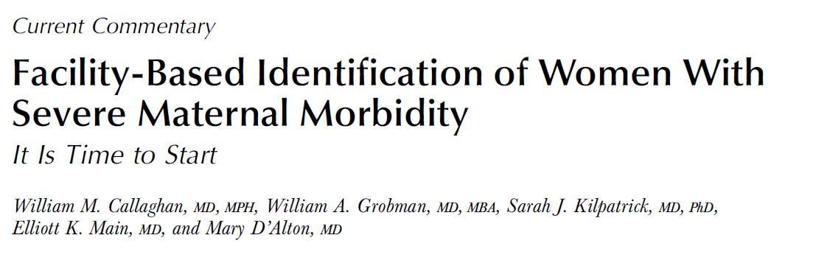
Facility surveillance AND REVIEW:
  Transfusion ≥4 units
  ICU admission

Slide 24


Alignment
The “M” in MFM
Proposals to establish maternal levels of care
  Hankins et al. Obstet Gynecol 2012; 120:929-34
Maternal Mortality Initiative (CDC/DRH)
National Maternal Health Initiative (HRSA/MCHB)
Every Mother Initiative (AMCHP)

Slide 25






Alignment

Slide 26
Preventability
37% deaths in Chicago 1992-98 (Kemp AJOG 2000:182;S164)
54% deaths in MA 1990-1999 (Nannini, 2002)
40% NC 1995-99 (Berg OG 2005;106:1228-34)
Preventable factors
  Providers (41% preventable deaths)
  Patients (15%)
  Both (15%) (Sachs NEJM, 1987:316:667-72)

Slide 27
Preventability Related to Cause
High preventability
  Hemorrhage (93%)
  Preexisting chronic
  disease (89%)
  PIH (60%)
  Infection (43%)
  Cardiovascular (40%)
Less preventability
  Choriocarcinoma (25%)
  Cardiomyopathy (22%)
  CVA (0)
  AFE (0)
Berg OG 2005;106:1228-34

Slide 28
Multivariate Analysis
Clinical diagnosis and provider related preventable factors sig associated with progression from severe morbidity on (p < .01)
System and patient factors ns
Geller AJOG 2004;191:939-44

Slide 29
Near Miss Preventable Factors
40% deaths preventable factors
45% near misses preventable factors
17% severe morbidities preventable factors (p = .01)
Clearly opportunity for slowing progression through the continuum at least from severe morbidity to worse
Geller AJOG 2004;191:939-44

Slide 30
Prevention or Opportunity to Alter
Outcome
Prevention morbidity: harder concept
  Reduce eclampsia, DIC, LOS, renal failure, HELLP, stroke etc.
Identifying opportunities to alter outcome
  Strong, possible, none

Slide 31
Examples of Preventable Factors
Provider
  Failure to identify high risk
  Incomplete/inappropriate management
  No referral to tertiary
System
    Communication
    Policies
    Equipment
    Medication
Patient

Slide 32
What To Do?
Obtain data
  Follow CDC 2001 recommendations for severe morbidity and death
Utilize multidisciplinary approach
Identify opportunities to alter outcome
Implement interventions based on data
  Educational programs on the basics: hemorrhage, hypertensive disease, infection, cardiac disease

Slide 33
Facility-Based Identification of Women with Severe Maternal Morbidity
Terminology: severe maternal morbidity
Identification of cases:
  ICU admission or
    3-4/1000 deliveries
  Transfusion of 4 or more units of blood products
    2/1000 deliveries
Review: should be done to lessons can be learned
  Facility based
Research:
  Are we identifying right cases
  Can we improve outcome
Callaghan OG 2014;123:978-81

Slide 34
SMM Review: Process
Identify women with 4 or more units of blood, ICU admission
Develop multidisciplinary committee
  OB, MFM, RN, CNM, OB anesthesia, others
Encourage debriefing after event
  This is not the same as a review
Primary data abstracted from record and presented to committee
Kilpatrick et al. OG 2014 in press

Slide 35
SMM Review: Process
Identify women with 4 or more units of blood, ICU admission
Develop multidisciplinary committee
  OB, MFM, RN, CNM, OB anesthesia, others
Encourage debriefing after event
  This is not the same as a review
Primary data abstracted from record and presented to committee for evaluation
Kilpatrick et al. Standardize severe maternal morbidity review: rationale and process. Obstet Gynecol 2014; 124: 361-366.

Slide 36

Council on Patient Safety in
Women’s Health Care Website
www.safehealthcareforeverywoman.org

Slide 37

Council on Patient Safety in
Women’s Health Care Website
www.safehealthcareforeverywoman.org
Select ‘Severe Maternal Morbidity Forms’ from dropdown

Slide 38

Council on Patient Safety in
Women’s Health Care Website
www.safehealthcareforeverywoman.org
Sign in with your registered email address or click ‘Need an account?’ to create one

Slide 39
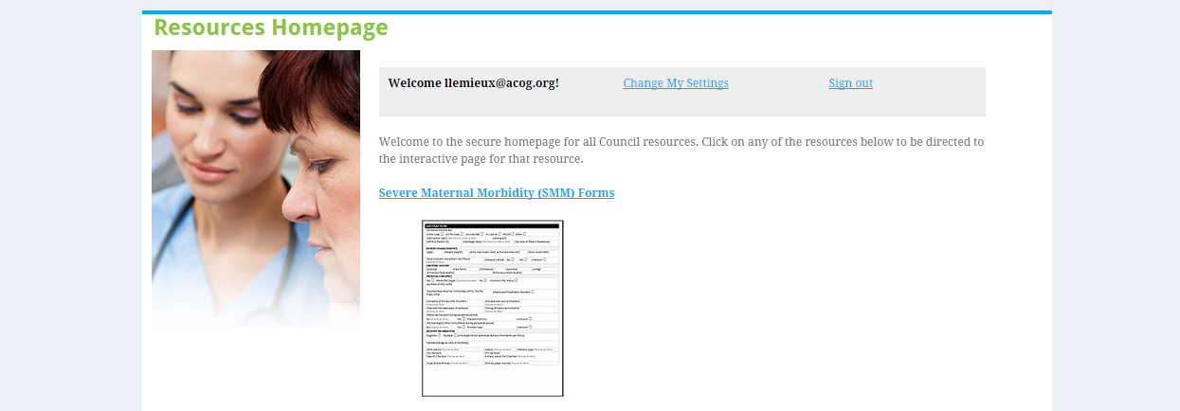
Council on Patient Safety in
Women’s Health Care Website
www.safehealthcareforeverywoman.org
Click the Severe Maternal Morbidity (SMM) Forms link in order to view and download

Slide 40
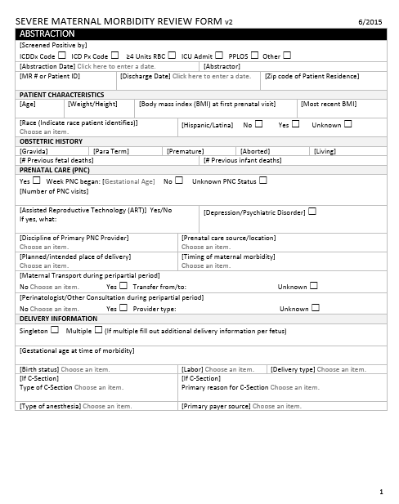
Council on Patient Safety in
Women’s Health Care Website
www.safehealthcareforeverywoman.org
Once clicked, it will open in Microsoft Word where data can be entered and saved on your local device.

Slide 41

Council on Patient Safety in Women’s Health Care Website
www.safehealthcareforeverywoman.org

Slide 42
SMM Review Process
Can use SMM abstraction and assessment form
  Abstraction:
    Trained abstractor
    Capture analyzable and descriptive data from medical record
    Identify specific morbidity
    Develop narrative of key aspects of morbidity
    Focused questions re: care quality
      Was hypertension recognized appropriately
      Did woman appropriately receive magnesium
      Was severe hypertension treated in a timely fashion
      Was woman delivered in a timely fashion

Slide 43
Assessment: Done by Committee
Identify whether opportunities to alter outcome (strong, possible, none)
If yes enumerate and make specific recommendations
Identify things that went well
Conduct of committee
  Just culture or other nonjudgmental approach

Slide 44
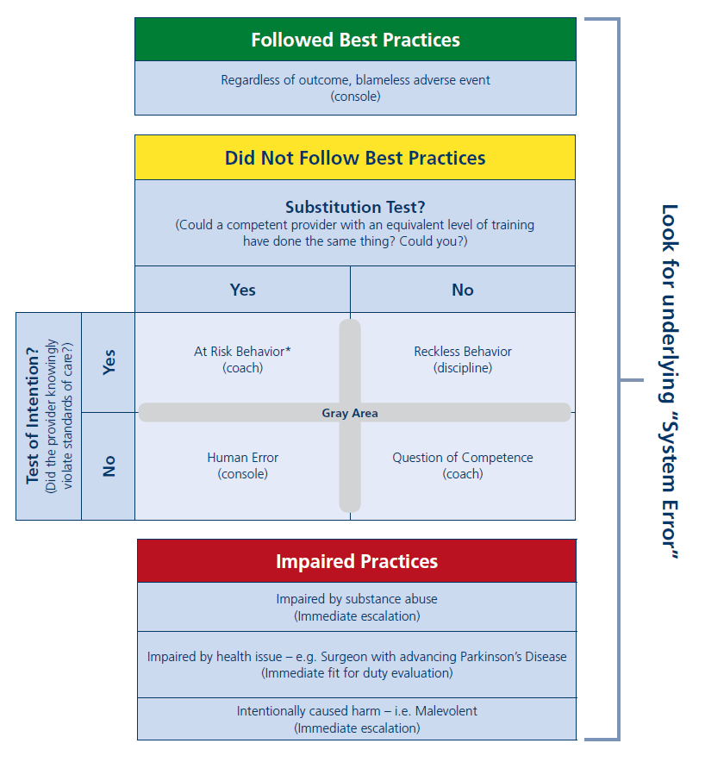
Just Culture

Slide 45
SMM Review Form
(6/3/2015 version)
ABSTRACTION
[Screened Positive by] NEW ICDDx Code ☐ ICD Px Code ☐ ≥4 Units RBC ☐ ICU Admit ☐ PPLOS ☐ Other
PATIENT CHARACTERISTICS mostly drop down boxes
OBSTETRIC HISTORY
PRENATAL CARE (PNC)
[Assisted Reproductive Technology (ART)] NEW Yes/No If Yes, what: | Depression/Psychiatric Disorder NEW
[Planned/intended place of delivery]
DELIVERY INFORMATION
[Gestational age at time of morbidity]
[Birth status]
[If C-Section] Type of C-Section
[Type of anesthesia]

Slide 46
Severe Maternal Morbidity Review Form
ABSTRACTION: CASE NARRATIVE AND TIMELINE
Should include brief synopsis focused on the specific severe maternal morbidity that occurred. It should be concise and pertinent to the particular SMM and include appropriate time line, evaluation and be in chronologic format. Please attempt to identify key moments that impacted care.
ASSESSMENT
[Primary Cause of Morbidity] * | [If trauma indicated as primary cause of morbidity] | [Other cause]
B. [Sequence of Morbidity: Clinical Cause of Morbidity] 1 and 2 reflect what initiated the final cause resulting in the severe morbidity and 3 is the final cause. For example: 1. Preeclampsia 2. uncontrolled hypertension 3 intracranial bleed So that 1, caused 2, that resulted in 3 – the severe morbidity event
1. 2. 3.
C. [Affected organ systems (can have >1)]
ASSESSMENT

Slide 47
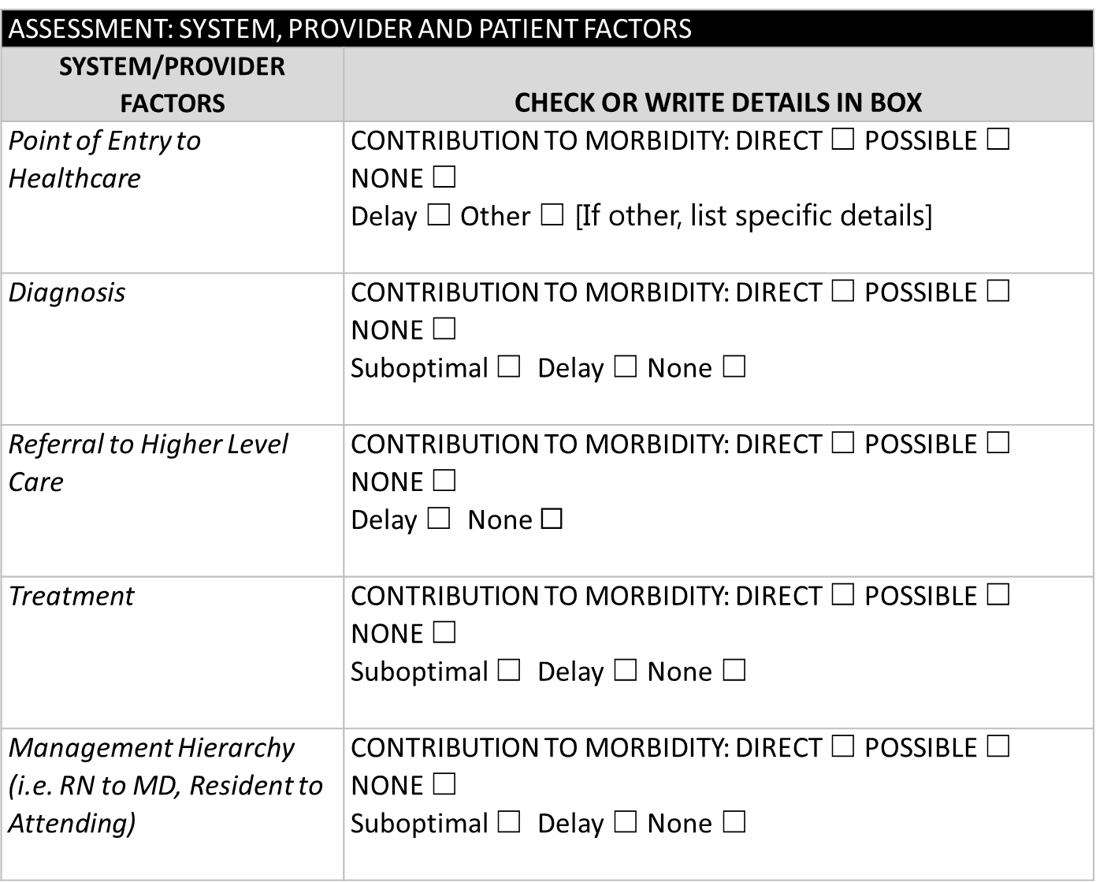
Severe Maternal Morbidity Review Form
Section Reorganized
ASSESSMENT: SYSTEM, PROVIDER AND PATIENT FACTORS

Slide 48
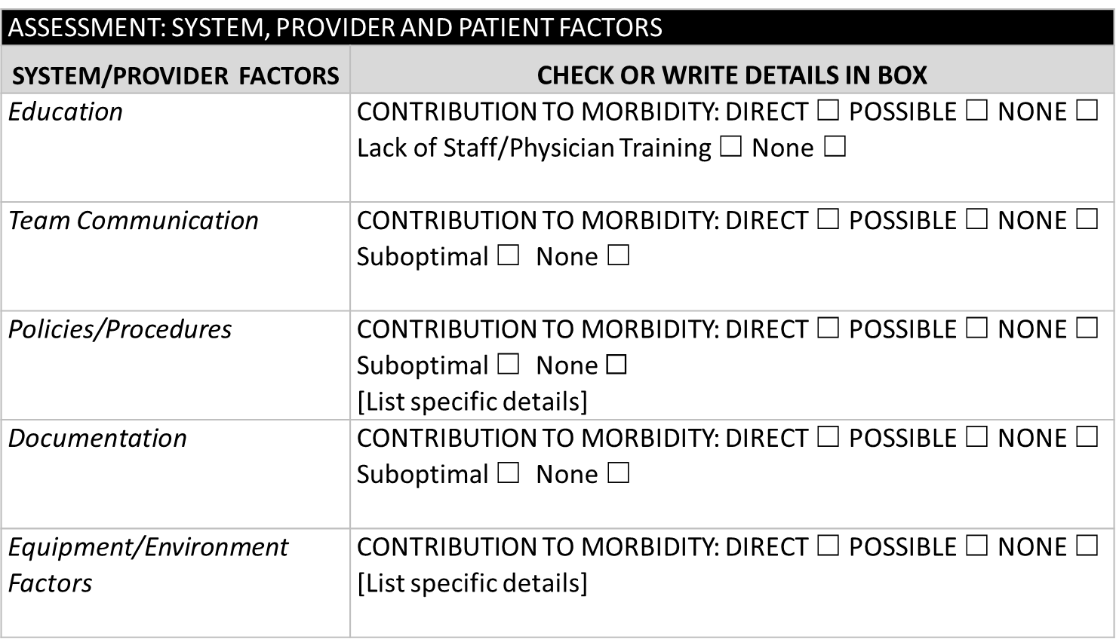
Severe Maternal Morbidity Review Form
Section Reorganized
ASSESSMENT: SYSTEM, PROVIDER AND PATIENT FACTORS

Slide 49
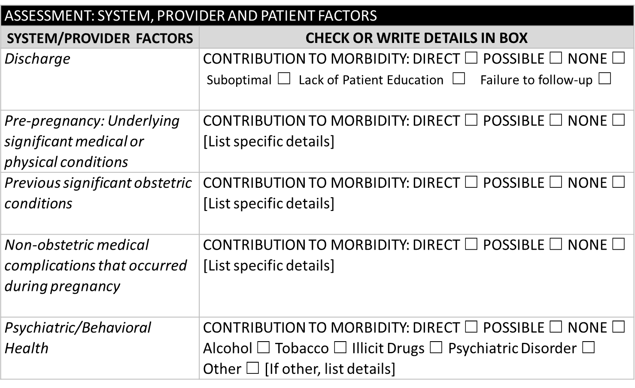
Severe Maternal Morbidity Review Form Section Reorganized
ASSESSMENT: SYSTEM, PROVIDER AND PATIENT FACTORS

Slide 50
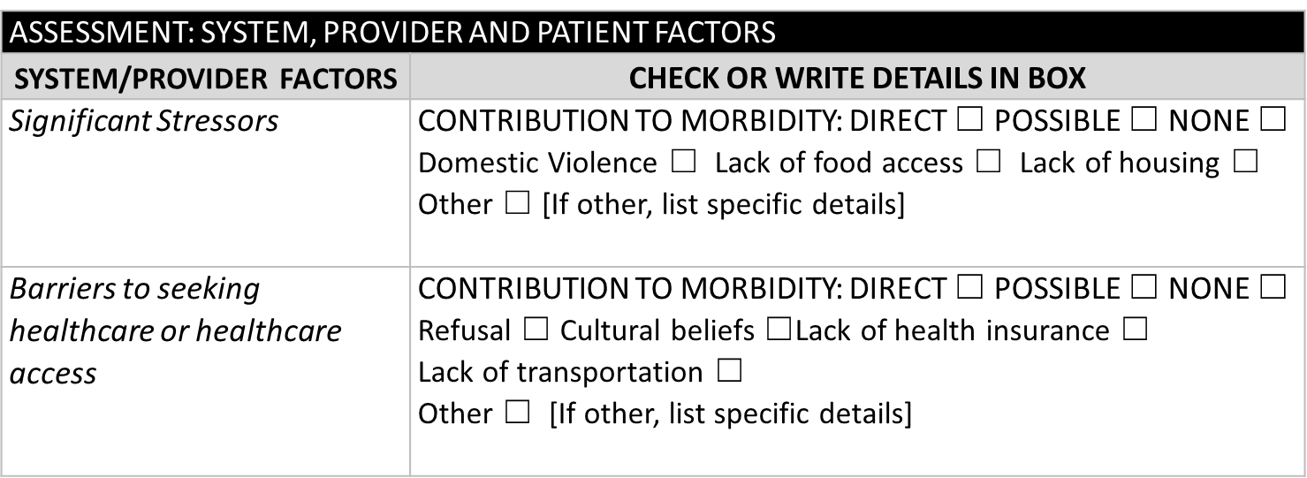
Severe Maternal Morbidity Review Form Section Reorganized
ASSESSMENT: SYSTEM, PROVIDER AND PATIENT FACTORS

Slide 51
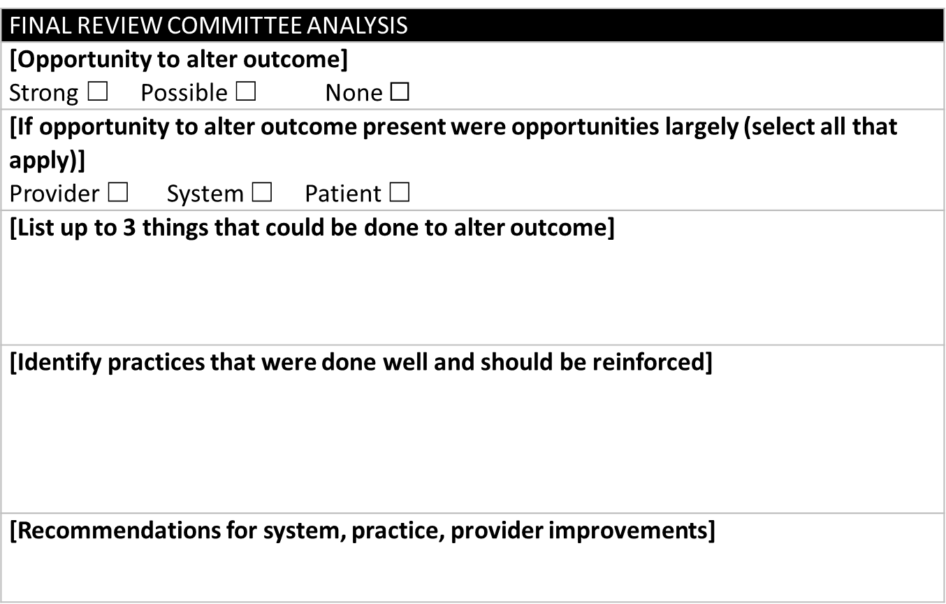
Severe Maternal Morbidity Review Form

Slide 52
Example 1
43 YO with known previa, presumed accreta
  Presents at 37 wks with hemorrhage
  To OR cesarean hysterectomy performed
    Becomes hypotensive, tachycardic, Develops DIC
    Difficulty finding extra surgical help
  EBL 4 liters, transfused 8 PRBCs, 6 FFP
  To SICU postop intubated
  Discharge home on POD 4

Slide 53
SMM Review Form Example 1
ABSTRACTION
[Screened Positive by] ICDDx Code ☐ ICD Px Code X ≥4 Units RBC X ICU Admit X PPLOS ☐ Other
PATIENT CHARACTERISTICS
OBSTETRIC HISTORY
PRENATAL CARE (PNC)
[Assisted Reproductive Technology (ART)] Yes/No If Yes, what: IVF | Most of these are drop down boxes
[Planned/intended place of delivery] Level 3
DELIVERY INFORMATION
[Gestational age at time of morbidity] 37
[Birth status] live born
[If C-Section] classical/hysterectomy Type of C-Section
[Type of anesthesia] general

Slide 54
SMM Review Form Example 1
ABSTRACTION: CASE NARRATIVE AND TIMELINE
Should include brief synopsis focused on the specific severe maternal morbidity that occurred. It should be concise and pertinent to the particular SMM and include appropriate time line, evaluation and be in chronologic format. Please attempt to identify key moments that impacted care.
ASSESSMENT
[Primary Cause of Morbidity] OB hemorrhage | [If trauma indicated as primary cause of morbidity] | [Other cause]
B. [Sequence of Morbidity: Clinical Cause of Morbidity] 1 and 2 reflect what initiated the final cause resulting in the severe morbidity and 3 is the final cause. For example: 1. Preeclampsia 2. uncontrolled hypertension 3 intracranial bleed So that 1, caused 2, that resulted in 3 – the severe morbidity event
1. previa, accreta 2. Placental hemorrhage, hysterectomy 3. DIC
C. [Affected organ systems (can have >1)] placental hemorrhage, hematologic
ASSESSMENT

Slide 55
SMM Review Form Example 1
FINAL REVIEW COMMITTEE ANALYSIS
[Opportunity to alter outcome] Strong ☐ Possible X None ☐
[If opportunity to alter outcome present were opportunities largely (select all that apply)] Provider X System X Patient ☐
[List up to 3 things that could be done to alter outcome] multidisciplinary planning for accreta before del Planned del before 37 wks Have better urgent way to reach gynecologic advanced surgical help
[Identify practices that were done well and should be reinforced] Emergent delivery handled well by initial providers
[Recommendations for system, practice, provider improvements] Implement system for accreta delivery planning Make contact list for 24 hr availability for surgical help

Slide 56
SMM Review Process Continued…
Have institutional mechanisms to implement change
Trend data internally potentially regionally, etc.
Review timing
Confidentiality
Focus on systems

Slide 57
SMM Review Cont…
Can use SMM abstraction and assessment form
  Abstraction:
    Trained abstractor
    Capture analyzable and descriptive data from medical record
    Narrative of key aspects of morbidity
    Focused questions re care quality
      Was hypertension recognized appropriately
      Did woman appropriately receive magnesium
      Was severe hypertension treated in a timely fashion
      Was woman delivered in a timely fashion

Slide 58
Example 2
43 YO with known previa, presumed accreta
  Plan made to deliver her at 36 wks
  Multidisciplinary team consulted and available
  Scheduled CS
    Plan of surgery made: midline skin, immed hyst
    AM, primary surgeon, gyn onc, ob anesthesia and backup IR available
    OR cesarean hysterectomy performed
  EBL 3 liters, transfused 6 PRBCs, 6 FFP
  To SICU postop intubated
  Discharge home on POD 4

Slide 59
SMM Review Form Example 2
ABSTRACTION
[Screened Positive by] ICDDx Code ☐ ICD Px Code X ≥4 Units RBC X ICU Admit X PPLOS ☐ Other
PATIENT CHARACTERISTICS
OBSTETRIC HISTORY
PRENATAL CARE (PNC)
[Assisted Reproductive Technology (ART)] Yes/No If Yes, what: IVF | Most of these are drop down boxes
[Planned/intended place of delivery] Level 3
DELIVERY INFORMATION
[Gestational age at time of morbidity] 37
[Birth status] liveborn
[If C-Section] classical/hysterectomy Type of C-Section
[Type of anesthesia] epidural

Slide 60
SMM Review Form Example 2
ABSTRACTION: CASE NARRATIVE AND TIMELINE
Should include brief synopsis focused on the specific severe maternal morbidity that occurred. It should be concise and pertinent to the particular SMM and include appropriate time line, evaluation and be in chronologic format. Please attempt to identify key moments that impacted care.
ASSESSMENT
[Primary Cause of Morbidity] OB hemorrhage | [If trauma indicated as primary cause of morbidity] | [Other cause]
B. [Sequence of Morbidity: Clinical Cause of Morbidity] 1 and 2 reflect what initiated the final cause resulting in the severe morbidity and 3 is the final cause. For example: 1. Preeclampsia 2. uncontrolled hypertension 3 intracranial bleed So that 1, caused 2, that resulted in 3 – the severe morbidity event
1. previa, accreta 2. Placental hemorrhage, hysterectomy 3.
C. [Affected organ systems (can have >1)] placental hemorrhage, hematologic
ASSESSMENT

Slide 61
SMM Review Form Example 2
FINAL REVIEW COMMITTEE ANALYSIS
[Opportunity to alter outcome] Strong ☐ Possible None X
[If opportunity to alter outcome present were opportunities largely (select all that apply)] Provider System Patient ☐
[List up to 3 things that could be done to alter outcome]
[Identify practices that were done well and should be reinforced] Excellent planning of care
[Recommendations for system, practice, provider improvements]

Slide 62
SMM Review Form Example 2
ASSESSMENT: SYSTEM, PROVIDER AND PATIENT FACTORS
ASSESSMENT: SYSTEM, PROVIDER AND PATIENT FACTORS
SYSTEM/PROVIDER FACTORS | CHECK OR WRITE DETAILS IN BOX | CONTRIBUTION TO MORBIDITY 1: DIRECT 2: POSSIBLE 3: NONE
Point of Entry | Delay ☐ None ☐
Diagnosis | Suboptimal ☐ Delay ☐ None ☐
Referral to Higher Level Care | Delay None ☐
Treatment | Suboptimal Delay None ☐

Slide 63
Maternal Mortality Rate,
California and United States; 1999-2010
Maternal Deaths per 100,000 Live Births
HP 2020 Objective – 11.4 Deaths per 100,000 Live Births
SOURCE: State of California, Department of Public Health, California Birth and Death Statistical Master Files, 1999-2010. Maternal mortality for California (deaths ≤ 42 days postpartum) was calculated using ICD-10 cause of death classification (codes A34, O00-O95,O98-O99) for 1999-2010. United States data and HP2020 Objective were calculated using the same methods. U.S. maternal mortality data is published by the National Center for Health Statistics (NCHS) through 2007 only. U.S. rates from 2008-2010 were calculated using NCHS Final Death Data (denominator) and CDC Wonder Online Database for maternal deaths (numerator). Accessed at http://wonder.cdc.gov on April 17, 2013. Produced by California Department of Public Health, Center for Family Health, Maternal, Child and Adolescent Health Division, April, 2013.

Slide 64
Main et al. In Press. AJOG
Data from CMQCC
  2012-2013
  > 66,000 deliveries in CA
Rate screen positive for SMM
  1.9%
True positive rate for SMM
  0.7%
False positive rate: 63%

Slide 65
What We Have Learned
Engagement of multidisciplinary group
Problems with documentation surprising
Choose 1-3 issues to address
  Laps were not being weighed in OR
  Not clear who was responsible for ordering antibiotics in OR
  Need for an accreta team
Need someone to keep/organize data
Could shorten by collecting less data

Slide 66
Final Thoughts
Review forms are just a suggestion
Important to capture analyzable data locally, regionally, etc.
ICU admission, transfusion of 4 or more units are not meant to be quality measures
Debriefs are not the same as reviews
Open to input regarding ease of use of forms

