Slide 1

ILPQC: Welcome
ILPQC Third Annual Conference
November 18, 2015

Slide 2

Happy 2nd Birthday ILPQC!
Thank you to all who have contributed to building a successful state perinatal quality collaborative for IL
  Sponsors
  Stakeholders
  Advisory Workgroups
  Leadership / Data teams
  Hospital Teams
  Families

Slide 3
Overall Conference Objectives
Use QI tools and methods to improve perinatal outcomes.
Identify successful past/present initiatives in Illinois to reduce adverse perinatal outcomes.
Lead or participate in the planning, implementation and sustenance of a perinatal quality improvement project based on one’s expertise.
Drive national, state, and local policies aimed to improve perinatal health care.

Slide 4
Illinois Perinatal Quality Collaborative
(ILPQC) Third Annual Conference
Approval for 6.8 contact hours
This continuing nursing education activity was approved by the Ohio Nurses Association (OBN-001-91), an accredited approver by the American Nurses Credentialing Center’s Commission on Accreditation.

Slide 5
CEU’s
To receive your contact hours you must attend the entire presentation and complete the evaluation from.
CEU certificates will be distributed at the end of the conference after the evaluation is turned in.
The planning committee and the speakers of the conference declare no conflict of interest.

Slide 6
Conference Agenda
8:00-8:10 | Welcome
8:10-8:45 | ILPQC Highlights: A Year in Review
8:45-9:35 | Keynote: Severe Maternal Morbidity: Why Review Sarah Kilpatrick, MD, PhD
9:35-10:15 | Building Sustainable Quality Improvement at the Hospital Level Barb Murphy, MSN, RN
10:15-10:30 | Break
10:30-11:15 | Panel: Strategies for Family Engagement in QI Terry Griffin, MS, APN, NNP-BC Panelists: • Maliha Shareef, MD • Licia Cirone, RN, BSN • Korina Sanchez, RN, BSN • Stacey Porter (parent) • Theresa Rekuc, BA (parent)
11:15-12:00 | Panel: Teams Share Strategies for QI Success Barb Murphy, MSN, RN Panelists: • Shanice Graham, BS • Melissa A. Byars RNC-OB, BSN • Adelaide B. Caprio, APN, CCNS, MSN • Rhonda Gale, RNC-NIC • Aarti Raghavan, MD • Glynis Adams, RNC, MS

Slide 7
Conference Agenda
12-1:30 | Networking Lunch and Poster Session
1:30-2:15 | Golden Hour - Improving Stabilization of the High-risk Neonate after Birth Gautham Suresh, MD, DM, MS, FAAP
2:15-3:00 | Antenatal Corticosteroids - Why are We Still Talking About This? Bryan T. Oshiro, MD
3:00-3:15 | Break
3:15-4:45 | Hot Topics in Neonatal and OB QI: Discussion of Current and Future Initiatives Neonatal Breakout: Gautham Suresh, MD, DM, MS, FAAP, Aki Noguchi, MD, ILPQC; Patricia Ittmann, DO, ILPQC; Obstetric Breakout Ann Borders, MD, MSc, MPH, ILPQC; Barbara Murphy, RN, MSN; Jeanne Mahoney, RN, BSN Family Engagement Breakout Terry Griffin, MS, APN, NNP-BC
4:45-5:00 | Wrap up & Evaluation

Slide 8
ILPQC Welcome:
Dr. Nirav Shah, MD, JD
ILPQC Third Annual Conference
November 18, 2015

Slide 9
ILPQC Highlights:
A Year in Review
ILPQC Third Annual Conference
November 18, 2015

Slide 10
Overview
ILPQC accomplishments for 2015
  Increase state-wide participation
  Expand QI services to hospital teams
  Acknowledge hospital team achievements in 2014
  Implement new initiatives
  Plan future initiatives for 2016 and beyond
Our initiative highlights
  Early Elective Delivery
  Neonatal Nutrition
  Golden Hour
  Birth Certificate Accuracy
  Launch of Maternal Hypertension

Slide 11

ILPQC Vision
A statewide perinatal quality collaborative that involves all perinatal stakeholders; utilizes data-driven, evidence-based practices; improves perinatal quality resulting in improved birth outcomes, improved health for women and infants, and decreased costs; builds on Illinois’ existing state-mandated Regionalized Perinatal System, and operates with long-term sustainable funding.

Slide 12
ILPQC Timeline
IL Perinatal Advisory Committee Prematurity Task Force Report Released
2nd Annual ILPQC Conference
3nd Annual ILPQC Conference
Stakeholder Meetings Begin
Website Launch
ILPQC Kick-Off Conference
Launch Birth Certificate Initiative
Start Up Funding CHIPRA / HFS
REDCap Data System launched
Launch EED and Neonatal Nutrition Initiatives
Launch Golden Hour Initiative
Consultation with Perinatal Quality Leaders
OH, CA, NC, FL
CDC Award with IDPH
Nov.
2012
Sept.
2013
Nov.
2013
Jun.
2014
Sept.
2014
Nov.
2014
Dec.
2014
Apr.
2015
Nov.
2015

Slide 13
Goal 1: Increase State-wide Participation
Increased the number of hospitals participating in QI initiatives from 50 to 109
Increased advisory group participation
  OB Advisory Group – 73 members representing 34 hospitals with 25-30 participants on each monthly call
  Neonatal Advisory – 17 members representing 17 hospitals
  Data Advisory – 20 members representing 17 hospitals

Slide 14

Hospital Engagement
109 hospitals participating in one or more ILPQC Initiative
107 hospitals in OB
Initiatives
  Over 95% of IL births covered by ILPQC
26 hospitals in Neonatal
Initiative
  Over 85% of IL NICU beds covered
  by ILPQC

Slide 15
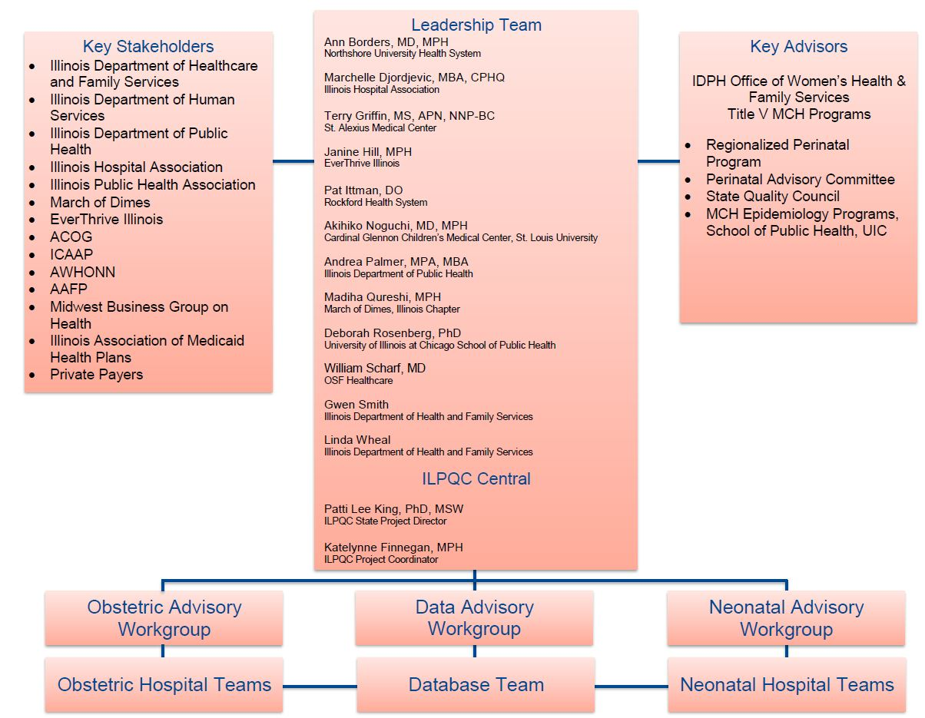
ILPQC Infrastructure

Slide 16
OB Advisory Group
Andrea Palmer
Angelique Rettig*
Angela Rodriguez
Angie Bowen
Ann Borders*
Barbara M. Scavone
Carol Andrychowski
Carol Burke*
Cindy Mitchell
Deb Landacre
Debbie Miller
Debra Kamradt
Debbie Schy
Felicia Feifer
Regina Gomez
Jean Goodman
Jim Keller*
*Hypertension Leadership Team
Jodee Brandon
Jude Duval
Lisa Sullivan
Maripat Zeschke*
Margaret Villareal
Mary Jean Handrigan
Maura Quinlan
Melissa Brantley
Myra Sabini
Nicole Chesis
Pam Wolfe
Pat Joschko
Patricia Heywood
Ralph Kehl
Roma Allen
Samantha Schoenfelder
Sirosh Rana

Slide 17
OB Advisory Group (cont.)
Sheila Rhodes
Trish O'Malley
Jennifer Woo
Mona LeGrand
Bill Grobman
Bridgette Blazek
Chelsea Rogers
Deb Rosenburg
Denise Massey
Emmet Hirsch
Emanuel Vlastos
Howard Strassner
Heather Stanley-Christian
Jessica Bimm Rosati
Julie Watson
Katie Warren
Kim Armour
Kristin Salyards
Lisa Doot Abinoj
Lori Andriakos
Mahmoud Ismail
Michael Leonardi
Michael Socol
Mayank Shah
Phil Higgins
Rob Abrams
Robbin Uchison
Sherry Jones
Sue Hesse
Susan Fulara
Tina Wheat
Amanda Bennett
April Caruso
Jean Mahoney
Jennifer Hofer
Kai Tao
Kisha Semenuk
Trishna Harris
Miranda Scott

Slide 18
Neonatal Advisory Group
Akhil Maheshwari
Akihiko Noguchi
Alok Rastogi
Anthony Bell
Elaine Shafer
Ellen Melo-Waak
Janine Khan
Jean Silvestri
Joel Fisher
Leslie Caldarelli
Marc Weiss
Matthew Derrick
Patricia Ittmann
Robert Covert
Venkata Majjiga
Vibhan Thaker
William Stratton

Slide 19
Data Advisory Group
Abel Kho
Aki Noguchi
Ann Borders
Brianne Augustine
Carol Rosenbusch
Chelsey Leruth
Cindy Mitchell
Deb Rosenberg
Don Houchins
Janelle Landis Kheshgi
Jenny Brandenburg
Jillian Baranggay
Marie Cleary-Fishman
Matthew Derrick
Meghan Harris
Pat Ittmann
Satyender Goel
Theresa Larsen
Tony Bell
William Scharf

Slide 20
Goal 2: Expand QI Services to
Hospital Teams
Expanded quality improvement (QI) support
  One-on-one QI support calls to over 30 hospitals
  5 PDSA-cycle workshop webinars with over 50 hospitals
  Monthly OB and Neo team calls
Increased collaborative learning opportunities
  Face-to-face meetings in April (Neo) and May (OB)
  6 BC QI topic workshops with about 30 hospitals
  Redesigned website with members’ only section to facilitate collaborative learning through discussion boards
  Developed real-time reports to work with rapid-response data system

Slide 21


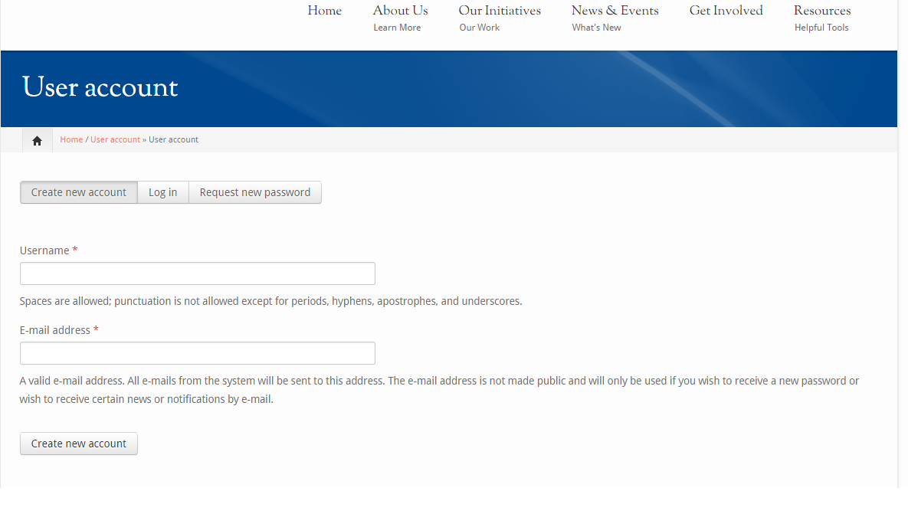
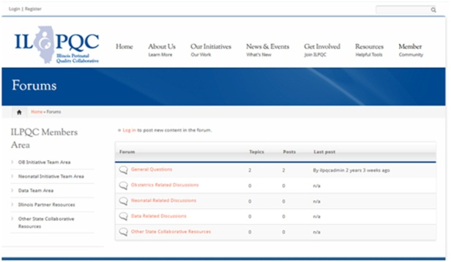
www.ilpqc.org
Launched members-only area to share initiative-specific resources and collaborate via discussion boards

Slide 22
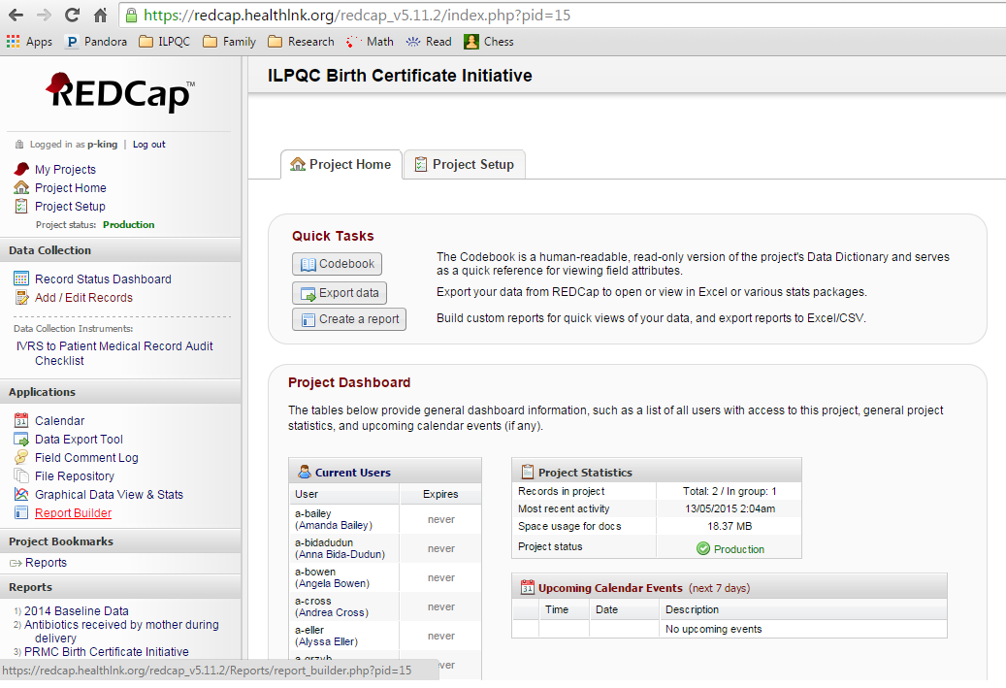
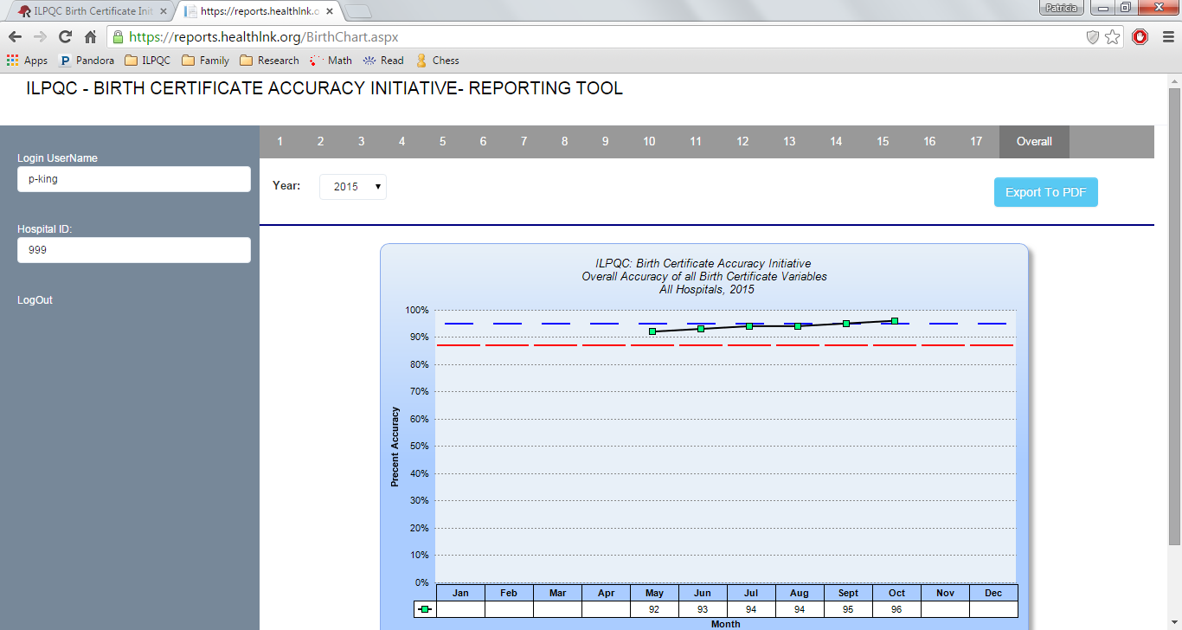
ILPQC REDCap Data System
Enter your monthly QI data and immediately get QI reports to see your progress over time and in comparison to other hospitals

Slide 23

Goal 3: Acknowledge Hospital
Team Achievements from 2014
Early Elective Delivery
  Sent letters of commendation to hospitals
    41 reaching goal of <5% EED
    43 completing 2014 data entry
  Provided 38 banners to hospitals with March of Dimes, IHA
Neonatal Nutrition
  Recognized superior performers at Neonatal Face-to-Face meeting

Slide 24

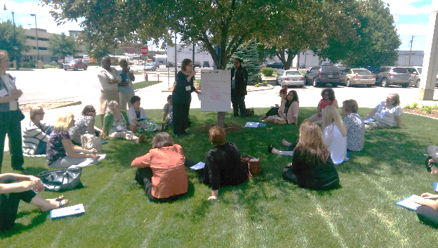
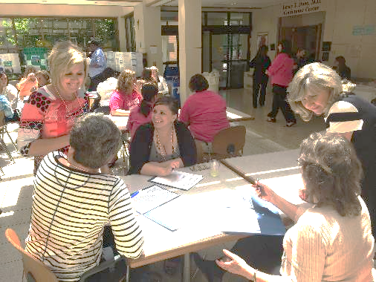

Goal 4: Working Together on
State-wide Initiatives

Slide 25

Early Elective Delivery Overview
Aim: Reduce EED to <5% across >=95% of participating hospitals and improve ability for hospitals to compare accurate EED data across time and across other Illinois hospitals.
Approach: Provided access to tool kits, learning sessions, secure reporting system to compare.
49 IL birthing hospitals submitted data
Quarterly data entry (PC-01) for 2013 thru 2014
41 hospitals received commendation for achieving goal of <5%

Slide 26
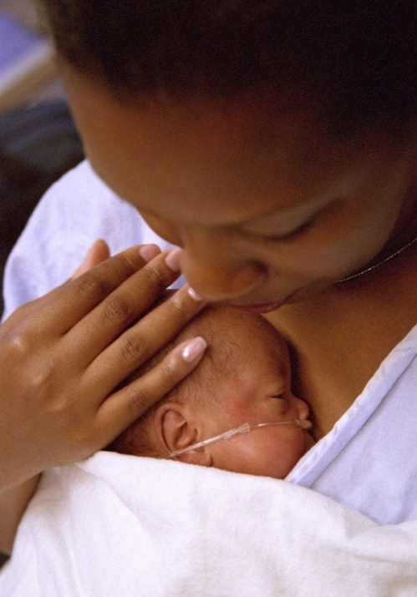
Neonatal Nutrition Initiative
Aim: Reduce from 45% to below 40% the percentage of very low birth weight (VLBW) infants discharged from a neonatal intensive-care unit (NICU) with weight <10th percentile by the end of 2014.
Approach: Evidence-based toolkit (based on CPQCC and VON) with best practices for parenteral & enteral nutrition
18 NICUs participated
Monthly data collection on all VLBW infants for babies
born in 2014. Data reported on 1,524 infants.
Improvement in process and growth measures
Notes:
Value: Decrease in charges for TPN – $4-4.5 million, Decrease in resources for special education

Slide 27
Outcome Measure:
Weight at Discharge

Slide 28
Outcome Measures:
Quarter 1 – 4, 2014
Vermont Oxford 2014
Weight < 10th percentile VON Best Quartile = 41%
Head Circumference < 10th percentile VON Best Quartile = 24%
 | Q1 | Q2 | Q3 | Q4 | VON Best Quartile 2014
Wt | 39.7% | 35.8% | 36.4% | 33.9% | 41%
Length | 42.8% | 37.4% | 38.0 | 34.1%
HC | 26.8% | 18.2% | 25.7% | 19.2% | 24%

Slide 29
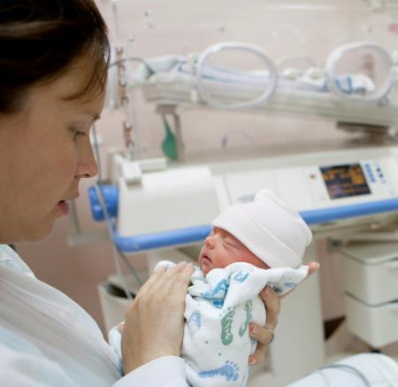
Neonatal Golden Hour Initiative
Aim: Improve outcomes of infants requiring resuscitation and stabilization by December 31, 2016
Approach: Establish workgroup, identify hospital teams, implement evidenced based practices for first hours of life
26 NICUs participating
Toolkit produced by multi-center, multi-disciplinary teams
Includes family engagement focus
Kick-off with hospitals April 2015
Data on over 1,000 infants entered as of November 2015

Slide 30
Neonatal Golden Hour:
Checklist

Slide 31
Admission Temperature

Slide 32

Birth Certificate
Optimization Initiative
Aim: In partnership with IDPH and IHA, obtain at least 95% accuracy on 17 key birth certificate variables
Approach: Obtain baseline data, implement collaborative learning on best practices to improve birth certificate accuracy for hospital teams (webinars, face to face and monthly teams calls), collect ongoing accuracy data to support PDSA cycles at the hospital level
Wave 1 (Roll-out Dec 2014)
  44 team rosters submitted
Wave 2 (Roll-out Mar 2015)
  63 team rosters submitted
Average of over 70 participants on monthly OB Teams Calls since March 2015

Slide 33
BC Accuracy: Overall Accuracy of All Variables

Slide 34
BC Accuracy to Date

Slide 35
Accuracy Distribution

Slide 36

March of Dimes Antenatal
Corticosteroids (ACT) Initiative
Aim: The March of Dimes Big 5 State Perinatal Collaborative (comprised of perinatal leaders from CA, FL, IL, NY and TX) is recruiting hospitals to join a 5-state pilot program to help hospitals work towards 100% administration of ACT to mothers who are candidates to receive antenatal steroids and deliver between 23-34 weeks gestation.
Approach: Establish workgroup, identify hospital teams, implement evidence-based practices for administration of antenatal corticosteroids to eligible mothers
12 teams participating
Face-to-face meeting October 2015
  Monthly webinars, baseline then monthly data collection, and QI work

Slide 37

ILPQC Maternal
Hypertension Initiative
Aim: Reduce the rate of severe morbidities in women with severe preeclampsia, eclampsia, or preeclampsia superimposed on pre-existing hypertension by 20% over the course of the initiative
Approach: Establish workgroup, identify hospital teams, implement evidence-based practices / protocols / AIM HTN Bundle
OB Advisory Workgroup and HTN Clinical Leadership Team developed process/outcome measures, toolkit/education, data form and reports
  Input from IDPH SQC / Perinatal Network Administrators / AIM Initiative / CA, NY, and NC collaboratives
  Launch Wave 1 in January 2016, Wave 2 May 2016

Slide 38
HTN Initiative Goal &
Measures
Goal: Reduce preeclampsia maternal morbidity
IL Measure | Type | Goal
Severe Maternal Morbidity No. of women with severe maternal morbidities (e.g. Acute renal failure, ARDS, Pulmonary Edema, Puerperal CNS Disorder such as Seizure, DIC, Ventilation, Abruption) / No. pregnant & postpartum women with new onset severe range HTN | Outcome | 20% reduction
Appropriate Medical Management in under 60 minutes No. of women in each time to treatment interval (<30,30-60,60-90, >90 min) after elevated BP is identified / No. of women with new onset severe range HTN | Process | 100%
Debriefs on all new onset severe range HTN cases | Process | 100%
Preeclampsia education provided prior to discharge | Process | 100%
Appropriately timed follow-up appointment scheduled prior to discharge | Process | 100%

Slide 39
Key Driver Diagram: Maternal Hypertension Initiative
GOAL: To reduce preeclampsia maternal morbidity in Illinois hospitals
Interventions
Key Drivers
Implement standard order sets and/or algorithms for early warning signs, diagnostic criteria, timely triage, monitoring and treatment of severe hypertension
Ensure rapid access to medications used for severe hypertension with guide for administration and dosage
Implement system plan for escalation, obtaining appropriate consultation, and maternal transport
Perform regular simulation drills of severe hypertension protocols with post-drill debriefs
Integrate severe hypertension processes (e.g. order sets, tracking tools) into your EHR
AIM: By December 2016, to reduce the rate of severe morbidities in women with preeclampsia, eclampsia, or preeclampsia superimposed on pre-existing hypertension by 20%
Readiness: Implementation of standard processes for optimal care of severe maternal hypertension in pregnancy
Recognition: Screening and early diagnosis of severe maternal hypertension in pregnancy
Standardize protocol for measurement and assessment of blood pressure and urine protein for all pregnant and postpartum women
Standardize response to early warning signs including listening to and investigating symptoms and assessment of labs
Implement facility-wide standards for patient-centered education of women and their families on signs and symptoms of severe hypertension
Educate OB, ED, and anesthesiology physicians, midwives, and nurses on recognition and diagnosis of severe hypertension that includes utilizing resources such as the AIM hypertension bundle and/or unit standard protocol
Response: Care management for every pregnant or postpartum woman with new onset severe hypertension
Execute facility-wide standard protocols for appropriate medical management in under 60 minutes
Create and ensure understanding of communication and escalation procedures (e.g. implementing a rapid response team through the use of TeamSTEPPS)
Develop OB-specific resources and protocols to support patients, families, staff through major complications
Provide patient-centered discharge education materials on preeclampsia and postpartum preeclampsia
Implement patient protocols to ensure follow-up within 7-10 days for all women with severe hypertension and 72 hours for all women on medications
Reporting/Systems Learning: Foster a culture of safety and improvement for care of women with new onset severe hypertension
Establish a system to perform regular debriefs after all new onset severe hypertension cases
Establish a process in your hospital to perform multidisciplinary systems-level reviews on all severe hypertension cases admitted to ICU
Continuously monitor, disseminate, and discuss your monthly data in ILPQC REDCap system at staff/administrative meetings
Add maternal hypertension assessment and treatment protocols and education to provider and staff orientations, and annual competency assessments

Slide 40
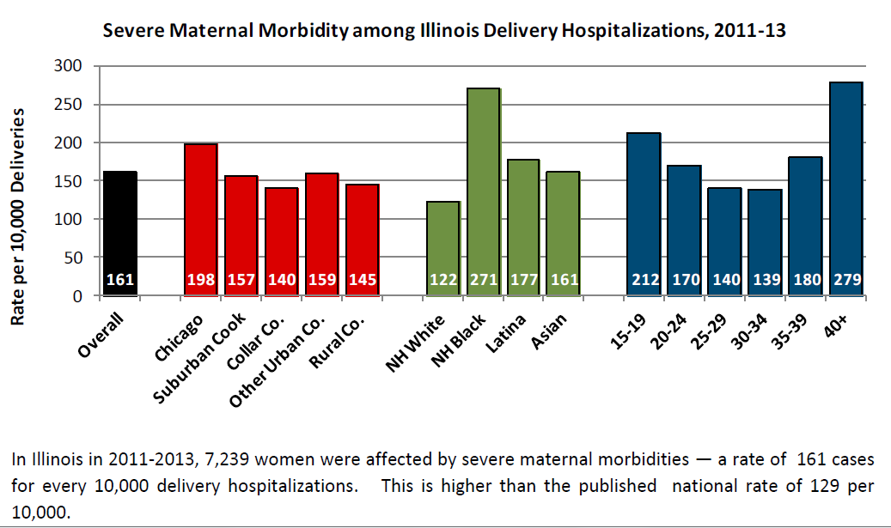
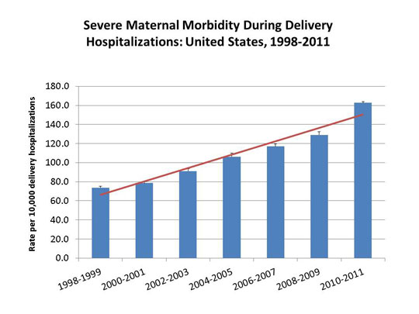
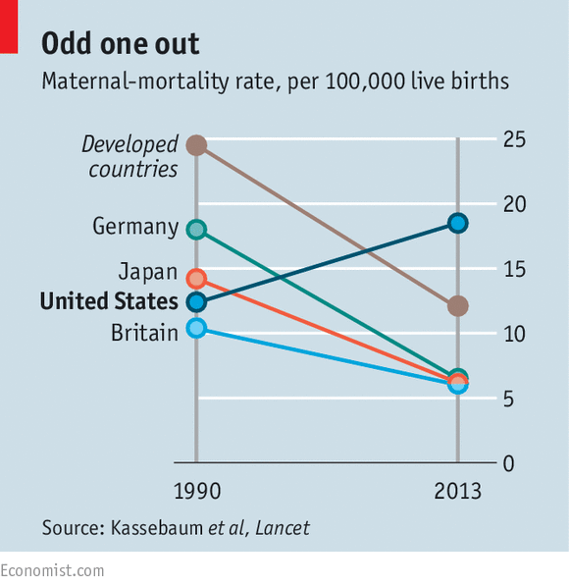
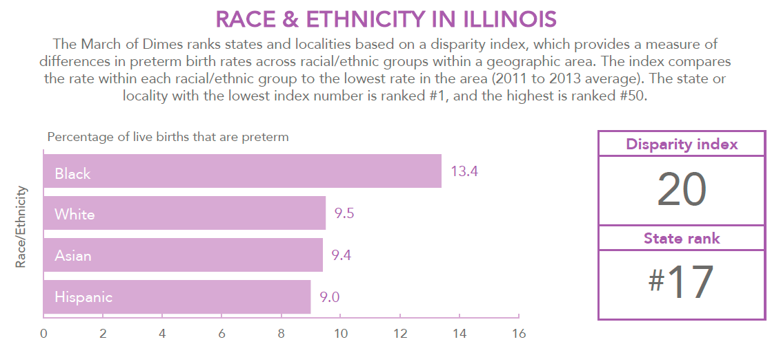
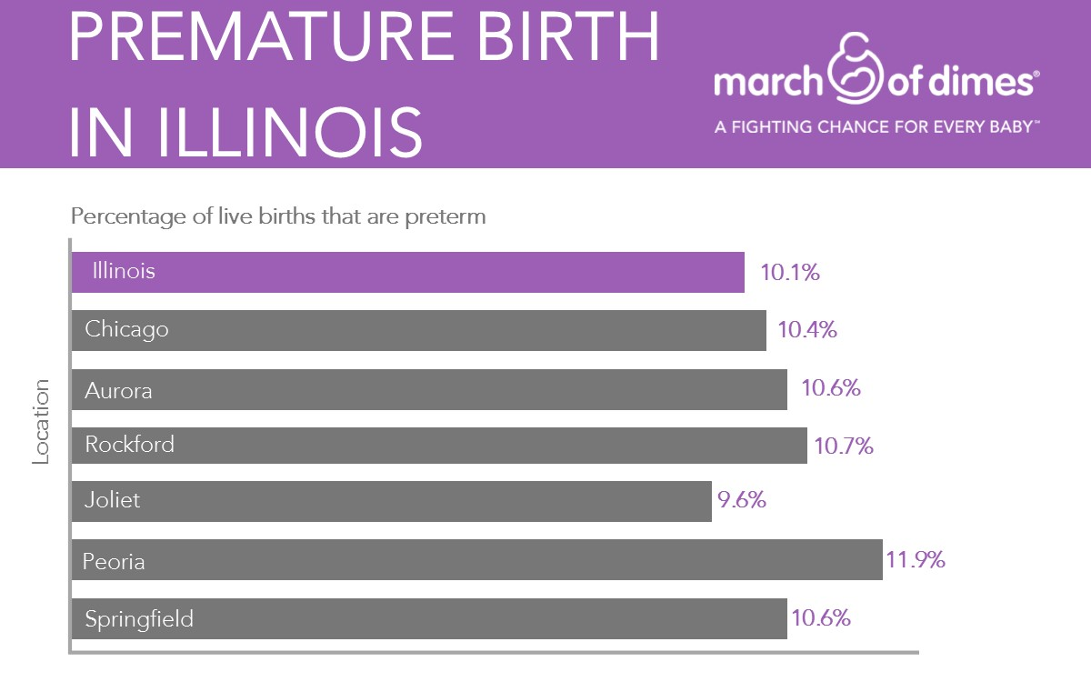
Looking ahead
Major challenges persist in maternal and neonatal health
Perinatal Quality Collaboratives providing evidenced based collaborative learning and data driven quality improvement support can make a difference.

Slide 41
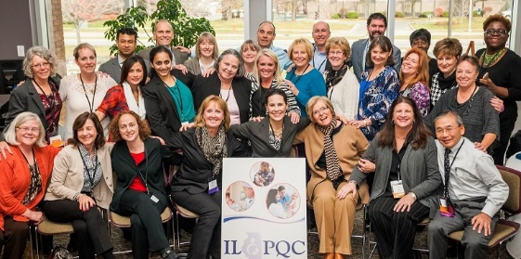
Improving Together
Overcoming these major challenges takes physicians, nurses, hospital teams, public health and other stakeholders working together to succeed
Thank you all – we look forward to continuing our work together to improve perinatal health

