Slide 1

Illinois Perinatal Quality Collaborative: Next Steps and Wrap Up
ILPQC Third Annual Conference
November 18, 2015

Slide 2
Wrap up from Breakouts:
OB
Neonatal
Family Engagement

Slide 3
Next Steps for ILPQC
Wrap-up Birth Certificate Accuracy Initiative, plan for sustainability through education / outreach with IDPH
Launch OB Maternal Hypertension Initiative
  Wave 1: January 2016, Wave 2: May 2016
Continue Neonatal Golden Hour Initiative
  Data reporting available January 2016
Continue to provide valued QI services to hospital teams
Continue to engage stakeholders / key advisory groups
Ongoing focus on sustainable funding
Plan for 2017 and beyond

Slide 4
To Participate in an
ILPQC QI Initiative
Contact info@ilpqc.org for more information on our 2016 initiatives
  OB Maternal Hypertension
    - Recruiting Wave 2 teams by May 2016
  Neonatal Golden Hour (continuing from 2015)

Slide 5
To Participate in an
Advisory Workgroup
Neonatal, Obstetric, and Data Advisory Workgroups meet regularly to provide guidance for ILPQC initiatives
Representation across state, perinatal levels, and professions (MDs, RNs, QI, public health)
Contact info@ilpqc.org to participate or for more information

Slide 6

Happy 2nd Birthday ILPQC!
Thank you to all who have contributed to building a successful state perinatal quality collaborative for IL
  Sponsors
  Stakeholders
  Advisory Workgroups
  Leadership / Data teams
  Hospital Teams
  Families

Slide 7
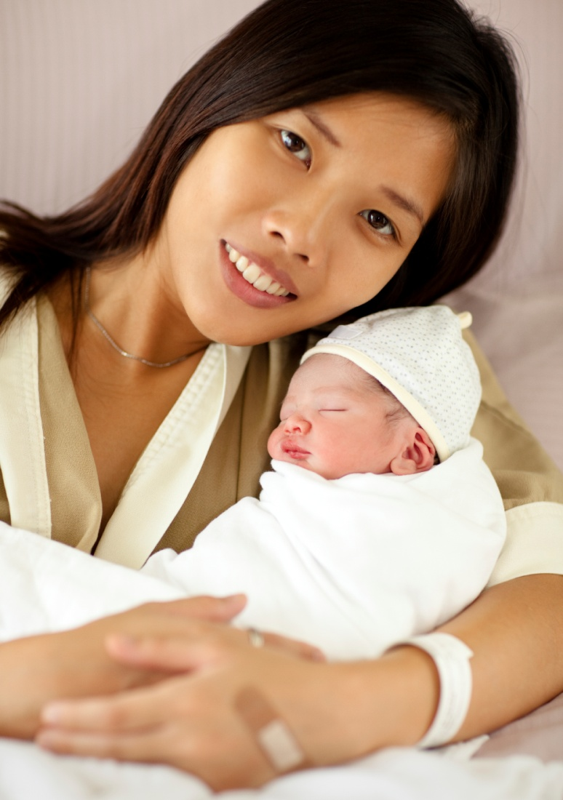
ILPQC Administrative Team
Ann Borders
ILPQC Executive Director, OB Lead
Aki Noguchi and Pat Ittmann
Neonatal Leads
Patricia Lee King
State Project Director
Kate Finnegan
Project Coordinator
Email us at info@ilpqc.org
Website: www.ilpqc.org

