Slide 1

Hot Topics in Obstetric QI: Discussion of Current and Future Initiatives
ILPQC Third Annual Conference
November 18, 2015

Slide 2
Overview
Panel:
  Sarah Kilpatrick, MD, PhD
  Jeanne Mahoney, RN, BSN
  Barb Murphy, MSN, RN
  Bryan Oshiro, MD
Birth Certificate Accuracy Initiative Lessons Learned
Discussion of Future Initiatives
Overview of Maternal Hypertension Initiative
  Improving Healthcare Response to Preeclampsia: CA HTN Toolkit, Barb Murphy, MSN, RN
  HTN Initiative Roll Out, AIM Bundles, Jeanne Mahoney, RN, BSN
Next steps

Slide 3
Birth Certificate Accuracy Initiative Lessons Learned
ILPQC Third Annual Conference
November 18, 2015

Slide 4
Overview
Review Birth Certificate data to date
Team Survey Results
  Barriers to accuracy
  Changes that had the largest impact
  Additional feedback
  Sustainability
Next steps

Slide 5
BC Accuracy: Overall Accuracy of All Variables

Slide 6
BC Accuracy September Data:
All Variables
Goal = 95.0% (red dashed line)
Baseline = 87.0% (blue dash dot line)
Overall accuracy for all 17 variables for September = 95.3% (black dotted line)
Total Hospitals Reporting August Data = 86

Slide 7
BC Accuracy to Date

Slide 8
Opportunities for Change
Variable | Baseline Accuracy | May Accuracy | June Accuracy | July Accuracy | August Accuracy | September Accuracy
Augmentation | 88.7 | 91 | 90 | 94 | 93 | 95
Antibiotics | 86.0 | 90 | 92 | 94 | 93 | 95
Gestation | 88.0 | 91 | 91 | 93 | 93 | 94
Infant Feeding | 83.7 | 87 | 90 | 89 | 89 | 90
SSN | 85.7 | 93 | 91 | 92 | 93 | 95
Prenatal Care | 78.3 | 84 | 85 | 89 | 88 | 90
WIC | 76.0 | 81 | 86 | 87 | 91 | 93
LMP | 81.0 | 83 | 87 | 87 | 91 | 91

Slide 9

Biggest Barriers to Accuracy

Slide 10

Barriers – Key Themes
Interpretation and understanding of definitions (15)
Many people involved in birth certificate process (11)
  Identification of who is responsible
  Communication and inefficiency of process
Locating accurate information among multiple and sometimes discrepant or incomplete sources (9)
  Too much reliance on worksheet
  Discrepancies between chart and prenatal
Information not documented in the chart or accessible in EHR (8)
Access to clear and accurate prenatal record (7)
Need for training and elimination of distractions for birth certificate abstractors (4)

Slide 11
Barriers- Quotes
  “Having many associates involved in the Birth certificate process.”
  “Different forms [or EMRs] had info in different places or did not have the info at all.”
  “Time constraints and conflicting priorities.”

Slide 12
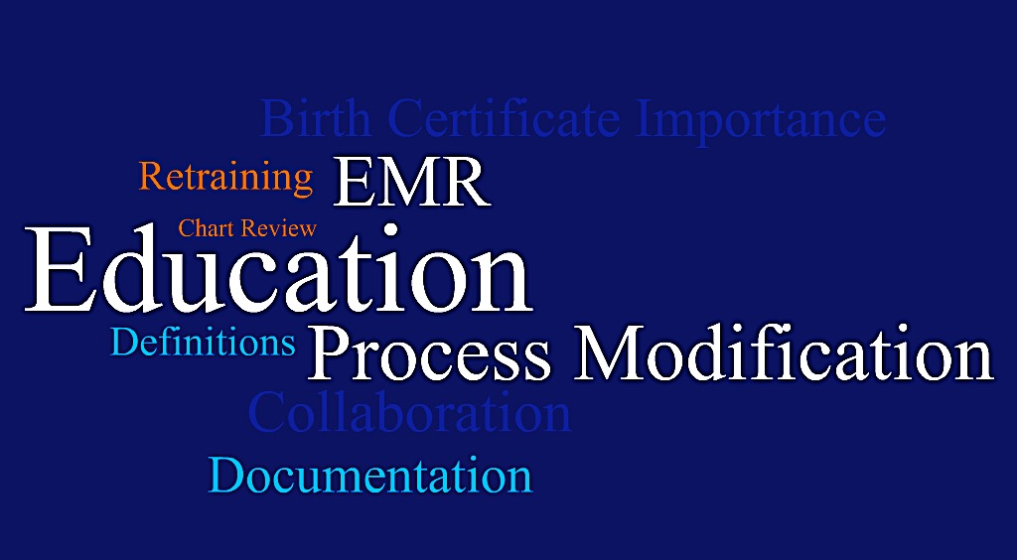
Changes that had Biggest Impact

Slide 13
Impact – Key Themes
Educating staff (38)
  Birth certificate importance
  Variables and definitions
  Location of information
Process flow improvements (25)
  Designated staff with clearly defined roles and responsibilities
  Team approach to completing information
  Double verification
Improvements in documentation (11)
  EMR modifications
  Information collection worksheets
Increased collaboration of all involved in the process (5)
  Information sharing
  Team approaches

Slide 14
Impact - Quotes
  “The flow of the birth certificate and its completion is not completed by a single RN. L&D and M/B are both responsible for filling out data.”
  “Had our Epic analysts build the WIC question into the triage section of the EMR.”
  “Limiting the number of people handling the information gathering.”
  “Identified most common errors and focused on reeducation.”

Slide 15
Suggestions for further improvement
  Provide variable definitions and guides up front
  Involve physicians offices and educate them on their role in birth certificate accuracy
  Condense the information collected
  More support for data collection and entry
“I wish there had been more support for data collection and entry - it was very time consuming.”
  “The state needs to provide MD offices with information on the Key Variables (LMP, pre-preg wt) and stress the importance of the accurate information on prenatal records.”

Slide 16
Achieving our Goals Together
“Thank you for all of your hard work around this. We now have a process that should help us achieve the 95% accuracy.”
“It was extremely helpful coming at this project as a team and utilizing resources from other hospitals dealing with the same issues.”
“The most helpful tool is redcap reports as it allows simple graphs to be printed/ saved to share with staff and physicians.”
“Great process, love the book with definitions it was so helpful.”

Slide 17
Resources that Best Support
Sustaining BC Accuracy
Percent of respondents selecting the resource

Slide 18
Birth Certificate Next Steps
Complete final 2 months of accuracy audits – these audits are vital to monitoring your improvement over time and identifying opportunities for improvement
  Submit November audit data by December 15, 2015
  Submit December audit data by January 15, 2016
Participate in birth certificate accuracy initiative audit wrap up OB Teams Call on December 7, 2015 from 12:30-1:30pm
Look for information on opportunities and resources for sustaining your birth certificate accuracy improvements in January 2016

Slide 19
Future OB QI Initiatives
ILPQC Third Annual Conference
November 18, 2015

Slide 20
Future Initiatives of Most
Interest to Teams for 2017
Ranking | Initiative | Rating Score
1 | Continue Hypertension | 1.96
2 | Hemorrhage 2.0 with AIM | 3.09
3 | Primary C-Section | 3.39
4 | Optimal Breastfeeding | 4.12
5 | Venous ThromboEmbolism | 5.05
6 | ACT Expansion of MOD | 5.48
7 | Postpartum LARC | 5.88
8 | Progesterone | 6.64

Slide 21
Other OB QI Initiatives of
Interest
Late preterm infant care
Standardized Pitocin use
Reducing elective inductions and augmentation rates between 39 weeks 0 days and 41 weeks 0 days

Slide 22
ILPQC: Overview of 2016 Maternal Hypertension Initiative
ILPQC Third Annual Conference
November 18, 2015

Slide 23
Overview
Preview of the ILPQC HTN Initiative
  Timeline
  Toolkit
  Materials for support
  Education

Slide 24

ILPQC Maternal
Hypertension Initiative
Aim: Reduce the rate of severe morbidities in women with severe preeclampsia, eclampsia, or preeclampsia superimposed on pre-existing hypertension by 20% over the course of the initiative
Approach: Establish workgroup, identify hospital teams, implement evidence-based practices / protocols / AIM HTN Bundle
OB Advisory Workgroup and HTN Clinical Leadership Team developed process/outcome measures, toolkit/education, data form and reports
  Input from IDPH SQC / Perinatal Network Administrators / AIM Initiative / CA, NY, and NC collaboratives
  Launch Wave 1 in January 2016, Wave 2 May 2016

Slide 25
Support from Other State
Collaboratives Working on HTN
CMQCC (California Collaborative)
Preeclampsia Initiative
    HTN Clinical Leads Teams multiple meetings with CMQCC to leverage their measures, data form, and process
PQCNC (North Carolina)– Conservative
Management of Preeclampsia
    Ongoing work with PQCNC to learn from their education plan
New York ACOG – Safe Motherhood Initiative
    Ongoing calls to learn about their education plan and quality improvement processes with 117 hospitals

Slide 26
ILPQC HTN:
Proposed Timeline
 | Activity | 11/15 | 12/15 | 1/16 | 2/16 | 3/16 | 4/16 | 5/16 | 6/16 | 7/16 | 8/16 | 9/16 | 10/16 | 11/16 | 12/16
Wave 1 | Launch initiative, Annual meeting
 | Wave 1 Teams call
 | Begin data collection, baseline data
 | Wave 1 feedback
Wave 2 | Enroll Wave 2 teams
 | 2-hour educational webinars for all teams
 | Face-to-face meetings to launch QI work
 | Monthly data collection/team calls

Slide 27
Welcome Wave 1 Teams
Advocate Illinois Masonic Hospital
Advocate Sherman Hospital
Advocate South Suburban
Blessing Hospital
Elmhurst Memorial Hospital
Illinois Valley Community Hospital
Ingalls Hospital
Kishwaukee Hospital
Loyola
Memorial Hospital of Carbondale
Northwest Community Hospital
Norwegian American
OSF Saint James – John W. Albrecht Medical Center
Riverside Hospital
Rockford Memorial Hospital
Silver Cross Hospital
St. Anthony Hospital- Chicago
St. Bernard Hospital
St. Elizabeth's Hospital- Belleville
St. John's Hospital
UIC Hospital
West Suburban

Slide 28
Three types of measures
Outcome Measures – Identify whether changes are leading to improvement and achieving the overall aims
  How is the system performing?
  What is the result?
Process Measures – identify changes to processes of care that can affect outcome measures. Measuring the results of these process changes will tell you if the changes are leading to an improved, safer system
Balancing Measures – identify changes in one part of the system that may result in new problems in other parts of the system.
CMQCC, 2013

Slide 29
HTN Initiative Goal &
Measures
Goal: Reduce preeclampsia maternal morbidity
IL Measure | Type | Goal
Severe Maternal Morbidity No. of women with severe maternal morbidities (e.g. Acute renal failure, ARDS, Pulmonary Edema, Puerperal CNS Disorder such as Seizure, DIC, Ventilation, Abruption) / No. pregnant & postpartum women with new onset severe range HTN | Outcome | 20% reduction
Appropriate Medical Management in under 60 minutes No. of women in each time to treatment interval (<30,30-60,60-90, >90 min) after elevated BP is identified / No. of women with new onset severe range HTN | Process | 100%
Debriefs on all new onset severe range HTN cases | Process | 100%
Preeclampsia education provided prior to discharge | Process | 100%
Appropriately timed follow-up appointment scheduled prior to discharge | Process | 100%

Slide 30
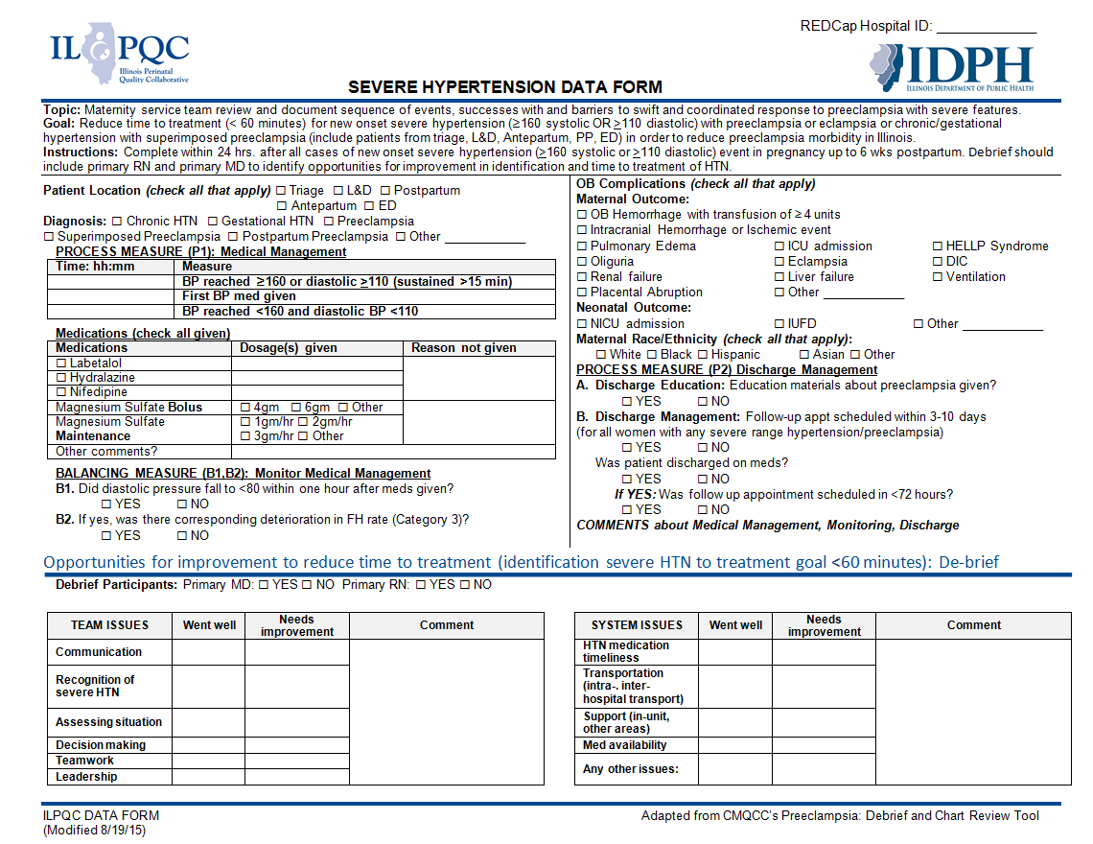
HTN: Draft Data Form

Slide 31
Alliance for Innovation on
Maternal Health (AIM)
ILPQC has been accepted as an AIM state
ILPQC to collect IL specific variables and AIM variables of interest
ILPQC will be able to compare HTN data across all AIM participating states quarterly
AIM resources and materials available to IL hospitals, including toolkits, webinar support, educational materials and provider / nursing training focused on:
  - Readiness - Recognition
  - Response - Reporting

Slide 32
AIM - Additional
Hypertension Measures
Provider education
Nursing education
Preeclampsia protocols
Preeclampsia EHR integration
Unit drill protocols
Patient/family support protocols
Debrief and multi-disciplinary case review protocols

Slide 33
Key Driver Diagram: Maternal Hypertension Initiative
GOAL: To reduce preeclampsia maternal morbidity in Illinois hospitals
Interventions
Key Drivers
Implement standard order sets and/or algorithms for early warning signs, diagnostic criteria, timely triage, monitoring and treatment of severe hypertension
Ensure rapid access to medications used for severe hypertension with guide for administration and dosage
Implement system plan for escalation, obtaining appropriate consultation, and maternal transport
Perform regular simulation drills of severe hypertension protocols with post-drill debriefs
Integrate severe hypertension processes (e.g. order sets, tracking tools) into your EHR
AIM: By December 2016, to reduce the rate of severe morbidities in women with preeclampsia, eclampsia, or preeclampsia superimposed on pre-existing hypertension by 20%
Readiness: Implementation of standard processes for optimal care of severe maternal hypertension in pregnancy
Recognition: Screening and early diagnosis of severe maternal hypertension in pregnancy
Standardize protocol for measurement and assessment of blood pressure and urine protein for all pregnant and postpartum women
Standardize response to early warning signs including listening to and investigating symptoms and assessment of labs
Implement facility-wide standards for patient-centered education of women and their families on signs and symptoms of severe hypertension
Educate OB, ED, and anesthesiology physicians, midwives, and nurses on recognition and diagnosis of severe hypertension that includes utilizing resources such as the AIM hypertension bundle and/or unit standard protocol
Response: Care management for every pregnant or postpartum woman with new onset severe hypertension
Execute facility-wide standard protocols for appropriate medical management in under 60 minutes
Create and ensure understanding of communication and escalation procedures (e.g. implementing a rapid response team through the use of TeamSTEPPS)
Develop OB-specific resources and protocols to support patients, families, staff through major complications
Provide patient-centered discharge education materials on preeclampsia and postpartum preeclampsia
Implement patient protocols to ensure follow-up within 7-10 days for all women with severe hypertension and 72 hours for all women on medications
Reporting/Systems Learning: Foster a culture of safety and improvement for care of women with new onset severe hypertension
Establish a system to perform regular debriefs after all new onset severe hypertension cases
Establish a process in your hospital to perform multidisciplinary systems-level reviews on all severe hypertension cases admitted to ICU
Continuously monitor, disseminate, and discuss your monthly data in ILPQC REDCap system at staff/administrative meetings
Add maternal hypertension assessment and treatment protocols and education to provider and staff orientations, and annual competency assessments

Slide 34
Proposed Education Plan
2-hour webinar in early May
  Why HTN initiative, Baseline Data Collection and Data Entry, Team Building, Educational resources, Wave 1 Teams Presenting on Process
Face-to-Face Collaborative Learning Session in last week of May
  HTN education, BP train the trainer, process flow, QI training, sharing across teams, National Experts and other state HTN initiatives hospital teams share QI experience
Monthly OB Teams Calls

Slide 35
Education Plan: Proposed Topics
Accurate measurement of blood pressure and identification of severe range hypertension
ACOG new treatment guidelines
Strategies to reduce time to treatment across settings
Updates on diagnosis of Preeclampsia
Drills and Simulations / Team Debriefs
Multidisciplinary Review / MMR
Patient engagement / Patient Education
Use of EHR

Slide 36
Patient Education Materials
What is it?
Why should you care?
What should you pay attention to?
What should you do if you have any of the signs?
ILPQC has an approximately 1 year per participating hospital supply of tear pads for patient education on preeclampsia from the Preeclampsia Foundation.
Notes:
Here is an example of patient education materials from the Preeclampsia Foundation.

Slide 37
HTN Roll-OutTimeline
  Wave 1 teams get started on January 25, 2016 OB Teams Call from 12:30-1:30pm
  Wave 2 team sign up by May 2016
      Submit Team Roster Form (Nurse lead, Physician Lead, QI lead if available) with REDcap Access Form by May 2016
      Forms available at www.ILPQC.org
    Questions contact us at: info@ilpqc.org
    2 hour HTN Kick Off Webinar early May
    HTN Face-to-Face meeting downstate last week May, will review process flow and storyboards

Slide 38

Improving Health Care Response to Preeclampsia: A California Quality Improvement Toolkit
Barbara Murphy, MSN, RN
Executive Director, CPQCC/CMQCC
Funding for the development of this toolkit was provided by:
Federal Title V block grant funding from the California Department of Public Health; Maternal, Child and Adolescent Health Division and Stanford University.

Slide 39
California Pregnancy-Associated Mortality
Review (CA-PAMR) Quality Improvement Review Cycle
1. Identification of cases
2. Information collection, review by multidisciplinary committee
3. Cause of Death, Contributing Factors and Quality Improvement Opportunities (QIO) identified
4. Strategies to improve care and reduce morbidity and mortality
5. Evaluation and Implementation of QI strategies and tools
Toolkits Developed:
Hemorrhage
Preeclampsia
Notes:
This is the process we go through to collect and analyze the data that guides us towards toolkit development.

Slide 40
Factors Contributing to Pregnancy-Related Deaths, CA-PAMR 2002-2004
Contributing Factor (at least one factor probably or definitely contributed) | Preeclampsia N (%) | TOTAL N (%)
OVERALL | 25 (100%) | 129 (89%)
PATIENT FACTORS | 16 (64%) | 104 (72%)
Underlying significant medical conditions | 8 (50%) | 40 (39%)
Delay or failure to seek care | 10 (63%) | 27 (26%)
Lack of understanding the importance of a health event | 9 (56%) | 16 (15%)
HEALTHCARE PROFESSIONALS | 24 (96%) | 115 (79%)
Delay in diagnosis | 22 (92%) | 62 (54%)
Use of ineffective treatment | 19 (79%) | 48 (42%)
Misdiagnosis | 13 (54%) | 36 (31%)
Failure to refer or seek consultation | 6 (25%) | 26 (23%)
HEALTHCARE FACILITY | 12 (48%) | 72 (50%)
Notes:
Contributing factors R/T the healthcare providers involved in the care of the patient were identified in 96% of the cases and of these, the factors which definitely or probably contributed to the fatal outcome were Delay in Dx, ineffective tx and misdiagnosis.
At least 1 healthcare facility factor was identified in 12 (48%) of the deaths and the most frequent factors that contributed to the deaths include: inadequate staff and lack of continuity of care.

Slide 41
CA-PAMR: Chance to Alter Outcome
Grouped Cause of Death; 2002-2004 (N=145)
Grouped Cause of Death | Chance to Alter Outcome
 | Strong / Good (%) | Some (%) | None (%) | Total N (%)
Obstetric hemorrhage | 69 | 25 | 6 | 16 (11)
Deep vein thrombosis/ pulmonary embolism | 53 | 40 | 7 | 15 (10)
Sepsis/infection | 50 | 40 | 10 | 10 (7)
Preeclampsia/eclampsia | 50 | 50 | 0 | 25 (17)
Cardiomyopathy and other cardiovascular causes | 25 | 61 | 14 | 28 (19)
Cerebral vascular accident | 22 | 0 | 78 | 9 (6)
Amniotic fluid embolism | 0 | 87 | 13 | 15 (10)
All other causes of death | 46 | 46 | 8 | 26 (18)
Total (%) | 40 | 48 | 12 | 145
Notes:
TALKING POINTS:
CA PAMR Committee judged that there was a strong-to-good chance to have altered the fatal outcome in 40% of all the pregnancy-related deaths in California in 2002 to 2004.
12 of the 25 cases of preeclampsia (50%) had a good–to-strong chance to alter outcome.
In comparison, none of the 15 deaths from amniotic fluid embolism had a good-to-strong chance to alter outcome.
Data Source: CA PAMR, Pregnancy-Related Deaths; 2002-2004 (N=145)

Slide 42
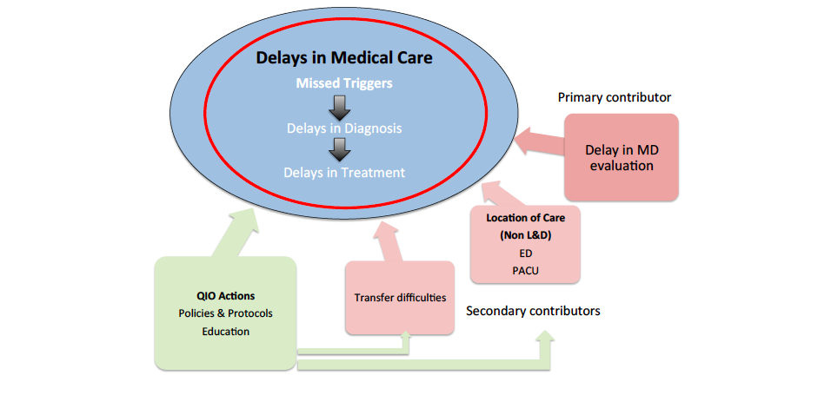
Major Themes in Quality Improvement Opportunities (QIO) among Preeclamptic Deaths, CA-PAMR, 2002-2004

Slide 43
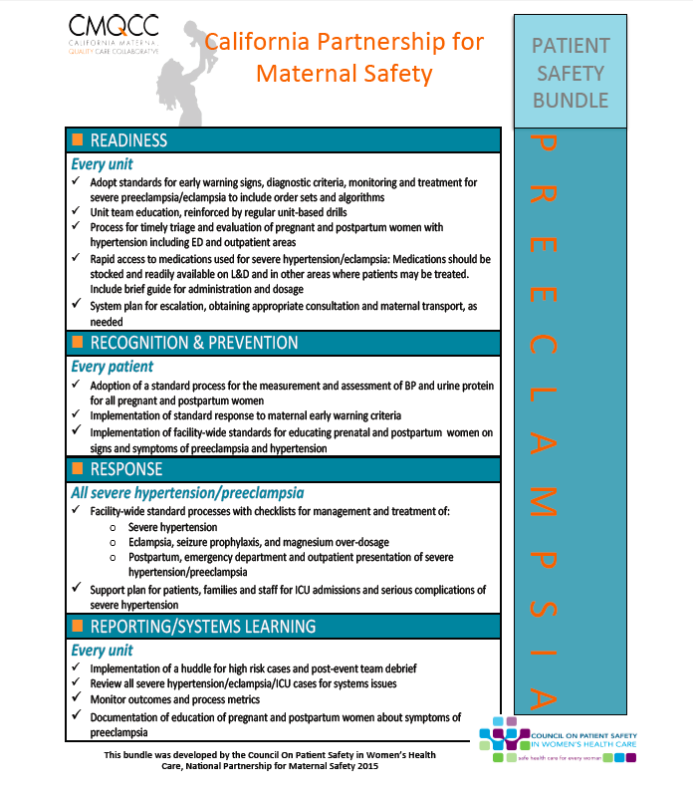

Slide 44
CPMS: Preeclampsia Patient Safety Bundle
Readiness - every unit:
  Adoption of standard process
  Team education; regular unit-based drills
  Timely triage and evaluation
  Rapid access to medication; guide for administration/dosage
  System plan for escalation, including consultation/transport
Recognition and Prevention – every patient:
  Adoption of standard process
  Implementation of standard response
  Prenatal and postpartum patient education

Slide 45
CPMS: Preeclampsia Patient Safety Bundle
Response – all severe hypertension/preeclampsia:
  Facility-wide standard processes/checklists for:
    Severe hypertension
    Eclampsia, seizure prophylaxis, MgSO4 overdose
    Postpartum, ED, outpatient presentation of severe hypertension/preclampsia
  Support plan for patients, families, staff
Reporting/Systems learning – every unit:
  Huddles for high-risk cases and post event team debrief
  Review of cases for systems issues
  Monitor outcomes/process metrics
  Documentation of patient education

Slide 46
CPMS: Preeclampsia Patient Safety Bundle
Minimal requirements for standard process:
  Provider notification for systolic BP =/> 160 or diastolic BP =/> 110, 2 measurements, 15 min apart
  After second elevated reading, initiate treatment within 60 min
  Include timing for use of MgSO4
  Include escalation measures for those unresponsive to standard treatment
  Describe manner/verification of postpartum follow-up within 7-10 days of birth
  Describe postpartum education

Slide 47
Clinical Pearls – Acute Treatment
Antihypertensive meds administered within 1 hour, ideally ASAP, for BP 160 systolic, and/or 105-110 diastolic or greater.
MgSO4 administered for seizure prophylaxis to patients with severe preeclampsia/neurological symptoms, and considered in patients diagnosed with preeclampsia without severe features.
MgSO4 – approved initial therapy for eclamptic seizure.
Algorithms for acute treatment readily available/posted on units.
Early postpartum follow-up – within 3-7 days if medication required; 7-14 days if no medication required.
Symptomatic postpartum patients presenting to ED assessed by or admitted to OB service.
Severe preeclampsia/eclampsia box of medications and supplies needed for the treatment of preeclampsia available in L&D, ED, other.
Be prepared for unexpected severe hypotension in patients with chronic cocaine/methamphetamine use or regional/general anesthesia.

Slide 48
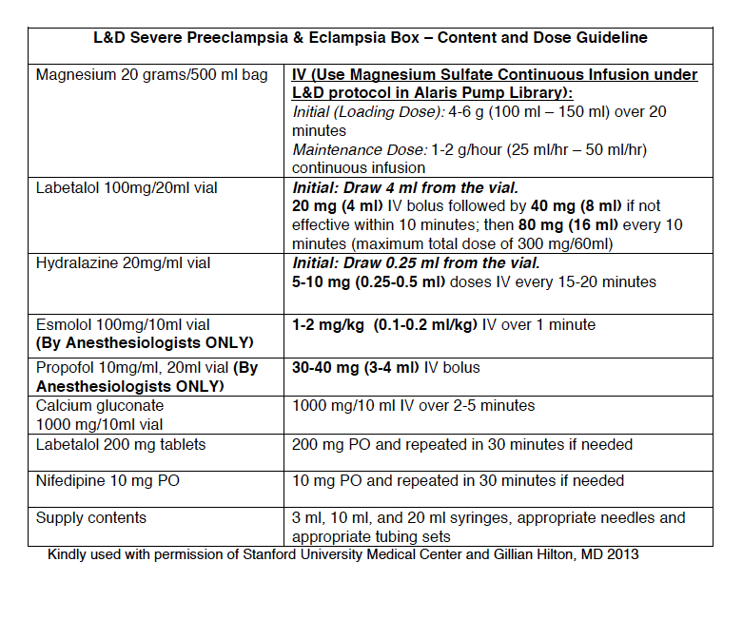
Labor and Delivery Medication Box and
Dose Guidelines for Severe Preeclampsia and Eclampsia
Notes:
This is a sample Box from Stanford University. Each facility can customize their own box based on their hospital formulary.

Slide 49
Protocol for Labetalol Treatment

Slide 50

Clinical Pearls – Patient Assessment
High index of suspicion for in pregnant women with new onset hypertension/proteinuria – 40% will develop preeclampsia.
Early onset preeclampsia (prior to 34 weeks) often more severe with atypical presentation (e.g., vague symptoms – HA, SOB, swelling, complaints of not feeling well).
Patients presenting to centers with limited resources to care for both mother/infant should be stabilized and transferred to a center with appropriate capacity.

Slide 51
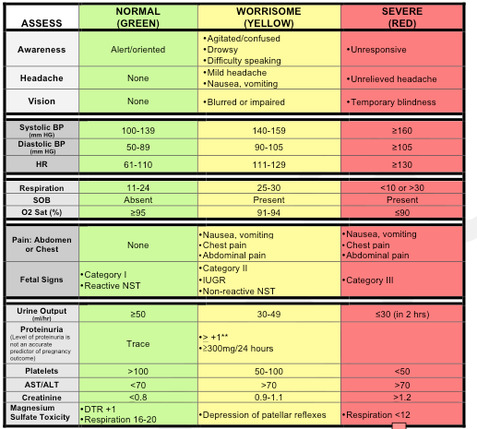
Preeclampsia Early Recognition Tool
Notes:
This is a tool that is designed to aid in the early recognition and response to a patient’s deteriorating condition as the disease process progresses in severity. The next slide is a continuation of this form with interventions based on the number of triggers.

Slide 52
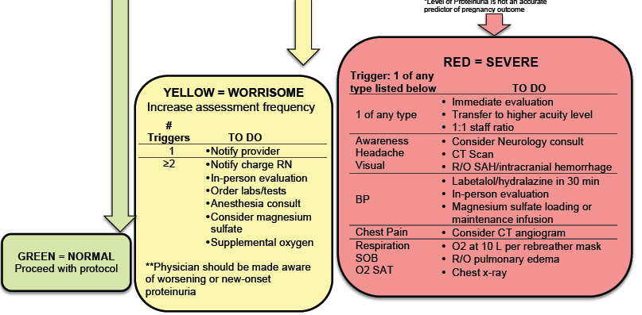
Clinical Signs to Watch for:
10.30.13v1
Notes:
The hope is that this Early Recognition Tool can be incorporated into the maternal notes and can be initiated in prenatal clinics and utilized as vital sign documentation until discharge. The chart stays with the patient until discharge creating a visual trend of individual physiology and allows assessment and treatment based on what is abnormal for the patient.

Slide 53
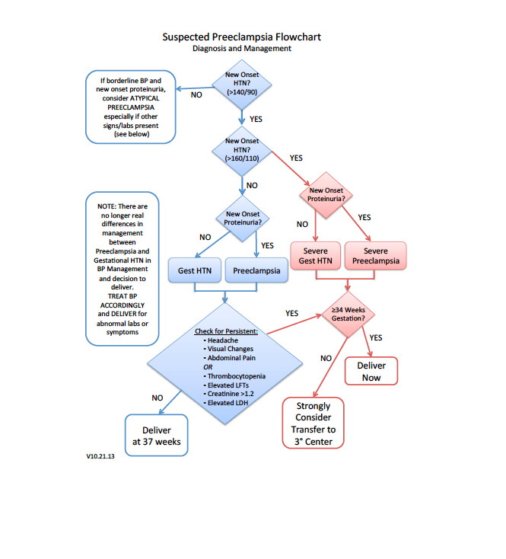

Slide 54
Clinical Pearls – Provider and Patient Education
Tendency to minimize signs and symptoms, leading to missed opportunity to treat and alter outcome.
Patient education strategies, re: signs and symptoms, targeted to educational level of patients, increases awareness and earlier intervention.
Adequate prenatal care/access to OB services emphasized for all socio-economic groups.
Implementation of QI strategies (checklists, team training and communication strategies) can reduce associated morbidity.
Counsel patients that hypertensive disorders during pregnancy may predict future cardiovascular risk.
No screening strategy exists to predict preeclampsia.

Slide 55
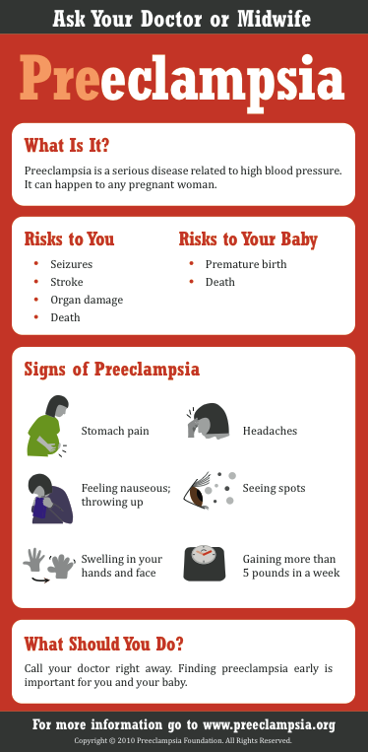
Patient Education Materials
This and many other patient education materials can be ordered from www.preeclampsia.org/market-place
Notes:
Here is an example of patient education materials from the Preeclampsia Foundation.

Slide 56

Getting The Job Done in Your Institution
Establish tools / new recommendations
Establish champions and collaborators
Provide convincing rationale for change
Get providers to adopt the changes
Provide convincing evidence that the proposed changes in clinical care will improve outcome
Distribute the convincing rationale and evidence
Notes:
Champions will be both local at each hospital, regional (through hospital local OB groups) and nationally by being in alignment with organizations like ACOG, SOGC, NICE.
Distribute the rationale and evidence including:
Data from maternal mortality reviews and other large databases. This may still be received with resistance as most physicians and other healthcare professionals will view their own personal experience as different.
Distribute the evidence and rationale through publications, and local and regional presentations.

Slide 57

For More Information and to
Download the
Toolkit
Visit our website: www.cmqcc.org
Or contact us:
info@cmqcc.org
Available online at www.cmqcc.org

Slide 58

Jeanne Mahoney, RN, BSN
Contact: aim@acog.org

Slide 59


Council for Patient Safety in Women’s Health Care

Slide 60

In 2014 the Council was awarded a 4 year cooperative agreement from the Health Resources and Services Administration (HSRA) Maternal and Child Health Bureau (MCHB)
AIM Objectives:
Partner development and strengthening
Maternal safety bundle implementation
Develop and implement new maternal safety bundles on safe reduction of primary Cesarean births, improvement of content and access to postpartum care, and reduction of peripartum racial disparities.
State and national data infrastructure development
Provide intensive technical assistance

Slide 61
Goals of AIM
By the end of 2018:
Reduce maternal mortality by 1,000 deaths
Reduce severe maternal morbidity by 100,000 incidents

Slide 62
AIM Strategies
Partner with provider organizations, public health and perinatal associations
Provide tools and TA for self-evaluation and quality improvement planning
Provide step by step implementation training
Provide real time data to promote quality improvement initiatives
Building on existing platforms and initiatives
Expect incremental adoption

Slide 63
Align with National Strategies
Partnership for Patients/HENS
AHRQ – Team Steeps
Joint Commission
COIIN
Healthy Start
Incorporate and share work on Maternal Safety
CMQCC
Other maternal quality improvement collaboratives
Safe Motherhood Initiative
Institute for Healthcare Improvement

Slide 64
Current Implementation
State Engagement for intensive implementation
  Focus on states with high maternal mortality rates.
  Teams involve public health, hospitals, providers, payers
  Current states : OK, MD, LA, FL, MI, IL
  Expected states for year 3 – NJ, SC, MS
Hospital Networks
  Have capacity to receive and transmit administrative data
    National Perinatal Information Center – 90 of the larger national hospitals
    Premier Quest hospitals – 300 birth hospitals focused on quality care
    Trinity Health Care – 40 birth hospitals with a large affiliation network
Next Steps
  States with the likely capacity to implement bundles and use data with available resources and some virtual technical assistance.

Slide 65
Bundles for AIM
Quality Improvement Action
Obstetric Hemorrhage
Hypertension in Pregnancy
Prevention of Maternal Venous Thromboembolism
Safe Reduction of Low Risk Primary Cesarean Births
Coming soon:
Reduction of Peri-Partum Racial Disparities
Postpartum care basics for maternal safety

Slide 66
AIM Resources
Archived webinars
  Several on HTN in pregnancy and postpartum involving OB/GYNs, nursing and anesthesia
  HTN Drills
  Maternal early warning systems
  Doing post event debriefing and formal reviews
  Patient, staff and family support during and after a severe event.
E learning modules
National data benchmarking
www.safehealthcareforeverywoman.org

Slide 67
Discussion
Questions
Ideas
Timeline?
Education topics?

Slide 68
OB Teams Next Steps
Birth Certificates QI Initiative Wrap up and Sustainability:
  Complete final 2 months of accuracy audits and participate in December 7, 2015 OB Teams Call from 12:30-1:30pm
  Look for information on opportunities and resources for sustaining your birth certificate accuracy improvements in January 2016
Hypertension Roll Out:
  Wave 1 teams get started on January 25, 2016 OB Teams Call from 12:30-1:30pm
  Wave 2 team sign up by May 2016
    Submit Team Roster Form (Nurse lead, Physician Lead, QI lead if available) with REDcap Access Form by May 2016
    Forms available at www.ILPQC.org
    Questions contact us at: info@ilpqc.org

