Slide 1
Storyboard Instructions
Adapted from the New York State Perinatal Quality Collaborative (NYSPQC)
This is a Storyboard template. Feel free to change font size, color, add slides, or use your own pages, but please provide as much information as possible that is requested in this template.
At the Face-to-Face Learning Session, use the Storyboard to tell your team’s story descriptively, clearly and creatively – photos, collages and illustrations are welcome.
There is no wrong way to create a Storyboard so don’t be afraid to be creative. Additionally, be sure to keep it simple; the Storyboard is not meant to be an extremely time-consuming project.
Storyboards must fit into a space approximately 28 x 40 inches. It may be created from a collection of letter-sized sheets (print outs of your power point slides or word documents) that are convenient for carrying while traveling. Seven to eight pages fit easily in the available space – depending on arrangement - but more can be accommodated by overlapping pages (see Slide 11 for sample layouts). Boards for posting and pushpins will be provided at the Face-to-Face.
Display Tips
  Fewer words: More pictures and graphics
  Real people pictures… At least of your teams
  Font size as big as possible
  Fancy not necessary
  Color to highlight key messages (If you don’t have a color printer, use bright highlighters)
  Clear titles and labels if you use graphs (X and Y axes, dates, brief explanation of what it shows)

Slide 2
Storyboard Template for
Illinois Teams
Adapted from the New York State Perinatal Quality Collaborative (NYSPQC)

Slide 3
Team Name
List team members and their roles

Slide 4
Describe your Hospital and your improvement team.
Team Leader Key Contact Info: Name, Phone, email

Slide 5
Hospital Population
Brief description of your demographics
Other additional information about cultural groups or important demographics others should know about you

Slide 6
Process Flow Diagram
See Process Flow Diagram Tip Sheet for guidance

Slide 7
Baseline Data
(Available at Face-to-Face Learning Session)
Baseline data, if entered in ILPQC REDCap data system by May 11, 2015 will be available at the Face-to-Face Learning Session

Slide 8
Changes
Include any initial ideas for changes you would like to make based on the results of your process flow document and baseline data collection

Slide 9
Strengths to Share
What strength or expertise does your team have that you would be willing to share with other teams?

Slide 10
Support Needed
What help does your team need from other teams?

Slide 11
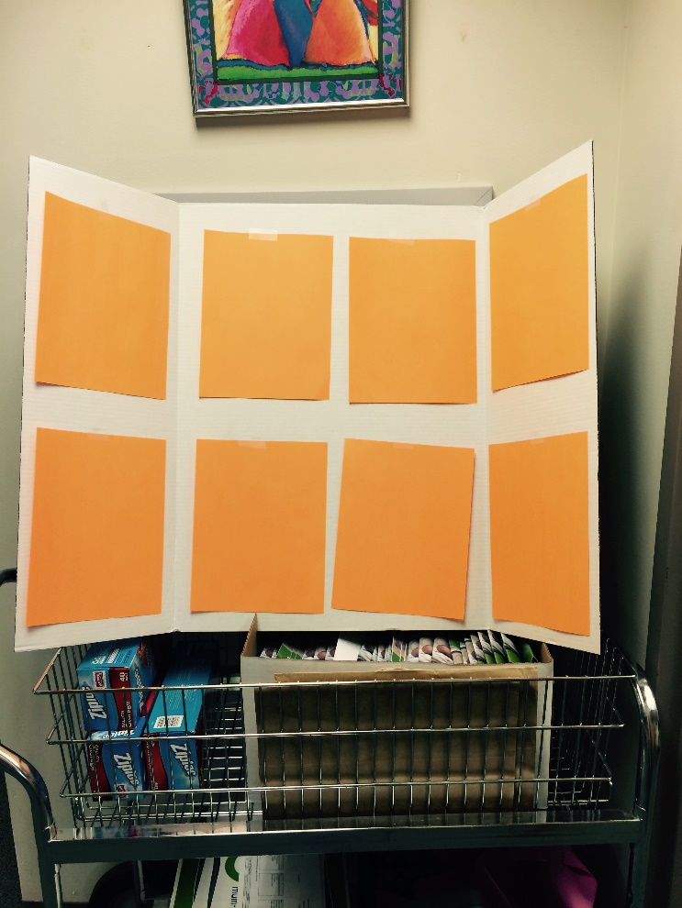
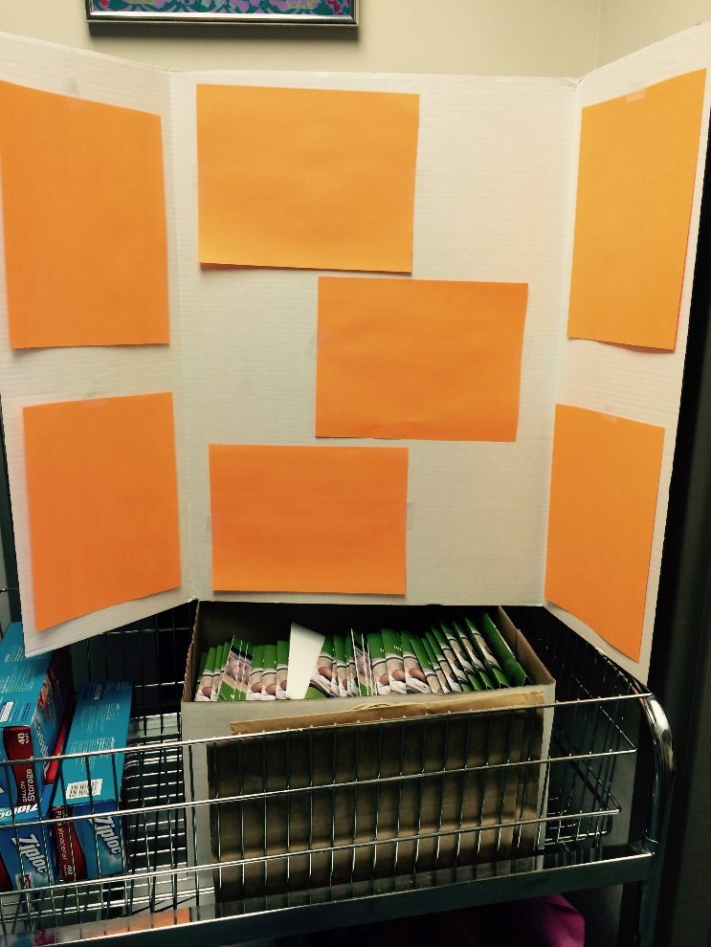
Sample Layouts
With 4 portrait oriented sheets in the middle panel
With 3 landscape oriented sheets in the middle panel

