Slide 1
Friday June 5, 2015, 10:-11:30
Training Course in MCH Epidemiology
Analytic Methods for
Quality Improvement
      Deb Rosenberg, PhD
      Research Associate Professor
      Epidemiology and Biostatistics
      U of IL at Chicago, Schl of Public Health
      drose@uic.edu
Ashley Hirai, PhD
Senior Health Scientist
Office of Epidemiology & Research
Maternal and Child Health Bureau
ahirai@hrsa.gov

Slide 2
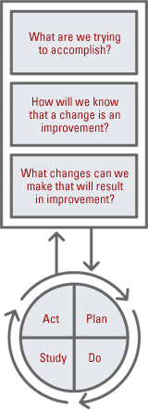
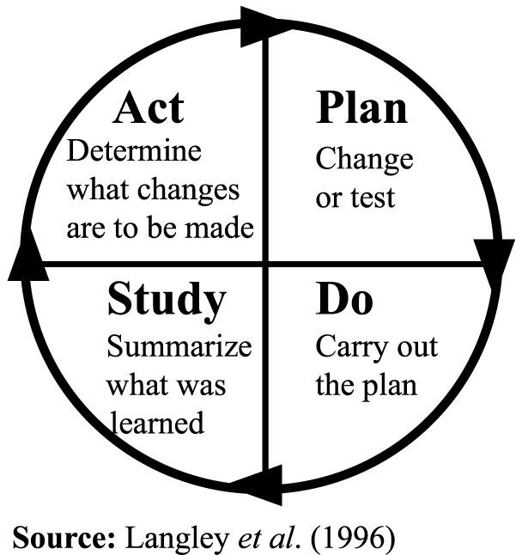
Quality Improvement
The Framework for QI

Slide 3
Importance of Data for QI
Data drives quality improvement
  “What gets measured, gets done”
  Plan, Do, Study, Act
Planning phase requires data to understand the problem and select strategies
Study/evaluate to ensure success; what’s effective, what might need refinement; explore variation to identify opportunities for improvement
Notes:
Centrality of data for CoIIN and QI in general – it’s what creates momentum, energy—what leads you to act and know if you’ve achieved success
Epitomized in the quote “what gets measured, gets done”

Slide 4
Quality Improvement
QI is sometimes differentiated from much public health epidemiology in terms of the questions being asked:
“Are we doing the right thing?”
(Evidence-Based Public Health Practice)
or
“Are we doing things right?”
(Quality Improvement or Program Evaluation)

Slide 5
Quality Improvement
Data for QI typically differ from data for needs assessment, surveillance or even for evaluation of population-based programs in that:
    data are collected continuously
    data can be accessed / displayed continuously
    time intervals are short, eg quarters, months or days
    sample sizes are small
    not necessarily comparison groups
    typically no statistical testing
    focus is usually on processes as opposed to outcomes

Slide 6
Quality Improvement
Integration of QI and Epidemiology
Parallel use of QI data and population-based data
The QI approach provides impetus to make population-based data more timely and accurate
The public health epidemiology approach provides impetus to ensuring QI initiatives address measurement and reporting issues
The two approaches can be synergistic, providing short and long term perspective on change / action

Slide 7
Quality Improvement
Integration of QI and Epidemiology
QI initiatives can:
identify data quality issues in population-based data sources
inform analysis of population-based data; refine conceptual framework for analysis and reporting
Population-based data can:
inform the design of a QI initiative
assess changes at the population level following completion of a QI initiative
provide a different perspective on an issue being addressed at the clinical / programmatic level

Slide 8
Quality Improvement
Integration of QI and Epidemiology
What is the Role of an Epidemiologist?
Thinking about patterns over time in epi terms, e.g. potential confounding and interaction, stratification, etc.
  (JoinPoint might be very useful in QI work)
More emphasis on appropriate comparison groups
Measure definition: thinking about numerators and denominators
Considering sample size
Examining intermediate outcomes
Improved design of reports—charts, tables, narrative

Slide 9
Quality Improvement
Integration of QI and Epidemiology:
What is the Role of an Epidemiologist?
Identify the QI priorities
Justify the need for QI initiatives
Select the best measures/indicators
Develop and test formulas and algorithms
Design and test reporting mechanisms
Assist with providing data on a timely basis
Assess variability and opportunities for improvement
Assess impact
Connect QI and population-based analysis

Slide 10
Quality Improvement
Terminology: Run charts and control charts
Trend Graphs in the QI World
A "run" refers to a consistency in points (not a consensus number, but typically at least 5)—contiguous points are above or below average, or monotonically increasing or decreasing
A "control" chart adds limits or boundaries for the process being measured—often the mean and +/- standard deviation, or the median and interquartile range are plotted.

Slide 11
Quality improvement
How to Analyze Variation Over Time
Run Charts
Graph of data over time
Centerline = median
4 run chart rules to determine random or non-random patterns
Control Charts
Graph of data over time or subgroups
Centerline = mean
Upper and lower control limits
5 rules to distinguish special and common and special cause variation

Slide 12
Quality improvement
How to Analyze Variation Over Time
Run Charts
Graphical display of data
Simple to make, use and interpret
Data is plotted in some order – often time order
Lets you
  Communicate and understand variation
  Displays key measures over time to make progress visible
  Determine if changes made are an improvement
  Illustrates if gains held

Slide 13
Quality improvement
How to Analyze Variation Over Time
Annotated Run Chart
Change 1
tested
Change 2
tested
Observed
Data
Value
(e.g., Infection Rate)
Time Order (e.g., Month)

Slide 14
Quality improvement
How to Analyze Variation Over Time
Steps to Constructing a Run Chart
Select the measure
Develop the X axis: a scale or a sequence
Develop the Y axis (Rule of thumb 25 percent space above and below plot)
Plot the data
Label the graph with a title and label both axes: X axis is sequence, Y axis is item of interest
Calculate and add median
Add annotations of tests of change or a goal line
Add “direction of goodness” arrow, if unclear
Tip: Avoid gridlines, regression lines. Less ink is best.
13
Notes:
These are mostly basic pointers Kristin’s gone over and what I really wanted to impress upon you here is
#3 Y-axis – to really zoom in on the variation so you can better see the changes
Rule of thumb – quarter of space below lowest point, quarter above –so most 50% is viewing the actual data
At first, I felt I was kind of cheating by doing this – how to lie with statistics , changes look a lot more impressive – ideally show 0 – 100% But point of QI is to examine that variation not show absolute scale/values; make note of scale or use the same scale when comparing across graphs

Slide 15
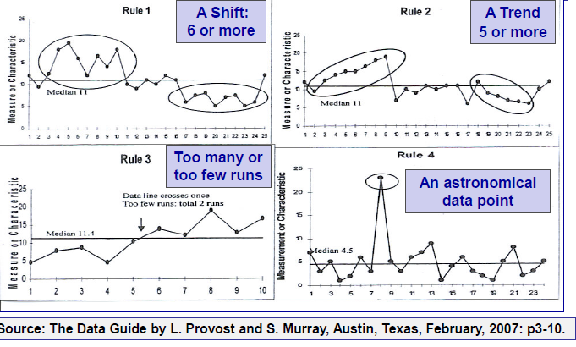
Quality Improvement
Four Simple "Rules" for Run Charts
Notes:
Feels like phase 10 – more detail on subsequent slides

Slide 16
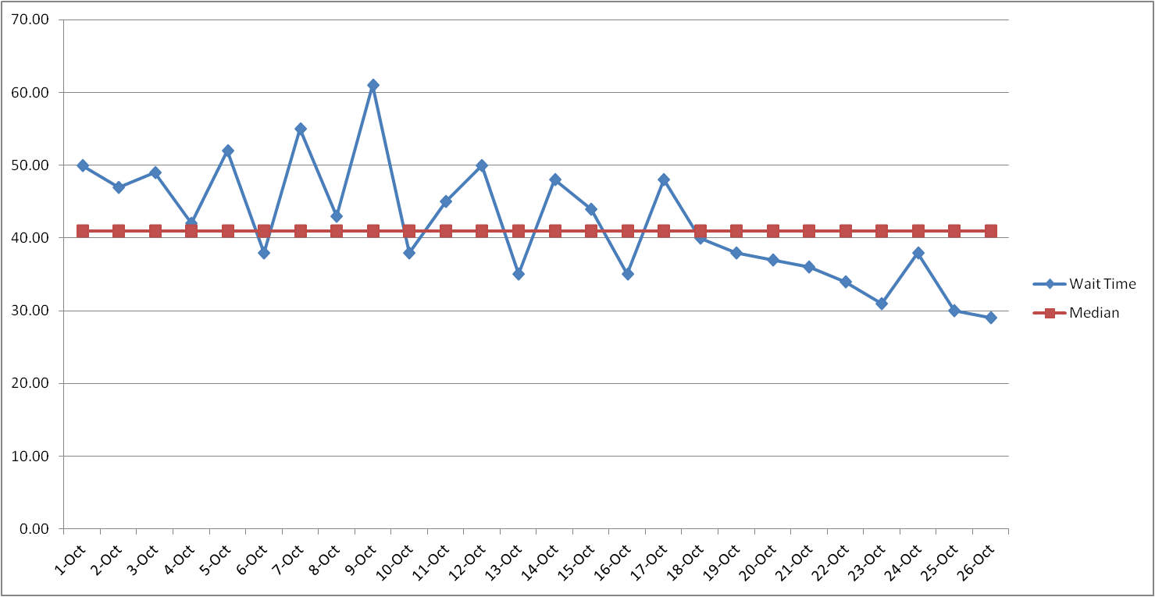
Quality Improvement
Four Simple "Rules" for Run Charts
Rule 1: A shift in the process is indicated by six or more consecutive points above or below the median. Points on the median do not add to or break a shift. Skip values on the median when counting the number of values.
Began to use nasal dose
Average Wait Time per Day

Slide 17
Quality Improvement
Four Simple "Rules" for Run Charts
Rule 1: A shift in the process is indicated by six or more consecutive points above or below the median. Points on the median do not add to or break a shift. Skip values on the median when counting the number of values.
Rule 2: A trend is indicated by five or more consecutive points all increasing or decreasing. If two consecutive points are the same, do not count one of them to assess the trend.
% Patients having a discussion about HU
16

Slide 18
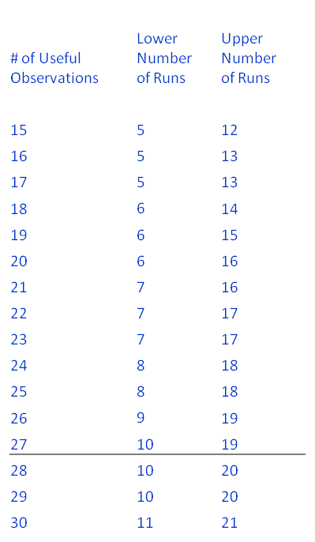
Quality Improvement
Four Simple "Rules" for Run Charts
Rule 1: A shift in the process is indicated by six or more consecutive points above or below the median. Points on the median do not add to or break a shift. Skip values on the median when counting the number of values.
Rule 2: A trend is indicated by five or more consecutive points all increasing or decreasing. If two successive points are the same, do not count one of them to assess the trend.
Rule 3: Too many or too few runs, or crossing of the median line
Count the number of data points that do not fall on median.
Count number of runs on run chart (number of times crossing
median +1)
Use this table (Table 3.4, Pg 80) to find lower and upper number of runs
based on the number of data points
If the number of runs in your data falls below the lower
limit or above the upper limit then this is a signal
Notes:
Can indicate something is affecting the process
Similar to Rule 1 in kind of identifying shifts in the process but doesn’t require a certain number of points (6 points below or above)
If you have only one crossing for example that means half are below and half are above the median – shift might have occurred
Having too many crossings could be an indication that if you have some of kind of cyclicity that should be explored
For example, something that might happen in a certain month/quarter of every year, day of week – if identified could help to minimize variation in a positive direction.
Tried to figure out pattern – looks like you basically take a third of points (lower run) and add half of points to that for upper

Slide 19
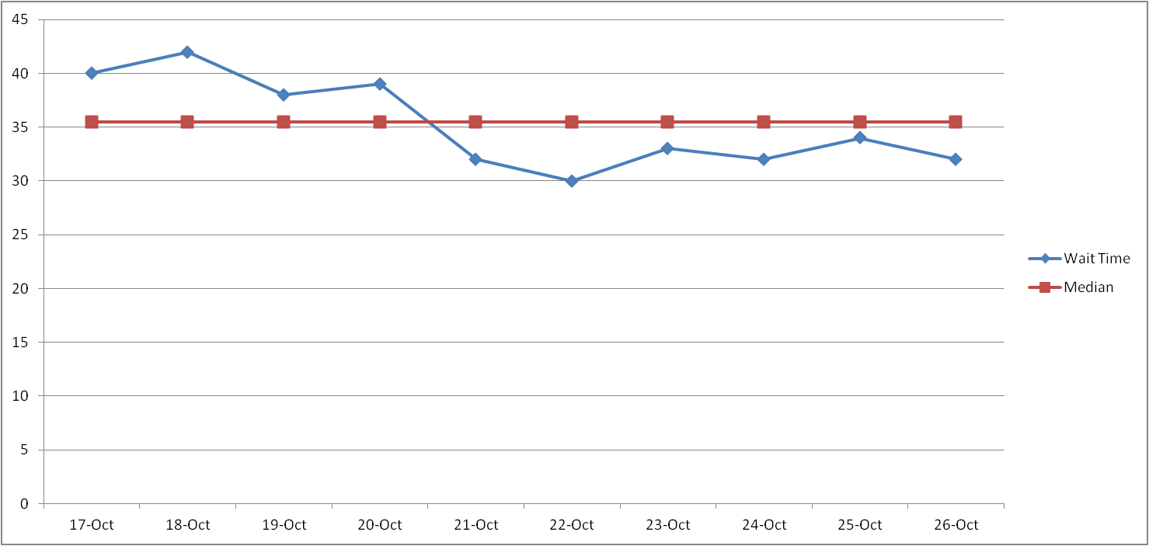
Quality Improvement
Four Simple "Rules" for Run Charts
Average Wait Time Per Day
10 Data points; should have between 3 and 9 crossings
18
Notes:
Also, just like a shift – just didn’t have six on either side
May be useful when you have fewer data points

Slide 20
Quality Improvement
Four Simple "Rules" for Run Charts
Rule 1: A shift in the process is indicated by six or more consecutive points above or below the median. Points on the median do not add to or break a shift. Skip values on the median when counting the number of values.
Rule 2: A trend is indicated by five or more consecutive points all increasing or decreasing. If two successive points are the same, do not count one of them to assess the trend.
Rule 3: Too many or too few runs indicate something is acting on the process.
Rule 4: An “astronomical” data point is a unusually large or small data point
19

Slide 21
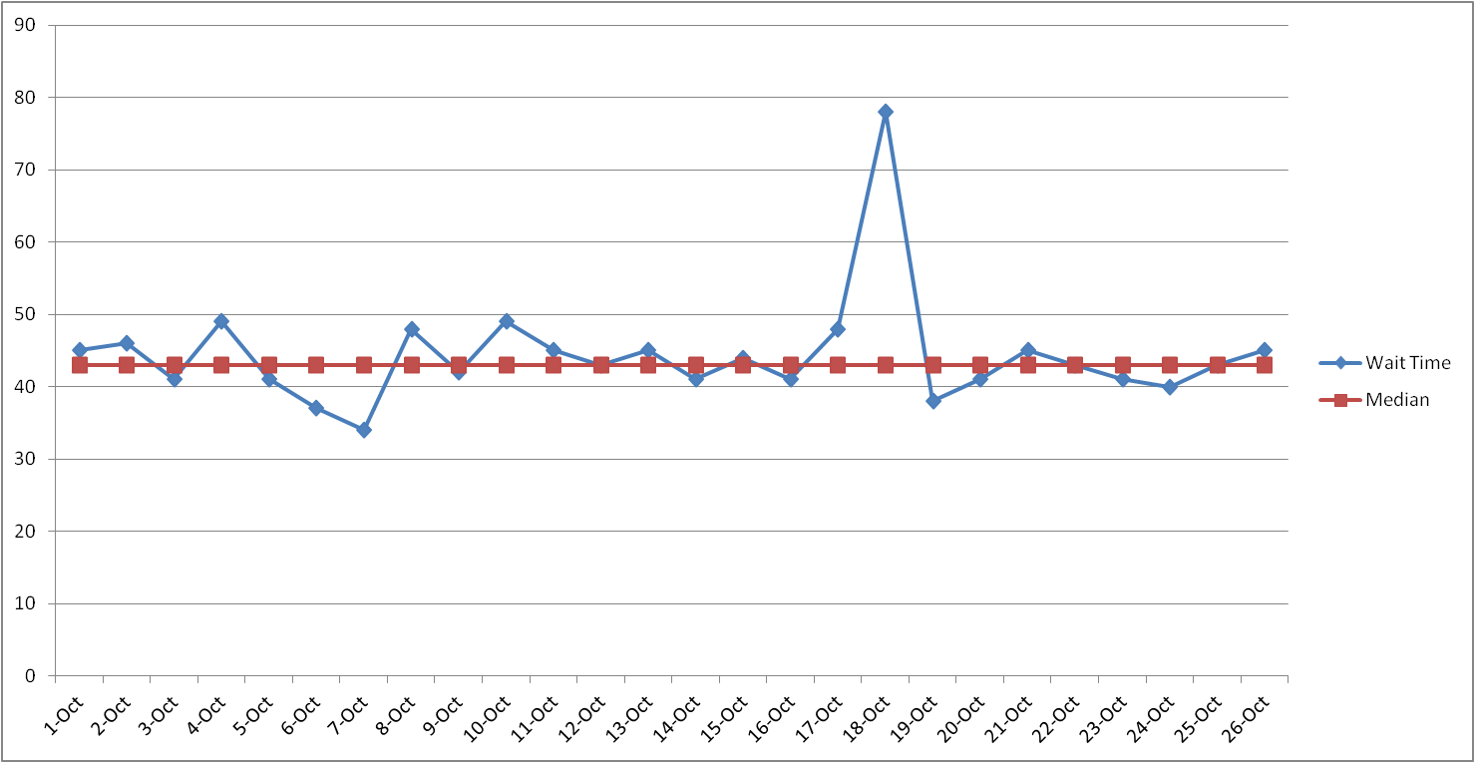
Quality Improvement
Four Simple "Rules" for Run Charts
Average Wait Time Per Day
3 staff call in sick
20

Slide 22
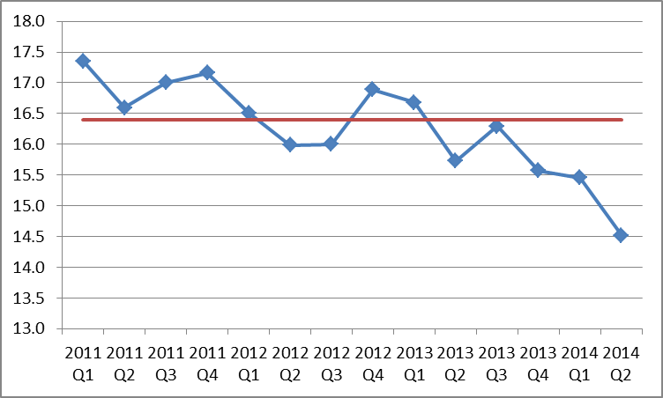
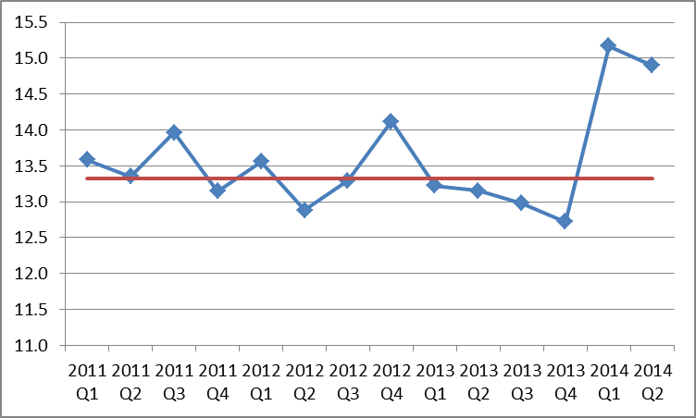
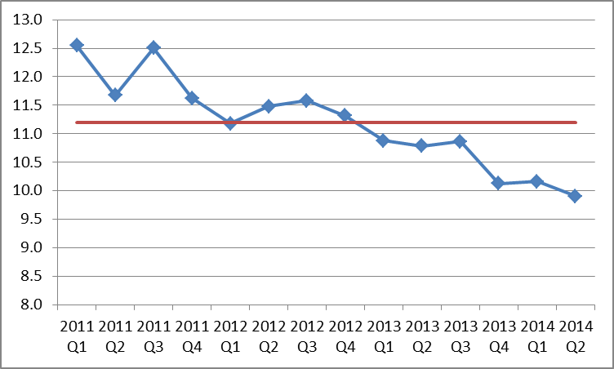
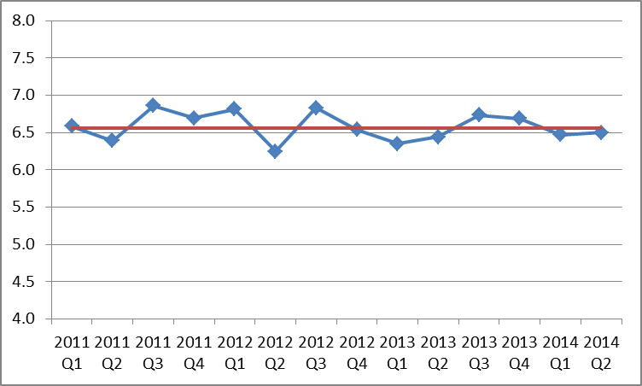
Check-in Exercise: Which Charts Suggest a Real Change? Why?
Notes:
These are data from CoIIN actually – smoking in pregnancy from the birth certificate
Reflect different states
Take a moment and turn to your neighbor to discuss which rule it might follow
Top Left: too few crossings 3 with 14 observations
Top Right: Anomaly – what might this reflect? This is like Type 1 error , QI tampering – luckily we know better
Bottom Left: shift 6 or too few crossings
Bottom right: no change pattern
Bottom line: we have some states and patterns to really learn from on the left

Slide 23
Quality Improvement
Control/Shewhart Charts
Statistical tool to distinguish between what are called "common" and "special" causes of variation
Centerline plus upper and lower limits
  Centerline = mean
  Upper and lower limits 3 standard errors from the center line
Recommend to start
with 20 data points
Notes:
Control charts add those confidence limits to help distinguish true variation
Adding statistics to the equation – can add more confidence to the process
Maybe help prevent flawed conclusions – what’s type 1 error? Type II?
Generally, QI folks are more concerned about type 1 error – not sure of history or genesis of that but they just really want to make sure a improvement is a true improvement and avoid false discovery/attribution
It does mean they may miss some true change – but that may be avoided when you know you’re testing new ideas and can look for break-points

Slide 24
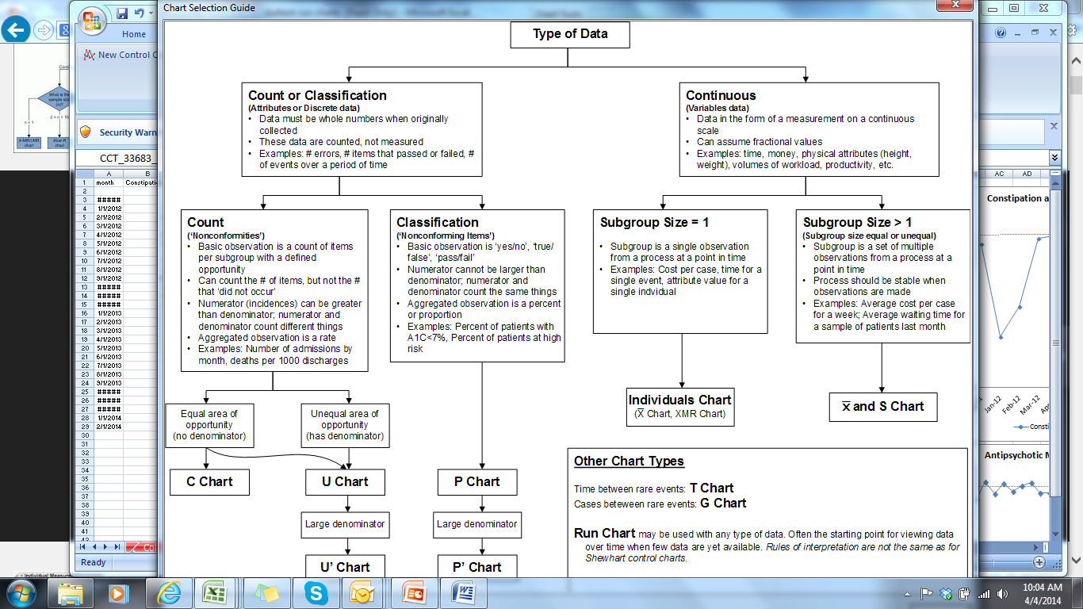
Rates %
Source: QI-Charts

Slide 25
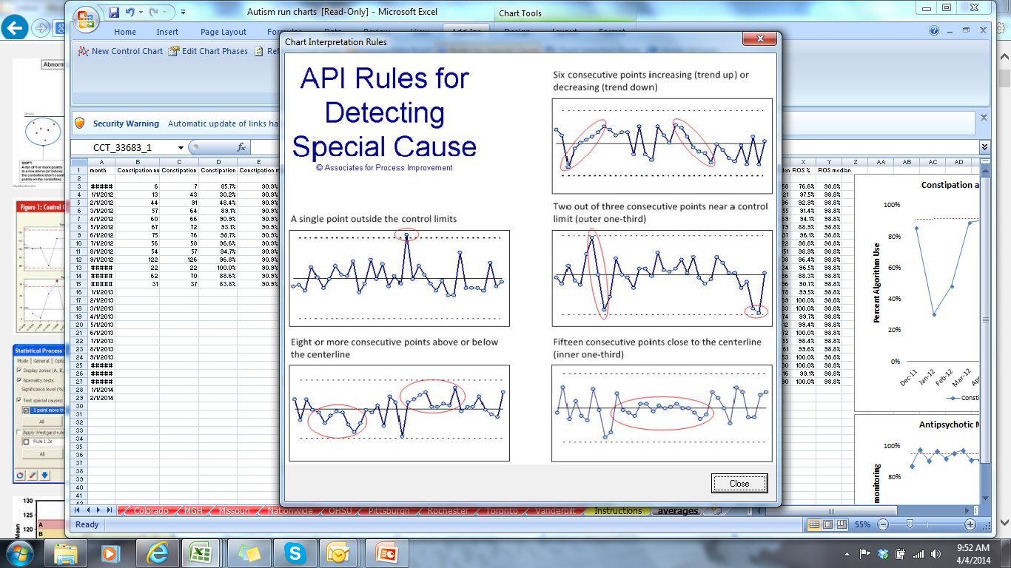
Source: QI-Charts
Notes:
Similar to the run chart rules
Limits are really only used for identifying those anomalies or large shifts where you may want to recalibrate the median and limits

Slide 26
Subgroups
Over units at same time
Over time within unit
Useful at project start
Try to learn from high/low performers
  States
  Counties
  Hospitals
  Clinics
Useful for tests of change
Try to learn from units that have improved
Identify, spread, and scale the strategy that led to improvement
Refine or improve strategies if no improvement seen

Slide 27
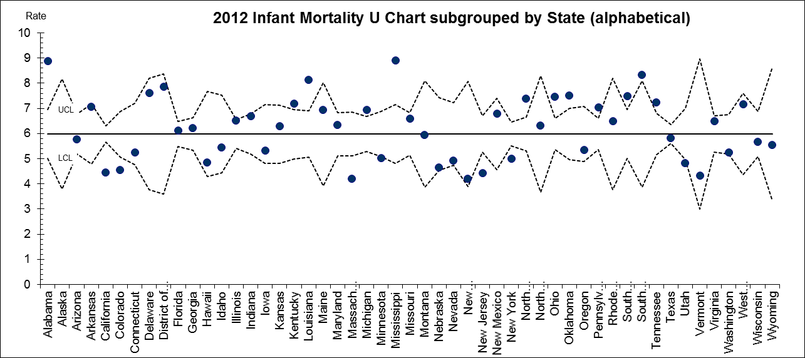
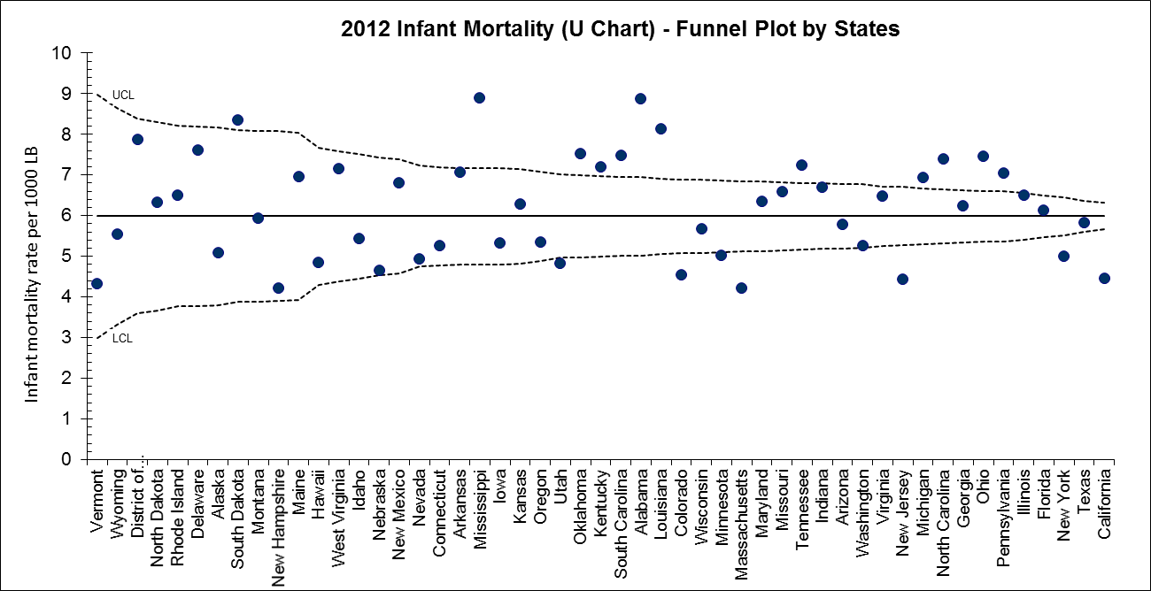

Slide 28
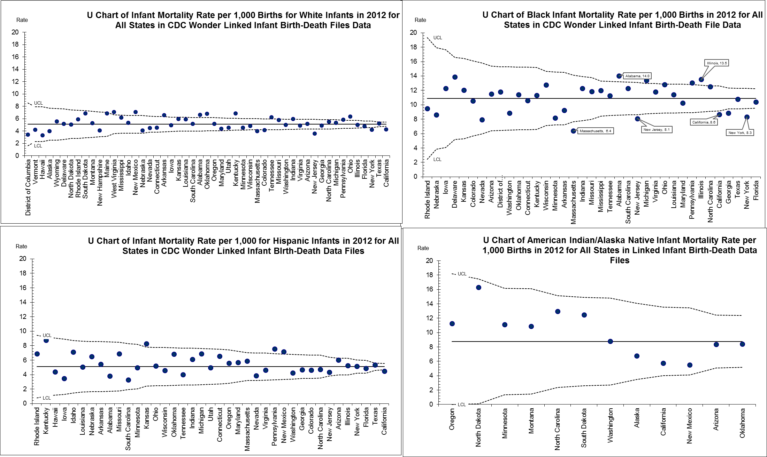
2012 Data: Infant Mortality Rate Funnel Plots Stratified by Race

Slide 29
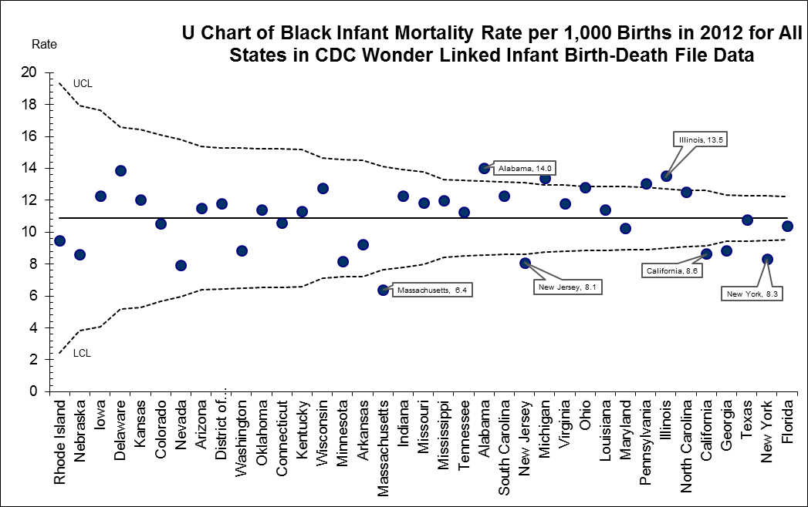

Slide 31
U.S. Infant Mortality Rate, 2000-2011*
Change not significant prior to 2007
* 2011 data are preliminary
Using Joinpoint Regression Software from the National Cancer Institute

Slide 33
When to revise limits?
When “trial” limits have been calculated with fewer than 20 subgroups
When the initial control chart has special causes and there is a desire to use the calculated limits for analysis of data to be collected in the future
When improvements have be made to the process and the improvements result in special causes on the control chart
When the control chart remains unstable for 20 or more subgroups and approaches to identify and remove the special causes have exhausted.

Slide 34
Control Charts for Population Data: Annual SUID by State – 1990-2013

Slide 35
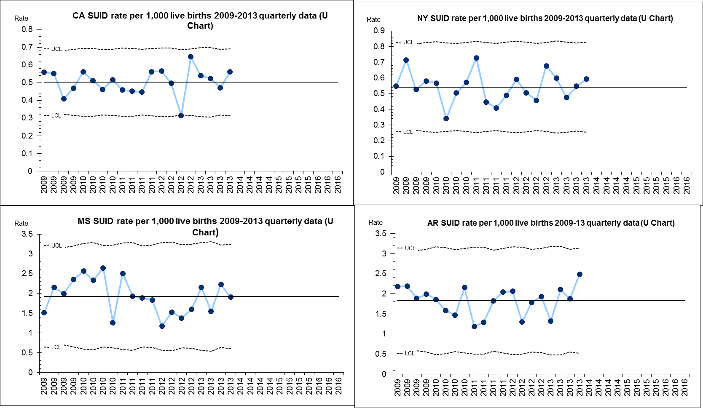
Control Charts for Population Data:
Quarterly SUID by State – 1990-2013

Slide 36
Examples from the field

Slide 37
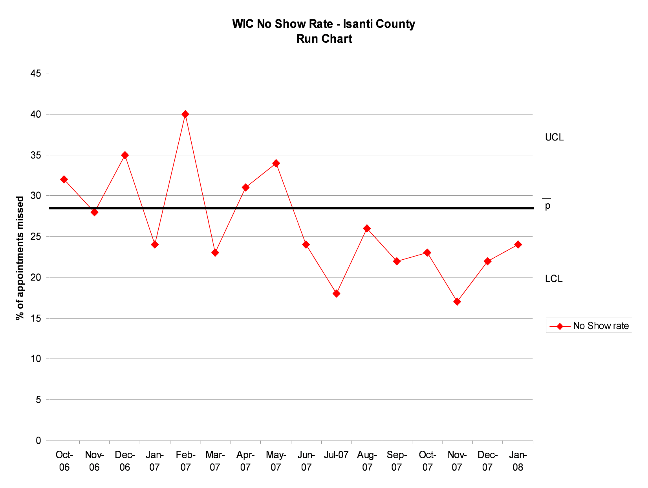
Quality Improvement
Minnesota : County WIC Data

Slide 38
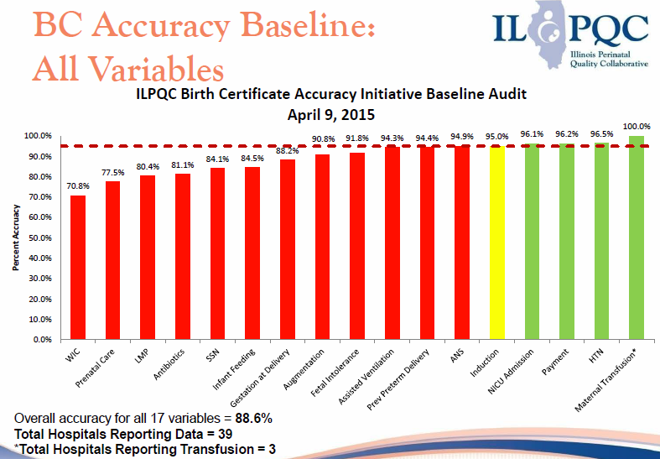
Quality Improvement

Slide 39
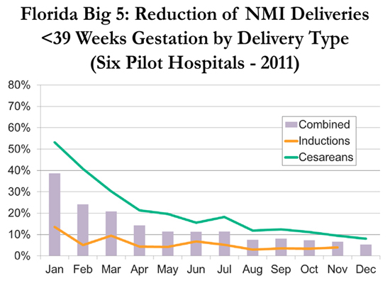
Quality Improvement

Slide 40
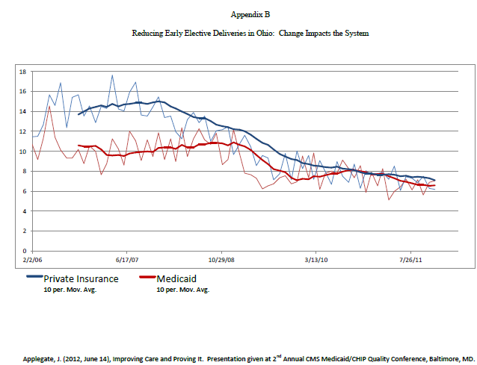
Quality Improvement
Ohio Early Elective Delivery Data

Slide 41
Quality Improvement
Illinois: Birth Certificate Data

Slide 42
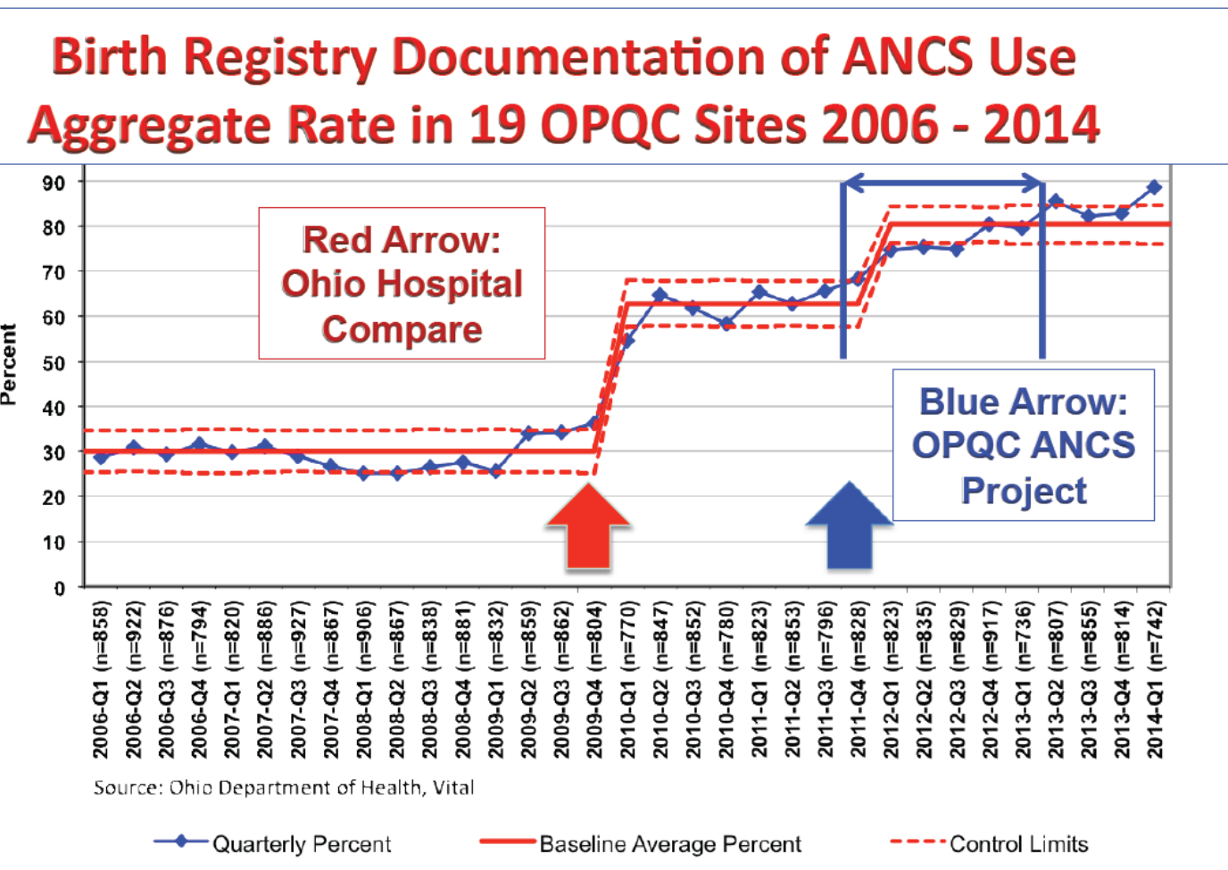

Slide 43

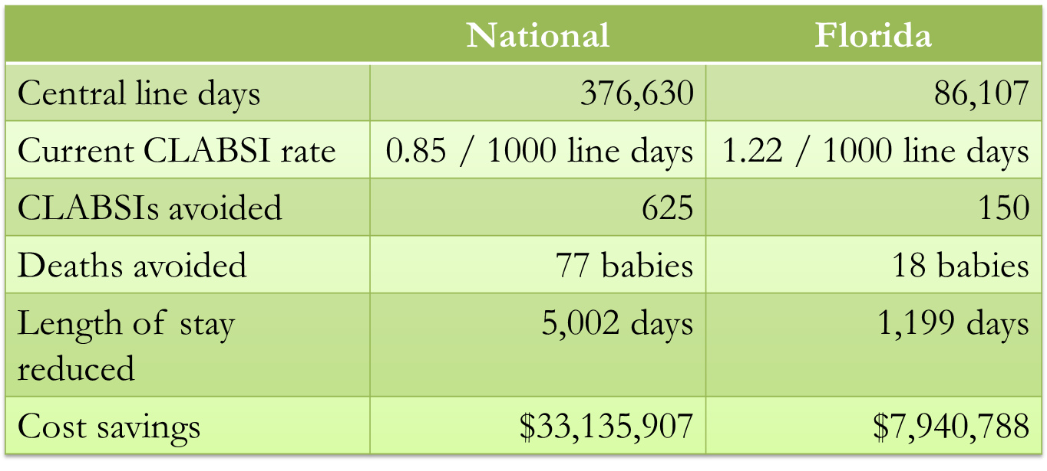
Where We’ve Come
Based on current central line-associated bloodstream infection (CLABSI) rates as of August 2013. Mortality rate 12.3%, increased length of stay of 8 days and estimated average cost of $53,000 per infection.
Notes:
Detailed results between December 2011 and August 2013 indicated that 150 infections were avoided in Florida - saving 18 lives, reducing length of stay by more than 1,199 days and saving over $7.9 million.

Slide 44
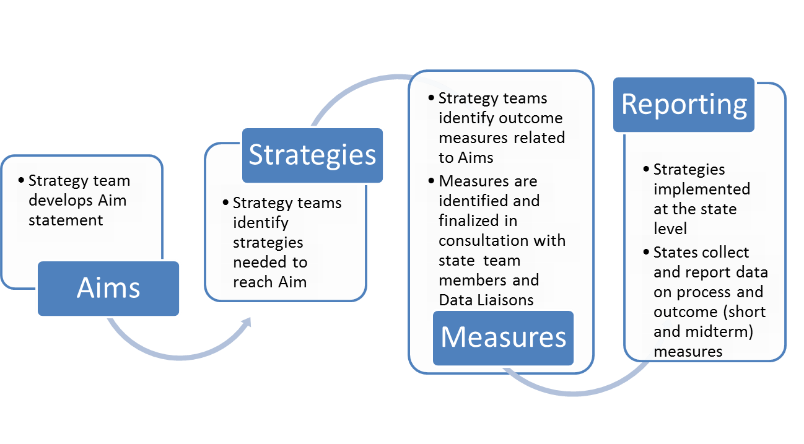
CoIIN Measure Selection Process
Note: The decision-making process to select outcome measures is grounded in the key characteristics of the COIN (Collaborative Innovation Network) model: Being a “cyber-team” (i.e., most work is distance-based); fostering innovation through rapid and on-going communication across all levels; and working in patterns characterized by meritocracy, transparency, and openness to contributions from everyone.
Notes:
Here’s a graphic of the measure selection process that strategy team data experts and co-leads help to facilitate
A team first develops aim statements and key strategies or drivers in a driver diagram
Then identifies outcome measures based on the aim which are finalized in consultation with state team members and data liaisons
real measure priorities for QI versus epi or research are timeliness and just enough data – willing to accept bias as long as its consistent—simple measures typically without adjustment
Then the strategies are implemented and a standard reporting process begins for the outcome measures

Slide 45
Regions IV/VI Aims & Primary Measures
Strategy Area and Measure | Data Source | Reporting Frequency
Early Elective Delivery Aim: By August 2014, reduce the proportion of non-medically indicated deliveries <39 weeks by 33%.
Early Elective Delivery Rate | Birth Certificate | Quarterly
Early Term Birth Rate | Birth Certificate | Quarterly
Smoking Cessation Aim: By August 2014, decrease the tobacco smoking rate by 3% among pregnant women .
Smoking During Pregnancy Rate | Birth Certificate | Quarterly
Quit Rate Prior to Pregnancy | Birth Certificate | Quarterly
Quit Rate During Pregnancy | Birth Certificate | Quarterly
Perinatal Regionalization Aim: By August 2014, increase the percent of mothers delivering at appropriate facilities (including infants <32 weeks gestation and/or less than 1500 grams) to 90% or by 20% above baseline.
Percent of VLBW infants delivered in Level III+ NICU | Birth Certificate | Semi-annually
Birthweight-specific mortality rates (<1,500g) | Linked Birth/Infant Death Certificate | Annually
Safe Sleep Aim: By August 2014, increase infant safe sleep practices by 5%.
Percent of infants placed on back to sleep | PRAMS | Semi-annually
Percent of infants not sharing a sleep surface | PRAMS | Semi-annually
Percent of infants placed in a safe sleep environment | PRAMS | Semi-annually
Interconception Care Aim: By August 2014 , modify Medicaid policies/procedures in 5-8 Southern states to improve access/financing of postpartum visits and ICC case management for women with prior adverse pregnancy outcomes.
Percent of women with a timely postpartum visit | Medicaid administrative/billing data | Semi-annually
Percent of women with a family planning visit | Medicaid administrative/billing data | Semi-annually
Percent of eligible women receiving ICC through a waiver or enhancement | Medicaid administrative/billing data | Semi-annually
Notes:
Here are the aims and measures across strategy team measures, data sources, and reporting frequency
EED had two quarterly measures from the birth certificate
Smoking cessation had three quarterly measures from the birth certificate
Perinatal regionalization had two measures, one from birth certificate, one from linked birth/death certificates measured semi-annually/annually
Safe Sleep had three semi-annual measures from PRAMS – currently still only have pre-CoIIN data from 2011 – undergoing a major change to electronic submission which should lead to future improvements in timeliness and a provisional system
ICC had three semi-annual measures from Medicaid administrative data – unable to get a critical mass of reporting within CoIIN timeframe –denominators varied by state in how they defined women with prior adverse pregnancy outcomes which were the target of state efforts/strategies; no consistent SAS code or data source (some linked, unlinked). Definitely lessons learned to support standard methodologies for Medicaid data in the national expansion.

Slide 46
Data Submission/Sharing Process
Developed a data use agreement (DUA)
Letter to State leadership from ASTHO/AMCHP
State data liaisons submitted data on a quarterly basis
  Provisional birth data within 6 weeks of quarter close
  Provisional death data within 6 months of annual close
Data uploaded to CoIIN data dashboard after quality control checks
Notes:
These were some of the steps taken to facilitate the data submission and sharing process
We first gathered information on preferences and capacity through the state data liaisons and MCH directors and learned that there was overwhelming demand for a streamlined/unified data submission process across strategy teams and a need for a data use agreement to keep data internal to the QI process and safe space for sharing given that many states don’t routinely release provisional statistics or for these particular measures and want to be protected if rates change from provisional to final
ASTHO/AMCHP sent a letter to State leadership (SHOs, MCH Directors, Vital Statistics and Medicaid Directors) to launch the formal request for data tracking and sharing within CoIIN and unite leadership in support of data timeliness
States began submitting data on a quarterly basis – six weeks after the close of a quarter
Sara Donahue made this a very organized process for states and we’ve had excellent reporting – only one state has yet to submit their 2014 data
Data uploaded to dashboard after quality control checks

Slide 47
Non-Medically Indicated Early Term Deliveries Among Singleton, Term Deliveries*
30% total decline translating to ~85,000 early elective deliveries averted since 2011 Q1
5 states met aim of 33% reduction
11 states had declines of 20%+
Region IV
APC ↓7% ↓11% ↓13%
  * Based provisional birth certificate data; denominator excludes women
  with medical indications present prior to and during pregnancy
Notes:
For EED, these are the regional total lines
Overall, 30% decline in EED…
You can see in Region VI (yellow) that is heavily weighted toward TX, progress appeared to decelerate within the CoIIN time frame compared to prior in 2011 – likely because they instituted a state-wide hard stop on reimbursement in Medicaid prior to CoIIN
Region IV (red line) generally accelerated their progress in CoIIN
Average annual change prior to CoIIN was 6% reduction, doubled in first year of CoIIN 12% (9% overall within CoIIN)

Slide 48
MCHB CoIIN—Percent of Non-Medically Indicated Early Term Deliveries Among Singleton Term Deliveries, Reg. IV/VI (Provisional)

Slide 49
Preterm Birth*
11 of 12 States had declines
5 States had declines of 10%+
3 States reduced disparity by 15-30%
* Includes provisional birth certificate data ; <37 weeks’ gestation
Excludes 1 State that did not submit 2014 data
Notes:
For Preterm Birth, although we requested quarterly data—I found that it was choppy, bounced around a lot so I converted it to semi-annual data for this graph
Overall, there was a 5% decline for Black infants, 7% decline for White infants, 6% decline overall
11 of 12 reporting states had declines
5 states had declines of 10%+
3 states reduced disparity by 15%-30%

Slide 50
Infant Mortality*
7 States achieved IMR reductions
3 States had declines of 10%+
6 States reduced disparity by 25%+
Black-White Rate Ratio 2.22 2.05 ↓ 14%
* Includes provisional birth/death certificate data
Notes:
Here is Infant Mortality by Race from 2011 – 2013 for all states across regions IV/VI combined
We can see the Black IMR declined by 7%
Essentially no change in White IMR and a 3% drop in overall IMR
The differential decline for black infants led to a decline in the disparity
From a rate ratio of 2.22 to 2.05 – corresponding to a 14% decline
Really impressive over two years—figures are robust because they contain 13 states combined
Looking at individual state data: 6 of 12 reporting states achieved IMR reductions
3 states had declines of 10% or more
6 reduced the disparity by 25% or more – sounds dramatic but important to keep in mind that only 2 of those states that optimally lowered the disparity through reductions in both Black and White IMR but steeper drops for Black but 5 did achieve Black reductions of 10% or more; 3 achieved white reductions of 10% or more

Slide 51
Data Challenges & Lessons Learned
Keeping it simple, reducing burden
Lack of timeliness for certain data
Need to make connections between process and outcome measures
Realizing that process measures may change more rapidly than outcome measures for certain strategies
Examine variability within and across states
Assessment/data improvement may be important goal for certain strategies
Notes:
Several teams had secondary measures and more than 3 primary measures with requests for data overall and by race/ethnicity
Midway through the CoIIN, we streamlined the measures eliminating all secondary measures and several primary measures that weren’t essential and eliminating requests for race/ethnic data where it didn’t make sense (EED—there weren’t disparities; ICC in Medicaid was already focused on a disparate population
We had some timeliness challenges with PRAMS and Medicaid data in terms of linkages/access
Working on some additional measures for them as I mentioned – SUID and HEDIS data
Another lesson learned was the need to make connections between process and outcome measures to know what changes/strategies resulted in improvements – the Ilab dashboard the NICHQ is developing for the national roll-out will be a one-stop shop where states enter and track both process and outcome measures
Also realizing that process measures may change more rapidly than outcome measures for certain strategies – ICC policy and procedural changes were not expected to make immediate changes in outcomes – takes time for full implementation; so for some teams it’s the process or activity measures that are really key within the 18-24 month timeframe of CoIIN
And for some teams, the first goal may be improved assessment—perinatal regionalization lacked standardized data on hospital levels of care so it was a huge accomplishment to have developed and piloted a survey to assess equipment and staffing that define levels – we are working to get that instrument added to an AAP hospital survey so we have a true national picture on levels of regionalization for the first time!
So success can come in lots of forms and not just in changing outcomes right away

Slide 52
Data Strengths & Opportunities
Epidemiologist engagement
Accelerated improvement
Timeliness of vital statistics
SAS code development and sharing
Data innovations and quality improvement
State Systems Development Initiative
Notes:
Engaging epidemiologists to be critical members of state teams in driving data to action was key – moving forward we have actively encouraged states to include an epi on the teams that attended subsequent summits in Region V and the national roll-out; great synergy in the PDSA cycle that requires both data and program staff
Timeliness of vital statistics was another huge win – all but two states in the country now have the electronic birth certificate and registration system; CoIIN provided a platform to breakdown political barriers to access and protect sensitivities related to provisional data. The South really provided an example for the roll-out about just how timely vitals can be.
CoIIN also helped to leverage resources to improve timeliness in other data systems—we know PRAMS is working on it and CMS and CDC have sponsored linkage trainings for Medicaid data; helped to foster critical partnerships around data
Data innovations and quality improvement – some states developed hospital feedback loops with the birth certificate—this is what the BC is saying your rate of EED is—motivate them to improve accuracy and documentation of conditions on the birth certificate. Similarly, others did validations against medical records with clerk training to improve data quality. TN did real time tracking of SUID cases.
SAS code shared in this platform of collaborative learning
SSDI funding to support data availability, timeliness, quality – workgroups formed on standards for data timeliness, within-state sharing agreements for data linkages –ongoing resource with a built in CoIIN component moving forward to FY15

Slide 53
Some QI lessons/principles
What gets measured gets done
  But you can’t fatten a cow just by weighing it
Data is for improvement, not for judgment
  In QI, we want to increase our failure rate
Work smarter, not harder
Share seamlessly, steal shamelessly
  Learn, spread, scale to reduce variation and improve systems

Slide 54
Bill’s Personal Discovery
Quality improvement initiatives can use rapidly available imperfect simple data to make decisions to change health care that can have a major population impact.
Examples:
Early elective delivery
Obstetric hemorrhage
Neonatal line infections

Slide 55
Deb’s Personal Discovery
Integrating QI thinking and methods with epidemiologic thinking and methods can strengthen each approach.
As data are applied in different ways, a wider range of people get energized and involved in making change happen.

Slide 56
Differences between QI, Performance Measurement, and Research/Evaluation¹
ASPECT | Improvement/ PDSA | Performance Measurement | Research/ Evaluation
Aim/Purpose | Improvement of process, system, and outcomes | Accountability | To generate new generalizable knowledge
Audience | Program Managers | Funders | Society
Scale | Smaller unit(s) within a system | Larger unit or population level | Either
Timeliness | Real time/ provisional | Final/annual | Multiyear
Bias | Accept stable bias | Measure and adjust to reduce bias | Design to eliminate bias
¹ Loosely based on Provost, Lloyd and Sandra Murray. The Health Care Data Guide Learning From Data for Improvement. San Francisco: Jossey Bass, 2011.

Slide 57
Differences between QI, Performance Measurement, and Research/Evaluation¹
ASPECT | Improvement/ PDSA | Performance Measurement | Research/ Evaluation
Comparison Groups | Internal and historical | Historical or benchmarks | External or randomized
Sample size | “Just enough” data, small, sequential samples | Obtain 100% of relevant and available data | “Just in case” data
Flexibility of hypothesis | Very flexible; changes as learning takes place | No hypothesis; meet objectives | Fixed hypothesis
Determining if a change is an improvement | Run charts or statistical process control charts | No formal test; met / not met | Hypothesis tests (t-test, X², etc…), focus on p-value
¹Provost, Lloyd and Sandra Murray. The Health Care Data Guide Learning From Data for Improvement. San Francisco: Jossey Bass, 2011.

Slide 58
Home Visiting or Healthy Start Discussion
What are some activities/indicators for QI?
What are some activities/indicators for performance measurement?
What are some activities/indicators for evaluation?

Slide 59
References and Resources
Provost LP, Murray S. The Health Care Data Guide: Learning from Data for Improvement. San Francisco: Jossey-Bass; 2011
Riley WJ, Moran JW, Corso LC, Beitsch LM, Bialek R, Cofsky A. Defining quality improvement in public health. J Public Health Manag Pract. 2010 Jan-Feb;16(1):5-7.
Dilley JA, Bekemeier B, Harris JR. Quality improvement interventions in public health systems: a systematic review. Am J Prev Med. 2012 May;42(5 Suppl 1):S58-71.
Benneyan JC, Lloyd RC, Plsek PE. Statistical process control as a tool for research and healthcare improvement. Qual Saf Health Care. 2003 Dec;12(6):458-64. Review.
http://www.ihi.org/resources/Pages/Tools/RunChart.aspx
Excel add-in QI Charts and QI Macro
Mohammed MA, Worthington P, Woodall WH. Plotting basic control charts: tutorial notes for healthcare practitioners. Qual Saf Health Care. 2008 Apr;17(2):137-45.
Koetsier A, van der Veer SN, Jager KJ, Peek N, de Keizer NF. Control charts in healthcare quality improvement. A systematic review on adherence to methodological criteria. Methods Inf Med. 2012;51(3):189-98.

Slide 60
Acknowledgements
Bill Sappenfield, MD, MPH
University of South Florida
Judith Shaw, EdD, MPH, RN, FAAP
Vermont Child Health Improvement Program
Lloyd Provost, MS
Associates in Process Improvement
Tricia Finnerty, MSc
National Institute for Children’s Health Quality

