Slide 1

Birth Certificate Accuracy Initiative
Monthly OB Teams Call
September 28, 2015
12:30 pm – 1:30 pm

Slide 2

Variables of the Month:
Audience Response
Go to respond.cc
Enter the code 644640
Answer the questions for the variables of the month discussion

Slide 3
Overview
Birth Certificate Accuracy Initiative update
QI topics of interest
  Team meetings and shortened QI Process Feedback Form
  Review data and identify opportunities for change
Variables of the month
  WIC
  Prenatal care
  SSN
Team Talks
  Presence St. Mary’s Hospital – Christa Regnier
  Northwestern Memorial Hospital – Debbie Miller
  Northwestern Lake Forest – Wendy Rusinak & Dr. Tanner Colegrove
Annual Meeting & Poster Session
Campus Catalyst
Next Steps

Slide 4
BC Accuracy August Data
107 team rosters submitted for initiative (44 wave 1, 63 wave 2)
August audit data due 9/15 in REDCap https://redcap.healthlnk.org/
    As of 9/25, 87 teams have entered data (81.3% of teams)!
QI Process Feedback Forms (as of 9/25)
    52 completed for May
    34 completed for June
    25 completed for July
    27 completed for August
    Report your QI process monthly:
  https://www.surveymonkey.com/r/876BS2C

Slide 5
Shortened QI Process
Feedback Form: Purpose
Based on your feedback we removed 5 fields!
Tool for your team meetings – take time each month to discuss what you’ve done in the previous month and your plan for next month and record it here
Information used to provide your team with help identifying opportunities for change and developing PDSA cycles
REDCap data alone doesn’t provide enough information on your QI process to facilitate PDSA support
There are no right or wrong answers

Slide 6
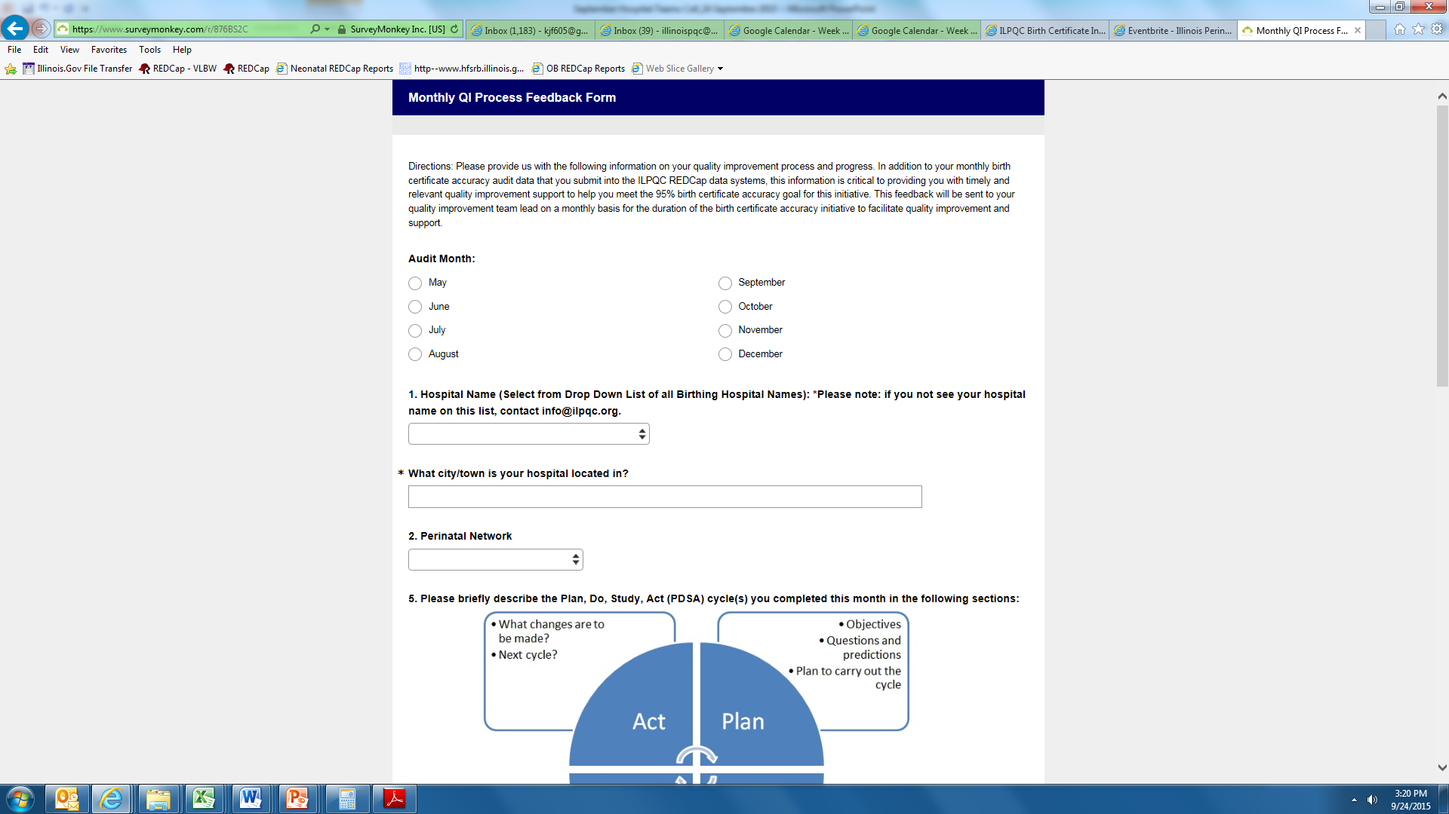
Shortened QI Process
Feedback Form (1/3)

Slide 7
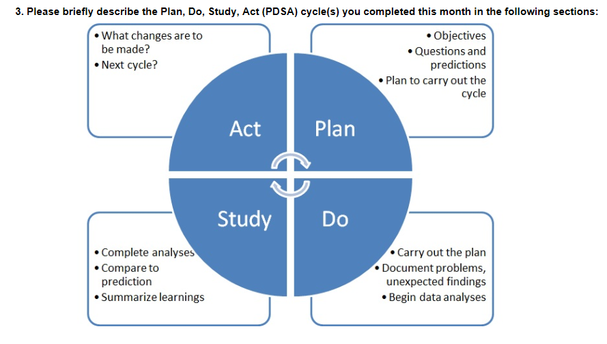
Shortened QI Process
Feedback Form (2/3)

Slide 8
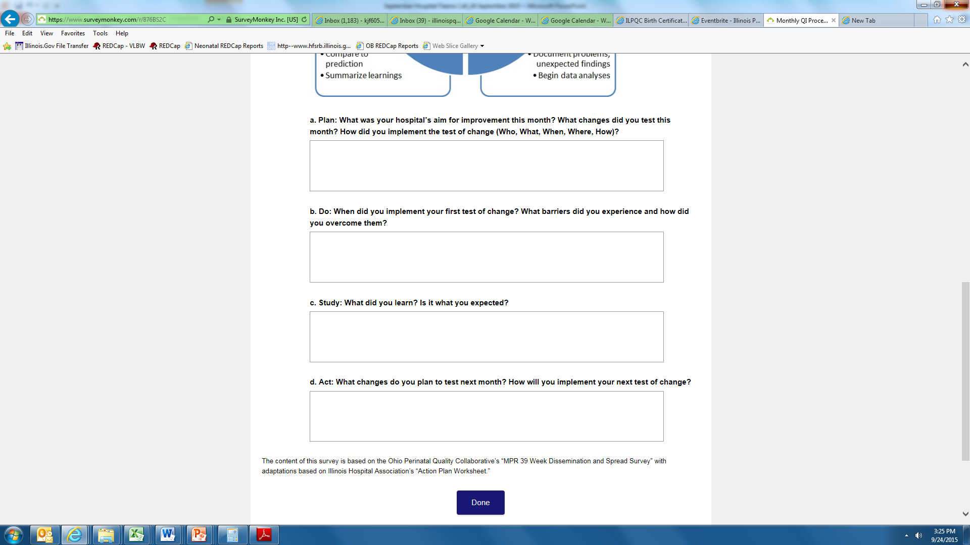
Shortened QI Process
Feedback Form (3/3)

Slide 9
BC Accuracy August Data:
All Variables
Goal = 95.0% (red dashed line)
Baseline = 87.0% (blue dash dot line)
Overall accuracy for all 17 variables for August = 95% (black dotted line)
Total Hospitals Reporting August Data = 87

Slide 10
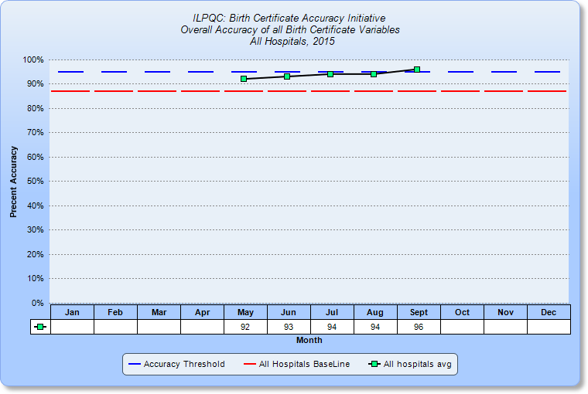
BC Accuracy: Overall Accuracy of All Variables
Note: Disregard September -only ONE hospital with September data entered!
2014 Baseline = 87.3%

Slide 11
QI Cycle Support Recap
Monthly QI cycle process
  OB Teams webinar on the 4th Monday of each month, 12:30-1:30
  Data reporting via REDCap and QI process feedback reporting via SurveyMonkey
  QI coaching calls with Perinatal Network Administrators and ILPQC as needed
  Meet with your team to discuss data report, QI process feedback form and plan next PDSA

Slide 12
Opportunities for Change
Let’s take a closer look at variables under 95% accuracy & identified on PDSA workshop calls
Variable | Baseline Accuracy | May Accuracy | June Accuracy | July Accuracy | August Accuracy
Augmentation | 88.7 | 91 | 90 | 94 | 93
Antibiotics | 86.0 | 90 | 92 | 94 | 93
Gestation | 88.0 | 91 | 91 | 93 | 93
Infant Feeding | 83.7 | 87 | 91 | 89 | 89
SSN | 85.7 | 93 | 91 | 92 | 93
Prenatal Care | 78.3 | 84 | 85 | 89 | 88
WIC | 76.0 | 81 | 86 | 87 | 90
LMP | 81.0 | 83 | 87 | 87 | 91

Slide 13
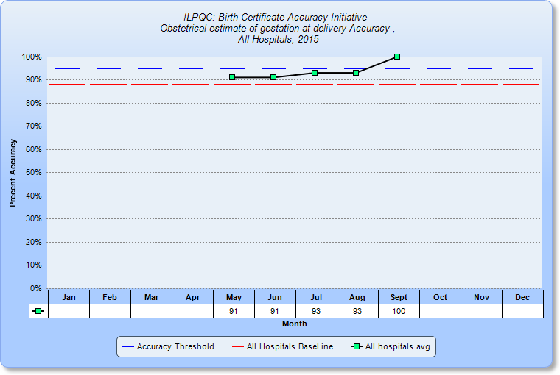
Opportunities for Change:
Gestation at Delivery
Note: Disregard September - only ONE hospital with September data entered!
2014 Baseline = 88.7%

Slide 14
Accuracy of Gestation at Delivery
Opportunity for Change | Possible PDSA
Fine-tuning education roll-outs for specific group/individual needs (initial education roll outs don’t reach everyone) | Reach out to a receptive staff member that needs additional support to develop a way to help them remember and apply the education (e.g. highlighting fields on forms, including tips/definitions on forms, etc.). Test the approach with 1 staff before rolling out a system/policy change
Making the GA easier to find from a consistent source | Look for opportunities that reduce the hunting for GA, including identifying the best source of this information and highlighting GA on this best source to reduce the need for staff to search and interpret multiple GAs in the medical record
Getting the GA in a timely, clear, and consistent format from your prenatal providers on the prenatal record | Work with a willing provider to explain the use and value of this information from their office for the birth certificate and brainstorm methods to improve their communication of GA on the prenatal record.
What are barriers to Gestation at Delivery accuracy at your hospital? Share in the chat box.

Slide 15
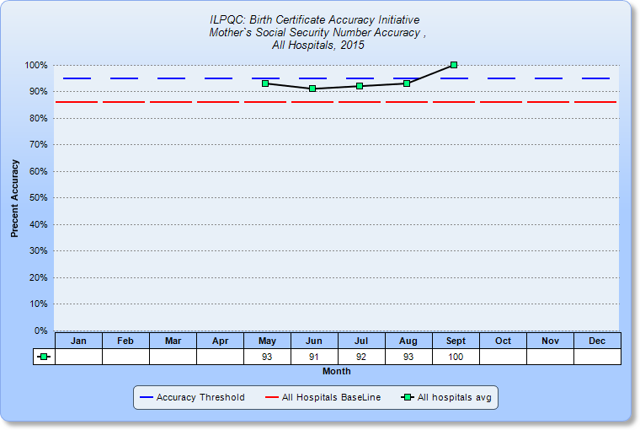
Opportunities for Change:
Mother’s SSN
Note: Disregard September - only ONE hospital with September data entered!
2014 Baseline = 86.0%

Slide 16
Accuracy of Mother’s SSN
Opportunity for Change | Possible PDSA
Mom doesn’t give SSN during the birth certificate interview / on birth certificate worksheet | Add a check for this information in the medical record into the process for birth certificate abstraction.
Mom doesn’t want to provide SSN | Have interviewing staff inform mom that it is a part of the statistical section of the birth record, and is required to be collected by the Federal Government. This information will never show on a copy of the birth record, and is considered confidential information.
What are barriers to Mother’s SSN accuracy at your hospital? Share in the chat box.

Slide 17
OB Teams Call
Birth Certificate optimization initiative
09/28/2015
Cindy Mitchell
HSHS St. John’s

Slide 18
Variables for Discussion
Mom’s Social Security number
Prenatal Care
WIC

Slide 19
Audience response
Go to respond.cc
Enter the code 644640
Answer the following questions

Slide 20
Mother’s social security number
Mom does not put her social security number on the birth certificate worksheet that she completes. You do see her social security number on the prenatal care record. Should you enter 999-99-9999 or the number listed on her prenatal care record?
a) 999-99-9999
b) The number listed on her prenatal care record

Slide 21
Mother’s social security number
Mom does not put her social security number on the birth certificate worksheet that she completes. You do see her social security number on the financial information form in her chart. Should you enter 999-99-9999 or the number from the financial information form in her chart?
a) the number from the financial information form in her chart
b) 999-99-9999

Slide 22
Mother’s social security number
Mom provides the last 4 digits of her social security number. Should you enter the portions you know (last 4 digits) and for the digits unknown enter 9’s or should you enter her social security number as 999-99-9999?
a) enter the 4 digits known with the rest as 9’s
b) 999-99-9999

Slide 23
Mother’s social security number
Definition: Enter the mother’s social security number
Enter the mother’s complete 9 digit social security number. Do not enter only the last 4 digits of the complete number.
If mom will not provide or does not have a SS# enter all 9’s.
Guidebook #19; pg. 15
Key Variable Document variable #1

Slide 24

Prenatal care
Mom finds out she is pregnant. Schedules an appointment with her doctor’s office. On that visit she sees the nurse and has an initial ultrasound for dating completed. They schedule her to see the CNM in 2 days. Which visit would be counted as the first prenatal care visit?
A) The visit where mom saw the nurse and had an ultrasound for dating
B) The visit two days later when she saw the CNM

Slide 25
Prenatal care
Mom was sent from her doctor’s office today for an induction of labor due to elevated blood pressure. When you go to complete the birth certificate the prenatal record on file has her last visit listed as 9/21/2015. Would you enter 9/21/2015 or 9/28/2015 as the date of her last prenatal care visit?
A) 9/28/2015
B) 9/21/2015
Recommend requesting an updated prenatal record from the providers office documenting the visit that mom had prior to her induction.

Slide 26
Prenatal care
Mom is visiting family in town when she goes into labor. She states she is 36w and she started her prenatal care in February. Mom states she saw her doctor 8 times during this pregnancy. She provides the name of the out of state physician she saw during her pregnancy. The office is called and are unable to locate any records for this mom. When completing the birth certificate do you use the 8 visits mom stated she had, mark no prenatal care, or unknown for the variable asking total number of visits recorded?
A) 8
B) No Prenatal Care
C) Unknown

Slide 27
Prenatal care
Definition: Date of 1st prenatal care visit.
The date the pregnant woman was first examined and/or counseled by a provider or healthcare professional.
This information you can get from the prenatal care record or use what mom puts on the birth certificate worksheet.
Enter all portions of the date that are known. If mom knows she started prenatal care in February of this year but cannot remember the date of the visit you can use 02/99/2015
Guidebook #30a; pg. 20
Key Variable Document variable #2

Slide 28
Prenatal care
Definition: Date of last prenatal care visit
The month, day, and year of the last prenatal care visit recorded in the prenatal care record.
Do not use a date based on what mom states as her last prenatal care visit
Must have documentation ~ request updated prenatal record and use what is documented in that record
Enter all known portions of the date ~ unknown portions of the date can be entered as 9’s.
Guidebook #30b; pg. 21

Slide 29
Prenatal care
Definition: Total number or prenatal care visits
Count only dates (visits) recorded in the prenatal care record
If no prenatal care enter 0 ~ also be sure the box for no prenatal care is checked on 30a.
Guidebook #31; pg. 21

Slide 30
WIC
When reviewing the birth certificate worksheet with mom you notice that she has left the question regarding receiving WIC benefits during her pregnancy blank. You ask her again and she says, “I don’t know what that means”. Would you mark yes, no, or unknown for this variable?
A) Yes
B) NO
C) Unknown

Slide 31
WIC
Definition: Did mother get WIC food for herself during this pregnancy?
This should be a question mom answers on the birth certificate worksheet.
Mark yes if she is receiving WIC
Mark no if she is not receiving WIC
Mark unknown if after discussion mom is unsure if she is receiving WIC
Guidebook #35; pg. 23
Key Variable Document variable #3

Slide 32

Questions

Slide 33
Team Talks
Presence St. Mary’s
  Christa Regnier
Northwestern Memorial Hospital
  Debbie Miller
Northwestern Lake Forest
  Wendy Rusinak & Dr. Tanner Colegrove

Slide 34
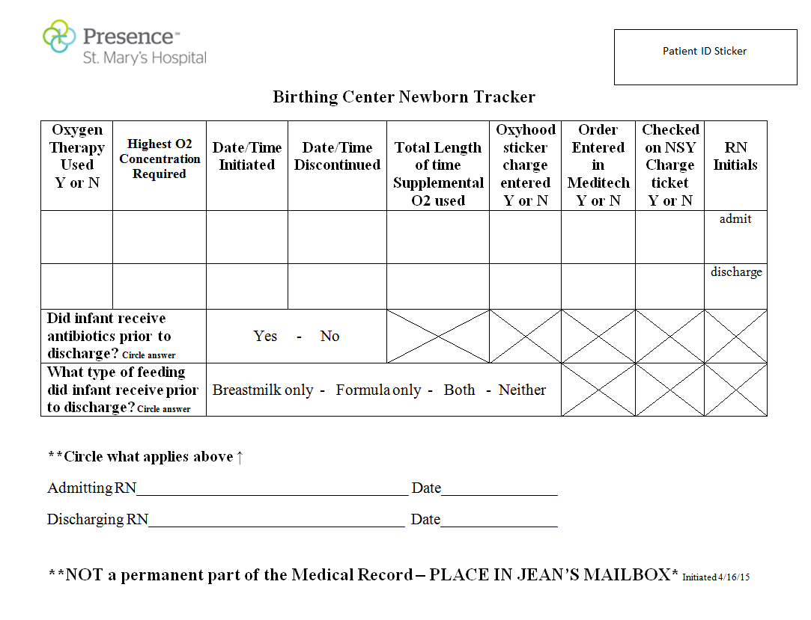
Team Talks

Slide 35
ILPQC 3rd Annual Meeting
ILPQC 3rd Annual Meeting to be held at UIC Forum on Wednesday, November 18 – register here:
  https://www.eventbrite.com/e/illinois-perinatal-quality-collaborative-3rd-annual-conference-tickets-18436586326
Block of hotel rooms available at Chicago Marriott UIC/Medical District
  Book before 10/11 to receive rate
  Rooms are $209/night + taxes and fees
  Call 1-312-491-1234 or use the link below and reserve a room under the "Illinois Perinatal Quality Collaborative Room Block”
Book your group rate for Illinois Perinatal Quality Collaborative Room Block

Slide 36
ILPQC 3rd Annual Meeting:
Poster Abstract Submission!
ILPQC 3rd Annual Meeting to be held at UIC Forum on Wednesday, November 18
Now accepting poster abstract submissions!
  Opportunity for ALL hospitals across the state to share a perinatal quality improvement projects!
  Posters detailing ANY quality improvement projects in development, current projects, or recently completed projects (not limited to ILPQC initiatives) are welcome!
  Instructions for submissions found here:
  http://bit.ly/1DPWBLe
  Abstracts to be submitted to Survey Monkey here:
  https://www.surveymonkey.com/s/ILPQCposters2015

Slide 37
campusCatalyst
campusCATALYST (cC) is a Northwestern undergraduate program that combines experiential learning with a course taught by a leader in the local non-profit community
Class is composed of 25 students who are split into teams of 5, and matched with local non-profit organizations and Kellogg MBA mentors to work on quarter-long consulting engagements
ILPQC was selected as a one of the non-profit sites for the Fall 2015 academic quarter
  5 students working with us on a business case for perinatal quality collaboratives for potential funders
  May reach out to a few team to have a brief conversation with these students to inform our business case

Slide 38
Future Initiatives
Survey on future initiatives to be sent out before the next teams call on 10/26
Results will be discussed at annual meeting
Potential initiatives:
  Maternal morbidity reduction/hypertension (continued work on 2016 initiative)
  Maternal morbidity reduction/hemorrhage (updating the initial statewide initiative, i.e. Hemorrhage 2.0, with new AIM / ACOG toolkits and bundles and protocols)
  Maternal morbidity reduction/Prevention of Venous Thromboembolism
  Antenatal corticosteroids optimization (expanding the Big V initiative)
  Primary cesarean section rate reduction
  Optimal breastfeeding
  Immediate postpartum LARC
  Optimizing Progesterone Therapy for prevention of preterm birth

Slide 39
Next Steps
Conduct monthly audit for September and enter data into REDCap by October 15
Submit monthly QI process feedback form for August via SurveyMonkey by October 15
Review your reports immediately in REDCap to evaluate your progress towards improved accuracy and identify opportunities for change
Meet with your team to discuss progress, complete QI feedback form and plan next PDSA.
Contact ILPQC or your PNA with any questions

Slide 40
Next OB Teams Meeting
September 28, 12:30-1:30pm
Need 2 teams to sign up for “Team Talks” for September – December meetings
Remember to register for the www.ilpqc.org
ILPQC website member’s only section
Send your Process Flow Diagram and PDSA worksheets to info@ilpqc.org to share with other teams in the ILPQC members section.

Slide 41

ILPQC Administrative Team
Ann Borders
ILPQC Executive Director, OB Lead
Aki Noguchi and Pat Ittmann
Neonatal Leads
Patricia Lee King
State Project Director
Kate Finnegan
Project Coordinator
Email us at info@ilpqc.org
Website: www.ilpqc.org

Slide 42


