Slide 1

Birth Certificate Accuracy Initiative
Monthly OB Teams Call
October 26, 2015
12:30 pm – 1:30 pm

Slide 2

Variables of the Month:
Audience Response
Go to respond.cc
Enter the code 784098
Answer the questions for the variables of the month discussion

Slide 3
Overview
Birth Certificate Accuracy Initiative update
QI topics of interest
  Review data and identify opportunities for change
Variables of the month – recap of challenging cases on variables with accuracy <95%
Team Talks
  West Suburban Medical Center – Robbin Uchison
  Edward Hospital – Pat Bradley
Annual Meeting Updates
Town Hall
campusCatalyst
Next Steps

Slide 4
BC Accuracy August Data
107 team rosters submitted for initiative (44 wave 1, 63 wave 2)
September audit data due 10/15 in REDCap https://redcap.healthlnk.org/
    As of 10/26, 86 teams have entered data (80.4% of teams)!
QI Process Feedback Forms (as of 9/25)
    52 completed for May
    34 completed for June
    25 completed for July
    27 completed for August
    35 completed for September
    Report your QI process monthly:
  https://www.surveymonkey.com/r/876BS2C

Slide 5
BC Accuracy September Data:
All Variables
Goal = 95.0% (red dashed line)
Baseline = 87.0% (blue dash dot line)
Overall accuracy for all 17 variables for September = 95.3% (black dotted line)
Total Hospitals Reporting August Data = 86

Slide 6
BC Accuracy to Date

Slide 7
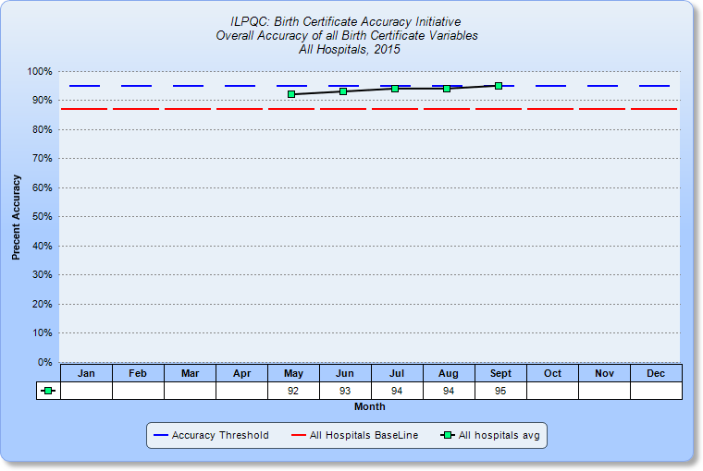
BC Accuracy: Overall Accuracy of All Variables
2014 Baseline = 87.3%

Slide 8
Accuracy Distribution
Patti reached out to provide QI support to teams with <90% accuracy for August and September
% Accuracy | August Teams Reporting | September Teams Reporting
<79.9% | 2 | 2
80-84.9% | 3 | 2
85-89.9% | 7 | 4
90-94.9% | 29 | 16
>95% | 48 | 57

Slide 9
QI Cycle Support Recap
Monthly QI cycle process
  OB Teams webinar on the 4th Monday of each month, 12:30-1:30
  Data reporting via REDCap and QI process feedback reporting via SurveyMonkey
  QI coaching calls with Perinatal Network Administrators and ILPQC as needed
  Meet with your team to discuss data report, QI process feedback form and plan next PDSA

Slide 10
Opportunities for Change
Variables under 95% accuracy & identified on PDSA workshop calls
Variable | Baseline Accuracy | May Accuracy | June Accuracy | July Accuracy | August Accuracy | September Accuracy
Augmentation | 88.7 | 91 | 90 | 94 | 93 | 95
Antibiotics | 86.0 | 90 | 92 | 94 | 93 | 95
Gestation | 88.0 | 91 | 91 | 93 | 93 | 94
Infant Feeding | 83.7 | 87 | 90 | 89 | 89 | 90
SSN | 85.7 | 93 | 91 | 92 | 93 | 95
Prenatal Care | 78.3 | 84 | 85 | 89 | 88 | 90
WIC | 76.0 | 81 | 86 | 87 | 91 | 93
LMP | 81.0 | 83 | 87 | 87 | 91 | 91

Slide 11
OB Teams Call
Birth Certificate optimization initiative
October 26, 2015
Cindy Mitchell
HSHS St. John’s

Slide 12
Variables for Discussion
Fetal Intolerance to Labor
Last Normal Menses
Mom’s Social Security Number
Prenatal Care
WIC
Previous Preterm Birth
NICU Admission

Slide 13
Audience response
Go to respond.cc
Enter the code 784098
Answer the following questions

Slide 14
Fetal Intolerance of Labor
Mom arrives and on exam is found to be 8cm dilated. Monitor shows repetitive late decelerations with minimal variability. Position is changed, oxygen applied, IV fluid bolus done without improvement in fetal status. Pt. moved to OR for c/s delivery. On arrival to OR pt. complains of urge to push and then delivers rapidly in the OR. Should the box for fetal Intolerance of Labor be checked?
a) Yes
b) No

Slide 15
Fetal Intolerance of Labor
Definition: Fetal intolerance of labor refers to an abnormal or concerning fetal heart rate tracing that does not respond to procedures to improve the fetal heart rate tracing and therefore requires an operative vaginal delivery or cesarean delivery in order to shorten time to delivery.
Characteristics of Labor and Delivery
Guidebook #46; pg48
Key Variable Document pg

Slide 16
Date of last normal menses
Mom comes in and delivers with no PNC. When completing the birth certificate mom states that her last period was October last year. How would you answer this variable on the birth certificate?
a) 10/99/2014
b) 99/99/9999

Slide 17
Date of last normal menses
Mom is unsure of the date of her last menstrual period but states she is very regular e​very 4 weeks. Should you use the EDC to calculate it?
a) Yes
b) No

Slide 18
Date of last normal menses
Definition: The date the mother’s last normal menstrual cycle began.
Do not calculate the date of when you think the last menstrual period should have been based off the EDC in the mom’s record
Enter all portions of the date mom does know and for those she is unsure of enter “99”
Example: Mom states her last period was sometime in January 2015 you would enter 01 99 2015
Sources: Prenatal Care Record (1st choice)
Admission H&P
Mom’s report
Date last normal menses began
Guidebook #40; pg 27
Key Variable Document variable #5

Slide 19
Mother’s social security number
Mom provides the last 4 digits of her social security number. Should you enter the portions you know (last 4 digits) and for the digits unknown enter 9’s or should you enter her social security number as 999-99-9999?
a) enter the 4 digits known with the rest as 9’s
b) 999-99-9999

Slide 20
Mother’s social security number
Definition: Enter the mother’s social security number
Enter the mother’s complete 9 digit social security number. Do not enter only the last 4 digits of the complete number.
If mom will not provide or does not have a ss# enter all 9’s.
Guidebook #19; pg 15
Key Variable Document variable #1

Slide 21
Prenatal care
Mom finds out she is pregnant. Schedules an appointment with her doctor’s office. On that visit she sees the nurse and has an initial ultrasound for dating completed. They schedule her to see the CNM in 2 days. Which visit would be counted as the first prenatal care visit?
A) The visit where mom saw the nurse and had an ultrasound for dating
B) The visit two days later when she saw the CNM

Slide 22
Prenatal care
Mom was sent from her doctor’s office today for an induction of labor due to elevated blood pressure. When you go to complete the birth certificate the prenatal record on file has her last visit listed as 9/21/2015. Would you enter 9/21/2015 or 9/28/2015 as the date of her last prenatal care visit?
A) 9/28/2015
B) 9/21/2015
Recommend requesting an updated prenatal record from the providers office documenting the visit that mom had prior to her induction.

Slide 23
Prenatal care
Mom is visiting family in town when she goes into labor. She states she is 36w and she started her prenatal care in February and that she saw her doctor 8 times during her pregnancy. She provides the name of the physician out of state that she saw during her pregnancy. When the office is called they don’t have any records on file for this mom. When completing the birth certificate do you use the 8 visits mom stated she had, mark no prenatal care, or unknown for the variable asking total number of visits recorded
A) 8
B) No Prenatal Care
C) Answer the question as Unknown (99)

Slide 24
Prenatal care
Definition: Date of 1st prenatal care visit.
The date the pregnant woman was first examined and/or counseled by a provider or healthcare professional.
Guidebook #30a; pg 20
Key Variable Document variable #2

Slide 25
Prenatal care
Definition: Date of last prenatal care visit
The month, day, and year of the last prenatal care visit recorded in the prenatal care record.
Do not use a date based on what mom states as her last prenatal care visit
Must have documentation ~ request updated prenatal record and use what is documented in that record
Enter all known portions of the date ~ unknown portions of the date can be entered as 9’s.
Guidebook #30b; pg 21

Slide 26
Prenatal care
Definition: Total number or prenatal care visits
Count only dates (visits) recorded in the prenatal care record
If no prenatal care enter 0 ~ also be sure the box for no prenatal care is checked on 30a.
Guidebook #31; pg 21

Slide 27
WIC
When reviewing the birth certificate worksheet with mom you notice that she has left the question regarding receiving WIC benefits during her pregnancy blank. You ask her again and she says, “I don’t know what that means”. Would you mark yes, no, or unknown for this variable?
A) Yes
B) NO
C) Unknown

Slide 28
WIC
Definition: Did mother get WIC food for herself during this pregnancy?
This should be a question mom answers on the birth certificate worksheet.
Mark yes if she is receiving WIC
Mark no if she is not receiving WIC
Mark unknown if after discussion mom is unsure if she is receiving WIC
Guidebook #35; pg 23
Key Variable Document variable #3

Slide 29
Previous Preterm Birth
Mom’s pregnancy outcomes:
1st pregnancy ~ 39w 4d
2nd pregnancy ~ 38w 0d
Current pregnancy delivers at 36w 6d
All babies did well and were discharged with mom on day 2.
For the current pregnancy would you check previous preterm birth?
Yes
No

Slide 30
Previous Preterm Birth
Mom's history states that she has had 2 prior deliveries. One at 39w 6d, a male infant who did well and went home in 48 hours. The second was a still birth at 32w 4d. This time she delivers at 36w 5d. Would you mark Yes or No on the birth certificate when asked previous preterm birth.
a) Yes
b) No

Slide 31
Previous Preterm Birth
Definition: A history of a previous pregnancy resulting in a LIVE BORN infant delivered prior to 37 completed weeks of gestation.
If mom delivers a live born infant anytime before 37w 0d this variable would be answered yes
If mom delivers a stillbirth before 37w 0d this would be answered no.

Slide 32

NICU Admission
Mom comes into the hospital in active labor at 37w 6d. Delivers without complications. Infant starts to have respiratory issues and is transferred to another hospital for higher level of care. Would you mark NICU admission on the birth certificate?
Yes
No

Slide 33
NICU Admission
Definition: Admission to a facility or unit with staffing and equipment to provide continuous mechanical ventilator support for a newborn.
DO NOT chose NICU admission if the infant was transferred to another hospital because that is a different variable.
Do choose NICU admission, if the infant was admitted to the:
NICU
Special Care Nursery,
Intensive Care Nursery, or
Pediatric Intensive Care in your hospital
Level II+ or III hospital should be the only facilities with a “yes” answer in this box.
Abnormal conditions of the newborn: NICU admission
Guidebook #55; pg 59
Key Variable Document variable #16

Slide 34
NICU Admission

Slide 35

Questions

Slide 36
Team Talks
West Suburban Medical Center
  Robbin Uchison
Edward Hospital
  Pat Bradley

Slide 37
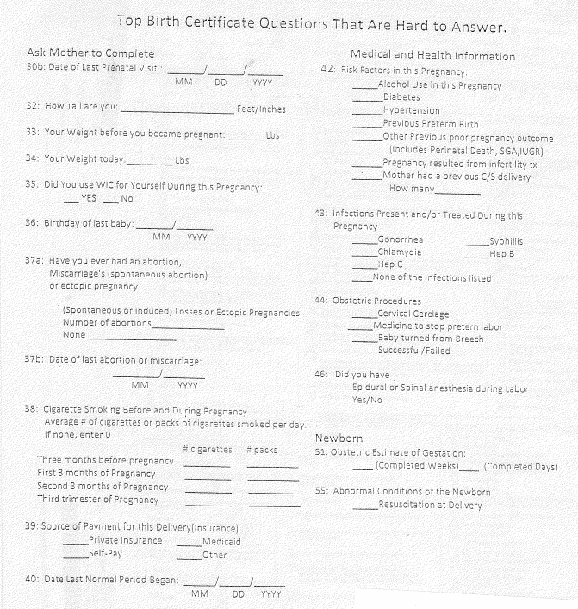

Slide 38
Birth Certificate Accuracy Quality Improvement Project
October 26, 2015

Slide 39


Edward Hospital - Naperville, IL
Opened in 1907 as a tuberculosis sanatorium
Converted to acute-care facility with 45 beds in 1955
Transitioned to regional center of excellence in the 1990s
Merged with Elmhurst Memorial Hospital to form Edward-Elmhurst Healthcare, July 2013

Slide 40

Obstetrics
Facilities:
  16 remodeled LDR’s
  37 remodeled post-partum beds
  3 surgical suites
Volumes:
  3200 deliveries per year
  10% of OB volume is high risk

Slide 41
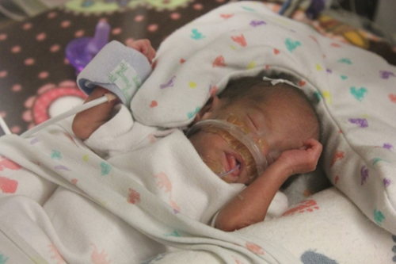
NICU
Facilities:
  22 single room NICU
  12 Level III beds
  23 Level II beds
  Ronald McDonald Family and Sleep Rooms
Volumes:
  Yearly average of 49 < 1500 gram infants
  Over 360 NICU discharges per year
  11% of deliveries are admitted to NICU

Slide 42
Obstetrical Staff
35 Obstetricians
63 Labor and Delivery RN’s
55 Mother Baby RN’s
17 OB Clerical Assistants
10 Lactation Consultants
7 PCT’s
22 OB Techs

Slide 43
Edward Hospital Project Team
Pat Bradley, RNC, BSN – Project Team Leader
Jill Moran, MD – Physician Champion
Diane Fitzpatrick, RNC, BSN – Nurse Champion
Melinda Panzarella, RNC, MSN, MBA – Quality Lead
Elaine Rea – Birth Certificate Representative
Linda Machtan – Birth Certificate Representative

Slide 44
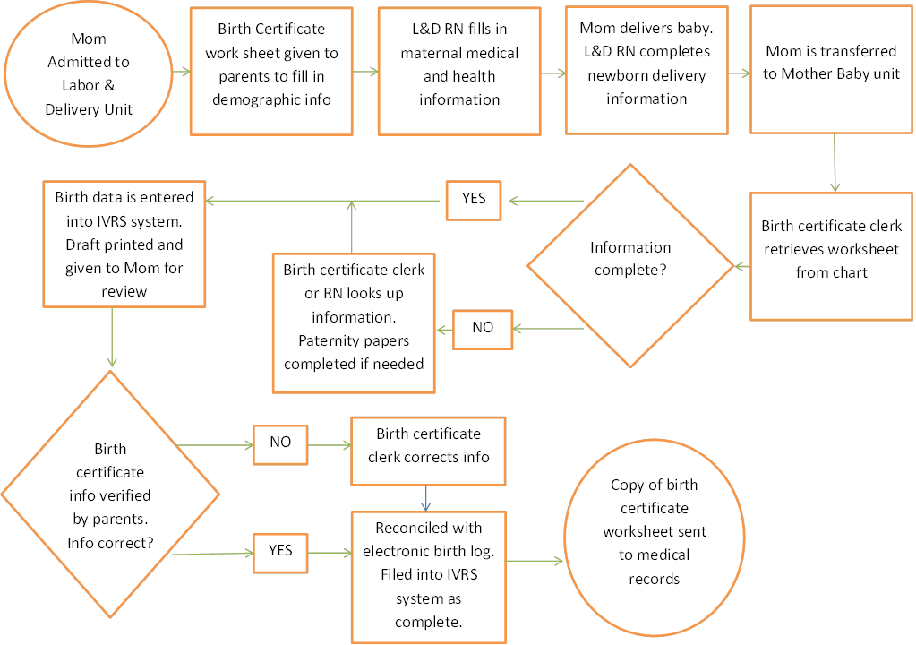
Process Flow Diagram-Initial

Slide 45
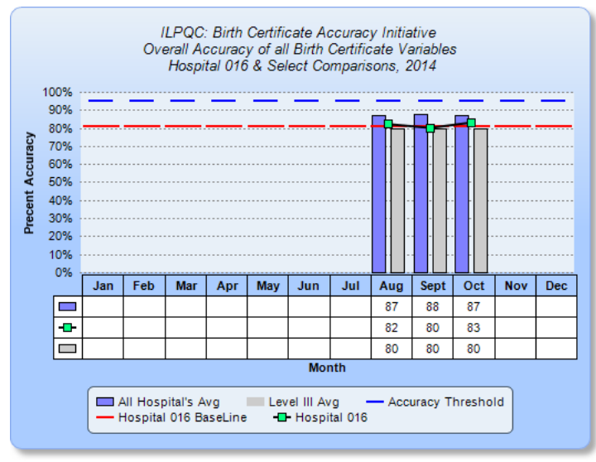
Overall Accuracy for 2014 Baseline Data Revealed at the ILPQC Face To Face

Slide 46
Changes
Education for nurses and birth certificate clerks
  Job responsibility. Who fills in which fields?
  Definitions of fields. What does each field mean?
  Where to look for missing information?
  How do you handle information that is not available or conflicting?

Slide 47
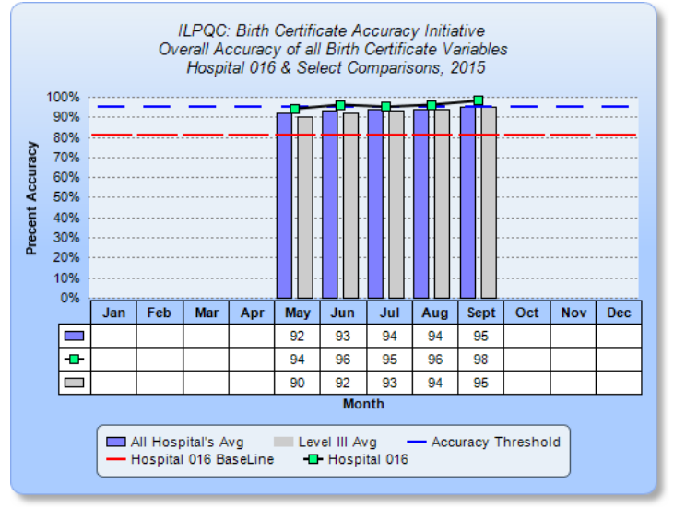
Overall Birth Certificate
Accuracy for 2015

Slide 48
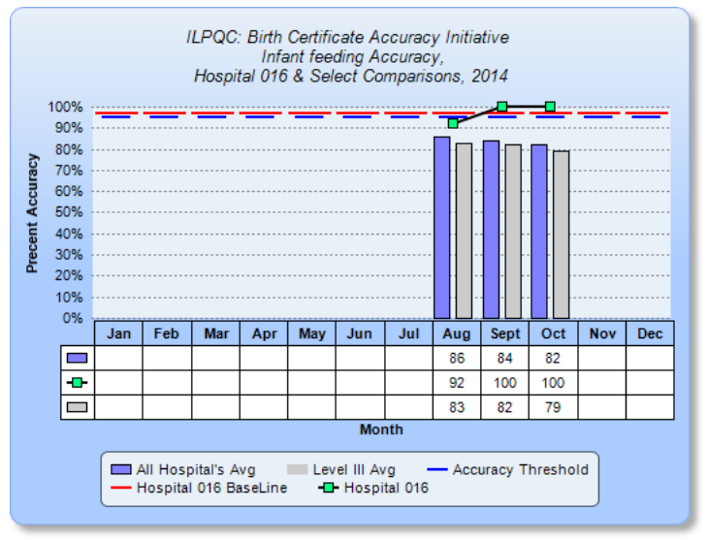
Variable # 17

Slide 49
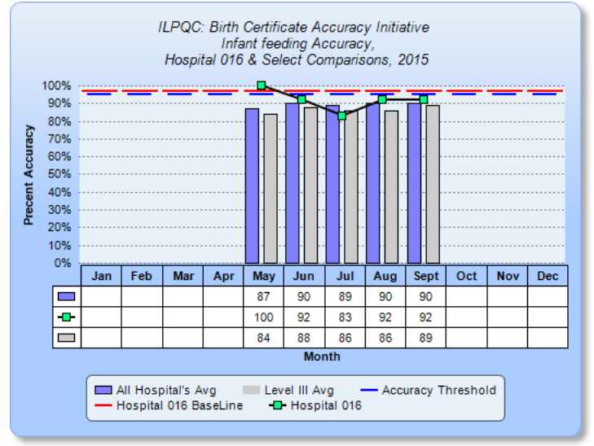
Variable # 17

Slide 50
Variable # 17-Do
How the infant is being fed
Responsibilities for birth certificate worksheet not performed as originally assigned
Data decreased in accuracy each month
Decrease in data all associated with formula fed infants

Slide 51
Quality Improvement Activity-Do
It was discovered for the variable “How the infant is being fed” there was a break in communication on transfer to M/B unit. Formula fed babies were marked as breastfeeding

Slide 52
Process Flow Diagram

Slide 53
Review in Responsibilities-ACT
Reiterate job responsibilities to L&D RN, M/B RN, and OB Clerical Assistants
L&D is to leave newborn information blank
M/B is to complete unanswered questions on birth certificate, after “Head to Toe Assessment”
OB Clerical Assistants re-educated on waiting until completed birth certificate worksheet before entering data into IVRS.

Slide 54
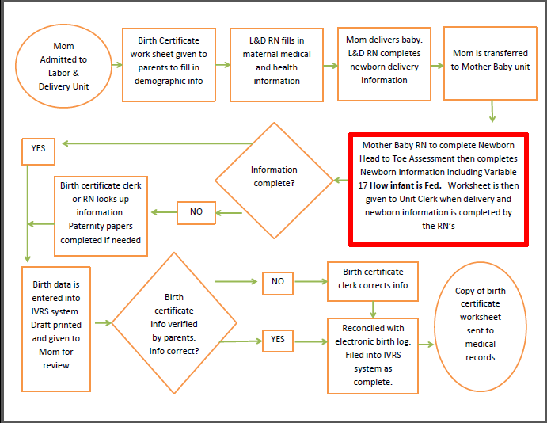
New Process Flow Diagram-Act

Slide 55
Act-Other Activities Planned
Unit Media Campaign Highlighting November Variable # 17 Goals of 95% accuracy or better
Email correspondence
Bulletin Board Visuals of Process and Definitions
Break Room and Staff Washroom Postings
Mid November Progress Report to Staff

Slide 56
Study
Goal to reach 95% Accuracy with November Data
If Goal Met we will continue with new Process Flow
If Goal not Met, Barriers will be identified and process change will take place or individuals will receive council and or reeducation

Slide 57

Dr. Jill Moran – Physician Champion

Slide 58
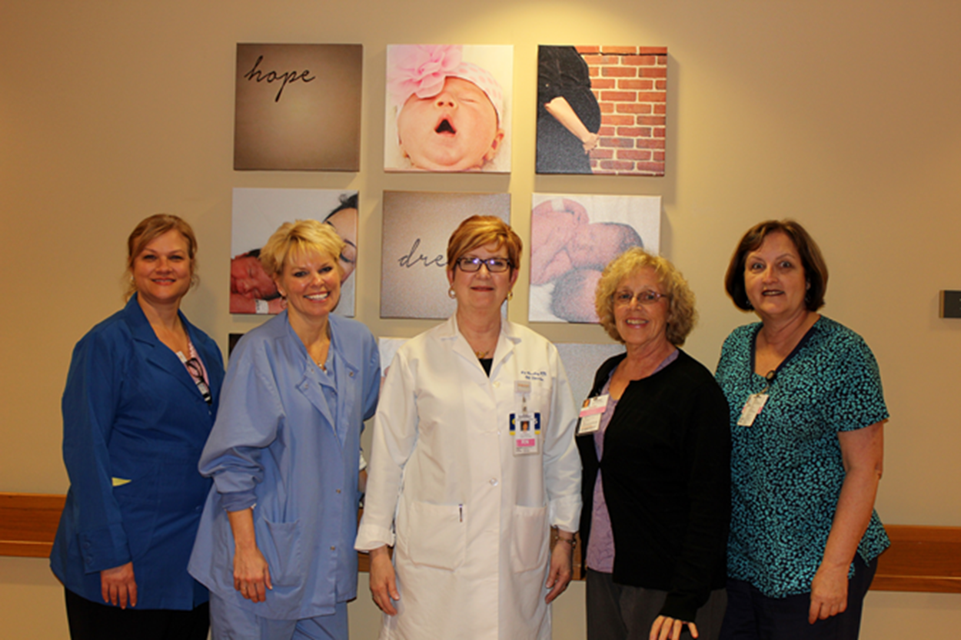
Edward Hospital Team – Questions?

Slide 59
Birth Certificate Accuracy Sustainability
One more OB Teams Meeting focused on Birth Certificate scheduled for December 2015
  Discussion of additional OB teams meeting in January
What does your hospital need to support sustaining these improvements in the future?
  Resources online
  Workgroup
  Please enter your ideas in the chat box or on the phone

Slide 60
ILPQC 3rd Annual Meeting
ILPQC 3rd Annual Meeting to be held at UIC Forum on Wednesday, November 18 – register here:
  https://www.eventbrite.com/e/illinois-perinatal-quality-collaborative-3rd-annual-conference-tickets-18436586326
220 registrants as of 10/22 – registration closes 11/6
42 posters submitted as of 10/22
  All abstracts will be accepted so get started on those posters!
Speakers include:
  Sarah Kilpatrick, MD, PhD: Severe Maternal Morbidity: Why Review
  Barb Murphy, MS, RN: Building Sustainable Quality Improvement in the Hospital
  Terry Griffin, MS, APN, NNP-BC: Panel: Family Partnership
  Barb Murphy, MS, RN: Panel: QI Success Stories
  Gautham Suresh, MD: Golden Hour - Improving Stabilization of the High-Risk Neonate after birth
  Bryan Oshiro, MD: Antenatal Corticosteroids - Why are we Still Talking About This?

Slide 61
Vote Today –
Future Initiatives Survey
Survey is live: https://www.surveymonkey.com/r/ZGKDW75
Results will be discussed at annual meeting in OB Breakout Session
Potential initiatives to rank in the survey:
  Maternal morbidity reduction/hypertension (continued work on 2016 initiative)
  Maternal morbidity reduction/hemorrhage (updating the initial statewide initiative, i.e. Hemorrhage 2.0, with new AIM / ACOG toolkits and bundles and protocols)
  Maternal morbidity reduction/Prevention of Venous Thromboembolism
  Antenatal corticosteroids optimization (expanding the Big V initiative)
  Primary cesarean section rate reduction
  Optimal breastfeeding
  Immediate postpartum LARC
  Optimizing Progesterone Therapy for prevention of preterm birth

Slide 62
Town Hall Meeting
Town Hall meeting with Rep. Harris and Senator Steans for their constituents on November 5 from 6-7:30pm
  Prenatal and Neonatal Quality: What Every Family Needs to Know
  Held at Swedish Covenant Hospital
  5 speakers/topics planned – 10 minutes per topic
    Nutrition and weight gain in pregnancy
    Pregnancy warning signs: depression, preterm birth, preeclampsia
    Optimal breastfeeding
    Immunizations
    Patient engagement and improving care with patient and families
  Q&A for 40 minutes

Slide 63





campusCatalyst
campusCATALYST (cC) is a Northwestern undergraduate program that combines experiential learning with a course taught by a leader in the local non-profit community
Class is composed of 25 students who are split into teams of 5, and matched with local non-profit organizations and Kellogg MBA mentors to work on quarter-long consulting engagements
ILPQC was selected as a one of the non-profit sites for the Fall 2015 academic quarter
  5 students working with ILPQC and top PQC’s in the country to develop a business case for perinatal quality collaboratives for potential funders
Jeanne Hou
Stephan Kienzle
Alan Neider
Allison Park
Victoria Yang

Slide 64
Next Steps
Conduct monthly audit for October and enter data into REDCap by November 15
Submit monthly QI process feedback form for October via SurveyMonkey by November 15
Review your reports immediately in REDCap to evaluate your progress towards improved accuracy and identify opportunities for change
Meet with your team to discuss progress, complete QI feedback form and plan next PDSA.
Contact ILPQC or your PNA with any questions

Slide 65
Next OB Teams Meeting
December 7, 12:30-1:30pm
Need 1-2 teams to sign up for “Team Talks” for December meeting
Remember to register for the www.ilpqc.org
ILPQC website member’s only section
Send your Process Flow Diagram and PDSA worksheets to info@ilpqc.org to share with other teams in the ILPQC members section.

Slide 66

ILPQC Administrative Team
Ann Borders
ILPQC Executive Director, OB Lead
Aki Noguchi and Pat Ittmann
Neonatal Leads
Patricia Lee King
State Project Director
Kate Finnegan
Project Coordinator
Email us at info@ilpqc.org
Website: www.ilpqc.org

Slide 67


