Slide 1

Maternal Hypertension Initiative:
Wave 1 Teams Call
March 28, 2016
12:30 – 1:30 pm

Slide 2
Overview
Wave 1
  Goals for Wave 1
  Wave 1 Data Status
  Wave 1 Survey
Recap: Lessons Learned from CMQCC HTN Initiative & Data Collection
Lessons Learned from PQCNC Conservative Management of Preeclampsia Initiative
  Arthur Olenndorff - Mission Health and PQCNC, Asheville, NC
  Mary Cascio - Mission Health, Asheville, NC
  DeeDee Plummer - Huntersville Medical Center, Huntersville, NC
ILPQC Team Talk
  Lorna Kaitei, RN,BSN,IBCLC – St. Bernard Hospital
Next Steps

Slide 3
Wave 1 – Goals (Jan-April)
Test implementation of data form at your hospital and collect baseline data
Share successes, challenges, and barriers with other Wave 1 hospitals via Team Talks
Learn from CA and NC teams successful strategies for data collection
Identify your hospital’s current process flow for managing patients with severe HTN across units
Provide feedback to improve data collection forms/process and share strategies with Wave 2

Slide 4
Steps for Data Form
Implementation
Implement the Severe HTN Data Form at the bedside for all women who have been identified with new onset severe HTN
Use chart review to collect discharge and outcome data on all women identified with new onset severe HTN
Use your EMR to identify all patients with new onset severe HTN to insure you’ve captured all cases through the bedside implementation of the Severe HTN Data Form, can use chart review to collect data on missed patients.
Enter data in REDCap by the 15th of the month for the previous month (i.e. April 15th for March data)

Slide 5
REDCap Tips for Data Entry
Clean data entry essential for report viewing (coming soon!)
Be sure to use your secure three digit ILPQC assigned Hospital ID (001-120) including any leading zeros
Questions on dates on data form:
  1st Date: date of initial maternal hypertensive event
  2nd Date: date of maternal adverse outcome
    1st and 2nd dates may be the same – hypertensive event and maternal outcome determined on the same day
    1st and 2nd dates may be different - hypertensive event and maternal outcome determined on the different days

Slide 6
Wave 1 – Data Entry Status
 | Total Records | # Teams with Data
January | 19 | 5
February | 39 | 11
March | 25 | 7
Overall | 83 | 11

Slide 7
Maternal HTN:
Time to Treatment

Slide 8
Maternal HTN:
Maternal Outcomes
*OB Hemorrhage with transfusion of ≥ 4 units, Intracranial Hemorrhage or Ischemic event,
Pulmonary Edema, ICU admission, HELLP Syndrome , Oliguria, Eclampsia, DIC, Renal failure,
Liver failure, Ventilation, Placental Abruption

Slide 9
Wave 1 Survey
Survey to collect feedback from Wave 1 hospitals, including:
  Team building and engagement
  Data form implementation status and feedback
  Evaluation of process flow across units
  Identification of opportunities for improvement
Please complete the survey by Friday, April 15th
https://www.surveymonkey.com/r/HTNwave1survey

Slide 10
Lessons Learned: CMQCC
Data collection strategies:
  Bedside data collection
  EMR keyword searches
  ICD-10 codes
  Delivery logs
  Pharmacy records
  Dashboards
  Charge RN binder, stickers
Process flow of identification & treatment of new onset severe HTN across different units

Slide 11
PQCNC: Lessons Learned
Arthur Olenndorff
  Mission Health, Asheville, NC
Mary Cascio
  Mission Health, Asheville, NC
DeeDee Plummer
  Huntersville Medical Center, Huntersville, NC

Slide 12

Hypertension in Pregnancy QI: The North Carolina Experience
ILPQC Monthly Call
March 28, 2016

Slide 13
Outline
Overview of Conservative Management of Preeclampsia (CMOP)
  Outcomes
  Preliminary data
Hospital Experience with data collection and team development
  Novant-Huntersville
  Mission Hospital
Questions and Answers

Slide 14
Conservative Management of Preeclampsia (CMOP)
Aims to create and strengthen a multidisciplinary hospital-based community focused on providing a standardized approach to the diagnosis and management of patients with hypertension in pregnancy in North Carolina
This will be achieved with a focus on
  Patient and family engagement
  Proper diagnosis of hypertension in pregnancy
  Proper management of preeclampsia and gestational hypertension
  Proper post-partum education and follow-up

Slide 15
CMOP: Pilot Phase and Phase 1
Pilot Phase
Phase 1
Feb 1 – Dec 31, 2014
21 participating sites
45% of NC deliveries
Did not include chronic HTN diagnosis
Focused on proper diagnosis and timing of delivery
March 1 – Dec 31, 2015
23 participating sites
47% of NC deliveries
Includes chronic HTN diagnoses
Focusing on timing of delivery and time to treatment of severe range BP

Slide 16
CMOP Phase 1 Interim Data (Unvalidated)
(3/1/15-12/31/15)
45,406 total deliveries at 21 actively particpating sites
6280 with any HTN diagnosis (13.8% HTN rate)
    2442 Cesarean deliveries (39% Cesarean Rate)
    1603 delivered < 37 weeks (26% PTD rate)
    108 potentially unindicated preterm deliveries
      52 delivered for gestational hypertension
      56 delivered for preeclampsia without severe features

Slide 17
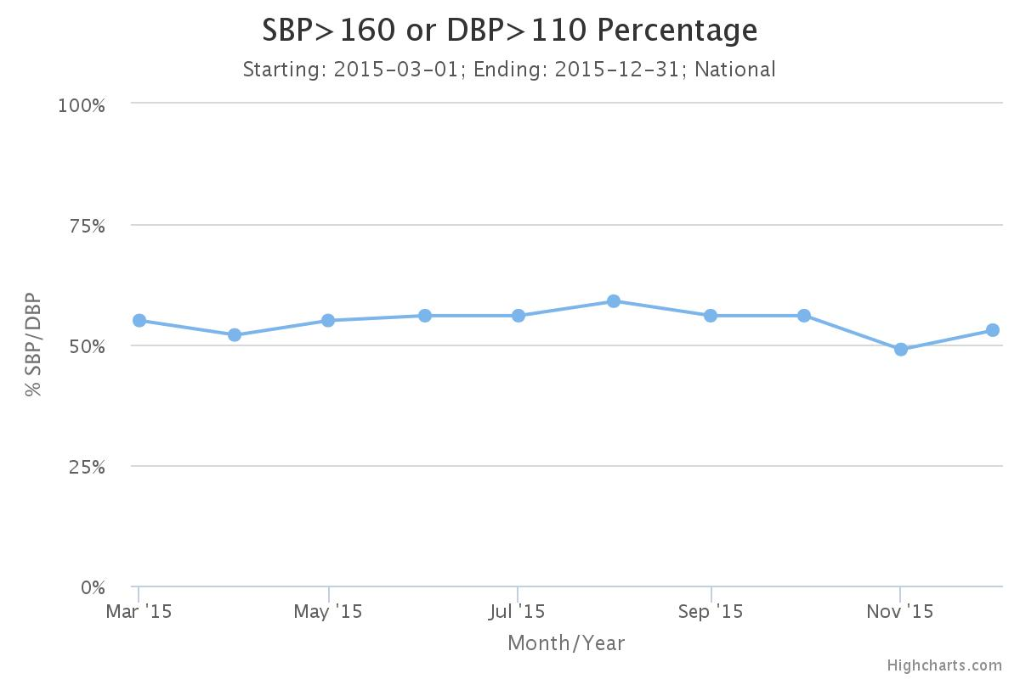

Slide 18
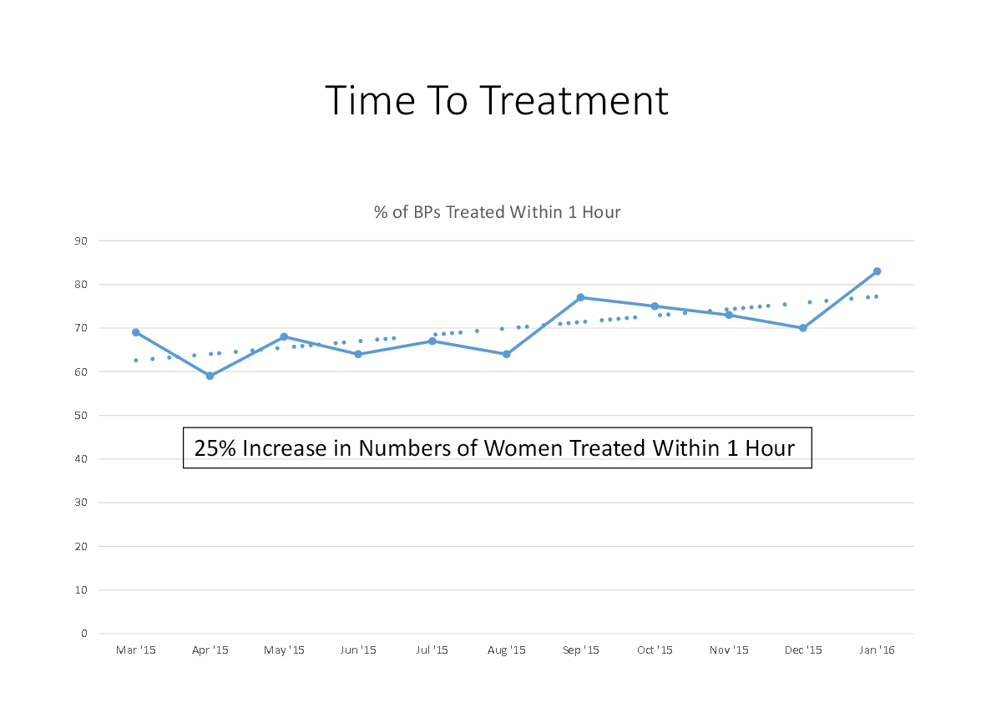

Slide 19
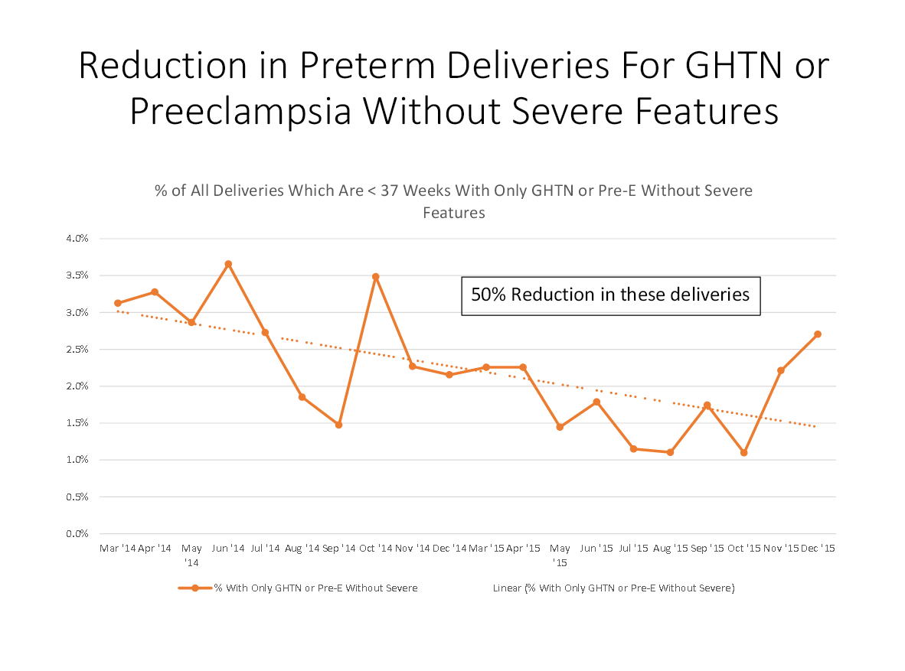

Slide 20
CMOP Impact
Enrolled 11,163 mothers with hypertensive disorder of pregnancy
Rate of hypertensive disorders in NC mothers is high: 14%
  National rate is 4-7%
Avoided estimated 96 preterm births (<37 weeks) based on 50% reduction in birth rates for < 37 week mothers
No increase in NICU admits or mortality
Assuming majority of these babies 32-36 weeks, estimate cost savings of $1.4M in initial NICU costs
Analyzing data for maternal ICU admits avoided

Slide 21
CMOP Phase 2
Kicked-off on February 10, 2016
Action plan broken down into 4-5 months long focus areas
  February-May: Beside Engagement
  May-September: Antenatal Steroids/Magnesium
  September-January: Discharge Education
Data collection decreased
  “Full” data on preterm deliveries
  Limited data set on term deliveries with severe range BP

Slide 22



Our CMOP Team
Team Members | Novant Health Huntersville Medical Center Lauren Riggins, MD Champion Barbara Metzelaars, CNM Champion Grace Murray, Patient Champion Amy Long, Nurse Manager Carol Mayernik, RN Champion Kim Bishop, RN Champion DeeDee Plummer, Team Lead
Counties Served | Mecklenburg Iredell Cabarrus Lincoln
Deliveries per Year | 1,420 deliveries per year
Staff Size | 9 physicians 5 midwives 35 nurses

Slide 23
In the beginning…
Barriers to Success
  Old terminology in EMR
  Provider management inconsistencies
  Blood pressure measurement practices
  Timely recognition of severe range BPs
  Insufficient understanding of acuity
  Implementation of order sets

Slide 24
Data Collection Process
Electronic Birth Log
100% of patients with any hypertensive disorder of pregnancy
Retrospective chart audits
Compare supporting documentation with diagnosis for accuracy/consistency
Evaluate time to treatment and control (TTTC)
Identify barriers with TTTC compliance

Slide 25
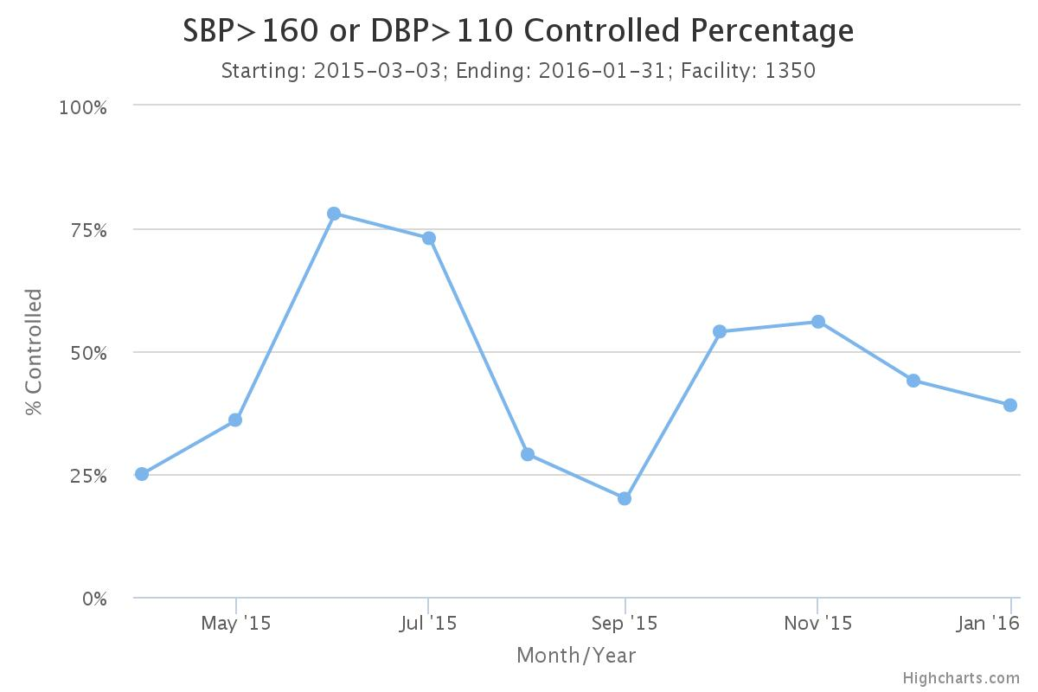

Slide 26
Take Away
Assumptions
Dissemination
Bedside engagement
Turning data into knowledge

Slide 27

Our CMOP Team
Team Members | Arthur Ollendorff, Physician Champion Mary Cascio, Team Lead Joni Lisenbee, Team Member CJ Smart, System Educator |  | Martha Hill, Data Collection Chelsea Weidner, Data Collection Christine Conrad, Team Educator Melissa Woodbury, Team Educator
Counties Served | Avery Buncombe Burke Cherokee Clay Graham Haywood Henderson | Jackson Macon Madison McDowell Mitchell | Polk Rutherford Swain | Transylvania Watauga Yancy
Deliveries per Year | 4091
Staff Size | 40+ Physicians 9+ CNMs 200+ RNs and CNAs
Notes:
The content of this slide is designed to provide a high level overview of your CMOP improvement team. Please share the names of your team members and their roles (e.g., Marty McCaffrey, Physician Champion), list the counties you serve, number of deliveries per year and your staff size. When you submit your storyboard, please provide the following:
A picture of your logo (with your hospital name) as an attachment when submitting your template so that we may include it in the upper left hand corner of each slide (you may also embed the logo in that location of the slides themselves, if that is preferred).
Please also move the star image on the slide over the location on the North Carolina map where your facility is located.

Slide 28
Our CMOP Journey
Outcomes
Improved Management
Improved Patient Engagement
Improved Discharge
Intervention 1
Staff education and patient engagement for accurate use of BP cuff to enhance continuity of care between units.
Intervention 2
Medications readily available on all OB units due to standardized orders and treatment plans for hypertension.
Intervention 3
Patient education developed and easily available for staff to implement with patients antepartum, intrapartum, and postpartum.
Notes:
How was the issue addressed or need met (from previous slide) as a result of your participation in the CMOP initiative? Using the Action Plan, identify “interventions” or “changes” you have made in practice that go beyond the care previously provided in your care setting.
If you are having trouble deciding what to share, select the changes you are most proud of or that make your unit unique.
What is the result or impact of the changes you have made? Use the “Outcomes” box to describe how the specific interventions described have changed care. The outcomes listed are just examples – feel free to add or delete, based on the specific work you’re sharing.

Slide 29
Data Collection Process
Capturing Patients with HTN
  Delivery log
  Diagnoses codes
  Monitoring severe range BP regardless of diagnosis
Assuring proper diagnosis is used
  MFMU Nurse Manager and Clinical Ladder RN review charts
  Asks physician champion if diagnosis unclear or provider coaching needed
Analytics for severe hypertension

Slide 30
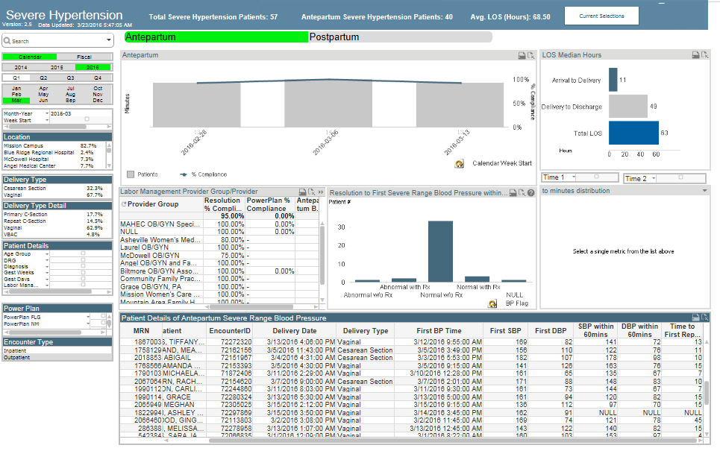

Slide 31
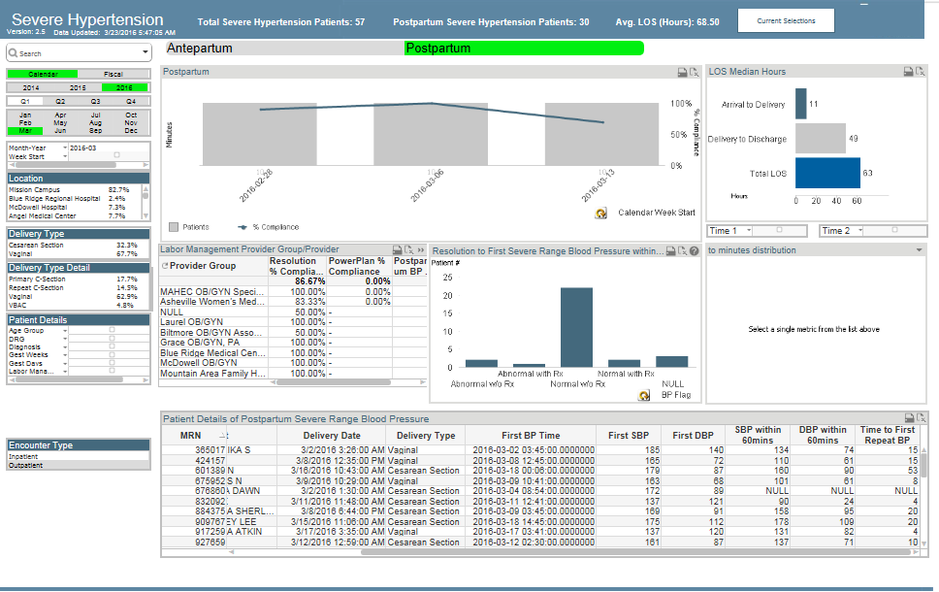

Slide 32
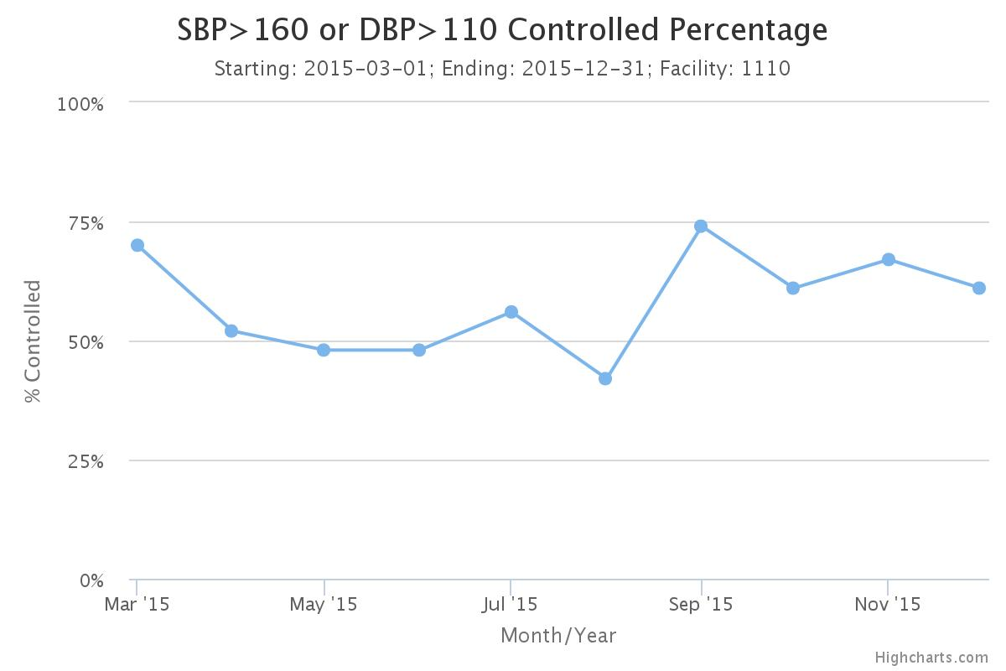
Our CMOP Journey
  “This time I knew what to look for. I took my blood pressure twice a day and knew how quickly things can get worse. When my blood pressure was around 150/90 I called the doctor immediately and we discussed options.”
Total Patients in CMOP: 614
Total Deliveries: 3533
A.S., Patient Advisor
  “Since the hypertension initiatives, I feel patient care is more universal, i.e. different physician groups are now using the same standards for diagnosis and treatment of OB hypertensive symptoms. This is less confusing for nurses and means better care for patients ”
Cindy, RN MFMU
Notes:
This slide should include qualitative and quantitative data to support slide 4. The data should answer the question: How do you know that the changes are resulting in improvement?
In the box on the top right, include the total # of charts you have entered over phase 1, as well as the total # of deliveries for your facility for that same period of time. Include at least one run chart from Delphi for an outcome of your choosing (e.g., TTC), just make sure it is relevant to the changes you have described. Also include 1 quote from a patient and 1 quote from a staff member related to your successes or areas you are working on.

Slide 33
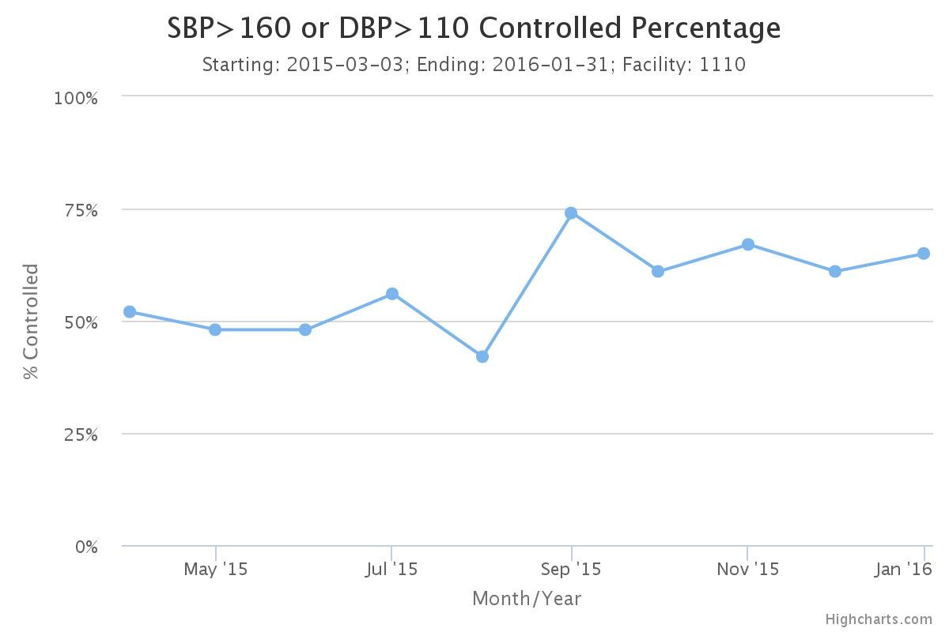

Slide 34


Slide 35
Team Talk
Lorna Kaitei, RN,BSN,IBCLC – St. Bernard Hospital

Slide 36
Team Talks – HTN Initiative
Teams assigned an OB Teams Call – look for email from Kate
  April
    Advocate South Suburban
    Elmhurst
  June
    NorthShore Evanston
    Loyola
  July
    Northwest Community
    Memorial Hospital of Carbondale
  August
    St. Anthony Hospital
    HSHS St. Elizabeth
  September
    Advocate Sherman
    Norwegian American
  October
    St. John’s
    Silver Cross
Generate discussion and learning through sharing
  Good foundation for storyboard/poster presentations!
Present 5-10 mins. on current QI work, including:
  How are you implementing the data form?
  What are your challenges and successes?
  How are you developing your process flow?
  Share your process flow diagrams

Slide 37
ABOG MOC Credits
The ABOG MOC standards now allow participation in ABOG-approved Quality Improvement Projects to meet the annual Improvement in Medical Practice (Part IV) MOC requirement.
ILPQC Maternal HTN Quality Improvement Initiative has been approved to meet ABOG Part IV Improvement in Medical Practice requirements for 2016 and 2017.
For further information, review the 2015 MOC Bulletin at http://www.abog.org/bulletins/MOC2016.pdf.

Slide 38
Process to Receive ABOG
MOC Credits
Physician Diplomates interested in applying their work on this initiative to their ABOG dashboard submit a letter to IPQC via info@ilpqc.org describing their participation in the initiative along with a letter from their quality improvement team lead, if a different person
ILPQC submits list of all physician diplomats who actively participated in the initiative to ABOG at end of the QI initiative
ABOG adds activity to physicians Diplomates’ personal dashboard in the “Open” section of IMP Activites
Within one month from the time of the QI initiative completion, ABOG will send the participating Diplomates an email requesting the Diplomate to complete and submit a short set of questions about his / her practice patterns after participating in this QI activity
Once the Diplomate completes and submits these questions, the activity moves from the “Open” section of IMP Activities to the “Completed” section of IMP activities and that will complete their Part IV requirement for year.

Slide 39
Wave 2 Recruitment
Currently recruiting teams for Wave 2!
  8 team rosters received as of 3/25
  Roster link:
  https://www.surveymonkey.com/r/HTNroster
  REDCap access form:
  https://docs.google.com/forms/d/16F_lITLmDvesqhvwaq6bQxlC17nHGmMchav1-feAsMo/viewform?c=0&w=
  Rosters and REDCap access forms due by 4/15
Please share with your networks!

Slide 40
Wave 1 Recap and Next Steps
Goals of Wave 1
  Test implementation of data form
  Provide feedback on data collection process
  Give team talks on successes, challenges, and barriers
  Begin working on and sharing process flow
  Learn from CA and NC teams on implementation of data collection tools
Continue baseline data collection/ implementing data form and entering data into REDCap to provide feedback on April Teams Call!
Complete Wave 1 survey by April 15
Remaining Wave 1 Team Calls
  Monday, April 25, 12:30 – 1:30 pm
2-hour implementation launch webinar May 2, 12:30 – 2:30 pm
Save the Date: Face-to-Face Collaborative Learning Session on May 23 from 9:45 am – 3:30 pm at Dove Conference Center at St. John’s in Springfield

