Slide 1
OB Teams Call
Birth Certificate optimization initiative
June 22, 2015
Cindy Mitchell

Slide 2
Variables for Discussion
Previous Preterm Birth
Fetal Intolerance to labor
Gestational Age

Slide 3

Audience response
Go to respond.cc
Enter the code 98001
Answer the following questions

Slide 4
Previous Preterm Birth
Mom’s pregnancy outcomes:
1st pregnancy ~ 39w 4d
2nd pregnancy ~ 38w 0d
Current pregnancy delivers at 36w 6d
All babies did well and were discharged with mom on day 2.
For the current pregnancy would you check previous preterm birth?
Yes
No
NO ~ the two deliveries prior to this current delivery were all term

Slide 5
Previous Preterm Birth
Same mom from last question. She delivers her next baby at 34w 2d.
Would you mark previous preterm birth on the birth certificate of baby #4?
Yes
No
Yes ~ the delivery prior to this one was at 36w 6d

Slide 6
Previous Preterm Birth
Mom's history states that she has had 3 prior deliveries. She delivered her first baby at 39w 6d, a male infant who did well and went home in 48 hours. The second was a still born male at 32w 4d. Her current pregnancy is a twin gestation that delivered at 19w 4 d. Twin A had no signs of life and Twin B was born with a heartbeat for 2 min .
Would Twin A and/or B need a birth certificate completed.
Twin A
Twin B
Both
Neither
Twin B
If you generate a birth certificate for either twin in the previous question would you check previous preterm birth on the birth certificate(s)?
N/A Neither twin would have a birth certificate
Yes
No
No ~ the delivery at 32 4d was not born alive

Slide 7
Previous Preterm Birth
Same mom from last question. She delivers her next baby at 34w 2d.
Would you mark previous preterm birth on the birth certificate for this baby?
Yes
No
Yes ~ one of the twins was considered a live born infant prior to 36w 6d

Slide 8
Previous Preterm Birth
Definition: A history of a previous pregnancy resulting in a LIVE BORN infant delivered prior to 37 completed weeks of gestation.
If mom delivers a live born infant anytime before 37w 0d this variable would be answered yes
If mom delivers a stillbirth before 37w 0d this would be answered no.
Risk Factors this Pregnancy
Guidebook #42; pg 31
Key Variable Document variable #7

Slide 9
Fetal Intolerance of Labor
Mom arrives and on exam is found to be 8cm dilated. Monitor shows repetitive late decelerations with minimal variability. Position is changed, oxygen applied, IV fluid bolus done without improvement in fetal status. Pt. moved to OR for c/s delivery. On arrival to OR pt. complains of urge to push and then delivers rapidly in the OR. Should the box for fetal Intolerance of Labor be checked?
A) Yes
B) No
No
Since there was not an operative vaginal delivery or a cesarean delivery this is not to be checked.

Slide 10
Fetal Intolerance of Labor
Mom has been in labor for 6 hours. She has been pushing for the last 2 hours. Baby is vertex at +3 station. Mom is refusing to push any more. Vacuum is applied to assist in delivery of the baby.
Would the fetal intolerance of labor box be checked on the infant’s birth certificate.
Yes
No
No ~ there was no evidence of fetal compromise that necessitated the need for a vacuum delivery

Slide 11
Fetal Intolerance of Labor
Definition: Fetal intolerance of labor refers to an abnormal or concerning fetal heart rate tracing that does not respond to procedures to improve the fetal heart rate tracing and therefore requires an operative vaginal delivery or cesarean delivery in order to shorten time to delivery.
Characteristics of Labor and Delivery
Guidebook #46; pg 48
Key Variable Document variable #12

Slide 12
Obstetric Estimate of Gestation
When looking up gestational age in mom's record you find the gestational age in at least 3 different places. The dates are all slightly different. Which gestational age should be the one recorded on the birth certificate?
EDD that the provider established based on results of early ultrasound and moms known LMP
The LMP that mom is not too sure about
The oldest gestational age
EDD that the provider established based on results of early ultrasound and moms known LMP

Slide 13
Estimated Due Date
The best Estimated Due Date is determined by:
Last menstrual period if confirmed by early ultrasound or no
ultrasound performed, or early ultrasound if no known last
menstrual period or the ultrasound is not consistent with last
menstrual period, or known date of fertilization (eg, assisted
reproductive technology)
Source: reVITALize 2014 ACOG ~ Obstetric Data Definitions

Slide 14
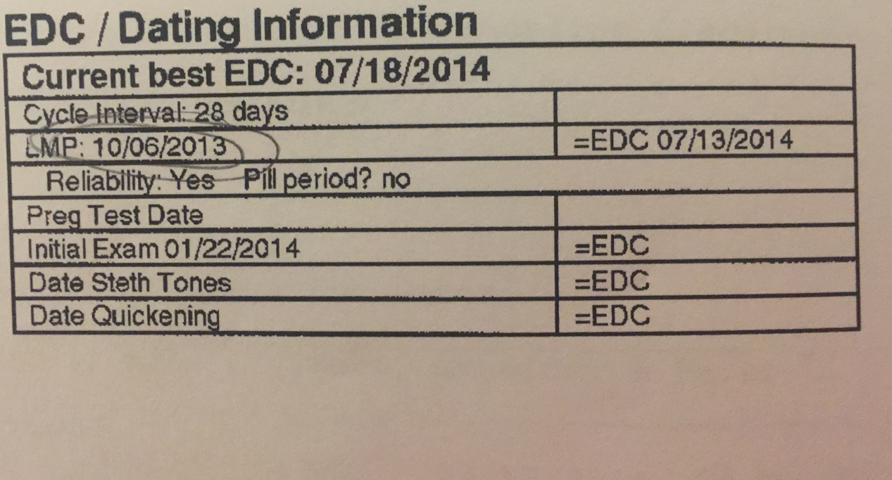
Estimated Due Date

Slide 15
Obstetric estimate of gestation
Definition: The BEST estimate of the infant’s gestation in completed weeks based on the prenatal care providers estimate of gestation.
Obstetric Estimate of Gestation,
Guidebook #51; pg 56
Key Variables document variable #14

Slide 16
Obstetric estimate of gestation
This estimate of gestation should be determined by all perinatal factors and assessments but NOT the neonatal exam.
Ultrasound completed in 1st trimester is preferred
When entering this number; NEVER round up or down
Enter number of weeks and days
If days is not known enter “99”
Goal of this project: the EDD/EDC found in the prenatal record will be the same gestational age the provider uses on the admission note.

Slide 17

Questions

