Slide 1

Maternal Hypertension Initiative:
Wave 1 Kick-off
January 25, 2016
12:30 – 1:30 pm

Slide 2
Overview
Why maternal hypertension?
Maternal hypertension initiative overview
AIM overview
Team building
Overview of data collection process
  Monthly REDCap data form
  Monthly QI Progress Form
  Quarterly, yearly, and outcome AIM data forms

Slide 3
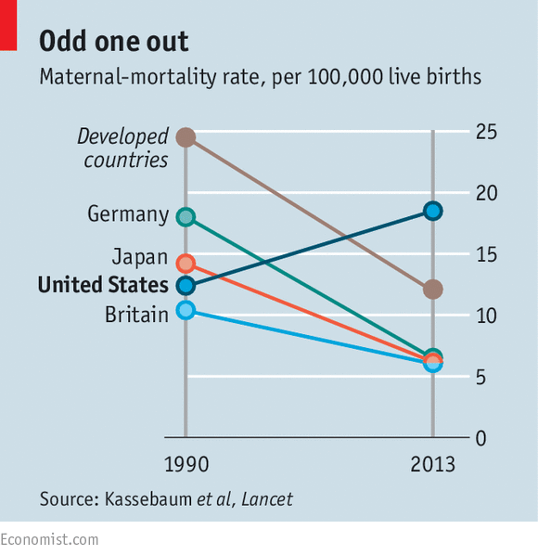
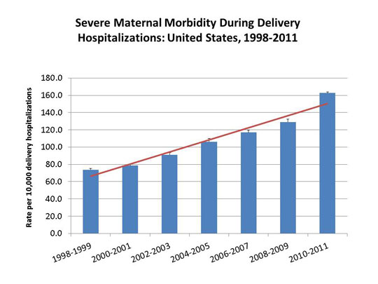
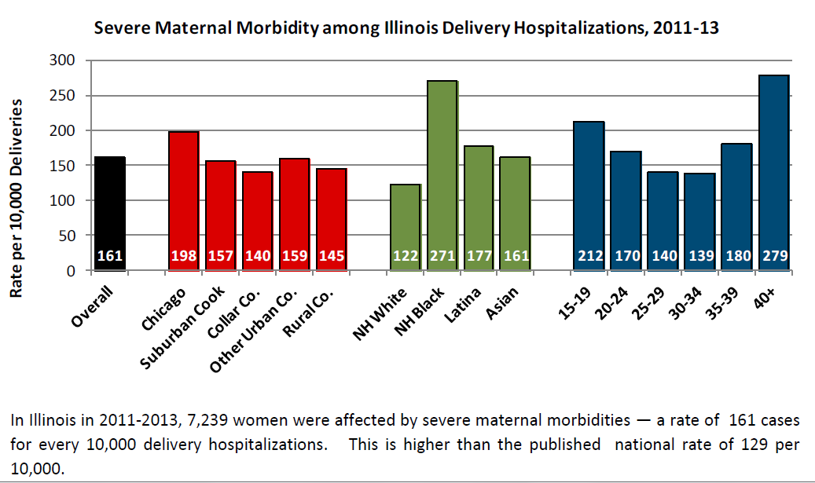
Why Maternal Hypertension?
Maternal morbidity and mortality increasing
Hypertension is a leading cause of maternal and perinatal morbidity and mortality
Pregnancy related hypertension/preeclampsia can escalate rapidly to stroke and seizures
Morbidity and mortality highly preventable through effective identification and timely treatment
National consensus among diverse stakeholders for the need to develop and implement a Severe Hypertension in Pregnancy Patient Safety Bundle to facilitate quality improvement in hospitals nationwide.
http://www.safehealthcareforeverywoman.org/eModules/eModule-Intro/presentation.html
Notes:
Hypertensive disorders in pregnancy are one of the leading causes of maternal and perinatal morbidity and mortality.
Unlike other hypertensive events, pregnancy related hypertension or preeclampsia can escalate rapidly to stroke and seizures.
Morbidity and mortality resulting from severe hypertensive disorders in pregnancy are often highly preventable through effective identification and timely treatment of severe range blood pressure with utilization of effective management strategies across hospital departments serving pregnant and postpartum women.
The American College of Obstetricians and Gynecologists (“ACOG”) and Centers for Disease Control and Prevention (“CDC”) Maternal Mortality/Severe Morbidity Action Meeting of 2012 built consensus among diverse stakeholders for the need to develop and implement a Severe Hypertension in Pregnancy Patient Safety Bundle to facilitate quality improvement in hospitals nationwide.

Slide 4

ILPQC Maternal
Hypertension Initiative
Aim: Reduce the rate of severe morbidities in women with severe preeclampsia, eclampsia, or preeclampsia superimposed on pre-existing hypertension by 20% by December 2017
Approach: Established workgroup (1/2015), identify hospital teams (5/2016), implement evidence-based practices / protocols / AIM HTN Bundle (6/2016-12/2017)
OB Advisory Workgroup and HTN Clinical Leadership Team developed process/outcome measures, toolkit/education, data form and reports
  Input from IDPH SQC / Perinatal Network Administrators / AIM Initiative / CA, NY, and NC collaboratives
  Launch Wave 1 in January 2016, Wave 2 May 2016

Slide 5
Support from Other State
Collaboratives Working on HTN
CMQCC (California Collaborative)
Preeclampsia Initiative
    HTN Clinical Lead Team multiple meetings with CMQCC to leverage their measures, data form, and process
PQCNC (North Carolina)– Conservative
Management of Preeclampsia
    Ongoing work with PQCNC to use lessons learned from their initiative and education plan resources
New York ACOG – Safe Motherhood Initiative
    Ongoing calls to use components of their education plan and quality improvement processes (have 117 hospitals)

Slide 6
Welcome Wave 1 Teams
Advocate Illinois Masonic Hospital
Advocate Sherman Hospital
Advocate South Suburban
Blessing Hospital
Elmhurst Memorial Hospital
Evanston Hospital
Illinois Valley Community Hospital
Ingalls Hospital
Kishwaukee Hospital
Loyola
Memorial Hospital of Carbondale
Northwest Community Hospital
Norwegian American
OSF Saint James – John W. Albrecht Medical Center
Riverside Hospital
Rockford Memorial Hospital
Rush University Medical Center
Silver Cross Hospital
St. Anthony Hospital- Chicago
St. Bernard Hospital
St. Elizabeth's Hospital- Belleville
St. John's Hospital
UIC Hospital
West Suburban

Slide 7
Wave 1 – Goals (Jan-April)
Test implementation of data form at your hospital and collect baseline data
Share successes, challenges, and barriers with other Wave 1 hospitals via Team Talks
Learn from CA and NC teams strategies for implementation of data collection tools
Provide feedback to improve data collection forms/process and share strategies with Wave 2
Identify your hospitals current process flow for managing pts with severe HTN, differ by unit

Slide 8
Wave 1 Team Calls
Monday, February 22 from 12:30 – 1:30 pm
Monday, March 28 from 12:30 – 1:30 pm (discuss date)
Monday, April 25 from 12:30 – 1:30 pm
Will hear from CA and NC teams and learn from their experiences with HTN initiatives
We will share with each other data collection challenges and strategies via Team Talks

Slide 9
ILPQC HTN:
Proposed Timeline 2016
 | Activity | 11/15 | 12/15 | 1/16 | 2/16 | 3/16 | 4/16 | 5/16 | 6/16 | 7/16 | 8/16 | 9/16 | 10/16 | 11/16 | 12/16
Wave 1 | Launch initiative at ILPQC annual meeting
 | Wave 1 Teams calls
 | Test data collection process and implementation, collect baseline data
 | Wave 1 feedback
Wave 2 | Enroll Wave 2 teams
 | 2-hour educational webinar for all teams – May 2, 12:30-2:30
 | Face-to-face meeting to launch QI work – May 23, 10am – 3:30
 | Monthly data collection/team calls (June 2016-Dec 2017)

Slide 10
Three types of measures
Outcome Measures – Identify whether changes are leading to improvement and achieving aims
  How is the system performing?
  What is the result?
Process Measures – identify changes to processes of care that can affect outcome measures. Measuring the results of these process changes will tell you if the changes are leading to an improved, safer system
Balancing Measures – identify changes in one part of the system that may result in new problems in other parts of the system.
CMQCC, 2013

Slide 11
HTN Initiative Goal &
Measures
Goal: Reduce preeclampsia maternal morbidity
IL Measure | Type | Goal
Severe Maternal Morbidity No. of women with severe maternal morbidities (e.g. Acute renal failure, ARDS, Pulmonary Edema, Puerperal CNS Disorder such as Seizure, DIC, Ventilation, Abruption) / No. pregnant & postpartum women with new onset severe range HTN | Outcome | 20% reduction
Appropriate Medical Management in under 60 minutes No. of women in each time to treatment interval (<30,30-60,60-90, >90 min) after elevated BP is identified / No. of women with new onset severe range HTN | Process | 100%
Debriefs on all new onset severe range HTN cases | Process | 100%
Preeclampsia education provided prior to discharge | Process | 100%
Appropriately timed follow-up appointment scheduled prior to discharge | Process | 100%

Slide 12
Alliance for Innovation on
Maternal Health (AIM)
ILPQC has been accepted as an AIM mentor state
Hospitals report IL specific variables and AIM variables of interest to ILPQC
ILPQC will be able to compare IL HTN data to all AIM participating states quarterly
AIM resources and materials available to IL hospitals include toolkits, webinars, educational materials and provider / nursing training focused on:
  - Readiness - Recognition
  - Response - Reporting

Slide 13
AIM - Hypertension Measures
Provider education - % completed
Nursing education - % completed
Preeclampsia protocol – yes/no
Preeclampsia EHR integration – yes/no
Unit drill protocols – yes / no
Patient/family support protocols –yes/no
Debrief and multi-disciplinary case review protocols – yes/no
All measures are reported quarterly or upon completion.

Slide 14
AIM Participation
ILPQC hospitals report AIM measures (focused on quality improvement initiative process) quarterly or yearly, into ILPQC REDCap data system
De-identified data shared with AIM to compare IL progress to national data
Data sharing agreements between hospitals and ILPQC to share de-identified data with AIM

Slide 15
Team Building
Your hospital team:
  Physician Lead
  Nurse Lead
  Quality Lead
  Other Team Members if available (ED, Anesthesiology, etc.)
Team activities
  Data form implementation
  Monthly meetings to review data, identify opportunities for improvement and plan quality improvement work
  Develop process flow diagram for different settings at your hospital and discuss opportunities for improvement
  Protocol/policy review
  Debriefs/case reviews

Slide 16
Data Collection Process
Frequency | Form | Content | Timeframe
Monthly | Severe HTN Data Form | Bedside and Chart Review | January 2016
 | QI Process Form 5 items | PDSA cycles | May 2016
Quarterly | AIM Report 3 items %, # | Education Unit Drills | May 2016
Annual | AIM Report 5 items Y/N, dates | EHR Family Support Debriefs Reviews | May 2016
 | Discharge data with IDPH | SMM Rates | May 2016
Our focus now
Details to follow in Wave 2

Slide 17
Severe HTN Data Form:
2 Options
Single data form to be used both at the bedside and for chart abstraction
Separate data forms
  Bedside data form
  Chart abstraction tool
Both options gather the same information
Use whatever works for your hospital team!

Slide 18
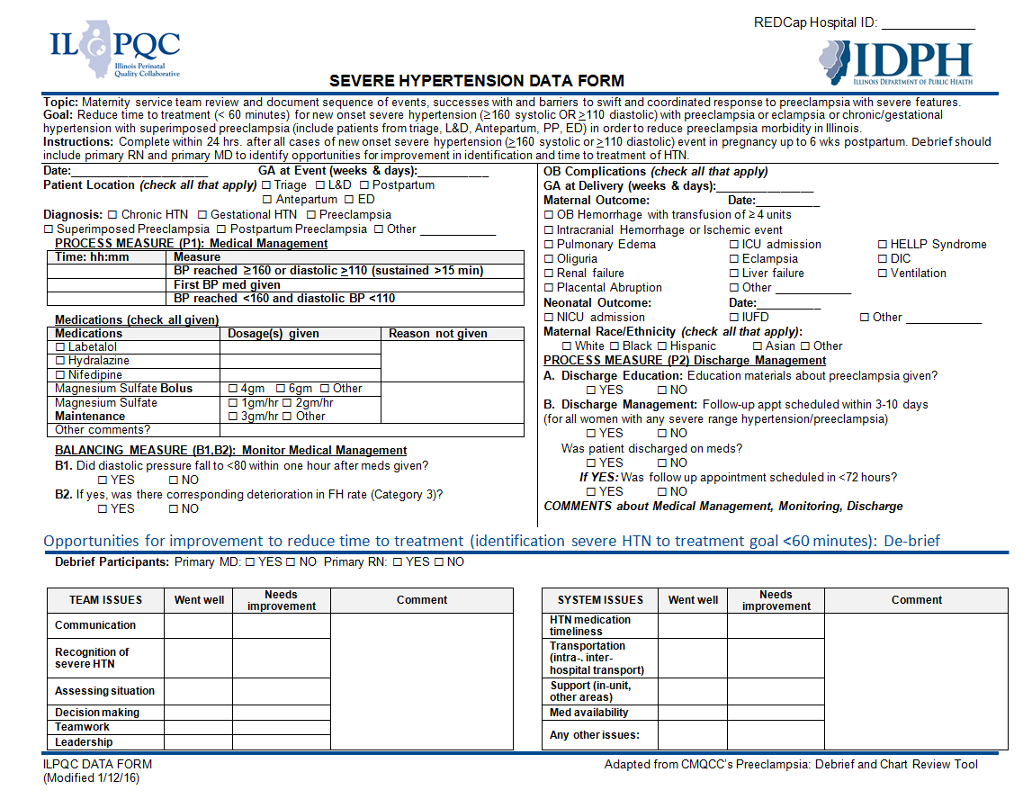
HTN: Draft Data Form
Option 1 – Single Form

Slide 19
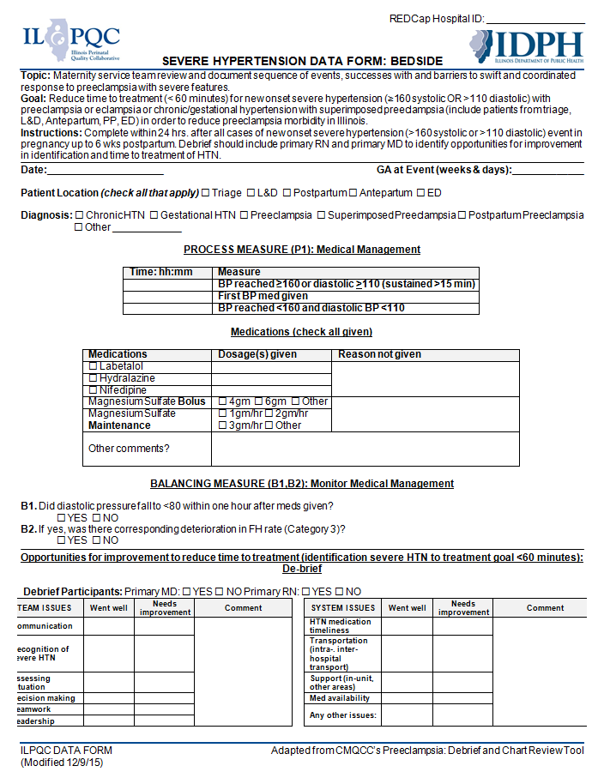
Option 2 – Two Forms
Bedside Form

Slide 20
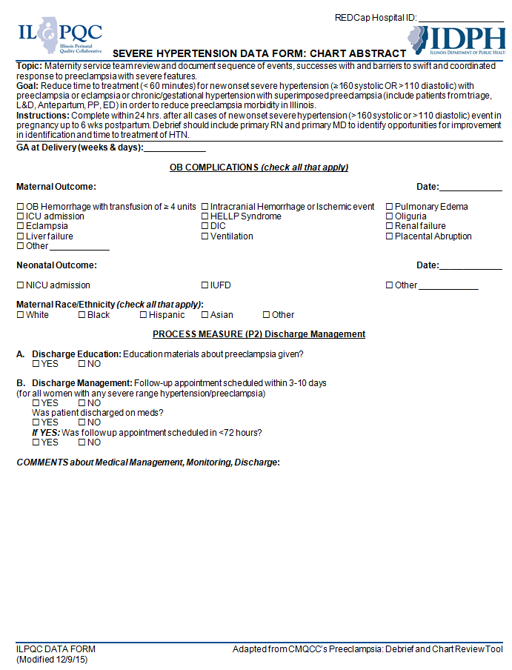
Option 2 – Two Forms
Chart Abstract Form

Slide 21
Live REDCap Demo:
Kate Finnegan
https://redcap.healthlnk.org/
Site navigation
  Log in
  How to find the HTN project
Record entry
  Saving and adding another record
How to edit a record
Troubleshooting - what to do if you forgot user name/password, don’t have access to a project, etc.

Slide 22
HTN Initiative Wave 1/Wave 2:
Education Roll-out
2-hour webinar on May 2 from 12:30 – 2:30
  Why HTN initiative, Data Collection and Entry, Team Building, Educational Resources, Wave 1 Teams Presenting on Process Flow and Data Form Implementation
Face-to-Face Collaborative Learning Session on May 23 from 10:00 am – 3:30 pm at Dove Conference Center at St. John’s in Springfield
  HTN clinical education plan and timeline, BP train the trainer, process flow, QI training, sharing across teams, National Experts and other state HTN initiatives hospital teams share QI experience
Monthly OB Teams Calls (June 2016-December 2017)

Slide 23
HTN Education Plan
Topics for Monthly Calls
  Accurate measurement of blood pressure
  Identification of severe range hypertension
  ACOG new treatment guidelines
  Strategies to reduce time to treatment across settings
  Updates on diagnosis of Preeclampsia
  Conservative management of preeclampsia
  Use of debriefs
  Drills and simulations
  Discharge education and follow up
Resources
  Key Driver Diagram
  CA Toolkit
  ACOG Guidelines
  AIM Bundles and Modules
  Council on Patient Safety Slide Sets and Audio Recordings
  Train the Trainer for BP Measurement

Slide 24
Key Driver Diagram: Maternal Hypertension Initiative
GOAL: To reduce preeclampsia maternal morbidity in Illinois hospitals
Interventions
Key Drivers
Implement standard order sets and/or algorithms for early warning signs, diagnostic criteria, timely triage, monitoring and treatment of severe hypertension
Ensure rapid access to medications used for severe hypertension with guide for administration and dosage
Implement system plan for escalation, obtaining appropriate consultation, and maternal transport
Perform regular simulation drills of severe hypertension protocols with post-drill debriefs
Integrate severe hypertension processes (e.g. order sets, tracking tools) into your EHR
AIM: By December 2017, to reduce the rate of severe morbidities in women with preeclampsia, eclampsia, or preeclampsia superimposed on pre-existing hypertension by 20%
Readiness: Implementation of standard processes for optimal care of severe maternal hypertension in pregnancy
Recognition: Screening and early diagnosis of severe maternal hypertension in pregnancy
Standardize protocol for measurement and assessment of blood pressure and urine protein for all pregnant and postpartum women
Standardize response to early warning signs including listening to and investigating symptoms and assessment of labs
Implement facility-wide standards for patient-centered education of women and their families on signs and symptoms of severe hypertension
Educate OB, ED, and anesthesiology physicians, midwives, and nurses on recognition and diagnosis of severe hypertension that includes utilizing resources such as the AIM hypertension bundle and/or unit standard protocol
Response: Care management for every pregnant or postpartum woman with new onset severe hypertension
Execute facility-wide standard protocols for appropriate medical management in under 60 minutes
Create and ensure understanding of communication and escalation procedures (e.g. implementing a rapid response team through the use of TeamSTEPPS)
Develop OB-specific resources and protocols to support patients, families, staff through major complications
Provide patient-centered discharge education materials on preeclampsia and postpartum preeclampsia
Implement patient protocols to ensure follow-up within 7-10 days for all women with severe hypertension and 72 hours for all women on medications
Reporting/Systems Learning: Foster a culture of safety and improvement for care of women with new onset severe hypertension
Establish a system to perform regular debriefs after all new onset severe hypertension cases
Establish a process in your hospital to perform multidisciplinary systems-level reviews on all severe hypertension cases admitted to ICU
Continuously monitor, disseminate, and discuss your monthly data in ILPQC REDCap system at staff/administrative meetings
Add maternal hypertension assessment and treatment protocols and education to provider and staff orientations, and annual competency assessments

Slide 25
Patient Education Materials
What is it?
Why should you care?
What should you pay attention to?
What should you do if you have any of the signs?
ILPQC has an approximately 1 year per participating hospital supply of tear pads for patient education on preeclampsia from the Preeclampsia Foundation to be distributed in May 2016. Spanish on back.
Notes:
Here is an example of patient education materials from the Preeclampsia Foundation.

Slide 26

Team Talks – HTN Initiative
Teams assigned an OB Teams Call
  Wave 1 teams begin talks in February
  Look for an email from Kate
Present 5-10 mins. on current QI work, including:
  How are you implementing the data form?
  What are your challenges and successes?
  How are you developing your process flow?
  Share your process flow diagrams
Generate discussion and learning through sharing
  Good foundation for storyboard/poster presentations!

Slide 27
Wave 1 Recap and Next Steps
Goals of Wave 1
  Test implementation of data form
  Provide feedback on data collection process
  Give team talks on successes, challenges, and barriers
  Begin working on and sharing process flow
  Learn from CA and NC teams on implementation of data collection tools
Wave 1 Team Calls
  Monday, February 22 from 12:30 – 1:30 pm
  Monday, March 28 from 12:30 – 1:30 pm (discuss date)
  Monday, April 25 from 12:30 – 1:30 pm
2-hour webinar on May 2 from 12:30 – 2:30 pm
Save the Date: Face-to-Face Collaborative Learning Session on May 23 from 10:00 am – 3:30 pm at Dove Conference Center at St. John’s in Springfield

Slide 28

Getting Started Q&A
Ways to ask questions:
  Raise your hand on Adobe Connect to ask your question by phone
  Post a question in the Adobe Connect chat box

