Slide 1

Maternal Hypertension Initiative:
Wave 1 Teams Call
February 22, 2016
12:30 – 1:30 pm

Slide 2
Overview
Goals for Wave 1
Lessons Learned from CMQCC HTN Initiative & Data Collection
  Holly Champagne, MSN, RNC-OB, CNS
    Kaiser Permanente, Roseville, CA
  Connie von Kholer, MSN, RNC-OB, C-EFM, CPHQ
    Miller Children's Hospital, Long Beach, CA
ILPQC Team Talk
  Angela Rodriguez
    Advocate Illinois Masonic Medical Center
Initiative Updates

Slide 3
Wave 1 – Goals (Jan-April)
Test implementation of data form at your hospital and collect baseline data
Share successes, challenges, and barriers with other Wave 1 hospitals via Team Talks
Learn from CA and NC teams successful strategies for data collection
Identify your hospital’s current process flow for managing patients with severe HTN across units
Provide feedback to improve data collection forms/process and share strategies with Wave 2

Slide 4
Steps for Data Form
Implementation
Implement the Severe HTN Data Form at the bedside for all women who have been identified with new onset severe HTN
Use chart review to collect discharge and outcome data on all women identified with new onset severe HTN
Use your EMR to identify all patients with new onset severe HTN to insure you’ve captured all cases through the bedside implementation of the Severe HTN Data Form (ICD-10 codes to be distributed this week via CDC and AIM), can use chart review to collect data on missed patients.

Slide 5
CMQCC Data Form
Implementation
Holly Champagne, MSN, RNC-OB, CNS
  Kaiser Permanente, Roseville, CA
Connie von Kholer, MSN, RNC-OB, C-EFM, CPHQ
  Miller Children's Hospital, Long Beach, CA

Slide 6
Hypertension Initiative Lessons
Kaiser Permanente, Roseville
Holly Champagne, MSN, CNS, RN-C
Labor and Delivery and Mother/baby units

Slide 7
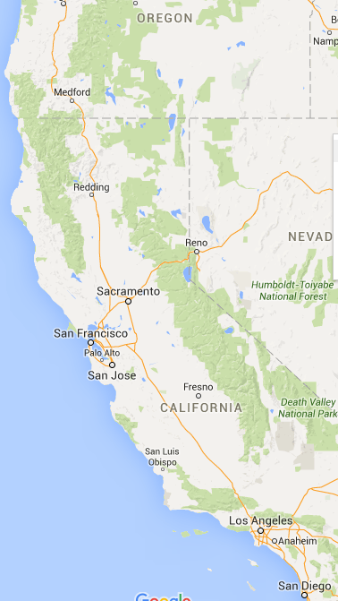
Snapshot
KP Roseville part of No. California system, largest delivery volume
Model- OB providers, CNMs, residents- around the clock
Part of CMQCC collaborative for hemorrhage toolkit
Culture of improvement
? How are we doing?

Slide 8
Data Collection Strategy
Multifaceted
ICD9 codes for all patients with hypertension
Charge RN binder, stickers
Pharmacy reports for IVP hydralazine and labetalol
Board sign out for other patients, readmits
Initial quick audit by mini-team
Results…

Slide 9
Process
Team formation- RNs both unit, MFM, OB,Qualtiy
Walked the process
Work and rework the algorithm
Fifth Agenda

Slide 10
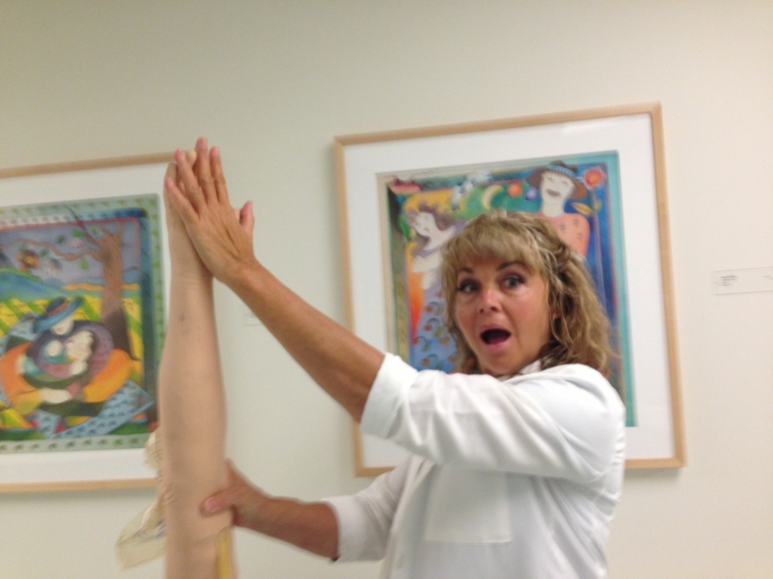
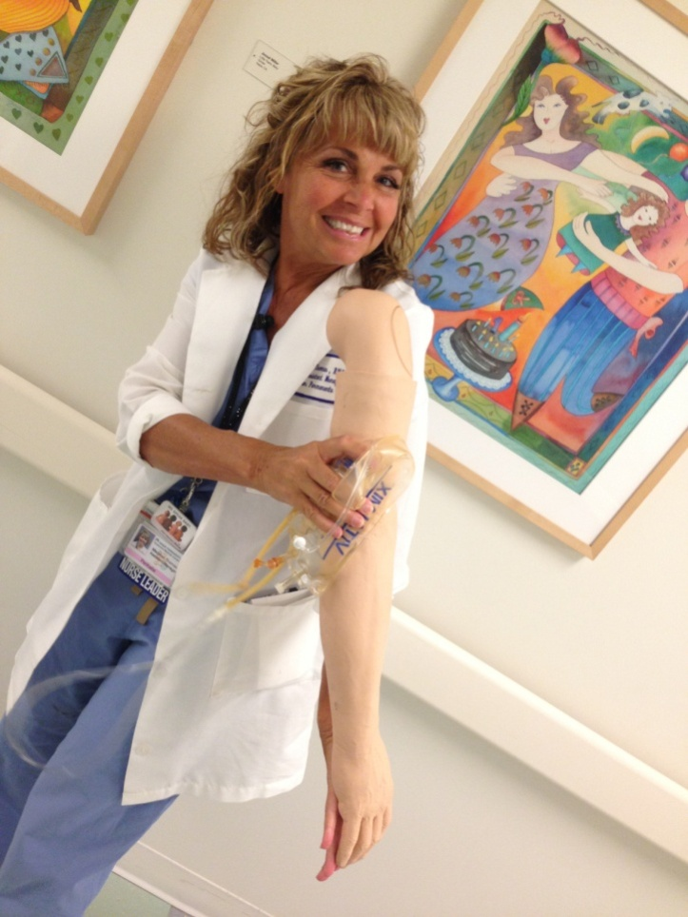
Importance of team

Slide 11
Treatment of Blood Pressure greater than or equal to 160/xx OR xx/110:
Position: semi-fowlers; cuff at level of heart; displace uterus
BP ≥ 160/xx or xx/110?
May recheck with manual cuff* in 10 minutes *(for verification)
Primary RN
Notify OB of BP
Notify Charge RN
yes
Remains
≥ 160/xx or xx/110?
30-60 min timeframe begins
and
Start IV and draw Labs
Recommend IVP med* within 30-60 min of 2nd BP
Monitor BP q 5 min ◊
Monitor EFM
Admit patient
Recommend:
Recheck every
30 minutes.
no
OB Provider
Order IV push labetalol or hydralazine *
Admit patient
*Med Notes:
Labetalol IVP: (q 10min PRN; 300mg max dose)
Peak response within 5 minutes
*Requires continuous pulse oximetry
x 1 hr after each dose.
On M/B unit: contact Mgr re
equip/staff requirements.
Contraindicated: Bronchial Asthma or
Heart Block
Hydralazine IVP:(q 20min PRN; 25mg max dose)
Onset: 5-15 min
Peak response: 10-80 min
Contraindicated: Mitral Valvular
disease
►Be sure to CHECK ORDER for details◄
then
◊ Recommend: Continue BPs
q 5 min. until BPs remain less than 160/xx or xx/110, then may repeat BP measurement
every 10 mins for 1 hour,
then every 15 mins for 1 hour,
then every 30 mins for 1 hour,
and then every hour for 4 hours.
consider
Difficult IV start, > 30-60 mins? Give PO nifedipine 10 mg for first med dose (may repeat q 20min PRN x6).
Does Patient meet criteria for severe preeclampsia? Magnesium Sulfate 4gm loading dose.
Rev 5/28/15

Slide 12
Learning from Long Beach, CA
Connie von Köhler, MSN, RNC-OB, CPHQ
Program Director,
Perinatal Outreach Education Program

Slide 13
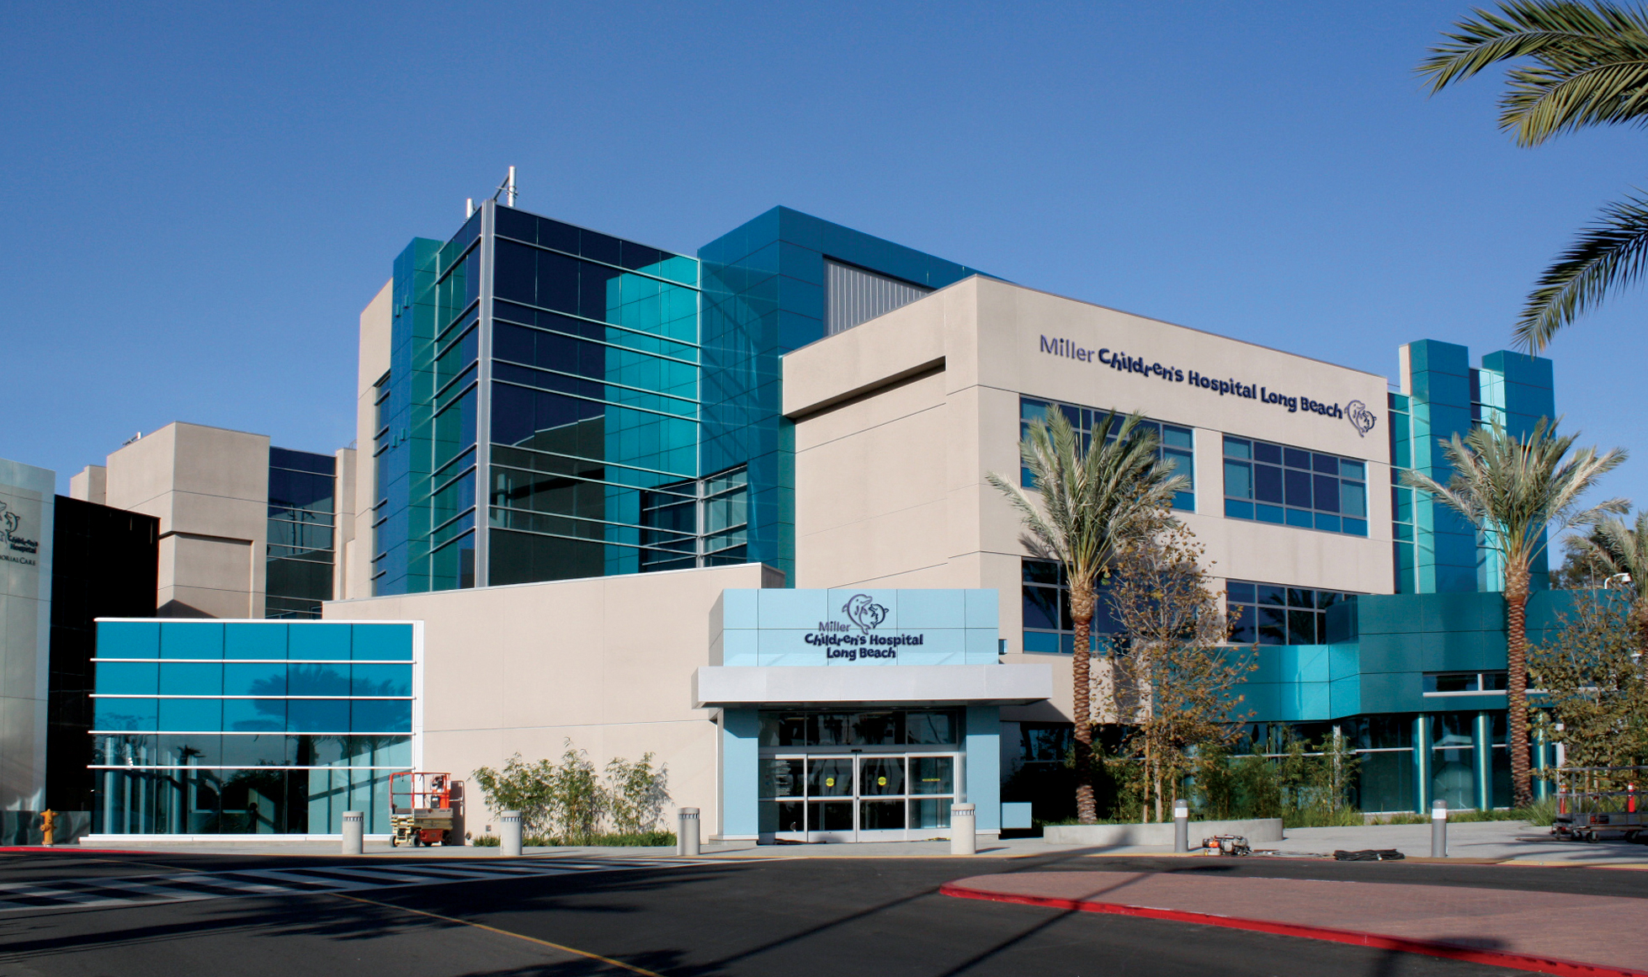

Slide 14
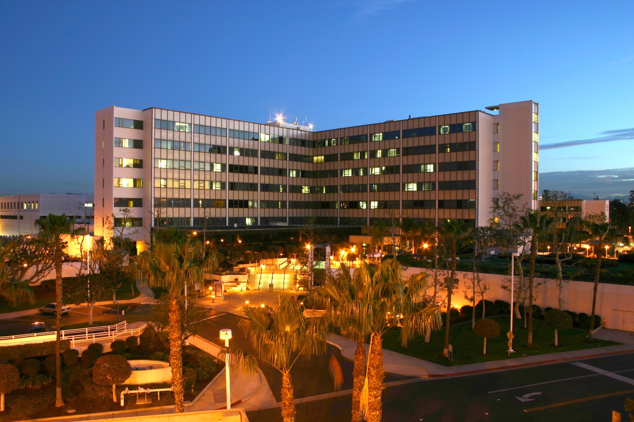

Slide 15
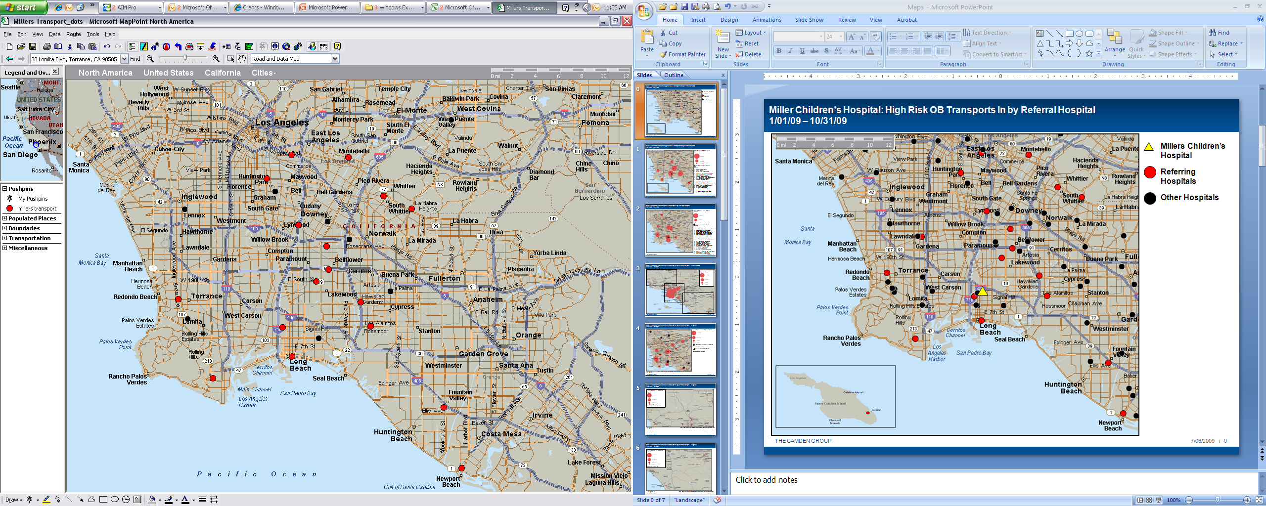
Regional Tertiary Center:
24/7 in-house Perinatology & Neonatology
Teach Service
80 Obstetricians on staff
500 deliveries monthly
107 licensed NICU beds

Slide 16
CMQCC Preeclampsia Collaborative (Feb 2013—Dec 2014)
Collecting Baseline Data
Implementing the Data Form
Process Flow of Identification & Treatment of “acute hypertensive episode”

Slide 17
Collecting Baseline Data
Active Track California Maternal Data Center
  Birth Certificate & ICD-9 hospital discharge data
  Originally sampled data 25 pts from 6 mo.
  Changed to full 6 mo. Pre-collaborative & revised data (full 18 mos.)

Slide 18

Preeclampsia Collaborative
Revision Data Collection:lution:
RSVP = 50%
Attendance = 100%
Who attended: Manager
Educators
Assistant Managers
Staff Nurse
Program Directors
Tuesday Dec.11, 2013
12N - finished! (4 hours)
Women’s Conference Room
Potluck lunch
Notes:
Say:
All with computers
(8 in all)

Slide 19
Process:
Preeclampsia Collaborative Data Collection Month:________________
Patient | MR # | Delivery Date | Time | Discharge Date | Delivery Route (Outcome Measure length of stay calculation) |  | Eclampsia 642.6 | Severe Preeclampsia 642.5 | Preeclampsia Superimposed 642.7 | None of the above | New onset Severe Hypertension | Highest B/P (Prior to Treatment) | Time of B/P triggering Treatment | Time 1st Treatment | Drug of Treatment | Labetalol |  | Hydralazinte |  | Other (state name of drug, dose, how given) | Lowest B/P for first hour after TX | Sudden change in FHR that required intervention? |  | If Yes, did the intervention require emergent delivery? |  | Debriefed
 |  |  |  |  | C/S | Vag |  |  |  |  |  |  |  |  |  | IV | PO | IV | PO |  |  | Yes | No | Yes | No | Yes | No

Slide 20
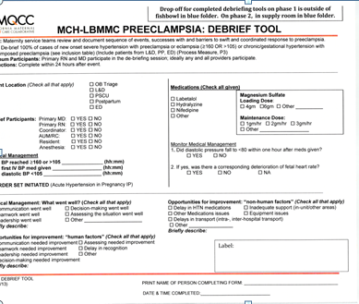
Debriefing Issues
  Staff uncomfortable completing
  Leadership vague on process
  Forms not completed
  Couldn’t find forms
  Submission process unclear

Slide 21

Process:
Notes:
Say:
Women’s Leadership Team hosted a party of appreciation:
Assistant Managers from L&D and Mother/Baby
Introduced one another, shared, little education:

Slide 22

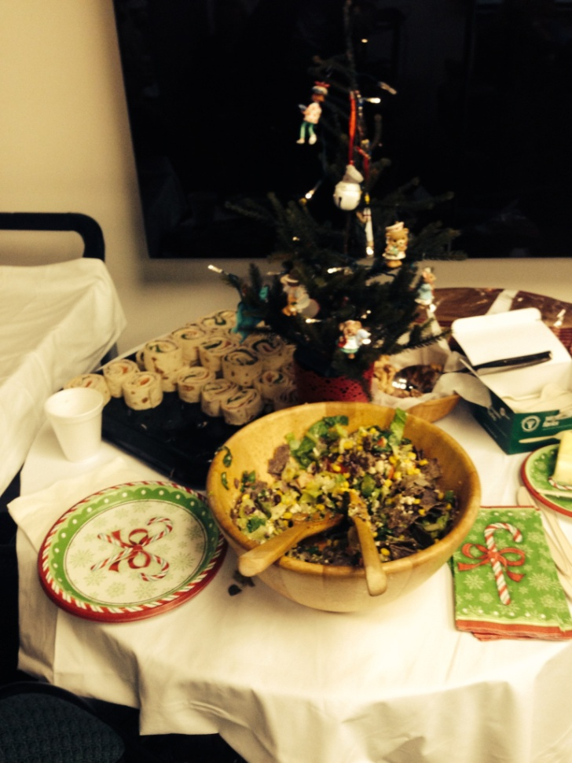
Food & Networking
3 Five Minute Presentations:
Preeclampsia Collaborative
Results of the Educational Module
Value & Ease of Debriefing
THEN:
30 minutes case based exercise
Notes:
Say:
(as a group)
Active learning with case based scenario’s – based on the cases used for original learning modules.
Stress the teaming with someone from ‘not your unit’ aspects.

Slide 23
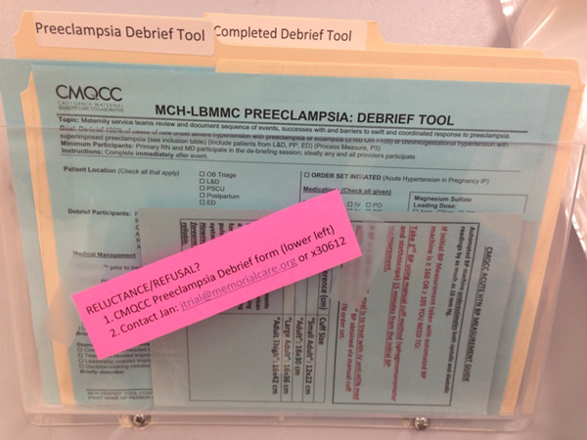
Closing the Loop
Debrief tool easy to find and return

Slide 24
On Going Data Review:
Combination of:
  CMDC list (45 days after end of month)
  Weekly list from Women’s pharmacist
    Pts who received: Labetalol or/& Hydralazine
  Debrief forms

Slide 25
Closing the Loop
Electronic Message Boards
Interprofessional
Best Practice Reminders
Addresses comment, concerns, questions
New messages every 2 weeks

Slide 26
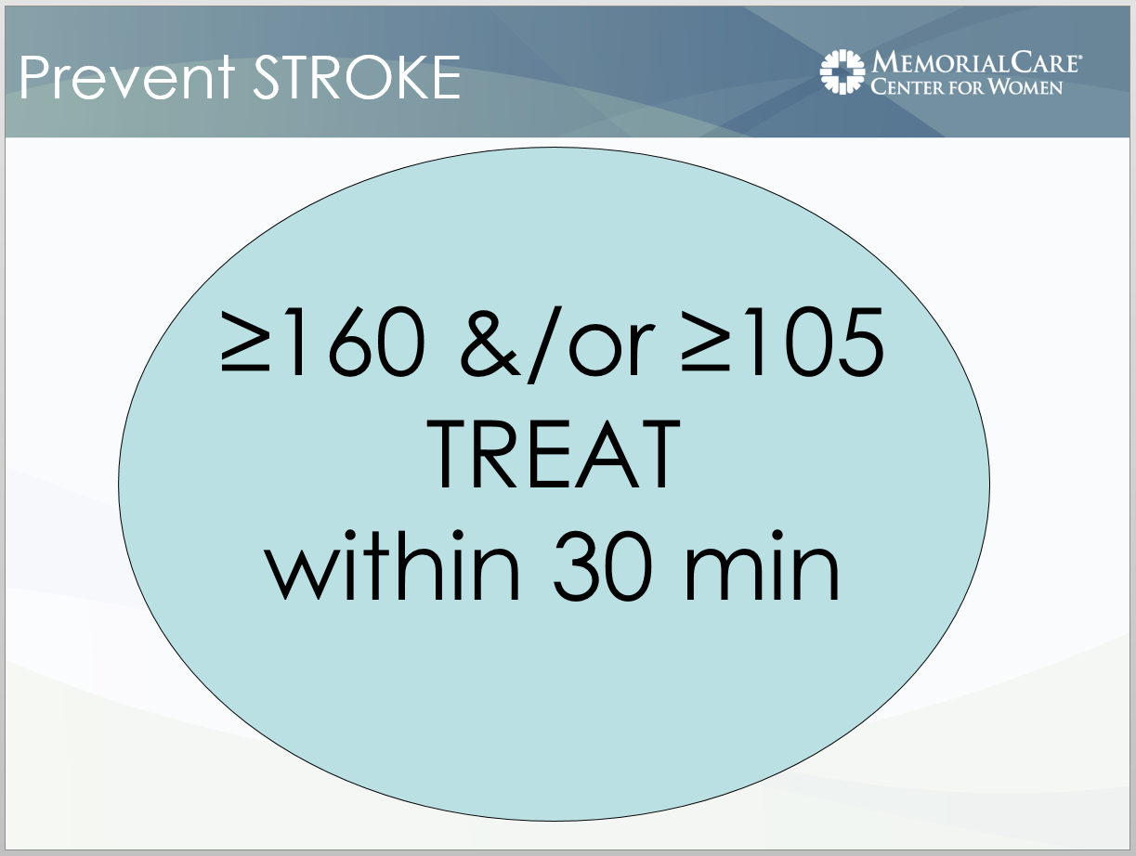

Slide 27
Process Flow:
Act
Data
Plan
Recognize
Do
Treat
Study
Debrief

Slide 28
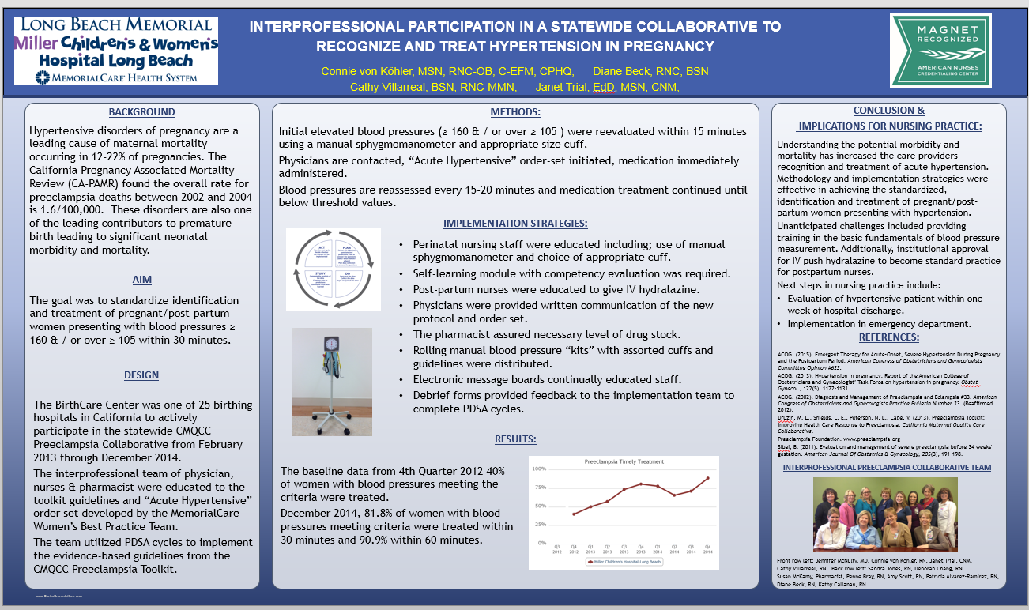

Slide 29
Team Talk
Angela Rodriguez
  Advocate Illinois Masonic Medical Center

Slide 30
ILPQC HTN Project
Initial Steps to
Wave 1 Implementation
At
Advocate Illinois Masonic Medical Center

Slide 31
Identify/Assemble Team Members
Team Lead
  Perinatal Coordinator
Nurse Champion
  Manager- OB Services
OB Physician Champion
  MFM Director
ED Champion
  Physician
Other Team Members
  Chairman, OB/GYN
  Medical Director, OB Services
Other Important Players
  Director of Informatics
  Perinatal Nurse

Slide 32
Attendance- Wave 1 Roll-out
Calendar invitation sent to all team members to assemble for January 25th Web Meeting (ILPQC HTN Wave 1 Roll-out)
RSVPs Collected
Reminder sent
All Team Members physically gathered to view January 25th Web Meeting

Slide 33
Test Patient Identification Process
Reviewed Inclusion/Eligibility Criteria
Database as a possible means for retrospective identification
Meeting with Director of Informatics
2 queries for January 2016 performed
  Risk Factors
    CHTN
    PIH
  Complications
    Pre-eclampsia
    Eclampsia

Slide 34
Test Data Form/Red Cap Entry
Requested “orientation” –Perinatal Nurse
Pulled Delivery Summary -Database
Pulled Discharge Summary -Database
Obtained Pertinent Information –EMR
  Dates/Times
  BPs
  Meds
  Education/DC Instructions
Entered “test case” into Red Cap Data

Slide 35
Next Steps
Possibly enter 1-2 more test patients (retrospectively)
Reassemble team
  Invitation sent for meeting on 02/24/16
  In person and call-in capability
  Schedule next team meeting
Make plans for staff education
  On project: goals, forms, processes, etc.
Make plans to implement form on OB Units and in ED (prospectively)
Set target dates
Once implemented, enter data in Redcap

Slide 36
Thanks for your attention

Slide 37

Team Talks – HTN Initiative
Teams assigned an OB Teams Call
  Wave 1 teams begin talks in February
  Look for an email from Kate
Present 5-10 mins. on current QI work, including:
  How are you implementing the data form?
  What are your challenges and successes?
  How are you developing your process flow?
  Share your process flow diagrams
Generate discussion and learning through sharing
  Good foundation for storyboard/poster presentations!

Slide 38
ABOG MOC Credits
The ABOG MOC standards now allow participation in ABOG-approved Quality Improvement Projects to meet the annual Improvement in Medical Practice (Part IV) MOC requirement.
ILPQC Maternal HTN Quality Improvement Initiative has been approved to meet ABOG Part IV Improvement in Medical Practice requirements for 2016 and 2017.
For further information, review the 2015 MOC Bulletin at http://www.abog.org/bulletins/MOC2016.pdf.

Slide 39
Process to Receive ABOG
MOC Credits
Physician Diplomates interested in applying their work on this initiative to their ABOG dashboard submit a letter to IPQC via info@ilpqc.org describing their participation in the initiative along with a letter from their quality improvement team lead, if a different person
ILPQC submits list of all physician diplomats who actively participated in the initiative to ABOG at end of the QI initiative
ABOG adds activity to physicians Diplomates’ personal dashboard in the “Open” section of IMP Activites
Within one month from the time of the QI initiative completion, ABOG will send the participating Diplomates an email requesting the Diplomate to complete and submit a short set of questions about his / her practice patterns after participating in this QI activity
Once the Diplomate completes and submits these questions, the activity moves from the “Open” section of IMP Activities to the “Completed” section of IMP activities and that will complete their Part IV requirement for year.

Slide 40
Wave 1 Recap and Next Steps
Goals of Wave 1
  Test implementation of data form
  Provide feedback on data collection process
  Give team talks on successes, challenges, and barriers
  Begin working on and sharing process flow
  Learn from CA and NC teams on implementation of data collection tools
Begin implementing data form and entering data into REDCap to provide feedback on March Teams Call!
Remaining Wave 1 Team Calls
  Monday, March 28, 12:30 – 1:30 pm
  Monday, April 25, 12:30 – 1:30 pm
2-hour implementation launch webinar May 2, 12:30 – 2:30 pm
Save the Date: Face-to-Face Collaborative Learning Session on May 23 from 9:45 am – 3:30 pm at Dove Conference Center at St. John’s in Springfield

