Slide 1

Illinois Maternal Hypertension Initiative Comprehensive Slide Set
Presented by:

Slide 2
Acknowledgments
This slide set was adapted from materials created by the following groups:
FPQC Hypertension in Pregnancy Initiative
  http://health.usf.edu/publichealth/chiles/fpqc/hip
CMQCC Preeclampsia Collaborative
  https://www.cmqcc.org/projects/past-projects/cmqcc-preeclampsia-collaborative
ACOG DII (New York) Safe Motherhood Initiative
  https://www.acog.org/About-ACOG/ACOG-Districts/District-II/Safe-Motherhood-Initiative
AIM Severe Hypertension in Pregnancy Bundle
  http://www.safehealthcareforeverywoman.org/secure/hypertension-bundle.php

Slide 3
Background
Worldwide and in the United States, hypertension is one leading cause of pregnancy-related deaths (PRDs) before, during, or after delivery.
Reports from North Carolina and California state that maternal deaths due to hypertension had significant prevention opportunities. (Berg, C. et al., 2005 & California Department of Public Health, 2011)

Slide 4
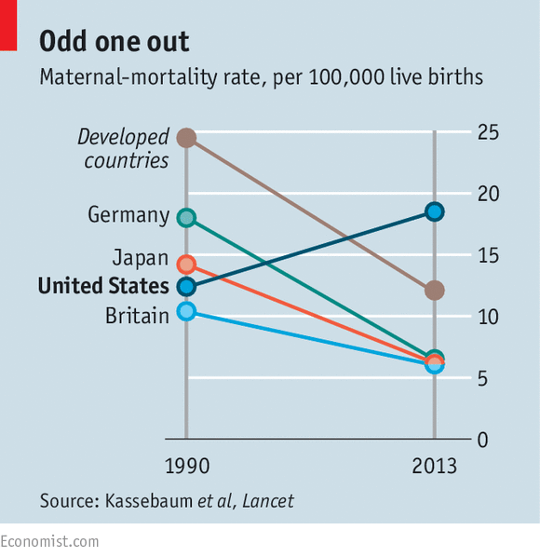
Maternal Mortality

Slide 5
Prevalence – ACOG 2013
Incidence of preeclampsia has increased by 25% in the past 20 years
Preeclampsia causes an estimated 60,000 maternal deaths yearly worldwide
There are 50 –100 near misses for every maternal death
Preeclampsia is a risk for future cardiovascular disease
Notes:
This slide provides some background on the importance of addressing Hypertension in Pregnancy.
Read slide. For more detail, please see the FPQC Slide Set “HIP Mortality Data Background”

Slide 6
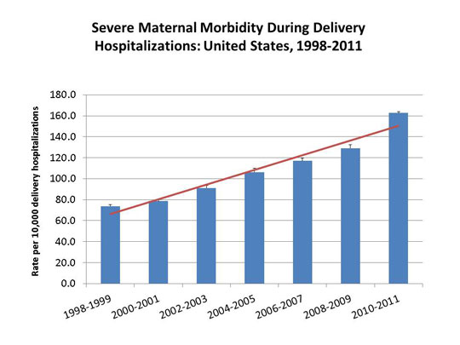
Maternal Morbidity

Slide 7
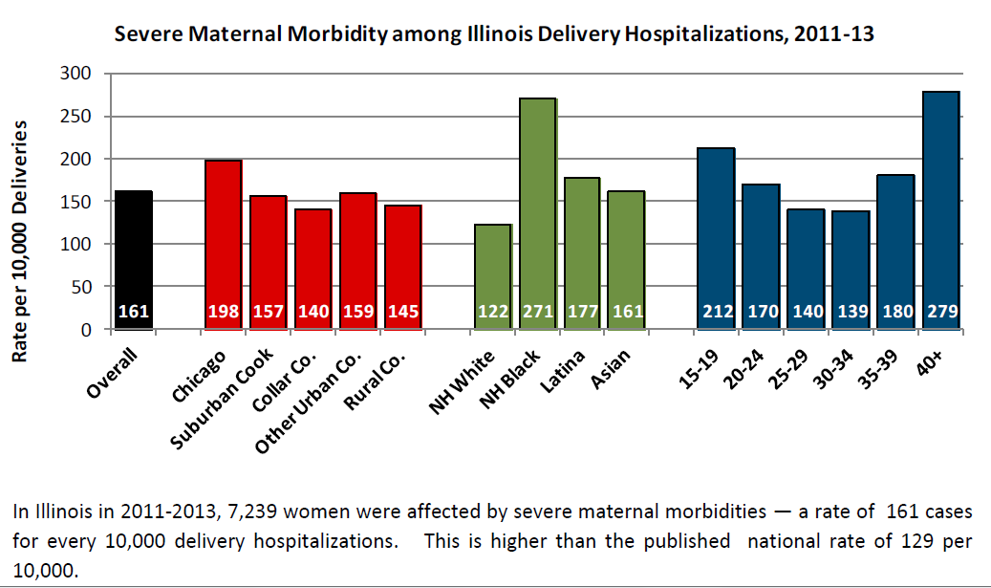
Maternal Morbidity:
Disparities in Illinois

Slide 8


Maternal Mortality Rate, California Residents: 1970-2010
15.5
PreE
Taskforce
14.0
PreE
Toolkit
Hemorrhage
Taskforce
Hemorrhage
Toolkit
Notes:
Maternal mortality in California is increasing and is as high as it was in the 1970’s. Why is maternal mortality increasing?
Changes in the coding of maternal deaths on death certificates may account for some (i.e., 30%) of the increase (Hoyert, 2007)
In addition, more pregnant women have chronic health conditions that contribute to worse outcomes
Numerous social factors (poverty, reduced education, exposure to chronic stress)
Hospital quality of care and health care provider issues also contribute to some degree
CA maternal deaths are decreasing after state wide initiatives of the CA Maternal Quality Collaborative for Hemorrhage and Hypertension

Slide 9

Where are the gaps?
Contributing Factors to Maternal Death | Preeclampsia | TOTAL
HEALTHCARE PROFESSIONALS | 96% | 79%
Delay in Diagnosis | 92% 1.7x | 54%
Use of Ineffective Treatment | 79% 1.6x | 42%
Misdiagnosis | 54% 1.7x | 31%
HEALTHCARE FACILITY | 12 (48%) | 72 (50%)
CA-PAMR 2002-2004

Slide 10
Where are the gaps?
Contributing Factors to Maternal Death | Preeclampsia | TOTAL
PATIENT FACTORS | 64% | 72%
Delay or Failure to Seek Care | 63% 2.4x | 26%
Lack of Understanding of the Importance of Health Event | 56% 3.7x | 15%
CA-PAMR 2002-2004

Slide 11

ILPQC Maternal
Hypertension Initiative
Aim: Reduce the rate of severe morbidities in women with severe preeclampsia, eclampsia, or preeclampsia superimposed on pre-existing hypertension by 20% by December 2017
Approach: Established workgroup (1/2015), identify hospital teams (5/2016), implement evidence-based practices / protocols / AIM HTN Bundle (6/2016-12/2017)
OB Advisory Workgroup and HTN Clinical Leadership Team developed process/outcome measures, toolkit/education, data form and reports
  Input from IDPH SQC / PNAs / AIM Initiative / CA, NY, and NC
  Launched Wave 1 in January 2016 with 24 teams
  Launched Wave 2 on May 2, 2016 with 110 teams

Slide 12
What are we trying to accomplish?
Early recognition of hypertension and correct diagnosis during and after pregnancy
Reduce time to treatment of severe range blood pressure, 160/110(105)
Deliver not too early and not too late
Provide patient education and appropriately timed follow up
Implementation of evidence based protocols
Notes:
First and foremost, early recognition of hypertension in pregnancy is vital to managing the potential impacts. Blood pressure must be treated and guidelines have been established including treating within one hour of confirmed readings. Magnesium sulfate is not a blood pressure medication, it is for seizure control and is recommended for use in preeclampsia with severe features local protocols need to be developed and followed. Women with hypertension in pregnancy require close follow up and the full HIP toolkit provides recommendations for all women postpartum. There is a two-sided one page document in the HIP toolkit that you may find helpful in assuring that you utilize elements of the Patient Safety Bundle developed by ACOG, SMFM, AWHONN, and others for readiness, recognition, response and reporting.

Slide 13

Key Clinical Pearl:
160/110 vs. 160/105
Controlling blood pressure
is the optimal intervention
to prevent deaths due to stroke
in women with preeclampsia.
The critical initial step in decreasing maternal morbidity and mortality is to administer anti-hypertensive medications as soon as possible (< 60 minutes) of documentation of persistent (retested within 15 minutes) BP ≥160 systolic, and/or >105-110 diastolic

Slide 14
Need
To
Treat*
BP ≥
160/110(105)
*BP persistent 15 minutes, activate treatment algorithm with IV therapy ASAP, < 30-60 minutes

Slide 15
ILPQC HTN Initiative
Goal & Measures
Goal: Reduce preeclampsia maternal morbidity
IL Measure | Type | Goal
Severe Maternal Morbidity No. of women with severe maternal morbidities (e.g. Acute renal failure, ARDS, Pulmonary Edema, Puerperal CNS Disorder such as Seizure, DIC, Ventilation, Abruption) / No. pregnant & postpartum women with new onset severe range HTN | Outcome | 20% reduction
Appropriate Medical Management in under 60 minutes No. of women treated at different time points (30,60,90, >90 min) after elevated BP is confirmed / No. of women with new onset severe range HTN | Process | 100%
Debriefs on all new onset severe range HTN* cases | Process | 100%
Discharge education and follow-up within 10 days for all women with severe range HTN, 72 hours with all women with severe range HTN on medications | Process | 100%
Severe range HTN: ≥160 systolic / ≥110(105) diastolic per hospital standard
*New onset severe range HTN: first episode of persistent severe range HTN (lasting >15 minutes) in a hospitalization (ER, L&D, or other inpatient setting), can be chronic HTN, gestational HTN, preeclampsia and/or postpartum diagnosis.

Slide 16
Opportunities for Quality Improvement
Early recognition of hypertension and response to clinical triggers of preeclampsia (pregnant and pp)
Importance of accurate BP measurement and identify severe range BP across all units.
Reduce time to treatment for BP >160/110(105)
Implement standardized use of ACOG protocols for acute treatment of severe range BP
Coordination of care (L&D, PP, ED, ICU) and timely evaluations and consultations
Postpartum follow-up and patient education

Slide 17
Where to start?
Staff education and standardized BP measurement
Rapid access to medications
IV treatment of BP’s ≥ 160mmHg systolic or ≥ 110(105) mmHg diastolic within 30-60 min
Standardize treatment algorithms / order sets
Early postpartum follow-up
Standardized postpartum patient educational materials.

Slide 18
Implementation of
AIM Hypertension Bundle
ILPQC Maternal Hypertension Initiative roll out will focus on implementation of the AIM Hypertension Patient Safety Bundle
Drive quality improvement through the 4 domains/key drivers
  Readiness (every Provider and unit)
  Recognition & Prevention (every case of HIP)
  Response (every patient)
  Reporting & Systems Learning (every multidisciplinary team)
Implementation of resources linked to bundle
  Visual aids, checklists, algorithm’s, protocols, etc.
  Education for physicians and nurses
  Key education topics and use of resources
ILPQC Maternal HTN Quality Improvement Initiative has been approved to meet ABOG Part IV Improvement in Medical Practice MOC requirements for 2016 and 2017 for participating OB/GYN physicians

Slide 19

AIM Hypertension Safety
Patient Bundle
Readiness (every Provider and Unit)
Recognition & Prevention (every patient)
Response (every case of HIP)
Reporting/Systems Learning (every multidisciplinary team)

Slide 20
Readiness at Your Hospital
Standardize preeclampsia diagnostic criteria
Process flow
Look at antepartum/postpartum, ED, and Triage
Protocols reflect current standards / evidence
  Samples available
Implementation Checklist
Order sets
AIM baseline survey

Slide 21
Updated Terminology and New Standards for Diagnostic Criteria

Slide 22
ACOG Executive Summary on Hypertension In Pregnancy, Nov 2013
1. The term “mild” preeclampsia is discouraged for clinical classification. The recommended terminology is:
  a. “preeclampsia without severe features” (mild)
  b. “preeclampsia with severe features” (severe)
2. Proteinuria is not a requirement to diagnose preeclampsia with new onset hypertension.
3. The total amount of proteinuria > 5g in 24 hours has been eliminated from the diagnosis of severe preeclampsia.
4. Early treatment of severe hypertension is mandatory at the threshold levels of 160 mm Hg systolic or 110 mm Hg diastolic.
5. Magnesium sulfate for seizure prophylaxis is indicated for severe preeclampsia and should not be administered universally for preeclampsia without severe features (mild).

Slide 23
ACOG Executive Summary on Hypertension In Pregnancy, Nov 2013
6. Preeclampsia with onset prior to 34 weeks is most often severe and should be managed at a facility with appropriate resources for management of serious maternal and neonatal complications.
7. Induction of labor at 37 weeks is indicated for preeclampsia and gestational hypertension.
8. The postpartum period is potentially dangerous. Patient education for early detection during and after pregnancy is important.
9. Long-term health effects should be discussed.
Notes:
It should be noted however that the CMQCC Preeclampsia task force recommends that magnesium sulfate be considered for preeclampsia without severe features.

Slide 24
Terminology
Previous
Present
Pregnancy Induced Hypertension (PIH)
Mild and Severe Preeclampsia
Hypertension in Pregnancy (HIP)
Preeclampsia with or without severe features
Preeclampsia with onset prior to 34 weeks is most often severe and should be managed at a facility with appropriate resources for management of serious maternal and neonatal complications.

Slide 25
Proteinuria
300 mg in a 24 hour period or
Protein/creatinine ratio 0.3 (mg/dL/mg/dL)
1+ or more proteinuria by dipstick if above are not available
The old 5 grams of protein has gone away . The amount of proteinuria does not correlate with outcome, or guide therapy

Slide 26
Delivery Management
Induction of labor at 37 weeks is indicated for preeclampsia and gestational hypertension.

Slide 27
Postpartum Attention
Patient education for early detection of signs and symptoms of preeclampsia during and after pregnancy is important.
Long-term health effects of preeclampsia, including increased risks of cardiovascular disorders, should be discussed.

Slide 28
Updated Classification of Hypertension in Pregnancy
Chronic (Preexisting) Hypertension
Abnormal blood pressure predating pregnancy or before 20 weeks gestation | Hypertension that predated the pregnancy Hypertension that develops before 20 weeks gestation and first trimester blood pressures are not known
Gestational Hypertension
Abnormal blood pressure first developing in pregnancy | Hypertension that develops after 20 weeks gestation in a woman with previously normal blood pressure At least two measurements taken 4 or more hours apart If hypertension occurs before 20 weeks gestation and first trimester blood pressure measurements are normal, then consider early onset gestational hypertension Rule out preeclampsia

Slide 29
Updated Classification of
Hypertension in Pregnancy
Preeclampsia
Abnormal blood pressure as described in gestational hypertension plus proteinuria | Greater than 300 mg total protein in a 24 hour collection Random urine protein (mg/dL) to creatinine (mg/dL) ratio of 0.3 1+ protein on urine dipstick if above quantifiable measures not available
Severe features for gestational hypertension and preeclampsia* | Systolic blood pressure greater than 160 mm Hg or diastolic blood pressure greater than 110 mm Hg (check blood pressure within 15 minutes to confirm since persistent elevation greater than 160 mm Hg or 110 mm Hg is a hypertensive emergency) CNS symptoms (generalized tonic clonic seizure, headache or visual disturbances) Pulmonary edema Platelet count less than 100,000/microliter Elevation serum transaminases more than 2 times over baseline or ALT greater than 70 Serum creatinine level greater than 1.1 mg/dL or doubling of serum creatinine HELLP syndrome

Slide 30
Updated Classification of
Hypertension in Pregnancy
Superimposed preeclampsia
Chronic hypertension with the development of preeclampsia | Sudden increase in blood pressure that was previously controlled requiring escalation of blood pressure medication New onset proteinuria or sudden increase in proteinuria Development of any of the criteria listed under “severe features”
Postpartum Hypertension
New onset condition OR Secondary to persistent hypertension | BP increases again 3-6 days postpartum Symptoms of preeclampsia or eclampsia, including stroke Can develop up to 4-6 weeks postpartum

Slide 31

Hospital Protocols,
Algorithms, Order sets
Facility-wide standard protocols with checklists and escalation policies for management and treatment of:
Severe range hypertension (ACOG treatment algorithms for IV therapy as soon as possible)
Eclampsia, seizure prophylaxis, and mag over-dosage
Postpartum presentation of severe hypertension/preeclampsia

Slide 32
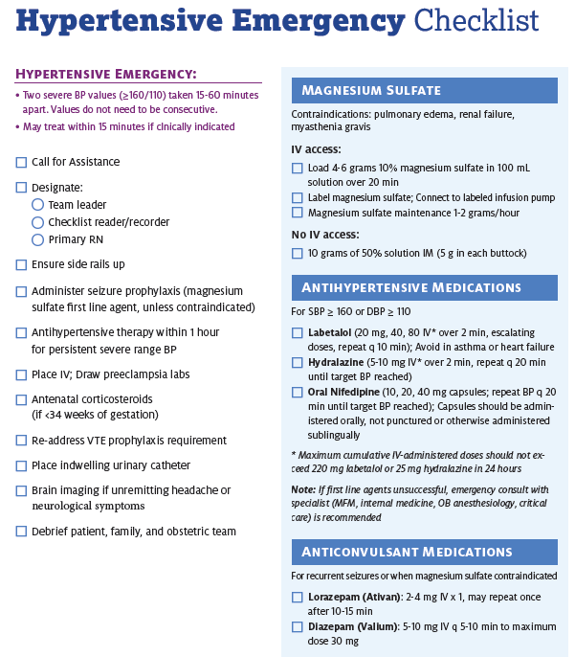

Slide 33
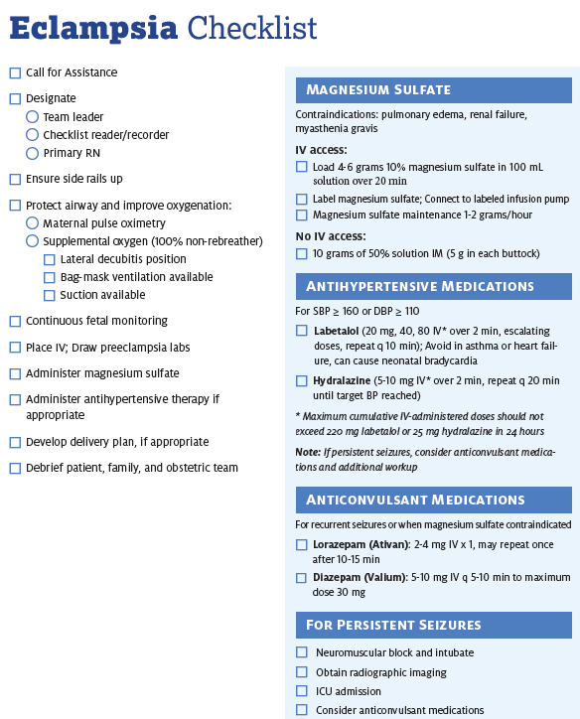

Slide 34
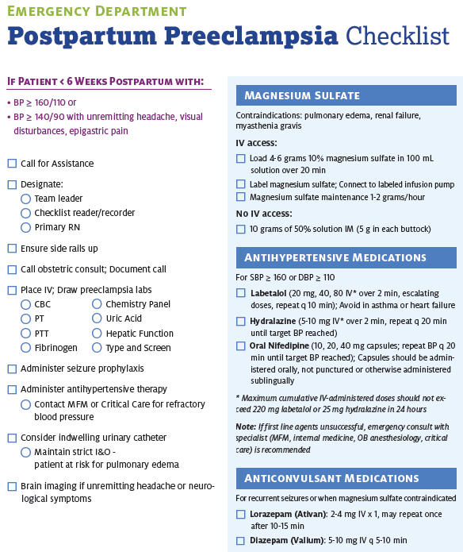

Slide 35
Readiness (every Provider and Unit)
Recognition & Prevention (every patient)
Standard protocol for measurement and assessment of BP, labs and urine protein for all pregnant and postpartum women
Standard and timely response to maternal early warning (danger) signs including listening to and investigating patient’s symptoms, fetal condition and assessment of labs
“The best way to diagnose preeclampsia is to listen to your patients.”
~ Dr. Baha Sibai

Slide 36

Importance of
Obtaining Accurate
Blood Pressure
Preeclampsia and preeclampsia with severe features are characterized by elevated blood pressure.
Failing to accurately measure blood pressure in a consistent manner can lead to misdiagnosis, delays in treatment, worsening disease, increased morbidity and even death.
Accurate blood pressure measurement is essential for clinical decision making
  Correct positioning of the woman
  Proper equipment (cuff sizes and shapes; calibrated readings)
Notes:
Hypertension in pregnancy is one of the leading causes of maternal mortality and morbidity. Having a standardized assessment of blood pressure is important to the early recognition and management of hypertension in pregnancy. Preeclampsia had the possibility of quickly becoming severe and resulting in seizures, strokes and other associated syndromes. In order to make good clinical decisions it is necessary to have accurate consistent assessments. To do this equipment must be appropriate in size and shapes of cuffs and well maintained.

Slide 37
Clinical Pearls
Take time to use correct equipment and measure her arm
Position the woman correctly
Initial blood pressure should be assessed after the woman has been resting with minimal distraction for 5 minutes.
BP ≥160/110(105) lasting for 15 minutes should be treated in under 30-60 minutes
Initial BP is ≥
140 systolic OR
≥ 90 diastolic
Repeat blood pressure in 15 minutes
Take in the same arm
Initial BP is ≥
160 systolic or
≥ 110(105) diastolic
Notify provider after first elevated BP
Reassess after 15 minutes
Do not reposition to side-lying
Activate treatment algorithms if remains ≥160/110(105)
Evaluate for preeclampsia
Activate Severe HTN Treatment Algorithm
Notes:
There are several key elements to accurate blood pressure. (read slide)

Slide 38
Appropriate Preeclampsia Evaluation

Slide 39
Key Clinical Pearl
Patients presenting with vague symptoms of:
  headache
  abdominal pain
  shortness of breath
  generalized swelling
  complaints of “I just don’t feel right”
should be evaluated for atypical presentations of preeclampsia or “severe features”
Sibai BM, Stella CL. Diagnosis and management of atypical preeclampsia-eclampsia. Am J Obstet Gynecol. May 2009;200(5):481 e481-487.

Slide 40
Laboratory Evaluation of Preeclampsia
Initial lab studies should include:
  CBC with platelet count
  AST, ALT, LDH
  Creatinine, Bilirubin, Uric acid, Glucose
  Urine protein / creatinine ratio
For women with acute abdominal pain, add:
  Serum amylase, lipase and ammonia
Notes:
Bilirubin comes on most liver function lab panels and is helpful in cases of severe HELLP syndrome and Acute fatty liver disease.

Slide 41
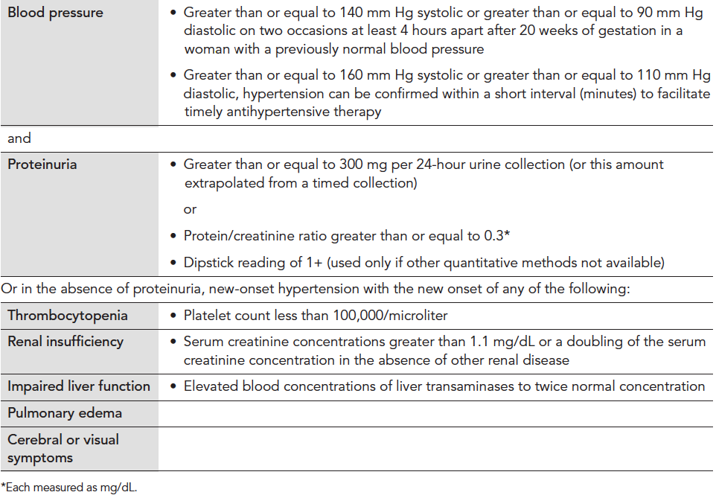
Diagnosis Criteria for
Preeclampsia
Executive Summary: Hypertension in Pregnancy, American College of Obstetricians and Gynecologist, Obstet Gynecol 2013;122:1122-31. Copyright permission received.
Notes:
The new ACOG guidelines which will be published in Fall 2013, may eliminate proteinuria as a criterion for diagnosis of preeclampsia.

Slide 42
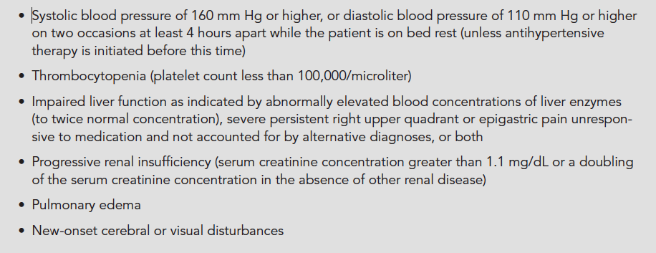
Diagnosis of Preeclampsia with
Severe Features
Executive Summary: Hypertension in Pregnancy, American College of Obstetricians and Gynecologist, Obstet Gynecol 2013;122:1122-31. Copyright permission received.
Notes:
To make the diagnosis of severe PE, you need to have documented SBP of 160 or greater on two occasions 4 hrs apart. However in the acute onset of HTN above threshold 160/105-110 it is unadvisable to wait 4 hrs for treatment. A BP should be repeated in 15 min and if still elevated above threshold, treat with antihypertensive medication within 30-60 min.

Slide 43
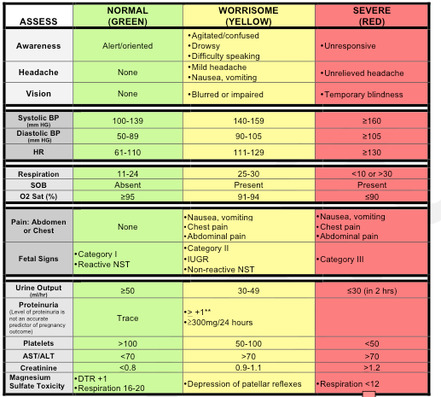
Preeclampsia Early Recognition Tool
Notes:
This is a tool that is designed to aid in the early recognition and response to a patient’s deteriorating condition as the disease process progresses in severity. The next slide is a continuation of this form with interventions based on the number of triggers.

Slide 44
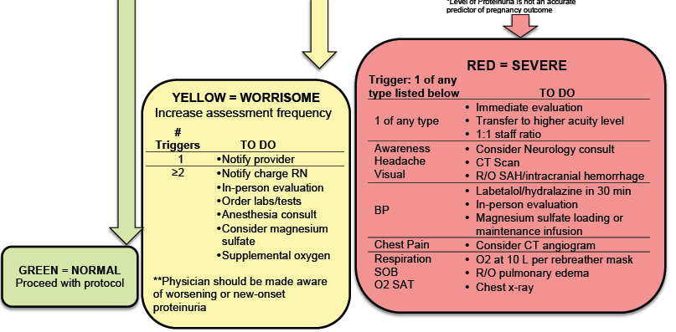
Clinical Signs to Watch for:
Notes:
The hope is that this Early Recognition Tool can be incorporated into the maternal notes and can be initiated in prenatal clinics and utilized as vital sign documentation until discharge. The chart stays with the patient until discharge creating a visual trend of individual physiology and allows assessment and treatment based on what is abnormal for the patient.

Slide 45
Timing of Delivery
Hypertension in Pregnancy
Not To Early….Not Too Late

Slide 46


Preeclamptic Balancing Act
Stroke
Hemorrhage
Renal Failure
Hepatic Failure
Subcapsular Hepatic Hematoma
Pulmonary Edema
Retinal detachment
Placental Abruption
Fetal and Maternal Death
Etc…
Prematurity
  ROP
  Sepsis
  NEC
  IVH
  CP
  RDS
  Etc…
CMOP

Slide 47
When to Deliver
Chronic Hypertension
  With no additional maternal or fetal complications, delivery before 38 0/7 weeks not recommended
  With superimposed preeclampsia, follow preeclampsia recommendations
Preeclampsia/Gestational Hypertension
  Without severe features:
    May expectantly manage until severe features present or 37 0/7 weeks
  With Severe Features
    Prior to viability- deliver
    May expectantly manage in appropriate setting until 34 weeks gestation, if maternal and fetal status stable
American College of Obstetricians and Gynecologists, Task Force on Hypertension in Pregnancy. Hypertension in pregnancy. Report of the American College of Obstetricians and Gynecologists' Task Force on Hypertension in Pregnancy. Obstet Gynecol. 2013 Nov;122(5):1122-31.

Slide 48
Key Clinical Pearl
In patients with preterm preeclampsia with severe features,
the disease can rapidly progress to significant maternal morbidity and/or mortality.
*Transfer to appropriate level of care if possible
Notes:
We must emphasize the fact that in patients with preterm preeclampsia the progression of disease is highly unpredictable and therefore the level of surveillance in these patients must be increased. We strongly recommend that all patients with new onset hypertension, new onset proteinuria or new onset symptoms under 34 weeks gestation, be admitted for a minimum 24 hour observation period. Serial blood pressure measurements and serial laboratory studies should be initiated to detect progression of disease and allow for ongoing fetal assessment.

Slide 49
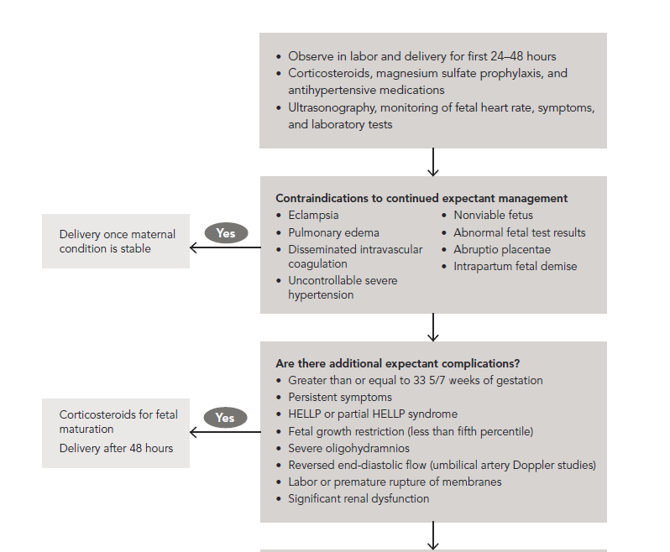
Management of Preeclampsia with Severe Features
at Less Than 34 Weeks Gestation
For women with severe preeclampsia and before fetal viability, delivery after maternal stabilization is recommended. Expectant management is not recommended.
American College of Obstetricians and Gynecologists, Task Force on Hypertension in Pregnancy. Hypertension in pregnancy. Report of the American College of Obstetricians and Gynecologists' Task Force on Hypertension in Pregnancy. Obstet Gynecol. 2013 Nov;122(5):1122-31
NO
EXPECTANT MANAGEMENT
Notes:
Can just show these protocols are available in the toolkit.

Slide 50
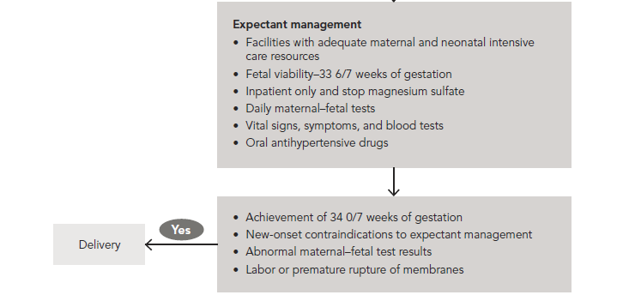
Expectant Management of Preeclampsia with
Severe Features at Less Than 34 Weeks Gestation
American College of Obstetricians and Gynecologists, Task Force on Hypertension in Pregnancy. Hypertension in pregnancy. Report of the American College of Obstetricians and Gynecologists' Task Force on Hypertension in Pregnancy. Obstet Gynecol. 2013 Nov;122(5):1122-31.

Slide 51
Indications for Delivery
34 weeks gestation OR
Any of the following:
  Uncontrolled hypertension despite therapy
  Recurrent symptoms such as headache, visual changes, RUQ pain
  Pulmonary edema
  Significant renal or hepatic dysfunction
  HELLP Syndrome or Disseminated Intravascular Coagulation
  Eclampsia
  Abruptio placenta
  Non reassuring fetal status: growth restriction, oligohydramnios, or abnormal fetal testing

Slide 52
Readiness (every Provider and Unit)
Recognition & Prevention (every patient)
Response (every case of HIP)
Process for timely triage and evaluation of pregnant and postpartum women with hypertension including emergency department and outpatient

Slide 53
Key Clinical Pearl
Controlling blood pressure
is the optimal intervention
to prevent deaths due to stroke
in women with preeclampsia.
Over the last decade, the UK has focused QI efforts on aggressive timely treatment of both systolic and diastolic blood pressure and has demonstrated a significant reduction in deaths.

Slide 54
Key Clinical Pearl
The critical initial step in decreasing maternal morbidity and mortality is to administer anti-hypertensive medications within 30-60 minutes of documentation of persistent (retested within 15 minutes) BP ≥160 systolic, and/or >105-110 diastolic.
Ideally, IV anti-hypertensive medications should be administered as soon as possible, and availability of a “preeclampsia box” will facilitate rapid treatment.
In Martin et al., stroke occurred in:
  23/24 (95.8%) women with systolic BP > 160mm Hg
  24/24 (100%) had a BP ≥ 155 mm Hg
  3/24 (12.5%) women with diastolic BP > 110mm Hg
  5/28 (20.8%) women with diastolic BP > 105mm Hg
Martin JN, Thigpen BD, Moore RC, Rose CH, Cushman J, May. Stroke and Severe Preeclampsia and Eclampsia: A Paradigm Shift Focusing on Systolic Blood Pressure, Obstet Gynecol 2005;105-246.

Slide 55
Need
To
Treat*
BP ≥
160/110(105)
*BP persistent 15 minutes, activate treatment algorithm with IV therapy ASAP, < 30-60 minutes

Slide 56
Hypertensive Medication
Administration Oral versus IV
First line therapy recommendations for acute treatment of critically elevated BP in pregnant women [>160/110(105)] are with either IV labetalol or hydralazine.
In the event that acute treatment is needed in a patient without IV access oral nifedipine may be used (10 mg) and may be repeated in 30 minutes.
PO (oral) nifedipine appears equally as efficacious as IV labetalol in correcting severe BP elevations.
Oral labetalol would be expected to be less effective in acutely lowering the BP due to its slower onset to peak and thus should be used only if nifedipine is not available in a patient without IV access.
ACOG Practice Bulletin #33, Reaffirmed 2012; ACOG Committee Opinion #514, 2012; Tuffnell D, Jankowitcz D, Lindow S, et al. BJOG 2005;112:875-880.

Slide 57
Hypertensive Medication Administration: Oral v. IV
IV Labetalol
  Onset: 2-5 min
  Peak: 5 min
PO Labetalol:
  Onset: 20 min-2 hrs
  Peak: 1-4 hrs
IV Hydralazine
  Onset: 5-20 min
  Peak: 15-30 min
PO Nifedipine
  Onset: 5-20 min*
  Peak: 30-60 min
*PO, (oral) not sublingual nifedipine, onset of action is 15-30 minutes depending on the reference source.
Am J Emerg Med. 1985 (6):524-30
BJOG 2012;119:78-85.
http://www.uspharmacist.com/content/d/feature/i/1444/c/27112/

Slide 58
Severe Hypertension Treatment
Algorithm
SBP > 155 and/or DBP > 105
Provider Notified
Blood Pressure Triggers
SBP ≥ 160 and/or DBP ≥ 110
Repeat in 15 minutes.
Notify Provider and Proceed
IV Access
FHR monitoring
Labs per PIH Order Set Pulse Oximeter
IV Anti-Hypertension Meds
First Line Medications
Seizure Prophylaxis
IV Labetalol
20 mg (over 2 min)
IV Hydralazine
5 or 10mg (over 1-2 min)
Per physician’s order
Magnesium Sulfate
Repeat BP in 10 min
If elevated, administer
IV Labetalol 40 mg
Repeat BP in 20 min
If elevated, administer
IV Hydralazine 10 mg
Bolus Dose: 4gm over 20 minutes
Maintenance Dose: 2gm per hour
Repeat BP in 10-15 min If elevated, administer
IV Labetalol 80 mg
Repeat BP in 20 min
If elevated, administer
IV Hydralazine 10 mg
PO Nifedipine If no IV access Initial Dose: 10 mg
May repeat dose at 20 minute intervals for a maximum of
5 doses.
Repeat BP in 20 min
If elevated,
IV Hydralazine
pre algorithm
anesthesia consult
Repeat BP in 20 min
If elevated, IV Labetalol 20 mg
pre algorithm
anesthesia consult

Slide 59
Key Clinical Pearl
Algorithms for acute treatment hypertension and eclampsia should be readily available or preferably posted in all clinical areas that may encounter pregnant women.
Notes:
SEGUE: One bundle that the Council on Patient Safety is still working on and hopes to deploy before the year is out is a Patient, Family and Staff support bundle. Eleni is going to talk a bit about that and what you can do even before it comes out.

Slide 60
Magnesium Sulfate & Nifedipine
3029 received Nifedipine for BP treatment
1469
1560
Magnesium
No Magnesium
Hypotension
0.4%
Hypotension
0.3%
Magpie Trial: Lancet 2002; 359:1877
Notes:
Hypotension not defined.

Slide 61
ACOG protocol
Standing Order (Labetalol)
Labetalol 20 mg IV over 2 minutes
If still elevated, labetalol 40 mg IV over 2 min
If still elevated, labetalol 80 mg IV over 2 min
Recheck in 10 min
Recheck in 10 min
Recheck in 10 min
If still elevated, Repeat labetalol 80mg over 10 minutes to achieve total dosage of 220mg (includes all previous administrations)
Recheck in 20 min
Switch to hydralazine 10 mg IV over 2 min
Seek consultation MFM, Critical Care, Anesthesia, Internal medicine
Target B/P
140 to <160 or 90-100
Notes:
1. Notify physician if systolic BP measurement is greater than or equal to 160 mm Hg or if diastolic BP measurement is greater than or equal to 110 mm Hg.
2. Institute fetal surveillance if undelivered and fetus is viable.
3. Administer labetalol (20 mg IV over 2 minutes).
4. Repeat BP measurement in 10 minutes and record results.
5. If either BP threshold is still exceeded, administer labetalol (40 mg IV over 2 minutes). If BP is below threshold, continue to monitor BP closely.
6. Repeat BP measurement in 10 minutes and record results.
7. If either BP threshold is still exceeded, administer labetalol (80 mg IV over 2 minutes). If BP is below threshold, continue to monitor BP closely.
8. Repeat BP measurement in 10 minutes and record results.
9. If either BP threshold is still exceeded, administer hydralazine (10 mg IV over 2 minutes). If BP is below threshold, continue to monitor BP closely.
10. Repeat BP measurement in 20 minutes and record results.
11. If either BP threshold is still exceeded, obtain emergency consultation from maternal–fetal medicine, internal medicine, anesthesia, or critical care specialists.
12. Give additional antihypertensive medication per specific order.

Slide 62
ACOG protocol
Standing Order (Hydralazine)
Hydralazine 5 or 10 mg IV over 2 minutes
Recheck in 20 min
If still elevated, hydralazine 10 mg IV over 2 min
Recheck 20 min
If still elevated, labetalol 20 mg IV over 2 min
Recheck in 10 min
If still elevated, labetalol 40 mg IV over 2 min
Emergency consults: MFM and anesthesia
Target B/P
140 to <160 or 90-100
Notes:
1. Notify physician if systolic BP is greater than or equal to 160 mm Hg or if diastolic BP is greater than or equal to 110 mm Hg.
2. Institute fetal surveillance if undelivered and fetus is viable.
3. Administer hydralazine (5 mg or 10 mg IV over 2 minutes).
4. Repeat BP measurement in 20 minutes and record results.
5. If either BP threshold is still exceeded, administer hydralazine (10 mg IV over 2 minutes). If BP is below threshold, continue to monitor BP closely.
6. Repeat BP measurement in 20 minutes and record results.
7. If either BP threshold is still exceeded, administer labetalol (20 mg IV over 2 minutes). If BP is below threshold, continue to monitor BP closely.
8. Repeat BP measurement in 10 minutes and record results.
9. If either BP threshold is still exceeded, administer labetalol (40 mg IV over 2 minutes) and obtain emergency consultation from maternal–fetal medicine, internal medicine, anesthesia, or critical care specialists.
10. Give additional antihypertensive medication per specific order.

Slide 63
ACOG protocol
Standing Order (Oral Nifedipine)
Nifedipine 10 mg PO (never crush or give SL)
Recheck in 20 min
If still elevated, nifedipine 20 mg PO
Recheck 20 min
If still elevated, nifedipine 40 mg PO
Recheck in 20 min
If still elevated, switch to labetalol or hydralazine protocol
Emergency consults: MFM and anesthesia, critical care or internal medicine
Notes:
1. Notify physician if systolic BP is greater than or equal to 160 mm Hg or if diastolic BP is greater than or equal to 110 mm Hg.
2. Institute fetal surveillance if undelivered and fetus is viable.
3. Administer nifedipine 10 mg PO
4. Repeat BP measurement in 20 minutes and record results.
5. If either BP threshold is still exceeded, administer nifedipine 20 mg PO. If BP is below threshold, continue to monitor BP closely.
6. Repeat BP measurement in 20 minutes and record results.
7. If either BP threshold is still exceeded, administer nifedipine 20 mg PO. If BP is below threshold, continue to monitor BP closely.
8. Repeat BP measurement in 20 minutes and record results.
9. If either BP threshold is still exceeded, administer labetalol (40 mg IV over 2 minutes) and obtain emergency consultation from maternal–fetal medicine, internal medicine, anesthesia, or critical care specialists.
10. Give additional antihypertensive medication per specific order.

Slide 64
ACOG Sample Order Sets
Labetalol
Hydralazine
Nifedipine
Emergent therapy for acute onset, severe hypertension during pregnancy and the postpartum period. Committee Opinion No. 623. American College of Obstetrics and Gynecologists. Obstet Gynecol 2015; 125:521-5.

Slide 65
Magnesium Therapy:
Key Clinical Pearl
Magnesium sulfate therapy for seizure prophylaxis (DOES NOT TREAT HTN) should be administered to any patients with:
  Preeclampsia with “severe features” i.e., subjective neurological symptoms (headache or blurry vision), abdominal pain, epigastric pain, OR BP > 160/110
  Eclampsia
  Should be considered in patients with preeclampsia without severe features

Slide 66
Late Postpartum Eclampsia
>48 hours following delivery, up to 4 weeks PP
Accounts for approximately 15% of cases of eclampsia
63% had no antepartum hypertensive diagnosis
The magnitude of blood pressure elevation does not appear to be predictive of eclampsia
The most common presenting symptom was headache, which occurred in about 70% of patients; other prodromal symptoms included shortness of breath, blurry vision, nausea or vomiting, edema, neurological deficit, and epigastric pain
Al-Safi Z, Imudia A, Filetti L, et al. Delayed Postpartum Preeclampsia and Eclampsia. Obstet Gynecol. 2011;118(5):1102-1107.

Slide 67
Patient Discharge / Education
Postpartum/ discharge protocols should include:
  Management and verification of postpartum follow-up & BP check within 7 to 10 days post-discharge
  Standardize discharge patient education for women with preeclampsia and/or severe range HTN
  Discharge instructions to include warning signs of preeclampsia for ALL postpartum patients

Slide 68
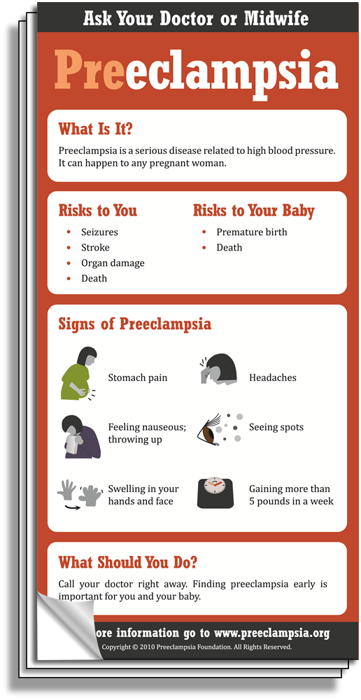
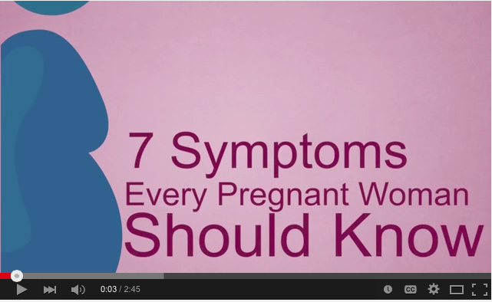

Materials for Prenatal &
Postpartum Patient Education
“7 Symptoms Every Pregnant Woman Should Know” video available in English and Spanish on YouTube™
You W, et al. Improving patient understanding of preeclampsia: a randomized controlled trial. Am J Obstet Gynecol 2012.
Notes:
Other patient education materials include:
Brochures
Magnets
Videos
Poster (avail. early 2016)
Providers can order at:
preeclampsia.org/store

Slide 70
Key Strategies to Improve Response

Slide 71

Rapid access to medications used for severe hypertension:
  medications should be stocked and immediately available
  Include brief guide for administration & dosage.
System plan for escalation for maternal hypertension, obtaining appropriate consultation, and maternal transport, as needed

Slide 72
Facility-wide standard protocols with checklists and escalation policies for management and treatment of:
Severe hypertension (standard use of ACOG algorithms)
Eclampsia, seizure prophylaxis, and mag over-dosage
Postpartum presentation of severe hypertension/preeclampsia

Slide 73
Minimum requirements for protocol:
Notification of primary physician or primary care provider if systolic BP ≥160 or diastolic ≥110 for 2 measurements within 15 min
After second elevated reading, treatment should be initiated ASAP (within 60 min of verification)
Includes onset and duration of magnesium sulfate therapy
Appropriate labs sent and fetal assessment

Slide 74
Minimum requirements for protocol (cont):
Includes escalation measures for those unresponsive to standard treatment
Describes management and verification of follow-up within 7 to 10 days postpartum
Describe postpartum patient education for women with preeclampsia
Discharge instructions to include warning signs of preeclampsia for ALL postpartum patients

Slide 75
Postpartum patients presenting to the ED with hypertension, preeclampsia or eclampsia should either be assessed by or admitted to an obstetrical service
Systems should be in place to screen all women for pregnancy AND postpartum status in the ER and for severe range BP

Slide 76
Timely Response Matters!
Process for timely triage and evaluation of pregnant and postpartum women with hypertension, reduce time to treatment for severe range BP.
Include emergency department and outpatient
Rapid access to medications used for severe hypertension: medications should be stocked and immediately available. Include brief guide for administration & dosage.
System plan for escalation, obtaining appropriate consultation, and maternal transport, as needed
Emergency protocols – Eclampsia management, HTN treatment algorithms

Slide 77
Key Clinical Pearl
Use of preeclampsia-specific checklists, team training and communication strategies, and continuous process improvement strategies will likely reduce hypertensive related morbidity.
Use of patient education strategies, targeted to the educational level of the patients, is essential for increasing patient awareness of signs and symptoms of preeclampsia.
Notes:
Education strategies include a clear and simply written list of patient symptoms to share with patients and their families during prenatal visits and upon discharge from the hospital. Written instructions should help patients to recognize preeclampsia symptoms and seek care.

Slide 78
ILPQC Maternal HTN Initiative
Jan 2016-Dec 2017

Slide 79
ILPQC HTN Initiative
Goal & Measures
Goal: Reduce preeclampsia maternal morbidity
IL Measure | Type | Goal
Severe Maternal Morbidity No. of women with severe maternal morbidities (e.g. Acute renal failure, ARDS, Pulmonary Edema, Puerperal CNS Disorder such as Seizure, DIC, Ventilation, Abruption) / No. pregnant & postpartum women with new onset severe range HTN | Outcome | 20% reduction
Appropriate Medical Management in under 60 minutes No. of women treated at different time points (30,60,90, >90 min) after elevated BP is confirmed / No. of women with new onset severe range HTN | Process | 100%
Debriefs on all new onset severe range HTN* cases | Process | 100%
Discharge education and follow-up within 10 days for all women with severe range HTN, 72 hours with all women with severe range HTN on medications | Process | 100%
Severe range HTN: ≥160 systolic / ≥110(105) diastolic per hospital standard
*New onset severe range HTN: first episode of persistent severe range HTN (lasting >15 minutes) in a hospitalization (ER, L&D, or other inpatient setting), can be chronic HTN, gestational HTN, preeclampsia and/or postpartum diagnosis.

Slide 80
What data will teams use to track progress?
Collect data all patients with severe range BP
  Time to treatment, patient outcome, discharge patient education and timely follow up scheduled
Identify all patients with severe range BP
  Bedside data collection to collect data on time to treatment and debrief
  Chart abstraction to confirm all pts identified (including missed high BP with no action taken), outcome and discharge data (education & F/U)

Slide 81
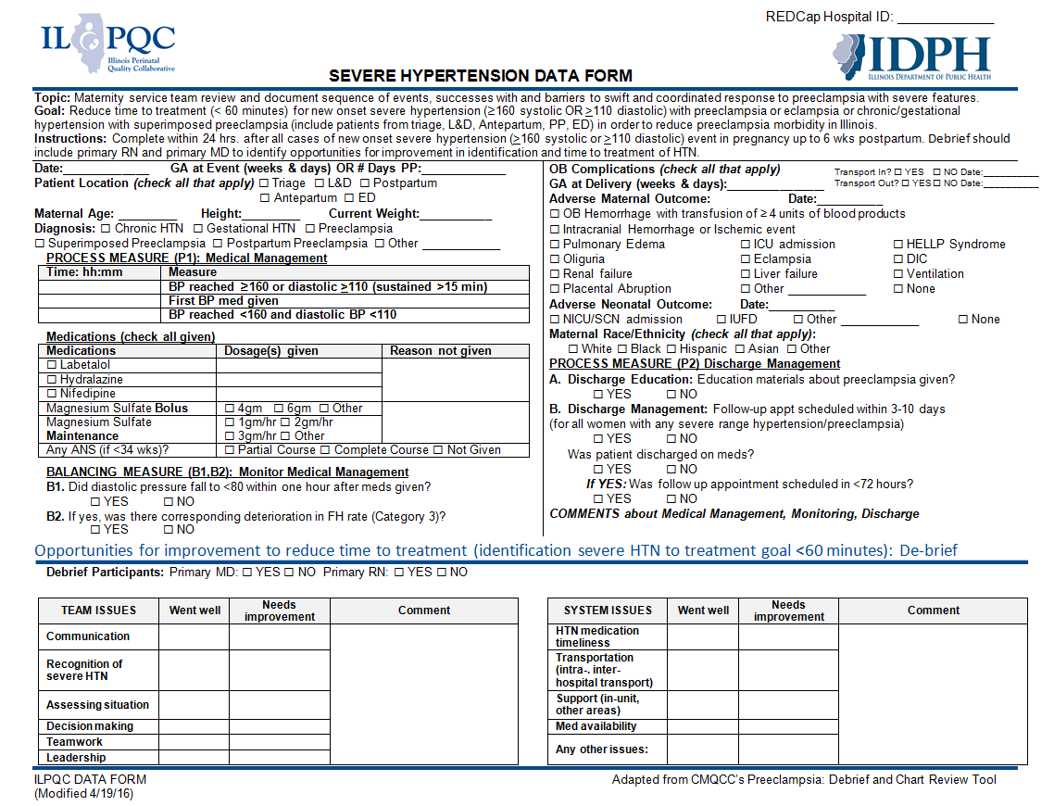
IL Maternal Hypertension:
Data Form

Slide 82
Key components for success
Early recognition of hypertension / preeclampsia triggers during pregnancy and postpartum period
Reduce time to treatment of severe range blood pressure, 160/110(105)
Provide patient education and appropriate discharge follow up
Implementation of evidence based protocols
  Management of severe HTN, preeclampsia triggers, magnesium, expectant management vs delivery, postpartum management, eclampsia
Notes:
First and foremost, early recognition of hypertension in pregnancy is vital to managing the potential impacts. Blood pressure must be treated and guidelines have been established including treating within one hour of confirmed readings. Magnesium sulfate is not a blood pressure medication, it is for seizure control and is recommended for use in preeclampsia with severe features local protocols need to be developed and followed. Women with hypertension in pregnancy require close follow up and the full HIP toolkit provides recommendations for all women postpartum. There is a two-sided one page document in the HIP toolkit that you may find helpful in assuring that you utilize elements of the Patient Safety Bundle developed by ACOG, SMFM, AWHONN, and others for readiness, recognition, response and reporting.

Slide 83
CMQCC: 4-Step Program to
Improve Preeclampsia Outcomes
Make the Right Diagnosis (new criteria)
Treat the BP!
Deliver not too early, and not too late
Patient education and early postpartum F/U

Slide 84
Need
To
Treat*
BP ≥
160/110(105)
*BP persistent 15 minutes, activate treatment algorithm with IV therapy ASAP, < 30-60 minutes

Slide 85
HTN Initiative Monthly
Team Calls: Schedule
Call Date | Topic
June 27 12:30 – 2:30 pm | Readiness and Reporting - Bundle / Toolkit Overview AND Drills, Simulation, and Debriefs
July 25 12:30 – 1:30 pm | Recognition - Accurate BP Measurement & Diagnosis
August 22 12:30 – 1:30 pm | Response - BP Medication and Treatment Algorithms
September 26 12:30 – 1:30 pm | Response - Timing of Delivery
October 24 12:30 – 1:30 pm | Response - Patient Education/Engagement and Postpartum Follow-up

Slide 86
Role of MD and CNM Providers
If notified of severe range BP
  Follow ACOG treatment guidelines for IV therapy and BP reassessment and escalation of therapy
  Goal is therapy within 30-60 minutes of confirmed elevated BP
  Determine need for immediate evaluation
  Participate in Debrief with nurse (what went well, any barriers to reducing time to treatment)

Slide 87
Role of MD and CNM Providers
Discharge Management
  All postpartum patients with gest HTN / preeclampsia need early postpartum follow up within 7-10 days to evaluate BP
  Standardize preeclampsia education for prenatal and postpartum patients

Slide 89
Additional Resources
Preeclampsia Foundation tools and materials
  www.preeclampsia.org
California Maternal Quality Care Collaborative
  www.CMQCC.org
Patient safety bundles and AIM program information
  www.safehealthcareforeverywoman.org
ACOG DII (New York) Safe Motherhood Initiative
  https://www.acog.org/About-ACOG/ACOG-Districts/District-II/Safe-Motherhood-Initiative
Illinois Perinatal Quality Collaborative (ILPQC)
  www.ilpqc.org
Notes:
There are other resources available for HIP that include:….

Slide 91
Contact
Email info@ilpqc.org
Visit us at www.ilpqc.org

Slide 92

IDPH

