Slide 1
ILPQC REDCap QI Summer Series
Topic: Birth Equity Initiative Reports
July 18th, 2024

Slide 2
Birth Equity Hospital Level Measures Data Dashboard Review

Slide 3
Birth Equity Dashboard Review – Accessing Data
Log into REDCap account
Open "Birth Equity Hospital Level Measures" project

Slide 4
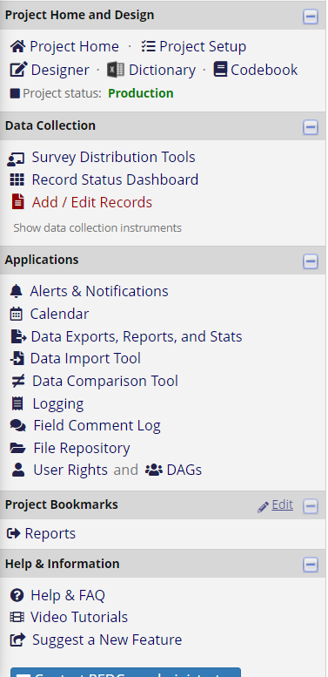
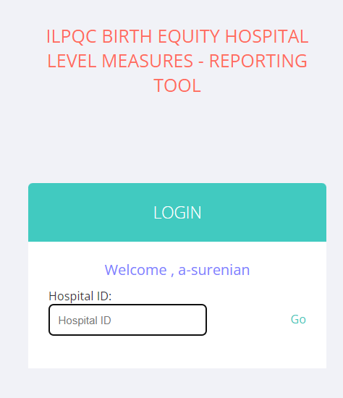
Birth Equity Dashboard Review – Accessing Data
3. Go to "Project Bookmarks" and click on "Reports"
4. Enter 3-digit Hospital ID and click "Go"

Slide 5
Birth Equity Dashboard Review – Accessing Data
5. Click through 1-10 to see structure measure progress
11-13 show implicit bias/respectful care education progress for providers, nurses, and staff
15-17 show social determinants of health screening and linkage workflow

Slide 6
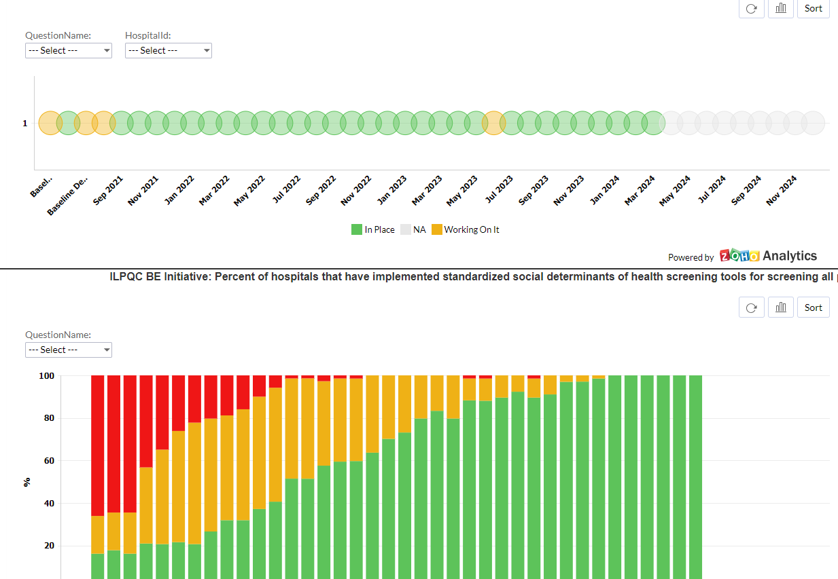
Birth Equity Dashboard Review – Accessing Data
EXAMPLE of Structure Measure Progress - Report 1

Slide 7
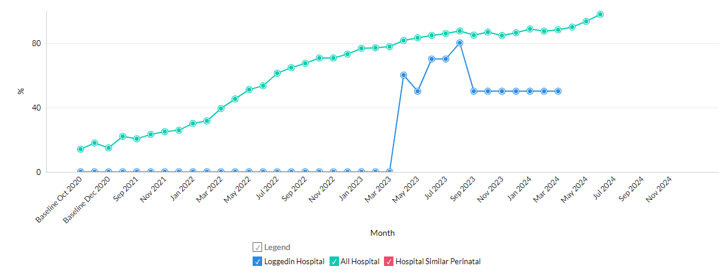
Birth Equity Dashboard Review – Accessing Data
EXAMPLE of Education Measure Progress - Report 11

Slide 8
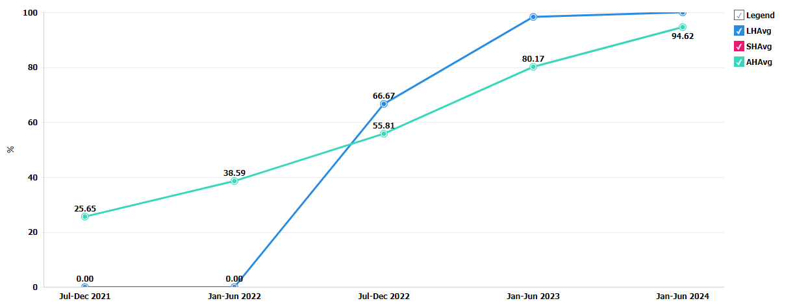
Birth Equity Dashboard Review – Accessing Data
Be sure to filter by Delivery Admission!
EXAMPLE of SDOH Screening Measure Progress - Report 15

Slide 9
Patient Reported Experience Measure (PREM) Data Dashboard Review

Slide 10
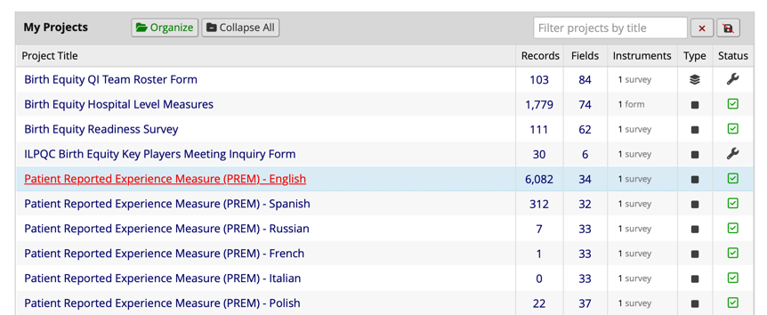
PREM Survey Dashboard Review – Accessing Data
Log into REDCap account
Open "Patient Reported Experience Measure (PREM) - English" project
Submissions from all languages are available in the English Reports for hospital teams

Slide 11
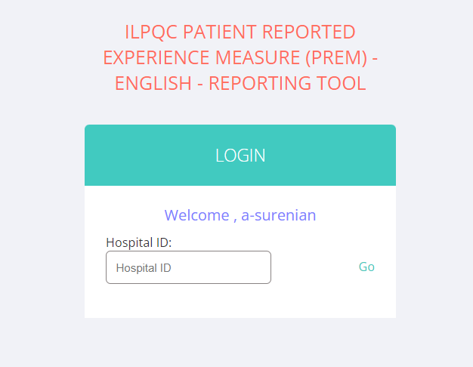
PREM Survey Dashboard Review – Accessing Data
3. Go to "Project Bookmarks" and click on "Reports"
4. Enter 3-digit Hospital ID and click "Go"

Slide 12
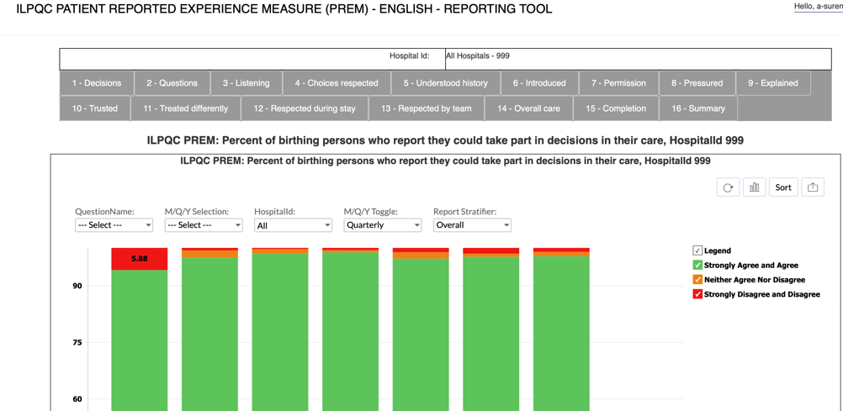
PREM Survey Dashboard Review – Accessing Data
5. Click through each of the numbered items to see PREM responses by question
FEATURE – keywords for each report to help users navigate to the correct report
(Q15 shows the percent of total deliveries with patient reported experience measure (PREM) completion)

Slide 13
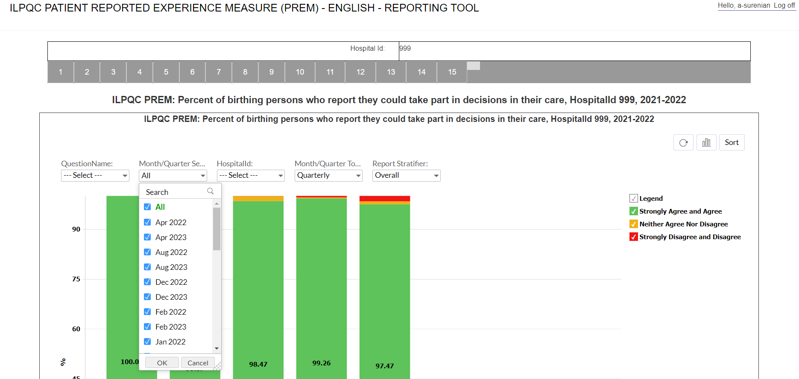
PREM Survey Dashboard Review – Accessing Data
6. To view data by month or quarter, use this drop-down menu

Slide 14
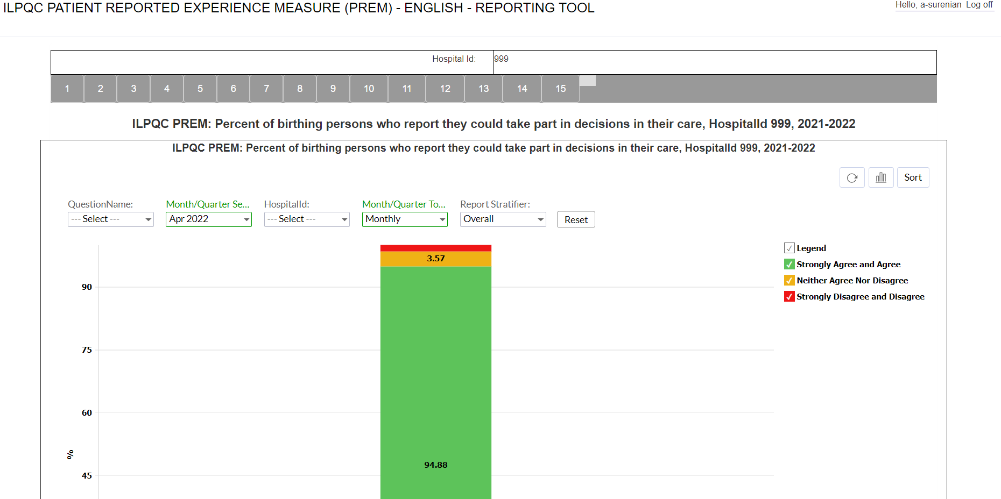
PREM Survey Dashboard Review – Accessing Data
If you want to view data by a specific month, remember to change the Month/Quarter toggle to "Monthly"!

Slide 15
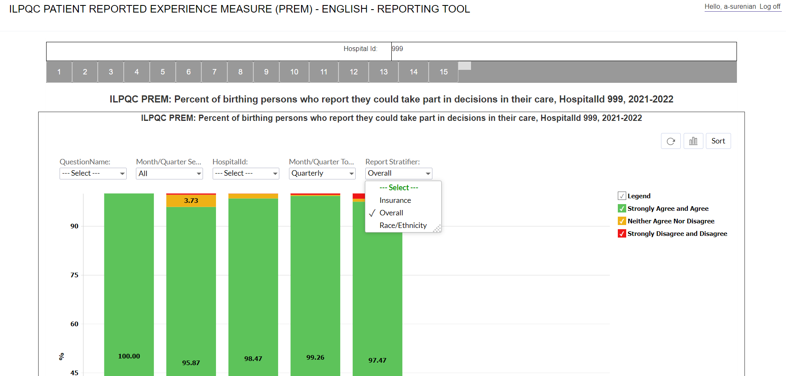
PREM Survey Dashboard Review – Accessing Data
7. To stratify data by race/ethnicity or insurance status, use the "Report Stratifier" drop-down menu

Slide 16
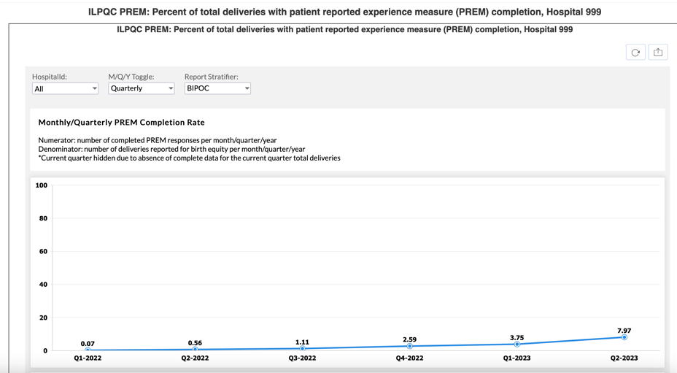
PREM Survey Dashboard Review – Accessing Data
8. Report 15 shows the percent of total deliveries with PREM completion.
Select your time period on the M/Q/Y toggle! Make sure to also select your Hospital ID under 'HospitalId'!

Slide 17
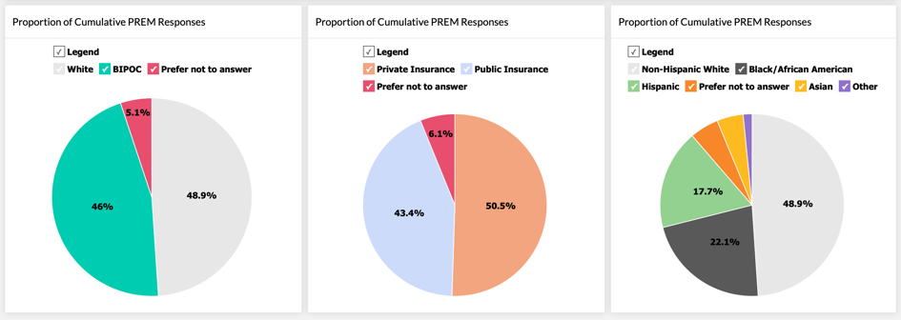
PREM Survey Dashboard Review – Accessing Data
Report 15 also shares monthly/quarterly/yearly PREM responses with race, ethnicity, and insurance breakdowns
Pie charts are a great visualization tool to add to abstracts, team meetings, etc.!

Slide 18
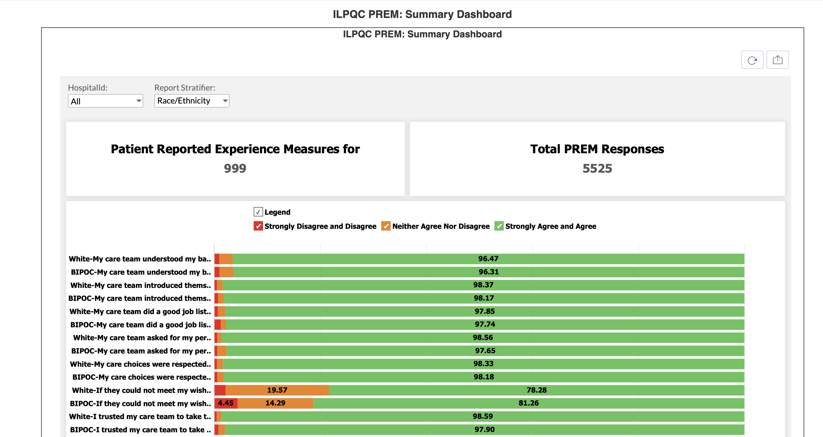
PREM Survey Dashboard Review – Accessing Data
Report 16 is the PREM summary dashboard. Teams can view both ILPQC total (ID: 999) or hospital-specific summaries of PREM responses. Make sure to select the correct hospital ID!
Opportunity to review summary data stratified by race/ethnicity AND insurance status!

Slide 19
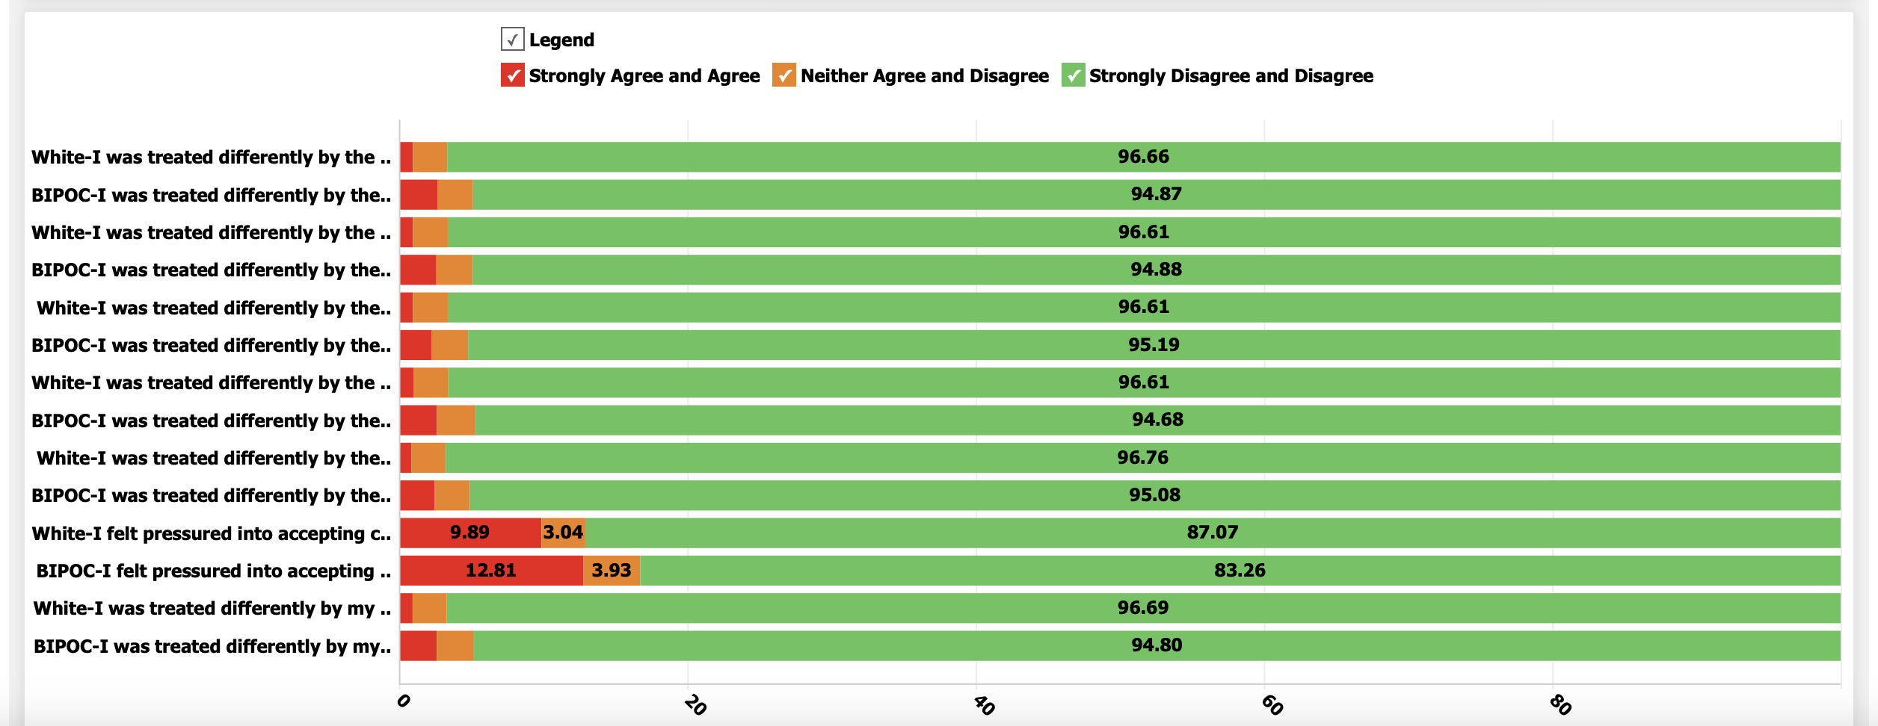
Summary Dashboard (Report 16) Continued

Slide 20
Live Demo & Questions

Slide 21
Additional Resources & Reminders

Slide 23
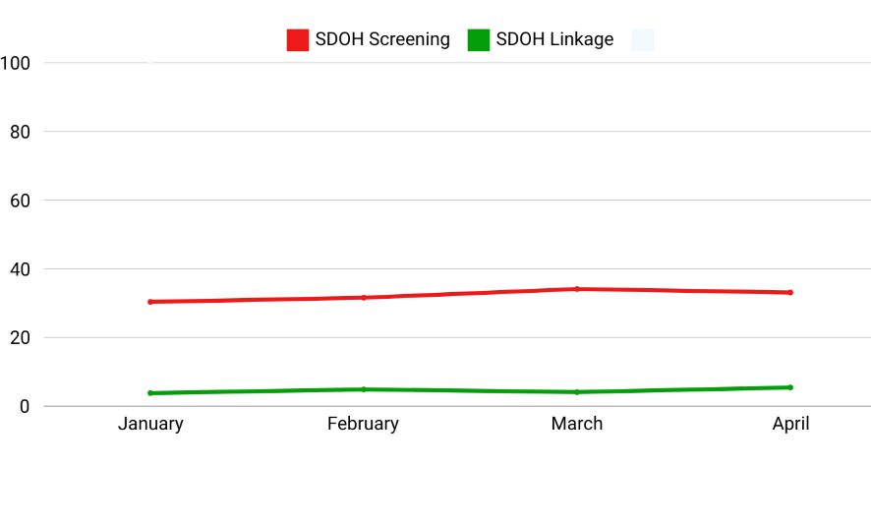
What’s Next?
SDOH Evaluation, Linkage, and documentation in EMR System
% Screened and Linked to Care
Month

Slide 25
PQI Champion Check-in Meeting: October 11th
All SPEAK UP Champions are invited to attend the PQI-hosted SPEAK UP post-training national conference call on October 11th at 12pm ET / 11am CT!
Attendees of the meeting will:
Inspire each other to continue the action plan implementation journey
Discuss progress made toward achieving action plan goals
Outline strategies and tactics to change structures and processes focused on eliminating perinatal disparities
Practice SPEAK UP communication strategies and tactics
Registration Link: https://www.perinatalqi.org/event/ChampionsOctoberMeeting2024

Slide 26
Upcoming BE Calls
Event | Day/Time
BE Sustainability Plan Office Hours (held in place of BE monthly webinars) | Monday, August 19th 12-1pm CT
BE September Sustainability Webinar | Monday, September 16th 12-1pm CT
ILPQC 2024 Annual Conference | October 30th, 2024 Westin Lombard Hotel

