Slide 1

ILPQC/IDPH Webinar Series: Illinois Maternal Morbidity and Mortality Report Recommendations for Clinical Practice
Part 1 Substance Use Disorders
February 2nd, 2024
12-1:30pm

Slide 2
Call Overview
Welcome and ILPQC overview of optimal OUD care from Mothers and Newborns affected by Opioids (MNO) Initiative
  Ann Borders, MD, MSc, MPH, Executive Director and Obstetric Lead, ILPQC
IDPH: IL Maternal Overdose Data Overview
  Cara Bergo, PhD, Maternal Mortality Epidemiologist, IDPH
IL DHS MAR NOW and DOPP Overview
  Nicole Gastala, MD, Medical Director Substance Use Prevention and Recovery, IDHS
  Kathleen Monahan, State Opioid Response Project Director, IDHS
ILPQC Hospital Sharing: Actionable Outpatient Strategies Based on MMRC Recommendations
  Katherine Austman, MD, Gibson Area Hospital
Resources & Next Steps
  Angel's Story Viewing
  Perinatal Syphilis Warmline – Maura Quinlan, MD, MPH, Women's Health Medical Advisor, IDPH

Slide 3
Focus for Today: optimal OUD care EVERYWHERE
Is your clinical team aware that substance use disorder is now the leading cause of maternal death in IL and that providing optimal OUD care can reduce maternal deaths?
Are you providing Optimal OUD care for every perinatal patient, are you: screening for SUD, linkage to MAT / recovery treatment services, providing Narcan? Can you sustain optimal OUD care?
Are you aware of new resources every clinic, L&D, ER should be using?
  OUD Hotline 24/7 to link patients to MAR-Now: treatment start and care coordination
  DOPP program to provide free Narcan kits to your patients
  Angel’s Story - video for provider / nurse / staff education on why Optimal OUD care matters and why we must do better!

Slide 4
Illinois Perinatal Quality Collaborative
(ILPQC)
Multi-disciplinary, multi-stakeholder Perinatal Quality Collaborative with 89 Illinois hospitals participating in 1 or more initiatives
Support participating hospitals’ implementation of evidenced-based practices using quality improvement science, collaborative learning and rapid response data

Slide 5
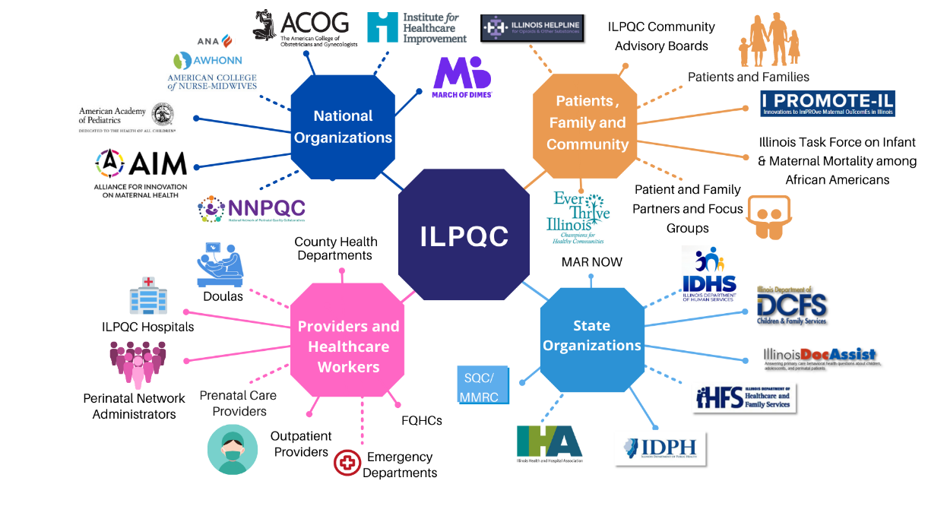
Together, WE ARE ILPQC!
Welcome community outpatient providers, ED providers, and local health departments!

Slide 6
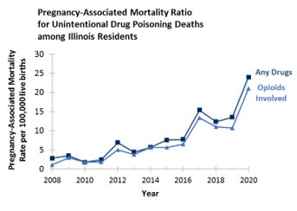
Maternal Deaths Due to Opioids in IL
Need our Urgent Attention!
32%
Pregnancy-Associated Mortality Ratio for Unintentional Drug Poisoning Deaths among Illinois Residents
Overdose is the leading cause of pregnancy-related deaths in Illinois*
​
*preliminary data from IDPH, 2018-2019, final data to be released Fall 2023
IDPH Maternal Morbidity and Mortality report on 2016-2017 deaths, 2021; IDPH Death Certificates, 2021
Notes:
All findings in this presentation are preliminary
Currently finalizing 2020 reviews
Working on Illinois Maternal Mortality Report 2023 for 2018-2020 Deaths
Report will be published in the Fall 2023
I think we use a slide about the increase in Overdose deaths showing rapid rise across last few years and include the preliminary 2018-2019 data 34%pregnancy related deaths from overdose because the rest of the info here not important

Slide 7


Too many pregnant/postpartum patients are losing their lives to OUD
Madelyn Linsenmeir
1988 to 2018
Anaya Rivers
1994 to 2019
The Burlington Free Press on Oct. 14, 2018
Photo Legacy.com
Daily News Philly.com on February 17, 2019
Photo Pendleton Candles Obituary Service on Facebook.com
OUD is a life-threatening medical condition
Screening and linking pregnant patients with OUD to treatment/services
Reduces overdose deaths for moms
Improves pregnancy outcomes
Increases parents/babies staying together
Notes:
Consider removing as it can “date” the module.
Madelyn Ellen Linsenmeir
https://www.legacy.com/obituaries/burlingtonfreepress/obituary.aspx?n=madelyn-ellen-linsenmeir&pid=190469930
Anaya Rivers
https://www.philly.com/news/columnists/opioid-overdose-addiction-anaya-rivers-obituary-jenice-armstrong-20190207.html

Slide 8
Treatment works:
Decreased overdose on MAT
(1) MAT saves lives across pregnancy/postpartum
(2) Postpartum is a risky time for all moms with OUD
Schiff DM, et al. Fatal and Nonfatal Overdose Among Pregnant and Postpartum Women in Massachusetts. Obstet Gynecol. 2018;132(2):466–474. doi:10.1097/AOG.0000000000002734
Notes:
There are TWO really interesting findings summarized on this graph. FIRST: The lowest time for OD was in the second and third trimester – likely when pts have the greatest interaction with medical care and resources. A corollary to this is that the number of overdoses is similar if not higher in the first year postpartum than in the year prior to becoming pregnant. Part of this is likely due to the absence of longitudinal support beyond antepartum and intrapartum care. SECOND: As you can see, the red bars indicate the number of OD events when pts are on MAT as compared to the gray bars which represent OD events not on MAT. In brief – MAT works and saves lives.

Slide 9




Mothers and Newborns affected by Opioids (MNO) Initiative
Opioid Use Disorder is an urgent obstetric issue
Opioid Use Disorder is a life-threatening chronic disease with lifesaving treatment available
There are key steps OB providers must take prenatally and on L&D to care for women with Opioid Use Disorder
Linking moms to MAT / Recovery Services
Reduces overdose deaths for moms
Improves pregnancy outcomes
Increases # parents and babies staying together

Slide 10

Optimal care for all pregnant / postpartum persons with OUD
Screen every pregnant patient for OUD with a validated screening tool
Provide Naloxone (Narcan) Counseling / prescription and screen for Hepatitis C
Warm hand-offs for MAT/recovery services and close OB follow up
Assess readiness for Medication Assisted Treatment (MAT)
Provide patient education on OUD/NAS and reduce stigma, promote empathy across clinical team
Link to MAT and Recovery Treatment Services
Notes:
What key strategies are we focused on. Use the circle graphics as what we need to do to achieve best practice. These are what we use in one of our posters
Add… Reduce stigma, close follow up & warm handoff

Slide 11
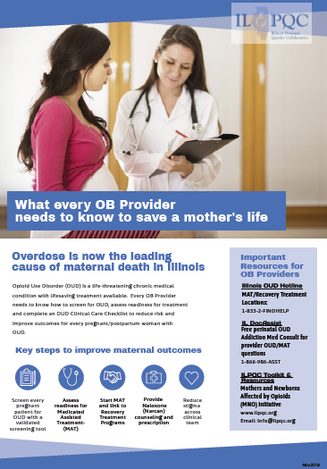
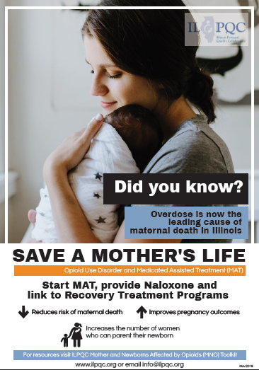

Slide 12
Mothers and Newborns affected by Opioids (MNO) 2018-2020
101 Birthing Hospitals in IL
91 Hospitals participated
2,095 patients with OUD delivered
(July 2018 – December 2020)
21,325 patients random sample of all deliveries
(July 2018 – December 2020)
Notes:
Here we show Illinois hospital participation in the ILPQC MNO-OB Initiative
Illinois has 101 birthing hospitals, and all hospitals joined the initiative.
92 teams submitted data into the ILPQC REDCap data system,
80 hospitals had hospital characteristics available for additional analysis.
In total, data on 2095 pregnant persons with OUD was collected through July 2018 - December 2020

Slide 13
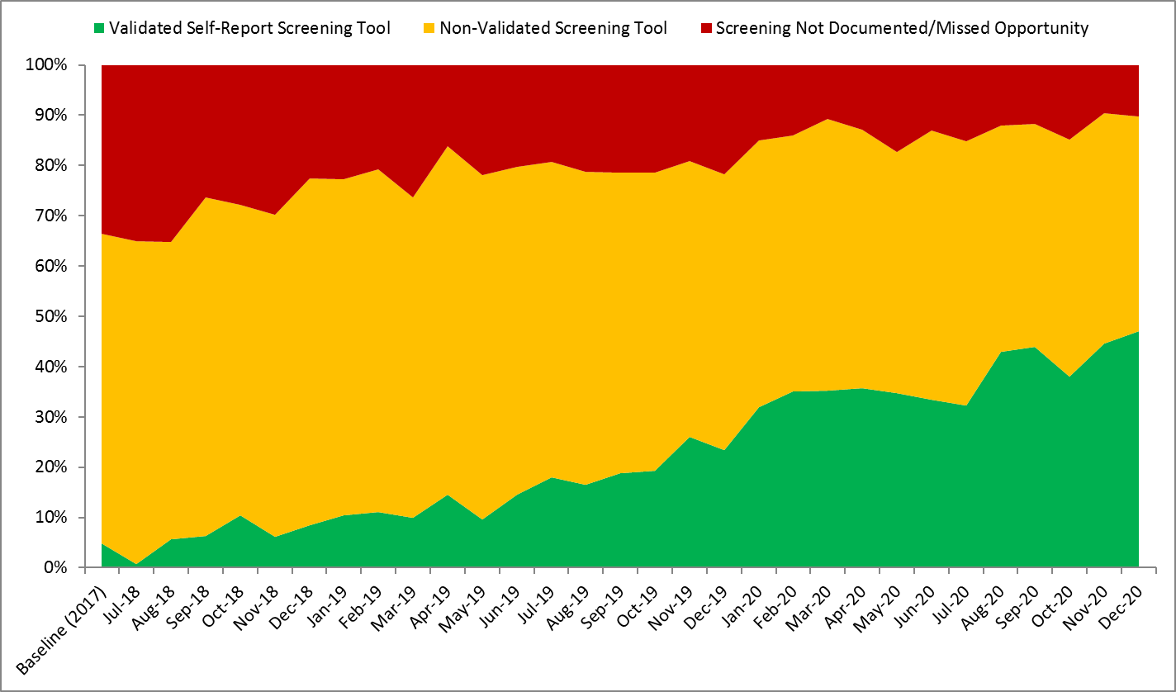
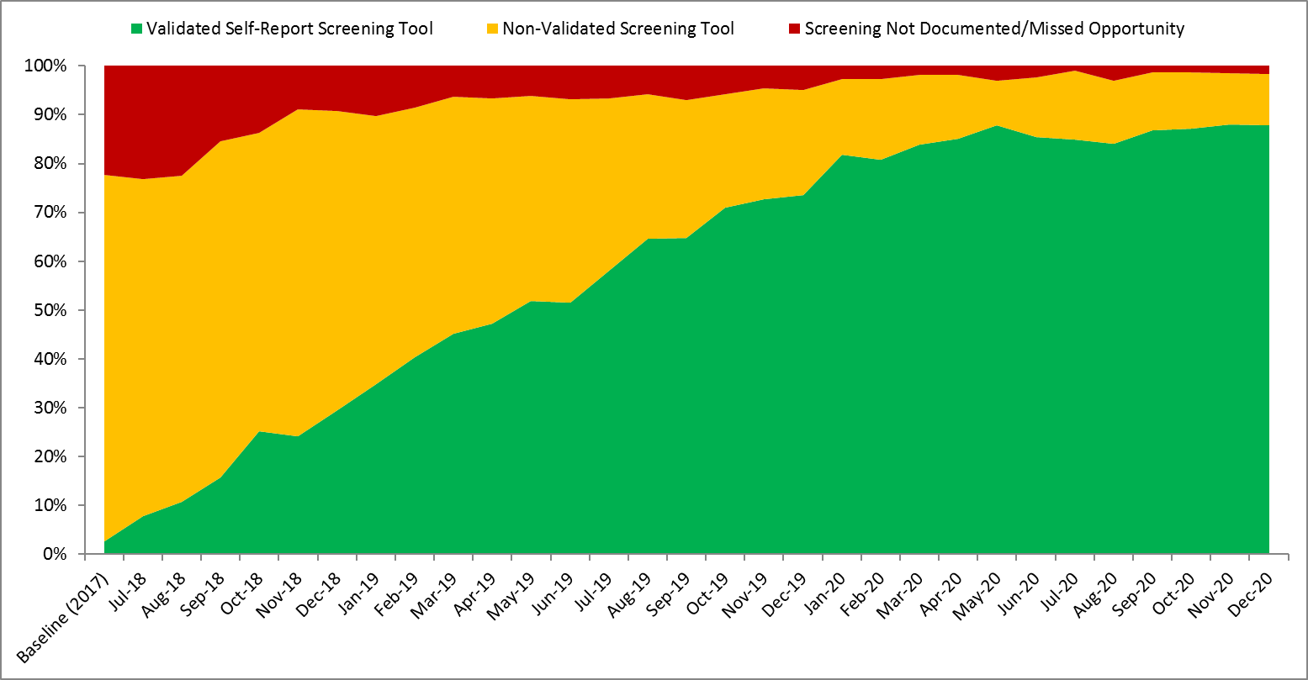
Validated Self-Report Screening for OUD
N = 21,320 patients
No Screening, Non-Validated Screening, Validated Screening
88%
42%
2%
2%
Prenatal
Labor and Delivery
Notes:
Random sample of all charts showing documentation of screening for universal verbal screening for OUD
*The 27,000 included 2021 data. 21320 is through 12/2020
Dan Confirm the numbers

Slide 14
Linking to MAT and Recovery Treatment Services
Linkage to MAT and Recovery Treatment Services prenatally or before delivery discharge increased from 40% baseline to > 70% goal over 2 years of the initiative
88%
41%
Notes:
24,430 screening
2,666 patients with OUD
1288 connected to MAT
Impact of initiative, # of patients in data set, # received MAT/RTS/ # received Narcan (Show the % of patients and the # of patients this touches), screening

Slide 15
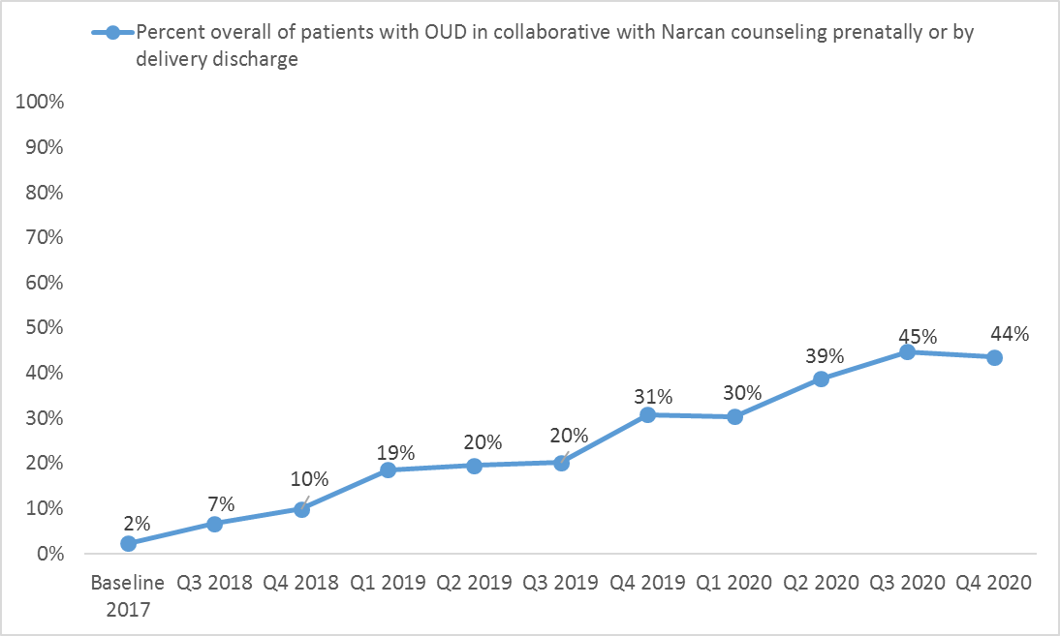
Providing Narcan Counseling
Teams increased Narcan counseling rates prenatally or before delivery discharge from 2% to over 40% across the initiative
44%
2%

Slide 16
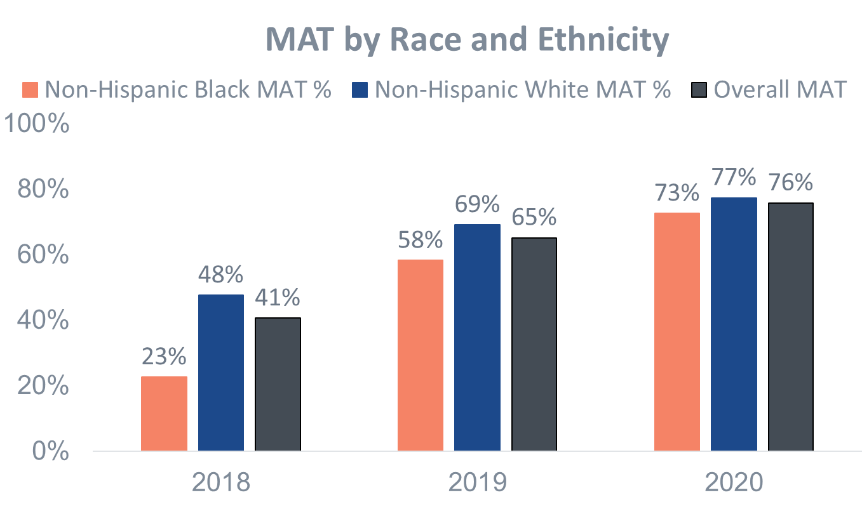
Improving equitable care and reducing disparities for patients receiving MAT
At baseline, Black patients with OUD were less likely to be on MAT, however across the initiative improvements in MAT rates were seen for all patients with the greatest improvement for Black patients.
Comparison of percent of patients with OUD receiving MAT by delivery discharge by race/ethnicity across the MNO Initiative
Notes:
Make the % blue and orange to match so you can see easily which has improved the most

Slide 17
Focus for Today: optimal OUD care EVERYWHERE
Is your clinical team aware that substance use disorder is now the leading cause of maternal death in IL and that providing optimal OUD care can reduce maternal deaths?
Are you providing Optimal OUD care for every perinatal patient, are you: screening for SUD, linkage to MAT / recovery treatment services, providing Narcan? Can you sustain optimal OUD care?
Are you aware of new resources every clinic, L&D, ER should be using?
  OUD Hotline 24/7 to link patients to MAR-Now: treatment start and care coordination
  DOPP program to provide free Narcan kits to your patients
  Angel’s Story - video for provider / nurse / staff education on why Optimal OUD care matters and why we must do better!

Slide 18
IL MMRC Data Overview
Cara Bergo, PhD, Maternal Mortality Epidemiologist, Illinois Department of Public Health

Slide 19
Illinois Maternal Morbidity
& Mortality
Cara Bergo, PhD MPH
Maternal Mortality Epidemiologist
Illinois Department of Public Health
Office of Women’s Health and Family Services
Notes:
-Ask what they know about MM

Slide 20
Maternal Mortality: The Tip of the Iceberg
Death
Severe
Morbidity
Minor
Complications
Healthy Pregnancy
Notes:
During 2018-2020, an average of 88 Illinois women died while pregnant or within one year of pregnancy
Maternal Mortality: general term used by Illinois to describe the death of a woman while pregnant or close in time to pregnancy
But death is only the most severe outcome along a continuum of morbidities and pregnancy complications
Each maternal death is a sentinel event that highlights critical issues in women’s health and healthcare
Much of what we measure as “maternal mortality” may actually be reflecting general problems in the health of women of reproductive age and we have chosen to shine a light on it for the period of conception to 1 year postpartum?

Slide 21
Maternal Mortality In Illinois

Slide 22
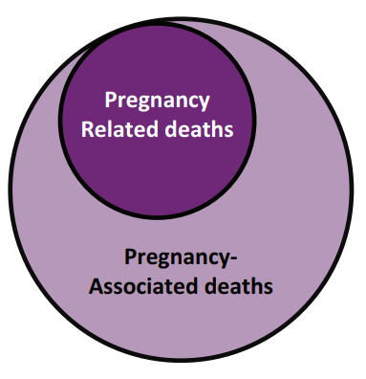
Important Definitions
Maternal Mortality: general term used by Illinois to describe the death of a woman while pregnant or close in time to pregnancy
Pregnancy-Associated Deaths: death while pregnant or within one year of pregnancy from any cause
Pregnancy-Related Deaths: death while pregnant or within one year of pregnancy from a cause related to a pregnancy

Slide 23

Illinois Review Committees
MMRC
MMRC-V
Maternal Mortality Review Committee
Established in 2000
Reviews deaths suspected to be medically related to pregnancy
Maternal Mortality Review Committee on Violent Deaths
Established in 2015
Reviews deaths resulting from homicide, suicide, drug overdose, or other drug-related causes
  Both committees serve as advisory bodies to the state Perinatal Advisory Committee and to IDPH
Notes:
In Illinois how we identify maternal deaths, report data and come up with ways to prevent future deaths is all through maternal mortality review committees.
Let’s give some background on maternal mortality review committees or MMRC’s. These are multidisciplinary committees that convene at the state level to comprehensively review deaths that occur during or within a year of pregnancy. Representatives from public health, obstetrics and gynecology, maternal-fetal medicine, nursing, midwifery, forensic pathology, mental and behavioral health, patient advocacy groups, and community-based organizations.
And really going back to these women’s stories, and the lives lost. The MMRCs review the medical records, the autopsy reports, EMS records, anything pertinent to how she lived and how she died. They look at a summary of the events that took place and what happened prior to the untimely death. They are learning the story and what went wrong and identifying ways that we can possibly do better in the future.
In Illinois we review information on all pregnancy associated deaths which includes all deaths during pregnancy or within on year of pregnancy.

Slide 24
Purpose & Vision of MMRC
Purpose: Determine contributing factors to maternal mortality and identify potential interventions to prevent future maternal deaths
Vision: Eliminate preventable pregnancy-related deaths in Illinois

Slide 25
An average of 88 pregnancy-associated deaths occurred each year during 2018-2020
Notes:
2021 & 2022

Slide 26
Black women continue to have the highest rate of pregnancy-related death
Pregnancy-Related Mortality Ratio (PRMR), By Race Ethnicity, Illinois 2015-2017 vs. 2018-2020

Slide 27
Pregnancy-related mortality increased among women on Medicaid

Slide 28
Pregnancy- related deaths have increased in all geographic areas
Pregnancy Related Mortality Ratio (PRMR) By Geography, Illinois 2015-2017 vs. 2018-2020

Slide 29
Substance use disorder continues to be the leading cause of pregnancy-related death
Underlying Cause of Death Categories for Pregnancy-Related Deaths, Illinois 2018-2020
Cause of Death Category | Number of Pregnancy-Related Deaths | Percent of Pregnancy-Related Deaths
Substance Use Disorder | 36 | 32%
Cardiac and Coronary Conditions | 16 | 14%
Pre-existing Chronic Medical Condition* | 13 | 12%
Sepsis (blood stream infection) | 10 | 9%
Mental Health Conditions resulting in suicide** | 9 | 8%
All Other Causes Combined | 29 | 25%
** These deaths were related to health conditions that women were known to have prior to pregnancy, including: autoimmune disease, sickle cell disease, diabetes, connective tissue disease, seizure disorder, lupus, chronic cirrhosis, and end-stage renal disease. These deaths are included as “non-cardiovascular deaths” by the CDC PMSS ** Includes deaths due to depression, schizophrenia, and bipolar disorder
Notes:
Describe SUD and how we see it as pregnancy related
The vast majority (~90% of substance use disorder deaths have another mental health condition contributing to the death)
They are intertwined factors that need to be addressed together. It is also sometimes hard to tell which began first.
Describe how hemmorhage went down but up in 2020

Slide 30
Most pregnancy-related deaths due to substance use disorder involved opioids, specifically fentanyl, and were due to 2 or more substances.
Data Sources: IDPH MMRC-V Data, 2018-2020

Slide 31
Timing of pregnancy-related deaths differs by cause of death
Data Sources: IDPH Maternal Death Tracking Data

Slide 32
Anne’s Story
Notes:
Anne’s Story Anne was a White woman in her 30s with a history of substance use disorder. She was on methadone for her substance use disorder for several years until she moved to Illinois from another state during her first trimester. She started prenatal care in Illinois during her second trimester and during one visit was given information to contact nearby substance use treatment facilities. Throughout the rest of her pregnancy, the prenatal care provider did not have any further discussions with her about substance use treatment. During her third trimester, she had a positive urine drug screening, but no treatment information was provided. After delivery, she had another positive urine drug test, and her baby was taken into Illinois Department of Children and Family Services (DCFS) care. At discharge from her delivery hospitalization, Anne was not connected with any substance use disorder treatment or recovery services. In the weeks that followed, Anne had multiple emergency department visits for heart problems where she disclosed substance use but did not receive referrals to substance use treatment or outpatient cardiology. Two months after delivery, she passed away from heart failure related to her substance use.
What can we learn from Anne’s death?
Lack of proper coordination into substance use disorder treatment programs for pregnant and postpartum women continues to be an issue for Illinois women. Anne disclosed her substance use to providers in many different health care settings, including during multiple emergency department visits, but did not receive a warm handoff to treatment or recovery services. Community-based support services are beneficial for women with substance use disorder to ensure they receive necessary referrals and care coordination to specialty providers. Clinical professionals interacting with women during pregnancy should have knowledge of community-based resources and support connecting patients to them.

Slide 33
Recommendations to Prevent Future Substance Use Disorder Deaths
Health care providers should adopt a validated self-reported screening tool and initiate medication-assisted recovery (MAR) services.
Hospitals and health systems should develop standardized protocols and policies to assure implementation of high-quality delivery of substance use care
Community-based organizations should expand substance use harm reduction and peer support programs.
State agencies should implement plans of safe care

Slide 34
Comments? Questions?
Please contact: cara.bergo@illinois.gov
Illinois Maternal Mortality Report: https://dph.illinois.gov/content/dam/soi/en/web/idph/publications/idph/topics-and-services/life-stages-populations/maternal-child-family-health-services/maternal-health/mmmr/maternal-morbidity-mortality-report2023.pdf

Slide 35
IL DHS MAR NOW and DOPP Overview
Nicole Gastala, MD, Medical Director Substance Use Prevention and Recovery, IL Department of Human Services
Kathleen Monahan, State Opioid Response Project Director, IL Department of Human Services

Slide 36


Lowering Barriers to MOUD:
Illinois Medication Assisted Recovery Now (MAR NOW)
Telehealth Hotline

Slide 37
Background on MAR

Slide 38
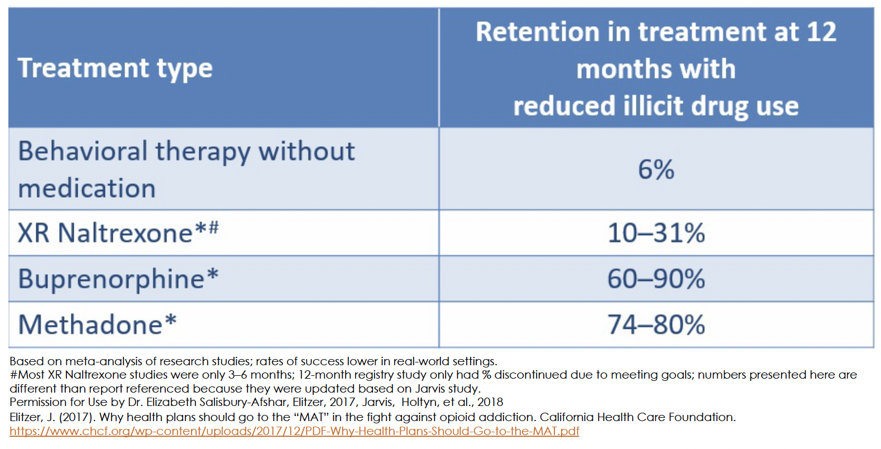
Evidence clearly indicates MAR is an effective treatment and harm reduction intervention

Slide 39
Discussing medications that can treat OUD with patients who have this disorder is the clinical standard of care. –
SAMHSA Tip 63
As compared to behavioral therapy alone, MOUD:
1) decreases illicit opioid use, 2) retains patients in treatment, and 3) reduces mortality

Slide 40
MOUD and Mortality
Number Needed to Treat to Prevent 1 Death in 1 Year
Statins 415
Mammogram 2970
Buprenorphine after an overdose 33
Methadone after an overdose 31

Slide 41
MAR NOW Program Overview

Slide 42
MAR NOW is now statewide:
a phone call can navigate your patients to OUD Treatment
Operates through the existing 24/7 IL Helpline for Opioids and Other Substances: 833-234-6343
Provides low-barrier, rapid access to buprenorphine, methadone, and naltrexone to all callers regardless of insurance status, income, ability to pay, or documentation status.

Slide 43
Program provides access to medication within 48 hours of first call
Patient Options:
Buprenorphine home induction
Same or next-day MAR appointment at FGC (methadone, buprenorphine, naltrexone)
Connection to other SUD care in the community (withdrawal management, residential treatment)
Individual calls 24/7 IL Helpline for OUD treatment, withdrawal support
IL Helpline directly transfers caller to MAR NOW Care Manager
24/7 Access
Connected to Care Manager & Provider
Care Managers provide free transportation, insurance enrollment, assistance with pharmacy access, and follow up to ensure patient is connected to long-term care

Slide 44
Hub and spoke model to ensures connection to ongoing community care
MAR NOW works closely with pharmacies to ensure that they have medications available and are able to assist patients
Mental health providers
Pharmacies
Mental health, primary care, and harm reduction services are key referral points to and from MAR NOW
Harm reduction providers
MAR NOW
Primary care providers
All patients connected to outpatient MAR for long-term treatment in the community
Cook County Jail
Program is working closely with jail and homeless shelter providers to offer linkage to MAR NOW
Community MAR providers
Homeless shelters and encampment outreach
Patients that leave treatment can come back to MAR NOW and be connected again to treatment in the community. MAR NOW can also serve as a bridge clinic for patients waiting for care.

Slide 45
Where to initiate MAR treatment via MAR NOW? Everywhere!
Emergency Department, Urgent Care, Outpatient, Inpatient
  Ask patient if they are interested in starting medication, re-starting medication or being connected to services for opioid use disorder
    If yes, have a team member give the patient access to a phone and help them call MAR NOW: (833) 234-6343
    The MAR (Medication-Assisted Recovery) team will take it from there including starting medication, case management, help with insurance, transportation and follow up
      ER/inpatient/clinic team can also start MAR if medically appropriate and MAR NOW case management team will coordinate follow-up and continuation
* MAR = Medication Assisted Recovery

Slide 46
Initial Program Data & Learnings

Slide 47
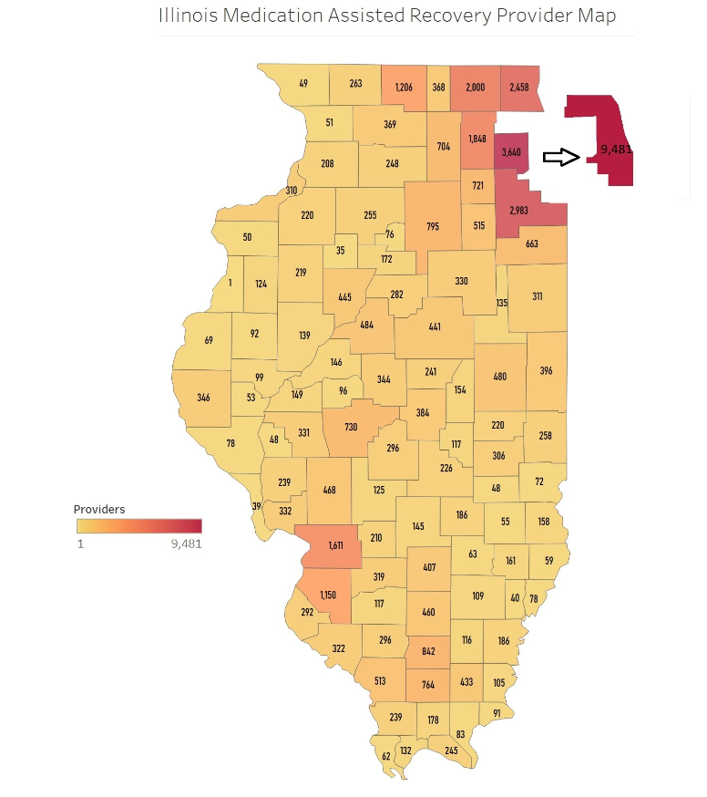

Slide 48
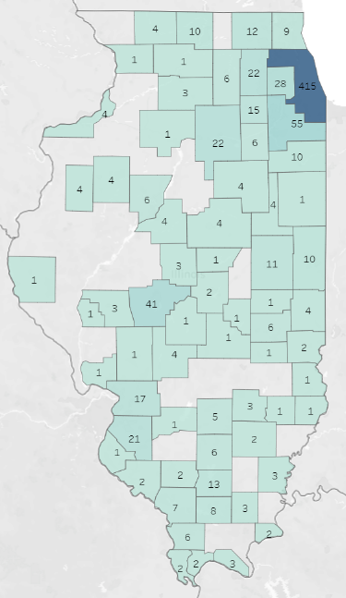

HHelpline Calls Transferred to MAR Now
Data is from
May 2022 – August 10th, 2023
County | Transferred Calls
Adams | 1
Alexander | 2
Bureau | 1
Carroll | 1
Champaign | 11
Christian | 1
Clark | 2
Clay | 3
Clinton | 1
Coles | 6
Cook | 415
Crawford | 1
Cumberland | 1
DeKalb | 6
DeWitt | 1
Douglas | 1
DuPage | 28
Edgar | 4
Ford | 4
Franklin | 13
Grundy | 6
Hardin | 2
Iroquois | 1
Jackson | 7
Jefferson | 6
Jersey | 1
Kane | 22
County | Transferred Calls
Kankakee | 10
Kendall | 15
Knox | 4
Lake | 9
LaSalle | 22
Lawrence | 1
Lee | 3
Livingston | 4
Logan | 3
Macon | 2
Macoupin | 1
Madison | 17
Marion | 5
Massac | 3
McHenry | 12
McLean | 4
Monroe | 1
Montgomery | 4
Morgan | 3
Moultrie | 1
Ogle | 1
Peoria | 6
Perry | 2
Pulaski | 2
Randolph | 2
Richland | 1
Rock Island | 4
Saline | 3
Sangamon | 41
County | Transferred Calls
Scott | 1
Shelby | 1
St. Clair | 21
Stephenson | 4
Tazewell | 4
Union | 6
Vermilion | 10
Warren | 4
Wayne | 2
White | 3
Will | 55
Williamson | 8
Winnebago | 10
Not Recorded | 395

Slide 49
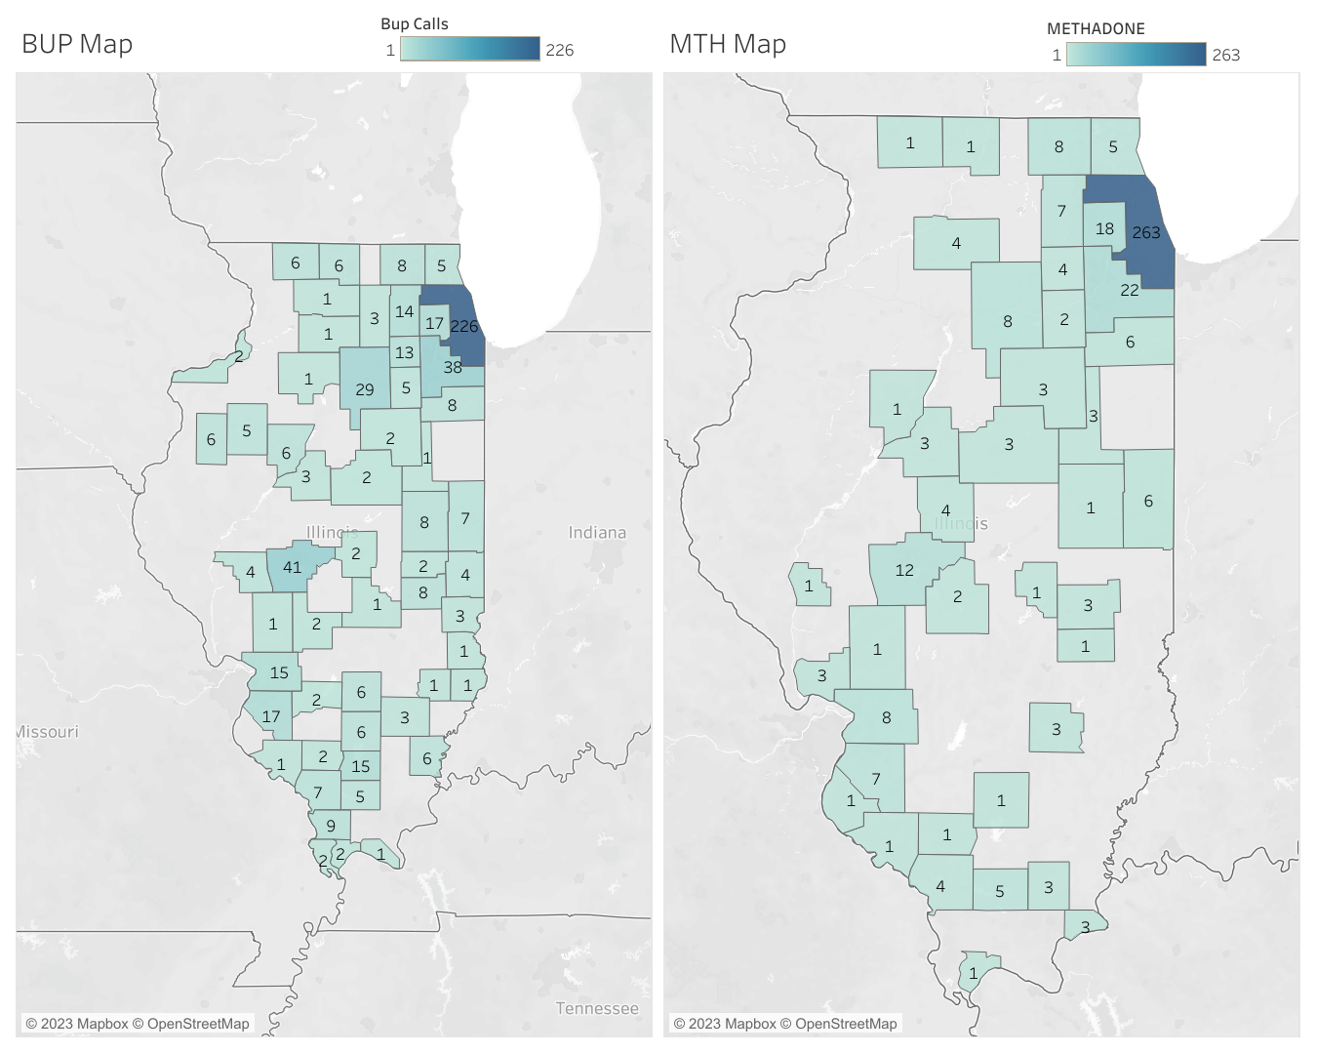
Helpline Calls Transferred to MAR Now for Callers Seeking Buprenorphine Services
Data is from
May 2022 – August 10th, 2023
County | Transferred Calls
Alexander | 2
Bureau | 1
Champaign | 8
Clark | 3
Clinton | 2
Coles | 8
Cook | 226
Crawford | 1
DeKalb | 3
Douglas | 2
DuPage | 17
Edgar | 4
Ford | 1
Franklin | 15
Grundy | 5
Jackson | 7
Jefferson | 6
Kane | 14
Kankakee | 8
Kendall | 13
County | Transferred Calls
Knox | 5
Lake | 5
LaSalle | 29
Lawrence | 1
Lee | 1
Livingston | 2
Macon | 2
Macoupin | 1
Madison | 15
Marion | 6
Massac | 1
McHenry | 8
McLean | 2
Montgomery | 2
Morgan | 4
Ogle | 1
Peoria | 6
Perry | 2
Pulaski | 2
Randolph | 1
County | Transferred Calls
Richland | 1
Rock Island | 2
Sangamon | 41
Shelby | 1
St. Clair | 17
Stephenson | 6
Tazewell | 3
Union | 9
Vermilion | 7
Warren | 6
Wayne | 3
White | 6
Will | 38
Williamson | 5
Winnebago | 6

Slide 50
Helpline Calls Transferred to MAR Now for Callers Seeking Methadone Services
County | Transferred Calls
Champaign | 1
Christian | 2
Clay | 3
Coles | 3
Cook | 263
Cumberland | 1
DuPage | 18
Ford | 3
Grundy | 2
Hardin | 3
Jackson | 4
Jefferson | 1
Jersey | 3
Kane | 7
Kankakee | 6
Kendall | 4
County | Transferred Calls
Lake | 5
LaSalle | 8
Lee | 4
Livingston | 3
Logan | 4
Macoupin | 1
Madison | 8
McHenry | 8
McLean | 3
Monroe | 1
Moultrie | 1
Peoria | 1
Perry | 1
Pulaski | 1
Randolph | 1
Saline | 3
Sangamon | 12
County | Transferred Calls
Scott | 1
St. Clair | 7
Stephenson | 1
Tazewell | 3
Vermilion | 6
Will | 22
Williamson | 5
Winnebago | 1
Data is from
May 2022 – August 10th, 2023

Slide 51
Initial data indicates program model successfully connects patients to care
May 9, 2022 – January 7, 2024: MAR NOW Call Data
 | Number | Percent of Total
Calls from patients seeking OUD care | 1425
Patients seeking methadone | 277 | 20%
Patients seeking buprenorphine | 1060 | 74%
Patients seeking withdrawal management w/ medical stabilization on MAR | 55 | 4%
Patients seeking residential treatment | 33 | 2%
May 9, 2022 – January 7, 2024: Patient Connection Data
 | Number | Percent of Total
Methadone patients attended first appointment | 226 | 82%
Buprenorphine patients connected to medication | 1044 | 98%
Withdrawal management & medical stabilization patients who showed at appointment | 53 | 96%
Residential treatment patients who showed at appointment | 30 | 91%
*Note: connection to care pending for recent callers, data current as of January 7
Connection to care is high across all treatment options.
Patients connected to withdrawal management and medical stabilization are also connected to FGC's mobile van and MAR.

Slide 52
Initial data demonstrates home induction is safe and effective
May 9, 2022 – January 7, 2024: Buprenorphine Patient Data
 | Number | Percent of Total
Calls from patients seeking buprenorphine | 1060
Buprenorphine patients connected to medication | 1044 | 98%
Patients connected to medication that received home induction | 978 | 94%
Patients connected to medication that received in-person induction | 66 | 6%
Home induction patients connected to a community provider for ongoing care | 960 | 98%
Home induction patients that experienced adverse events during induction | 2 | 0.2%
Home induction patients terminated from care due to suspicions of misuse or diversion | 0 | 0%
*Note: connection to care pending for recent callers, data current as of January 7
FGC physicians provide a 14-day prescription for home induction, after which patients are connected to a community provider.

Slide 53
Early Learnings
Providing transportation to clinic appointments and pharmacies lowers barriers to care and increases first appointment attendance rate
Concerted outreach to pharmacies is required to ensure that buprenorphine is available and pharmacists will fill prescriptions
Patients often need intensive follow-up from Care Managers to ensure they can make it to their first appointment.
Operating through the existing IL Helpline for Opioids and Other Substances provides baseline patient demand, aligns City and State efforts, streamlines expansion of program statewide, and allows for patient data matching to capture more information on demographics
Calls for withdrawal management and residential treatment are common, and provide opportunity for education around buprenorphine treatment.

Slide 54


Receive free Narcan point-of-care kits to provide to patients
Enroll in the Illinois Drug Overdose Prevention Program (DOPP)
Once approved and registered, order no-cost Narcan kits to distribute to patients/clients
Give out a Narcan Kit and SAVE A LIFE TODAY
Website: DHS.Illinois.gov/accessnarcan

Slide 55
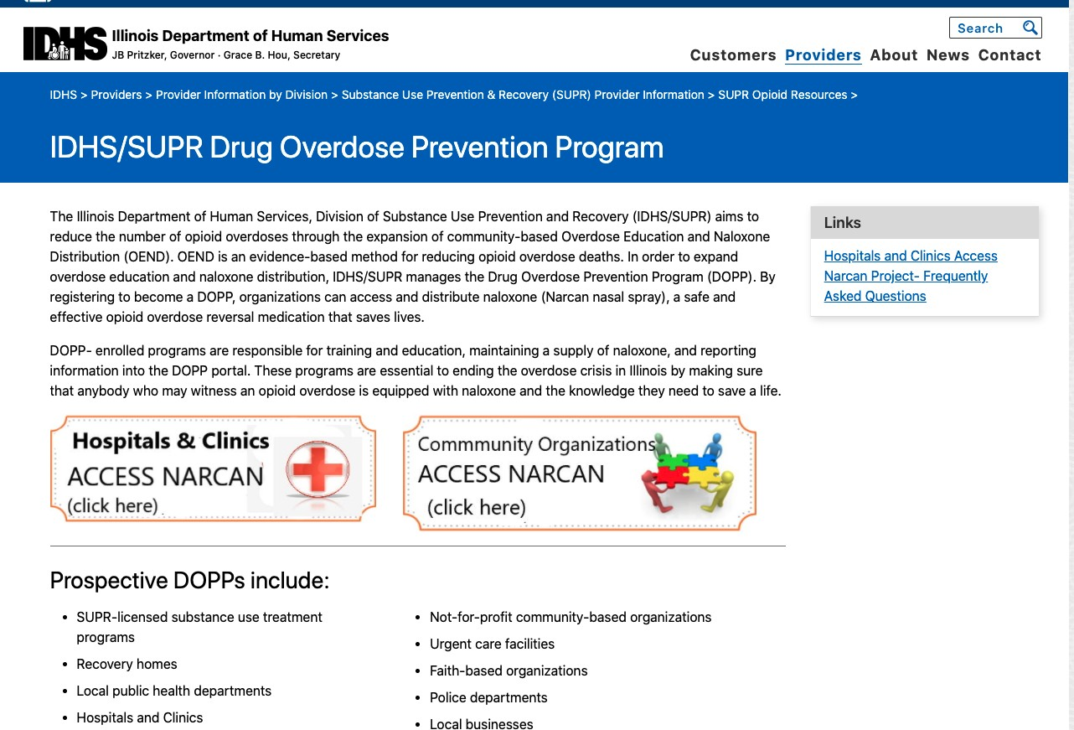
The Drug Overdose Prevention Program: sign up

Slide 56
Access Narcan – That’s it!
Once no-cost Narcan account is set-up, login with credentials
Submit order – we suggest max 10 cases per order to start
Will be approved by SUPR within a few days
Narcan shipped via 2-day FedEx
Organization can order as much as is necessary to meet patient/community needs without hoarding

Slide 57
State Opioid Response
Naloxone Saturation
Illinois is investing $12+million to make nasal naloxone more widely available
Goal to saturate the state with naloxone.
For Calendar Year 2023, 365,028 2-dose boxes of Narcan were shipped in Illinois
Sign up today and start handing out free kits
Website: DHS.Illinois.gov/accessnarcan

Slide 58
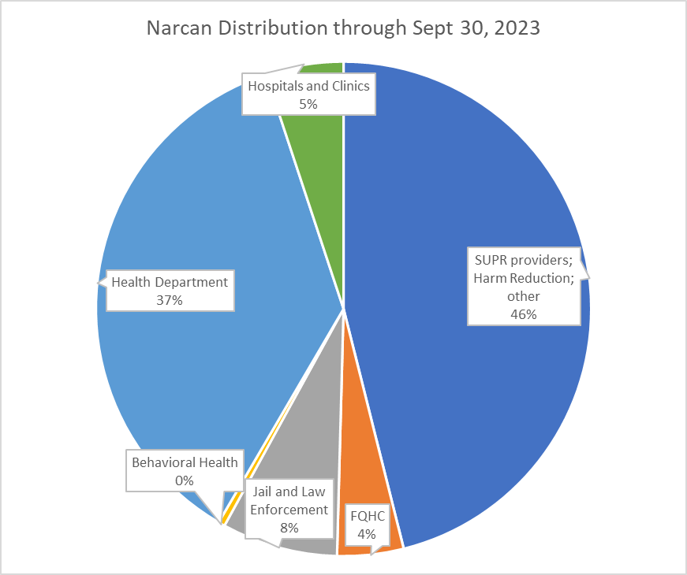
State Opioid Response
Narcan Distribution by Category

Slide 59
For DOPP Questions Contact
DHS.DOPP.Coordinator@Illinois.gov
For Access Narcan Questions Contact
Kathleen.Monahan@Illinois.gov

Slide 60
ILPQC Hospital Sharing: Actionable Outpatient Strategies Based on MMRC Recommendations
Katherine Austman, MD, Gibson Area Hospital

Slide 61
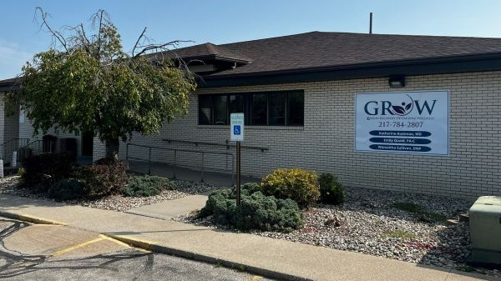

Slide 62
OB Providers should adopt a universal, validated, self-reported screening tool for substance use disorders at the first prenatal care visit, delivery admission, and postpartum visits.

Slide 63
Screening
Verbal / written self reported screening for SUD
– recommended by most major medical societies
  Validated tools
    NIDA (now TAPS)
    5 P’s (pregnancy)
    CRAFFT (adolescents)
NIH NIDA resource

Slide 64

Providers should review the prescription monitoring program (PMP) and document results of that review before prescribing controlled substances.
IL Prescription Monitoring Program

Slide 65
Healthcare providers, including emergency department and obstetric providers, should use the state opioid hotline and MARNow program to link patients to medication-assisted recovery services

Slide 66


MAR NOW

Slide 67


All hospitals should engage in the Drug Overdose Prevention Program (DOPP) to be able to provide point of care Narcan for pregnant and postpartum patients during delivery admission or in the emergency department

Slide 68
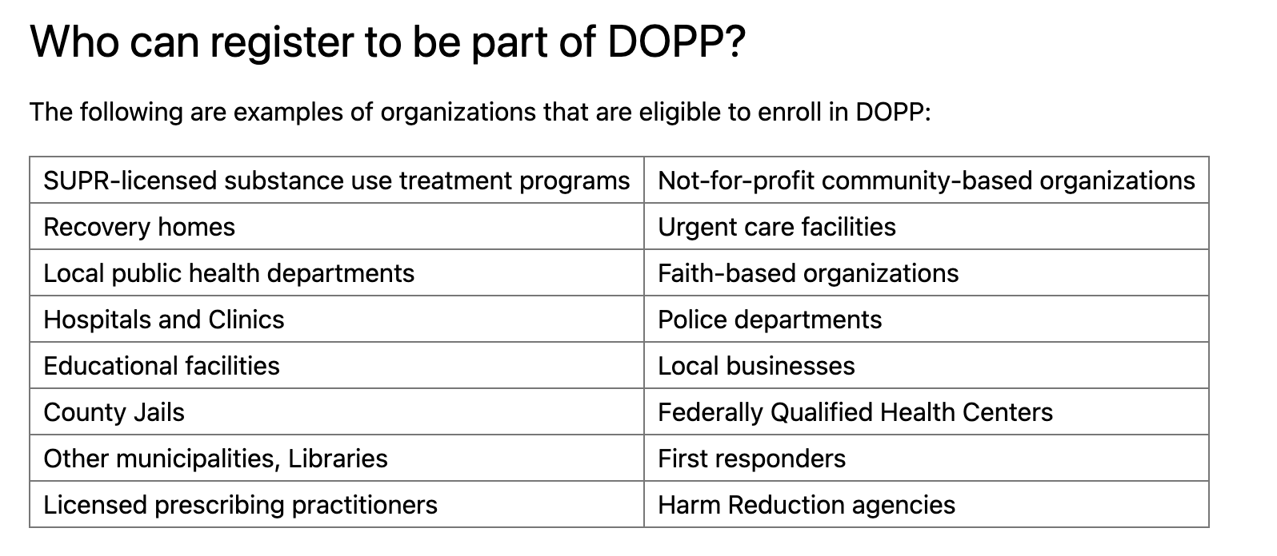

Slide 69
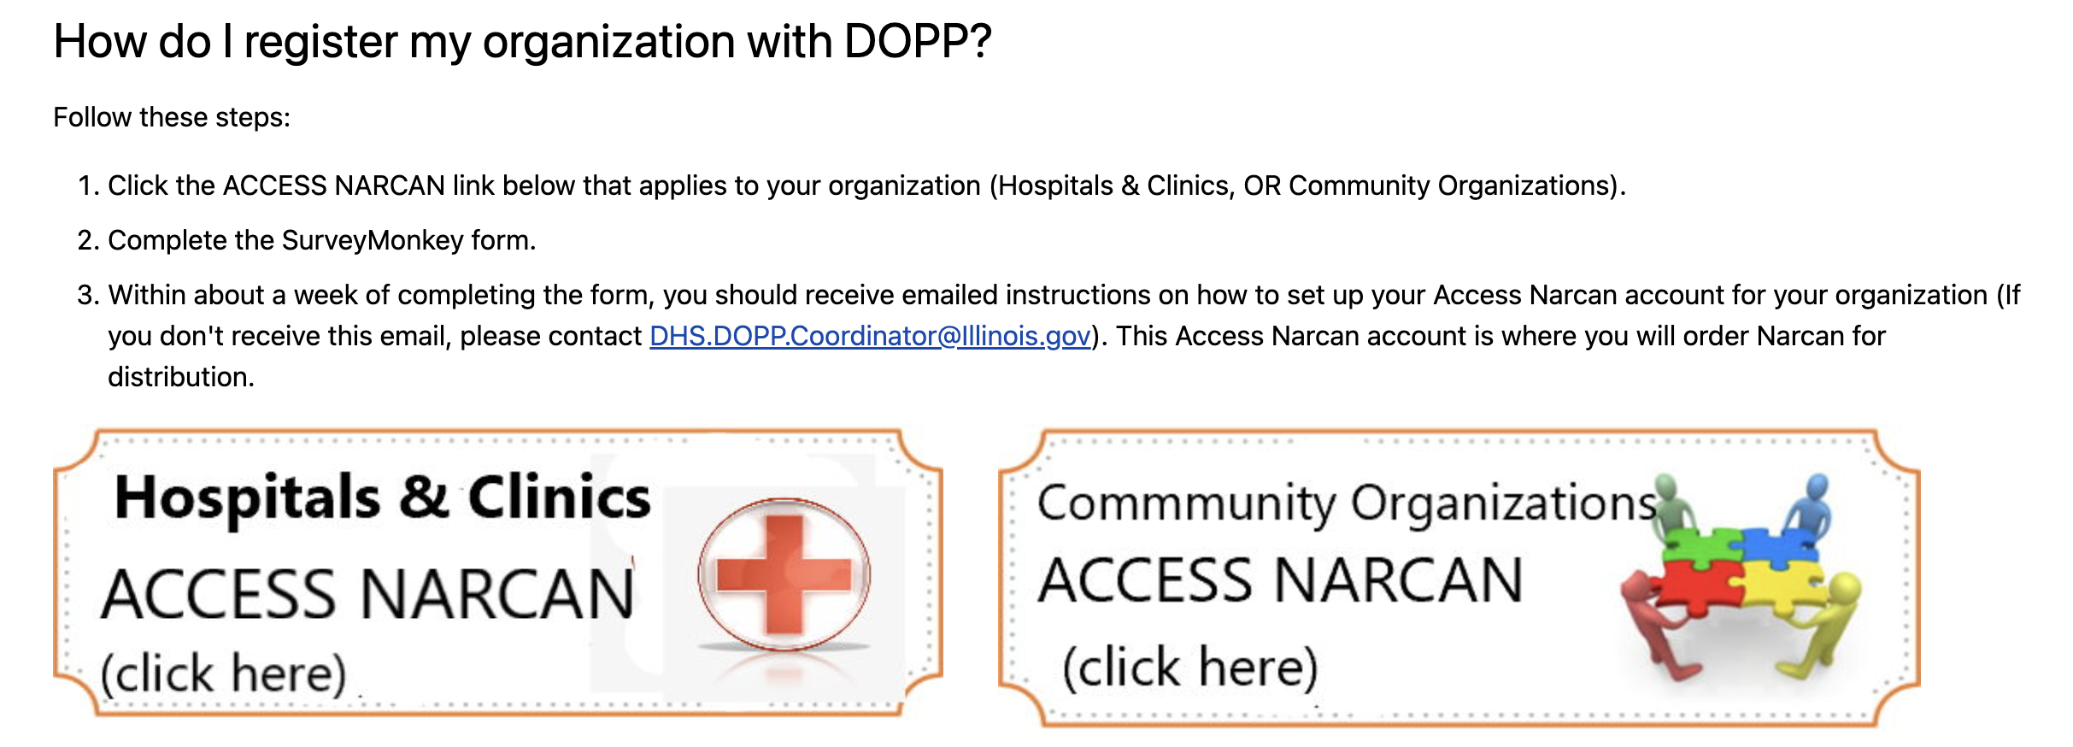

Slide 70
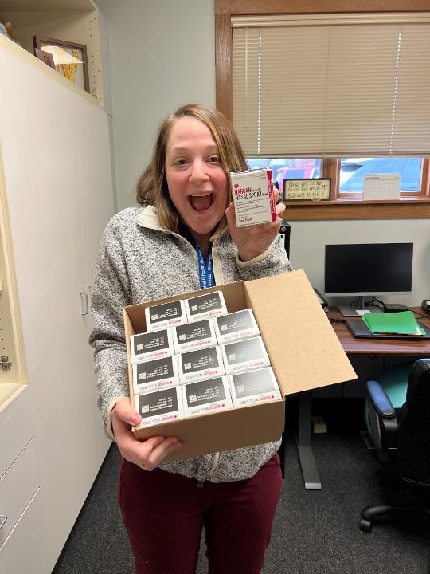

Slide 71
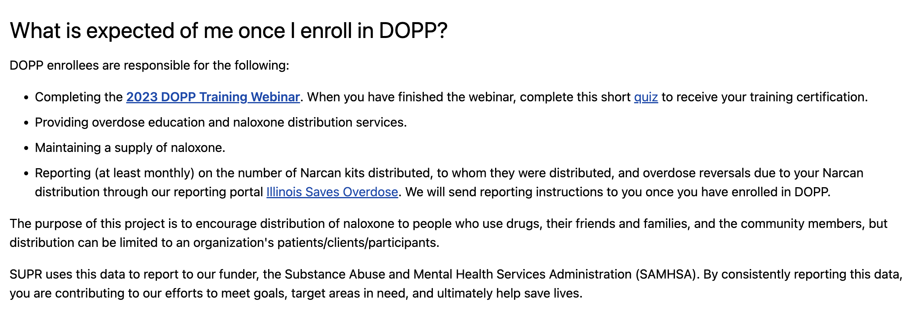

Slide 72
Resources and Next Steps

Slide 73
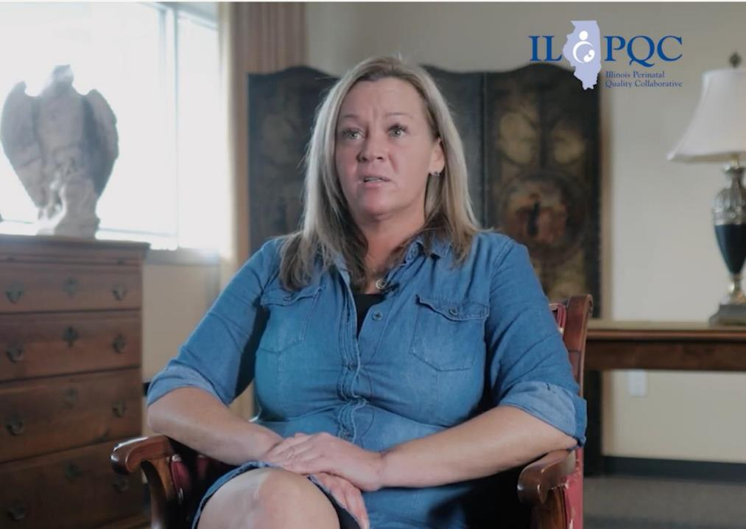
Angel's Story
ILPQC provider education video
An inspiring patient story that touches on the importance of SBIRT, reducing stigma and providing Narcan to all at-risk patients
Find this video on our youtube channel or ilpqc.org

Slide 74
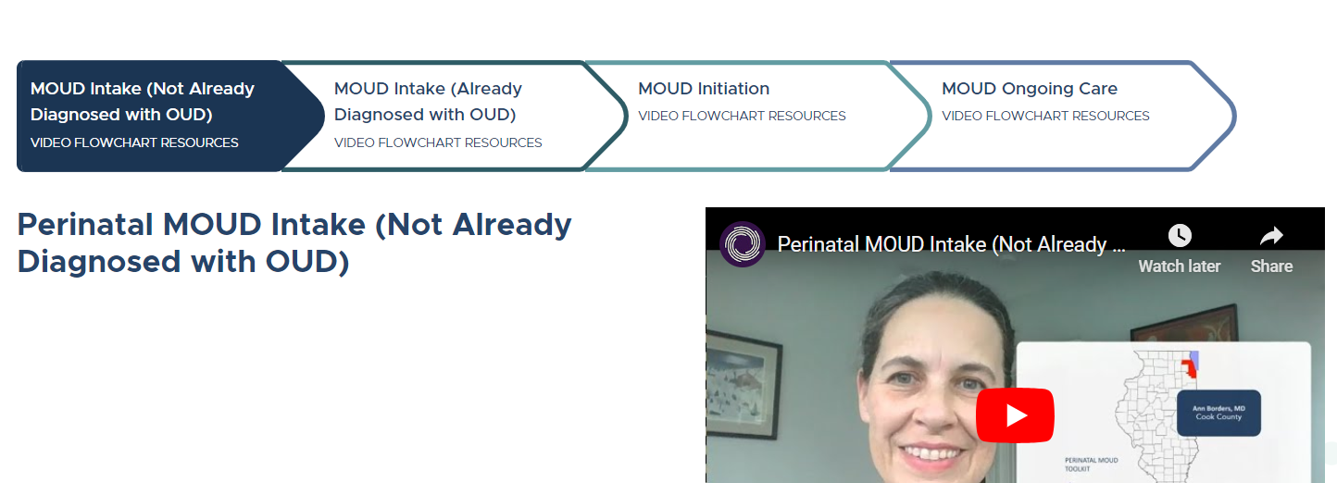
NEW Perinatal MOUD Videos
Watch here: https://e.helplineil.org/perinatal/

Slide 75

IL DocAssist
Warmline for free perinatal substance use technical/clinical support for providers caring for OUD patients

Slide 76
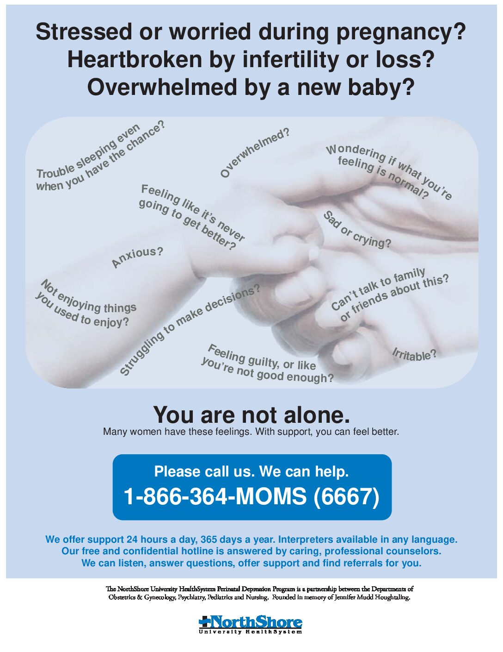
IL MOMS Hotline
A free, confidential 24-hour hotline—866.364.MOMS (6667) — for residents of Illinois to help find perinatal mental health information, support and linkage to resources.

Slide 77

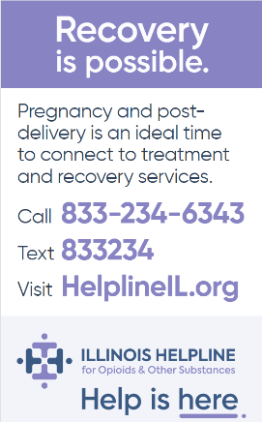


OUD Helpline Communication Campaign for OB Clinics, ED Units, L&D units, Community Groups
Magnet
Wallet Card
Provider poster
Order FREE materials here -->
To Order IL Helpline Wallet Cards & Posters
https://store.helplineil.org/

Slide 78
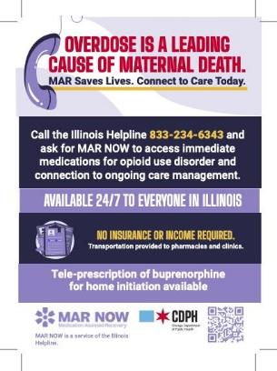


Order/Download Materials for FREE!
To Order IL Helpline Wallet Cards & Posters
https://store.helplineil.org/
To Download FREE MAR NOW Posters & Resources
https://www.chicago.gov/city/en/depts/cdph/supp_info/behavioral-health/overcome-opioids/overcome-opioids-resources.html

Slide 79
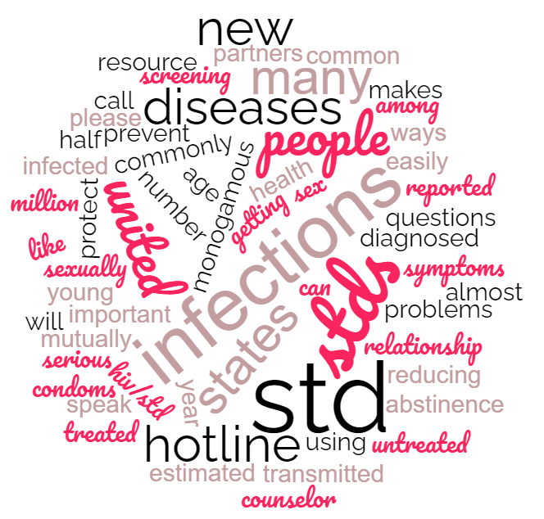
IDPH resources to address increasing incidence of STIs
Maura Quinlan, MD MPH
Women’s Health Medical Advisor, IDPH

Slide 80
Congenital Syphilis Cases in Illinois
30
22

Slide 81
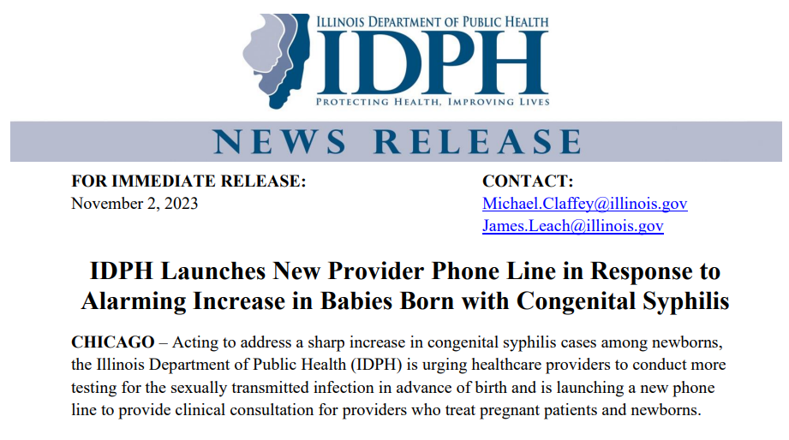

Perinatal syphilis warmline launched 11/1/2023
(800) 439-4079

Slide 82
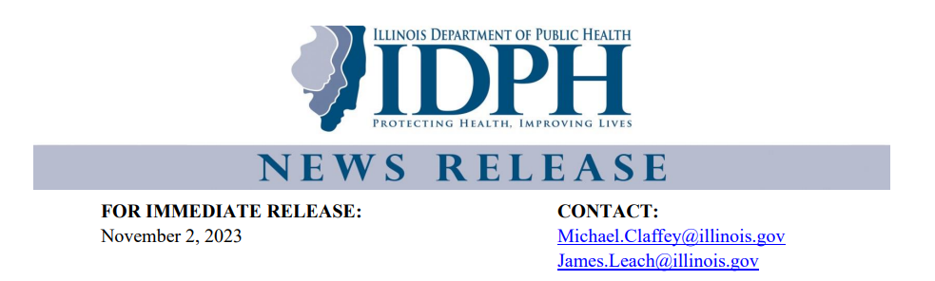
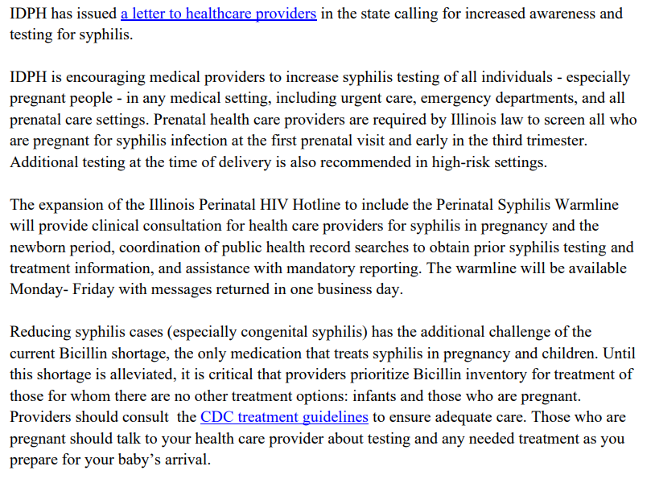

Slide 83
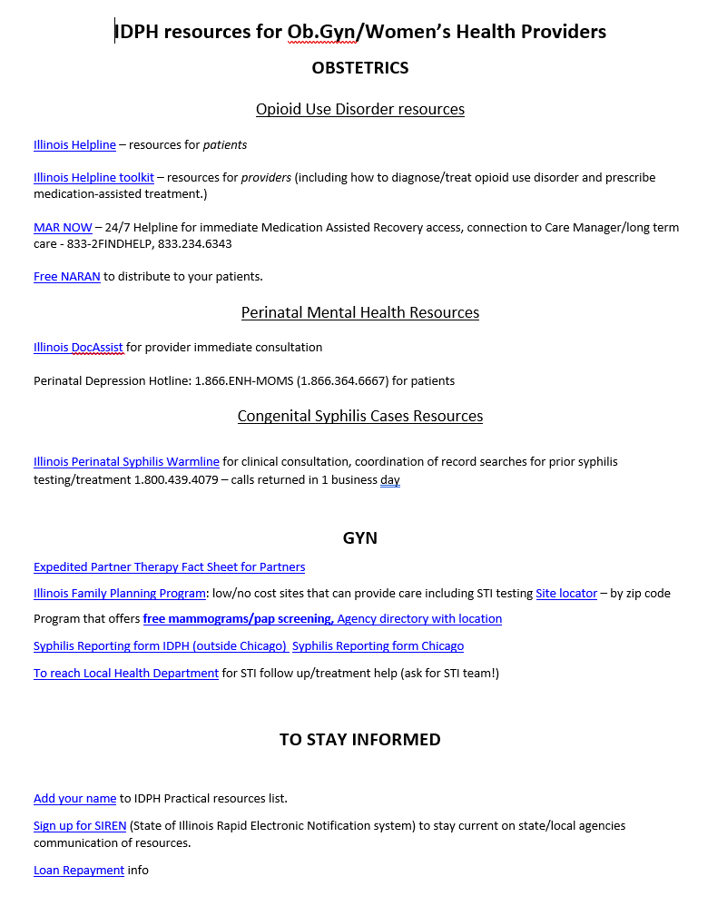

All IDPH resources in one place!
Scan above for resource list!
Reach out with questions: Maura.Quinlan@illinois.gov

Slide 84




Understanding Hospital
Approaches to Toxicology Testing
become part of the national conversation!
A team of researchers are working with state perinatal quality collaboratives to better understand hospital approaches to substance use screening, toxicology testing, and reporting.
We’re curious about your hospital’s pregnancy tox screening practices.
Help standardize our approaches & shape policy with our quick web-based survey.
8 IL hospitals have already chimed in. Join us!
access the survey here:
https://redcap.link/toxpracticesurvey
Questions? Reach out to: 617-798-0905 or mghtoxsurvey@mgb.org

Slide 85


Slide 86









Thanks to our Funders
In kind support:

