Slide 1

MNO-OB Crossing the Finish Line, Preparing for Sustainability
March 8, 2021
12:30 – 1:30pm

Slide 2
Call Overview
Housekeeping Items
MNO-OB Finishing Strong and Preparing for Sustainability
MNO-OB Learning Other Teams Plans for Sustainability
Round Robin Sharing

Slide 3

Build Your Teams QI Capacity!
Are you or a member of your hospital QI team looking to learn and build quality improvement skills and strategies?
ILPQC will be offering every ILPQC hospital team at least 1 spot for a member to take QI courses with the Institute for Healthcare Improvement (IHI) Open school for two years!
Details coming Summer 2021!

Slide 4


Slide 5

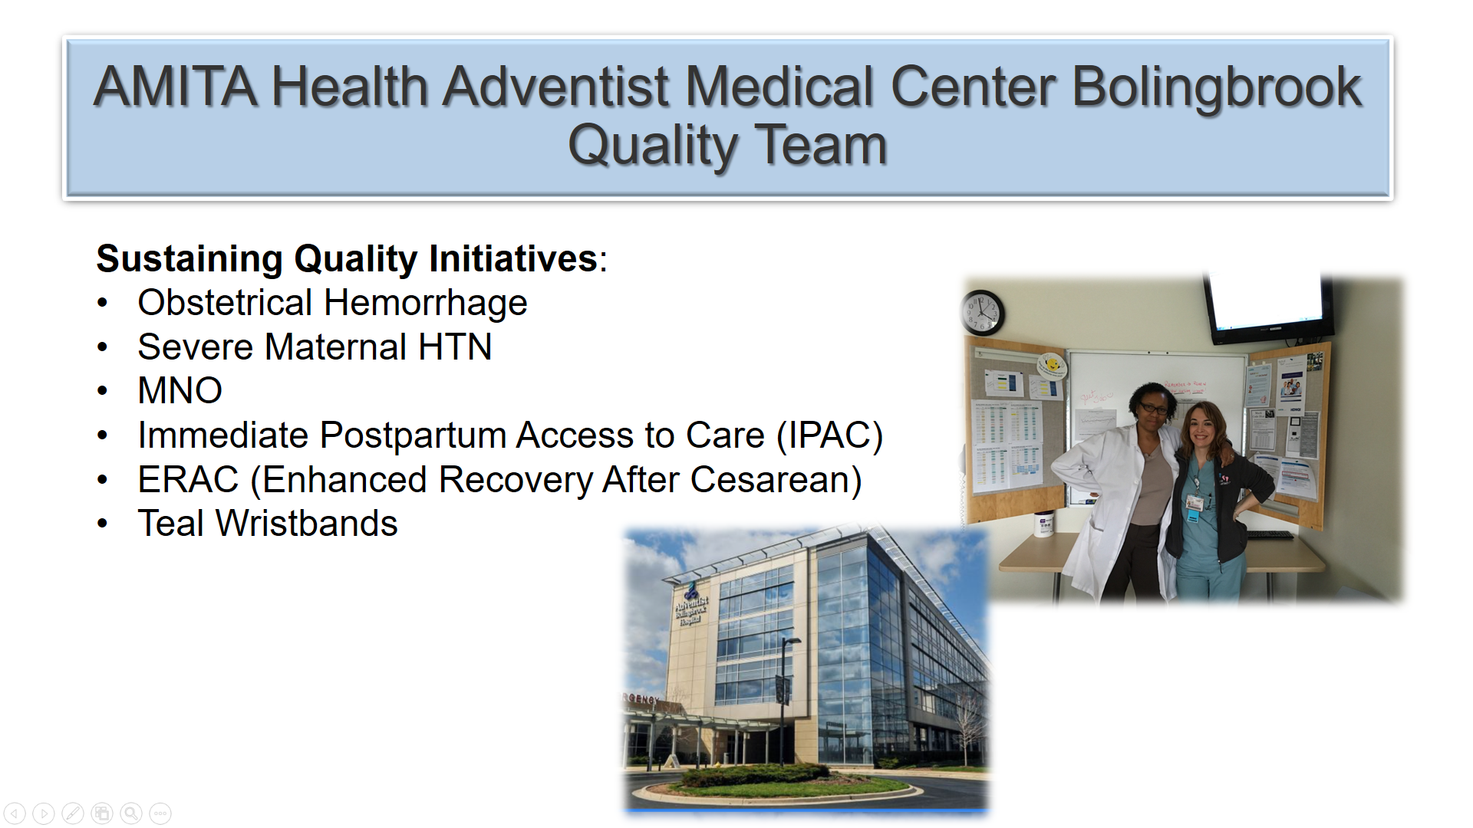
You are ILPQC!
Get READY… ILPQC wants to celebrate you during our virtual Face-to-Face!
Coordinate with your colleagues to create a slide or send in a picture to celebrate your QI team
Ideas to include on slide:
  Team/Hospital Picture
  Picture of QI bulletin board
  Location/Region
  Birth Volume/NICU Beds
  Perinatal Level and Network
  Current & Future Initiatives
  Contact information for your team for collaboration
Submit by emailing your slide or picture to info@ilpqc.org

Slide 6

2021
Annual Conference
October 28th, 2021

Slide 7
MNO-OB: Finish Strong & Prepare for Sustainability

Slide 8
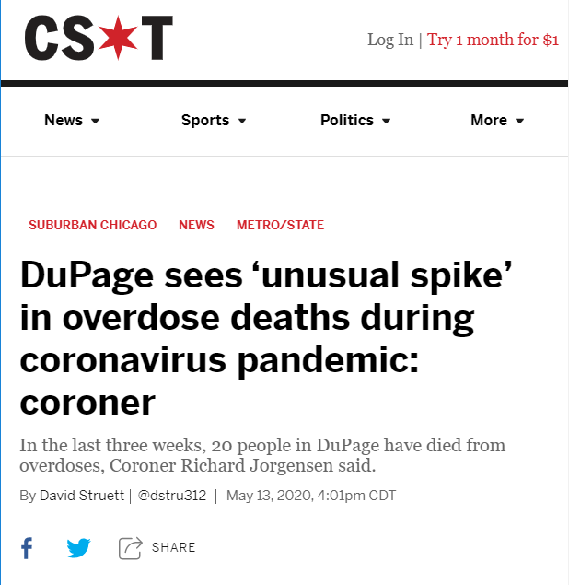
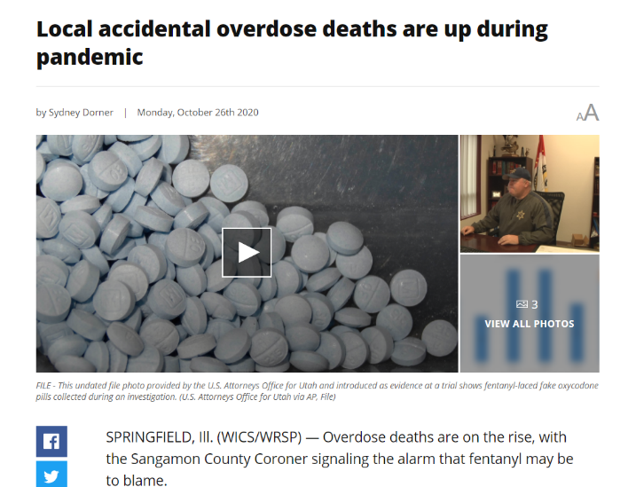
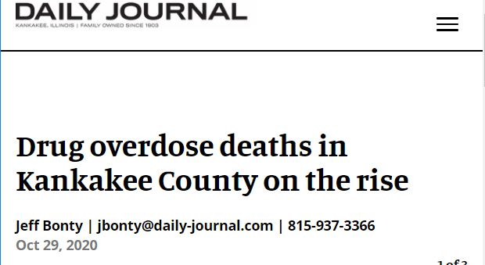
Providing Optimal OUD Care every patient, every time
With the opioid crisis in Illinois continuing & worsening, it is essential for every hospital to identify pregnant patients with OUD and provide optimal OUD care for every patient, every time, to save lives
Notes:
Headlines from Chicago tribune? Patient?
Crisis is continuing/worsening- Initiative to provide optimal care for OUD, by providing optimal care every time you can save lives
Systems in place & moving to sustainability to ensure optimal care is provided every time
What we accomplished

Slide 9
National Guidance to Engage
OB Providers in Optimal OUD Care
Narcan/Naloxone: FDA Recommends that all healthcare professionals discuss Narcan/naloxone prescription with all patients with OUD and all patients on opioids (Link here).
Hepatitis C Screening: CDC & USPSTF recommend HCV screening for all adults, including pregnant and non-pregnant individuals (Link here).
Substance Use Screening: USPSTF recommends screening for adults 18 years or older, including pregnant and non-pregnant individuals for Substance Use Disorder with a validated verbal screening tool (Link here). ACOG recommends screening all pregnant patients with a validated SUD screening tool (Link here).
    Have you shared these national guidelines with your
    OB Providers?

Slide 10
MNO Important Updates
MNO Data in Sustainability: making it easier to track sustainability
MNO-OB sustainability data collection is live in REDCAP and updated paper data forms available on the ILPQC website
MNO-OB teams discontinue monthly structure measures starting in 2021. All MNO teams will continue to submit monthly patient data (paired down) and monthly screening data (OB Teams)
Sustainability Plans:
Submission of a sustainability plan is essential to qualify for QI Awards of Excellence moving forward!
ILPQC will follow up with PNAs about who hasn’t submitted one
Let us know how we can help.

Slide 11

MNO-OB AIMs
Increase patients with OUD connected to MAT & Recovery Treatment Services prenatally or by discharge to >70%
Increase patients with OUD receiving Narcan Counseling to >60%, Hep C Screening to >70%, and patient education to >80%
Increase prenatal screening for OUD with validated tool to >50%
Maintain L&D Screening
Notes:
We need to talk about when MNO started, how many hospitals have participated. Also would like a picture of a patient rather than the graphics…they seem a little busy and think a picture would grab attention more.

Slide 12
Optimal OUD Care
To succeed, every OB provider and clinical care team member must be educated on the following:
  Implementation of validated screening tool prenatal and L&D
    Screen ALL patients for SUD/OUD prenatally and L&D
  Activate the use MNO-OB Folders
    When patients screen + use folders to activate OUD algorithm, complete OUD checklist and nursing workflow
  Confirm optimal OUD Care is provided
    L&D Huddle for all OUD patients on L&D to review MNO folder, and checklist, confirm optimal care elements provided
    Improve Narcan counseling: OUD order set, Narcan on formularly and Med to Bed program
    Prenatal care team conference for prenatal OUD patients identified to discuss optimal OUD care plan with OB/ neonatology/ nursing / SW
Notes:
Why, empathy matters. Education on the two key elements. Heads need to swivel to mom. Mom is the one at maternal risk. Words matter empathy. Push education piece here.
Crossing the finish line
-You need these systems in place (this content is good on the systems.)
AND you need your proivders to know that this is a leading cause of maternal death big maternal risk and provide care with empathy. Education for providers and staff.

Slide 13







MNO Education for all OBs & RNs
Stigma & bias education
    Words Matter e-Module from ILPQC AC Conference
    CDC Opioid Use and Pregnancy e-Module
Implement stigma & bias education
Provider & RN e-Modules
    MNO-OB Provider eModule
    MNO-OB Nursing eModule
Shares key strategies for caring for pregnant and pp women with OUD
Post & distribute in clinical areas including prenatal sites
Provider & RN education campaign
    MNO-OB Education Flyers
Train providers to talk to patients about readiness for MAT & linking to recovery treatment services.
SBIRT Simulations Guide and e-training
    1hr SBIRT IRETA Training e-Module
    ACOG District II SBIRT Training 6 Min Video

Slide 14


Women and Infants Outreach Series
“Maternal Opioid Dependence”
March 30th, 2021 12:00pm to 1:00pm
https://wustl-hipaa.zoom.us/webinar/register/WN_7GfLp-0QQ0WU7yf20M2xdw
Jeannie C. Kelly, MD, MS
Assistant Professor of OBGYN
Division of Maternal Fetal Medicine
Medical Director: Obstetrical Inpatient Services
Maternal Transport Services; C.A.R.E. in Pregnancy
Washington University, St. Louis, MO
Educational objectives:
At the conclusion of this presentation, the attendees will be able to discuss and provide an update:
1. Recognize the growing problem of opioid use disorder nationally, locally, and in our patient population.
2. Discuss our role as Ob/Gyns in creating and managing the opioid epidemic
3. Review recommended management of pregnancies affected by opioid dependence
CONTINUING EDUCATION PROVIDED BY
Washington University School of Medicine in St. Louis, Continuing Medical Education.
ACCREDITATION
In support of improving patient care, Washington University School of Medicine in St. Louis is jointly accredited by the Accreditation Council for Continuing Medical Education (ACCME), the Accreditation Council for Pharmacy Education (ACPE), and the American Nurses Credentialing Center (ANCC) to provide continuing education for the healthcare team.
CREDITAwarded for this Activity
American Medical Association (AMA): Washington University School of Medicine in St. Louis designates this live activity for a maximum of 1 AMA PRA Category 1 CreditsTM. Physicians should claim only the credit commensurate with the extent of their participation in the activity.
American Nurses Credentialing Center (ANCC): Washington University School of Medicine in St. Louis designates this live activity for a maximum of 1 ANCC contact hours.
DISCLOSURE STATEMENT:
It is the policy of Washington University School of Medicine in St. Louis, Continuing Medical Education, that planners, faculty and other persons who may influence content of this CME activity disclose all relevant financial relationships with commercial interests in order for CME staff to identify and resolve any potential conflicts of interest prior to the educational activity. Faculty must also disclose any planned discussion of unlabeled/unapproved uses of drugs or devices during their presentation. Detailed disclosures will be made in activity handout materials.
This is a free course. It will be virtual
For questions and concerns, please contact:
Nicole Bruce @ Nicole.bruce@bjc.org
Planning committee: Jan Chandarlis, Barb Garrison and Dr. Biehals have no disclosures.

Slide 15
Connect Patients to the Illinois Helpline Opioid and Other Substances
As of March 1st, 2021, the PMP allows providers to connect patients to the Illinois Opioid and Other Substances Helpline. The Helpline is provided by the Illinois Department of Human Services‘ (IDHS) Division of Substance Use Prevention and Recovery to help patients get the treatment and recovery services they need.
To take advantage of this new addition here are the steps:
  1. Search for a patient.
  2. Click on the Helpline icon.
  3. Fill in the required fields, obtain patient consent, and submit the form.
The PMP will send the patient information that's needed to the Helpline. A trained Helpline specialist will contact the patient to assess their needs and provide service referrals within the next 48 hours.

Slide 16
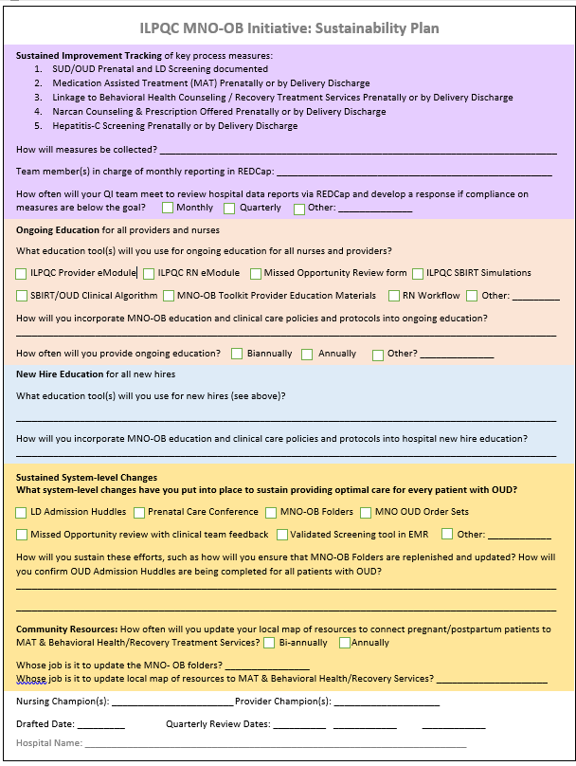
ILPQC MNO-OB Sustainability Plan
Only 29 (32%) of MNO-OB Teams have submitted a sustainability plan so far
This plan helps capture your QI team’s plan for MNO sustainability
How can we help support teams complete this step?
Should be submitted to PNAs and ILPQC
Notes:
Include a due date
Make them feel like they are making it super easy
Easy to complete template
Teams will submit it to ILPQC and perinatal network administrator when completed
Join us Nov XZ for the MNO webinar

Slide 17
MNO-OB Sustainability Data

Slide 18

MNO-OB Excellence Award Criteria for Optimal OUD Care
All Data Submitted + Sustainability Plans
+
6 Structure Measures In Place (Screening Prenatal, Screening L&D, SBIRT/OUD Protocol, Mapping, Checklist, Patient Education)
+
All Process Measure goals met >70% MAT, >70% Recovery Treatment Services >60% Narcan, >70% Hep C >70% Patient Education, >50% Prenatal Screening

Slide 19
MNO-OB and Neonatal
QI Award of Excellence Next Steps
Didn’t qualify for MNO OB or Neonatal Excellence award? Don’t worry…
Teams who are working to achieve AIMs will have upcoming opportunities to receive QI Awards of Excellence in Q4 2020 and into 2021
To qualify for an award, you must also submit a completed sustainability plans to ILPQC & your Perinatal Network Administrator

Slide 20
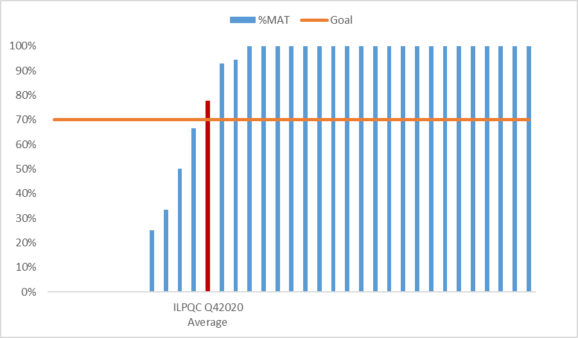
MAT by Hospital
Oct – Dec 2020

Slide 21
MAT by Network
Oct – Dec 2020
Network | Yes | Total | %MAT
Northwestern | 6 | 6 | 100%
St. Francis | 7 | 7 | 100%
Rockford | 1 | 1 | 100%
Cardinal Glennon | 38 | 46 | 83%
ILPQC Q42020 Average | 70 | 90 | 78%
Rush | 3 | 4 | 75%
St. John's | 6 | 10 | 60%
U Chicago | 3 | 5 | 60%
UIC | 3 | 5 | 60%
Loyola | 3 | 6 | 50%
Stroger | NA | NA | NA

Slide 22
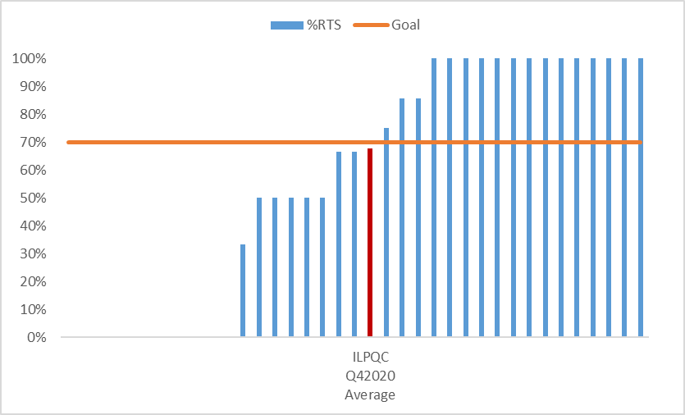
RTS by Hospital
Oct – Dec 2020

Slide 23
RTS by Network
Oct – Dec 2020
Network | Yes | Total | %RTS
Cardinal Glennon | 40 | 52 | 77%
Loyola | 5 | 7 | 71%
ILPQC Q42020 Average | 78 | 115 | 68%
Northwestern | 4 | 6 | 67%
St. John's | 7 | 11 | 64%
St. Francis | 10 | 17 | 59%
U Chicago | 4 | 7 | 57%
Rush | 3 | 6 | 50%
UIC | 4 | 8 | 50%
Rockford | 0 | 1 | 0%
Stroger | NA | NA | NA

Slide 24
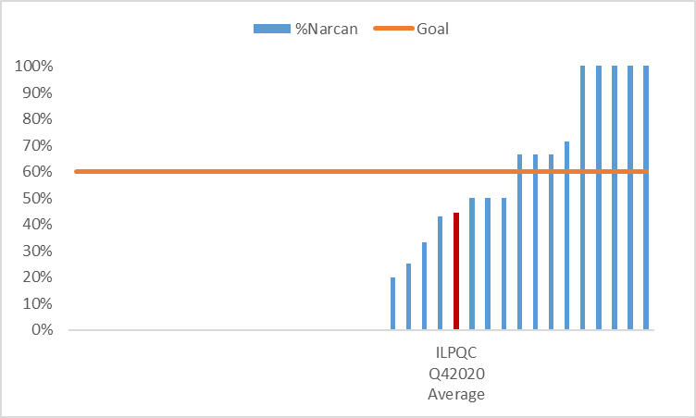
Narcan Counseling by Hospital
Oct – Dec 2020

Slide 25
Narcan Counseling by Network
Oct – Dec 2020
Network | Yes | Total | %Narcan
Cardinal Glennon | 35 | 52 | 67%
ILPQC Q42020 Average | 51 | 115 | 44%
U Chicago | 3 | 7 | 43%
St. Francis | 6 | 17 | 35%
Rush | 2 | 6 | 33%
St. John's | 3 | 11 | 27%
Northwestern | 1 | 7 | 14%
UIC | 1 | 7 | 14%
Loyola | 0 | 7 | 0%
Rockford | 0 | 1 | 0%
Stroger | NA | NA | NA

Slide 26
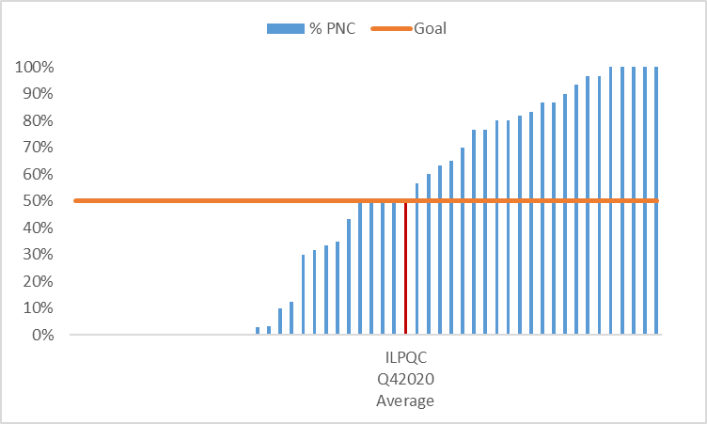
Prenatal Screening by Hospital
Oct – Dec 2020

Slide 27
Prenatal Screening by Network
Oct – Dec 2020
Network | %PNC Screening
UIC | 77%
Rush | 62%
St. Francis | 59%
Loyola | 51%
U Chicago | 49%
ILPQC Q42020 Average | 44%
Northwestern | 42%
Cardinal Glennon | 33%
Stroger | 33%
Rockford | 24%
St. John's | 13%

Slide 28
Teams patients with OUD data submission status
Month | Total Patients | Teams with Patients | Teams without Patients | Total Teams Reporting
Jan-20 | 74 | 34 | 35 | 69
Feb-20 | 78 | 30 | 38 | 68
Mar-20 | 62 | 31 | 39 | 70
Apr-20 | 52 | 25 | 42 | 67
May-20 | 48 | 29 | 36 | 65
Jun-20 | 50 | 26 | 37 | 63
Jul-20 | 53 | 27 | 36 | 63
Aug-20 | 65 | 30 | 31 | 61
Sep-20 | 54 | 24 | 37 | 61
Oct-20 | 44 | 23 | 36 | 59
Nov-20 | 30 | 14 | 36 | 50
Dec-20 | 44 | 22 | 32 | 54
Jan-21 | 45 | 15 | 23 | 38
Feb-21 | 19 | 8 | 8 | 16

Slide 29
MNO-OB: Teams Sharing sustainability plans

Slide 30

MNO-OB Teams Sharing
Success for Sustainability
What is the process for planning your sustainability? What are your strategies for achieving the Narcan & Prenatal Screening Goals?
What is your team plan to cross the finish line for any measures you haven’t met yet?
Hospital Name
University of Chicago Medical Center
Saint Anthony Hospital-Chicago

Slide 31
MNO at UChicago
2020-2021 Data
Sustainability Plan
Crossing the Finish Line

Slide 32
Data 2/2020-2/2021
98% of patients being screened with validated 5Ps tool prior to delivery
  Chart auditing monthly to assess missed opportunities
Identified 5 OUD cases (0-2/month) and 51 SUD cases (3-9/month) over past year
  Small percentage of our patient population (~2%)
  SBIRT notes for positive 5Ps screenings – 9% completion rate
For 5 OUD cases:
  Narcan prescriptions – 40%
  OUD Checklist initiation – 40%
  Substance Use added to problem list – 80%
  Contraception Counseling – 80%
  Hep C Screening – 100%
  Social Work Consult – 80%
Challenge: familiarity with the protocol and workflow initiation
Notes:
Over the last 3 months, 5Ps screening inpatient up to 98% completion rate after increased messaging reinforcement of importance at daily huddles (from 95%)
Challenge: teaching hospital with monthly rotation of residents and many new hire nurses

Slide 33
Sustainability Plans
Increased provider and nursing education focused on information gained from audits
      Continually refresh initiative signage around the unit to increase familiarity
      MNO education for new hires included as part of orientation process
      Reference binders and SharePoint resource folders readily available
      Additional Grand Rounds scheduled
Creation of AgileMD Pathway in Epic to assist staff with following workflow and completing OUD Checklist items
Epic updates for easier entry for consults, order sets, prescriptions, etc. will follow patient through pregnancy
Notes:
Our OUD Checklist is in a location in Epic that neither providers nor nurses use for anything else – often being missed in charting. AgileMD pathway will resolve this.

Slide 34
Crossing the Finish Line
GOAL: 100% validated screening prior to delivery
  Outpatient screening and referral system in place, training and go-live coming next month
GOAL: Increased workflow adherence
  Narcan prescriptions with all opioid prescriptions
  OUD Checklist initiation for 100% of OUD cases
  New physician team lead with lots of OUD experience
  Missed opportunity reviews to become part of M&M/Whitesheet monthly conferences
  Meetings were on hold from April 2020, restarted January 2021
Notes:
Workflow Goal: extra focus on life-saving Narcan and OUD Checklist initiation – two areas where we struggle the most currently

Slide 35

Mothers and Newborns Affected by Opioids - Sustainability
Saint Anthony Hospital
Chicago, Illinois
Michele A Bucciero, MD MBA-HCM
Medical Director of Perinatal Services

Slide 36
Sustainability Plan
Binder with all materials kept in nursing station
Regular updates and education at staff meetings
Verified screening tool for all patients at time of admission
Early involvement of Social Services, Neonatology and Anesthesia upon patient admission
Many patient resources available including in-house detox unit for postpartum patients when desired (pre-COVID) as well as multiple MAT providers, some with walk-in clinic hours to start therapy

Slide 37
Challenges
Low numbers of affected patients make it difficult for staff to retain information around treatment plans
Majority of our affected patients received no prenatal care and are walk-ins, not interested in keeping infants or receiving treatment
Many leave Against Medical Advice and refuse all treatment offered
Many different outpatient clinics (all with different EMRs) makes it difficult for everyone to adopt a verified screening tool (especially during stresses of COVID)
Difficulty reminding providers to give Rx for Narcan at discharge, some insurances refuse to cover medication
Patient’s social circumstances make outpatient follow-up difficult – lack of stable housing and phone access, transportation difficulties

Slide 38
Additional Round-Robin Sharing
Please feel encouraged to share briefly (1-2 min) about your teams sustainability plan and any next steps to achieve initiative AIMs:
West Suburban Medical Center | Swedish American Hospital | SSM St. Mary’s Centralia/Good Samaritan
Vista Medical Center East | Stroger Hospital | Silver Cross
UI Hospital | St. Joseph MC- Joliet | Rush-Copley
UPH Trinity | St. Joseph- Breese | Rush University Medical Center
UPH Methodist | St. Margaret’s | Roseland Hospital
Swedish Hospital | SSM St. Marys- STL | Riverside

Slide 39
MNO-OB Sustainability Checklist
Submit ILPQC monthly MNO-OB Patient, Screening, & Structure Measure data through December 2020 by March 15, 2021 in ILPQC Data System Facilitate completion of education with all providers and nurses, determine plan for continuing & new hire education
Review data for AIMs with your team
Connect with your Perinatal Network Administrator if you are not yet at the MAT, RTS, Narcan, or Screening AIMs
Develop sustainability plan with your QI team (draft plan provided by ILPQC), submit to your Perinatal Network Administrator & ILPQC
MNO Sustainability Data for 2021 – scaled down monthly data on all patients with OUD and random sample to track screening rates. Necessary to track all teams across the finish line for QI Excellence Awards and to track sustainability!

Slide 40
MNO-OB Sustainability Webinars
Date | Topic
March 8th, 2021 12:30-1:30pm | MNO-OB Initiative Sustainability Call
May 26th, 2021 | OB Virtual Face-to-Face Meeting
June 14th, 2021 12:30-1:30pm | MNO-OB Initiative Sustainability Call
September 13th, 2021 12:30-1:30pm | MNO-OB Initiative Sustainability Call
December 13th, 2021 12:30-1:30pm | MNO-OB Initiative Sustainability Call
All hospital teams will be assigned month to give Sustainability Update

Slide 41










THANKS TO OUR
FUNDERS
In Kind Support

