Slide 1

MNO-OB Crossing the Finish Line, Preparing for Sustainability
November 9, 2020
12:30 – 1:30pm

Slide 2
Call Overview
8th Annual Conference Debrief
MNO-OB Finishing Strong and Preparing for Sustainability
MNO-OB Sharing Strategies for Success: Learning from Award
Hemorrhage and hypertension continuing education requirement

Slide 3
8th Annual Conference
Debrief
Please share your comments/feedback about the Annual Conference!
605 providers, nurses, allied health professionals, public health professionals and more attended the online meeting- record attendance!
8 national speakers participated in the conference speaking to topics including Birth Equity, Promoting Vaginal Birth, Newborn Antibiotic Stewardship, Patient/Family Advisors Strategies, and other state perinatal quality collaborative work.
27 ILPQC hospital teams received QI Excellence Awards for optimal care provided in MNO-OB & Neonatal, and 6 awards given for IPLARC
25 ILPQC hospital teams submitted QI Posters, and 12 received awards for excellence for their abstracts and posters

Slide 4
Post Conference Information
ILPQC have recordings from the 8th annual conference available
  Linked here: https://ilpqc.org/2020annualconference/
Please complete evaluation to receive CMEs credit, if you attended the conference and still interested
  Linked Here: www.cme.northwestern.edu
Poster are still available on the conference webpage as well
  Linked here: https://ilpqc.org/2020annualconference/
Now Available!

Slide 5

MNO-OB Excellence Award Criteria for Optimal OUD Care
All Data Submitted
+
6 Structure Measures In Place (Screening Prenatal, Screening L&D, SBIRT/OUD Protocol, Mapping, Checklist, Patient Education)
+
All Process Measure goals met >70% MAT, >70% Recovery Treatment Services >60% Narcan, >70% Hep C >70% Patient Education, >50% Prenatal Screening

Slide 6

MNO-OB Excellence Award for Optimal OUD Care
ILPQC Mothers and newborns affected by opioids Initiative
Advocate Sherman Hospital
Advocate BroMenn Medical Center
Barnes Jewish Hospital
CGH Medical Center
Elmhurst Memorial Hospital
NM Lake Forest Hospital
NorthShore University Health System Highland Park Hospital
Palos Health
Riverside Medical Center
Saint Anthony Hospital
St Margaret's Hospital
Notes:
NEED TO UPDATE

Slide 7

MNO-OB QI Award of
Excellence Next Steps
Didn’t qualify for MNO-OB Excellence award? Don’t worry…
Teams who are working to achieve AIMs will have upcoming opportunities to receive QI Awards of Excellence in Q4 2020 and into 2021

Slide 8
MNO-OB: Finish Strong & Prepare for Sustainability

Slide 9
Providing Optimal OUD Care every patient, every time
With the opioid crisis in Illinois continuing & worsening, it is essential for every hospital to identify pregnant patients with OUD and provide optimal OUD care for every patient, every time, to save lives
Optimal OUD care can only be achieved by implementing standardized and sustainable systems of care, ensuring the OB clinical team understands their role to reduce risk of maternal death and treats all patients with empathy and respect
Notes:
Headlines from Chicago tribune? Patient?
Crisis is continuing/worsening- Initiative to provide optimal care for OUD, by providing optimal care every time you can save lives
Systems in place & moving to sustainability to ensure optimal care is provided every time
What we accomplished

Slide 10

MNO-OB AIMs
Increase patients with OUD connected to MAT & Recovery Treatment Services prenatally or by discharge to >70%
Increase patients with OUD receiving Narcan Counseling to >60%, Hep C Screening to >70%, and patient education to >80%
Increase prenatal screening for OUD with validated tool to >50%
Notes:
We need to talk about when MNO started, how many hospitals have participated. Also would like a picture of a patient rather than the graphics…they seem a little busy and think a picture would grab attention more.

Slide 11

93%
93%
Standardized L&D Screening
Standardized Prenatal Screening
Since Spring 2018, 92 MNO-OB teams have cared for over 2,384 pregnant/postpartum women with Opioid Use Disorder, averaging 71 women per month
Reported OUD screening data (L&D and prenatal) for 21,080 pregnant women
95%
95%
Standardized
Mapping of Resources
Standardized
SBIRT/OUD Protocol
95%
95%
Standardized OUD Clinical Checklist
Standardized Patient Education

Slide 12
Screening for SUD/OUD
AIM ACHIEVED!
>80%
87%
Random sample of 10 deliveries per month reviewed for documentation of SUD/OUD screening
N = 21,080 to date
Prenatal
L&D
Red = No screening
Yellow = Screened single question
Green= Screened with validated SUD/OUD screening tool
44%
GOAL: ≥ 50%

Slide 13


Connected to MAT
AIM ACHIEVED!
>70%
At baseline Quarter 4 2017, 4 out of 10 patients with OUD were connected to MAT prenatally or by deliver discharge
As of Quarter 3 2020, 7 of 10 patients with OUD were connected to MAT!
Notes:
MAT

Slide 14

Linked to Recovery
Treatment Services
AIM ACHIEVED!
>70%
At baseline Quarter 4 2017, 5 out of 10 patients with OUD were linked to recovery treatment services prenatally or by delivery discharge
As of Quarter 3 2020, 7 of 10 patients with OUD were connected to recovery treatment services before delivery discharge!
Notes:
Recovery Treatment

Slide 15
Optimal OUD Care

Slide 16
Narcan Counseling:
A Story of Collaborative Improvement
Quarter 4, 2017
1 of 10
Quarter 3, 2020
5 of 10
patients with OUD received Narcan Counseling
prenatally or by delivery discharge
Notes:
ILPQC has listened to hospital team’s feedback to create responsive and easy-to-understand tools and strategies for providing Narcan Counseling, a key risk reduction strategy, for all patients with OUD
ILPQC partnered with community and state organizations including IDPH, DHS, IL DocAssist, and others to learn and share strategies with ILPQC hospitals
There is still more hard work ahead, but teams have made significant progress…

Slide 17

Lessons Learned,
Systems for Optimal OUD Care
Individual hospital sharing of experiences greatly shaped the strategies developed to ensure systems for optimal OUD care for every patient including:
MNO-OB Folders
L&D OUD Huddles
OUD Order sets
Strategies for improving prenatal screening & Narcan counseling
Notes:
Team feedback re:
-

Slide 18
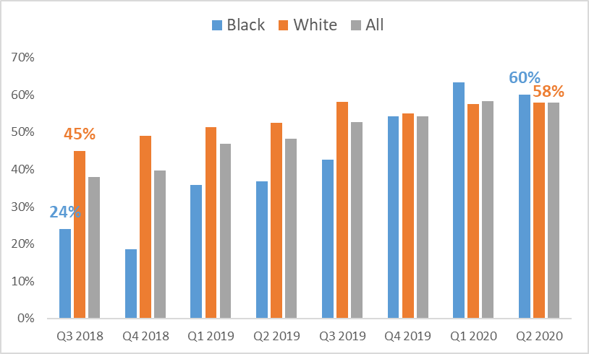
Improving equitable care and reducing disparities for patients receiving MAT
At baseline, Black patients with OUD were less likely to be on MAT, however across the initiative improvements in MAT rates were seen for all patients with the greatest improvement for Black patients.
Comparison of percent of patients with OUD receiving MAT by delivery discharge by race/ethnicity across the MNO Initiative
Notes:
Make the % blue and orange to match so you can see easily which has improved the most

Slide 19

Strategies for System
Implementation for OUD Care
To provide optimal care, we must activate the OUD systems for every patient seen with opioid use disorder
Notes:
Autumn, can we find a new picture?

Slide 20
Optimal OUD Care
To succeed, every OB provider and clinical care team member must be educated on the following:
  Implementation of validated screening tool prenatal and L&D
    Screen ALL patients for SUD/OUD prenatally and L&D
  Activate the use MNO-OB Folders
    When patients screen + use folders to activate OUD algorithm, complete OUD checklist and nursing workflow
  Confirm optimal OUD Care is provided
    L&D Huddle for all OUD patients on L&D to review MNO folder, and checklist, confirm optimal care elements provided
    Improve Narcan counseling: OUD order set, Narcan on formularly and Med to Bed program
    Prenatal care team conference for prenatal OUD patients identified to discuss optimal OUD care plan with OB/ neonatology/ nursing / SW
Notes:
Why, empathy matters. Education on the two key elements. Heads need to swivel to mom. Mom is the one at maternal risk. Words matter empathy. Push education piece here.
Crossing the finish line
-You need these systems in place (this content is good on the systems.)
AND you need your proivders to know that this is a leading cause of maternal death big maternal risk and provide care with empathy. Education for providers and staff.

Slide 21
Action steps for every hospital
Systems Activated
Provider and staff
education provided
LD Huddles
MNO Folders
Prenatal Care Conference
Key education
Components
Leading cause of maternal death
Optimal OUD care
Reduce stigma
Promote empathy
Must take action to save lives

Slide 22

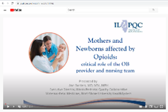





MNO Education for all OBs & RNs
Stigma & bias education
    Words Matter e-Module from ILPQC AC Conference
    CDC Opioid Use and Pregnancy e-Module
Implement stigma & bias education
Provider & RN e-Modules
    MNO-OB Provider eModule
    MNO-OB Nursing eModule
Shares key strategies for caring for pregnant and pp women with OUD
Post & distribute in clinical areas including prenatal sites
Provider & RN education campaign
    MNO-OB Education Flyers
Train providers to talk to patients about readiness for MAT & linking to recovery treatment services.
SBIRT Simulations Guide and e-training
    1hr SBIRT IRETA Training e-Module
    ACOG District II SBIRT Training 6 Min Video

Slide 23
MNO-OB Finishing Strong & Planning for Sustainability

Slide 24

QI Sustainability Phase
We must maintain and sustain the MNO efforts in providing optimal care for every patient
Saving Lives
OUD continues to be on the rise and patients’ lives are on the line.
Notes:
AIM to MAINTAIN!
Picture of patient
This is about saving womens lives
We know these numbers are going up
We have go to sustain optimal care for patients to sustain these efforts.

Slide 25


Sustainability Plan
Sustainability Plan
Compliance Monitoring
New Hire Education
Ongoing Staff/Provider Education
Sustained System-level Changes
What systems do you have in place to ensure your QI work is continuously integrated into your clinical culture?

Slide 26
Strategies for Sustainable Change
Compliance Monitoring
Monitor MAT and Behavioral Health/Recovery Treatment
Monitor Narcan counseling and prescribing
Plan for training residents, new providers on optimal OUD care
Plan for training new nursing hires on optimal OUD care
Maintain Systems Changes
Identify who will be responsible for maintaining MNO-OB Folders
New Hire & Ongoing Education
QI team to continue with MNO Missed Opportunity Review forms and provide feedback
Monitor prenatal screening and on LD
QI team will create a plan to monitor compliance and engagement with OUD L&D huddles
Plan for ongoing education for inpatient and outpatient clinical staff
Notes:
Ann, we could remove if we need to tighten this up.

Slide 27
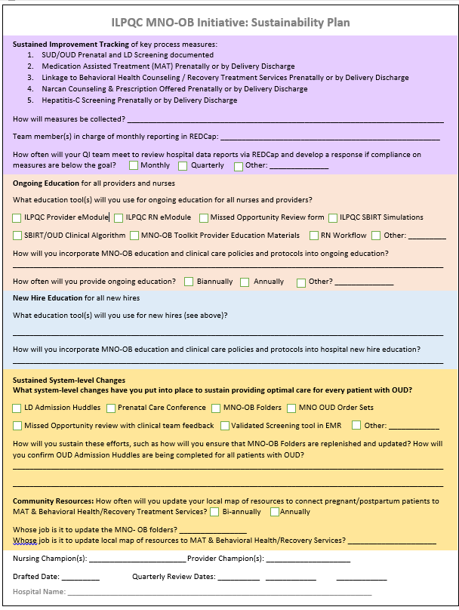
ILPQC MNO-OB Sustainability Plan
Helps capture your QI team’s plan for MNO sustainability
Submit plan to ILPQC and your PNA by Jan 1
Due January 1st
Notes:
Include a due date
Make them feel like they are making it super easy
Easy to complete template
Teams will submit it to ILPQC and perinatal network administrator when completed
Join us Nov XZ for the MNO webinar

Slide 28
MNO-OB Preparing for Sustainability Checklist
Submit ILPQC monthly MNO-OB Patient, Screening, & Structure Measure data through December 2020 by March 15, 2021 in ILPQC Data System
Facilitate completion of education with all providers and nurses, determine plan for continuing & new hire education
Review data for AIMs with your team
Connect with your Perinatal Network Administrator if you are not yet at the MAT, RTS, Narcan, or Screening AIMs
Develop sustainability plan with your QI team (draft plan provided by ILPQC), submit to your Perinatal Network Administrator & ILPQC
Continue to collect / submit data on sustainability measures for compliance monitoring. Compliance data form and reports will be active January 2021

Slide 29
MNO-OB: Sharing strategies for success from award winners

Slide 30
MNO-OB QI Award Winners
Sharing Strategies for Success
Advocate Sherman Hospital
Advocate BroMenn Medical Center
Barnes Jewish Hospital
CGH Medical Center
Elmhurst Memorial Hospital
NM Lake Forest Hospital
NorthShore University Health System Highland Park Hospital
Palos Health
Riverside Medical Center
Saint Anthony Hospital
St Margaret's Hospital

Slide 31
MNO-OB Panel
Sharing Strategies for Success
Which strategies were most important for your success in achieving the ILPQC QI Excellence Award and getting across the finish line
What steps are you taking for sustainability for the following:
  Compliance monitoring
  Education (ongoing & new hire)
  Systems changes (MNO-OB Folders & Mapping resources)
Hospital Name
Advocate Sherman Hospital
Advocate BroMenn Medical
Barnes Jewish Hospital
CGH Medical Center
Elmhurst Memorial Hospital
NM Lake Forest Hospital
NorthShore Highland Park Hospital
Palos Health
Riverside Medical Center
Saint Anthony Hospital
St Margaret's Hospital

Slide 32
MNO-OB Next Steps
OUD Systems
Provider Education
Sustainability Plan
Continue to cross the finish line and ensure all systems are in place to provide optimal OUD care
Ensure all clinical team members receive education and know how to activate the OUD Systems and provide stigma free care
Begin preparing for sustainability and work with your QI team to complete & submit your sustainability plan

Slide 33
MNO-OB Sustainability Webinars
Supporting MNO-OB teams into 2021s
Date | Topic
November 9th, 2020 12:30-1:30pm | MNO-OB Initiative Sustainability Call
January 11th, 2021 12:30-1:30pm | MNO-OB Initiative Sustainability Call
March 29th, 2021 12:30-1:30pm | MNO-OB Initiative Sustainability Call
May 26th, 2021 12:30-1:30pm | OB Virtual Face-to-Face Meeting

Slide 34

MNO-OB ongoing support for every team to achieve sustainable success
Ongoing data compliance monitoring
QI support to help teams cross the finish line
  Grand Rounds
  OB provider meeting
  Hospital QI support calls
Regional perinatal network meetings, data monitoring and support

Slide 35

Upcoming Buprenorphine Waiver Training Opportunities
There are several available remote national trainings for ASAM Treatment of OUD Blended Courses for OB providers available via this link: https://www.asam.org/education/live-online-cme/waiver-qualifying-training/ob-gyn-focus
NEW: Moving Beyond the Barriers of Treating Opioid Use Disorder provides a deeper dive into implementing office-based treatment for opioid use disorder.

Slide 36
Hemorrhage and HTN continuing Education

Slide 37
Maternal Hypertension &
OB Hemorrhage Continuing
Education
To reduce maternal morbidity and mortality and build on current quality improvement efforts, I PROMOTE-IL and ILPQC support hospital efforts to provide ongoing education for managing obstetric hemorrhage and maternal hypertension, as specified in Public Act 101 0390.
There are several ways for birthing facilities to fulfill this annual training requirement, including e-modules, simulations, or drills from AIM, ACOG and other leading national groups available on the ilpqc.org website.
Notes:
Updated 9/25/20

Slide 38
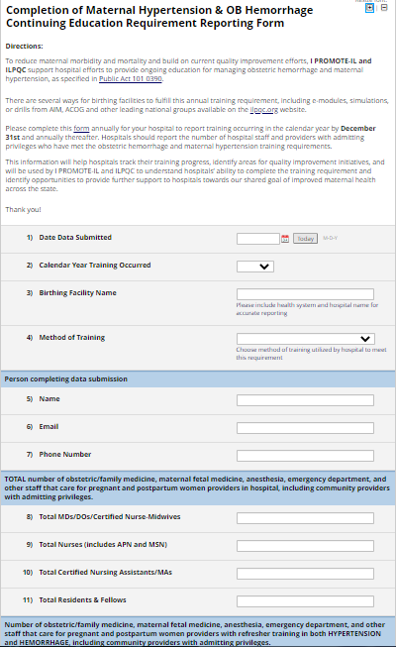
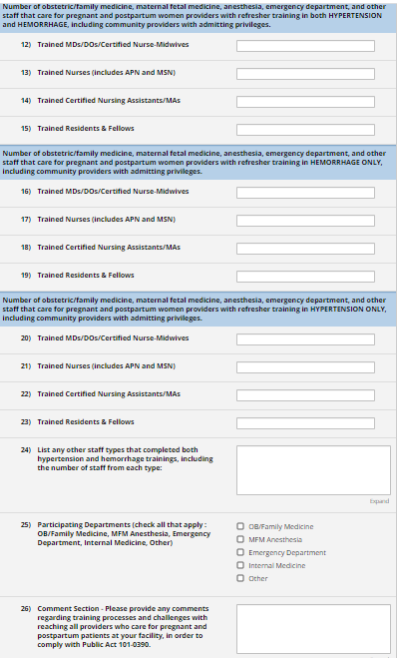
Preview of Survey Form
Notes:
*Only 26 questions short and easy to complete

Slide 39
Hypertension and
Hemorrhage Reporting
Please complete this form annually for your hospital to report training occurring in the calendar year by December 31st and annually thereafter.
Hospitals should report the number of hospital staff and providers with admitting privileges who have met the obstetric hemorrhage and maternal hypertension training requirements.
Notes:
Updated 9/25/20
This information will help hospitals track their training progress, identify areas for quality improvement initiatives, and will be used by I PROMOTE-IL and ILPQC to understand hospitals’ ability to complete the training requirement and identify opportunities to provide further support to hospitals towards our shared goal of improved maternal health across the state.

Slide 40
QI Leadership Development
Opportunity
Call for team leads (nurse and/or provider champions) to support QI leadership development
  Discussion of strategies to engage clinical teams
  How to lead successful QI team meetings
  Optimizing use of monthly data to drive QI
  Networking opportunity with other team leads
QI Leader Support Call:
Friday, 11/13 12-1
Look for email with Zoom link and registration

Slide 41
PVB Timeline
November
Official
Kick-off!
December 14th
Team Webinars start
January
Baseline Data Reporting due
Labor Culture Survey
Launch
December
ILPQC PVB Data Calls
11/5 12:00pm OR 11/19 1:00pm
Baseline Data Reporting Begins
QI Leader Support Call
11/13 12:00pm
Monthly Data Reporting Begins
Notes:
November
- QI Leader Support calls: How to be a successful team lead, nurse/provider champion (QI Leader Support Calls)
- Data calls: Data person or team lead to attend data calls

Slide 42


Coming Soon:
Statewide Launch
Recruit wave 1 (Nov-Jan)
Wave 1 team test data form (Feb-Apr)
Statewide launch (May)
Notes:
Change photo to mother

Slide 43




THANKS TO OUR
FUNDERS
Email info@ilpqc.org or visit us at www.ilpqc.org

