Slide 1

MNO:
Developing and Implementing Sustainability Plan Workshop
May 5th, 2021
11:00am-12:00pm

Slide 2
Overview
Welcome/introductions
Face-to-Face Announcements
MNO Sustainability Updates
MNO Sustainability Plan Overview
MNO Resources for Consideration
Q&A / Discussion

Slide 3
2021
Face- to- Face Virtual Meeting

Slide 4

2021 Virtual Face-to-Face

Slide 5
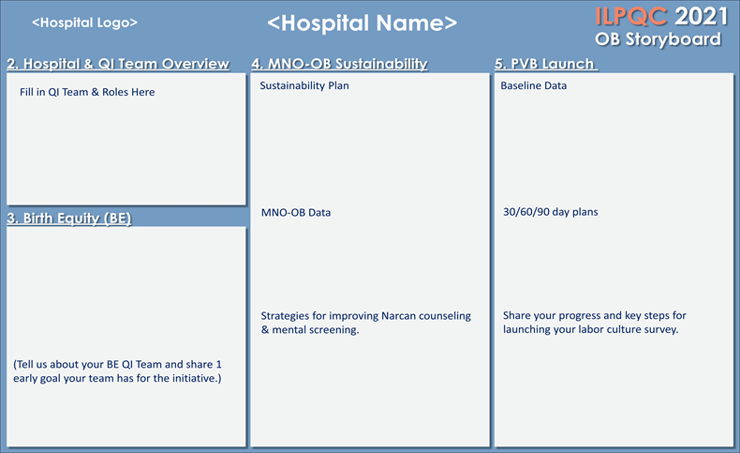
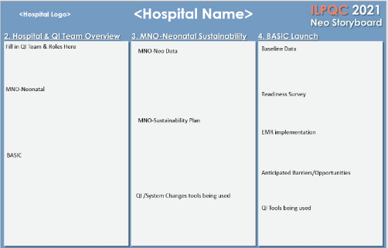
F2F Storyboard Session
All teams will be asked to create a story board for the May 2021 “Face to Face” to share their QI teams progress on ILPQC initiatives

Slide 6

4 Steps to Get Ready for the
ILPQC Face-to-Face
1.
Save the date
Qualify for an award
Submit Storyboard
Email Hospital slide
Save the date- Registration opening soon!
Held Virtually May 26th(OB) & May 27th (Neo) 2021
Meeting will be from 8:30am-3:30pm (OB) 8:15am-3:00pm (Neo)
2.
Please submit all initiative baseline data
Complete and submit hospital and patient level data Jan thru March. 2021 (Q1) by April 30th
3.
Coordinate with your colleagues working across initiatives to complete the ILPQC storyboard template
Have one person from your hospital submit by May 11th
4.
Please upload your team photo/slide collage via the AC survey or email to info@ilpqc.org by May 11th
Notes:
Autumn, can you make sure this information is correct?

Slide 7
MNO OB & Neo Sustainability Updates

Slide 8

MNO-OB Excellence Award Criteria for Optimal OUD Care
All Data Submitted* + Sustainability Plan Data Due Friday May 14th, 2021
+
6 Structure Measures In Place (Screening Prenatal, Screening L&D, SBIRT/OUD Protocol, Mapping, Checklist, Patient Education)
+
All Process Measure goals met >70% MAT, >70% Recovery Treatment Services >60% Narcan, >70% Hep C >70% Patient Education, >50% Prenatal Screening
*Baseline Q4 2017, July 2018 – April 2021 data for MNO Monthly OUD & Screening data. Monthly Structure Measures discontinued after December 2020

Slide 9
All Data Submitted + Sustainability Plan
MNO-Neonatal Excellence Award Criteria for Optimal OEN Care
All Data Submitted* + Sustainability Plan Data Due Friday May 14th, 2021
+
4 Structure Measures In Place (Prenatal Consult, Pharmacologic Care, Non-Pharmacologic Care, Coordinated Discharge)
+
All Process Measure goals met >70% Breastfeeding; <20% Pharmacologic Treatment; >95% Coordinated Discharge
*Baseline Q4 2017, July 2018 – April 2021 data for MNO Monthly OEN data
Monthly Structure Measures discontinued after December 2020

Slide 10
MNO Important Updates
ILPQC Data System:
MNO-OB & Neonatal sustainability data collection is live in REDCAP and updated paper data forms available on the ILPQC website
MNO-OB & Neo teams discontinue monthly structure measures starting in 2021. Teams will continue to submit monthly patient data (paired down) and monthly screening data (OB Teams)
Sustainability Plans:
ILPQC will follow up with PNAs about who hasn’t submitted one
Note: Submission of a sustainability plan is essential to qualify for QI Awards of Excellence moving forward!

Slide 11
MNO Sustainability Plan Overview

Slide 12
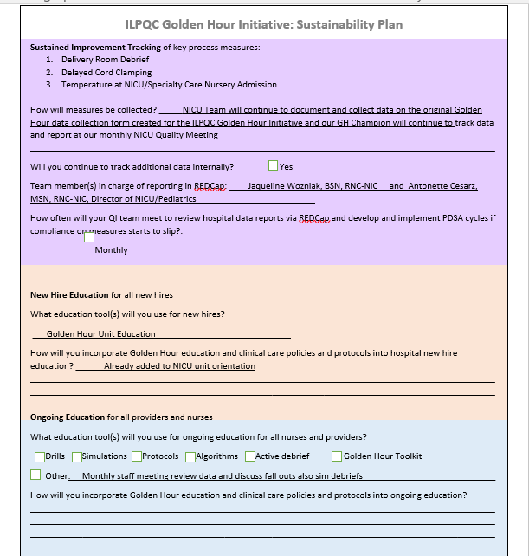
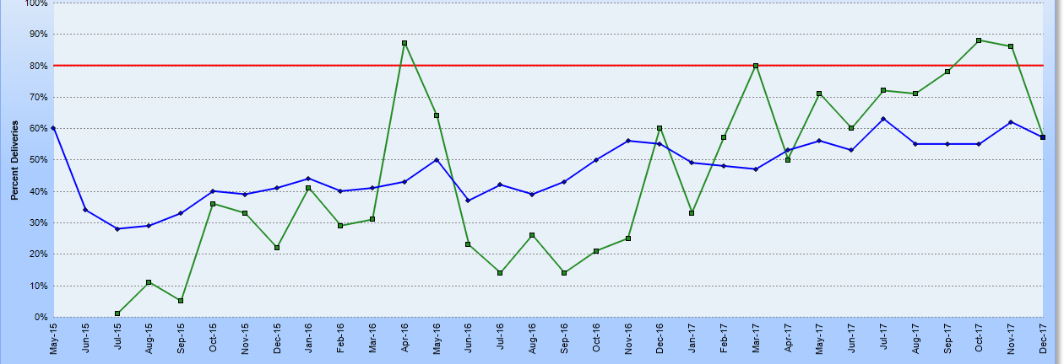
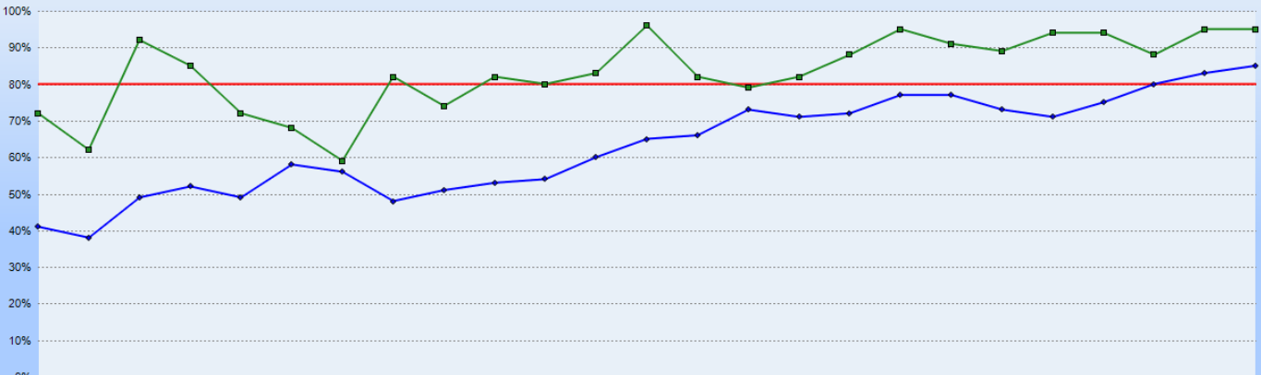
Sustainability Works:
Examples from Golden Hour
And Hypertension
Monthly team meetings to discuss fall outs and simulation debriefs
Hospital A & B (actual hospitals in collaborative) participated in Golden Hour and HTN from 2015 – 2017
They completed a sustainability plan and shared with their network administrator & ILPQC
Data from 2015 – 2017 on debriefing and Time to Treatment shows improvement, and 2018 – 2020 shows sustainment!

Slide 13

Sustainability Plan:
Compliance Monitoring
Sustained Improvement Tracking of Key Process Measures
How will measures be collected?
Team members in charge of reporting in REDCap
How often will QI team meet to review hospital data reports via REDCap and develop compliance on measures that start to slip?

Slide 14

Sustainability Plan:
New Hire & Continuing Education
How can your team be ready for continuing & new-hire education?
What education tool(s) will be used for new hires
How will MNO education and clinical care policies be incorporated into new hire education?
What education tool(s) will be used for ongoing education for all nurses and providers?
How often will ongoing education be provided

Slide 15

Sustainability Plan:
Sustained System-Level Changes
How can your team be ready for sustained system-level changes?
Plan to ensure MNO folders are replenished and updated
Determine how often team will update local map of resources for coordinating a discharge plan
Implement systems changes to ensure optimal OUD/OEN care is provided for every patient, every time- regardless of number!

Slide 16

Live Overview of MNO
Sustainability Plans
Quick Chewy, share your screen!
*Chewbacca Noises*

Slide 17
MNO Sustainability Checklist
Continue to collect / submit data on sustainability measures for compliance monitoring. Compliance data form and reports will be active January 2021
Facilitate completion of education with all providers and nurses, determine plan for continuing & new hire education
Review data for AIMs with your team
Connect with your Perinatal Network Administrator if you are not yet at the initiative goals
Develop sustainability plan with your QI team (draft plan provided by ILPQC), submit to your Perinatal Network Administrator & ILPQC

Slide 18
Sustainability Plan
Submission Status
U Chicago Network: 6/13 (46%)
Stroger Network: 1/3 (33%)
Northwestern Network: 9/12 (75%)
UIC Network: 2/6 (33%)
Loyola Network: 2/6 (33%)
Rush Network: 4/10 (40%)
Rockford Network: 1/9 (11%)
St. Francis Network: 1/11 (9%)
St. John’s Network: 1/13 (7%)
Cardinal Glennon Network: 6/10 (60%)
Submit by 5/14!

Slide 19
MNO Resources for Consideration

Slide 20


MNO-OB Folder
Make folders & store on L&D
Train charge nurses to get folder when OUD screen + identified, engage OB providers
Share folders with outpatient sites
Patient Education Materials
Prescription Pain Medicines and Pregnant Women
NAS- You are the Treatment
NAS: What you Need to Know
Contraception Counseling for Women with OUD
Clinical Team Resources
OUD/SBIRT Clinical Algorithm
OUD Clinical Care Checklist
Narcan- Quick start guide & Save a Life Flyer for OB to review and prescribe to patient
OUD Protocol
Nurse Workflow
Give to OB to complete
Give to and reviewwith Moms
For nurse

Slide 21
MNO-Neo Folder
Make folders & store in common area
Train charge nurses to get folder when made aware of OEN for prenatal consult or newborn admission
Share all the info with clinical care team
Patient Education Materials
NAS- You are the Treatment
NAS: What you Need to Know
ILPQC Newborn Care Diary
Clinical Team Resources
Prenatal Consult Checklist
NAS Assessment tool (if needed)
ILPQC Infant Bedside Sheet
Your hospitals prn pharm guidelines
St. Mary’s Decision Tree
Breastfeeding Guidelines
MNO Discharge Worksheet
MNO Discharge Checklist
NAS Clinical Debrief Review Form
Give to and reviewwith Moms

Slide 22







MNO Education for all OBs & RNs
Stigma & bias education
    Words Matter e-Module from ILPQC AC Conference
    CDC Opioid Use and Pregnancy e-Module
Implement stigma & bias education
Provider & RN e-Modules
    MNO-OB Provider eModule
    MNO-OB Nursing eModule
Shares key strategies for caring for pregnant and pp women with OUD
Post & distribute in clinical areas including prenatal sites
Provider & RN education campaign
    MNO-OB Education Flyers
Train providers to talk to patients about readiness for MAT & linking to recovery treatment services.
SBIRT Simulations Guide and e-training
    1hr SBIRT IRETA Training e-Module
    ACOG District II SBIRT Training 6 Min Video

Slide 23
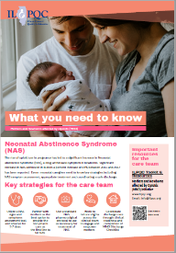
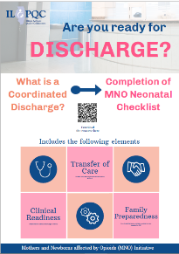

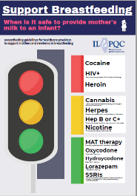
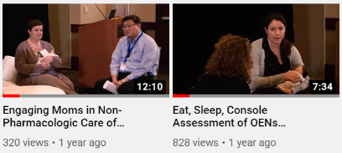
Education Resources for MNO-Neonatal Teams
Eat-Sleep-Console Simulation & Debrief Video
Engaging Mom in Non-Pharmacologic Care Simulation & Debrief Video
MNO-Neonatal Key Messages and Strategies Poster
Mothers are the Best Treatment Option Poster
Supporting Breastfeeding Poster
AWHONN: Knowledge of and Perceived Competence in Trauma-Informed Care and Attitudes of NICU Nurses Toward Mothers of Newborns With Neonatal Abstinence Syndrome (6/15/2020)
AAP: Plans of Safe Care for Infants Exposed to Opioids online course
Notes:
AWHONN: Knowledge of and Perceived Competence in Trauma-Informed Care and Attitudes of NICU Nurses Toward Mothers of Newborns With Neonatal Abstinence Syndrome (6/15/2020)
AAP: Plans of Safe Care for Infants Exposed to Opioids online course

Slide 24
Q&A / Discussion

Slide 25
MNO-OB & Neonatal
Sustainability Call Schedule
June 2021:
MNO-Neonatal: 6/7/2021 @ 1pm
MNO-OB: 6/14/2021 @ 12:30pm
September 2021:
MNO-Neonatal: 9/6/2021 @ 1pm
MNO-OB: 9/13/2021 @ 12:30pm
December 2021:
MNO-Neonatal: 12/6/2021 @ 1pm
MNO-OB: 12/13/2021 @ 12:30pm
ILPQC will have 2-3 MNO-OB teams share on the calls regarding their progress towards initiative aims + their sustainability plan
Notes:
Dan, please update

Slide 26










THANKS TO OUR
FUNDERS
In Kind Support

