Slide 1

MNO-OB Crossing the Finish Line, Preparing for Sustainability
January 11, 2021
12:30 – 1:30pm

Slide 2
Call Overview
MNO-OB Finishing Strong and Preparing for Sustainability
MNO-OB Learning Other Teams Plans for Sustainability
Hemorrhage and hypertension continuing education requirement

Slide 3
Providing Optimal OUD Care every patient, every time
With the opioid crisis in Illinois continuing & worsening, it is essential for every hospital to identify pregnant patients with OUD and provide optimal OUD care for every patient, every time, to save lives
Optimal OUD care can only be achieved by implementing standardized and sustainable systems of care, ensuring the OB clinical team understands their role to reduce risk of maternal death and treats all patients with empathy and respect
Notes:
Headlines from Chicago tribune? Patient?
Crisis is continuing/worsening- Initiative to provide optimal care for OUD, by providing optimal care every time you can save lives
Systems in place & moving to sustainability to ensure optimal care is provided every time
What we accomplished

Slide 4
MNO-OB: Finish Strong & Prepare for Sustainability

Slide 5

MNO-OB AIMs
Increase patients with OUD connected to MAT & Recovery Treatment Services prenatally or by discharge to >70%
Increase patients with OUD receiving Narcan Counseling to >60%, Hep C Screening to >70%, and patient education to >80%
Increase prenatal screening for OUD with validated tool to >50%
Notes:
We need to talk about when MNO started, how many hospitals have participated. Also would like a picture of a patient rather than the graphics…they seem a little busy and think a picture would grab attention more.

Slide 6

MNO-OB Excellence Award Criteria for Optimal OUD Care
All Data Submitted + Sustainability Plans
+
6 Structure Measures In Place (Screening Prenatal, Screening L&D, SBIRT/OUD Protocol, Mapping, Checklist, Patient Education)
+
All Process Measure goals met >70% MAT, >70% Recovery Treatment Services >60% Narcan, >70% Hep C >70% Patient Education, >50% Prenatal Screening

Slide 7
MNO-OB QI Award of
Excellence Next Steps
Didn’t qualify for MNO-OB Excellence award? Don’t worry…
Teams who are working to achieve AIMs will have upcoming opportunities to receive QI Awards of Excellence in Q4 2020 and into 2021
To qualify for an award, you must also submit a completed MNO-OB Sustainability plan to ILPQC & your Perinatal Network Administrator

Slide 8
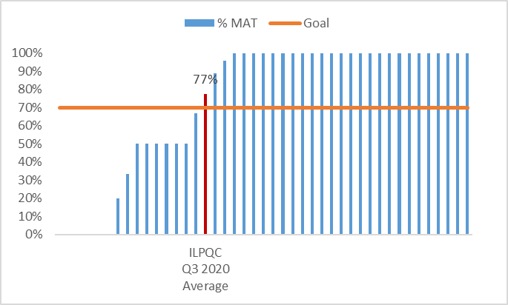
MAT Q3 2020
6 teams at 0%
15 teams below goal
28 teams above goal

Slide 9
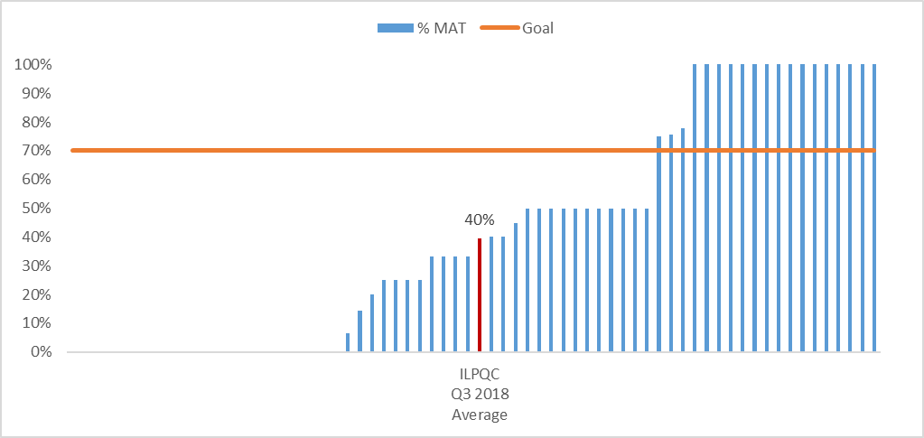
MAT Q3 2018
23 teams at 0%
49 teams below goal
19 teams above goal

Slide 10
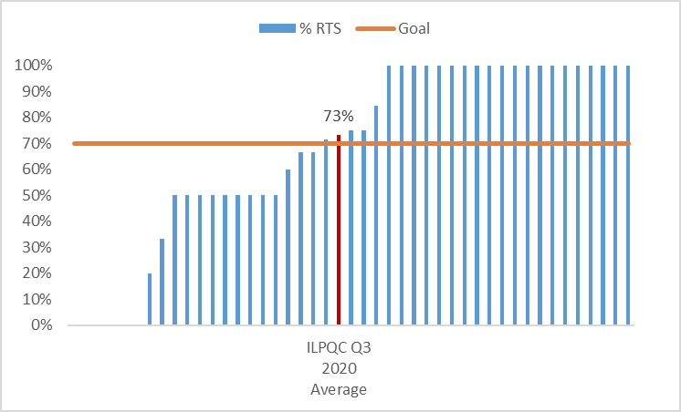
RTS Q3 2020
6 teams at 0%
20 teams below goal
25 teams above goal

Slide 11
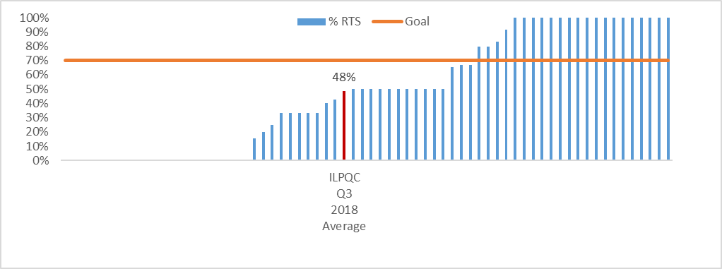
RTS Q3 2018
21 teams at 0%
46 teams below goal
22 teams above goal

Slide 12
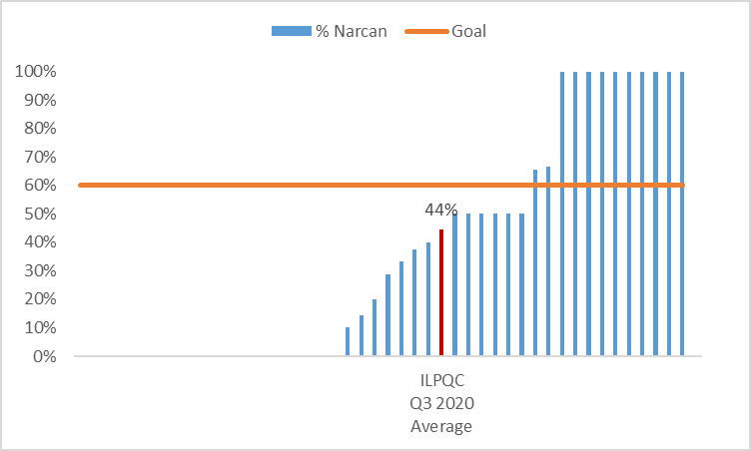
Narcan Q3 2020
20 teams at 0%
33 teams below goal
12 teams above goal

Slide 13
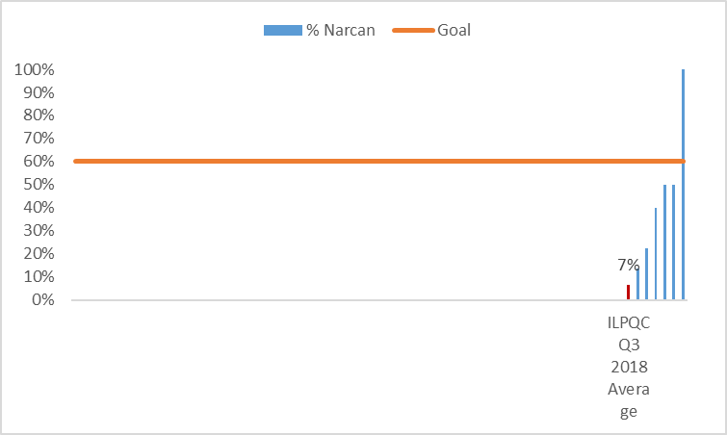
Narcan Q3 2018
61 teams at 0%
63 teams below goal
1 team above goal

Slide 14
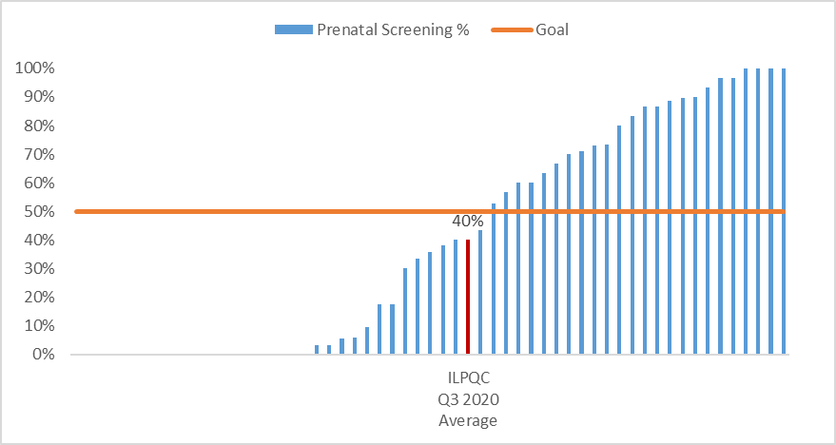
Prenatal Screening Q3 2020
19 teams at 0%
32 teams below goal
24 teams above goal

Slide 15
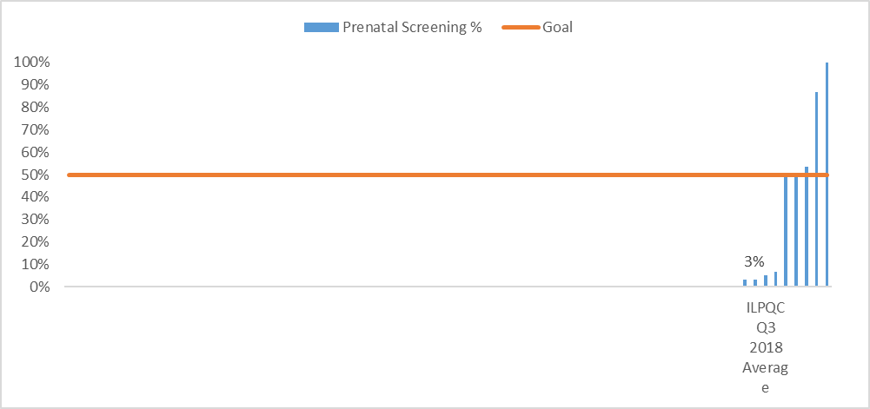
Prenatal Screening Q3 2018
66 teams at 0%
70 teams below goal
5 teams above goal

Slide 16
MAT Q3 2020 Perinatal Networks
Perinatal Network | # Hospitals | Yes MAT | Grand Total | % MAT
Cardinal Glennon | 7 | 45 | 50 | 90%
Loyola | 4 | 6 | 10 | 60%
Northwestern | 5 | 11 | 13 | 85%
Rockford | 3 | 3 | 4 | 75%
Rush | 4 | 12 | 13 | 92%
St. Francis | 3 | 9 | 13 | 69%
St. John's | 6 | 6 | 16 | 38%
Uchicago | 7 | 9 | 11 | 82%
UIC | 3 | 3 | 4 | 75%
Stroger | 0 | 0 | 0 | N/A
ILPQC Q3 2020 Average | 42 | 104 | 134 | 78%

Slide 17
Recovery Treatment Services Q3 2020 Perinatal Networks
Perinatal Network | # Hospitals | Yes RTS | Grand Total | % RTS
Cardinal Glennon | 7 | 57 | 68 | 84%
Loyola | 4 | 9 | 10 | 90%
Northwestern | 5 | 15 | 17 | 88%
Rockford | 3 | 3 | 6 | 50%
Rush | 4 | 9 | 19 | 47%
St. Francis | 3 | 10 | 14 | 71%
St. John's | 8 | 9 | 19 | 47%
Uchicago | 7 | 10 | 12 | 83%
UIC | 3 | 3 | 5 | 60%
Stroger | 0 | 0 | 0 | N/A
ILPQC Q3 2020 Average | 44 | 125 | 170 | 74%

Slide 18
Narcan Q3 2020 Perinatal Networks
Perinatal Network | # Hospitals | Yes Narcan | Grand Total | % Narcan
Cardinal Glennon | 7 | 42 | 68 | 62%
Loyola | 4 | 4 | 10 | 40%
Northwestern | 5 | 6 | 16 | 38%
Rockford | 3 | 1 | 6 | 17%
Rush | 4 | 7 | 19 | 37%
St. Francis | 3 | 5 | 14 | 36%
St. John's | 8 | 1 | 19 | 5%
Uchicago | 8 | 8 | 13 | 62%
UIC | 3 | 2 | 5 | 40%
Stroger | 0 | 0 | 0 | N/A
ILPQC Q3 2020 Average | 45 | 76 | 170 | 45%

Slide 19
Prenatal Screening Q3 2020 Perinatal Networks
Perinatal Network | # Hospitals | Prenatal Screening %
Cardinal Glennon | 5 | 20%
Loyola | 5 | 60%
Northwestern | 9 | 33%
Rockford | 4 | 35%
Rush | 4 | 58%
St. Francis | 6 | 71%
St. John's | 8 | 25%
Uchicago | 10 | 38%
UIC | 4 | 36%
Stroger | 1 | 18%
ILPQC Q32020 Average | 56 | 40%

Slide 20
Optimal OUD Care
To succeed, every OB provider and clinical care team member must be educated on the following:
  Implementation of validated screening tool prenatal and L&D
    Screen ALL patients for SUD/OUD prenatally and L&D
  Activate the use MNO-OB Folders
    When patients screen + use folders to activate OUD algorithm, complete OUD checklist and nursing workflow
  Confirm optimal OUD Care is provided
    L&D Huddle for all OUD patients on L&D to review MNO folder, and checklist, confirm optimal care elements provided
    Improve Narcan counseling: OUD order set, Narcan on formularly and Med to Bed program
    Prenatal care team conference for prenatal OUD patients identified to discuss optimal OUD care plan with OB/ neonatology/ nursing / SW
Notes:
Why, empathy matters. Education on the two key elements. Heads need to swivel to mom. Mom is the one at maternal risk. Words matter empathy. Push education piece here.
Crossing the finish line
-You need these systems in place (this content is good on the systems.)
AND you need your proivders to know that this is a leading cause of maternal death big maternal risk and provide care with empathy. Education for providers and staff.

Slide 21
Action steps for every hospital
Systems Activated
Provider and staff
education provided
LD Huddles
MNO Folders
Prenatal Care Conference
Key education
Components
Leading cause of maternal death
Optimal OUD care
Reduce stigma
Promote empathy
Must take action to save lives

Slide 22







MNO Education for all OBs & RNs
Stigma & bias education
    Words Matter e-Module from ILPQC AC Conference
    CDC Opioid Use and Pregnancy e-Module
Implement stigma & bias education
Provider & RN e-Modules
    MNO-OB Provider eModule
    MNO-OB Nursing eModule
Shares key strategies for caring for pregnant and pp women with OUD
Post & distribute in clinical areas including prenatal sites
Provider & RN education campaign
    MNO-OB Education Flyers
Train providers to talk to patients about readiness for MAT & linking to recovery treatment services.
SBIRT Simulations Guide and e-training
    1hr SBIRT IRETA Training e-Module
    ACOG District II SBIRT Training 6 Min Video

Slide 23
MNO-OB Finishing Strong & Planning for Sustainability

Slide 24

QI Sustainability Phase
We must maintain and sustain the MNO efforts in providing optimal care for every patient
Saving Lives
OUD continues to be on the rise and patients’ lives are on the line.
Notes:
AIM to MAINTAIN!
Picture of patient
This is about saving womens lives
We know these numbers are going up
We have go to sustain optimal care for patients to sustain these efforts.

Slide 25
Strategies for Sustainable Change
Compliance Monitoring
Monitor MAT and Behavioral Health/Recovery Treatment
Monitor Narcan counseling and prescribing
Plan for training residents, new providers on optimal OUD care
Plan for training new nursing hires on optimal OUD care
Maintain Systems Changes
Identify who will be responsible for maintaining MNO-OB Folders
New Hire & Ongoing Education
QI team to continue with MNO Missed Opportunity Review forms and provide feedback
Monitor prenatal screening and on LD
QI team will create a plan to monitor compliance and engagement with OUD L&D huddles
Plan for ongoing education for inpatient and outpatient clinical staff
Notes:
Ann, we could remove if we need to tighten this up.

Slide 26
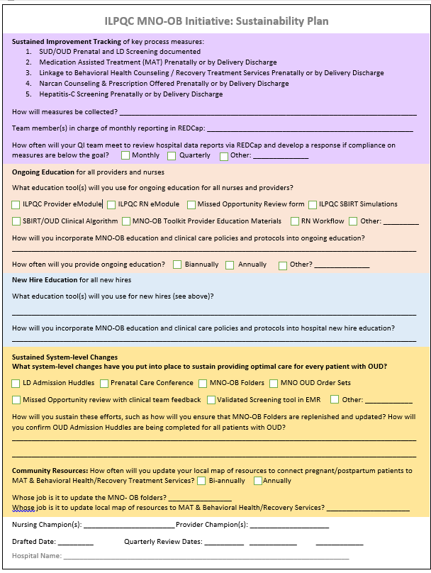
ILPQC MNO-OB Sustainability Plan
Helps capture your QI team’s plan for MNO sustainability
If your team have not yet submitted plans to ILPQC and your PNA, please submit it
Due 1/31
Email info@ilpqc
Notes:
Include a due date
Make them feel like they are making it super easy
Easy to complete template
Teams will submit it to ILPQC and perinatal network administrator when completed
Join us Nov XZ for the MNO webinar

Slide 27
MNO-OB Preparing for Sustainability Checklist
Submit ILPQC monthly MNO-OB Patient, Screening, & Structure Measure data through December 2020 by March 15, 2021 in ILPQC Data System Facilitate completion of education with all providers and nurses, determine plan for continuing & new hire education
Review data for AIMs with your team
Connect with your Perinatal Network Administrator if you are not yet at the MAT, RTS, Narcan, or Screening AIMs
Develop sustainability plan with your QI team (draft plan provided by ILPQC), submit to your Perinatal Network Administrator & ILPQC
Continue to collect / submit data on sustainability measures for compliance monitoring. Compliance data form for patients and screening and reports will be active January 2021 *Structure Measures stop as of 12/31/2020)*

Slide 28
MNO-OB: Teams Sharing sustainability plans

Slide 29

MNO-OB Teams Sharing
Success for Sustainability
What is the process for planning your sustainability?
What is your team plan to cross the finish line for any measures you haven’t met yet?
Hospital Name
OSF St. Francis Medical Center
Northwestern Memorial Hospital
Elmhurst Memorial Hospital

Slide 30

OSF Saint Francis Medical Center
Peoria, Illinois
MNO-OB Sustainment Plan
Deb Wenell, RNC, BSN & Rita Haedicke, RNC, MSN

Slide 31
SUSTAINMENT PLAN
Tracking of Key Process Measures
Ongoing Education
New Hire Education
Sustained System Level Changes
  L&D Admission Huddle
  Prenatal Care Conference
  MNO OB Folders
  Missed Opportunity Form Reviews with clinical team feedback
Updated Community Resources
MNO-OB/NEO Workgroup Meeting Quarterly

Slide 32

CROSSING THE FINISH LINE
Completion of Education & provision of resource materials to Affiliated Prenatal Sites
Continued education and feedback to ensure consistent completion and documentation on OUD Checklist
OUD Order Set completion/implementation
Narcan Counseling/Prescription
ILPMP Lookup Guidelines

Slide 33



Slide 34
Northwestern Memorial Hospital MNO-OB Sustainability Plan
ILPQC MNO-OB Sustainability Webinar
January 11, 2021
Shannon Dunne
Deborah Miller
Kristy Stec

Slide 35
ILPQC MNO-OB Initiative: Sustainability Plan
Sustained Improvement Tracking of Key Process Measures
SUD/OUD prenatal and L&D screening documentation
Medication Assisted Treatment prenatally or by delivery discharge
Linkage to behavioral health counseling/recovery treatment services prenatally or by delivery discharge
Narcan counseling and prescription offered prenatally or by delivery discharge
Hepatitis C Screening prenatally or by delivery discharge
Cases will be identified through delivery/EDW/Midas reports.
Manual chart review with data entry into REDCap
MNO-OB Team will meet monthly to review data reports.

Slide 36
MNO OB Substance Use/OUD Documented Prenatally
ILPQC Target 50%

Slide 37
MNO OB Substance Use/OUD Documented on L&D

Slide 38
ILPQC MNO-OB Sustainability Metrics

Slide 39
ILPQC MNO-OB Initiative: Sustainability Plan
Education
Ongoing Education
MNO-OB Toolkit Provider Education Materials
RN Workflow
Information will be reviewed at the Annual Skills Day
New Hire Education
RN Workflow
Information added to New Hire Lecture Day

Slide 40
ILPQC MNO-OB Initiative: Sustainability Plan
Sustained System Level Changes and Community Resources
System Level Changes
MNO-OB Folder
Missed Opportunity Review with Clinical Team Feedback
Validated Screening Tool in EMR
MNO-OB Champions and Clinical Coordinators will ensure that MNO-OB folders are replenished. Case reviews and appropriate follow-up will confirm OUD Admission Huddles are being completed for all OUD patients.
Community Resources
Update local resource map annually by NMH MNO Ob Team
Education Coordinators will update MNO-OB folders

Slide 41
Questions?
Thank you

Slide 42
MNO-OB Next Steps
OUD Systems
Provider Education
Sustainability Plan
Continue to cross the finish line and ensure all systems are in place to provide optimal OUD care for every patient
Ensure all clinical team members receive education and know how to activate the OUD Systems and provide stigma free care
Begin preparing for sustainability and work with your QI team to complete & submit your sustainability plan

Slide 43
patient success stories/case studies
We are encouraging all hospital teams to share their patient success stories/case study.
Please notify us at info@ilpqc.org if your team is interested in sharing a case.
We would like to hear from you!

Slide 44
MNO-OB Sustainability Webinars
Date | Topic
January 11th, 2021 12:30-1:30pm | MNO-OB Initiative Sustainability Call
March 8th, 2021 12:30-1:30pm | MNO-OB Initiative Sustainability Call
May 26th, 2021 | OB Virtual Face-to-Face Meeting
June 14th, 2021 12:30-1:30pm | MNO-OB Initiative Sustainability Call
September 13th, 2021 12:30-1:30pm | MNO-OB Initiative Sustainability Call
December 13th, 2021 12:30-1:30pm | MNO-OB Initiative Sustainability Call
All hospital teams will be assigned month to give Sustainability Update

Slide 45
Hemorrhage and HTN continuing Education

Slide 46
Maternal Hypertension &
OB Hemorrhage Continuing
Education
To reduce maternal morbidity and mortality and build on current quality improvement efforts, I PROMOTE-IL and ILPQC support hospital efforts to provide ongoing education for managing obstetric hemorrhage and maternal hypertension, as specified in Public Act 101 0390.
There are several ways for birthing facilities to fulfill this annual training requirement, including e-modules, simulations, or drills from AIM, ACOG and other leading national groups available on the ilpqc.org website.
Notes:
Updated 9/25/20

Slide 47
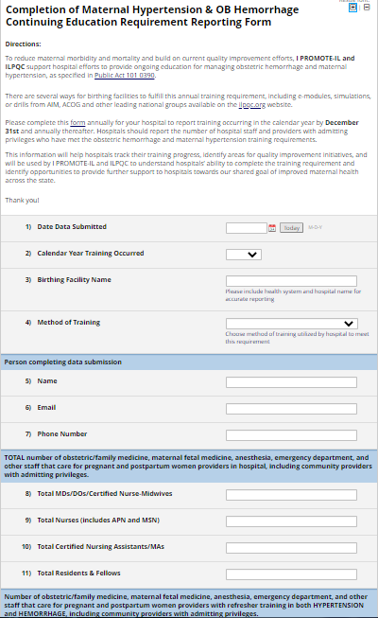
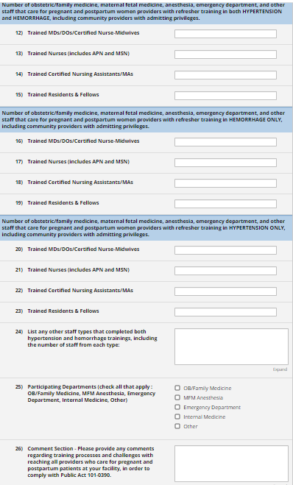
Preview of Survey Form
Notes:
*Only 26 questions short and easy to complete

Slide 48
Hypertension and
Hemorrhage Reporting
Please complete this form annually for your hospital to report training occurring in the calendar year by January 31st and annually thereafter.
Hospitals should report the number of hospital staff and providers with admitting privileges who have met the obstetric hemorrhage and maternal hypertension training requirements.
Notes:
Updated 9/25/20
This information will help hospitals track their training progress, identify areas for quality improvement initiatives, and will be used by I PROMOTE-IL and ILPQC to understand hospitals’ ability to complete the training requirement and identify opportunities to provide further support to hospitals towards our shared goal of improved maternal health across the state.

Slide 49

Getting Started with
Birth Equity in 2021
Two hospitals from each network will participate in Wave 1*. The following networks please connect with ILPQC to identify hospitals from your networks who will participate in Wave 1.
  Rush
  Rockford
  Loyola
  St. John's
Wave 1 teams will review and test data form with three monthly webinars in Mar-May – we are continuing to work on focusing strategies and measures for initiative
Birth Equity initiative team rosters due by May with launch at Face to Face

Slide 50










THANKS TO OUR
FUNDERS
In Kind Support

