Slide 1

Teams Sharing Progress on Crossing the MNO-OB Finish Line
August 24, 2020
12:30 – 1:30pm

Slide 2
Save the date!
ILPQC VIRTUAL 2020 Annual Conference October 29, 2020

Slide 3
ILPQC 2020 Line-up for AC
Dr David LaGrew (CA)-Promoting Vaginal Birth
Dr. Dmitry Dukhovny (OR)- Antibiotic Stewardship
PQC Leader Panel:
  Dr. Susan Hwang (CO), Charlene Collier (MS), Brenda Barker (TN)
Dr. Veronica Gillispie (LA)- Birth Equity
Patient stories
  Kristen Terlizzi – Accreta Foundatation
  LaTosia Rouse- NNPQC

Slide 4
Annual Poster Session
Call for Abstracts & Posters
Due October 9th for consideration for awards of excellence; October 23rdfor late breaking
Posters must be submitted by October 23rd to be displayed during Annual Conference
All hospital teams encouraged to submit on complete or in-progress QI work
  Especially encourage hospitals that have not previously submitted, including Level I/II
  Poster template and support available from ILPQC
  Special award category
Submit via survey form – Link will be distributed during next week

Slide 5
I-promote

Slide 6
Maternal Hypertension & OB
Hemorrhage continuing education requirement
Public Act 101-0390 passed by the State of Illinois in 2019 requires all birthing facilities to conduct annual continuing education on maternal hypertension and obstetric hemorrhage.
All obstetric, emergency departments, and other staff that care for pregnant and postpartum women must complete the 2020 training requirement by December 31, 2020
There are several ways for birthing facilities to fulfill this annual training requirement, including e-modules, simulations, and drills from AIM, ACOG and other leading national groups available on ilpqc.org website
The data form reporting completion of training requirements should be submitted annually by each hospital via a survey that will be available on the ilpqc.org website
Notes:
Ieshia updated 8/20/2020

Slide 7
Coming Soon
ILPQC maternal hypertension and OB hemorrhage continuing education resources will be live on ilpqc.org.
  Webpage with continuing education resources
  Annual data collection form survey link
Notes:
Please update Ieshia 8/20/2020

Slide 8
MNO-OB: Data Review & Key Strategies

Slide 9
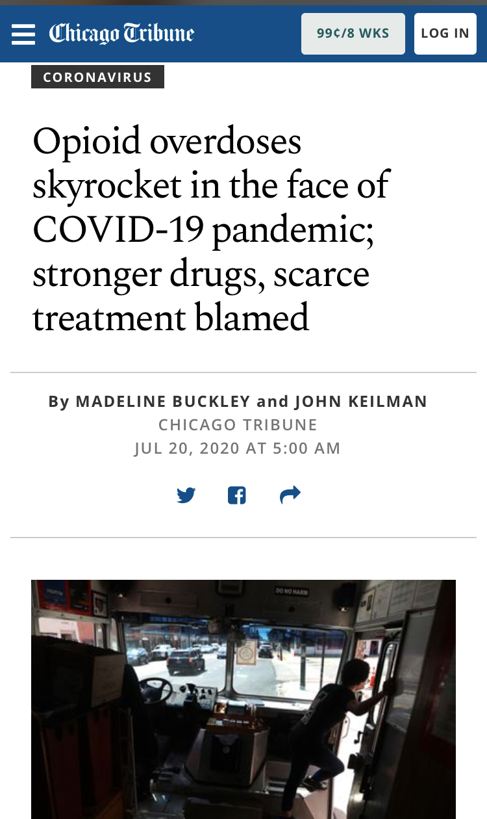
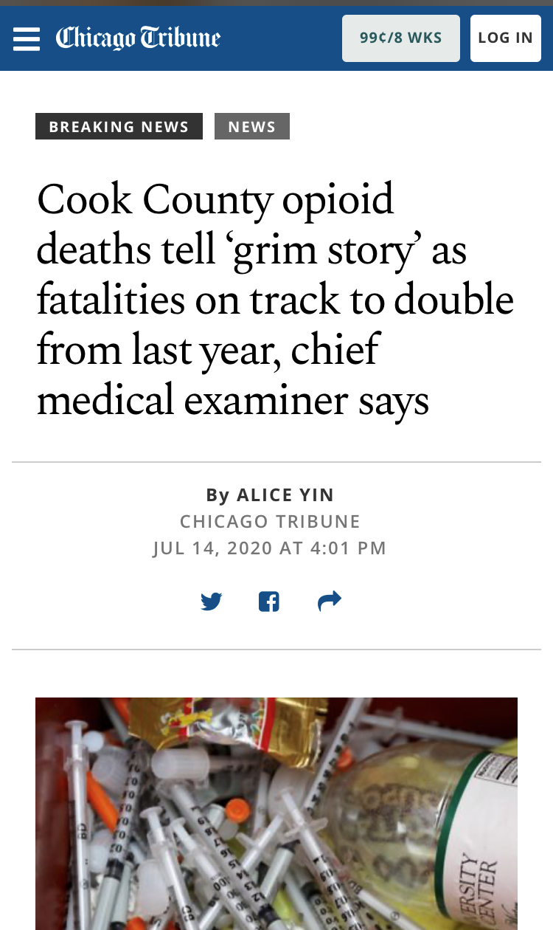
Engage OB Providers, Prescribe Narcan, Save Lives
https://www.chicagotribune.com/coronavirus/ct-opioid-deaths-spiking-covid-19-20200720-2ulyztrprzgrzffasff5c4l4hq-story.html
https://www.chicagotribune.com/news/breaking/ct-cook-county-opioid-deaths-medical-examiners-office-2020-20200714-l52fihc5sbhthlrnr73e22in2a-story.html

Slide 10
Crossing the finish line with MNO-OB
This summer we have been focusing on helping all hospital teams achieve key aims to cross the finish line and move into sustainability
Not all teams are there yet, but these aims are achievable
  MAT by delivery discharge ≥ 70%
  Linkage to Recovery Treatment Services ≥ 70%
  Narcan counseling by delivery discharge ≥ 60%
  Prenatal SUD/OUD validated tool screening ≥ 50%
Our goal is to reduce maternal mortality from overdose, improve pregnancy outcomes and increase the # woman who can parent by providing optimal OUD care every hospital, every patient, every time

Slide 11
Making Systems Change Happen
100%
90%
of teams have a validated screening tool in place on L&D
of teams have a validated screening tool in place prenatally
90%
93%
of teams have a SBIRT protocol/algorithm in place on L&D
of teams have mapped community resources for women with OUD
91%
90%
of teams have implemented an OUD Clinical Care Checklist on L&D
of teams have implemented standardized patient education on L&D

Slide 12
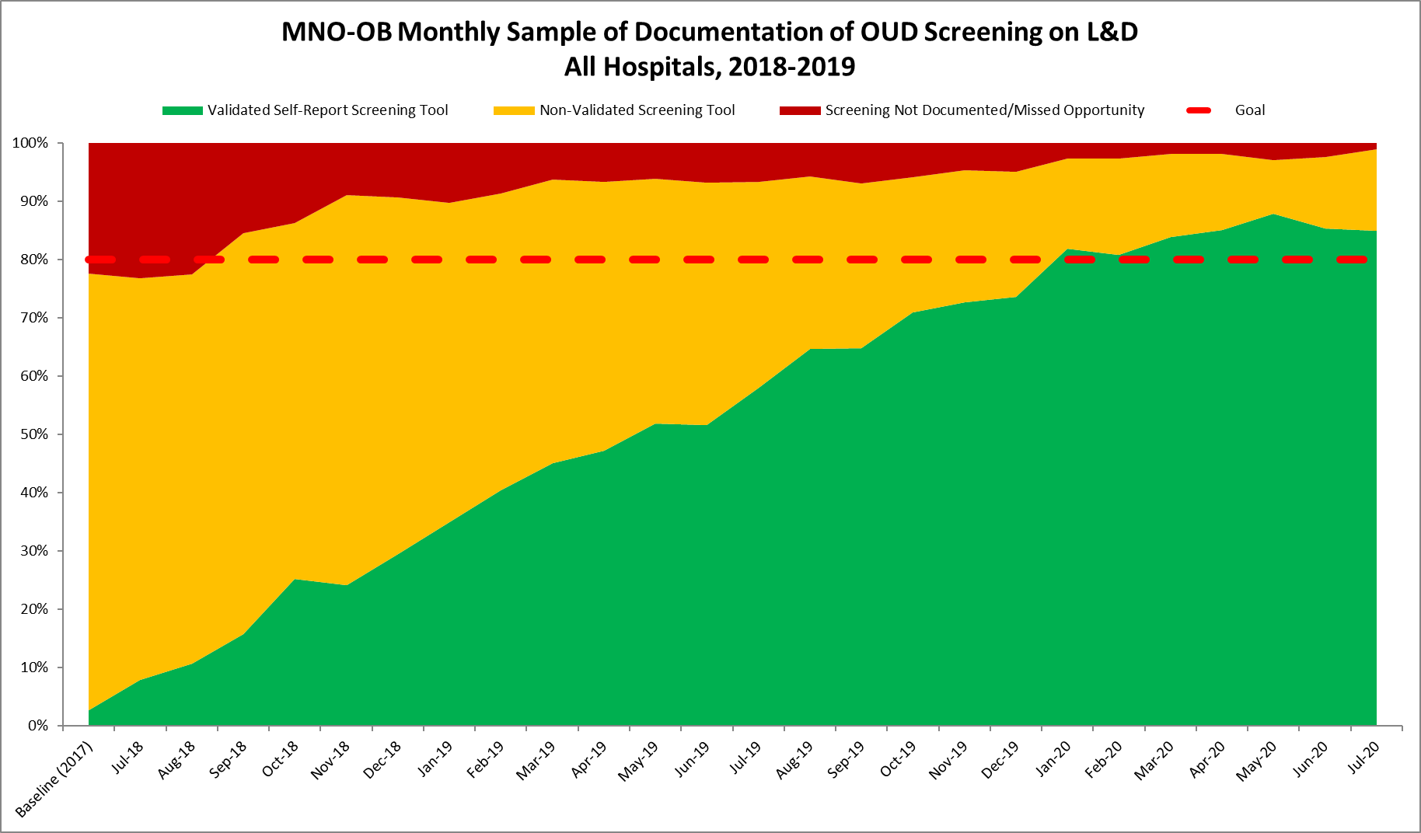
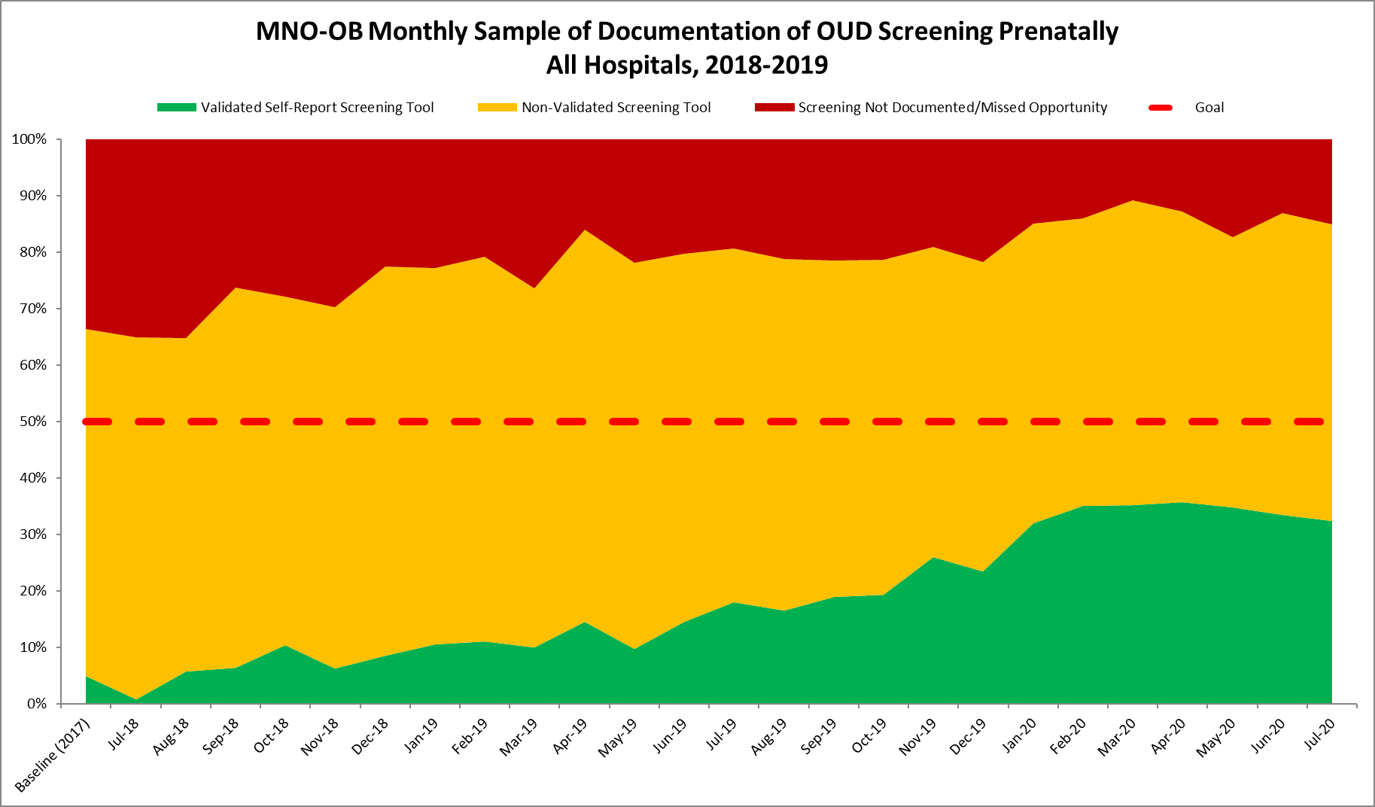
Documentation of Screening for SUD/OUD with Validated Tool
Random sample of 10 deliveries per month reviewed for documentation of SUD/OUD screening
N = 18,800 to date
85%
Prenatal
L&D
Red = No screening
Yellow = Screened single question
Green= Screened with validated SUD/OUD screening tool
32%
GOAL: ≥ 50%

Slide 13
Women with OUD on MAT by Delivery Discharge
Need all teams to push to assess readiness for MAT and achieve % on MAT before delivery discharge above 70%. We are almost there!!!
Goal = ≥ 70%

Slide 14
MAT Q2 2020 Rate by Hospital
Number DOES NOT correlate to Hospital REDCAP ID Number
Hospital Ranking | Yes | Total | % MAT
1 | 2 | 2 | 100%
2 | 1 | 1 | 100%
3 | 1 | 1 | 100%
4 | 1 | 1 | 100%
5 | 3 | 3 | 100%
6 | 4 | 4 | 100%
7 | 1 | 1 | 100%
8 | 6 | 6 | 100%
9 | 2 | 2 | 100%
10 | 4 | 4 | 100%
11 | 2 | 2 | 100%
12 | 3 | 3 | 100%
13 | 1 | 1 | 100%
14 | 23 | 29 | 79%
15 | 6 | 8 | 75%
ILPQC Q2 20202 Rate | 73 | 121 | 60%
16 | 3 | 5 | 60%
17 | 7 | 12 | 58%
18 | 1 | 2 | 50%
19 | 1 | 2 | 50%
20 | 1 | 5 | 20%
21 | 0 | 1 | 0%
22 | 0 | 1 | 0%
23 | 0 | 1 | 0%
24 | 0 | 1 | 0%
25 | 0 | 2 | 0%
26 | 0 | 2 | 0%
27 | 0 | 4 | 0%
28 | 0 | 2 | 0%
29 | 0 | 2 | 0%
30 | 0 | 1 | 0%
31 | 0 | 2 | 0%
32 | 0 | 1 | 0%
33 | 0 | 1 | 0%
34 | 0 | 1 | 0%
35 | 0 | 2 | 0%
36 | 0 | 3 | 0%

Slide 15
Recovery Treatment Services Q2 2020 Rate by Hospital
Number DOES NOT correlate to Hospital REDCAP ID Number
Hospital Rankings | Yes | Total | % RT
1 | 1 | 1 | 100%
2 | 1 | 1 | 100%
3 | 1 | 1 | 100%
4 | 3 | 3 | 100%
5 | 1 | 1 | 100%
6 | 2 | 2 | 100%
7 | 1 | 1 | 100%
8 | 4 | 4 | 100%
9 | 1 | 1 | 100%
10 | 27 | 29 | 93%
11 | 10 | 12 | 83%
12 | 3 | 4 | 75%
13 | 6 | 8 | 75%
14 | 4 | 6 | 67%
15 | 2 | 3 | 67%
ILPQC Q2 20202 Rate | 78 | 121 | 64%
16 | 3 | 5 | 60%
17 | 3 | 5 | 60%
18 | 1 | 2 | 50%
19 | 1 | 2 | 50%
20 | 1 | 2 | 50%
21 | 1 | 2 | 50%
22 | 1 | 3 | 33%
23 | 0 | 1 | 0%
24 | 0 | 2 | 0%
25 | 0 | 1 | 0%
26 | 0 | 1 | 0%
27 | 0 | 1 | 0%
28 | 0 | 2 | 0%
29 | 0 | 4 | 0%
30 | 0 | 2 | 0%
31 | 0 | 1 | 0%
32 | 0 | 2 | 0%
33 | 0 | 1 | 0%
34 | 0 | 2 | 0%
35 | 0 | 1 | 0%
36 | 0 | 2 | 0%

Slide 16
Narcan Q2 2020 Rate by Hospital
Number DOES NOT correlate to Hospital REDCAP ID Number
17 | 0 | 1 | 0%
18 | 0 | 1 | 0%
19 | 0 | 2 | 0%
20 | 0 | 5 | 0%
21 | 0 | 1 | 0%
22 | 0 | 1 | 0%
23 | 0 | 1 | 0%
24 | 0 | 2 | 0%
25 | 0 | 2 | 0%
26 | 0 | 1 | 0%
27 | 0 | 4 | 0%
28 | 0 | 2 | 0%
29 | 0 | 2 | 0%
30 | 0 | 1 | 0%
31 | 0 | 2 | 0%
32 | 0 | 1 | 0%
33 | 0 | 2 | 0%
34 | 0 | 8 | 0%
35 | 0 | 1 | 0%
36 | 0 | 2 | 0%
Hospital Ranking | Yes | Total | % Narcan
1 | 1 | 1 | 100%
2 | 2 | 2 | 100%
3 | 1 | 1 | 100%
4 | 3 | 3 | 100%
5 | 1 | 1 | 100%
6 | 4 | 4 | 100%
7 | 1 | 1 | 100%
8 | 25 | 29 | 86%
9 | 7 | 12 | 58%
10 | 2 | 4 | 50%
11 | 1 | 2 | 50%
12 | 1 | 2 | 50%
ILPQC Q2 2020 Rate | 52 | 121 | 43%
13 | 1 | 3 | 33%
14 | 1 | 3 | 33%
15 | 1 | 6 | 17%
16 | 0 | 5 | 0%

Slide 17
Women with OUD Connected to Recovery Treatment Services by delivery
Way to go!!!
Goal ≥ 70%

Slide 18
Narcan Counseling & Documentation
Keep up the hard work!
Goal ≥ 60%

Slide 19
Hepatitis C Screen by delivery discharge
Way to go!!!
Goal = ≥ 70%

Slide 20
Patient education prenatally or by delivery discharge
Almost there, keep up the hard work!
Goal = ≥ 70%

Slide 21
To be awarded at the 2020 ILPQC annual conference
MNO-OB Excellence Award
for Successful Completion of Key Initiative AIMs
*All Data Submitted
+
6 Structure Measures In Place (Screening Prenatal, Screening L&D, SBIRT/OUD Protocol, Mapping, Checklist, Patient Education)
+
All Process Measure goals met** >70% MAT, >70% Recovery Treatment Services >60% Narcan, >70% Hep C >70% Patient Education, >50% Prenatal Screening
**Determined by Cumulative data for Quarter 3 (July - September) of 2020
*All Data Submitted for Baseline (Oct – Dec 2017) and July 2018 through September 2020
*MNO-OB Monthly Patient Data, Monthly OB Structure Measures, Monthly Sample of Documentation of Screening
    DATA DUE Friday, October 16th by MIDNIGHT

Slide 22
Call to action…
Prenatal OUD Screening
Systems for Optimal OUD Care
Narcan
We must improve prenatal screening with a validated self-reported screening tool (standard of care)
Goal is for you to have >50% of your affiliated prenatal sites standard of care screening for SUD/OUD
Consider audits and providing site specific data to assist with buy-in
L&D Care Team Huddles- initiated by the LD charge nurse to include all care team members review checklist & algorithm in MNO Folders (some teams use MNO Missed Opportunities Form as huddle guide)
OUD Order sets- to assist providers in key elements in checklist
Prenatal Care team conference
Use draft OB Chair letter to prenatal sites
Narcan prescription is a LIFE-SAVING strategy that every OUD patient needs
Use tools/systems of OUD care (MNO-OB Folder, OUD Order sets and Huddles) to ensure patient is counseled and co-prescribed before delivery discharge
Hang flyers/educate
Partner with pharmacy team
MNO Folders

Slide 23
Optimal OUD Care
Screen all patients for OUD with validated screening tool prenatal and L&D
When patients screen + use MNO folder to activate OUD protocol and complete OUD checklist
Confirm optimal care provided
  L&D Huddle for all OUD patients called by charge nurse on L&D to review MNO folder, and OUD checklist, confirm all key elements of care completed before delivery discharge
  Prenatal care plan meeting for prenatal OUD patients identified, call organized by nurse navigator, SW or prenatal care team, with OB/Neo/SW/ Nursing can help confirm OUD checklist, consults, key care elements including MAT, linkage to recovery treatment services and Narcan counseling are completed.

Slide 24
Implementation of an
LD Admission Huddle
Which patients?
  For all for all OUD patients
Who?
  Initiated by the LD Charge Nurse and includes all care team members
    LD RN, MD/CNM, Residents, Social Work and/or Neo/Peds
What?
  to review MNO folder, and OUD checklist, confirm all key elements of care completed before delivery discharge. Some teams use the missed opportunity review as a one pager to complete during the huddle
When?
  Following LD admission
Has your team implemented LD Huddle?
Please press *6 to unmute and share your experiences

Slide 25
LD MNO Admission Huddles
Ok we have a patient with OUD to discuss, do we have the key clinical team together. I have an MNO-OB Folder here. Let’s start the conversation and review the contents in the folder to make sure optimal OUD care has been completed.
Great, I have her chart opened right here so we can review it against what you have
Let’s start with reviewing the OUD Algorithm and checklist together, do you have the nursing workflow?
Ok it looks like our patient needs narcan counseling, linkage to recovery treatment service before discharge, Hep C screen and neonatology consult / NAS education….
Ok let’s determine who can make sure she gets Narcan counseling documented, has she been linked to recovery treatment service appointment who can make that appt, is there a Hep C screen documented? Has neonatology met with her yet?
So let’s repeat back who will do what and when so we can update the checklist. Dr. X here is the OUD Algorithm so you an document, Nurse X here is the OUD nurse workflow, neonatology can you make sure to review this patient education with her

Slide 26
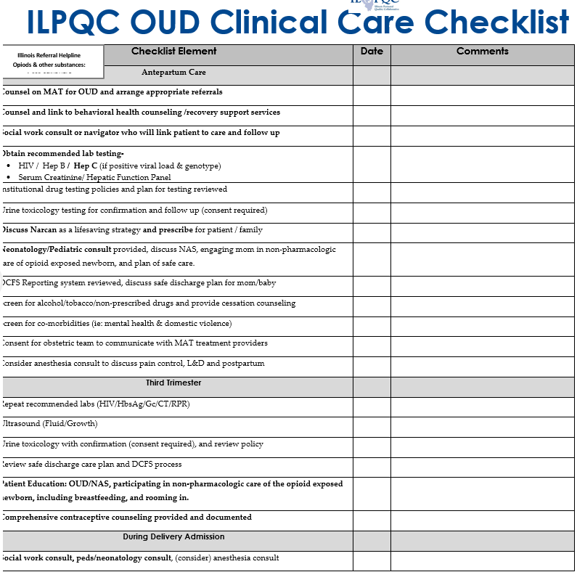
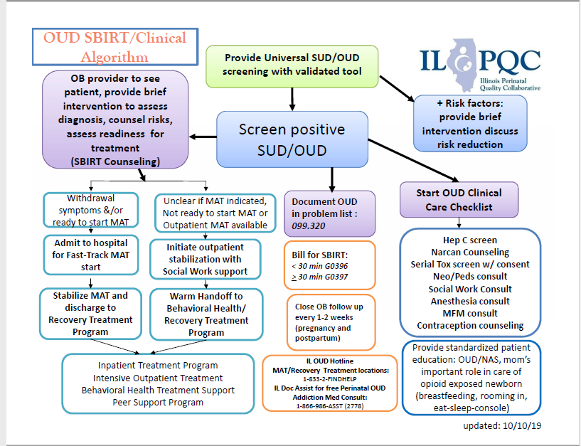
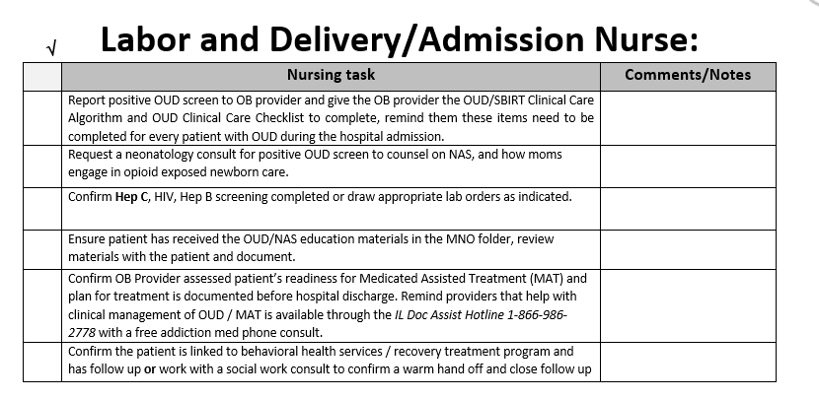
Key MNO-OB Folder Items
OUD Clinical Care Checklist
OUD/SBIRT Algorithm
Nurse Workflow

Slide 27
Missed Opportunities Review
can be used as a OUD Huddle tool
Some teams have used the MNO Missed Opportunity Review Form to complete a real-time review during L&D admission to confirm every OUD patient has received optimal OUD care and all key elements will be completed prenatally or before delivery discharge

Slide 28

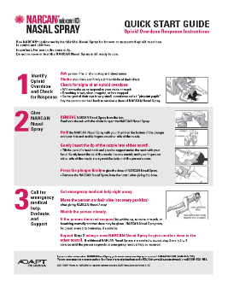
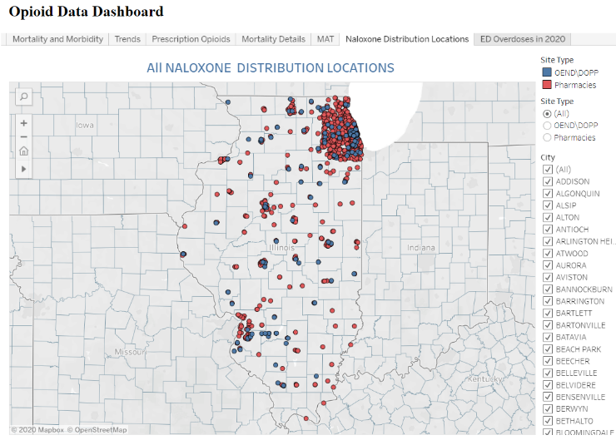
NARCAN Tools & Resources for Teams
Narcan- Save a Life Flyer – provider education on how to prescribe Narcan
Narcan Quick Start Guide – handout for patients on how to use Narcan
IL DHS Helpline for Opioids & Other Substances Magnet: https://helplineil.org/app/home you can search for community-based Naloxone/Narcan distribution locations and view by insurance status
IDPH Opioid Data Dashboard- Naloxone Distribution Locations & contact information: https://idph.illinois.gov/OpioidDataDashboard/
IL DocAssist 866-986-ASST (2778)→ Free Addiction Medicine Consult for caring for pregnant & postpartum with OUD… Ask them about Narcan Counseling!!!
Has your team utilized ALL of these resources to optimize Narcan Counseling & Prescription offer?

Slide 29
New FDA Recommendation for Narcan/Naloxone
Added a labeling change to require that patient handouts for opioids and opioid use disorder (OUD) treatment drugs include information about naloxone
Recommends that all healthcare professionals discuss Narcan/naloxone prescription with all patients with OUD and all patients on opioids
All patients are at risk of experiencing an overdose, especially those also on benzodiazepines or other central nervous system depressants, those who have experienced a prior overdose, those with OUD, and anyone who lives with someone at risk of opioid overdose
https://www.fda.gov/drugs/drug-safety-and-availability/fda-recommends-health-care-professionals-discuss-naloxone-all-patients-when-prescribing-opioid-pain

Slide 30
ILPQC Supporting Teams to Cross the Finish Line
Please share your thoughts on the following support strategies…
Partnership to provide Regional Strategies Meetings at each Perinatal Network Meeting
Providing 1:1 QI Support
Hosting 2 QI Topic Calls
  Outpatient prenatal screening- 8/18 (25 people attended)
  Optimizing Narcan prescribing- TBD
Sharing Optimal OUD strategies
  MNO Folders
  L&D Care Team Huddles
  Prenatal Careplan Team Conference for OUD pregnant patients
  OUD Order set

Slide 31
New ILPQC MNO-OB eModules!
ILPQC has created MNO-OB Provider and Nursing eModules that can be used at your hospitals for new hire and continuing education!
These eModules have an OB Provider and Nurse perspective that focus on the key strategies for caring for pregnant and postpartum women with OUD
The MNO-OB Provider eModule is available here: https://www.youtube.com/watch?v=o96ujHGA2NQ
The MNO-OB Nursing eModule will be available by the end of the week

Slide 32
MNO-OB: Teams Sharing Progress on Crossing the MNO-OB Finish Line

Slide 33

MNO-OB Round Robin
Please share your implementation experience on the following Optimal OUD Strategies:
  Prenatal Screening
  MNO Folders
  L&D Care Team Huddles
  Prenatal Care Team Conference for OUD pregnant patients
  OUD Order set

Slide 34
Together we can achieve
MNO Success
Review your MNO-OB data
Take action to improve prenatal validated OUD screening, and use systems to ensure optimal care for EVERY OUD patient prenatal / before delivery discharge every time
Determine what strategies your team needs to ensure your team can cross the MNO-OB finish line and achieve MNO aims by October.
Reach out to ILPQC for assistance to help you get there

Slide 35

Upcoming Buprenorphine Waiver Training Opportunity
The ASAM Treatment of Opioid Use Disorder Course covers all evidence-based practices and medications for treating patients with opioid use disorder. This course is designed for women’s healthcare providers.
The ASAM Treatment of Opioid Use Disorder Course is designed for:
Physicians, nurse practitioners, physician assistants, and healthcare team members working with patients with opioid use disorder.
Physicians, nurse practitioners, and physician assistants who wish to obtain a waiver to prescribe buprenorphine in oﬃce-based treatment or.
Course Format:
  Blended – four hours online, four hours live webinar
  Four hours of self-paced online learning
  Four hours of live learning on September 25, 2020
  Are you an NP or PA? ASAM also provides the additional 16 hours required for NPs and PAs to qualify for a waiver free of charge
When: September 25, 2020 | 8:00 am – 12:30 pm
LOCATION: Live Webinar
COST: $25
REGISTRATION:
https://elearning.asam.org/p/SLUSSM925
CONTACT:
Email: education@ASAM.org
Call: (301) 656-3920
Notes:
Ieshia updated 8/7/2020

Slide 36
MNO-OB Regional Strategies for Success Meetings by Network
Team | Date | Team | Date
Northwestern Network | Completed (July 17, 2020) | St. Francis Network | September 2, 2020
UIC Network | September 18, 2020 | St. John’s Network | October 24, 2020
Loyola Network | September 8, 2020 | Stroger Network | Completed (August 19, 2020)
UChicago Network | Completed (August 18, 2020) | Rush Network | Being Scheduled
Cardinal Glennon Network | August 26, 2020 | Rockford Network | Being Scheduled
Notes:
Update

Slide 37
Upcoming MNO-OB Teams Calls
Date | Topic
September 28, 2020 | Sharing progress towards implementation of strategies to cross the finish line
October 2020 | No Teams Call… 2020 Annual Conference
Nov/Dec 2020 | Sustaining the Gains→ Preparing for Sustainability

Slide 38
MNO-OB 2020 Timeline
Summer 2020:
All teams work to cross the finish line, and start sustainability plan
Fall & Winter 2020
Work to implement sustainability plan, ILPQC 1:1 QI Support for hospitals
2021:
Quarterly Sustainability check in Calls with Teams, implement sustainability plans

Slide 39
Promoting vaginal birth
(PVB)

Slide 40
Next Steps for Hospitals in PVB
Thank you to teams who have already submitted a roster for PVB!
We encourage teams who haven’t submitted a QI team roster yet to please do so as this is how we’ll be able to make sure you receive all communications and receive a toolkit. Note: a component active participation in an ILPQC QI initiative means that a team has submitted a roster.
Please submit a roster by 9/15 to guarantee shipment for your PVB Toolkit by Annual Conference

Slide 41
PVB Timeline
June-Sept | Oct | Nov | Dec | Jan
MNO-OB | Annual Conference | ILPQC PVB Data Form Webinars | PVB team webinars start monthly and baseline data reporting (Oct-Dec 2019) begins | Monthly data reporting begins Baseline data reporting due
This means: October Annual Conference transition from MNO Active Phase to Sustainability and start of PVB data collection and monthly calls after Annual Conference in November 2020
Follow this link to submit your hospital’s PVB roster
https://redcap.healthlnk.org/surveys/?s=NF8MPDY9LF

Slide 42
Birth Equity

Slide 43
Birth Equity Initiative Update
Plan to convene clinical leads to discuss preliminary aims, drivers, and measures for Birth Equity Initiative in September
Initial ideas in development for discussion include:
  Addressing social determinants of health during prenatal, delivery, and postpartum care to improve birth equity (e.g. Mapping resources, screening/referral tool)
  Utilize race/ethnicity medical record and quality data to improve birth equity (e.g. accurate race/ethnicity data collection, health measure dashboards, review of patient satisfaction data)
  Engage patients, birth partners, and communities to improve birth equity (e.g. patient advisor on QI team, engage doulas in care team, patient reported experience)
  Engage and educate providers and nurses to improve birth equity (implicit bias training, education on listening to patients, hiring strategies)
Wave 1 testing of data form in early 2021, launch in May 2021
Notes:
Ieshia updated 7/9/2020

Slide 44



THANKS TO OUR
FUNDERS
Email info@ilpqc.org or visit us at www.ilpqc.org
Notes:
Updated 10/22/19

