Slide 1




What do we need every
OB Provider to know about OUD?
Opioid Use Disorder is an urgent obstetric issue
Opioid Use Disorder is a life-threating chronic disease with lifesaving treatment available, reducing stigma improves outcomes
There are key steps OB providers need to take prenatally and on L&D to care for women with Opioid Use Disorder
Linking moms to MAT / Recovery Services
Reduces overdose deaths for moms
Improves pregnancy outcomes
Increases # women who can parent their baby
Notes:
Updated with Ann’s revisions from Sim slide set
Opioid Use Disorder is a chronic disease with life saving treatment available
There are key steps OB providers need to take to care for women with Opioid Use Disorder
Opioid Use Disorder is an urgent Obstetric issue
Active Clinical Culture Change, Engaging OB Providers
Engaging outpatient care sites
Implementing a Standardized System-Wide OUD Protocol

Slide 2





MNO OUD Protocol- Key steps for OB Clinical Team
Screen and document positive result
Provide SBIRT risk assessment and brief counseling re: benefits of treatment, assess readiness for MAT and recovery services
Activate care coordination and navigation to link woman to MAT, and behavioral health counseling/ recovery programs and close F/U
Activate the OUD protocol for every screen positive woman
reduces maternal death
improves pregnancy outcomes
increases the # women who can parent their baby
Insert and complete OUD clinical care checklist in electronic medical record (or paper chart) (prenatal / L&D)
Provide patient education re: OUD and NAS, and engaging in newborn care via neonatology consult, counseling, hand-outs.

Slide 3

OB providers opportunity for optimal care for all women with OUD
Screen every pregnant patient for OUD with a validated screening tool
Provide Naloxone (Narcan) Counseling / prescription and screen for Hepatitis C
Assess readiness for Medication Assisted Treatment (MAT)
Warm hand-offs for MAT/recovery services and close OB follow up
Provide patient education on OUD/NAS and reduce stigma, promote empathy across clinical team
Start MAT and link to Recovery Treatment Programs
Notes:
What key strategies are we focused on. Use the circle graphics as what we need to do to achieve best practice. These are what we use in one of our posters
Add… Reduce stigma, close follow up & warm handoff

Slide 4
Optimal OUD Obstetric Care
Given the high risk of maternal death from OUD, need systems to make sure optimal OUD OB care is provided for every patient, every time.
MNO Folders
  Store in prenatal care sites and L&D, contains all provider, nurse and patient resources needed for optimal care. Obtain MNO folder for every OUD pt.
Prenatal Care Team Conference for OUD pregnant pts
  Multidisciplinary prenatal care meeting /call with OB/MFM, neonatology/peds, nursing, SW to review algorithm & checklist to confirm key clinical elements completed.
L&D Care Team Huddles
  Called by charge nurse, care team huddle for every OUD pt with OB/MFM, nursing, neonatalogy/peds, SW, anesthesia, addiction med/psych etc, review MNO Folders, checklist and care plan confirm optimal care provided.
OUD Order set
  Establish OUD order set with Narcan order, Hep C screen, consults, and key elements from checklist.

Slide 5
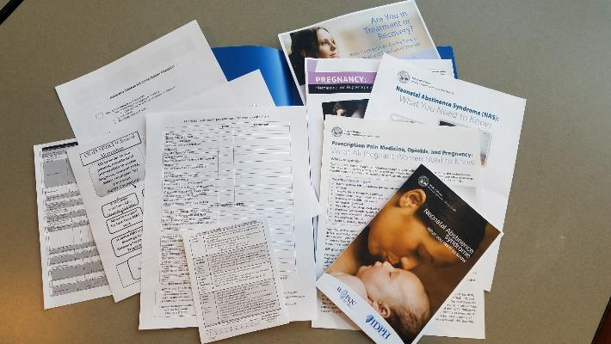
MNO Folders: keep in prenatal
sites and L&D for every OUD pt
OUD Algorithm, OUD Checklist, Narcan scripts for providers, nursing workflow and patient education material
Provider Resources
Patient Resources
Notes:
Sample folder

Slide 6
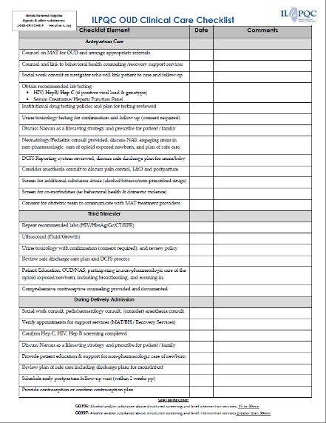
ILPQC OUD Clinical Care
Checklist
Every pregnant or postpartum woman with OUD needs checklist completed
Examples of key checklist items:
Assessed for readiness for MAT
Link to Recovery Treatment Program
Narcan counseling and prescription
Contraception counseling and plan
Hep C screening
Pediatric/neo consult completed
Social work consult completed
Standardized education provided on NAS and role in newborn non-pharmacologic care

Slide 7
MNO Nursing Workflow Resource
Nurses caring for patient with OUD L&D and postpartum should use the Nursing Workflow in the MNO Folder for key clinical steps needed to reduce risk of maternal death from OUD
Notes:
Consider removing orange box and need to make a general statement about this for other state RNs

Slide 8
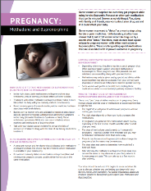
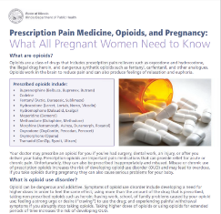

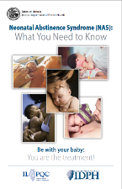
Provide Patient Education on OUD and NAS
Every patient with OUD needs education documented:
Provide Patient Education Resources from MNO Folder
Neonatal / Peds consult
Include information on:
  Treatment for OUD during and after their pregnancy
  OUD and NAS
  Maternal participation in newborn care: rooming in/ eat-sleep-console
  Breastfeeding for OENs
Did you know?
Pregnant women have the greatest engagement for OUD treatment and recovery
Notes:
* I pulled this information from CMQCC/AIM bundle under the bundle implementation guide

Slide 9
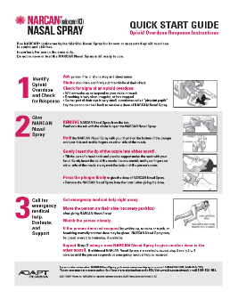
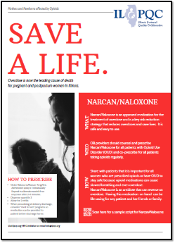
Always Counsel & Prescribe
Naloxone/Narcan
Counsel and prescribe for all pregnant & postpartum women with OUD and co-prescribe for all patients who take opioids regularly
It is safe/easy to prescribe and is a key risk reduction medication that reduces overdose death
Share that we want all women who take opioids to stay safe, opioids can cause slowed breathing and accidental overdose, Narcan is a safety medicine as it reverses overdose
Order Naloxone/Narcan 4mg/0.1mL, administer spray x 1 intranasally, repeat in alternate nostril if no response after 2-3 minutes, dispense quantity 2, 2 refills.
Narcan comes in 2 pack (give one to family)

