Slide 1
Mothers and Newborns affected by Opioids - OB Initiative
Aim: ≥70% women with OUD receive MAT and are connected to Recovery Treatment Services prenatally or by delivery discharge
Goals:
All pregnant women
screened with a universal validated screener prenatally and during their L&D admission
Women with OUD during pregnancy or by delivery discharge
Assessed for readiness for MAT, linked to MAT and Recovery Treatment Services
OUD clinical care checklist completed
Receive Narcan, Hep C, contraception counseling, SW Consult
Pediatric / neonatal consult on NAS
Receive OUD/NAS patient education
107 hospitals participating in the MNO OB & Neonatal Initiative kick off May 2018
101 MNO-OB Hospital QI Teams
88 MNO-Neo Hospital QI Teams
Facilitate monthly MNO-OB & Neo collaborative learning webinars, twice a year in-person meetings
Paper & Online MNO-OB & Neonatal QI toolkit for teams including sample protocols, guidelines, and patient & provider education

Slide 2
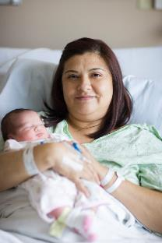
MNO-OB Initiative Aims: What Must We Achieve to Save Lives
≥70%
Medication Assisted Treatment
≥80%
Universal Validated
OUD Screening
≥70%
BH/Recovery
Treatment
Services
Prenatal &
Labor & Delivery
≥70%
OUD Clinical Care
Checklist
≥80%
Patient Education
OUD/NAS
Narcan provided
Counseling/Materials
Hepatitis C screen
Neo/Peds Consult

