Slide 1
MNO-OB Sustainability Call
June 14, 2021
12:30pm – 1:30pm

Slide 2
Call Overview
Introductions
Face-to-Face Recap
Housekeeping Items
MNO-OB Finishing Strong and Preparing for Sustainability
MNO-OB Learning Other Teams Plans for Sustainability

Slide 3
ILPQC Face to Face Recap
Share your thoughts and comments about the meeting!

Slide 4
To obtain your AMA PRA Category 1 Credits™ certificate
www.cme.northwestern.edu
*NOTE* Credits must be claimed by June 30th, 2021
Email to follow at the conclusion of the OB meeting
In order to obtain your AMA PRA Category 1 Credit(s)™, at the completion of this activity please follow these steps:
Sign in to Northwestern University Feinberg School of Medicine’s Office of CME website: www.cme.northwestern.edu
using the email and password used to register for this activity.
After logging into Cloud CME, go to My CME and click on Evaluations & Certificates. You will see the activity ILPQC OB & Neonatal Face-to-Face Meeting listed. Click on "Complete Evaluation.
Once you complete the evaluation form, your certificate will auto-generate. Please print a copy for your records. A copy of your credits will be saved on your transcript that can be found under “My CME” then click “Transcript.”
For additional questions or assistance, please email cme@northwestern.edu
Illinois Perinatal Quality Collaborative
4

Slide 5
Face-to-Face Debrief
Please share your comments/feedback about the Face-to-Face!
ILPQC Virtual Face-to-Face Recap
o By the numbers:
503 providers, nurses, allied health professionals, public health professionals and more attended the online meeting- record attendance!
3 national speakers participated in the conference speaking to topics including Birth Equity, Illinois Maternal Mortality, Patient/Family Advisors Strategies, and other state perinatal quality collaborative work.
37 ILPQC hospital teams submitted storyboards
64 ILPQC hospital teams won PVB Outstanding Launch Award
4 ILPQC hospital teams achieved the MNO-OB QI Award of Excellence in Optimal OUD Care (in addition to 11 teams who have already received the QI Excellence Award)
5

Slide 6
Post Face-to-Face Information
ILPQC will have recordings Face-to-Face Meeting available by the end of June
Linked here: https://ilpqc.org/ilpqc-2021-virtual-ob-face-to-face/
Password: OBF2F21
Please complete evaluation to receive CMEs credit, if you attended the conference and still interested
Linked Here: www.cme.northwestern.edu
Storyboards are still available on the conference webpage as well
Linked here: https://ilpqc.org/ilpqc-2021-virtual-ob-face-to-face/
6

Slide 7
Post Conference Feedback
We want to hear from you!
Please come off mute and share your thoughts on the following:
What was your favorite part of the Face-to-Face?
What feedback do you have on the general flow and additions made to the OB Face-to-Face
Would you make any changes to the Face-to-Face? If so, please share ideas.
7

Slide 8
Mothers and Newborns affected by Opioids (MNO-OB)
Strategies to sustain optimal OUD care in 2021

Slide 9
MNO-OB Excellence Award Criteria for Optimal OUD Care
All Data Submitted
+
6 Structure Measures In Place (Prenatal Screening, L&D Screening, SBIRT, Mapping Resources, OUD Protocol, Patient Education)
+
All Process Measure goals met >70% MAT & Recovery Treatment Services; >60% Narcan Counseling; >50% Prenatal Screening

Slide 10
MNO-OB QI Excellence Awards for Optimal OUD Care
Previous MNO-OB QI Excellence Award Winners:
Advocate Sherman Hospital
Carle BroMenn Medical Center
Barnes Jewish Hospital
CGH Medical Center
Elmhurst Memorial Hospital
NM Lake Forest Hospital
NSUHS Highland Park Hospital
Palos Hospital
Riverside Medical Center
Saint Anthony Hospital
St. Margaret's Hospital
New MNO-OB QI Excellence Award Winners
Edward Hospital
OSF St. Elizabeth Medical Center
Rush-Copley Medical Center
West Suburban Medical Center
Illinois Perinatal Quality Collaborative

Slide 11
MNO-OB Optimal OUD Care Honorable Mentions
Based on Jan – Mar 2021 data, these teams are very close to receiving the QI Excellence Award (3 of 4 measures achieved)
Advocate Good Samaritan Hospital
Alton Memorial Hospital
NM McHenry Hospital
Loyola University Medical Center
Northwestern Memorial Hospital
Award winners based on achievement of MNO-OB aims between April – June 2021 will be announced on the September MNO-OB call- make sure to have data submitted by July 31st!
Illinois Perinatal Quality Collaborative

Slide 12
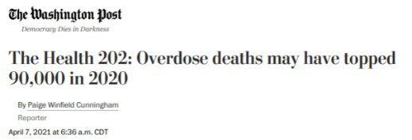
The Opioid Epidemic – National Impact
Over 81,000 drug overdose deaths occurred in the United States in the 12 months ending in May 2020, the highest number of overdose deaths ever recorded in a 12-month period, according to recent provisional data from the Centers for Disease Control and Prevention (CDC).
Illinois Perinatal Quality Collaborative

Slide 13
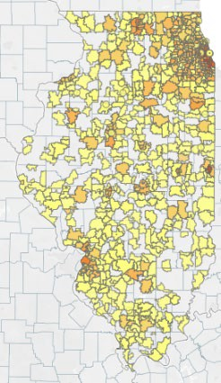
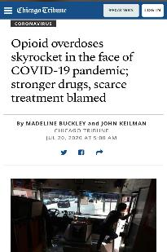
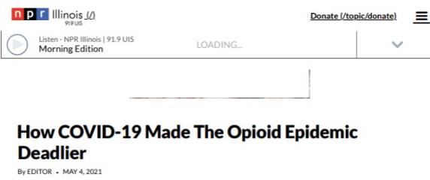
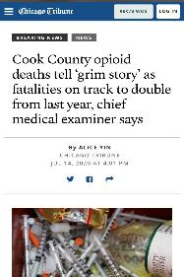
The Opioid Epidemic Impact in Illinois
There were 2,219 opioid overdose deaths in 2019, a 3% increase from 2018.
Overdose Counts by ZIP 2019 (IDPH)
80% of drug overdose deaths in 2019 involved opioids
Illinois Perinatal Quality Collaborative

Slide 14
Important Definitions
Pregnancy-Associated Deaths: death while pregnant or within one year of pregnancy from ANY cause
Pregnancy-Related Deaths: death while pregnant or within one year of pregnancy from a cause related to a pregnancy
Pregnancy complication
Chain of events initiated by pregnancy
Aggravation of underlying condition by physiologic effects of pregnancy
14

Slide 15
Trend in Pregnancy-Associated Mortality
120
Illinois averaged 75 pregnancy-associated deaths each year during 2008-2017
100
Number of Deaths
103
80
92
80
77
60
70 70 70
72
65
40
55
The highest number of deaths occurred during 2017
20
0
2007
2008
2009
2010
2011
2012
2013
2014
2015
2016
2017
2018
Year
15

Slide 16
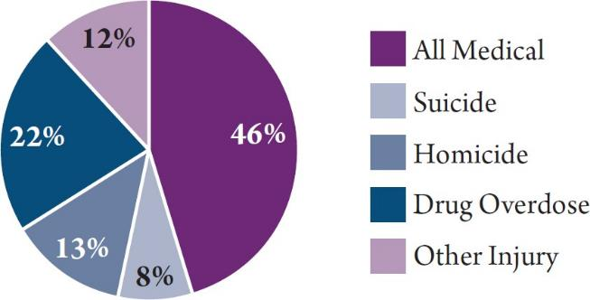
Underlying Cause of Death for Pregnancy-Associated Deaths
Medical causes combined made up 46% of deaths
Drug overdose 22% of deaths
Homicide 13% of deaths
Suicide 8% of deaths
Data Sources: IDPH Death Certificate Data, 2016-2017
16
Due to rounding, percentages do not add up to 100%

Slide 17
Pregnancy-Related Mortality Ratio by Race/Ethnicity
50
Black women were nearly three times as likely as White women to die from a pregnancy-related cause
In the first report, the Black- White disparity in pregnancy- related mortality was wider
The narrowing of the disparity is due to worsening mortality among white women, not improvements for black women
PRMR (per 100,000 births)
40
30
20
16
10
14
47
0
White
Black
Race/Ethnicity
Hispanic
17

Slide 18
Top Four Underlying Causes of Pregnancy-Related Deaths
Cause of Death Category | # Pregnancy- Related Deaths | % Pregnancy- Related Deaths
Mental Health Conditions (including substance use disorder) | 24 | 40%
Pre-existing Chronic Medical Condition | 5 | 8%
Hemorrhage | 5 | 8%
Hypertensive Disorders of Pregnancy | 5 | 8%
All Other Causes Combined | 21 | 35%
18
Due to rounding, percentages do not add up to 100%

Slide 19
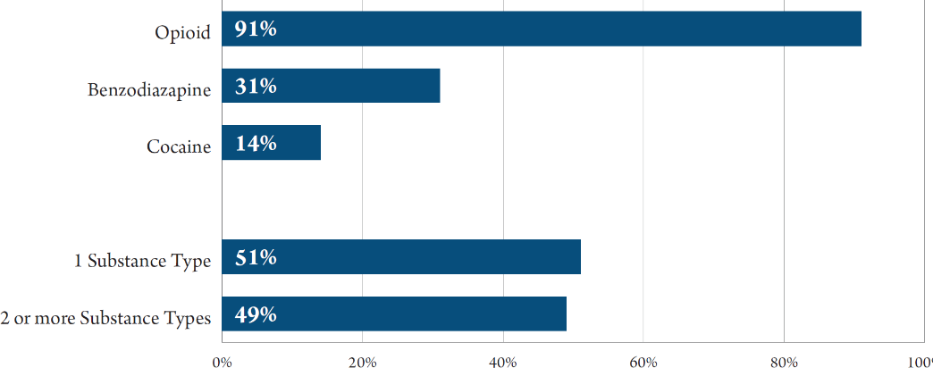
Types of Substances Involved in Drug Overdose Pregnancy-Associated Deaths
19
Data Sources: IDPH MMRC-V Data, 2016-2017

Slide 20
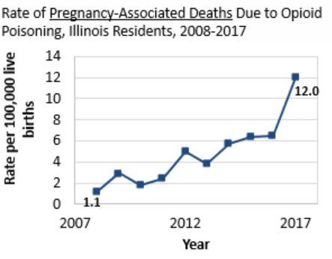
Maternal deaths due to opioids in IL
Mental health conditions, including substance use disorder, were the leading cause of pregnancy-related deaths
IDPH Maternal Morbidity and Mortality report on 2016-2017 deaths, released April 29, 2021.
Data Source: Illinois death certificates, 2008-2017.
Illinois Perinatal Quality Collaborative

Slide 21
Our Goal: Optimal OUD care every time
Screen every pregnant patient for OUD with a validated screening tool
Assess readiness for Medication Assisted Treatment (MAT)
Start MAT and link to Recovery Treatment Programs
Provide Naloxone (Narcan) Counseling / prescription and screen for Hepatitis C
Warm hand-offs for MAT/recovery services and close OB follow up
Provide patient education on OUD/NAS and reduce stigma, promote empathy across clinical team
Illinois Perinatal Quality Collaborative

Slide 22
MNO’s Impact Since 2018:
MAT and Recovery Treatment Services
Teams have cared for over 2,666 pregnant persons with OUD
MAT
Recovery Treatment
Goal
100%
90%
86%
80%
70%
60% 41%
50%
40%
30%
20%
10%
0%
Teams have connected 1,288 pregnant persons to MAT & recovery treatment services across the initiative
Baseline (2017)
Jul-18 Aug-18 Sep-18 Oct-18 Nov-18 Dec-18 Jan-19 Feb-19 Mar-19 Apr-19 May-19 Jun-19 Jul-19 Aug-19 Sep-19 Oct-19 Nov-19 Dec-19 Jan-20 Feb-20 Mar-20 Apr-20 May-20 Jun-20 Jul-20 Aug-20 Sep-20 Oct-20 Nov-20 Dec-20 Jan-21 Feb-21 Mar-21
Illinois Perinatal Quality Collaborative

Slide 23
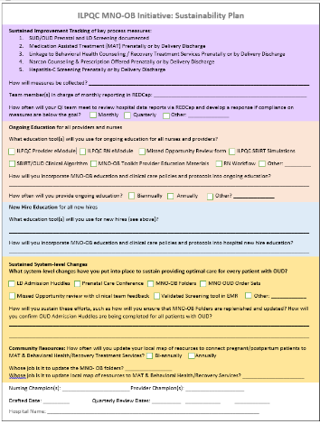
ILPQC MNO-OB Sustainability Plans
Only 32 (35%) of MNO-OB Teams have submitted a sustainability plan so far
This plan helps capture your QI team’s plan for MNO sustainability
Please submit to PNAs and ILPQC by June 30th!
ILPQC held a MNO-OB: Completing Your Sustainability Plan workshop on May 5th, you can review the recording here: https://northwestern.zoom.us/rec/share/OVP6GucS-8gzT0hmGoDQFeX_hGwC4ZvXNN3sAJxTWRP_cf13_iJSaWpw0mwN6BZs.jTBuqOTh-kC9y0ok

Slide 24
Sustainability Plan Submission Status
U Chicago Network: 6/12 (50%)
Stroger Network: 1/3 (33%)
Northwestern Network: 9/12 (75%)
UIC Network: 2/6 (33%)
Loyola Network: 4/5 (80%)
Rush Network: 4/10 (40%)
Rockford Network: 3/9 (33%)
St. Francis Network: 2/11 (18%)
St. John’s Network: 1/13 (7%)
Cardinal Glennon Network: 6/10 (60%)
Submit by 6/30!

Slide 25
MNO’s Impact Since 2018: Screening
Validated Self-Report Screening Tool
Screening Not Documented/Missed Opportunity
Non-Validated Screening Tool Goal
82%
Teams have sampled over 24,430 charts for documentation of screening with a validated screening tool and achieved and sustained the L&D goal of >80%
100%
90%
80%
70%
60%
50%
40%
2%
L&D Screening
30%
20%
10%
0%
Validated Self-Report Screening Tool
Non-Validated Screening Tool
Opportunity: continue to improve prenatal screening to identify pregnant persons early in pregnancy to provide optimal OUD care. We are almost to our goal of >50%.
Screening Not Documented/Missed Opportunity
Goal
100%
90%
80%
47%
70%
60%
50%
40%
20% 2%
Prenatal Screening
30%
10%
0%
Illinois Perinatal Quality Collaborative

Slide 26
MNO’s Impact Since 2018: Narcan
Teams have increased Narcan counseling rates from 2% to over 40% across the initiative!
Narcan Counseling
Goal
100%
90%
80%
40%
70%
60%
50%
40%
Teams have ensured 534 pregnant persons receive Narcan counseling across the initiative!
30%
2%
20%
10%
0%
Opportunity: Every month an average of
Baseline (2017)
Jul-18 Aug-18 Sep-18 Oct-18 Nov-18 Dec-18 Jan-19 Feb-19 Mar-19 Apr-19 May-19 Jun-19 Jul-19 Aug-19 Sep-19 Oct-19 Nov-19 Dec-19 Jan-20 Feb-20 Mar-20 Apr-20 May-20 Jun-20 Jul-20 Aug-20 Sep-20 Oct-20 Nov-20 Dec-20 Jan-21 Feb-21 Mar-21
21 pregnant persons with OUD DO NOT receive Narcan counseling before delivery discharge.
WE CAN ACHIEVE OUR GOAL of >60%!
Illinois Perinatal Quality Collaborative

Slide 27
Key Strategies to Achieve
Optimal OUD Care in Sustainability
Illinois Perinatal Quality Collaborative

Slide 28
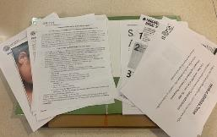
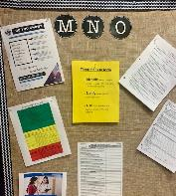
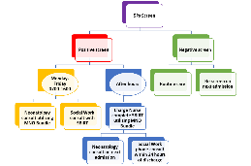
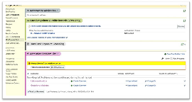
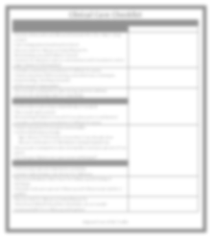
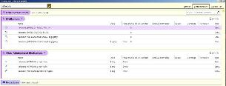
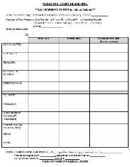
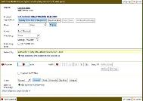
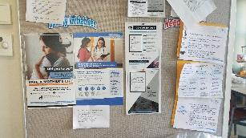
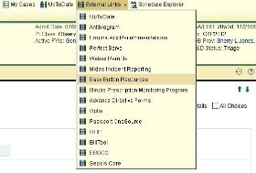
Hospital Strategies to Sustain Optimal OUD Care
Memorial Hospital Carbondale SBIRT, Narcan order set, and community resources
Carle BroMenn OUD Algorithm, Checklist, and Debrief
 | Clinical Care Checklist
 | Checklist Element Antepartum Care | Date | Comments
 | Routine ultrasounds and lab work (include HIV, STIs, Hep C, drug screen) Case management/social work referral
 | Discuss need for Narcan at home/Narcan Rx Neonatology consult/Pediatric Consult
 | Consent for obstetric team to communicate with treatment center (sign release of information)
 | Consider anesthesia consultation if difficult IV access Patient education (NAS screening, extended stay, rooming-in, breastfeeding, Eat-Sleep-Console) MFM consult if appropriate Discuss pain management plan during and after delivery
 | Discuss safe discharge plan for mom/baby
 | ot
 | olk | it
Rush Copley MNO Folders & Bulletin Board
NCH Education Campaign & MNO Folders
Admission to Hospital
Confirm lab results (draw initial OB labs if needed) Place social work consult
Neonatology/Pediatric Consult (if not done prior to admission) Consider anesthesia consultation if difficult IV access
Patient education (if not given antenatally) Confirm Methadone dosage
-Sign release of information from clinic if not already done
-Discuss continuance of Methadone during hospital stay
Discuss pain management plan during labor and post-partum (if n done)
*Do not give Nubain-can cause acute withdrawal*
Post-Partum
Perform post-partum depression screening Connect with primary care doctor for follow-up
Discuss methadone clinic hours for follow-up and timing of discharge
Schedule early post-partum follow-up with Obstetrician (within 2 weeks)
Discuss need for Narcan at home/Narcan Rx
Tylenol and NSAIDS should be scheduled, not as needed Social work/DCFS to follow up with patient
Adapted from ILPQC To
Illinoi
s Perinatal Quality Collaborative

Slide 29
MNO Education for all OBs & RNs
Stigma & bias education
Implement stigma & bias education
Provider & RN e-Modules
Shares key strategies for caring for pregnant and pp women with OUD
SBIRT Simulations Guide and e-training
Train providers to talk to patients about readiness for MAT & linking to recovery treatment services.
Provider & RN education campaign
Post & distribute in clinical areas including prenatal sites
Illinois Perinatal Quality Collaborative
27

Slide 30
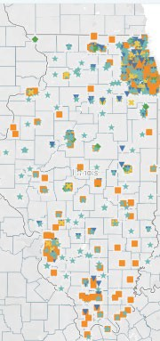
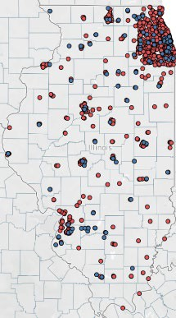
Resources Available to Help Achieve Optimal OUD Care
Illinois MAT Providers
Naloxone Distribution Locations
All links available on the ILPQC
website
Illinois Perinatal Quality Collaborative
http://idph.illinois.gov/opioiddatadashboard/ 28

Slide 31
What Comes Next? Sustain in 2021
Continue compliance monitoring to achieve optimal OUD care
Sustainability Plan
Compliance Monitoring
Work with your team to complete and
implement your sustainability plan-
only 36 of 92 (40%) of teams have submitted a sustainability plan
New Hire Education
Attend MNO Sustainability webinars in
2021 to learn and share strategies with other IL hospitals
Continuing Education
ILPQC will provide QI support to teams not yet achieving AIMs
Systems Changes
Illinois Perinatal Quality Collaborative
29

Slide 32
MNO-OB Learning Other Teams Plans for Sustainability

Slide 33
MNO-OB Team Panel
Annabel Tomas, BSN, RNC-OB, Kelly Hert, RN, BSN ; OSF St. Elizabeth Medical Center
Danielle Labarre, BSN, RNC, C-EFM; Edward Hospital
Illinois Perinatal Quality Collaborative
31

Slide 34
OSF St. Elizabeth Medical Center
Annabel Tomas, BSN, RNC-OB, Kelly Hert, RN, BSN

Slide 35
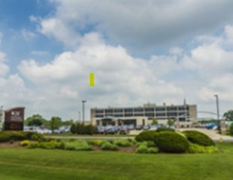
OSF SEMC
14 bed OB unit
OB Triage, Antepartum, L&D, Postpartum, OR & Recovery room, Level 2 designated Nursery
35 deliveries/month or 400/year
4 LDRs
2 triage/antepartum rooms
6-8 Postpartum rooms
6 single; 2 double occupancy
1 OR & 1 RR
Nursery: 10 open cribs, 3 panda warmers, 2 incubators
Northern region OSF Healthcare
I.80 region: CFH, SPMC, SEMC

Slide 36
ILPQC MNO-OB Initiative: Sustainability Plan
Sustained Im provement Tradcing of kev p ro ces:s me asur es:
1. SUD/ OUD P,ran ata l ;m c:I lD Screening docume nt ed
Me d"cation Assi:;t ed rea lrn ent [MAT) Prena t ally DI" by Delivery Discha rge
Lin k<@E t o Beha io ral Healt h Co ^{I} ns el ing / Recovery Treatm ent Services Pr en:ataDv or by D elive ry Di!S'Ch!arge
Co uns el i ng & P,rescri pt ion Offered Prenata ll'y or by Del i...-ery D:isoharge
Hepatitis-C Screening Pran, ata lly or by Del i'o'ery Disoharge
OSF
SAINT EL ZABETH
MEDlCAL CENTER
How wi I mea91.Jres b e collectecf Cont inu e □. r same prptocols cf SP to□I. data c□ll ectio 11 in r edcap. tr acl in g our fold ers given
to patients an d ide nt ifyi ng m issed o pport uniti es/ fa ll outs.
Te am mem be:rM in char ge cf m o.nthl'y rep ort ing in
S and ra, RN
m ea:;ures are b e □w lihe goal? 0 M onthly ■
How o ft en ·will you r QJ team meet to re.iew h.□.spital data report s ia an d deve lo p a resp cms e if o□m p ll ance 011
Qu art erly 0 0t he r: _
OAgoing IEdura tioo for all pr□Yi d ers arnl m1r.ses
Wha t ed lllCa ti on t oo l[ s ) will you use for ongo ing educati on far all mm es and p r□Yi d ers ?
0 ILPQ(; Pro !li de r 0 ILPOC RN
M issec:I Opp ort unity Re-v;ew fo rm OILPOC SB llff Simulati on s.
0 -SBIRT/OUD Cli ni cal Al gor it hm 0 M NO'--OB T□o.lk i t Providler 6d u u3t ion Mat:er'ials ■RN Wor kth:nv O Ot her; _
How wi l l you in corp orat e M NO-OB ed ucaliicm an d di · cal care poli cies an d pr ot ocol s i nt o on g oi ng edu u3t io,n Pres ent at unit
meet ings an d OB.liP1;: ser\lices m eeti rn:;s; t::! lt (!J e du cati on a:nn ually
How o ft en will ou pro!lide ongoing education? 0 Biann ual ly ■ An nu allfl'
Ot her ? U· ; meet · ng s.m onthly
New Hire 6du ra tion far all n ew trires
Win t edlllCa ti on t .ool{s) wi[I you ¹u se fo r ne-w h ir es {see above )? RNg!!i!Qi:J9 ; missed oppa rtu nity re--.riew forms; RtJ \'1/"or ld l □w:
How wil l yo incorporate MNO-OBeducati on an d firaeal care poli cies an dl pr ot occ4s i nt o ha.s plital n ew hi re ed ucation? E­ mod ulesh rid ea.s i n Heallf1:;tream: p eer trai ni ng duri ng or ientation Health stream ed\Jcation; liJ;! rp r ocedu, r es of NA&
ESC: p eer tr.a:i ni ng d u ri ng or ientation of our MNO proces.s an d use of SP t o o l a:nd fo lde rs
Sustained System--leve!I Changes
What t ern-level m anges have \fOU put int o plaAll! to susta in pr oviding optimal care for e\ill!ry patient with OUD!
DlD Admission Hud dl es. Pr en;atal C3re Conl erence ■M N0 -0 13 Folde rs OM NO OUD Orde r Sets
M issed Opp::irru ni ty r e11iew w it h cfini cal tea m feedback
Vali dat ed Screening tool in EM R ■ Ot her: Offioe dliinics
uscn vafid ate-d scre eni n t:o□!ts d u r i arte Yi sits c□m m nic at i n witl-1 OB nit an d addi n t□ t ne ir renat al record· ESC
fl ows h eet tn Ef,, R.
How wil l you str6tai n t hP..se effo rts, such as h ow w il I yo u en s.ure hat M N O-OB Fol ders. are re eni sti.ed and pd ated? □w w ill yo u con fi r m OUD Adm ission H udd l es .are bein g complete c:I fur all pat ien ts wit h OUD? Jami e,.RNI & San dra ,.RN re p-Jeni sh and update folders: Cha r ge RN & ILPOCM NO t eam lea der ens.ure comm un icatian 'li ith staff fur patients ident ified wi h OUD.
Bi- aninuall ■
C-0mm1111ity Reso ur oes: H ow often will yo upd.at e you r l cc al map of re sour ces to c□n ne pr egn ant / po stp artu m pati ents.to
M.!\T & BehaYi o r.a11--! ealt h/ R.ec ove;ry Tr e-atment Servi ces?
Ann ual l
to u pdate th e M NO-- OB fo lde rs? Je.!l)i llJ:I.& Sami r a. RN
to u pdate lo eal a_p o1i r= 1,1rces t o MA & Behavior al Heallf1/R1ecovery SE, ic es.c Kelly , RIN & Case MS ,

Slide 37
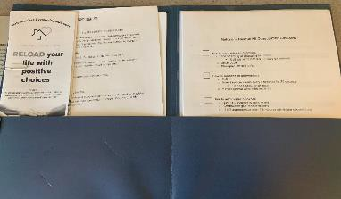
Our ILPQC Resource Area
Making sure we have:
Folder accessible and put together for staff at all times.
Resources that are easy to give to those in need.
Our staff continually educated
The abilities, tools, and resources to keep going with this great work!

Slide 38
Edward Hospital
Danielle Labarre, BSN, RNC, C-EFM (unable to attend today’s meeting sharing thoughts on next slide)

Slide 39
Edward Hospital MNO-OB Strategies
Clinical Care Checklist stars in the prenatal offices and crosses over to inpatient
Chart audits
Missed opportunities presented at staff meetings and physician department meetings
Required annual education in Healthstream (e-learning) including new employees
Automatic social work consult with a + 5P screen or if cord tissue is sent
Illinois Perinatal Quality Collaborative
39

Slide 40
Obtain a Certificate in
Quality Improvement Science!
IHI Open School, a free opportunity to asynchronously complete up to 13 continuing education hours
Access starting June 2021 for two years
ILPQC will send out an inquiry form to designate a specific number of members across OB & Neonatal QI initiatives at your hospital access to the training!
Pump up your Quality Improvement skills!
Illinois Perinatal Quality Collaborative

Slide 41
MNO-OB Sustainability Webinars
Date | Topic
May 26th, 2021 | OB Virtual Face-to-Face Meeting
June 14th, 2021 12:30-1:30pm | MNO-OB Initiative Sustainability Call
September 13th, 2021 12:30-1:30pm | MNO-OB Initiative Sustainability Call
December 13th, 2021 12:30-1:30pm | MNO-OB Initiative Sustainability Call
Each hospital team will be assigned a call to give a sustainability update

Slide 42
Save the Date:
ILPQC 2021 Annual Conference
Calling all perinatal health care providers, nurses, allied health professionals, and public health/community partners!
Thursday, October 28th, 2021 In-Person/Virtual TBD
Illinois Perinatal Quality Collaborative
41

Slide 43
Thanks to our Funders
In kind support:

Slide 44
West Suburban Medical Center

