Slide 1

MNO- Neo Teams Call:
Crossing the Finish Line with Coordinated Discharge
June 15, 2020
1:00 – 2:00pm

Slide 2
Before we begin…
In this time when the country and our communities are in crisis and shaken by the effects of racism and bias we are stricken by the impact on our communities, families, patients and colleagues. As we move forward together as the community of ILPQC, we consider the impact of institutional racism and implicit and explicit bias on maternal and newborn health outcomes.
We remain focused on promoting equity and reducing maternal and newborn disparities in everything we do together as a collaborative, from Covid-19 impact, through our upcoming Birth Equity Initiative and in each of our ongoing and upcoming initiatives.
Together as a collaborative we can listen, learn from each other, take responsibility for change and do better. Please send thoughts or comments to info@ilpqc.org.

Slide 3
Equity Links
Please see the following links and publications for information that may help your organization consider next steps to address birth equity and reduction of perinatal racial and ethnic disparities.
AIM: Reduction of Peripartum Racial/Ethnic Disparities Patient Safety Bundle (May 2018)
ACOG: Reduction of Peripartum Racial and Ethnic Disparities: a conceptual framework and maternal safety consensus bundle (May 2018)
ACOG Committee Opinion No. 729: Importance of Social Determinants of Health and Cultural Awareness in the Delivery of Reproductive Health Care (January 2018)
SMFM: Strategies to overcome racism's impact on pregnancy outcomes (May 2020)
SMFM: Strategies to provide equitable care during COVID-19 (May 2020)
ACOG: Addressing Health Equity During the COVID-19 Pandemic (May 2020)
AAP: Racial and Ethnic Disparities in the Health and Health Care of Children (May 2013)
AAP Policy Statement: The impact of racism on child and adolescent health (August 2019)

Slide 4
Call Overview
ILPQC General Updates
MNO-Neo: Support Hospital Teams to Achieve the Initiative Goals
MNO-Neo Team Talk- Courtney Buss, RN, MSN; Advocate Sherman Hospital
QI Corner
ILPQC BASIC Initiative Updates

Slide 5
Please join ILPQC in a warm welcome for our new Project Coordinator!
Ieshia Johnson, MPH

Slide 6
ILPQC Updates

Slide 7
COVID-19 Check in
Thank you to the nurses, doctors, health care workers and public health teams across our state at work confronting the COVID-19 pandemic
How are you doing?
What additional questions do you have?
How can ILPQC help? On the COVID-19 webinars? On the COVID-19 webpage?
Moving webinars to every-other-week

Slide 8
Updated AAP Neonatal Guidance
AAP FAQs: Management of Infants Born to Mothers with Suspected or Confirmed COVID-19 (5.21.2020)
Newborn Care (5/21/20): Guidance for the care of infants whose mothers have suspected or confirmed COVID-19. Includes precautions for birth attendants, rooming-in, breastfeeding, testing, neonatal intensive care, visitation and hospital discharge.
  https://services.aap.org/en/pages/2019-novel-coronavirus-covid-19-infections/faqs-management-of-infants-born-to-covid-19-mothers/
  Newborn Screening During the COVID-19 Pandemic (4/15/20): Guidance recommending that pediatricians continue to follow federal and state guidelines on newborn bloodspot screening, newborn hearing screening, and critical congenital heart disease screening.
    https://services.aap.org/en/pages/2019-novel-coronavirus-covid-19-infections/guidance-on-newborn-screening-during-covid-19/
Breastfeeding Guidance Post Hospital Discharge for Mothers or Infants with Suspected or Confirmed SARS-Co V-2 Infection (4/23/20): Guidance developed to support pediatricians providing direct care for breastfeeding families after discharge from the newborn hospital stay.
  https://services.aap.org/en/pages/2019-novel-coronavirus-covid-19-infections/breastfeeding-guidance-post-hospital-discharge/

Slide 9
2020
Face- to- Face Meeting

Slide 10
Virtual F2F by the numbers
315 providers, nurses, and public health professionals at the obstetric meeting and 264 at the neonatal meeting
70 hospitals received quality improvement awards recognizing their achievement of initiative benchmarks
22 small group breakouts discussed strategies and next steps for initiatives
55 virtual storyboards shared teams’ quality improvement work on our website

Slide 11
Feedback highlights from evaluation
Overall valued the virtual option while missing the in-person interaction and appreciated the real time improvements between first and second day
Provide as much navigation/ technical guidance pre meeting as possible
Allow more time for storyboards
Streamline / alternatives to expedite breakout entry
Explore strategies to help facilitate more “face time,” sharing, and discussion in virtual breakouts

Slide 12
MNO-Neo

Slide 13
Crossing the finish line with MNO-Neonatal
  OENs receiving breastmilk from eligible mothers at discharge> 70%
  OENs with NAS symptoms receiving pharmacologic treatment <20%
  OENs discharged with a coordinated discharge plan> 95%

Slide 14
Additional Support and
Compliance Monitoring
Discharge: Hospitals reporting 3+ patients below 50% Discharge rate (Q1 2020)
Discharge: Hospitals with discharge structure measure in RED or YELLOW (Q1 2020)
Need to confirm optimal care provided for OENs for every hospital, every patient, every time

Slide 15
Poll Time!
Question 1: Which aspects of clinical readiness does your team face barriers with achieving?
Question 2: Which aspects of family preparedness does your team face barriers with achieving?
Question 3: Which aspects of transfer of care does your team face barriers with achieving?

Slide 16
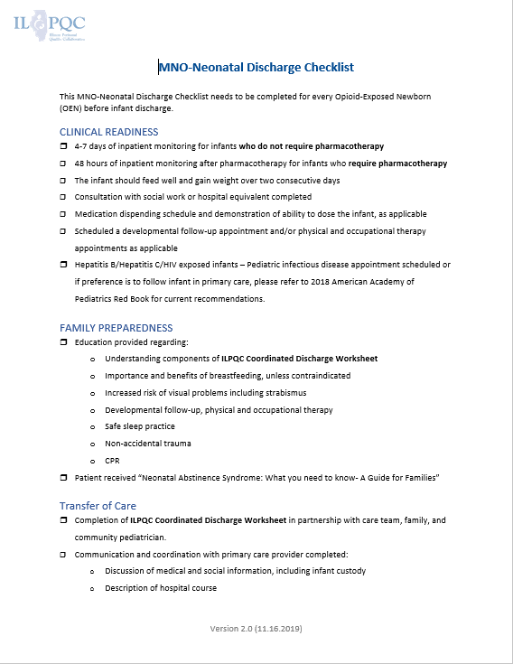
What is a Coordinated discharge?
  Implementation and completion of this document is
  ALL you need for a “Coordinated Discharge”

Slide 17

What is a Coordinated discharge?
Key Elements
Clinical Readiness: infant meets clinical discharge criteria
Family Preparedness: mother/family provided with education
Transfer of Care: Coordinated Discharge Worksheet is completed in partnership

Slide 18
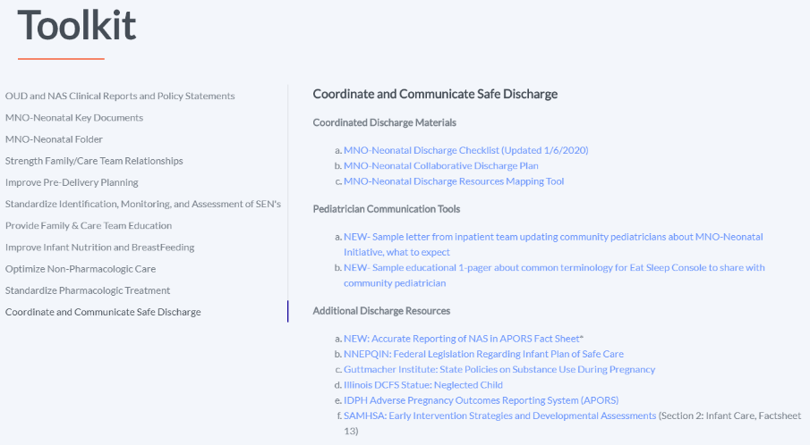
https://ilpqc.org/mothers-and-newborns-affected-by-opioids-neonatal-initiative/

Slide 19
Discharge by Hospital (Q1 2020)
*Hospital number in left column DOES NOT correspond to REDCap Hospital ID*
Hospital | Yes | Total | % Discharge
19 | 3 | 6 | 50%
20 | 1 | 2 | 50%
21 | 1 | 2 | 50%
22 | 1 | 2 | 50%
23 | 2 | 5 | 40%
24 | 2 | 6 | 33%
25 | 1 | 3 | 33%
26 | 1 | 3 | 33%
27 | 4 | 15 | 27%
28 | 0 | 1 | 0%
29 | 0 | 1 | 0%
30 | 0 | 3 | 0%
31 | 0 | 1 | 0%
32 | 0 | 2 | 0%
33 | 0 | 2 | 0%
34 | 0 | 2 | 0%
35 | 0 | 1 | 0%
36 | 0 | 1 | 0%
37 | 0 | 1 | 0%
38 | 0 | 5 | 0%
39 | 0 | 2 | 0%
Hospital | Yes | Total | % Discharge
1 | 2 | 2 | 100%
2 | 4 | 4 | 100%
3 | 1 | 1 | 100%
4 | 1 | 1 | 100%
5 | 3 | 3 | 100%
6 | 4 | 4 | 100%
7 | 1 | 1 | 100%
8 | 1 | 1 | 100%
9 | 3 | 3 | 100%
10 | 1 | 1 | 100%
11 | 4 | 4 | 100%
12 | 1 | 1 | 100%
13 | 2 | 2 | 100%
14 | 2 | 2 | 100%
15 | 1 | 1 | 100%
16 | 11 | 11 | 100%
17 | 34 | 34 | 100%
18 | 7 | 8 | 88%
ILPQC Q1 2020 Rate | 99 | 150 | 66%

Slide 20
Making Systems Change Happen
83%
89%
of teams have a prenatal consult protocol in place
of teams have a non-pharm protocol in place
85%
89%
of teams have a pharm protocol in place
of teams have a discharge protocol in place

Slide 21
Received Maternal Breastmilk from Eligible Mothers at Infant Discharge
AIM = ≥ 70%

Slide 22
Received Pharmacologic Treatment
AIM = ≤ 20%
Notes:
Can we put the day slides here?

Slide 23
Discharged with a Coordinated Plan
AIM = ≥ 95%

Slide 24
Discharge by Hospital
*Hospital number in left column DOES NOT correspond to REDCap Hospital ID*
150 OENs discharged in Quarter 1, 2020
22 of 39 (56%) of ILPQC hospitals are below Discharge Goal for Quarter 1 2020 and 12 of 39 (31%) at 0%.

Slide 25
Strategies to help all hospitals
1:1 follow up with hospitals not at goal
Provide hospitals quarterly data to compare progress and share with providers
Partner with regional networks to support teams achieving aims. F/U MNO regional network calls focus on systems / collaborative efforts to improve linkage to improve discharge
Follow up with teams discharging patients not receiving coordinated discharge
Notes:
Would include feedback from questions we just answered. LC

Slide 26
Team Talk
Courtney Buss, RNC, MSN; Advocate Sherman Hospital

Slide 27
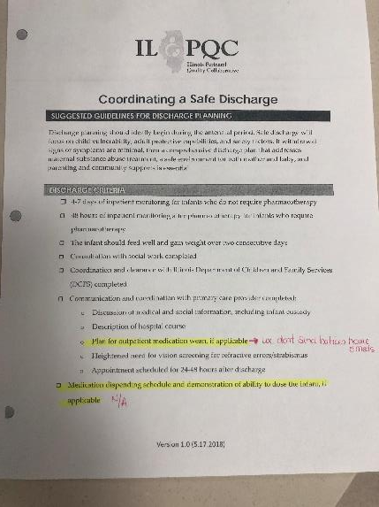
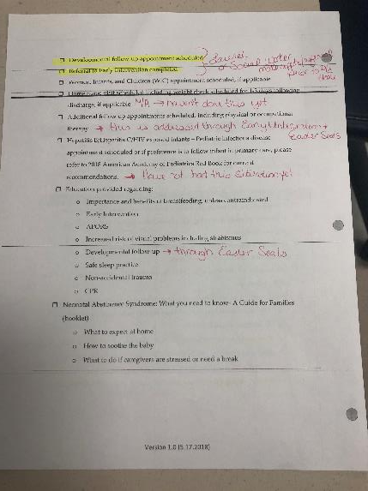
Coordinated Discharge Plan

Slide 28
MNO-Neo QI COrner

Slide 29
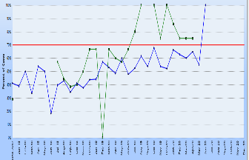
Reviewing your data
Connect with your QI team and share your teams current data reports
Identify any “Data Drops”
What is a data drop & what does it mean for our QI team?
  Look at your systems changes:
    Coordinated Discharge
    Prenatal Consult
    Non-pharm & Pharm Protocols
  Was there an unexpected drop/decline?
  How has the current events impacted your QI work?
  What processes/systems need to be reviewed and addressed?
  Create a PDSA cycle to address any areas of need that your QI team identifies

Slide 30
Upcoming MNO-Neonatal Teams Calls
Date | Topic
July 2020 | “The Goldilocks Effect”- Providing “just the right amount/length” of Pharmacologic Treatment to OENs with NAS symptoms while optimizing non-pharm care
August 2020 | Ensuring Systems and Culture Change in Place for Sustainability
September 2020 | Ensuring Systems and Culture Change in Place for Sustainability
October 2002 | Canceled- 2020 Annual Conference
Notes:
Other Topic ideas:
-Multi Substance Exposure
-Working with Patient/Family Challenges; Meeting Mothers and Families where they are at

Slide 31
Babies antibiotic stewardship improvement collaborative (BASIC) Updates

Slide 32
BASIC Vision
ILPQC Hospitals, regardless of perinatal levels, will implement standardized system-wide guidelines, policies, and protocols
to provide appropriate antibiotics
to appropriate babies
for the appropriate length of time
Notes:
Added 10/22/19

Slide 33
Accomplishments since
November 2020
What we have
What we’ve done
Proven effective strategies from other PQCs
Draft aims and key driver diagram
Review of work by North Carolina, Tennessee, VON
4 BASIC clinical leadership meetings
Kick-off Planning Committee meeting in March 2020
Coming soon
Measures, data form, WAVE 1!
Starting Wave 1 recruitment in July!

Slide 34
BASIC DRAFT SMART AIMs
DRAFT Right Baby AIM: Decrease the number of babies ≥35 (0/7) weeks exposed to antibiotics to by 20% (and/or absolute rate of 3% (or 4%) depending on BASIC Initiative Baseline Data)
  Newborns ≤34 (6/7) weeks will be tracked but not reported on as an AIM
DRAFT Right Length of Time AIM: Decrease the number of babies with any antibiotic continued past 36 hours from the initial dose despite a negative blood culture by 20% and/or absolute rate of 0.5%
  Sub AIM: Decrease the number of babies ≥35 (0/7) weeks with an antibiotic course duration >36 hours by 20% and/or absolute rate of 0.5%
  Sub AIM: Decrease the number of babies ≤34 (6/7) weeks with an antibiotic course duration >36 hours by 20% and/or absolute rate of 0.5%
Notes:
Added 10/22/19

Slide 35
Notes:
Added 10/22/19

Slide 36
BASIC 2020 Timeline
June-July 2020:
Workgroup finalize AIMs, Measures, Data Form
Aug-Oct 2020:
Wave 1 tests data collection process
October 29, 2020
Statewide Launch
November 2020: Monthly webinars begin
How does our discussion of progress on helping teams finish strong on MNO impact this timeline?
Email Dweiss@northshore.org if interested in participating in Wave 1!
Notes:
Added 10/22/19

Slide 37



THANKS TO OUR
FUNDERS
Notes:
Updated 10/22/19

