Slide 1

MNO- Neo Teams Call:
Breastfeeding and Non-Pharmacologic Care
July 20, 2020
1:00 – 2:00pm

Slide 2
Call Overview
MNO-Neonatal: Next steps to support hospital teams achieve the initiative goals and debrief
BASIC 2020 planning updates and discussion
Save the date

Slide 3
Crossing the finish line with MNO-Neonatal
We must achieve the following statewide performance on key measures:
  OENs receiving breastmilk from eligible mothers at discharge> 70%
  OENs with NAS symptoms receiving pharmacologic treatment <20%
  OENs discharged with a coordinated discharge plan> 95%

Slide 4
Crossing the Finish Line with MNO-Neo
This summer into fall we will focus on helping all hospital teams achieve key aims to cross the finish line and move into sustainability
Not all teams are there yet, but these aims are achievable and we have clear strategies to achieve our goals to decrease NAS pharmacologic care as appropriate, increase breastfeeding for eligible mothers, & coordinate discharge to ensure optimal care for OENS in every hospital, for every patient, every time.

Slide 5
Making Systems Change Happen
83%
89%
of teams have a prenatal consult protocol in place
of teams have a non-pharm protocol in place
85%
89%
of teams have a pharm protocol in place
of teams have a discharge protocol in place

Slide 6
Received Maternal Breastmilk from Eligible Mothers at Infant Discharge
AIM = ≥ 70%

Slide 7
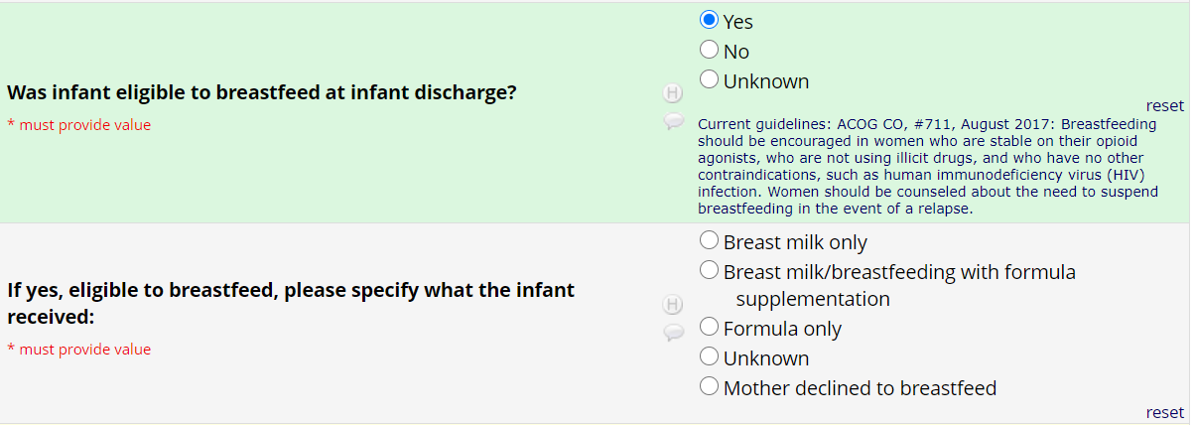
UPDATED REDCAP Question!

Slide 8
Received Pharmacologic Treatment
AIM = ≤ 20%
Notes:
Can we put the day slides here?

Slide 9
Discharged with a Coordinated Plan
AIM = ≥ 95%

Slide 10
Mothers engaged in Non-Pharmacologic Care

Slide 11
Use of ESC & Modified-Finnegan for NAS Assessments

Slide 12
Use of PRN & Standard Dosing for Pharmacologic Treatment

Slide 13
Optimizing Breastfeeding and non-pharmacologic care

Slide 14

Strategies for
MNO-Neo Teams
NAS Assessment tool
Systems for NAS Care
Coordinated Discharge
We must provide non-pharm care as the first line treatment for OENs and NAS care.
OEN Admission Team Huddles- initiated by the charge nurse to include all care team members to obtain and launch tool in the MNO-Neo Folders
Partner with OB team to implement Prenatal Care team conferences
Key strategy for building partnerships for ongoing care for OENs
Use tools/systems of NAS care (MNO-Neo Folder, Prenatal Care team conference and Admission Huddles) to begin the process
Implement standardized protocols for care teams to engage families in optimizing non-pharmacologic
Provide education to mother/families prenatally during Prenatal Care team conferences
NAS Clinical debrief- implement of a NAS Clinical Debrief Review Form with the clinical team
Educate staff on MNO Coordinated Discharge Checklist and Collaborative Discharge Plan included in MNO-Neo folder for early activation

Slide 15
OEN Admission Huddle
What is it?
  A gathering of key clinical care team members at newborn admission to NICU/SCN/NBN to review the MNO folder and begin the coordinated discharge
Who should be involved?
  Key clinical care team members Neo, Peds, Nursing, Social Work, etc.
When should it occur?
  Called by the charge nurse or head nurse when clinical care team members Neo, Peds, Nursing, Social Work, etc.
Why should we implement this strategy?
  Launch and review the MNO folder and begin the coordinated discharge

Slide 16
Systems for
Optimal OEN Care
MNO Folders. Initiate the MNO folder to help create a standardized system to provide the highest level of care for every OEN (including the coordinated discharge materials) to provide the highest level of care for every OEN
OEN Admission Huddle. Utilize an “OEN Admission Huddle” with the care team (Neo, Peds, Nursing, Social Work, etc.) at newborn admission to NICU/SCN/NBN to review the MNO folder and begin the coordinated discharge
MNO-Neonatal Education Campaign. Implement standardized education for providers and nurses on key elements of the MNO-Neonatal initiative, including the importance of engaging families in non-pharmacologic care and coordinated discharge planning.
Non-Pharmacologic Care. Implement standardized protocols for care teams to engage families in optimizing non-pharmacologic care as the first line of treatment for OENs
Coordinated Discharge. Include the MNO Coordinated Discharge Checklist and Collaborative Discharge Plan in every MNO-Neonatal folder activated by the care team when the mother delivers.

Slide 17
Care Team Resources to
Optimize Non-Pharm Care
ILPQC Prenatal Consultation Checklist- include important information to share with mother/family about engaging in non-pharmacologic care of the newborn
ILPQC Infant Bedside Checklist- tool to be used by the care team during NAS Assessments to track non-pharmacologic care being optimized by care team and family. Built in process to facilitate huddles with the family
Breastfeeding Traffic Light- tool that provides guidance on supporting breastfeeding for pregnant persons with OUD, lays out contraindications in easy to understand table
NAS Clinical Debrief Form- Use this form to review missed opportunities in caring for Mothers and Newborns affected by Opioids with the clinical care team. This form will facilitate review of: prenatal consult, non-pharmacologic care, breastfeeding, and coordinated discharge
Should all be included in the MNO-Neo Folder!

Slide 18


Coming Soon!
Join us at ILPQC and participate this August National Breastfeeding Awareness for MNO
Post **NEW** ILPQC Breastfeeding Awareness Resources in your staff lounges and on your unit
Share and distribute ILPQC Breastfeeding Packet that you receive in you MNO-Neo Newsletter
Complete at least 1 Breastfeeding Missed Opportunity Review form to improve non-pharm care and encourage breastfeeding for eligible infants

Slide 19

NEW Breastfeeding
Education Resource for Providers!
Download this resource on ILPQC.org!

Slide 20
Care Team Education to
Optimize Non-Pharm Care
MNO-Neonatal Key Messages and Strategies Poster
Mothers are the Best Treatment Option Poster
Supporting Breastfeeding Poster
Eat-Sleep-Console Simulation & Debrief Video
Engaging Mom in Non-Pharmacologic Care Simulation & Debrief Video

Slide 21
Resources to Engage
Families in Non-Pharm Care
ILPQC Newborn Care Diary- tool to be used by the family to NAS Assessments to track non-pharmacologic care being optimized and partner with the care team. Built in empower the family in engaging in the care of the newborn (included in the MNO Folder!)

Slide 22
MNO-OB 2020 Timeline
Summer 2020:
All teams work to cross the finish line, and start sustainability plan
Fall & Winter 2020
Work to implement sustainability plan, ILPQC 1:1 QI Support for hospitals
2021:
Quarterly Sustainability check in Calls with Teams, implement sustainability plans

Slide 23
Upcoming MNO-Neonatal Teams Calls
Date | Topic
July 2020 | Breastfeeding & Non-Pharmacologic Care
August 2020 | Optimizing non-pharmacologic care to support and reduce pharmacologic treatment of NAS symptoms
September 2020 | Coordinated Discharge… begins at newborn admission to NICU/SCN/NBN
October 2020 | Canceled- 2020 Annual Conference
Notes:
Other Topic ideas:
-Multi Substance Exposure
-Working with Patient/Family Challenges; Meeting Mothers and Families where they are at

Slide 24
MNO-Neonatal discussion/round robin

Slide 25
MNO-Neo Discussion/
Round Robin
What strategies are your hospitals using optimize non-pharmacologic care?
What are barriers you are facing and what can we learn from other hospitals in the collaborative or from the key strategies?

Slide 26
Babies antibiotic stewardship improvement collaborative (BASIC) Updates

Slide 27
BASIC 2020 Timeline
June-July 2020:
Workgroup finalize AIMs, Measures, Data Form
Aug-Oct 2020:
Wave 1 tests data collection process
October 29, 2020
Statewide Launch
November 2020: Monthly webinars begin
Notes:
Added 10/22/19

Slide 28
Save the date!
ILPQC VIRTUAL
Annual Conference 2020 October 29, 2020

Slide 29



THANKS TO OUR
FUNDERS
Notes:
Updated 10/22/19

