Slide 1

MNO- Neo Teams Call:
MNO-Neonatal Key Strategies Round Robin, Part 2
April 20, 2020
1:00 – 2:00pm

Slide 2
Call Overview
ILPQC General Updates
MNO-Neo: Support Hospital Teams to Achieve the Initiative Goals
MNO-Neonatal Key Strategies Round Robin, Part 2
ILPQC BASIC Initiative Updates

Slide 3
AAP COVID-19 Guidance
AAP- FAQs: Management of Infants Born to Mothers with Suspected or Confirmed COVID-19 (4.2.2020)
AAP- Initial Guidance: Management of Infants Born to Mothers with COVID-19 (4.2.2020)

Slide 4

Round Robin COVID-19
How are you doing?
What additional questions do you have?
How can ILPQC help?

Slide 5
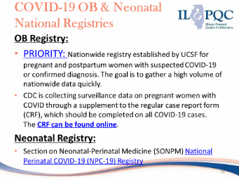
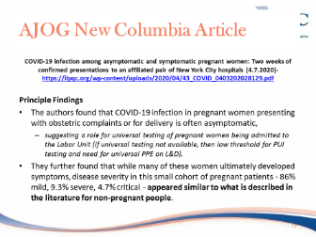
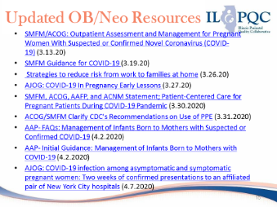
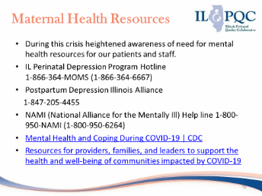
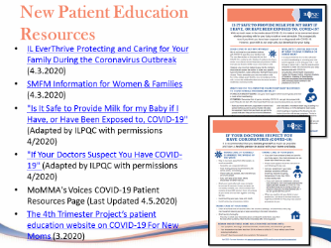
ILPQC COVID-19 Webinar Resources
Please review the recording of ILPQC webinar available here to learn more about resources available.
Notes:
Dan, please add webinar recording link

Slide 6
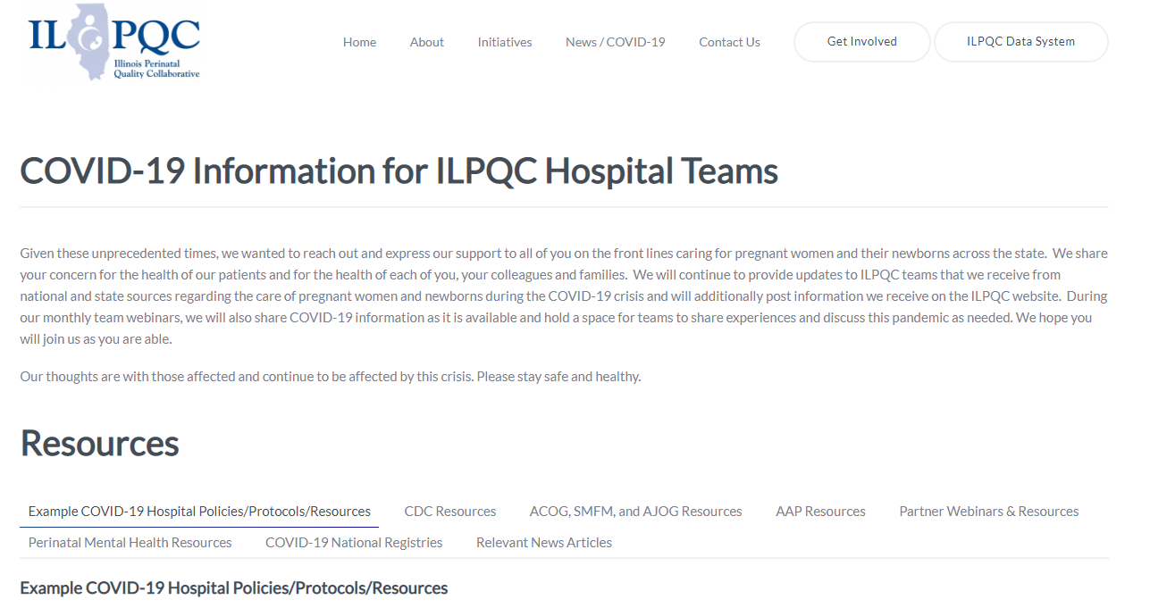
ILPQC COVID-19 Webpage www.ilpqc.org
ILPQC will post national guidelines and OB & Neonatal COVID-19 example protocols & resources
please note dates as guidelines are changing rapidly
https://ilpqc.org/covid-19-information/

Slide 7
More information
We continue to give thanks to the nurses, doctors, health care workers and public health teams across our state at work confronting the COVID-19 pandemic.
Please send questions, comments and recommendations for future COVID-19 OB/Neo discussion webinars to info@ilpqc.org
Recording of ILPQC webinar available here
Next call: Friday April 24th, 12pm – 1:00pm CST
Notes:
Dan, please add webinar link

Slide 8
Mental Health Resources
During this crisis heightened awareness of need for mental health resources for our patients and staff.
IL Perinatal Depression Program MOMS Hotline
1-866-364-MOMS (1-866-364-6667)
24/7 & answered live by licensed mental health professionals
Postpartum Depression Illinois Alliance: 1-847-205-4455
NAMI (National Alliance for the Mentally Ill) Help line 1-800-950-NAMI (1-800-950-6264)
Postpartum Support International (800-944-4773)
Mental Health and Coping During COVID-19 | CDC
Resources for providers, families, and leaders to support the health and well-being of communities impacted by COVID-19

Slide 9

IL Perinatal
Depression & Anxiety Hotline
Answered live 24/7
Staffed by licensed mental
health professionals trained in
perinatal mood & anxiety
disorders
Support for moms, partners,
families & providers

Slide 10

2020
Face- to- Face Meeting

Slide 11
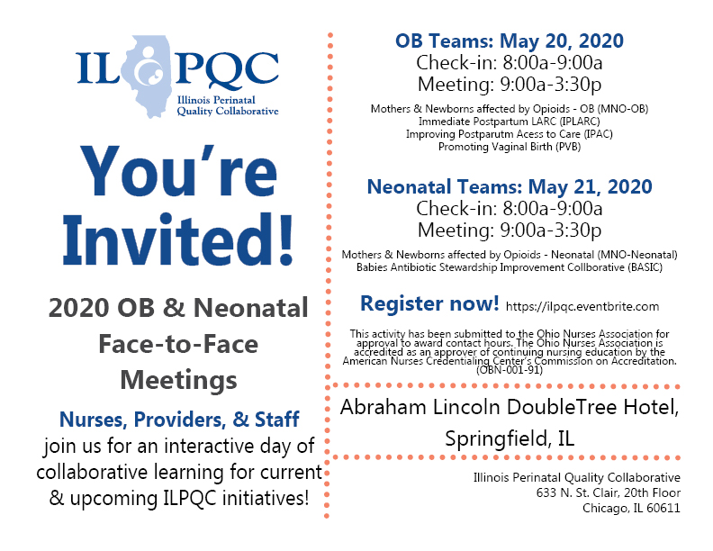
NEW VIRTUAL MEETING

Slide 12

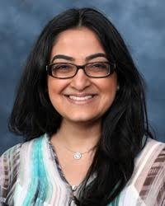

2020 Face-to-Face
Speakers and Panels
Dr. Martin McCaffrey
Antibiotic Stewardship
Dr. Sangeeta Schroeder
QI Strategies Sustainability
MNO #1
MNO #2
MNO #3

Slide 13
2020 Face-to-Face
Volunteer Opportunities
F2F Breakout Facilitators
  ILPQC will NOW RECRUITING with each perinatal network to recruit:
    1 RN & 1 OB Provider, for total of 10 pairs
    1 RN & 1 Neonatal provider, for total of 10 pairs
Please email: info@ilpqc.org if interested in being a breakout facilitator!

Slide 14
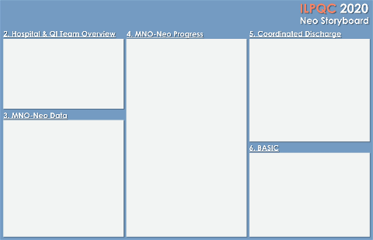
F2F Storyboard Session
All teams will be asked to create a story board for the May 2020 “Face to Face” to share progress towards achieving MNO-Neo
Storyboard should focus on how teams are doing with achieving the 4-key strategies for achieving the MNO-Neonatal Initiative: NAS Assessment Tool, MNO-Neo Folder, Provider Education Campaign, NAS Clinical Debrief
Notes:
Our goal is to send out the template and instructions in the news letter after the webinar -ap

Slide 15

<Hospital Logo>
<Hospital Name>
Fill in QI Team & Roles Here
NAS Assessment Tools
<Picture of QI Team, Hospital>
MNO-Neo Folders
Education Campaign
Breastfeeding
Pharm/Non-Pharm Treatments
Review of all NAS cases
Coordinated Discharge Plans

Slide 16
To be awarded at the May 2020 ILPQC OB Face to Face
QI Excellence Awards
ILPQC Mothers and Newborns affected by Opioids- Neo
QI Champion | QI Leader: Culture & Systems Change | QI Leader: Systems Change
*All Data Submitted | All Data Submitted | All Data Submitted
+ | + | +
4 Structure Measures In Place | 4 Structure Measures In Place | 4 Structure Measures In Place
+ | +
3 Process Measure goals met** | 1-2 Process Measure goals met | (also route for teams with no patients)
**Determined by Cumulative data for Quarter 1 (January - March) of 2020
*All Data Submitted for Baseline (Oct – Dec 2017) and July 2018 through March 2020
*MNO-Neonatal Monthly Patient Data & Monthly Neonatal Structure Measures
    DATA DUE MONDAY, May 4th by MIDNIGHT

Slide 17
Key Strategies for MNO Success
- What every hospital needs to achieve aims
NAS signs and symptoms assessment tool
MNO-Neo Folders
Create MNO folders to store in common area for nurse to pull for every OEN. Engage all clinical care team members with key tools and provide materials to mothers/families.
MNO-Neo Education Campaign
Hang posters, hand out flyers, and provide online training, Grand Rounds and MNO talks at provider meetings
NAS Clinical Debrief
Implementation of a NAS Clinical Debrief Review Form with the clinical team for every infant with NAS
Implementation of an NAS assessment tool to assist in partnering with mothers/families in providing non-pharm care as the 1st line tx.

Slide 18
Face to Face MNO-Neo QI Awards
  Award criteria will be the same, but for a different time period:
    ALL Patient & Structure Measures Submitted:
      Baseline and July 2018 - March 2020 data
      *note: if any monthly data is missing, a team won’t qualify for an award*
    Structure Measures ‘IN PLACE’ by March 2020:
      Neonatal Prenatal Consult
      Non-Pharmacologic Protocol
      Pharmacologic Protocol
      Discharge Plan
    Outcome Measures Achieved by March 2020:
      Breastfeeding >70%
      Pharm treatment <20%
      Discharge plan >95%
    DATA DUE MONDAY, APRIL 27th at MIDNIGHT
Can get to green by implementing MNO Folders
Goal is to provide every OEN optimal care

Slide 19
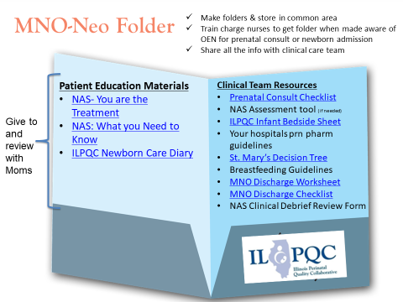
Implement MNO-Neo Folders
in 3 Easy Steps
Print all materials with one click here!
Print 5-10 to keep on your units
Orient & Educate Providers & Nurses to Folder Contents and Protocol to use for all screen+ patients
If patient screens + for OUD, ask nurse to pull MNO folder for easy access to materials for provider, nurse and patient

Slide 20
Monthly Case Review of All
OEN Cases in 4 Easy Steps
Identify all OEN cases at least monthly
QI Team reviews medical record to identify missed opportunities for optimal care using the form
Nurse champion provides feedback to patient’s nursing team as indicated
Provider champion provides feedback to neonatal/pediatric provider as indicated

Slide 21
MNO-Neo Data Review

Slide 22
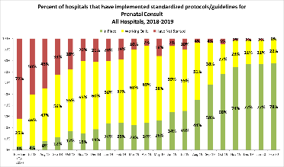
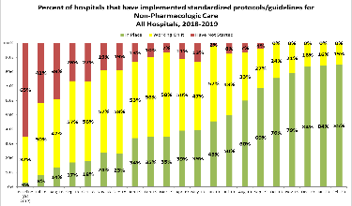
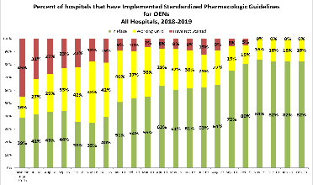
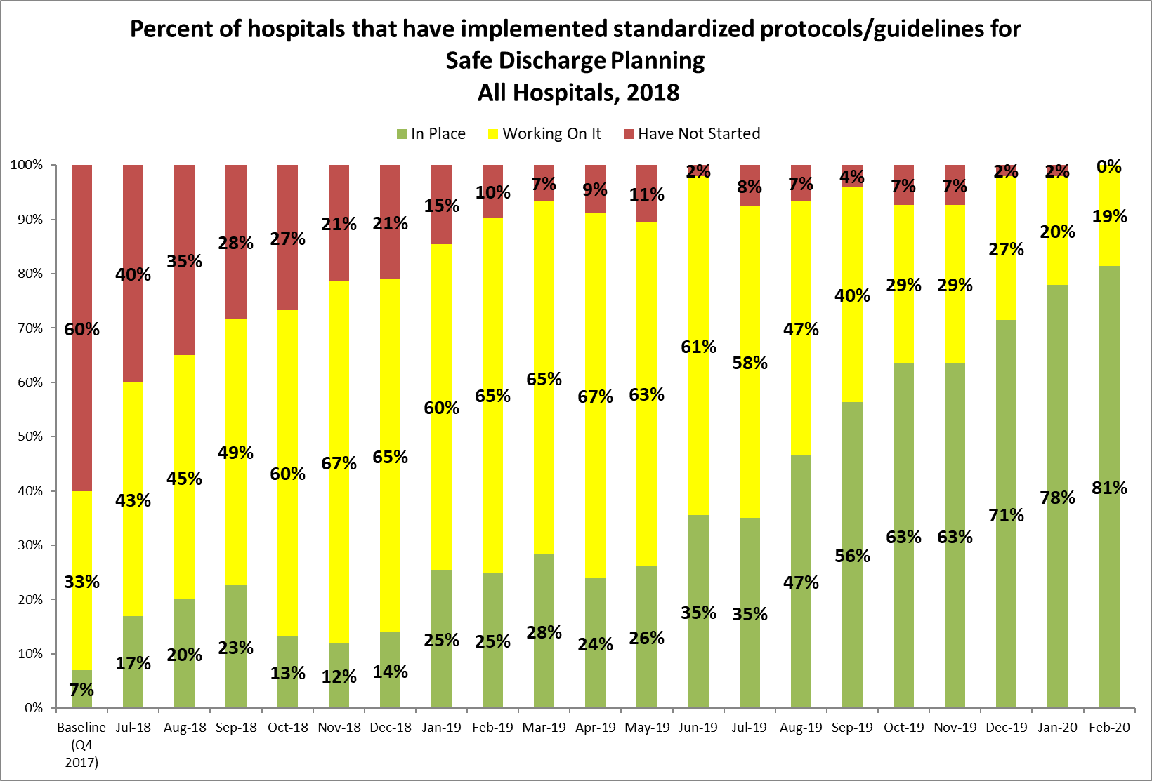
Making Systems Change Happen
80% of teams have a prenatal consult protocol in place
85% of teams have a non-pharm protocol in place
85% of teams have a pharm protocol in place
85% of teams have a discharge protocol in place

Slide 23
Received Maternal Breastmilk from Eligible Mothers at Infant Discharge
AIM = ≥ 70%

Slide 24
Received Pharmacologic Treatment
AIM = ≤ 20%

Slide 25
Discharged with a Coordinated Plan
AIM = ≥ 95%

Slide 26
MNO-Neo Strategies for success Round Robin

Slide 27
Key Strategies for MNO Success
- What every hospital needs to achieve aims
NAS signs and symptoms assessment tool
MNO-Neo Folders
Create MNO folders to store in common area for nurse to pull for every OEN. Engage all clinical care team members with key tools and provide materials to mothers/families.
MNO-Neo Education Campaign
Hang posters, hand out flyers, and provide online training, Grand Rounds and MNO talks at provider meetings
NAS Clinical Debrief
Implementation of a NAS Clinical Debrief Review Form with the clinical team for every infant with NAS
Implementation of an NAS assessment tool to assist in partnering with mothers/families in providing non-pharm care as the 1st line tx.

Slide 28
Any Hospitals from Last Month who didn’t get a Chance to Share?
Advocate BroMenn Medical Center
Advocate Children's Hospital- Park Ridge
Advocate Children's- Oak Lawn
Advocate Condell Medical Center
Advocate Good Samaritan Hospital
Advocate Good Shepherd Hospital
Advocate Illinois Masonic Medical Center
Advocate Lutheran General Hospital
Advocate Sherman Hospital
Advocate South Suburban Hospital
Advocate Trinity Hospital
Alton Memorial Hospital
AMITA Alexian Brothers Womens and Childrens Hospital at St. Alexius
AMITA Health Adventist Medical Center Hinsdale
AMITA Health Alexian Brothers Medical Center
AMITA Health Saints Mary and Elizabeth Medical Center
AMITA Health St. Joseph Hospital - Chicago
AMITA Health St. Mary's Hospital
AMITA Mercy Medical Center
AMITA Resurrection Medical Center
AMITA St. Joseph Medical Center - Joliet
Anderson Hospital
Barnes-Jewish Hospital
Blessing Hospital
Carle Foundation Hospital
CGH Medical Center
Children's Hospital of Illinois- Peoria, OSF
Crawford Memorial Hospital
Edward Hospital
Elmhurst Memorial Hospital
FHN Memorial Hospital
Gateway Regional Medical Center
Graham Hospital
HSHS Holy Family Greenville
HSHS St. Mary's Hospital - Decatur
Illinois Valley Community Hospital
Ingalls Memorial Hospital
Iroquois Memorial Hospital
Little Company of Mary Hospital
Loyola University Medical Center

Slide 29
Hospitals Sharing This Month…
MacNeal Hospital
Memorial Belleville Hospital
Memorial Hospital Carthage Illinois
Memorial Hospital East
Memorial Hospital of Carbondale
Memorial Medical Center
Mercy Hospital & Medical Center - Chicago
Morris Hospital and Health Care Centers
Mount Sinai
NM Central DuPage Hospital
NM Delnor Hospital
NM Hospital Huntley
NM Hospital McHenry
NM Kishwaukee Hospital
NM Lake Forest Hospital
NorthShore University Health System - Evanston Hospital
NorthShore University Health System - Highland Park Hospital
Northwest Community Hospital
Northwestern Medicine McHenry Hospital
Northwestern Memorial Hospital
Norwegian American Hospital
OSF St. Anthony Medical Center- Rockford
OSF St. Elizabeth Medical Center
OSF St. Francis Medical Center
OSF St. James - John W. Albrecht Medical Center
Palos Community Hospital
Riverside Medical Center
Roseland Hospital
Rush University Medical Center
Rush-Copley Medical Center
Silver Cross Hospital
SSM Cardinal Glennon Children's Hospital
SSM Health Good Samaritan
SSM Health St. Mary's Hospital- Centralia
SSM St. Mary's Hospital - St.Louis
St. Anthony Hospital
St. John's Hospital
St. Joseph Hospital - Breese
St. Louis Children's Hospital
Stroger Hospital of Cook County
Swedish American Hospital
Swedish Covenant Hospital
Touchette Regional Hospital
Unity Point Health Methodist
UnityPoint Health Trinity
University of Chicago
UI Health
Vista Medical Center East
West Suburban Medical Center

Slide 30
Please share your MNO-Neo Team’s progress on implementing…
Assessment tools you are using to increase non-pharm care
Systems are you putting into place to ensure the folders are used
Parts of the Neo Provider/ Nurse education campaign you implemented and what you’re planning to do in the next month
Have you started implementing a monthly NAS Clinical Debrief? What has been successful?
Has your team cared for a mother and newborn affected by opioids during COVID-19? What strategies has your team employed / barriers identified to optimize care?
*6
Unmute

Slide 31
Upcoming MNO-Neonatal Teams Calls
Date | Topic
May 18, 2020 | No Teams Webinar. Please attend the Virtual Face to Face on May 20 (OB) and May 21 (Neonatal), 2020
June 15, 2020 | Crossing the Finish Line and Preparing for MNO-Neonatal Sustainability
Notes:
Other Topic ideas:
-Multi Substance Exposure
-Working with Patient/Family Challenges; Meeting Mothers and Families where they are at

Slide 32

Babies antibiotic stewardship improvement collaborative (BASIC) Updates

Slide 33
BASIC Vision
ILPQC Hospitals will implement standardized guidelines, policies, and protocols to:
  (1) provide appropriate antibiotics
  (2) to appropriate patients
  (3) for the appropriate length of time
Notes:
Added 10/22/19

Slide 34

BASIC Update
After discussion with Neonatal Co-Leads, ILPQC Central, Perinatal Network Administrators, and hearing from hospital teams it has been decided that planning and launch of the BASIC Initiative has been put on a temporary hiatus to allow teams to focus on COVID-19
We’ll provide monthly updates on the trajectory of planning, Wave 1, and statewide initiative launch. If anyone is interested in ad hoc planning, please let us know and we’ll find ways to engage you in background planning
Notes:
Added 10/22/19

Slide 35



THANKS TO OUR
FUNDERS
Notes:
Updated 10/22/19

