Slide 1



COVID-19 Strategies for OB & Neonatal Units
September 10, 2021
12:00 – 1:15pm

Slide 2

Welcome
Please be certain you are on “mute” when not speaking to avoid background noise.
Whether you have joined by phone or computer audio, you can mute and unmute yourself by clicking on the microphone icon.
The following shortcuts can also be used
For PC: Alt + A : Mute or Unmute
For Mac: Shift + Command + A: Mute or Unmute
For telephone: *6 : Mute or Unmute
2

Slide 3
Housekeeping:
We Are Recording Now
3

Slide 4
ILPQC Covid 19 webinars
The strategies shared today are examples from individual institutions not IDPH or ILPQC recommendations.
This is our 24nd COVID-19 strategies for OB/Neonatal Units webinar in coordination
with IDPH, since April 2020. Please see https://ilpqc.org/covid-19-information/ for
future webinar registration, prior recorded webinars and written out Q/A’s from those webinars.
The next webinar will be Friday, October 1, noon to 1:15pm. We are moving to every other month and determining the needed frequency going forward
Please let us know if your hospital would like to share on an upcoming webinar, please put questions/comments into the chatbox or email directly to info@ilpqc.org
4

Slide 5
Overview
Introduction
Overview of updated data and recommendations
  Patient story: Mallory Goepel, – MSN, RN, NNP-BC, NICU Nurse Practitioner, St. Louis Children’s Hospital, sharing her own story of severe Covid during pregnancy
Discussion of OB Unit Strategies
  Jeannie Kelly, MD, MS – Director Maternal Fetal Transport, Maternal Fetal Medicine, Barnes Jewish Hospital, St. Louis
  Rob Abrams, MD, Executive Director - SIU Center for Maternal - Fetal Medicine, HSHS St. John's Hospital, Springfield
  Ayesha Hasan, MD – Maternal-Fetal Medicine, University of Illinois Medical Center, Chicago
Discussion of NEO Unit Strategies
  Mallory Goepel – MSN, RN, NNP-BC, NICU Nurse Practitioner, St. Louis Children’s Hospital
  Justin Josephsen, MD – Medical Director, St. Mary’s Hospital NICU, Neonatologist Cardinal Glennon Children’s Hospital, St. Louis
  Leslie Caldarelli, MD – NICU Director, Prentice Women's Hospital, Chicago
5

Slide 6

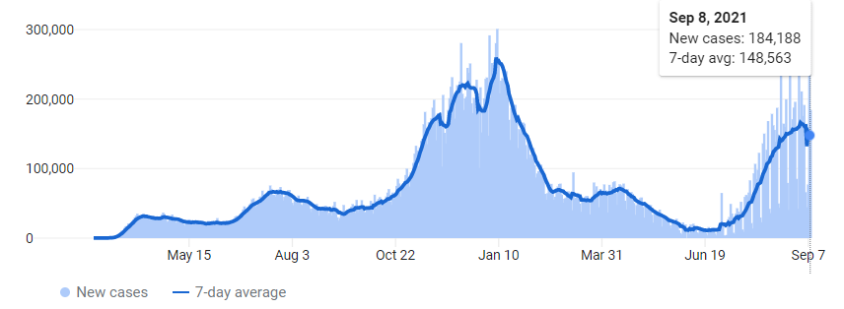
US COVID case trend
6
Notes:
Updated 9/9

Slide 7


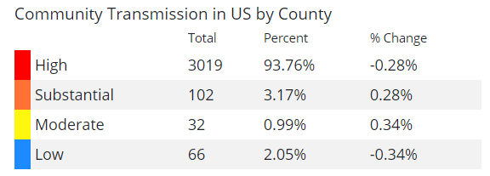
COVID spreads across the Country
Updated 9/9/21

Slide 8
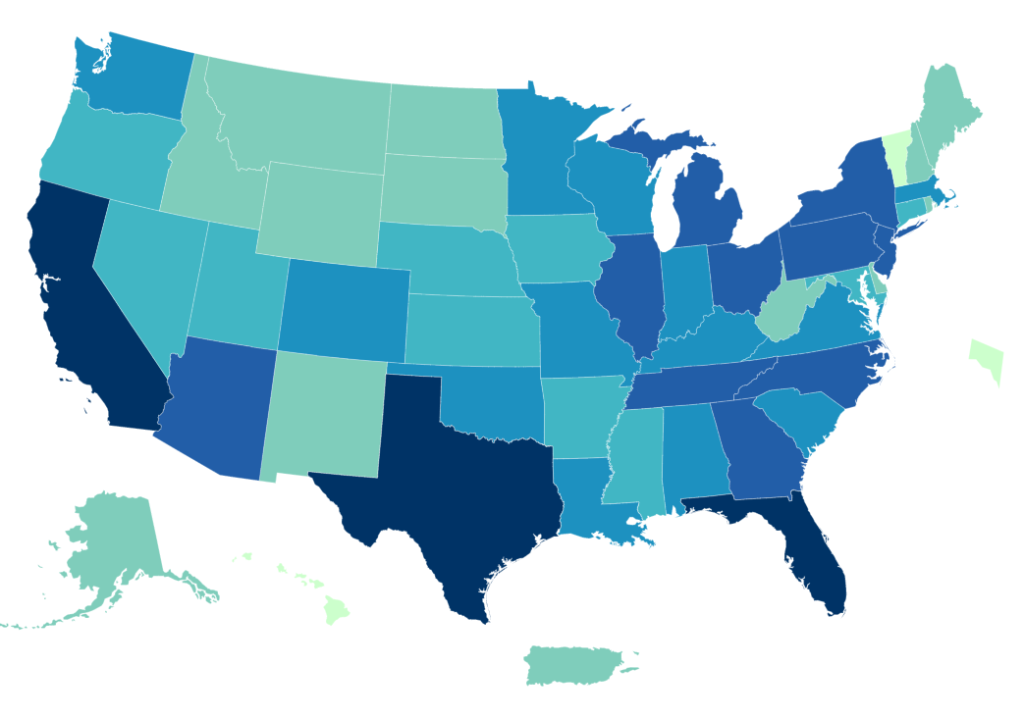
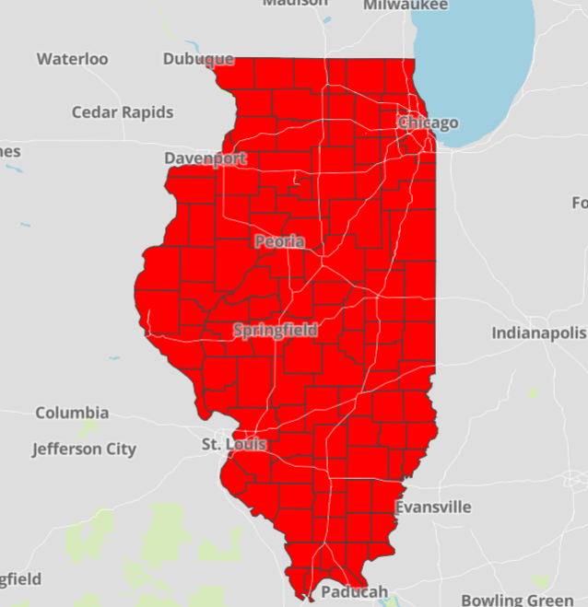
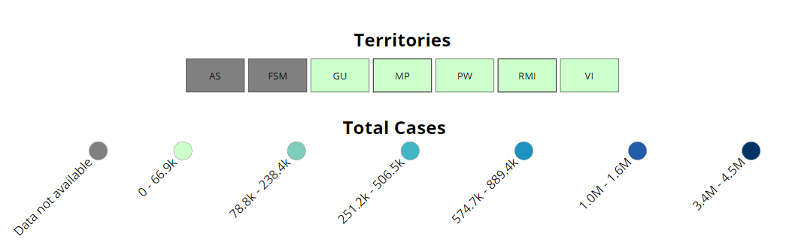
Data Update: September 9, 2021
CDC/IDPH: COVID-19 Outbreak
CDC https://covid.cdc.gov/covid-data-tracker/#cases_totalcases | IDPH https://www.dph.illinois.gov/covid19
Total cases: 40,523,954 confirmed Total deaths: 652,480 confirmed | 1,559,077 Confirmed Positive Cases 24,215 Deaths
Notes:
Updated 9/9/2021

Slide 9
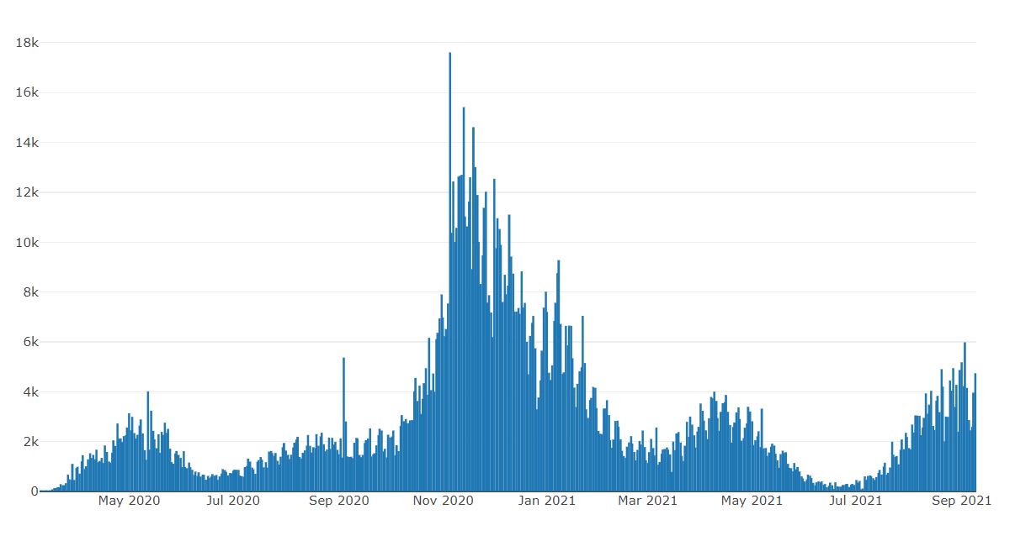

Illinois Daily Incidence
IDPH daily data summary
9
Notes:
Update 9/9
https://www.dph.illinois.gov/covid19/covid19-statistics

Slide 10
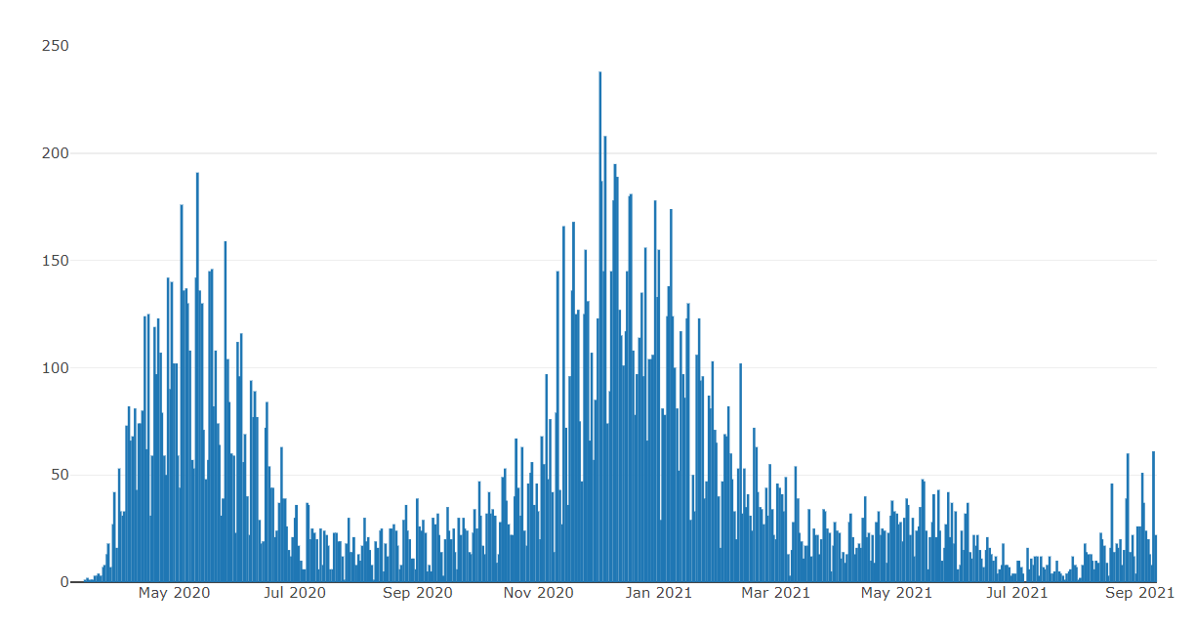
Illinois Covid Deaths
IDPH daily data summary
10
Notes:
Update 9/9
https://www.dph.illinois.gov/covid19/covid19-statistics

Slide 11
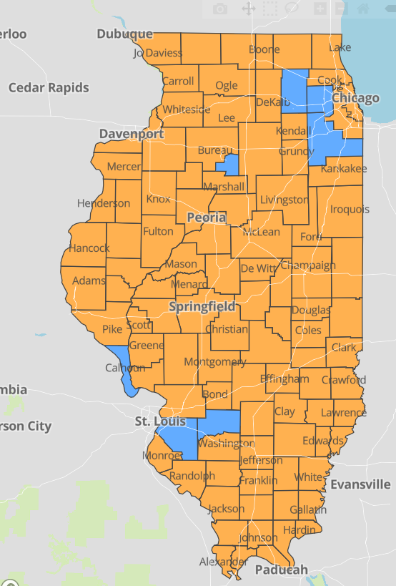
IDPH County Level COVID -19
Risk Metrics
Week 34: 8/22/2021 Through 8/28/2021
Blue indicates that the county is experiencing overall stable COVID-19 metrics.
Orange indicates there are warning signs of increased COVID-19 risk in the county.
Notes:
Update 9/9
https://www.dph.illinois.gov/countymetrics?county=Cook

Slide 12
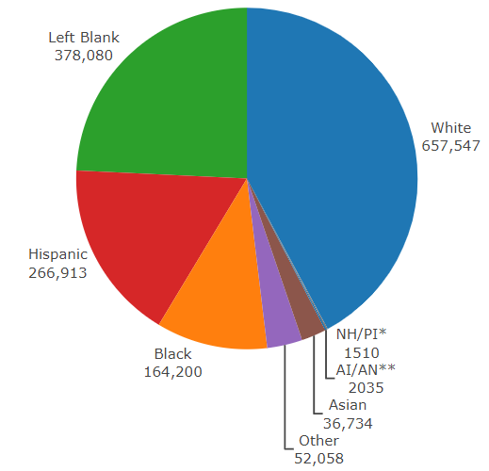
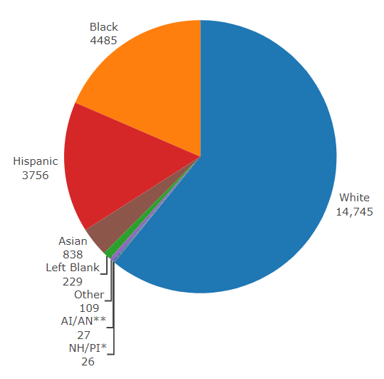
Data Update September 9, 2021 IDPH: COVID-19 Outbreak Race Demographics
https://www.dph.illinois.gov/covid19
Confirmed Cases
Deaths
13
Notes:
Updated 9/9

Slide 13
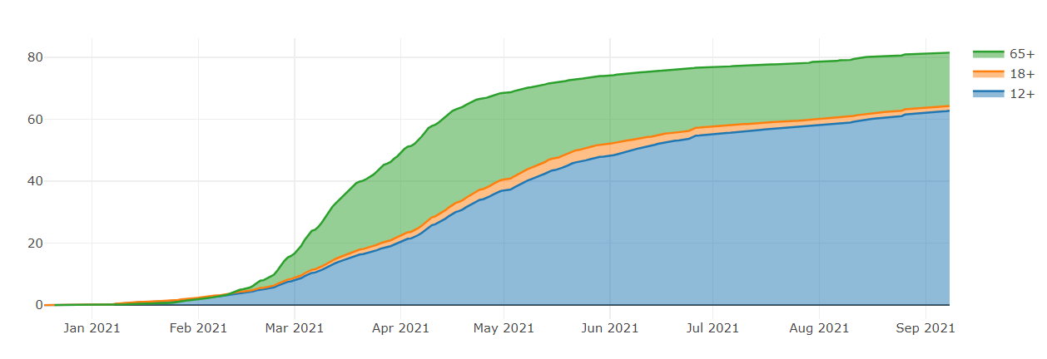
Illinois Population Vaccinated Fully
Notes:
Updated 9/9/2021
https://www.nytimes.com/interactive/2020/us/coronavirus-us-cases.html

Slide 14
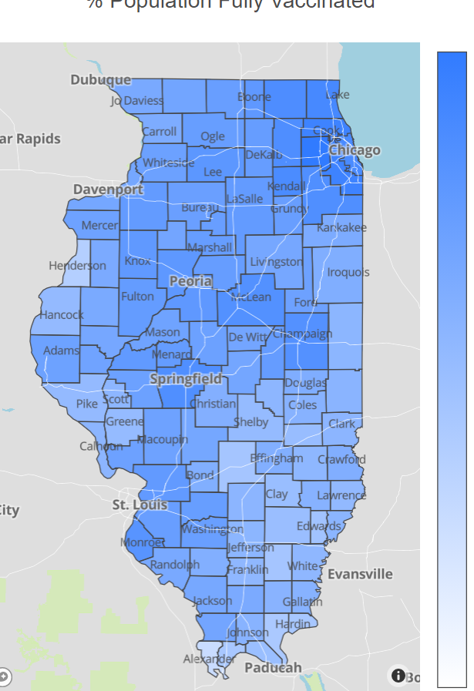
Illinois Daily Reported Administered Vaccine Doses
Last updated 9/9/2021
Illinois Perinatal Quality Collaborative
14

Slide 15
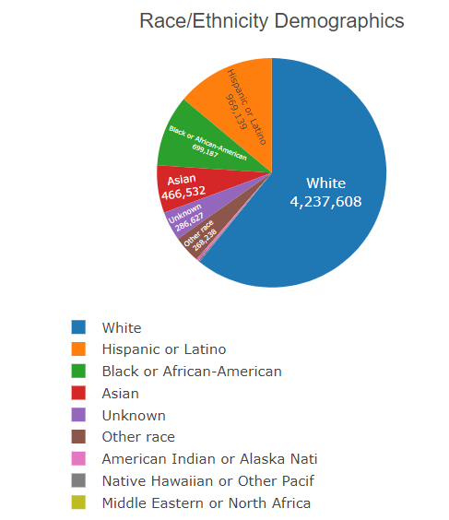
Vaccine by Race/Ethnicity Demographics
Updated 9/9/2021

Slide 16
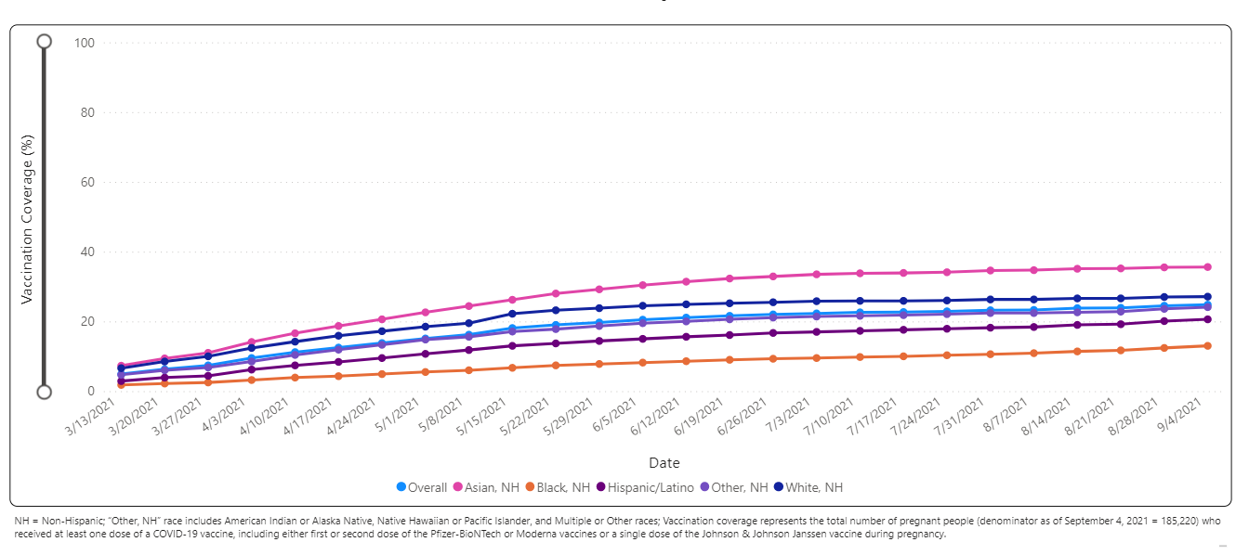
Percent of Pregnant People aged 18-49 years receiving at least one dose of a COVID-19 vaccine during pregnancy overall, by race/ethnicity, and date reported to CDC (9/4/21)

Slide 17
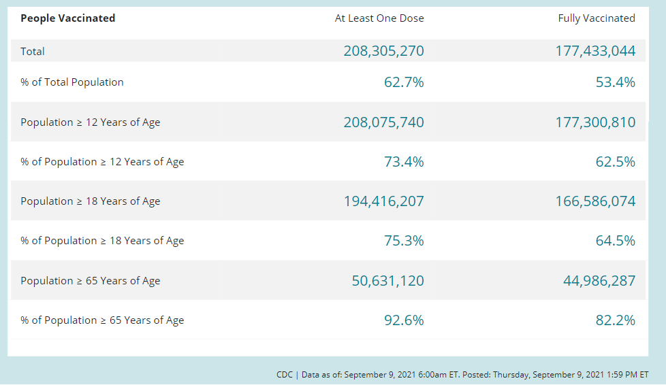
COVID-19 Vaccinations in the United States as of September 9, 2021

Slide 18
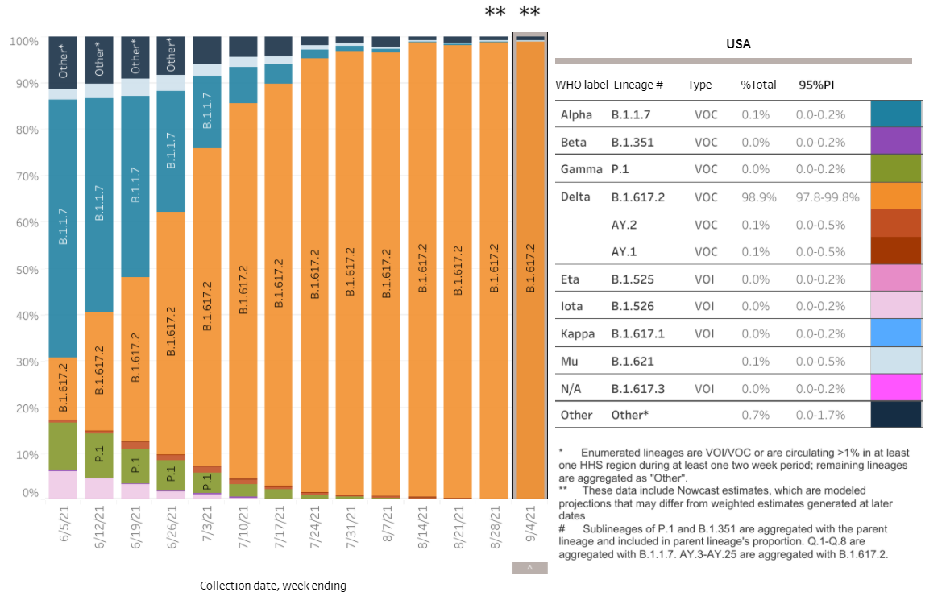
SARS-CoV-2 Variants Circulating in the United States CDC, through September 4, 2021
Delta Variant (B.1617.2)
Identified in India in December 2020
• More highly transmissible and higher risk hospitalization
• First detected in the U.S. in March 2021
• U.S. Delta variant proportion:
• May: 0.1% of circulating strains
• July: 82% of circulating strains https://covid.cdc.gov/covid-data-tracker/#
September: 98.9% strains

Slide 19
CDC MMWR showing Delta breakthrough infections risk: 8/6/21
CDC MMWR: Outbreak of SARS-CoV-2 Infections, including Covid-19 vaccine breakthrough infections, associated with large public gatherings - Barnstable County, MA, July 2021 (released August 6, 2021)
Outbreak of 1000 cases from 4th of July parties on Cape Cod with high rates of vaccination
469 cases reviewed by the CDC, 346 (74%) vaccinated, 90% Delta variant,
274 (79%) were symptomatic, 4 (1.2%) fully vaccinated patients were hospitalized. No deaths reported
Similar levels of high viral load between vaccinated / unvaccinated patients
Delta variant is highly transmissible, 1000 x’s higher viral load, than alpha variant
Data behind updated guidelines recommending masks for indoor public spaces regardless of vaccination status

Slide 20
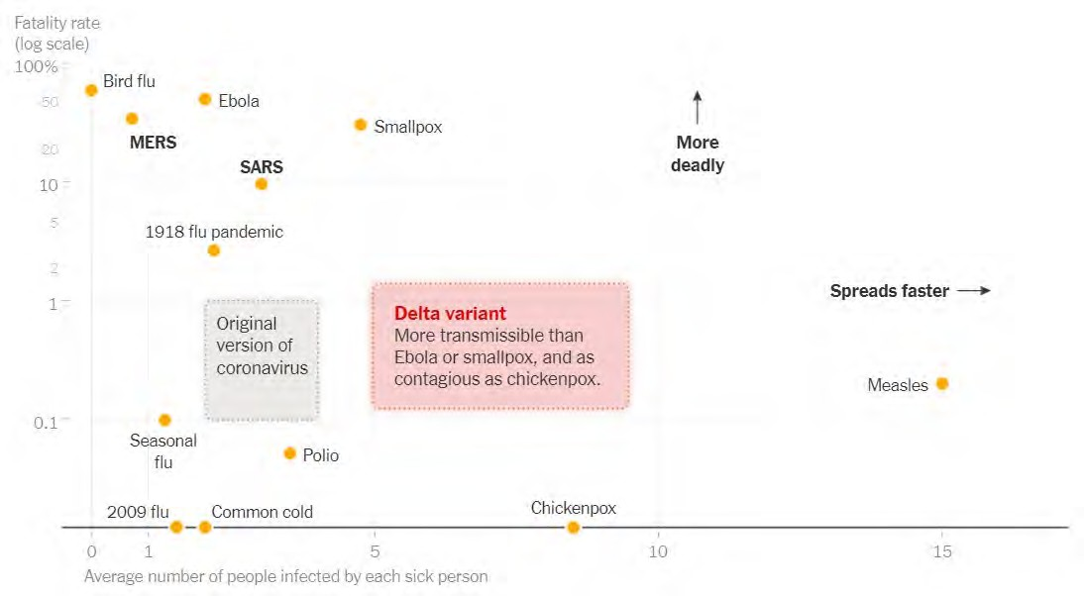
Delta Variant“ fatality rate by number infected by each sick person

Slide 21
Vaccine efficacy and Delta variant
Pfizer 2-dose vaccine available data
UK data:
  Viral effectiveness (VE) against symptomatic disease :
    93.7% among persons with the Alpha variant
    88.0% among those with the Delta variant
  VE against hospitalization:
    95% among persons with the Alpha variant
    96% among persons with the Delta variant
Israel:
  VE against infection and symptomatic disease: 64%
  VE against hospitalization and death: 93%
    Lopez Bernal J, Andrews N, Gower C, et al. Effectiveness of Covid-19 vaccines against the B.1.617.2 (delta) variant; https://www.thelancet.com/journals/lancet/article/PIIS0140- 6736(21)01358-1/fulltext
    Stowe et al. PHE preprint: https://khub.net/web/phe-national/public-library/-/document_library/v2WsRK3ZlEig/view/479607266; https://www.gov.il/en/departments/news/06072021-04
    NEJM: Effectiveness of Covid-19 Vaccines against the B.1.617.2 (Delta) Variant. (7.21.21)
UK data: Effectiveness after one dose of Pfizer vaccine was notably lower among persons with the delta variant (30.7%; 95% confidence interval [CI], 25.2 to 35.7) than among those with the alpha variant (48.7%; 95% CI, 45.5 to 51.7);

Slide 22
Delta Variant Sumary
Is more transmissible than prior variants – R0 close to 6-8 (similar to chicken pox)
Higher rates of hospitalization are seen
Can lead to breakthrough cases in fully vaccinated
  Those infected and vaccinated, given high viral loads 1000 x higher than alpha variant
  May cause more severe disease*
Vaccine effectiveness remains high against severe disease and hospitalization, but decreasing against infection
Need for increased vaccination and mask wearing indoors in public spaces
*The Lancet, June 14, 2021 https://www.thelancet.com/journals/lancet/article/PIIS0140-6736(21)01358-1/fulltext

Slide 23

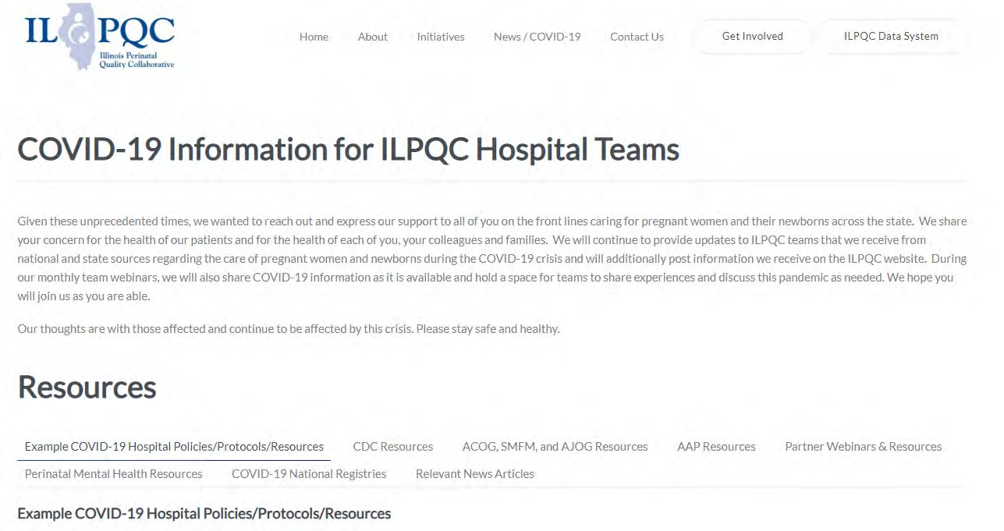
ILPQC COVID-19 Webpage www.ilpqc.org
ILPQC posts national guidelines and OB & Neonatal COVID-19 example hospital protocols & resources
please note dates as guidelines are changing rapidly
https://ilpqc.org/covid-19- information/

Slide 24
Updated OB (ACOG/SMFM) Resources
ACOG:COVID-19 FAQs for Obstetrician-Gynecologists, Obstetrics (Updated 7.1.21)
ACOG: Practice Advisory: Vaccinating Pregnant and Lactating Patients Against COVID-19. (Updated 7.30.21)
SMFM: Provider Considerations for Engaging in COVID-19 Vaccine Counseling With Pregnant and Lactating Patients. (Updated 8.23.21)
SMFM: SMFM Learning: Myth-Busting COVID-19 Vaccines in Pregnancy. (09.10.21)

Slide 25
ACOG Update 7.30.21 Summary
ACOG strongly recommends that all eligible persons, including pregnant and lactating individuals, receive a COVID-19 vaccine or vaccine series.
Obstetrician-gynecologists and other women’s health care practitioners should lead by example by being vaccinated and encouraging eligible patients to be vaccinated as well.
ACOG recommends that pregnant individuals be vaccinated against COVID-19.
ACOG recommends that lactating individuals be vaccinated against COVID-19.
While a conversation with a clinician may be helpful, it is not a requirement prior to vaccination, as this may cause unnecessary barriers to access.

Slide 26
ACOG Update 7.30.21
Claims linking COVID-19 vaccines to infertility are unfounded and have no scientific evidence supporting them. ACOG recommends vaccination for all eligible people who may consider future pregnancy.
For patients who do not receive the vaccine, the discussion should be documented in the patient’s medical record. During subsequent office visits, obstetrician–gynecologists should address ongoing questions and concerns and offer vaccination again. Clinicians should reinforce the importance of other prevention measures such as hand washing, physical distancing, and wearing a mask.

Slide 27
Communicate Vaccine Confidence
ACOG Update 7.30.21
Vaccine hesitancy, particularly around COVID-19 vaccines, exists among all populations.
When communicating with patients it is extremely important to underscore the general safety of vaccines and emphasize the fact that no steps were skipped in the development and evaluation of COVID-19 vaccines.
This can be done by briefly highlighting the safety requirements of vaccines, and ongoing safety monitoring even after vaccines are made available.
The following are some messages to consider using when discussing COVID-19 vaccines with patients:
  Vaccines are one of the greatest public health achievements of the 20th century. Before the widespread use of vaccines, people routinely died from infectious diseases, several of which have since been eradicated thanks to robust immunization programs.
  All available COVID-19 vaccines are highly effective.
  Several vaccines have safely been given to pregnant and lactating individuals for decades.
  To date, safety data on COVID-19 vaccines administered during pregnancy do not reveal any safety concerns.
  The rigor of COVID-19 vaccine clinical trials with regards to monitoring safety and efficacy meet the same high standards and requirements as with a typical vaccine approval process.

Slide 28
Maternal and obstetrical risk of disease
Data indicate that pregnancy is an independent risk factor for severe COVID-19 disease.
  3-fold increased risk for ICU admission,
  2.4-fold increased risk for needing ECMO,
  1.7-fold increased risk of death due to COVID-19, compared with symptomatic nonpregnant patients.
  Pregnant patients with comorbidities (body mass index greater than 35 kg/m2, diabetes, and heart disorders) and those older than age 35 also appear to have a particularly elevated risk of adverse maternal outcomes.
  Data also indicate an increased rate of adverse obstetric outcomes, including cesarean delivery, preterm birth, and possibly stillbirth in pregnant patients with symptomatic SARS-CoV-2 infection.

Slide 29
SMFM: Provider Considerations for Engaging in Covid-19 Vaccine Counseling with Pregnant and Lactating Patients (updated 8/23/21)
Currently the CDC is recommending that moderately to severely immunocompromised people receive an additional dose of an mRNA vaccine
Although full vaccination is still providing stable and highly effective protection against hospitalizations and severe outcomes, a decrease in vaccine effectiveness against SARS-CoV-2 infection over time has been observed.
Because the current protection against severe disease, hospitalization, and death could diminish in the months ahead, especially among those who are at higher risk for complications or were vaccinated during the earlier phases of the vaccination rollout, the U.S. Department of Health and Human Services (HHS) has developed a plan to begin offering booster shots beginning the week of September 20.
Individuals would receive a booster shot starting 8 months after an individual’s second dose.
This plan is subject to the FDA conducting an independent evaluation and determination of the safety and effectiveness of a third dose of the Pfizer and Moderna mRNA vaccines and CDC’s Advisory Committee on Immunization Practices (ACIP) issuing booster dose recommendations based on a thorough review of the evidence.

Slide 30
Updated Neonatal /AAP Resources
AAP: Supporting Emotional and Behavioral Health during the COVID19 Pandemic. (Updated 7.28.21)
AAP: Post Covid Conditions in Children and Adolescents. (Update 7.28.21)
AAP: Children and COVID-19: State-Level Data Report. (update 9.7.21)

Slide 31
AAP: Children and COVID-19: State-Level Data Report
September 2, 2021
As of September 2, over 5 million children have tested positive for COVID-19 since the onset of the pandemic. About 252,000 cases were added the past week, the largest number of child cases in a week since the pandemic began. After declining in early summer, child cases have increased exponentially, with over 750,000 cases added between August 5 and September 2.
The age distribution of reported COVID-19 cases was provided on the health department websites of 49 states, New York City, the District of Columbia, Puerto Rico, and Guam. Since the pandemic began, children represented 15.1% of total cumulated cases. For the week ending September 2, children were 26.8% of reported weekly COVID-19 cases.
AAP: Children and COVID-19: State-Level Data Report. (update 9.7.21)

Slide 32
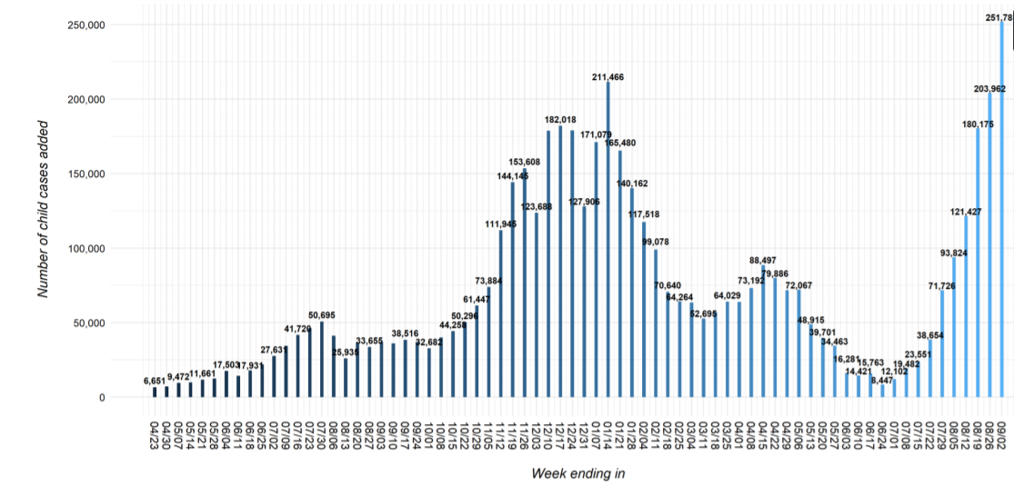
United States: Number of Child COVID-19 Cases Added in Past Week
(Sept 2, 2021)

Slide 33
Updated OB/Neo Covid Publications
AJOG: COVID-19 vaccine response in pregnant and lactating women: a cohort study. (3.21.21)
BMC Pediatrics: Newborn antibodies to SARS-CoV-2 detected in cord blood after maternal vaccination – a case report. (3.22.21)
U.S. News: Promising News for Pregnant People Who Want a COVID-19 Vaccine. (4.6.21)
NEJM: Preliminary Findings of mRNA Covid-19Vaccine Safety in Pregnant Persons. (4.21.21)
AJOG: Professionally responsible coronavirus disease 2019 vaccination counseling of obstetrical and gynecologic patients. (5.2021)
Obstetrics & Gynecology: Severe Acute Respiratory Syndrome Coronavirus 2 (SARS-CoV-2) Vaccination in Pregnancy: Measures of Immunity and Placental Histopathology. (5.11.21)
Obstetrics & Gynecology: Cord blood antibodies following maternal coronavirus disease 2019 vaccination during pregnancy (4.1.2021)
NEJM: Effectiveness of Covid-19 Vaccines against the B.1.617.2 (Delta) Variant. (7.21.21)
NEJM - Breakthrough infections in vaccinated healthcare workers. (7.28.21)
NY Times: Covid Updates: New C.D.C. Mask Guidelines Rest on Data Showing the Vaccinated May Transmit Virus. (7.29.21)
Bloomberg: Pregnant, Unvaccinated and Intubated: Case Surge Alarms Doctors. (8.23.21)
NEJM: Resurgence of SARS-CoV-2 Infection in a Highly Vaccinated Health System Workforce. (9.9.21)

Slide 34
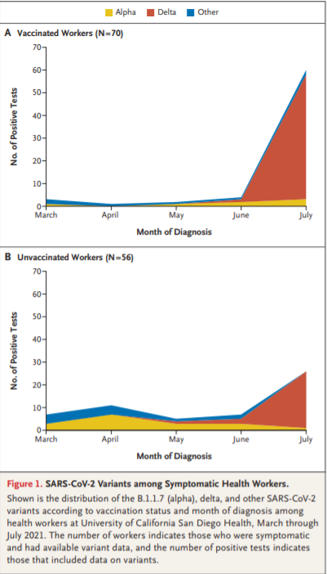
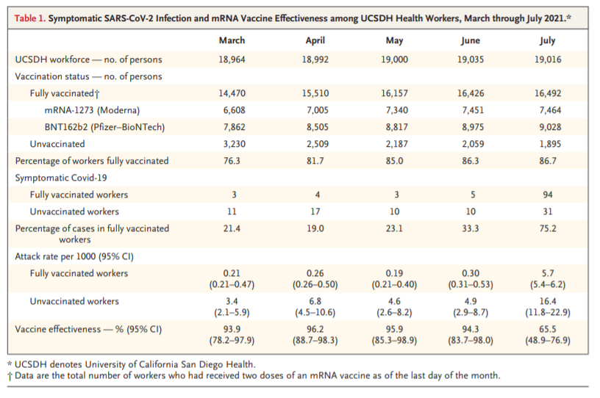
Resurgence of SARS-CoV-2 Infection in a Highly Vaccinated Workforce
(NEJM, 9/9/21)Vaccinated
Health System WorkforceVaccinated
Health System Workforce

Slide 35
Resurgence of SARS-CoV-2 Infection in a Highly Vaccinated Workforce
(NEJM, 9/9/21)
Key take aways….
  We need the remainder of our health care work force vaccinated ASAP
  We need patients vaccinated
  Combination of Delta variant surging with significant increase in infectious risk and likely waning immunity puts even vaccinated at risk of symptomatic infection.
  We need to be diligent with mask wearing in the hospital and in the community
  We need to be rigorous with testing to identify infected patients and workforce
  Be ready when booster recommendations released, likely in the next 2 weeks
  As hospitals across the country and our state experience ongoing surge we need to protect the healthcare workforce to continue to serve on the front lines

Slide 36
IDPH / HFS / CDC
CDC MMRC: Patterns in COVID-19 Vaccination Coverage, by Social Vulnerability and Urbanicity — United States. (6.4.21)
CDC: Safety of COVID-19 Vaccines. Video link. (Updated 6.8. 2021)
CDC: Myths and Facts on Covid-19 vaccines. (Updated 7.7.21)
CDC updated mask guidance: Interim Public Health Recommendations for Fully Vaccinated People. (7.27.21)
CDC MMWR: Outbreak of SARS-CoV-2 Infections, including Covid-19 vaccine breakthrough infections, associated with large public gatherings - Barnstable County, MA, July 2021. (8.6.2021)
CDC: New CDC Data: COVID-19 Vaccination Safe for Pregnant People. (8.11.21)
CDC: Receipt of mRNA COVID-19 vaccines preconception and during pregnancy and risk of self-reported spontaneous abortions. (8.9.21)
CDC: Percent of Pregnant People aged 18-49 years receiving at least one dose of a COVID-19 vaccine during pregnancy. (9.4.21)
•

Slide 37
Receipt of mRNA COVID-19 vaccines preconception and during pregnancy and risk of self-reported spontaneous abortions, CDC v-safe COVID-19 Vaccine Pregnancy Registry 2020-21 (CDC, August.2021)
There is no compelling biological reason to expect that mRNA COVID-19 vaccination (either preconception or during pregnancy) presents a risk to pregnancy. It is well documented that SARS-CoV-2 infection during pregnancy is associated with severe illness and increased risk of adverse pregnancy outcomes. Among recognized pregnancies in high-income countries, 11–16% end in spontaneous abortion (SAB).
Among 2,456 pregnant persons who received an mRNA COVID-19 vaccine preconception or prior to 20 weeks’ gestation and reported to the Vsafe pregnancy registery, the cumulative risk of SAB from 6–19 weeks’ gestation was 14.1% (95% CI: 12.1, 16.1%). Using direct age standardization to the selected reference population, the age-standardized cumulative risk of SAB was 12.8% (95% CI: 10.8–14.8%).
When compared to the expected range of SABs in recognized pregnancies, these data suggest receipt of an mRNA COVID-19 vaccine preconception or during pregnancy is not associated with an increased risk of SAB. These findings add to accumulating evidence that mRNA COVID-19 vaccines during pregnancy are safe.

Slide 38
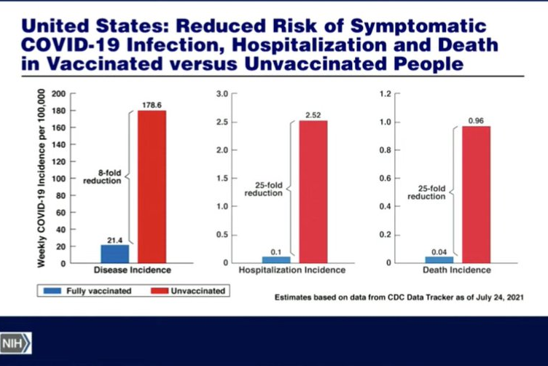
New CDC Data
7/24/21

Slide 39
CDC Mask Recommendations
7/27/21 “the war has changed”
Updated information for fully vaccinated people given new evidence on the B.1.617.2 (Delta) variant currently circulating in the United States.
Added a recommendation for fully vaccinated people to wear a mask in public indoor settings in areas of substantial or high transmission (now 99% of the United States)
Added information that fully vaccinated people might choose to wear a mask regardless of the level of transmission, particularly if they are immunocompromised or at increased risk for severe disease from COVID-19, or if they have someone in their household who is immunocompromised, at increased risk of severe disease or not fully vaccinated.
Added a recommendation for fully vaccinated people who have come into close contact with someone with suspected or confirmed COVID-19 to be tested 3-5 days after exposure, and to wear a mask in public indoor settings for 14 days or until they receive a negative test result.
CDC recommends universal indoor masking for all teachers, staff, students, and visitors to schools, regardless of vaccination status.

Slide 40
V-SAFE vaccine monitoring
– what data is being gathered pregnant patients
As of Sept 7, 2021, there have been over 156,658 pregnancies reported in CDC’s V-SAFE post-vaccination health checker
CDC is currently enrolling pregnant individuals in a pregnancy registry with over 5,104 enrolled.
Evidence gathered through these system provide clinicians with critically needed data to inform future recommendations related to COVID-19 vaccination during pregnancy
https://www.cdc.gov/coronavirus/2019-ncov/vaccines/safety/vsafe.html

Slide 41
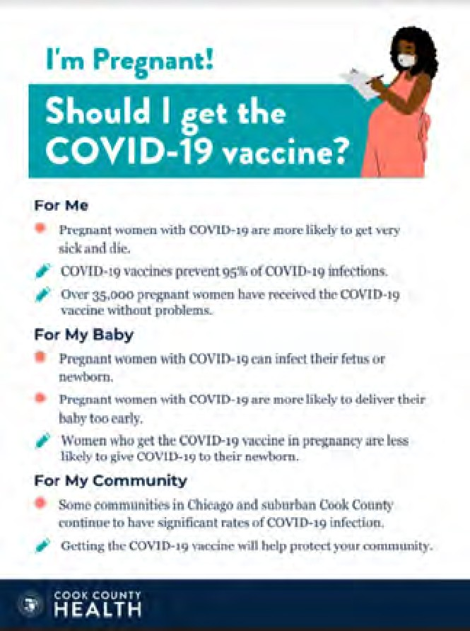
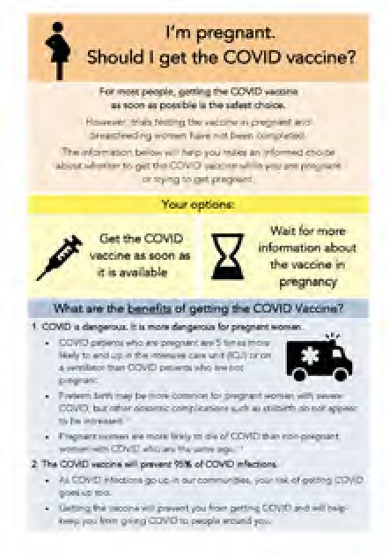

COVID Vaccine
Patient Education Examples
University of Massachusetts Medical School – Baystate: Covid Vaccine Info for Pregnant/Breastfeeding Patients English.
Available in:
Spanish, Nepali, Portuguese, Arabic, Turkish, Somali, Chinese, Vietnamese, Russian (3.17.21)
SMFM Patient Education (English/Spanish): COVID-19 Vaccines and Pregnancy. (3.4.21)
CDC: Safety of COVID-19 Vaccines. Video link. (Updated 6.8. 2021)
Cook County Health: Should I get the COVID-19 vaccine?
Flyer English and Spanish (6.11.21)
CDC: Information about COVID-19 Vaccines for People who Are Pregnant or Breastfeeding. (3.18.21)

Slide 42
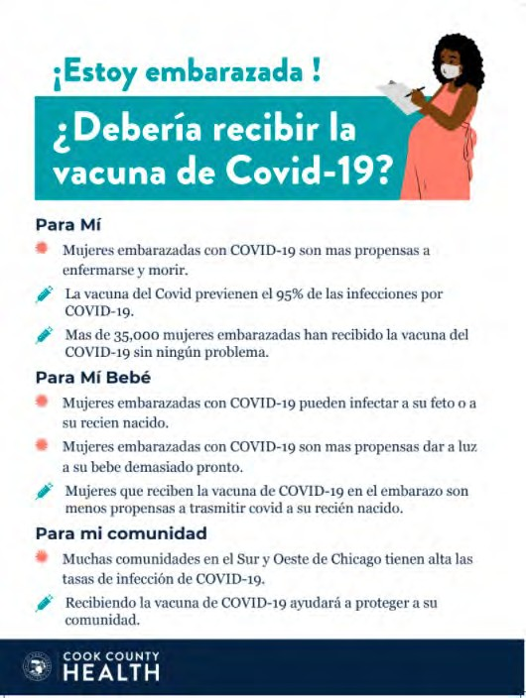
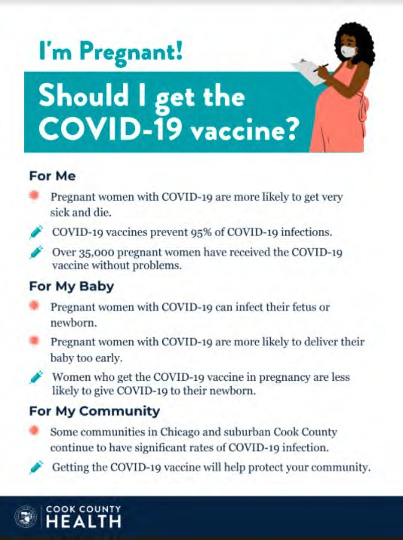
POSTERS

Slide 43
OB Discussion Panel
  Patient story: Mallory Goepel – MSN, RN, NNP-BC, NICU Nurse Practitioner, St. Louis Children’s Hospital, sharing her own story of severe Covid during pregnancy
Discussion of OB Unit Strategies
  Jeannie Kelly, MD, MS – Director Maternal Fetal Transport, Maternal Fetal Medicine, Barnes Jewish Hospital, St. Louis
  Rob Abrams, MD, Executive Director - SIU Center for Maternal - Fetal Medicine, HSHS St. John's Hospital, Springfield
  Ayesha Hasan, MD – Maternal-Fetal Medicine, University of Illinois Medical Center, Chicago

Slide 44
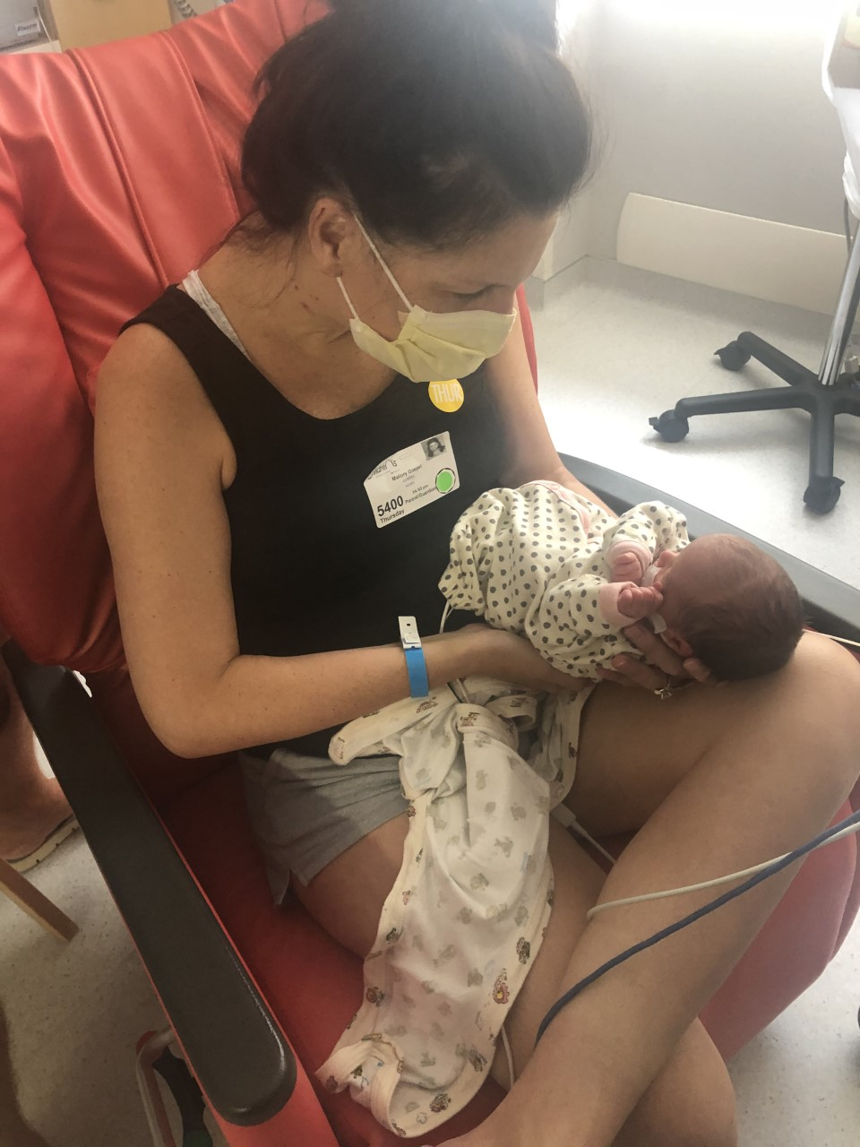

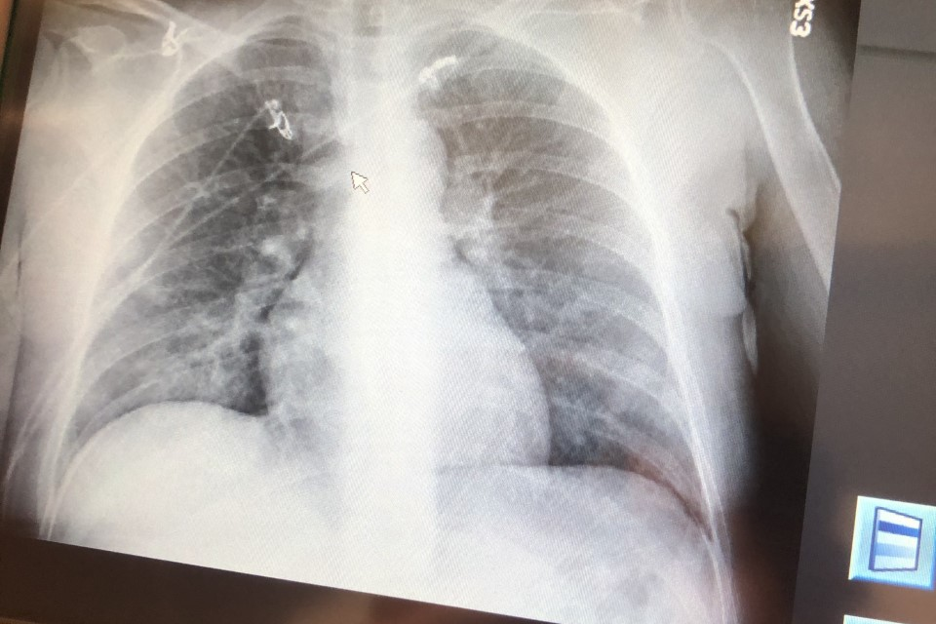
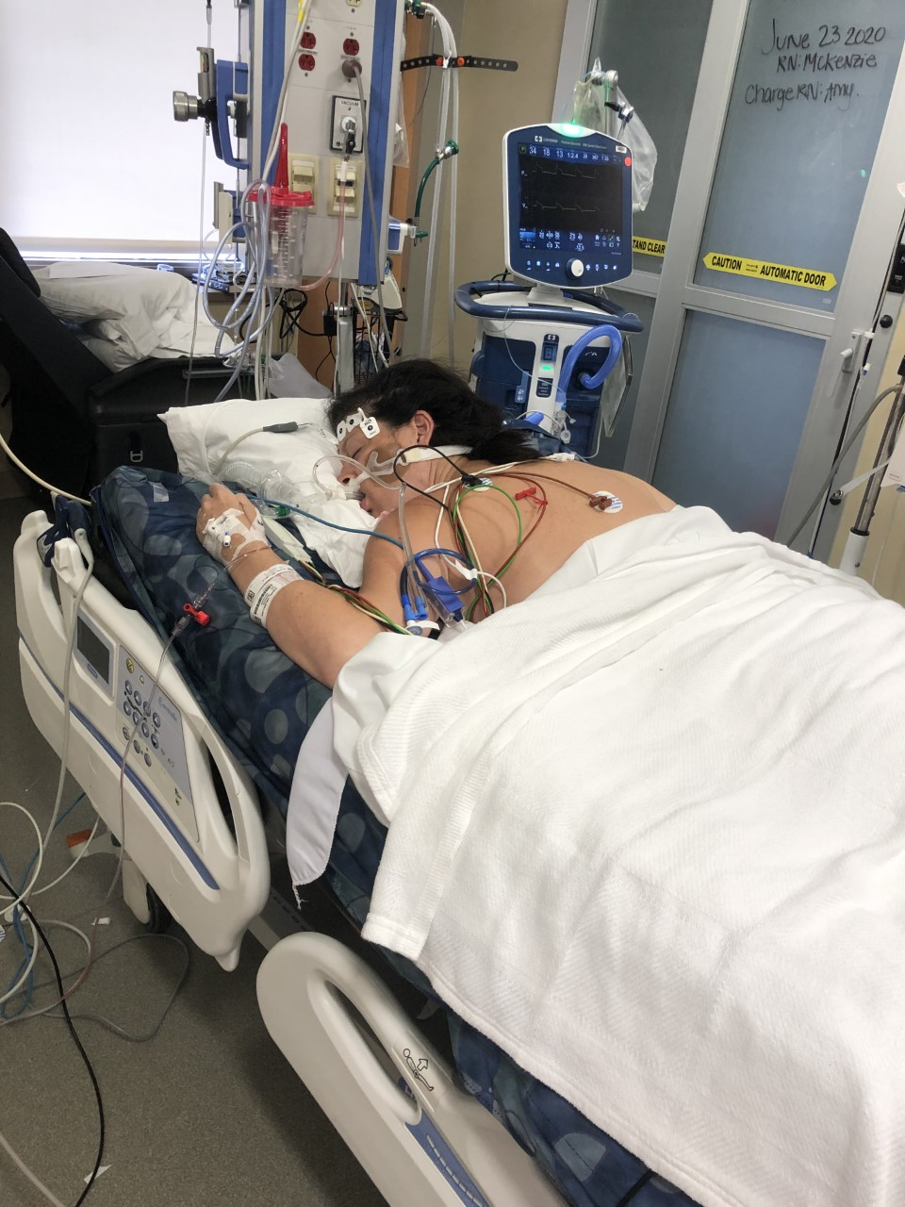

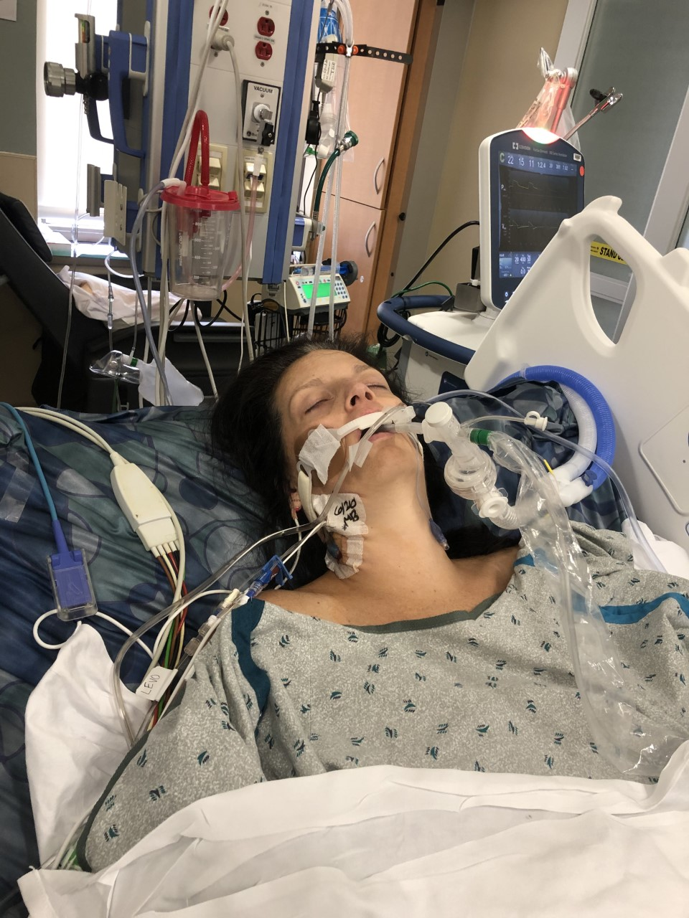
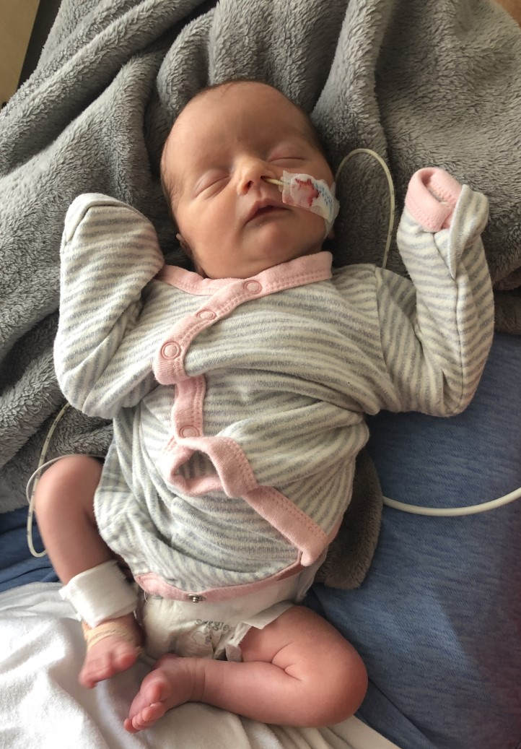
Mallory Goepel Patient Story
July 2020

Slide 45


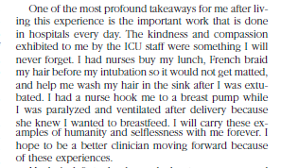

Slide 46

Barnes-Jewish Hospital affiliated with Washington University Physicians
St. Louis, Missouri
10,125 employees
1,266 beds
Parkview Tower
Opened Feb. 2018
  Women and Infants
    18 Labor rooms
    12 Triage bed unit
    18 Antepartum bed unit
    34 Postpartum bed unit
    3 OR’s
      1 for Fetal Surgery
3,665 Deliveries
545 Inbound Maternal Transfers
150 Bed NICU St. Louis Children’s Hospital (August 2020)

Slide 47
Our updates
Our current numbers
  Riding a third wave
  2 in ICU currently, pregnant
Monoclonal antibodies
Inpatient vaccination pilot

Slide 50
Monoclonal antibodies for COVID-19

Slide 51

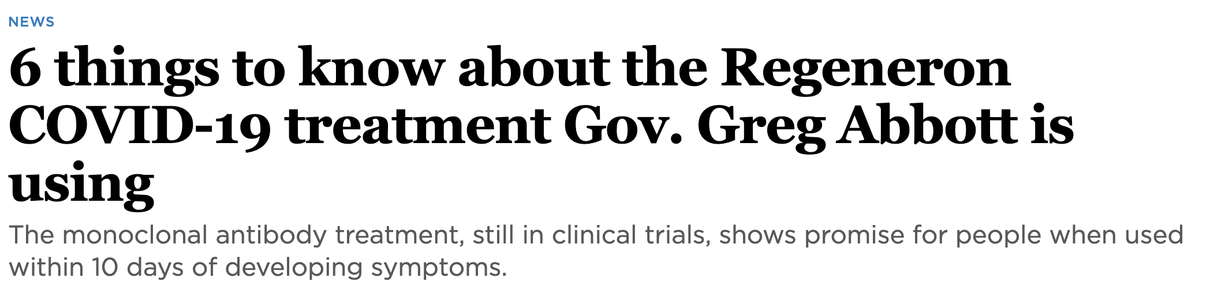
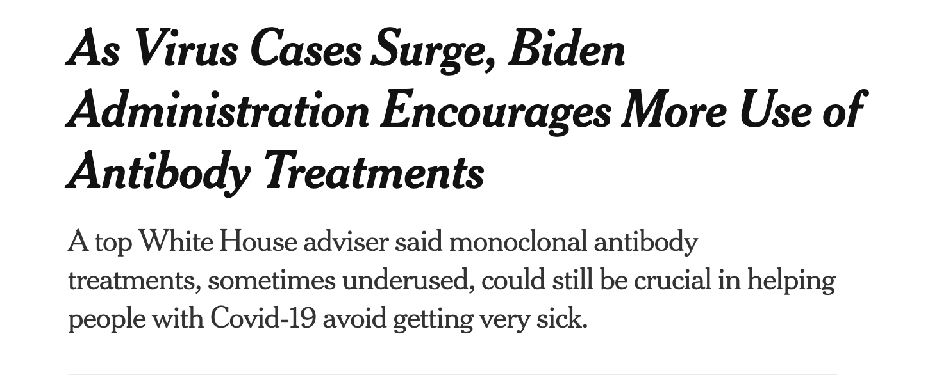

Slide 52
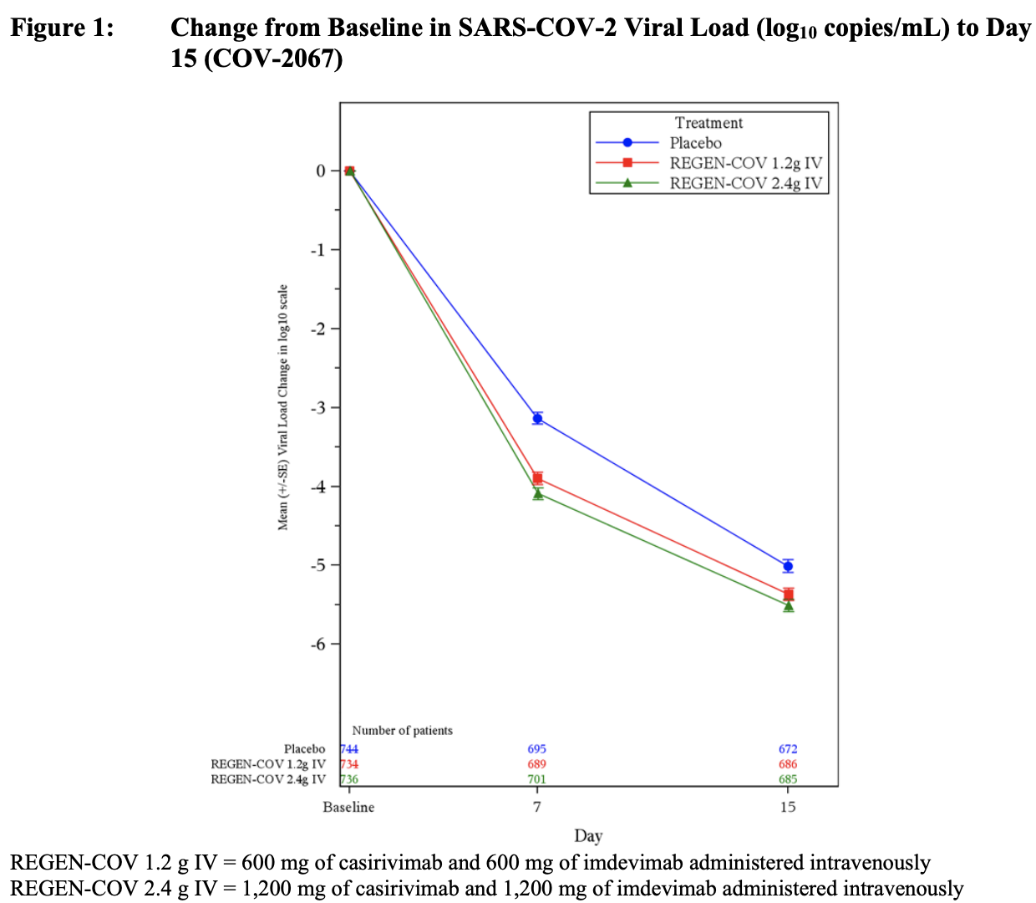
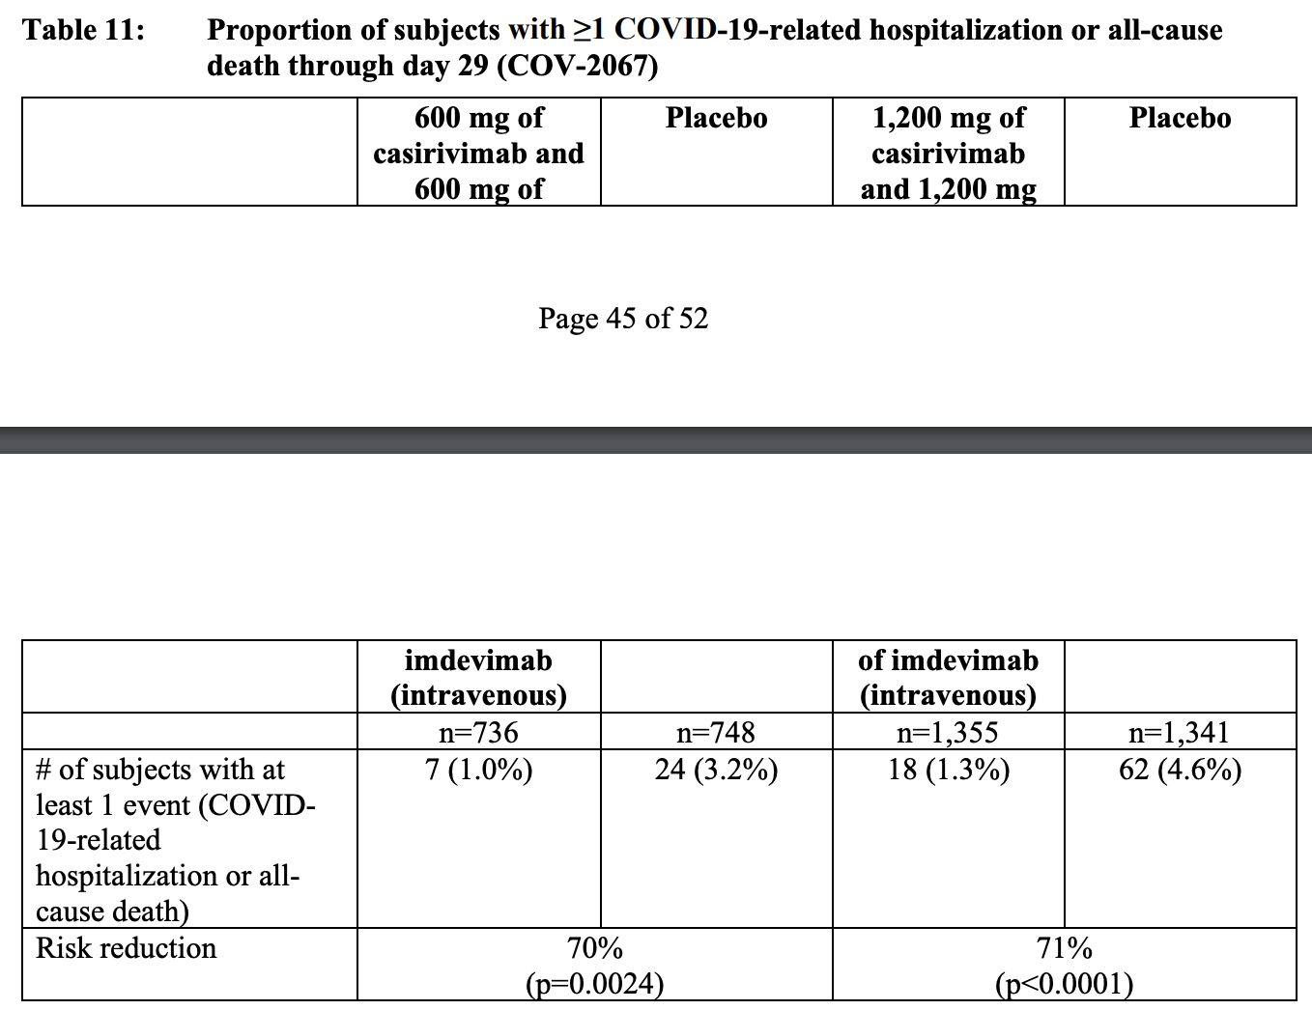

Slide 53
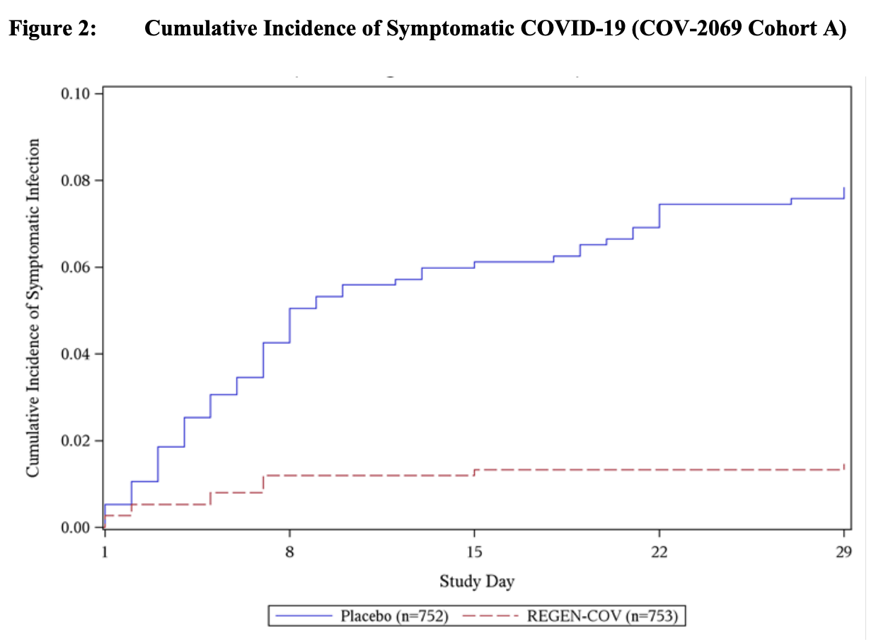
Post-exposure Prophylaxis of COVID-19

Slide 54
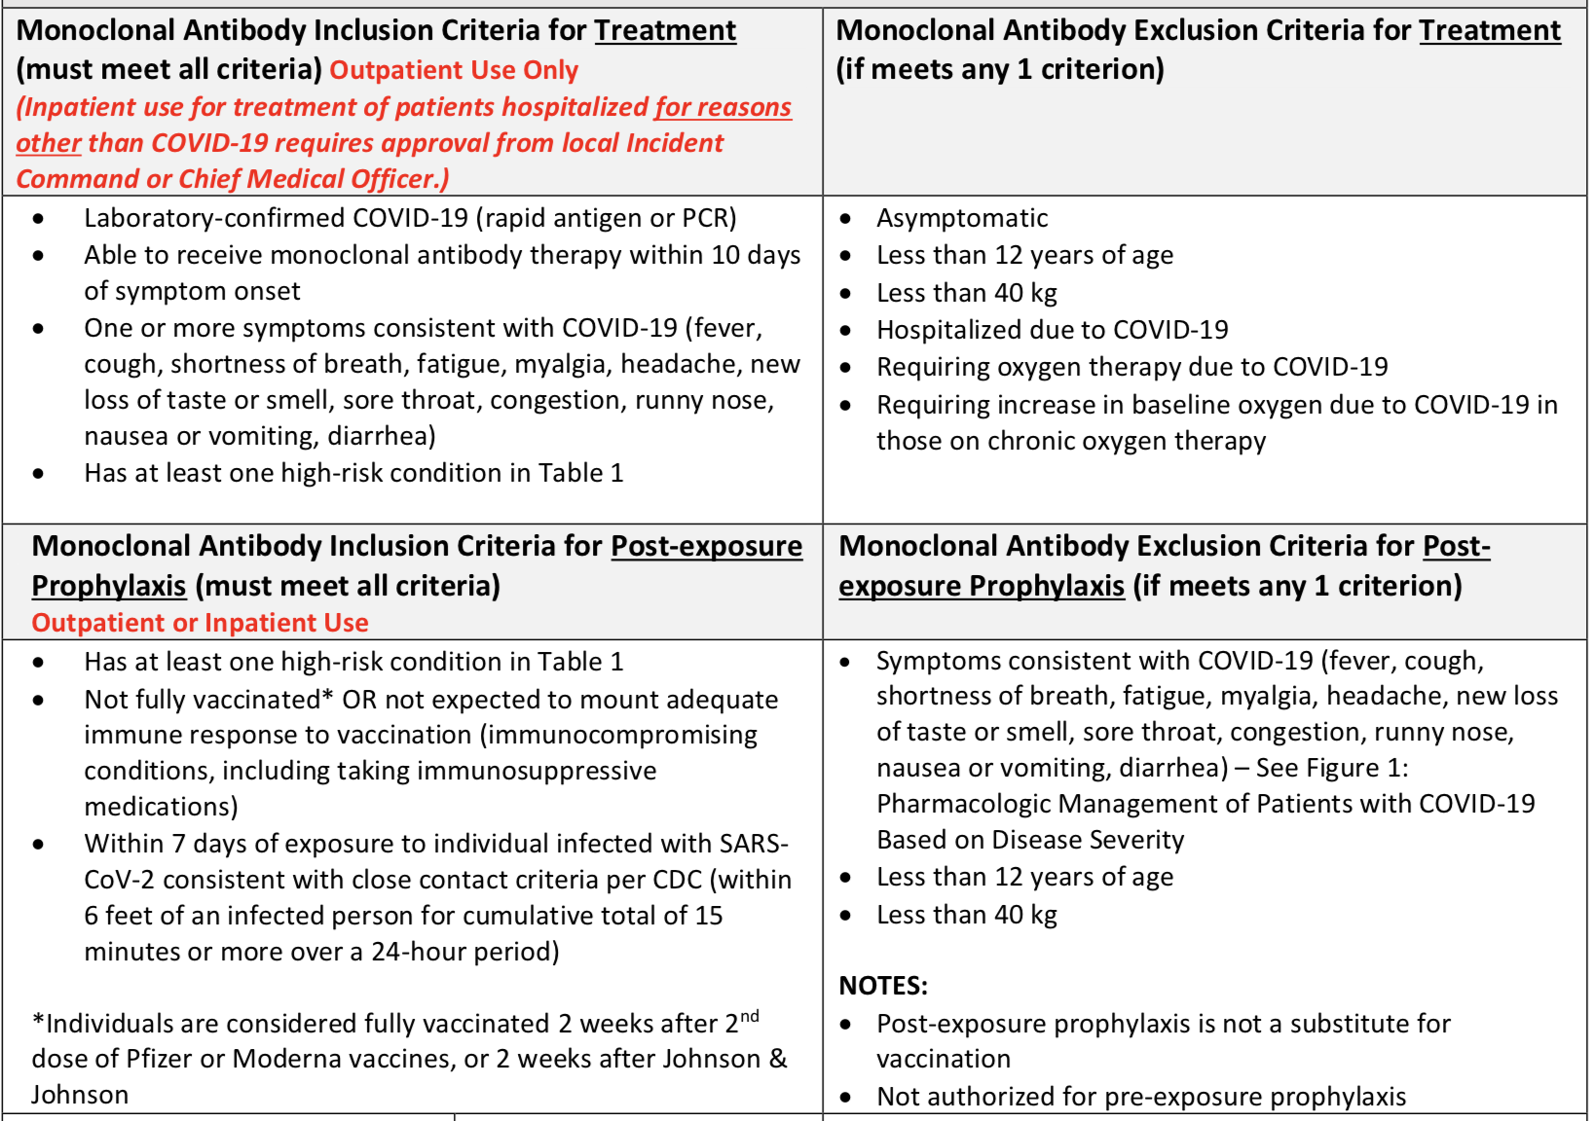
BJC monoclonal antibodies protocol

Slide 55
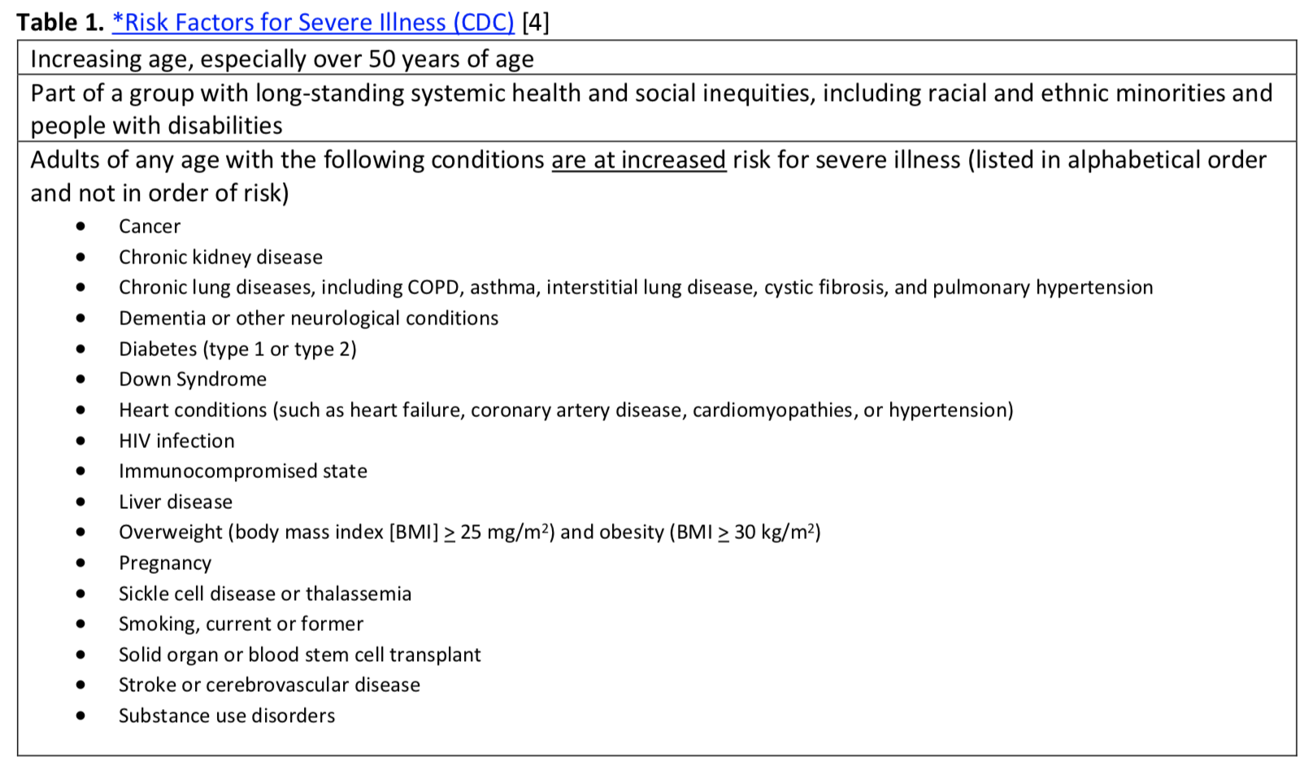

Slide 56
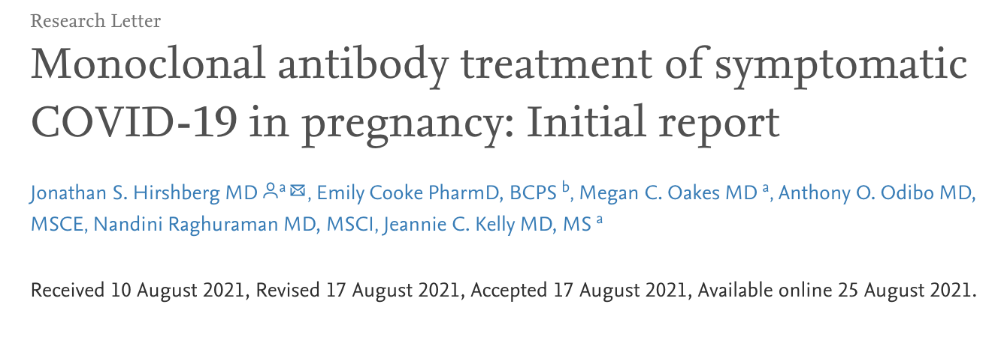
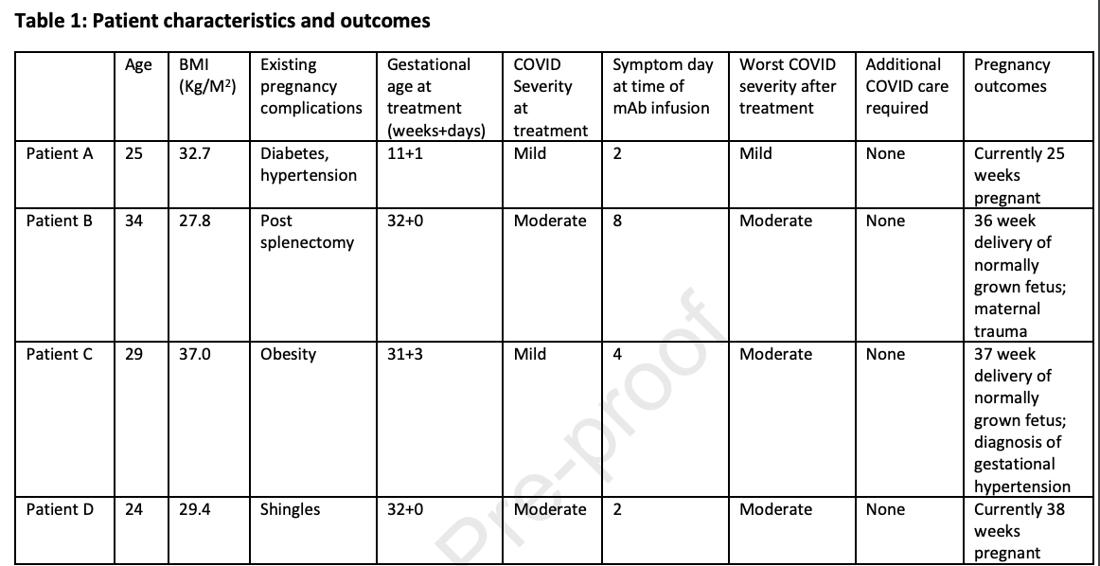

Slide 57
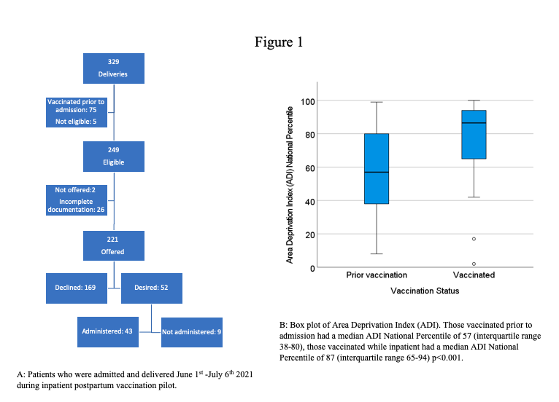
Inpatient L&D Vaccination Pilot

Slide 58
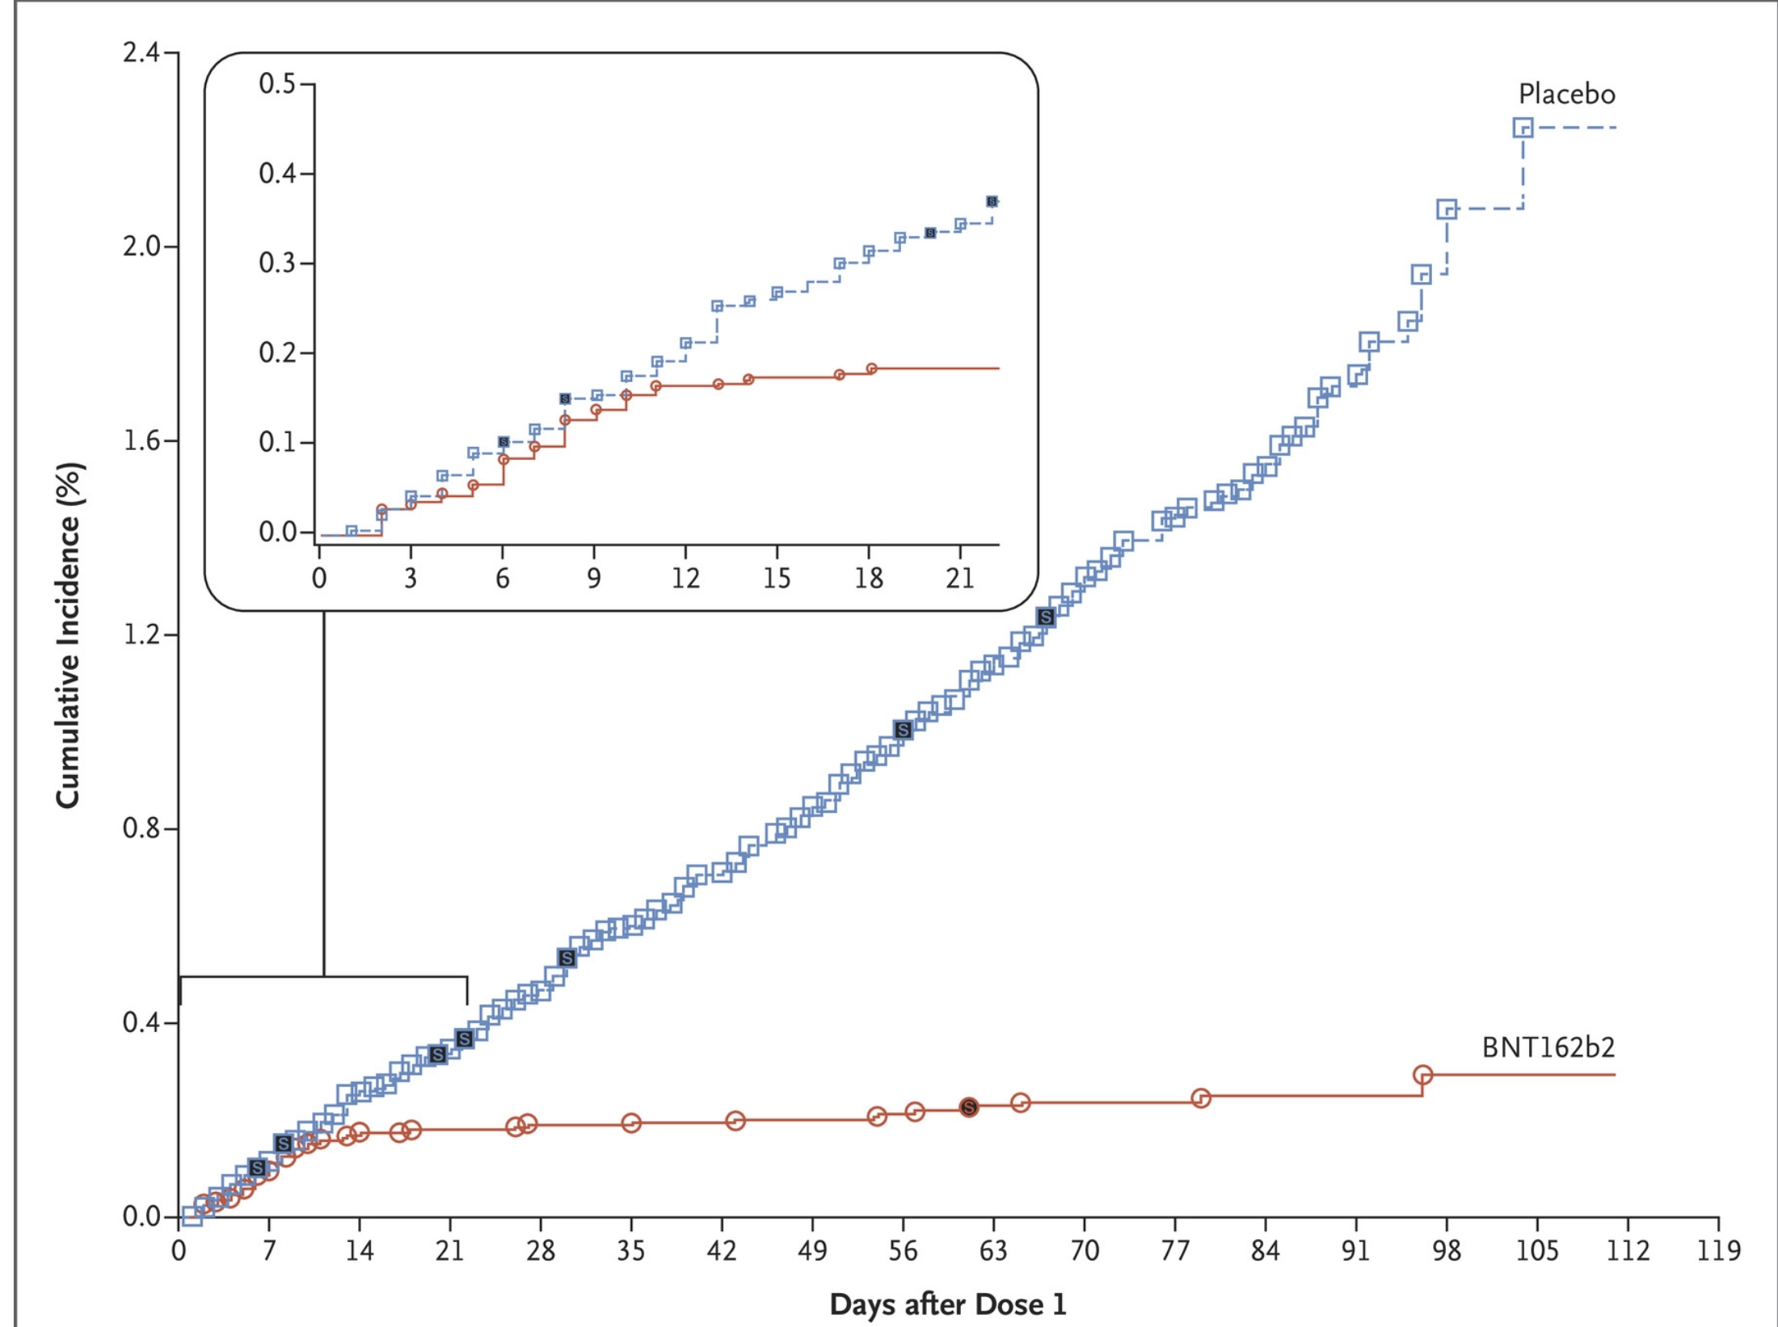
Mabs
Vaccine

Slide 59
Neonatal Discussion Panel
  Mallory Goepel – MSN, RN, NNP-BC, NICU Nurse Practitioner, St. Louis Children’s Hospital
  Justin Josephsen, MD – Medical Director, St. Mary’s Hospital NICU, Neonatologist Cardinal Glennon Children’s Hospital, St. Louis
  Leslie Caldarelli, MD – NICU Director, Prentice Women's Hospital, Chicago

Slide 60
Thank You
We continue to give thanks to the nurses, doctors, health care workers, public health teams and others across our state at work confronting the COVID-19 pandemic.
Please send questions, comments and recommendations, cases / willingness to share for future COVID-19 OB/Neo discussion webinars to info@ilpqc.org
Recording of this webinar, Q/A and registration for the next webinar on Friday, October 1, 12-1pm, will be available at www.ilpqc.org

Slide 61












Thanks to our Funders
In kind support:

