Slide 1

COVID-19 Strategies for OB & Neonatal Units
October 2, 2020
12:00 – 1:15pm

Slide 2

Welcome
Please be certain you are on “mute” when not speaking to avoid background noise.
Whether you have joined by phone or computer audio, you can mute and unmute yourself by clicking on the microphone icon.
The following shortcuts can also be used
For PC: Alt + A : Mute or Unmute
For Mac: Shift + Command + A: Mute or Unmute
For telephone: *6 : Mute or Unmute

Slide 3
Housekeeping:
We Are Recording Now

Slide 4
ILPQC Covid 19 webinars
The strategies shared today are examples from individual institutions not IDPH or ILPQC recommendations.
This is our 13th COVID-19 strategies for OB/Neonatal Units webinars in coordination with IDPH, since April 3rd. Please see https://ilpqc.org/covid-19-information/ for future webinar registration, prior recorded webinars and written out Q/A’s from those webinars.
The next webinar will be Friday, November 6, noon to 1:15pm. We are continuing monthly webinars for now.
Please let us know if your hospital would like to share on an upcoming webinar, please put questions/comments into the chatbox or email directly to info@ilpqc.org

Slide 5
Overview
Introduction
Discussion of Neonatal Unit Strategies
  Joseph Hageman, MD – Neonatology, Director of Quality Improvement, Comer’s Childrens Hospital, University of Chicago
  Justin Josephsen, MD, Medical Director – St. Mary’s Hospital NICU, Neonatologist Cardinal Glennon Children’s Hospital, St. Louis
  Leslie Caldarelli, MD, NICU Director, Prentice Women's Hospital, Chicago
  Beau Batton, MD- Chief Neonatology, SIU School of Medicine, Director of Newborn Services HSHS St. John’s Hospital, Springfield
Discussion of OB Unit Strategies
  Jeannie Kelly, MD – Director Maternal Fetal Transport, Maternal Fetal Medicine, Barnes Jewish Hospital, Washington University, St. Louis
  Catalin Buhimschi, MD, MMS, MBA – Director Division of Maternal Fetal Medicine, University of Illinois Hospital, Chicago
  Ashish Premkumar – Maternal Fetal Medicine, John H. Stroger, Jr. Hospital of Cook County, Chicago
Notes:
Chief of the Neonatology division of Pediatrics at SIU School of Medicine, and the Director of Newborn Services at HSHS St. John's Children's Hospital.

Slide 6
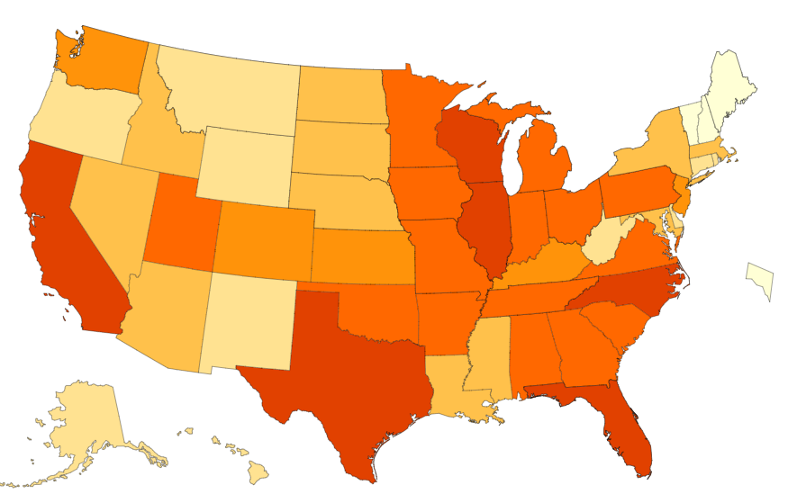
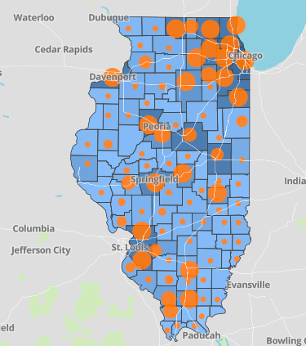
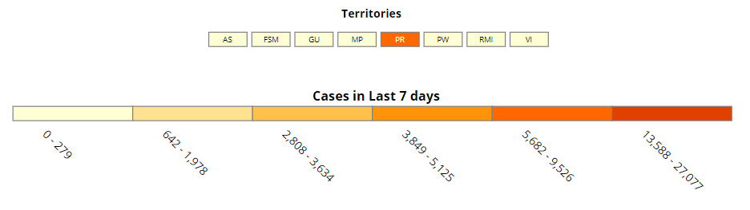
Data Update October 1, 2020
CDC/IDPH: COVID-19 Outbreak
CDC https://www.cdc.gov/coronavirus/2019-ncov/cases-updates/cases-in-us.html | IDPH https://www.dph.illinois.gov/covid19
Total cases: 7,168,077 confirmed Total deaths: 205,372 confirmed | 293,274 Confirmed Positive Cases 8,672 Deaths
Notes:
Ieshia updated 10/1/2020

Slide 7
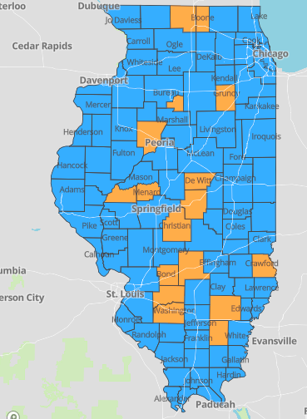
IDPH County Level COVID-19 Risk Metrics
Week 38: 9/13/2020 Through 9/19/2020
Blue indicates that the county is experiencing overall stable COVID-19 metrics.
Orange indicates there are warning signs of increased COVID-19 risk in the county.
Notes:
Ieshia updated 10/1/2020

Slide 8
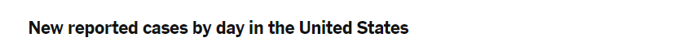
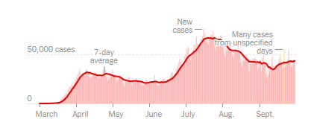
US COVID case trend
Notes:
Ieshia updated 10/1/2020
https://www.nytimes.com/interactive/2020/us/coronavirus-us-cases.html

Slide 9
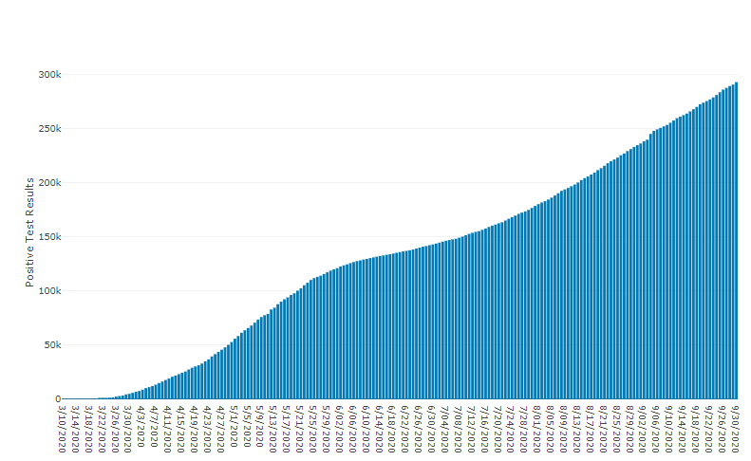
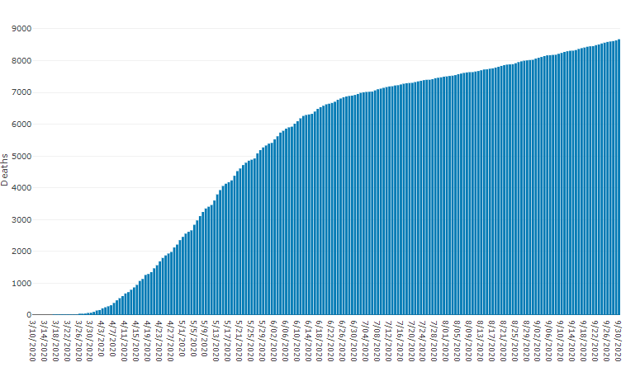
Data Update October 1, 2020
IDPH: COVID-19 Outbreak
https://www.dph.illinois.gov/covid19
IL Positive Cases Over Time
IL Deaths Over Time
Total: 293,274 Confirmed Positive Cases
Total: 8,672 Deaths
Notes:
Ieshia update 10/1/2020
http://www.dph.illinois.gov/covid19/covid19-statistics

Slide 10
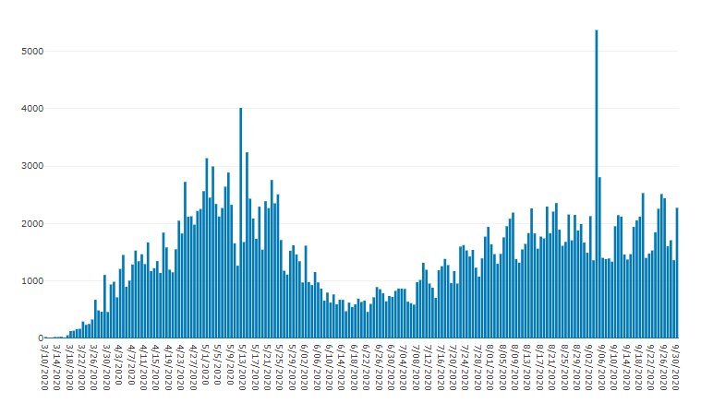
Illinois Daily Incidence
IDPH daily data summary
Notes:
Ieshia updated 10/1/2020
https://www.dph.illinois.gov/covid19/covid19-statistics

Slide 11
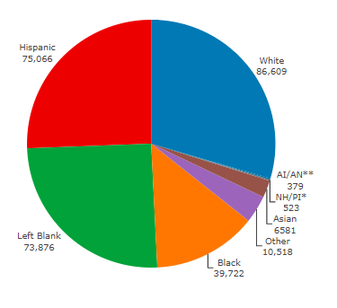
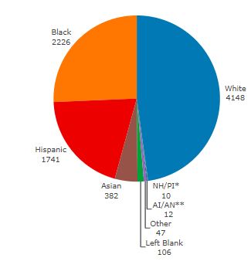
Data Update October 1, 2020
IDPH: COVID-19 Outbreak
Race Demographics
https://www.dph.illinois.gov/covid19
Confirmed Cases
Deaths
Notes:
Ieshia updated 10/1/2020
http://www.dph.illinois.gov/covid19/covid19-statistics

Slide 12
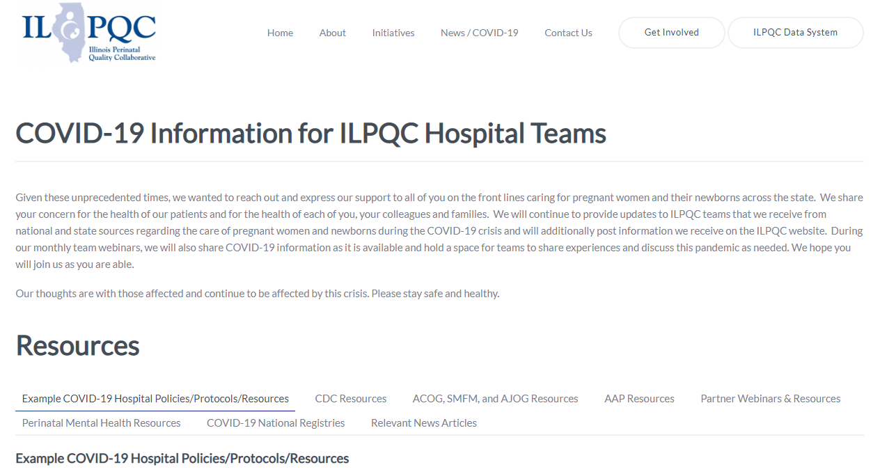
ILPQC COVID-19 Webpage www.ilpqc.org
ILPQC posts national guidelines and OB & Neonatal COVID-19 example hospital protocols & resources
please note dates as guidelines are changing rapidly
https://ilpqc.org/covid-19-information/

Slide 13
Updated OB (ACOG/SMFM) Resources
SMFM: Management Considerations for Pregnant Patients with COVID-19 (7.2.2020) updated
ACOG: COVID-19 FAQs for Obstetrician-Gynecologists, Ethics. (7.14.2020)
ACOG: Coronavirus (COVID-19), Pregnancy, and Breastfeeding: A Message for Patients (7.14.2020)
ACOG: Coronavirus (COVID-19) and Women’s Health Care: A Message for Patients. (7.23.20)
SMFM: Coronavirus (COVID-19) and Pregnancy: What Maternal-Fetal MedicineSubspecialists Need to Know (7.23.2020)
ACOG:COVID-19 FAQs for Obstetrician-Gynecologists, Obstetrics (Updated 8.4.2020)​​
ACOG: Wellness in the Time of COVID-19. (9.2020)​
ACOG: COVID-19 Practice Advisory (Updated 9.25.2020)

Slide 14
Updated Neonatal /AAP Resources
COVID-19 Testing Guidance: Guidance developed to help pediatric practices determine when to test for severe acute respiratory syndrome-coronavirus 2 (SARS-CoV-2) infection in their patient population. (9/30/2020)
Breastfeeding Guidance Post Hospital Discharge for Mothers or Infants with Suspected or Confirmed SARS-Co V-2 Infection: Guidance developed to support pediatricians providing direct care for breastfeeding families after discharge from the newborn hospital stay. Post-discharge guidance and education are essential to support families, ensure the health of mothers and infants, and ensure mothers are able to reach their breastfeeding goals. (Updated 9/18/2020)
FAQs: Management of Infants Born to Mothers with Suspected or Confirmed COVID-19: Includes precautions for birth attendants, rooming-in, breastfeeding, testing, neonatal intensive care, visitation and hospital discharge. (Updated 9/9/2020)
Family Presence Policies for Pediatric Inpatient Settings During the COVID-19 Pandemic: Guidance on family presence policies developed to support family-centered care for all children and particularly for children with special health care needs, including those with disabilities, medical complexity, and serious illness. (9/9/2020)
Multisystem Inflammatory Syndrome in Children (MIS-C) Interim Guidance: Clinical guidance for pediatricians including signs, symptoms, diagnosis and management of this rare but serious complication associated with COVID-19. (9/1/2020)
Frequently Asked Questions: Interfacility Transport of the Critically Ill Neonatal or Pediatric Patient with Suspected or Confirmed COVID-19: Guidance for both ground and air patient movements that balances infection control with transport safety to reduce risks for medical staff and patients. (8/26/2020)

Slide 15
Updated OB/Neo Covid Publications
NEJM: False Negative Tests for SARS-CoV-2 Infection — Challenges and Implications (6.5.2020)
OBGYN: Prone Positioning for Pregnant Women With Hypoxemia Due to Coronavirus Disease 2019 (COVID-19) (6.9.2020)
BMJ: Clinical manifestations, risk factors, and maternal and perinatal outcomes of coronavirus disease 2019. (9.1.2020) ​
JAMA: Corticosteroids in COVID-19 ARDS Evidence and Hope During the Pandemic (9.2.2020)
JAMA: Association Between Administration of Systemic Corticosteroids and Mortality among Critically Ill Patients with COVID-19. (9.2.2020)
JAHA: Extracorporeal Life Support in Pregnancy: A Systematic Review. (9.2020)
Science: Immune responses to SARS-CoV-2 infection in hospitalized pediatric and adult patients. (9.21.2020) ​
AJOG: Pre-procedural asymptomatic COVID-19 in obstetric and surgical units. (9.21.2020)​
AJOG: Epidemiology of COVID-19 in Pregnancy: Risk Factors and Associations with Adverse Maternal and Neonatal Outcomes. (9.24.2020)​
AJOG: Risk factors for severe acute respiratory syndrome coronavirus 2 infection in pregnant women. (9.2020)​
ACOG: Clinical Implications of Universal Severe Acute Respiratory Syndrome Coronavirus. (8.2020)​
JAMA: Association of SARS-CoV-2 Test Status and Pregnancy Outcomes. (9.23.2020)
PHOA: Public Health Agency of Sweden's Brief Report: Pregnant and postpartum women with severe acute respiratory syndrome. (9.2020)

Slide 16
Birth Equity Links
Please see the following links and publications for information that may help your organization consider next steps to take action to address birth equity and reduction of perinatal racial and ethnic disparities.
AIM: Reduction of Peripartum Racial/Ethnic Disparities Patient Safety Bundle (2018)
ACOG: Reduction of Peripartum Racial and Ethnic Disparities: a conceptual framework and maternal safety consensus bundle (May 2018)
ACOG Committee Opinion No. 729: Importance of Social Determinants of Health and Cultural Awareness in the Delivery of Reproductive Health Care (January 2018)
SMFM: Strategies to overcome racism's impact on pregnancy outcomes (May 2020)
SMFM: Strategies to provide equitable care during COVID-19 (May 2020)
ACOG: Addressing Health Equity During the COVID-19 Pandemic (May 2020)
AAP Policy Statement: The impact of racism on child and adolescent health (Aug 2019)
Today: Black. Pregnant. And COVID-19 positive. (7.8.2020)
CDC: COVID-19 Response Promising Practices in Health Equity II (7.31.2020)
CDC: HEAR HER Campaign (8.4.2020)strategies promote birth equity and reduce preventable maternal mortality

Slide 17
IDPH / HFS / CDC Communications
HFS: Provider Notice Issued Blood Pressure Monitoring Kit (7.2.2020)​ - Medicaid now covers home BP cuffs for all pregnant / postpartum patients
CDC: Evaluation and Management Considerations for Neonates At Risk for COVID-19. (8.3.2020)​
CDC: Data on COVID-19 during Pregnancy. (9.25.2020)
CDC MMR: SARS-CoV-2 Infection Among Hospitalized Pregnant Women: Reasons for Admission and Pregnancy Characteristics. (9.25.2020)​
CDC MMR: Characteristics and Maternal and Birth Outcomes of Hospitalized Pregnant Women with Laboratory-Confirmed COVID-19. (9.25.2020)

Slide 18
CDC: Weekly COVID-19
Pregnancy Data
Last updated September 25, 2020
Tracking data on COVID-19 during pregnancy can protect moms and babies affected by COVID-19.
Pregnant women with COVID-19, United States [January 22-September 22, 2020]
TOTAL CASES 23,222
TOTAL DEATHS 55

Slide 19
CDC MMWR Sept 25 2020
Covid and Pregnancy Data
Among 598 hospitalized pregnant women with COVID-19, 55% were asymptomatic at admission.
Severe illness occurred among symptomatic pregnant women, including intensive care unit admissions (16%), mechanical ventilation (8%), and death (1%).
Pregnancy losses occurred for 2% of pregnancies completed during COVID-19-associated hospitalizations and were experienced by both symptomatic and asymptomatic women.

Slide 20
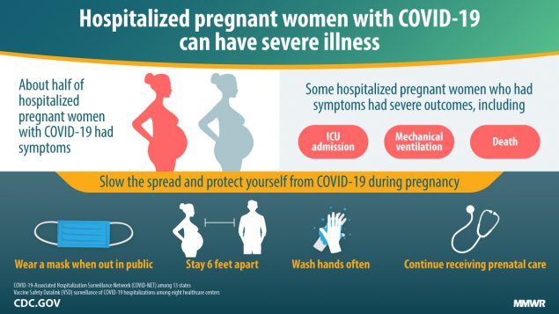
CDC patient education

Slide 21
COVID Mental Health Support Resources for Physicians & Healthcare Workers
Project Parachute: offers pro-bono teletherapy (video or phone) to frontline workers
  https://project-parachute.org/
Physician Support Line
  staffed by volunteer psychiatrists
  offers free and confidential peer support to physicians in the U.S.
  available daily by calling 1 (888) 409-0141 from 8 a.m. to 3 a.m. EST.
For the Frontlines: 24/7 help line provides free crisis counseling for frontline workers. Text FRONTLINE to 741741

Slide 22
COVID-19 Support for Patients
The Wingspan Project
  https://www.thewingspanproject.org/community-response-program.html
  Pro bono psychotherapy for individuals from underserved and/or underrepresented communities, with emphasis on those impacted by recent protests and/or COVID-19
  Marcy Lichterman LCSW & Solveig Roverud LCSW are participating therapists with perinatal expertise

Slide 23
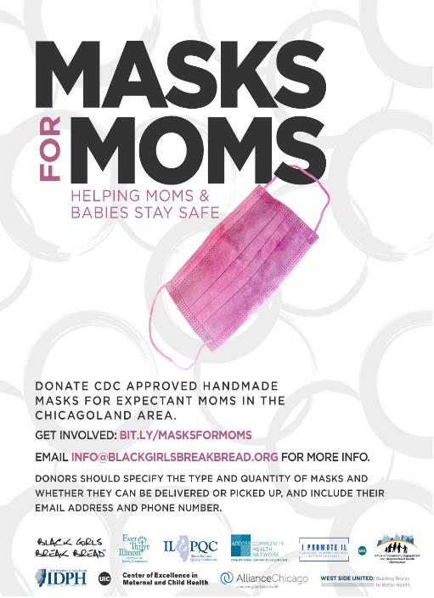
Masks for MOMS
Masks for MOMS Illinois launched on April 21, 2020 to help meet the need for cloth masks among pregnant and postpartum persons in the Chicagoland area in response to the COVID-19 Pandemic.
We will continue to accept donations through mid-Sept; for more information: https://coeinmch.uic.edu/masks-for-moms/
If your Chicagoland site needs masks for labor/delivery or postpartum patients, please email coemch@uic.edu
  To date:
    13,700 masks have been donated
    Over 140 donors and volunteers have contributed
    Masks have been donated to the following sites and hospitals:
Healthcare Sites | Hospitals
• Access Community Health Network • Chicago Family Health Center • Christian Community Health Center • Erie Family Health Centers • Esperanza Health Centers • Family Christian Health Center • Friend Family Health Center • Near North Health Service Corp • PCC Community Wellness Centers • PrimeCare Health Centers • UI Health Mile Square South Shore Health Center | • Advocate Trinity Hospital • Cook County Hospital • Lawndale Christian Hospital • Norwegian American Hospital • Roseland Hospital • Rush University Medical System • South Suburban Hospital • UChicago Medicine- Bernard Mitchell • UChicago Medicine- Ingalls Memorial Hospital • University of Illinois Hospital

Slide 24

ILPQC 8th Annual Conference

Slide 25
Perinatal Sentinel Surveillance Reminder
IDPH has a sentinel surveillance system for hospitals conducting universal COVID-19 testing at labor & delivery
  Invitation email and materials sent from IDPH on 8/17 (to hospitals that indicated on state survey that they are doing universal testing)
  Hospitals report aggregate data to REDCap each week
    Daily counts for five data points
    Brief questions about testing and specimen types in use at hospital
  Voluntary hospital participation is needed – if interested, contact:
    Amanda.C.Bennett@Illinois.gov
    Sonal.Goyal@Illinois.gov

Slide 26
Discussion of Neonatal Unit Strategies

Slide 27

Comer Children’s Hospital
University of Chicago Medicine
Poj Lysouvakon, MD, Jackie Eisenberg, MD,
Joseph R. Hageman, MD

Slide 28
Case presentation
KM is a male newborn of 39 5/7 weeks’ gestational age born to a 31yo G4P3013 mother.
Maternal history: sickle cell trait, psoriasis, which was untreated during this pregnancy, and latent tuberculosis, which was treated three years ago.
Adequate prenatal care, and prenatal labs were unremarkable:
COVID-19 diagnosed 12 days prior to delivery after developing cough and fatigue. Self-quarantine at home for 12 days prior to delivery and was cleared by her primary care physician (PCP) given her lack of fever and greater than ten days since the onset of symptoms.
Presented to labor and delivery with leaking fluid, frequent and regular contractions.
She continued to have cough and congestion, and given her history of a positive SARS-CoV-2 test; she was enrolled in the institution’s “PUI” pathway. She was placed on special respiratory pre- cautions and was tested again for SARS-CoV-2, which resulted in a positive screen 7 hours after admission.

Slide 29
Case Presentation
Delivered by cesarean section after a failed trial of labor after cesarean (TOLAC) secondary to failure to descend and fetal intolerance of labor. The rupture of membranes was 14 hours prior to delivery with clear fluid.
The NICU team was present for the delivery and donned full PPE, including N95 masks, gowns, and eye protection per hospital guidelines for positive COVID status. They reported that the infant cried spontaneously at birth and assigned APGAR scores of 9 and 9 at one and five minutes. Cord gases were within the normal range.
Hospital policy at the time recommended the separation of infants from SARS CoV-2 positive mothers after delivery. Infants are monitored in isolation rooms in the NICU during their hospital stays, and breast milk expression is encouraged.
The mother initially planned to separate from her infant but later refused separation, and the infant roomed in with her.
We recommended that she wear a mask at all times, keep the patient at least 6 feet from her except during feeds, and practice hand hygiene prior to all encounters with the infant. We encouraged the mother to give her newborn pumped breastmilk.
For COVID-positive parents who choose to breastfeed directly, we recommend that they be masked and gowned (except for the exposed breast) and to practice good hand and skin hygiene.

Slide 30
Hospital course
KM had an unremarkable hospital stay.
He passed a CCHD screen but failed his hearing screen bilaterally and was referred for repeat testing as an outpatient as well as CMV screening with his PCP.
He had a circumcision on postnatal day of life 1, which he tolerated well. Discharge bilirubin was in the low intermediate risk zone. His physical examination was normal, and he had normal vital signs during his hospitalization.
Per hospital protocol, KM was tested for SARS-CoV-2 at 24 hours after birth with a negative result.
He was discharged home on day 3 with a prolonged hospital stay due to maternal observation. She experienced peripartum hypoxia for several hours requiring supplemental oxygen with a normal chest radiograph and normal post-partum course after discontinuation of oxygen. She was discharged home on Lovenox.
At the time of discharge, KM had lost 3% of his birthweight and was taking PO formula well with normal stools and voids.
He was discharged home with his mother, where he will live with his father and two older siblings. Our hospital guideline recommended continuing separation of KM from his mother at home while she is symptomatic as well as good hand hygiene.

Slide 31
Neonatal Discussion Panel
Joseph Hageman, MD – Neonatology, Director of Quality Improvement, Comer’s Childrens Hospital, University of Chicago
Justin Josephsen, MD, ILPQC Neonatal Lead, Medical Director – St. Mary’s Hospital NICU, Neonatologist Cardinal Glennon Children’s Hospital, St. Louis
Leslie Caldarelli, MD, ILPQC Neonatal Lead, NICU Director, Prentice Women's Hospital, Chicago
Beau Batton, MD- Chief Neonatology, SIU School of Medicine, Director of Newborn Services HSHS St. John’s Hospital, Springfield
Notes:
UPDATE

Slide 32
Discussion of OB Unit Strategies

Slide 33

Barnes-Jewish Hospital affiliated with Washington University Physicians
St. Louis, Missouri
  Women and Infants
    18 Labor rooms
    12 Triage bed unit
    18 Antepartum bed unit
    34 Postpartum bed unit
    3 OR’s
      1 for Fetal Surgery
10,125 employees
1,266 beds
Parkview Tower
Opened Feb. 2018
3,665 Deliveries
545 Inbound Maternal Transfers
150 Bed NICU St. Louis Children’s Hospital (August 2020)

Slide 34
Case
28 yo G2P1001 @ 26 weeks presents with fever, cough, shortness of breath
- poorly controlled Type 2 diabetes, A1C 11.4%
- chronic hypertension on nifedipine 30mg XR
- 1 prior full term cesarean delivery
Rapid COVID swab positive
Transferred to ICU for respiratory failure on high flow oxygen

Slide 35

Early hospital course
Day 1 – ICU on high flow oxygen
Day 2 – transferred to floor on 2L NC
Day 3 – rapid onset of severe respiratory failure
– Transferred to ICU
– Intubated on maximum ventilatory settings
– Cannulated and V-V (right femoral to right IJ) ECMO initiated

Slide 37
FiO2
Gas sweep

Slide 38
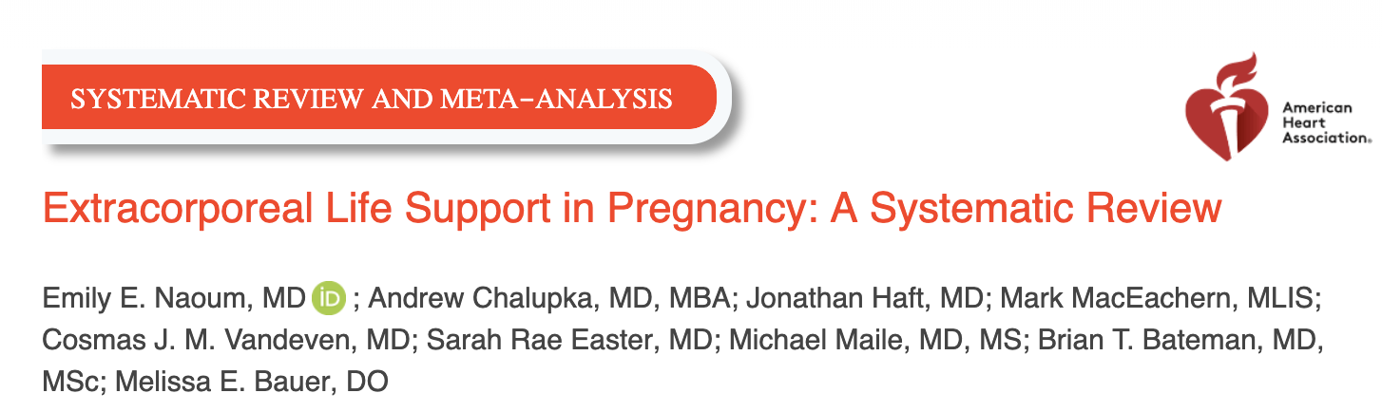
30 day maternal survival: 75.4
1 year maternal survival: 74.3%
81 cases of antenatal ECMO:
  80.2% maternal survival
  64.7% fetal survival
  Average 11 days duration
Non-pregnant survival: 20-50%

Slide 39
Unanswered questions
Fetal monitoring
Threshold to delivery
Anticoagulation management
Maternal code management

Slide 40
What we did:
Family meeting with power of attorney (grandmother)
  No delivery intervention for fetal indication
  Twice daily “NSTs”
Help optimize ventilatory settings with ICU team
  Permissive hypercapnia and lung protective settings
Frequent multidisciplinary team communication
  Critical Care
  Cardiothoracic Surgery
  OB Anesthesia
  Neonatology

Slide 41
Brief Hospital Course
Dexamethasone, convalescent plasma, Remdesivir, epoprostenol
ECMO settings remain high with FiO2 at 100% and gas sweeps maximized
ECMO Day 7: superimposed preeclampsia by blood pressures and proteinuria, nicardipine drip initiated
ECMO Day 9: GI bleed
ECMO Day 10, 11, 12: bronchoscopy performed to remove mucus plugs
ECMO Day 15: CVVH initiated
ECMO Day 16: Family/team meeting meeting

Slide 42
Family/Team Meeting discussion
Patient not improving on 2+ weeks of maximal vent and ECMO settings
Complications from pregnancy and ECMO have started
Is there a role for a controlled delivery at this point?
GA: 29 weeks 1 day

Slide 43
Delivery
Patient underwent mostly uncomplicated repeat CS in cardiothoracic OR.
EBL: 1500
Neonate: born paralyzed and sedated, intubated and admitted to NICU
AGPARS: 1, 4
Gas: pH: 7.28, PCO2 60, Base excess -2
Heparin drip restarted POD#2

Slide 44
Postpartum
ECMO settings weaned down significantly following delivery.
COVID BAL negative POD#5
Gas sweep off POD#7 with plans to decannulate POD#8
Neonate doing well in NICU with Grade I IVH

Slide 45
OB Discussion Panel
Jeannie Kelly, MD – Director Maternal Fetal Transport, Maternal Fetal Medicine, Barnes Jewish Hospital, Washington University, St. Louis
Catalin Buhimschi, MD, MMS, MBA – Director Division of Maternal Fetal Medicine, University of Illinois Hospital, Chicago
Ashish Premkumar – Maternal Fetal Medicine, John H. Stroger, Jr. Hospital of Cook County, Chicago

Slide 46
Thank You
We continue to give thanks to the nurses, doctors, health care workers, public health teams and others across our state at work confronting the COVID-19 pandemic.
Please send questions, comments and recommendations, cases / willingness to share for future COVID-19 OB/Neo discussion webinars to info@ilpqc.org
Recording of this webinar, Q/A and registration for the next webinar on Friday, 11/6/20 will be available at www.ilpqc.org

Slide 47



THANKS TO OUR
FUNDERS
Email info@ilpqc.org or visit us at www.ilpqc.org
Notes:
Updated 10/22/19

Slide 48
Outpatient Monitoring for pregnant patients with mild or no symptoms
Outpatient monitoring with a 14-day self-quarantine can be considered for pregnant patients with COVID-19 who have mild symptoms or are asymptomatic. Recommendations for outpatient monitoring is outlined.
Check on outpatient Covid positive patients regularly and review signs/symptoms to call, recognize can worsen around day 7-10
For 3rd trimester patients who need outpatient fetal or maternal monitoring establish protocol: schedule at the end of the day with limited staff with appropriate PPE
After 14 days from positive test or symptom onset, if symptoms improved and no fever >72 hours then can be considered recovered.
SMFM: Management Considerations for Pregnant Patients with COVID-19 (7.2.2020) updated

Slide 49
The severity scale for COVID-19
Asymptomatic or presymptomatic disease or presumptive infection is defined as a positive COVID-19 test result with no symptoms.
Mild disease is defined as flu-like symptoms, such as fever, cough, myalgias, and anosmia without dyspnea, shortness of breath, or abnormal chest imaging.
Moderate disease is defined by evidence of lower respiratory tract disease with clinical assessment (dyspnea, pneumonia on imaging, abnormal blood gas results, refractory fever of 39.0 °C /102.2 °F or greater, while maintaining an oxygen saturation of greater than 93% on room air at sea level.
Severe disease is defined by a respiratory rate greater than 30 breaths per minute (bpm), hypoxia with oxygen saturation less than or equal to 93%, a ratio of arterial partial pressure of oxygen to fraction of inspired oxygen of less than 300, or greater than 50% lung involvement on imaging.
Critical disease is defined as multi-organ failure or dysfunction, shock, or respiratory failure requiring mechanical ventilation or high-flow nasal cannula.
SMFM: Management Considerations for Pregnant Patients with COVID-19 (7.2.2020) updated

Slide 50
Inpatient monitoring may be needed for the following categories of patients:
Pregnant COVID-19 patients with moderate to severe signs and symptoms or oxygen saturation less than 95%. (incudes dyspnea)
Pregnant COVID-19 patients with comorbid conditions, eg, uncontrolled hypertension, inadequately controlled gestational or pregestational diabetes, chronic renal disease, chronic cardiopulmonary disease, or immunosuppressive states (intrinsic or medication-related)
Pregnant COVID-19 patients with fevers greater than 39 °C despite acetaminophen, raising concern for secondary hemophagocytic lymphohistiocytosis (sHLH) or "cytokine storm syndrome." sHLH is a fulminant and often fatal hypercytokinemia associated with multi-organ failure. The disease is defined by unremitting fever, cytopenia, and high ferritin levels. If a patient has an Hscore (see Table 1) indicating a high probability for sHLH, inpatient observation is warranted.
SMFM: Management Considerations for Pregnant Patients with COVID-19 (7.2.2020) updated

Slide 51
Timing of Delivery: mild symptoms
In an asymptomatic or mildly symptomatic woman positive for COVID-19 at 37 to 38 6/7 weeks of gestation without other indications for delivery, expectant management can be considered until 14 days after the polymerase chain reaction (PCR) result was noted to be positive OR until 7 days after onset of symptoms and 3 days after resolution of symptoms. This option allows for decreased exposure of health care workers and the neonate to SARS-CoV-2.
In an asymptomatic or mildly symptomatic woman positive for COVID-19 at 39 weeks of gestation or later, delivery can be considered to decrease the risk of worsening maternal status.
SMFM: Management Considerations for Pregnant Patients with COVID-19 (7.2.2020) updated

Slide 52
Timing of Delivery: critical illness
The timing of delivery requires carefully weighing the benefits and risks for the patient and fetus, and the decision to deliver requires close communication between the maternal-fetal medicine and critical care teams. Improvement in lung mechanics gained by early delivery is theoretical. In the third trimester, the pressure of the uterus can decrease expiratory reserve volume, inspiratory reserve volume, and functional residual capacity, which can increase the risk of severe hypoxemia in pregnant patients, especially those who are critically ill.
Although data regarding delivery timing and acute respiratory distress syndrome are limited, it is reasonable to consider delivery in the setting of worsening critical illness.
SMFM: Management Considerations for Pregnant Patients with COVID-19 (7.2.2020) updated

