Slide 1



COVID-19 Strategies for OB & Neonatal Units
October 1, 2021
12:00 – 1:15pm

Slide 2

Welcome
Please be certain you are on “mute” when not speaking to avoid background noise.
Whether you have joined by phone or computer audio, you can mute and unmute yourself by clicking on the microphone icon.
The following shortcuts can also be used
For PC: Alt + A : Mute or Unmute
For Mac: Shift + Command + A: Mute or Unmute
For telephone: *6 : Mute or Unmute
2

Slide 3
Housekeeping:
We Are Recording Now
3

Slide 4
ILPQC Covid 19 webinars
The strategies shared today are examples from individual institutions not IDPH or ILPQC recommendations.
This is our 25th COVID-19 strategies for OB/Neonatal Units webinar in coordination with IDPH, since April 2020. Please see https://ilpqc.org/covid-19-information/ for
future webinar registration, prior recorded webinars and written out Q/A’s from those webinars.
The next webinar will be Friday, November 5, noon to 1:15pm. We are moving to every other month and determining the needed frequency going forward
Please let us know if your hospital would like to share on an upcoming webinar, please put questions/comments into the chatbox or email directly to info@ilpqc.org
4

Slide 5
Overview
Introduction
Overview of updated data and recommendations
Discussion of OB Unit Strategies
  Emily Zantow, MD, – Maternal-Fetal Medicine Fellow, Department of Obstetrics & Gynecology – Saint Louis University School of Medicine, SSM Health St. Mary’s Hospital – St. Louis
  Rebecca Williams- Maternal Outreach Educator, Saint Louis University School of Medicine, SSM Health St. Mary’s Hospital – St. Louis
  Ashish Premkumar, MD – Maternal-Fetal Medicine, John H. Stroger, Jr. Hospital of Cook County
Discussion of NEO Unit Strategies
  Justin Josephsen, MD – Medical Director, St. Mary’s Hospital NICU, Neonatologist Cardinal Glennon Children’s Hospital, St. Louis
  Leslie Caldarelli, MD – NICU Director, Prentice Women's Hospital, Chicago
IDPH updates – Amanda C. Bennett, PhD, MPH - CDC Field Assignee in Maternal and Child Health Epidemiology, Illinois Department of Public Health, Office of Women's Health and Family Services
5

Slide 6

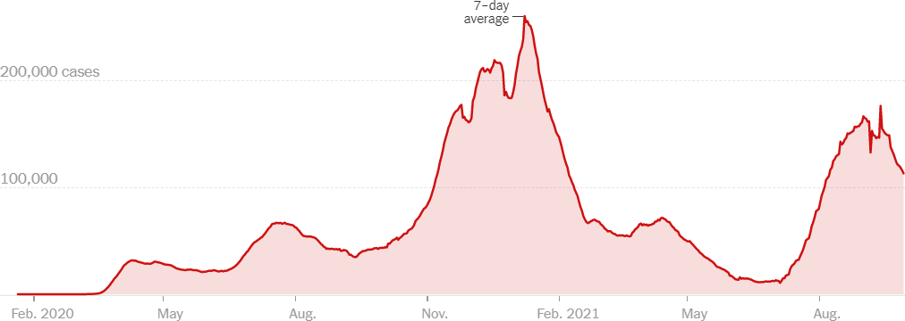
US COVID case trend
6

Slide 7

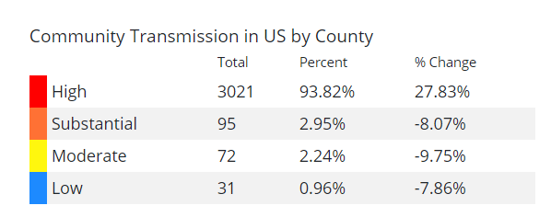
COVID
spreads across the Country
Updated 9/30/21

Slide 8




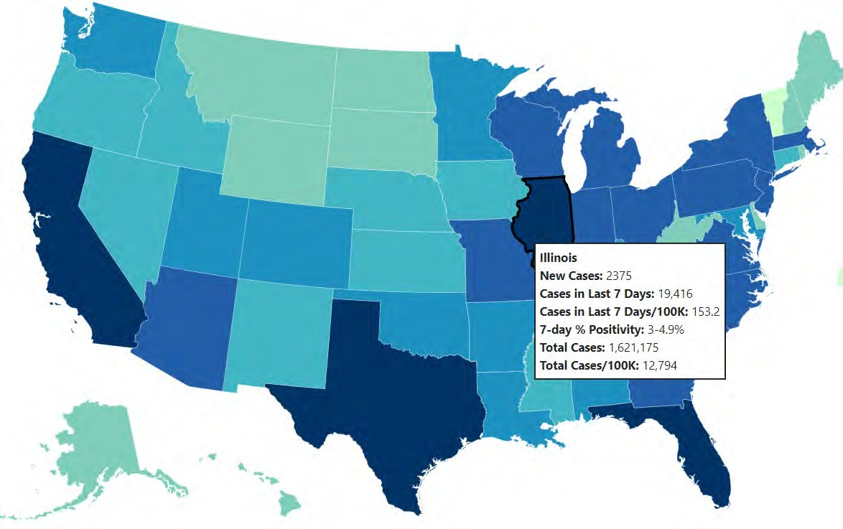
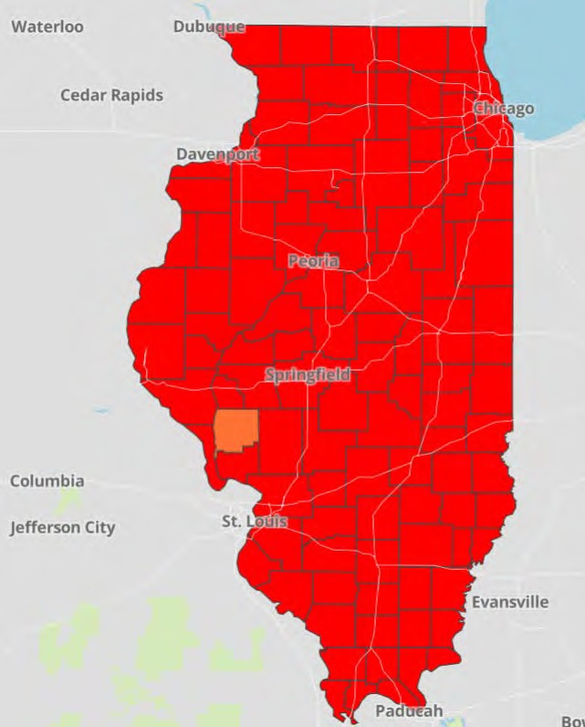

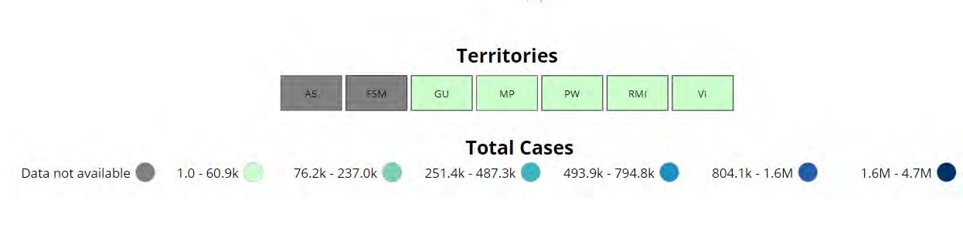
Data Update: September 30, 2021
CDC/IDPH: COVID-19 Outbreak
CDC
https://covid.cdc.gov/covid-data-tracker/#cases_totalcases
IDPH
https://www.dph.illinois.gov/covid19
Total cases: 43,169,823 confirmed
Total deaths: 691,517 confirmed
1,627,508 Confirmed Positive Cases
24,976 Deaths
8

Slide 9
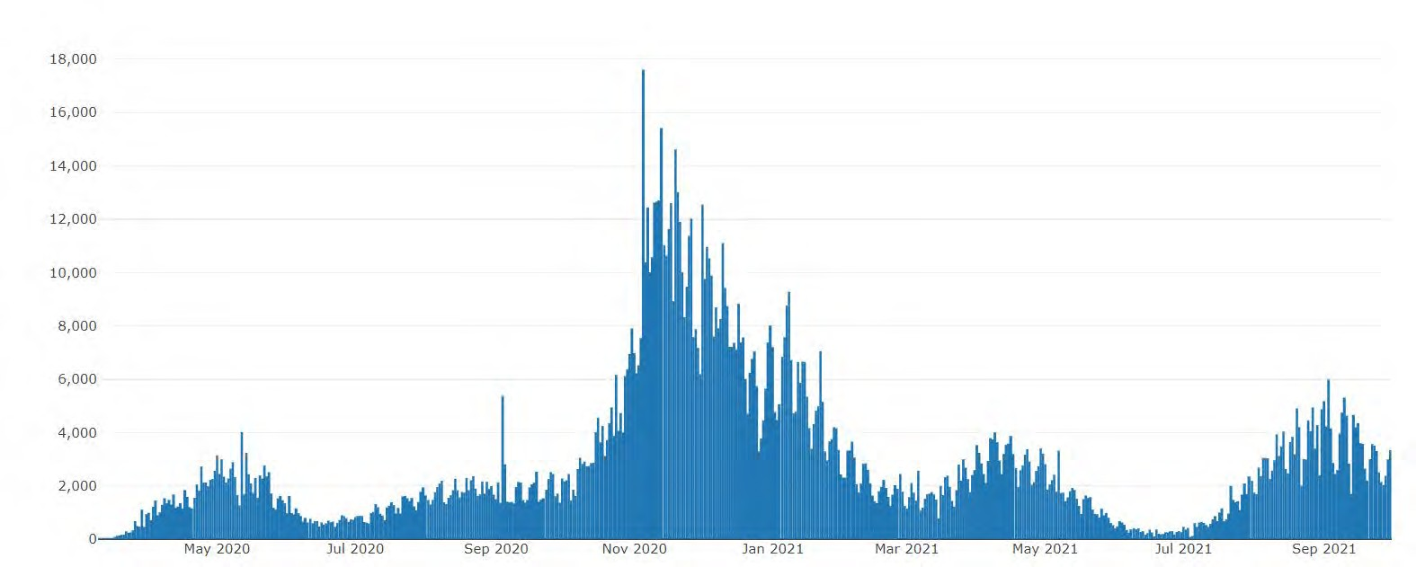

Illinois Daily Incidence
IDPH daily data summary
9

Slide 10
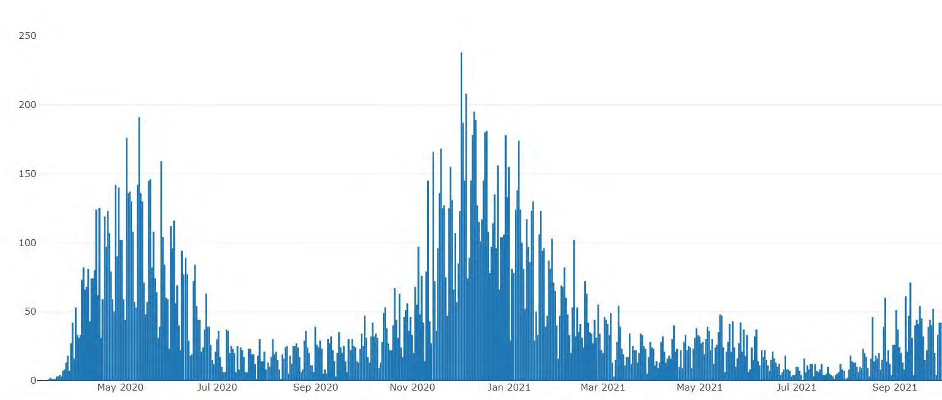
Illinois Covid Deaths
IDPH daily data summary
10

Slide 11

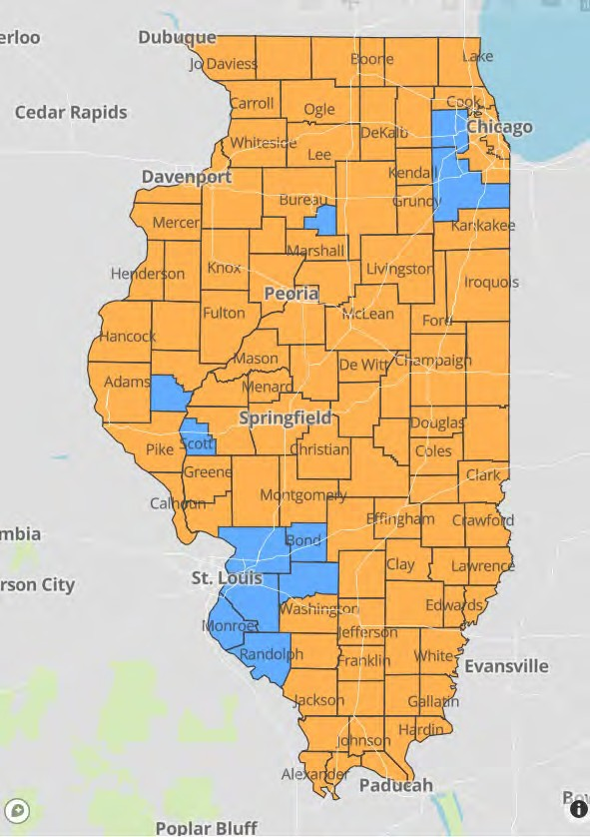
IDPH County Level COVID -19
Risk Metrics
Week 37: 9/12/2021 Through 9/18/2021
Blue indicates that the county is experiencing overall stable COVID-19 metrics.
Orange indicates there are warning signs of increased COVID-19 risk in the county.
11

Slide 12
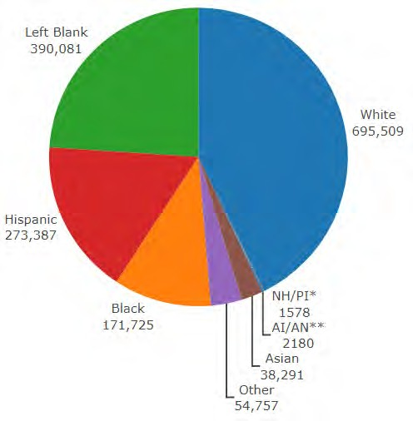
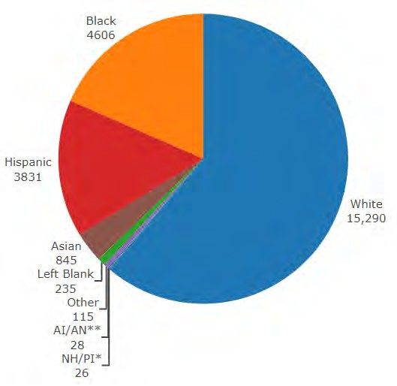
Data Update September 30, 2021 IDPH: COVID-19 Outbreak Race Demographics
https://www.dph.illinois.gov/covid19
Confirmed Cases
Deaths
13

Slide 13

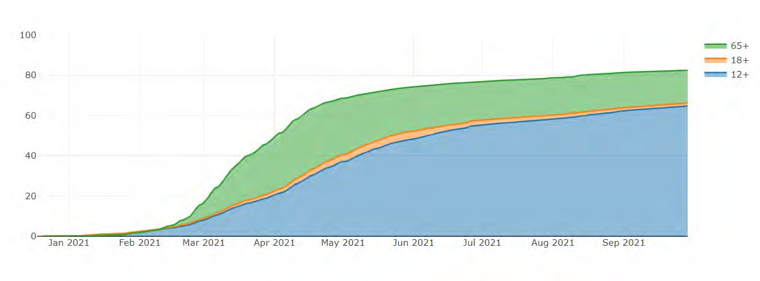
Illinois Population Vaccinated Fully
13

Slide 14

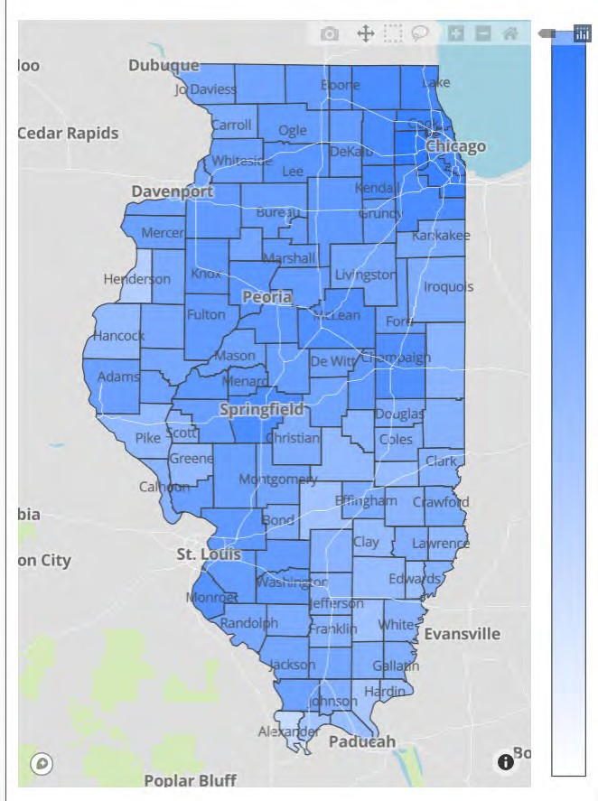

Illinois Daily Reported Administered Vaccine Doses
Last updated 9/30/2021
Illinois Perinatal Quality Collaborative
14

Slide 15
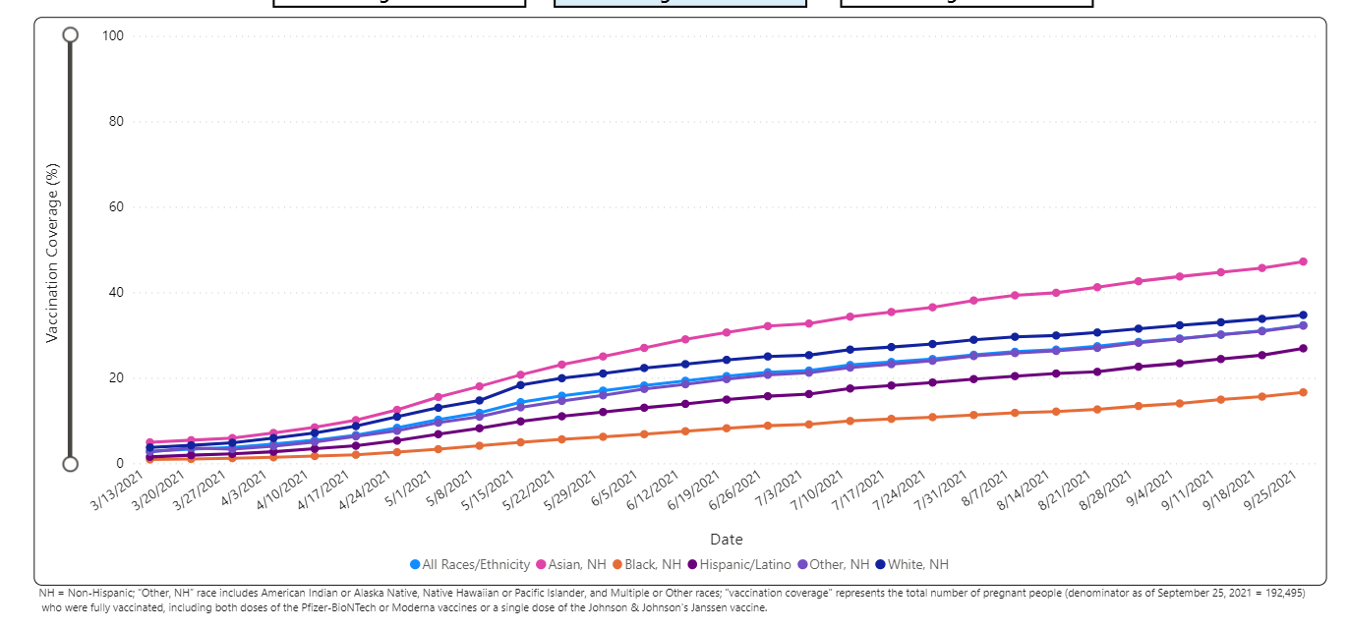
Percent of Pregnant People aged 18-49 years receiving at least one dose of a COVID-19 vaccine during pregnancy overall, by race/ethnicity, and date reported to CDC (9/25/21)
Notes:
https://urldefense.com/v3/__https://covid.cdc.gov/covid-data-tracker/*vaccinations-pregnant-women__;Iw!!Dq0X2DkFhyF93HkjWTBQKhk!BRT8JkbGHSHMqUvlHo57UsXRx3oQL6Au0KIaOe8oN7qp9yWGe1oyTAFdCw-PzSyj1gqEUOSiCw$

Slide 16

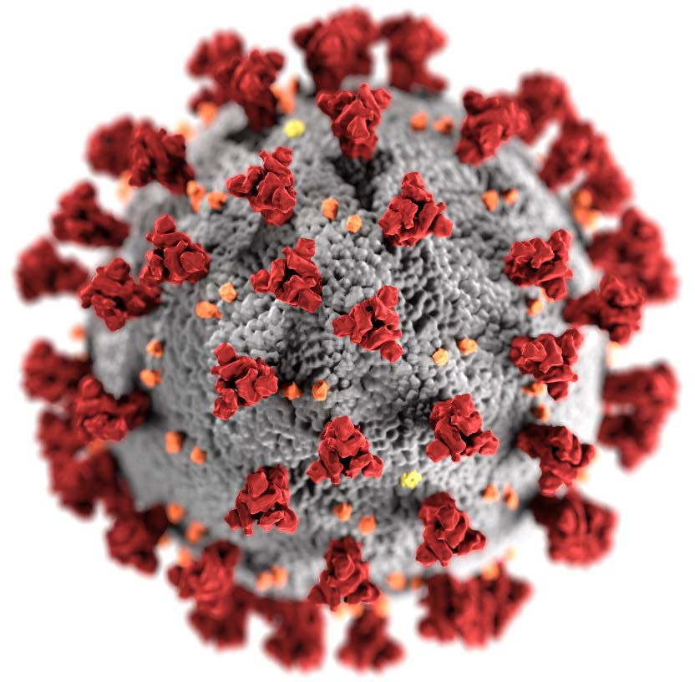

CDC Coronavirus Disease 2019 Response
Updates on COVID-19 and Pregnancy
Dana Meaney-Delman, MD, MPH FACOG Lead, Maternal Immunization
ACIP Meeting September 22, 2021
cdc.gov/coronavirus

Slide 17
















COVID-19 cases, ICU admission and death among pregnant people
(National COVID-19 Case Surveillance Data; Jan 22, 2020 – Sep 13, 2021)
16000
100
14000
90
ICU admission (n)
Death (n)
Total pregnant people
80
Total laboratory-confirmed cases
12000
70
Total ICU admission or deaths
10000
women
60
8000
50
6000
40
30
4000
20
2000
10
0
0

Slide 18
Severe illness and adverse maternal, pregnancy, and neonatal outcomes among pregnant women with COVID-19
Compared with non-pregnant WRA* with COVID-19
Odds Ratios [95% CI]
Number of events / Total
ICU admission
2.13 (1.93-2.95)
10,184 / 601,108
Invasive ventilation
2.59 (2.28-2.94)
3,550 / 601,044
ECMO
2.02 (1.22-3.34)
137 / 461,936
0
2 4 6 8 10 12 14
Compared with pregnant women without COVID-19
Odds Ratios [95% CI]
Number of events / Total
Maternal death
2.85 (1.08-7.52)
16 / 4,820
Preeclampsia**
1.33 (1.03-1.73)
28,326 / 424,344
Preterm birth
1.47 (1.14-1.91)
719 / 8,549
Stillbirth
2.84 (1.25-6.45)
35 / 5,794
NICU admission
4.89 (1.87-12.81)
848 / 5,873
0 2 4 6 8 10 12 14
Data from Allotey, J et al. unless otherwise noted; *Women of reproductive age; ** Preeclampsia data from Wei et al.; ECMO: Extracorporeal membrane oxygenation

Slide 19
Severe illness and death for symptomatic pregnant women with COVID-19 compared to symptomatic nonpregnant women
No. (%)*
Outcomes of Interest | Symptomatic Pregnant women with COVID-19 | Symptomatic Nonpregnant women with COVID-19 | Crude RR (95% CI) | aRR (95% CI) †
 | (N = 23,434) | (N = 386,028)
ICU Admission | 245 (1.1) | 1,492 (0.4) | 2.7 (2.4-3.1) | 3.0 (2.6-3.4)
Mechanical Ventilation | 67 (0.3) | 412 (0.1) | 2.7 (2.1-3.5) | 2.9 (2.2-3.8)
ECMO§ | 17 (0.1) | 120 (0.0) | 2.3 (1.4-3.9) | 2.4 (1.5-4.0)
Death | 34 (0.2) | 447 (0.1) | 1.3 (0.9-1.8) | 1.7 (1.2-2.4)
* Percentages calculated among total in pregnancy status group; those with missing data on outcomes were counted as not having the outcome
† Adjusted for age, race/ethnicity, and presence of underlying conditions. Nonpregnant women are the referent group.
§ Extracorporeal membrane oxygenation
Zambrano LD, Ellington S, Strid P, et al. Update: Characteristics of Symptomatic Women of Reproductive Age with Laboratory-Confirmed SARS-CoV-2 Infection by Pregnancy Status — United States, January 22–October 3, 2020. MMWR Morb Mortal Wkly Rep. ePub: 2 November 2020.
DOI: http://dx.doi.org/10.15585/mmwr.mm6944e3external icon.

Slide 20
ACIP Meeting, 9/23/21
Maternal Immunization Lead, Dana Meaney Delman, MD, MPH
We now see increased numbers of pregnant people admitted to the ICU in July and August," The trend has continued into September. "The deaths reported in August is the highest number of deaths reported in any month since the start of the pandemic," About 97% of the pregnant people treated in the hospital for Covid-19 have been unvaccinated, she said.
"We know that pregnant people with Covid-19 can become very sick. Some will die, and many will experience pregnancy and neonatal complications," she said.
"We know that because of Covid some children will grow up without their mothers. We know that Covid-19 vaccines are safe and effective. If you are pregnant, postpartum, breastfeeding, trying to get pregnant now or might become pregnant in the future, please get vaccinated."

Slide 21

CDC: COVID-19 Vaccination for Pregnant People to Prevent Serious Illness, Deaths, and Adverse Pregnancy Outcomes from COVID-19. (9.29.21)
As of September 27, 2021, more than 125,000 laboratory-confirmed COVID-19 cases have been reported in pregnant people, including more than 22,000 hospitalized cases and 161 deaths.¹
The highest number of COVID-19-related deaths in pregnant people (n=22) in a single month of the pandemic was reported in August 2021.
Data from the COVID-19-Associated Hospitalization Surveillance Network (COVID-NET) in 2021 indicate that approximately 97% of pregnant people hospitalized (either for illness or for labor and delivery) with confirmed SARS-CoV-2 infection were unvaccinated.²
In addition to the risks of severe illness and death for pregnant and recently pregnant people, there is an increased risk for adverse pregnancy and neonatal outcomes, including preterm birth and admission of their neonate(s) to an intensive care unit (ICU).

Slide 22
CDC: COVID-19 Vaccination for Pregnant People to Prevent Serious Illness, Deaths, and Adverse Pregnancy Outcomes from COVID-19. (9.29.21)
Healthcare providers should communicate the risks of COVID-19, the benefits of vaccination, and information on the safety and effectiveness of COVID-19 vaccination in pregnancy.
Compared with non-pregnant symptomatic people, symptomatic pregnant people have more than a two-fold increased risk of requiring ICU admission, invasive ventilation, and ECMO, and a 70% increased risk of death.⁶
Healthcare providers should strongly recommend that people who are pregnant, recently pregnant (including those who are lactating), who are trying to become pregnant now, or who might become pregnant in the future receive one of the authorized or approved COVID-19 vaccines as soon as possible.

Slide 23
CDC: COVID-19 Vaccination for Pregnant People to Prevent Serious Illness, Deaths, and Adverse Pregnancy Outcomes from COVID-19. (9.29.21)
CDC recommends urgent action to help protect pregnant people and their fetuses/infants.
CDC recommends urgent action to accelerate primary vaccination for people who are pregnant, recently pregnant (including those who are lactating), who are trying to get pregnant now, or who might become pregnant in the future. Efforts should specifically address populations with lower vaccination coverage and use approaches to reduce racial and ethnic disparities.
In addition, pregnant people should continue to follow all recommended prevention measures and should seek care immediately for any symptoms of COVID-19. Healthcare providers should have a low threshold for increased monitoring during pregnancy due to the risk of severe illness.

Slide 24

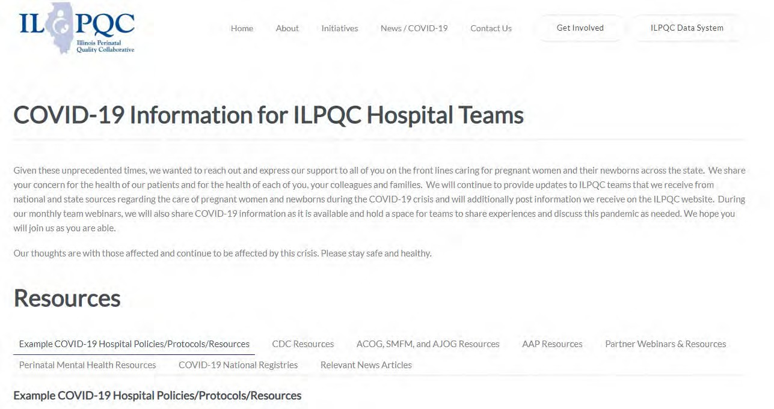
ILPQC COVID-19 Webpage www.ilpqc.org
ILPQC posts national guidelines and OB & Neonatal COVID-19 example hospital protocols & resources
please note dates as guidelines are changing rapidly
https://ilpqc.org/covid-19- information/

Slide 25
Updated OB (ACOG/SMFM) Resources
ACOG: Practice Advisory: Vaccinating Pregnant and Lactating Patients Against COVID-19. (Updated 7.30.21)
SMFM: Provider Considerations for Engaging in COVID-19 Vaccine Counseling With Pregnant and Lactating Patients. (Updated 8.23.21)
SMFM: SMFM Learning: Myth-Busting COVID-19 Vaccines in Pregnancy. (09.10.21)
ACOG: Statement of Strong Medical Consensus for Vaccination of Pregnant Individuals Against COVID-19. (Updated 9.14.21)
SMFM: Provider Considerations for Engaging in COVID-19 Vaccine Counseling With Pregnant and Lactating Patients. (Updated 9.24.21)
ABOG: Statement Regarding Dissemination of COVID-19 Misinformation (9/27/21)
Notes:
ACOG: Statement of Strong Medical Consensus for Vaccination of Pregnant Individuals Against COVID-19. (Updated 9.14.21)

Slide 26
ACOG: 9/14/21 Statement of Strong Medical Consensus for Vaccination of Pregnant Individuals Against COVID-19.
“As the leading organizations representing experts in maternal care and public health professionals that advocate and educate about vaccination, we strongly urge all pregnant individuals—along with recently pregnant, planning to become pregnant, lactating and other eligible individuals—to be vaccinated against COVID-19.
“Pregnant individuals are at increased risk of severe COVID-19 infection, including death. With cases rising as a result of the Delta variant, the best way for pregnant individuals to protect themselves against the potential harm from COVID-19 infection is to be vaccinated.
“Data from tens of thousands of reporting individuals have shown that the COVID-19 vaccine is both safe and effective when administered during pregnancy. The same data have been equally reassuring when it comes to infants born to vaccinated individuals. Moreover, COVID-19 vaccines have no impact on fertility.
“Pregnant individuals and those planning to become pregnant should feel confident in choosing vaccination to protect themselves, their infants, their families, and their communities.”

Slide 27
SMFM: Provider Considerations for Engaging in COVID-19 Vaccine Counseling With Pregnant and Lactating Patients. (Updated 9.24.21)
On September 24, 2021, the CDC issued updated interim guidance for individuals who are at highest risk for COVID-19 to receive a Pfizer-BioTech COVID-19 booster shot. This includes guidance that people aged 18-49 with underlying medical conditions may receive a booster shot of Pfizer vaccine at least 6 months after their Pfizer primary series, based on their individual benefits and risks. Pregnancy is included as an underlying medical condition.
All pregnant patients at least 6 months after their Pfizer vaccine should be offered a booster vaccine. Information on Moderna boosters is coming soon.

Slide 28

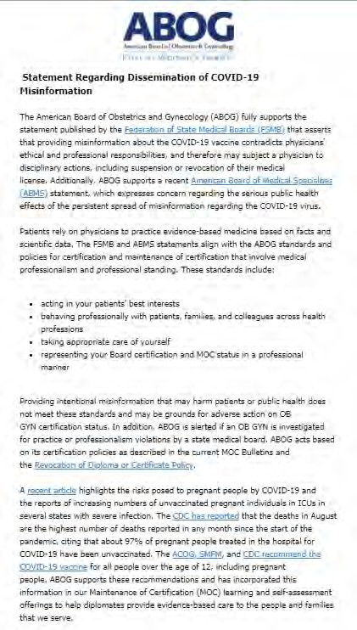

Statement Regarding Dissemination of COVID-19
Misinformation
(9/27/21)
Illinois Perinatal Quality Collaborative
30

Slide 29
ABOG: Statement Regarding Dissemination of COVID-19 Misinformation (9/27/21)
Federation of State Medical Boards (FSMB) asserts that providing misinformation about the COVID-19 vaccine contradicts physicians' ethical and professional responsibilities, and therefore may subject a physician to disciplinary actions, including suspension or revocation of their medical license.

Slide 30
Updated Neonatal /AAP Resources
AAP: Supporting Emotional and Behavioral Health during the COVID19 Pandemic. (Updated 7.28.21)
AAP: Post Covid Conditions in Children and Adolescents. (Update 7.28.21)
AAP: Children and COVID-19: State-Level Data Report. (9.23.21)
31

Slide 31
AAP: Children and COVID-19: State-Level Data Report September 23, 2021
Cumulative Number of Child COVID-19 Cases*
5,725,680 total child COVID-19 cases reported, and children represented 16.0% (5,725,680/35,852,579) of all cases
Overall rate: 7,607 cases per 100,000 children in the population
Change in Child COVID-19 Cases*
206,864 child COVID-19 cases were reported the past week from 9/16/21-9/23/21 (5,518,815 to 5,725,680) and children represented 26.7% (206,864/775,480) of the weekly reported cases
Over two weeks, 9/9/21-9/23/21, there was an 8% increase in the cumulated number of child COVID-19 cases since the beginning of the pandemic (432,843 cases added (5,292,837 to 5,725,680))
AAP: Children and COVID-19: State-Level Data Report. (9.23.21)
Illinois Perinatal Quality Collaborative
32

Slide 32
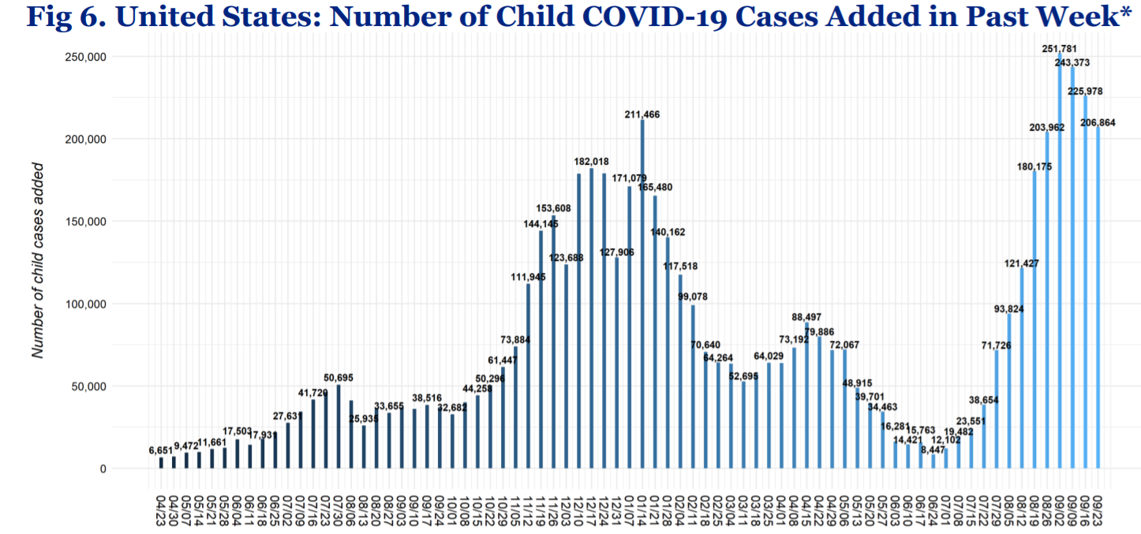
United States: Number of Child COVID- 19 Cases Added in Past Week
9/23/21

Slide 33
Updated OB/Neo Covid Publications
AJOG: COVID-19 vaccine response in pregnant and lactating women: a cohort study. (3.21.21)
BMC Pediatrics: Newborn antibodies to SARS-CoV-2 detected in cord blood after maternal vaccination – a case report. (3.22.21)
AJOG: Professionally responsible coronavirus disease 2019 vaccination counseling of obstetrical and gynecologic patients. (5.2021)
Obstetrics & Gynecology: Severe Acute Respiratory Syndrome Coronavirus 2 (SARS-CoV-2) Vaccination in Pregnancy: Measures of Immunity and Placental Histopathology. (5.11.21)
Obstetrics & Gynecology: Cord blood antibodies following maternal coronavirus disease 2019 vaccination during pregnancy (4.1.2021)
NEJM: Effectiveness of Covid-19 Vaccines against the B.1.617.2 (Delta) Variant. (7.21.21)
NEJM - Breakthrough infections in vaccinated healthcare workers. (7.28.21)
Bloomberg: Pregnant, Unvaccinated and Intubated: Case Surge Alarms Doctors. (8.23.21)
AJOG: Monoclonal antibody treatment of symptomatic COVID-19 in pregnancy: initial report. (8.25.21)
NEJM: Resurgence of SARS-CoV-2 Infection in a Highly Vaccinated Health System Workforce. (9.9.21)
The Lilly: Pregnancy and coronavirus vaccines: Your questions answered. (9.24.21)
34

Slide 34
JAMA: Characteristics and Outcomes of Women With COVID-19 Giving Birth at US Academic Centers During the COVID-19 Pandemic. (08.11.21)
499 US Academic medical centers, Among 869 079 women, 18 715 (2.2%) had COVID-19, and 850 364 (97.8%) did not.
Expectant mothers with COVID-19 are 40% more likely to deliver their babies prematurely, according to a study co-authored by UCIrvine Health surgeon Dr. Ninh T. Nguyen,
A COVID-19 infection during pregnancy also poses a five times greater risk for intensive care treatment during childbirth, according to the study published by JAMA Network Open.
"For expectant mothers, it is important to take steps to minimize the risk of COVID-19 infection," said Nguyen, chair of the UCI School of Medicine's Department of Surgery. "Infection at the time of childbirth is associated with higher risk for ICU admission, preterm birth and even death."

Slide 35
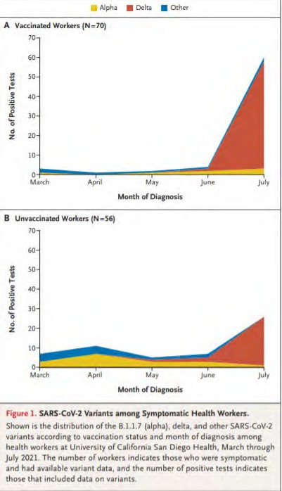
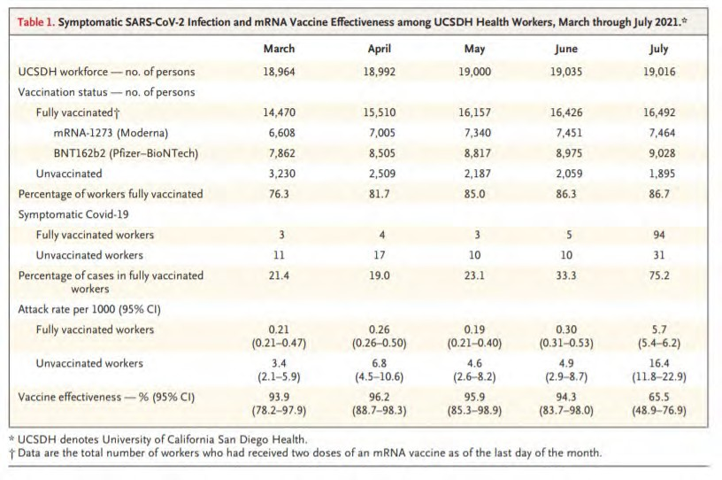
Resurgence of SARS-CoV-2 Infection in a Highly Vaccinated Workforce
(NEJM, 9/9/21)Vaccinated
Health System WorkforceVaccinated Health System Workforce

Slide 36
Resurgence of SARS-CoV-2 Infection in a Highly Vaccinated Workforce
(NEJM, 9/9/21)
Key take aways….
  We need the remainder of our health care work force vaccinated ASAP
  We need patients vaccinated
  Combination of Delta variant surging with significant increase in infectious risk and likely waning immunity puts even vaccinated at risk of symptomatic infection.
  We need to be diligent with mask wearing in the hospital and in the community
  We need to be rigorous with testing to identify infected patients and workforce
  Be ready when booster recommendations released, likely in the next 2 weeks
  As hospitals across the country and our state experience ongoing surge we need to protect the healthcare workforce to continue to serve on the front lines

Slide 37
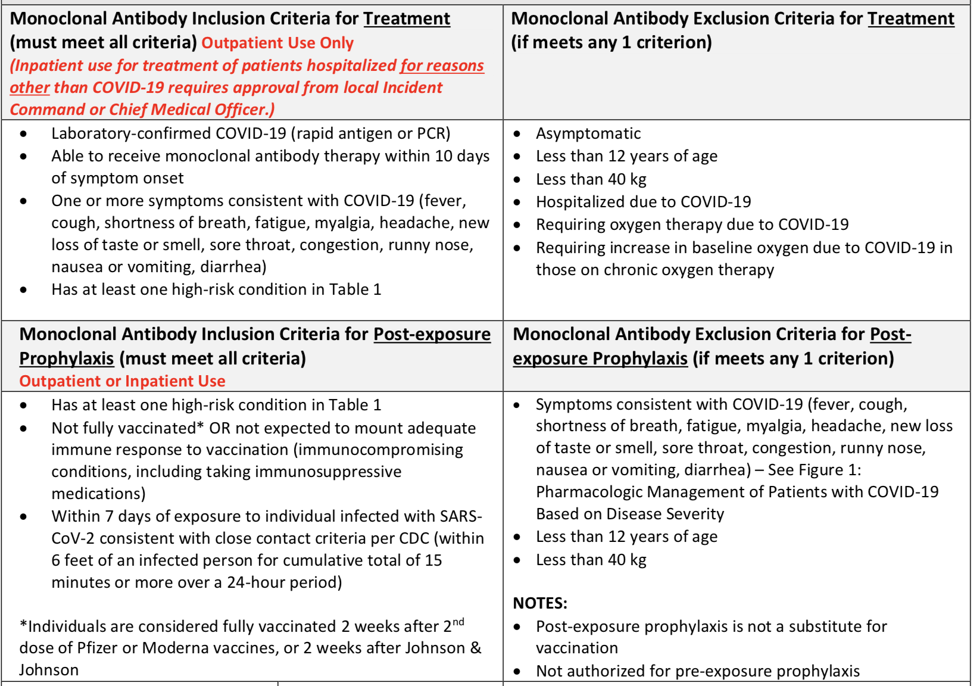
Barnes Jewish BJC monoclonal antibodies protocol
AJOG: Monoclonal antibody treatment of symptomatic COVID-19 in pregnancy: initial report. (8.25.21)

Slide 38
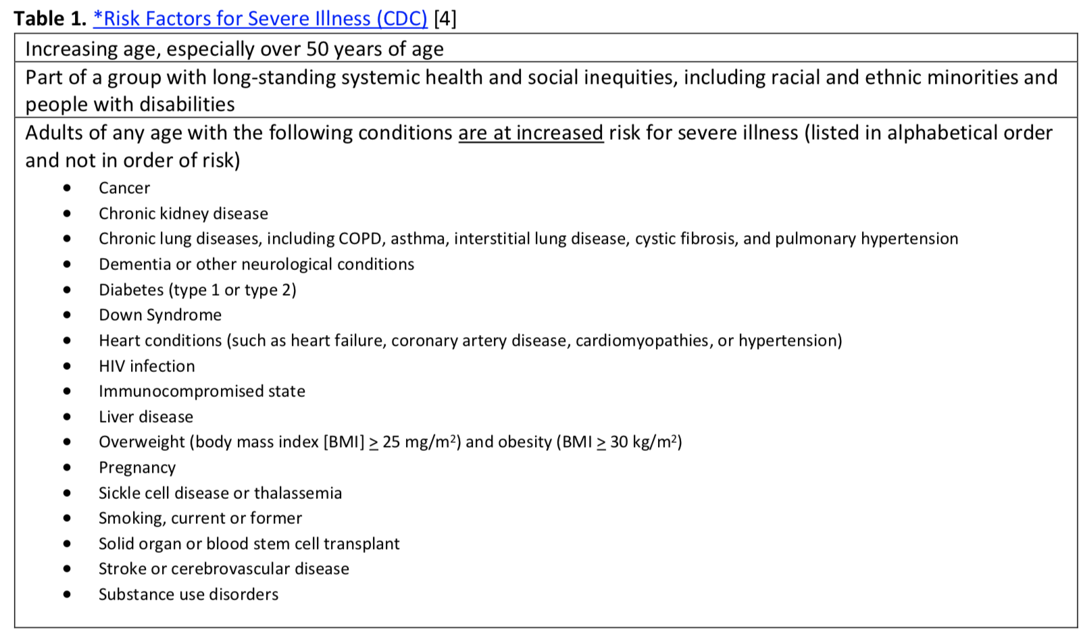

Slide 39
IDPH / HFS / CDC
CDC: Myths and Facts on Covid-19 vaccines. (Updated 7.7.21)
CDC updated mask guidance: Interim Public Health Recommendations for Fully Vaccinated People. (7.27.21)
CDC MMWR: Outbreak of SARS-CoV-2 Infections, including Covid-19 vaccine breakthrough infections, associated with large public gatherings - Barnstable County, MA, July 2021. (8.6.2021)
CDC: New CDC Data: COVID-19 Vaccination Safe for Pregnant People. (8.11.21)
CDC: Receipt of mRNA COVID-19 vaccines preconception and during pregnancy and risk of self-reported spontaneous abortions. (8.9.21)
• CDC: Percent of Pregnant People aged 18-49 years receiving at least one dose of a COVID-19 vaccine during pregnancy. (9.4.21)
CDC Official Health Advisory : COVID-19 Vaccination for Pregnant People to Prevent Serious Illness, Deaths, and Adverse Pregnancy Outcomes from COVID-19. (9.29.21)
37

Slide 40
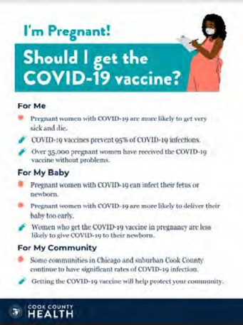
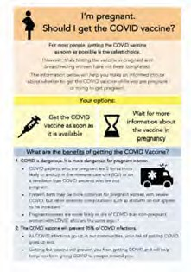

COVID Vaccine
Patient Education Examples
University of Massachusetts Medical School – Baystate: Covid Vaccine Info for Pregnant/Breastfeeding Patients English.
Available in:
Spanish, Nepali, Portuguese, Arabic, Turkish, Somali, Chinese, Vietnamese, Russian (3.17.21)
SMFM Patient Education (English/Spanish): COVID-19 Vaccines and Pregnancy. (3.4.21)
CDC: Safety of COVID-19 Vaccines. Video link. (Updated 6.8. 2021)
Cook County Health: Should I get the COVID-19 vaccine?
Flyer English and Spanish (6.11.21)
CDC: Information about COVID-19 Vaccines for People who Are Pregnant or Breastfeeding. (3.18.21)

Slide 41
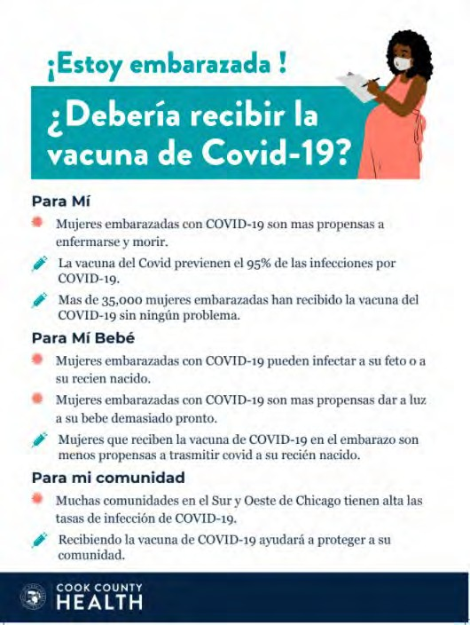

POSTERS

Slide 42
OB Discussion Panel
Discussion of OB Unit Strategies
  Emily Zantow, MD, – Maternal-Fetal Medicine Fellow, Department of Obstetrics & Gynecology – Saint Louis University School of Medicine, SSM Health St. Mary’s Hospital
– St. Louis
  Rebecca Williams- Maternal Outreach Educator, Saint Louis University School of Medicine, SSM Health St. Mary’s Hospital – St. Louis
  Ashish Premkumar, MD – Maternal-Fetal Medicine, John H. Stroger, Jr. Hospital of Cook County

Slide 43


Designated Administrative Perinatal Center for the Southern Illinois Perinatal Network
Over 3100 births in 2019
Labor & Delivery Unit
13 LDR rooms, 6 Triage rooms, 2 OR
Antepartum Unit
28 Antepartum rooms
10 Perinatal Special Care Unit rooms
Mother/Baby Unit
30 Postpartum rooms
Level III NICU – opened in 2018 42 beds

Slide 44



SSM Health
St. Mary’s Hospital St. Louis
Home to the Saint Louis University School of Medicine’s Department of Obstetrics, Gynecology and Women’s Health residency program
Supported by neonatologists from SSM Health Cardinal Glennon Children's Hospital
Awarded for Excellence in Maternity Care
Commitment to the safety and well-being of all mothers and babies
Only Hospital in the region to receive this recognition
44

Slide 45
CW, 22 year old G1P0 at 30w4d
PMH: Hyperemesis in early pregnancy
Admitted to St. Mary’s after presenting to OSH with c/o SOB, chest pain, cough, chills, and HA x 3 days, no h/o asthma, CT PE at OSH with read concerning for COVID pneumonia (groundglass infiltrates)
  Tested COVID positive on admission
  4L O2 on NC sat 96%, but RR in the 40s
  ABG pH 7.43, pCO2 30, HCO3 20, Hgb 8.6, plts 119
  IM consult: Start Dexamethasone and Remdesivir, Lasix, SpO2 goal >94%, no visitor for quarantine
HD #1 – Electrolytes overall WNL, tachycardia improving, if 5L NC consistently needed, will be transferred to an airborne isolation room. Continued dexamethasone, remdesivir, albuterol prn. Transferred to TCU late evening for increasing O2 requirements and worsening clinical status/need for possible BiPAP.
  SpO2 91-93% on 6L NC, RR 50s, shallow, tachypneic
  VBG pH 7.36, pCO2 29, HCO3 16
  Consented for emergent cesarean if indicated by worsening respiratory status
45

Slide 46
CW, 22 year old G1P0 at 30w4d
HD #2 – Increased O2 requirement, symptoms improved, remained dyspneic with exertion
  Increased to 12L O2/min via venti mask overnight, SpO2 97%
o Hgb 8.6>8.4, WBC 2.5>3.1, plt 129>144
  Continued diuresis
HD #3 – Reported SOB is improved, continued chest pain and cough, dyspnea on exertion
  15L O2 via Venti mask, maintaining SpO2 91-98%, HR 100-120
  Mid-Morning: Reported increased WOB, tachycardic, tachypneic – RR 30s, O2 sats >95%
  Noon: Visible distress, tachycardic, increased RR, O2 sats 88%, switched to AirVo NC per RT, O2 sats improved to 96%
  Evening: Uncomfortable-appearing, tachycardic, tachypneic, on 35L AirVo, O2 sats 95% with desats 85-89% with coughing or movement
  Transferred to ICU for intubation and immediate cesarean section
46

Slide 47
CW, 22 year old G1P0 at 30w4d
2042 – transferred to ICU, 2056 – intubation, 2057 – delivery
  Female infant, 1780g, apgars 7/8, transferred to NICU in stable condition on bCPAP
  Arterial Cord Gas: pH 7.30, Base excess -2.9
  Venous Cord Gas: pH 7.31, Base excess -2.5
Extubated on PPD#1, transferred up to floor on nasal cannula, no O2 requirement by PPD#5, received dexamethasone 6mg QD for total of 10 days and Remdesivir for total of 5 days.
PPD#8 staples removed from incision, superficial wound separation due to small hematoma, set up for home health dressing changes, incision followed in clinic without evidence of infection
47

Slide 48


Lessons Learned
Excellent communication, preparation, and collaboration between Labor & Delivery, Maternal-Fetal Medicine and Internal Medicine physician teams.
Communication opportunity identified with the ICU/ Critical Care team at the time of the patient’s upgrade to critical condition.
Processes have since changed, Critical Care team is included in consultation earlier in pregnant COVID patients in respiratory distress.
48

Slide 49


Thank You
49

Slide 50
OB Discussion Panel
Discussion of OB Unit Strategies
  Emily Zantow, MD, – Maternal-Fetal Medicine Fellow, Department of Obstetrics & Gynecology – Saint Louis University School of Medicine, SSM Health St. Mary’s Hospital
– St. Louis
  Rebecca Williams- Maternal Outreach Educator, Saint Louis University School of Medicine, SSM Health St. Mary’s Hospital – St. Louis
  Ashish Premkumar, MD – Maternal-Fetal Medicine, John H. Stroger, Jr. Hospital of Cook County

Slide 51
Neonatal Discussion Panel
Justin Josephsen, MD – Medical Director, St. Mary’s Hospital NICU, Neonatologist Cardinal Glennon Children’s Hospital, St. Louis
Leslie Caldarelli, MD – NICU Director, Prentice Women's Hospital, Chicago

Slide 52
IDPH update
Amanda C. Bennett, PhD, MPH
CDC Field Assignee in Maternal and Child Health Epidemiology, Illinois Department of Public Health, Office of Women's Health and Family Services

Slide 53
Impact of COVID-19 Pandemic on Maternal and Infant Health
No significant changes during pandemic:
  Preterm birth
  Breastfeeding
  Risk-appropriate care
  NICU admission
  Maternal hospital transport
  Neonatal hospital transport
  Low risk cesarean rate
  No prenatal care
Significant changes during pandemic:
  Planned home births
  Adequate prenatal care utilization
* All indicators examined using birth certificate data, which is still provisional for 2020-2021

Slide 54
Home Births
During COVID-19 Pandemic
Increase in planned home births starting April 2020
  In absolute numbers, about 15 “extra” planned home births per month in state
No change in unplanned home births
Overall home birth rate still very low in Illinois

Slide 55
Prenatal Care Utilization
During COVID-19 Pandemic
Significantly decrease in adequate prenatal care July 2020 – Jan 2021
PNC rates returned to baseline in more recent months
Mostly due to decrease in number of visits
  Not as many women receiving “adequate-plus” care
* Kotelchuck Adequacy of Prenatal Care Utilization Index

Slide 56
Thank You
We continue to give thanks to the nurses, doctors, health care workers, public health teams and others across our state at work confronting the COVID-19 pandemic.
Please send questions, comments and recommendations, cases / willingness to share for future COVID-19 OB/Neo discussion webinars to info@ilpqc.org
Recording of this webinar, Q/A and registration for the next webinar on Friday, November 5, 12-1pm, will be available at www.ilpqc.org

Slide 57












Thanks to our Funders
In kind support:

