Slide 1
COVID-19 Strategies for OB & Neonatal Units
November 5, 2021
12:00 – 1:15pm

Slide 2
Welcome
Please be certain you are on “mute” when not speaking to avoid background noise.
Whether you have joined by phone or computer audio, you can mute and unmute yourself by clicking on the microphone icon.
The following shortcuts can also be used
For PC: Alt + A : Mute or Unmute
For Mac: Shift + Command + A: Mute or Unmute
For telephone: *6 : Mute or Unmute
2

Slide 3
Housekeeping:
We Are Recording Now
3

Slide 4
ILPQC Covid 19 webinars
The strategies shared today are examples from individual institutions not IDPH or ILPQC recommendations.
This is our 26th COVID-19 strategies for OB/Neonatal Units webinar in coordination with IDPH, since April 2020. Please see https://ilpqc.org/covid-19-information/ for
future webinar registration, prior recorded webinars and written out Q/A’s from those webinars.
The next webinar will be Friday, December 3, noon to 1:15pm. We are continuing monthly for now, but determining the needed frequency going forward
Please let us know if your hospital would like to share on an upcoming webinar, please put questions/comments into the chatbox or email directly to info@ilpqc.org
4

Slide 5
Overview
Introduction
Overview of updated data and recommendations
Discussion of OB Unit Strategies
Helen Cejtin, MD, MPH – Attending Physician, Obstetrics and Gynecology, Cook County Health
Ashish Premkumar, MD – Maternal-Fetal Medicine, John H. Stroger, Jr. Hospital of Cook County
Layan Alrahmani, MD – Maternal Fetal Medicine, Loyola University Medical Center
Discussion of NEO Unit Strategies
Justin Josephsen, MD – Medical Director, St. Mary’s Hospital NICU, Neonatologist Cardinal Glennon Children’s Hospital, St. Louis
Leslie Caldarelli, MD – NICU Director, Prentice Women's Hospital, Chicago
5

Slide 6
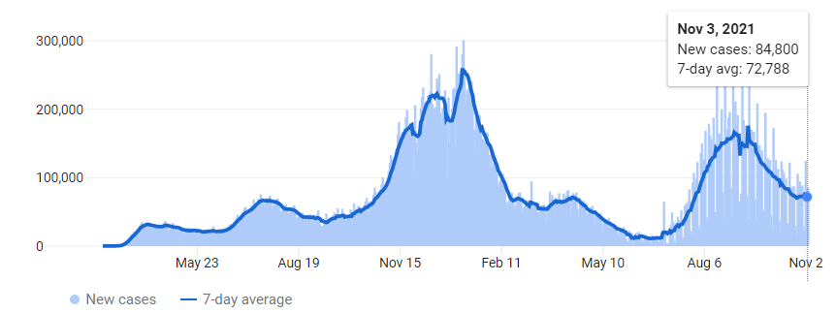
US COVID case trend
6

Slide 7
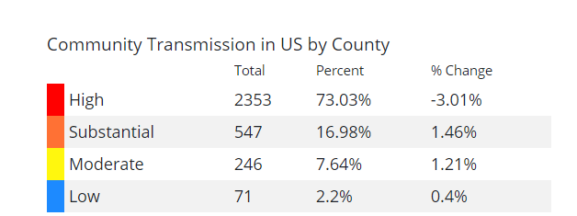
COVID
spreads across the Country
Updated 11/4/21

Slide 8
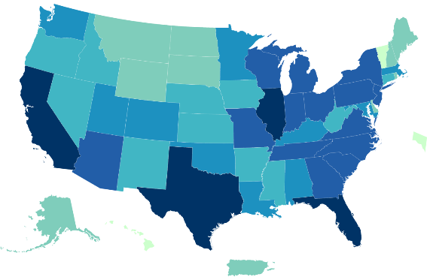
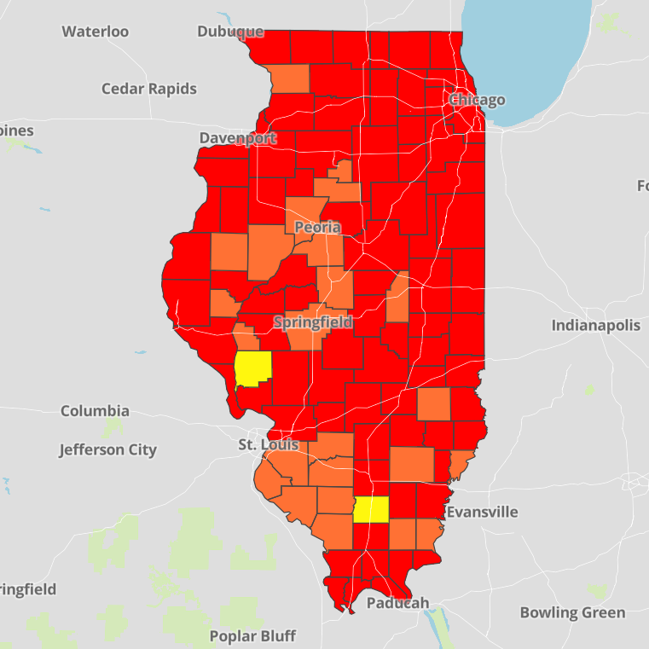
Data Update: November 4, 2021
CDC/IDPH: COVID-19 Outbreak
CDC
https://covid.cdc.gov/covid-data-tracker/#cases_totalcases
IDPH
https://www.dph.illinois.gov/covid19
Total cases: 46,100,477 confirmed
Total deaths: 746,705 confirmed
1,710,044 Confirmed Positive Cases
25,926 Deaths
8

Slide 9
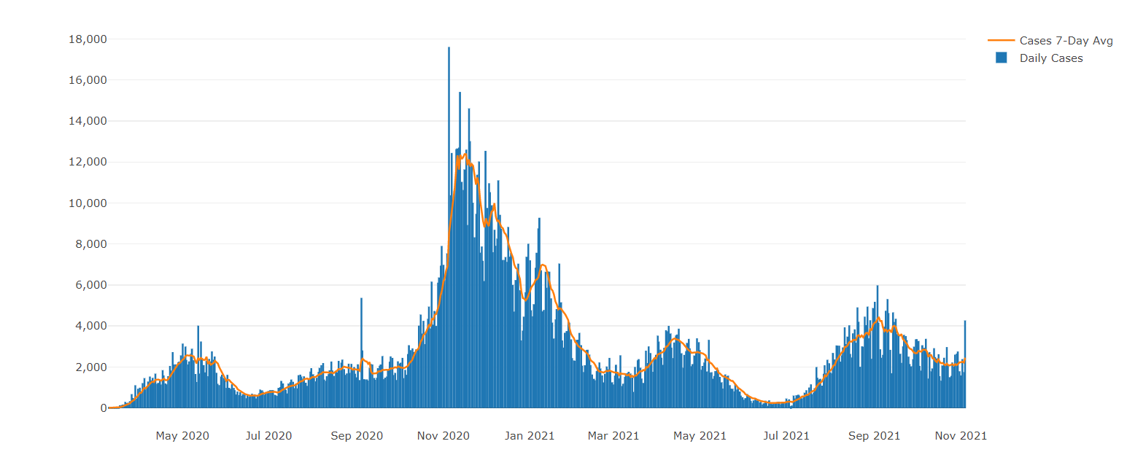
Illinois Daily Incidence
IDPH daily data summary
9

Slide 10
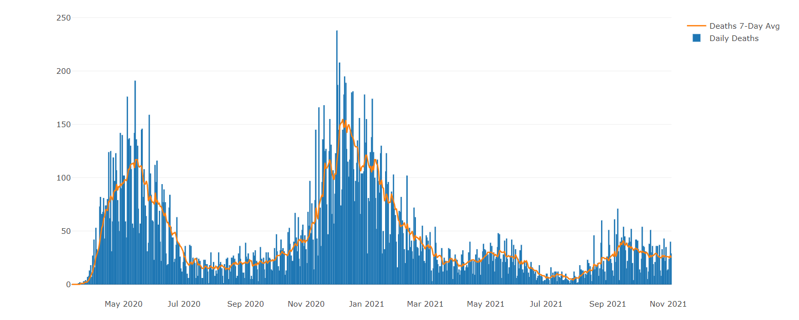
Illinois Covid Deaths
IDPH daily data summary
10

Slide 11
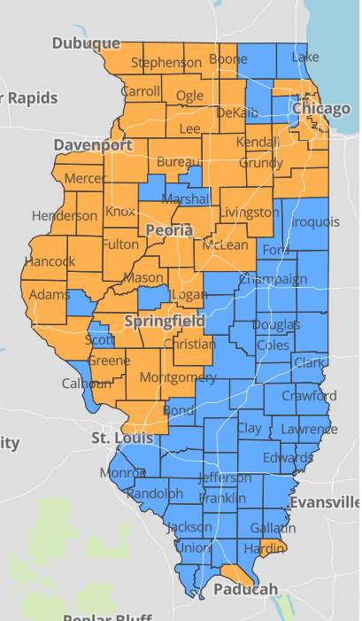
IDPH County Level COVID -19
Risk Metrics
Week 42: 10/17/2021
Through 10/23/2021
Blue indicates that the county is experiencing overall stable COVID-19 metrics.
Orange indicates there are warning signs of increased COVID-19 risk in the county.
11

Slide 12
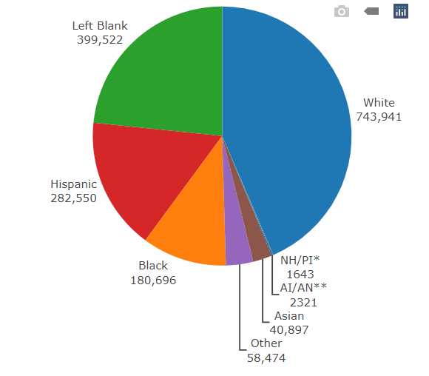
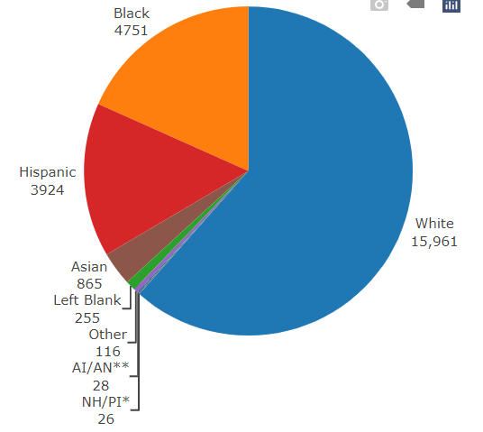
Data Update November 4, 2021 IDPH: COVID-19 Outbreak Race Demographics
https://www.dph.illinois.gov/covid19
Confirmed Cases
Deaths
13

Slide 13
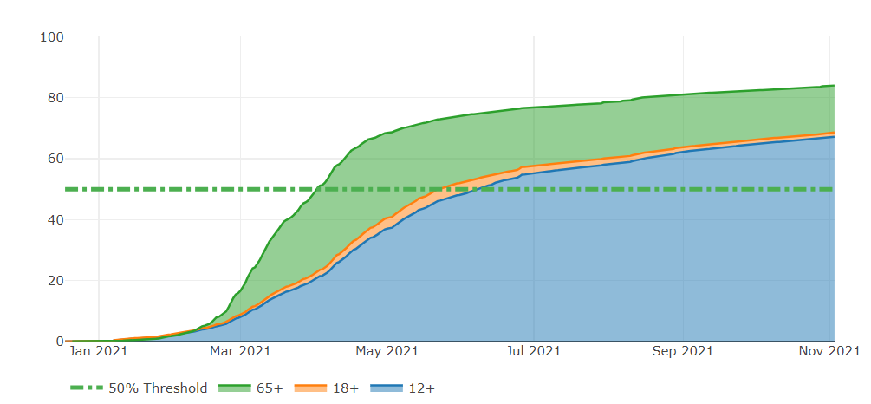
Illinois Population Vaccinated Fully
13

Slide 14
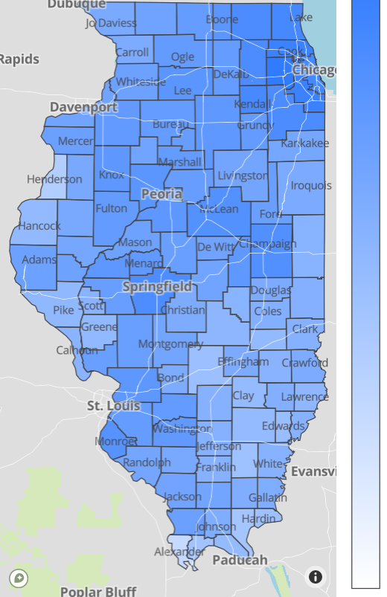
Illinois Daily Reported Administered Vaccine Doses
Last updated 11/4/2021
Illinois Perinatal Quality Collaborative
14

Slide 15
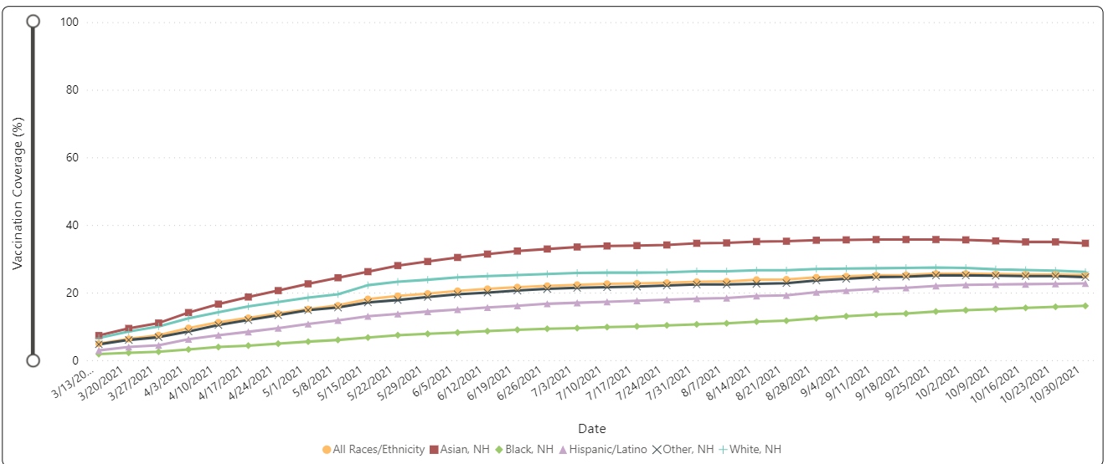
Percent of Pregnant People aged 18-49 years receiving at least one dose of a COVID-19 vaccine during pregnancy overall, by race/ethnicity, and date reported to CDC (10/30/21)
Notes:
https://urldefense.com/v3/__https://covid.cdc.gov/covid-data-tracker/*vaccinations-pregnant-women__;Iw!!Dq0X2DkFhyF93HkjWTBQKhk!BRT8JkbGHSHMqUvlHo57UsXRx3oQL6Au0KIaOe8oN7qp9yWGe1oyTAFdCw-PzSyj1gqEUOSiCw$

Slide 16
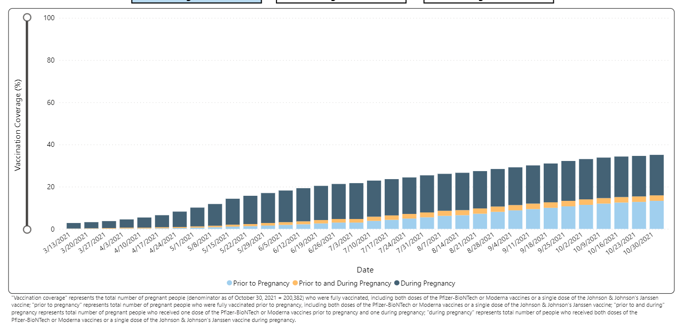
Notes:
https://urldefense.com/v3/__https://covid.cdc.gov/covid-data-tracker/*vaccinations-pregnant-women__;Iw!!Dq0X2DkFhyF93HkjWTBQKhk!AZLmkCzjPqbpDlw3HSvzpeV2yHLjASTwFArm1NOsQ1zqBmsgYQCTjWJcfL5ZsjyF2-lUxyxYPA$

Slide 17
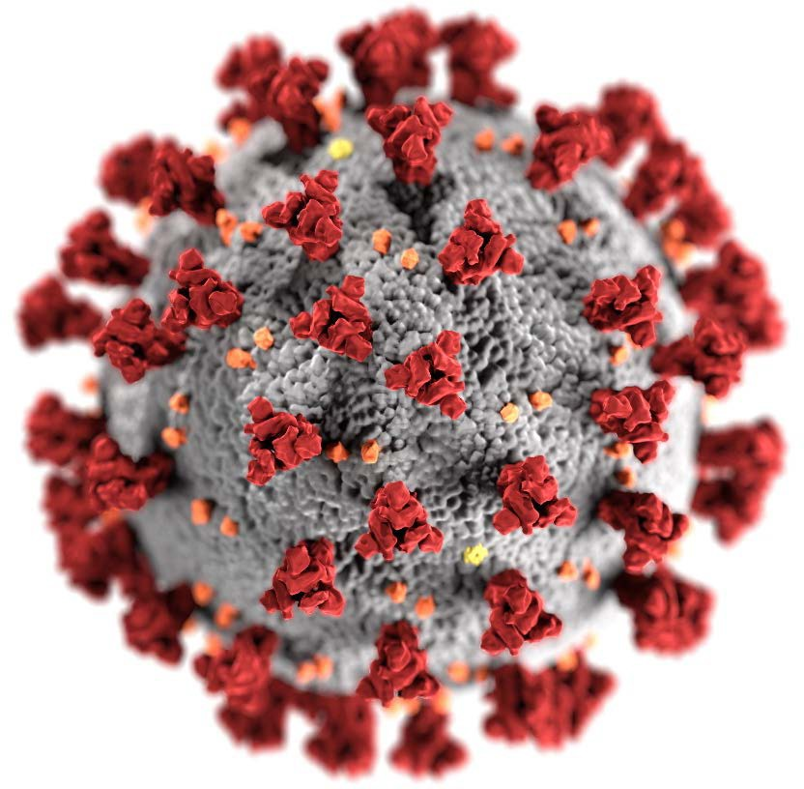
CDC Coronavirus Disease 2019 Response
Updates on COVID-19 and Pregnancy
Dana Meaney-Delman, MD, MPH FACOG Lead, Maternal Immunization
ACIP Meeting September 22, 2021
cdc.gov/coronavirus

Slide 18
COVID-19 cases, ICU admission and death among pregnant people
(National COVID-19 Case Surveillance Data; Jan 22, 2020 – Sep 13, 2021)
16000
100
14000
90
ICU admission (n)
Death (n)
Total pregnant people
80
Total laboratory-confirmed cases
12000
70
Total ICU admission or deaths
10000
women
60
8000
50
6000
40
30
4000
20
2000
10
0
0

Slide 19
Severe illness and death for symptomatic pregnant women with COVID-19 compared to symptomatic nonpregnant women
No. (%)*
Outcomes of Interest | Symptomatic Pregnant women with COVID-19 | Symptomatic Nonpregnant women with COVID-19 | Crude RR (95% CI) | aRR (95% CI) †
 | (N = 23,434) | (N = 386,028)
ICU Admission | 245 (1.1) | 1,492 (0.4) | 2.7 (2.4-3.1) | 3.0 (2.6-3.4)
Mechanical Ventilation | 67 (0.3) | 412 (0.1) | 2.7 (2.1-3.5) | 2.9 (2.2-3.8)
ECMO§ | 17 (0.1) | 120 (0.0) | 2.3 (1.4-3.9) | 2.4 (1.5-4.0)
Death | 34 (0.2) | 447 (0.1) | 1.3 (0.9-1.8) | 1.7 (1.2-2.4)
* Percentages calculated among total in pregnancy status group; those with missing data on outcomes were counted as not having the outcome
† Adjusted for age, race/ethnicity, and presence of underlying conditions. Nonpregnant women are the referent group.
§ Extracorporeal membrane oxygenation
Zambrano LD, Ellington S, Strid P, et al. Update: Characteristics of Symptomatic Women of Reproductive Age with Laboratory-Confirmed SARS-CoV-2 Infection by Pregnancy Status — United States, January 22–October 3, 2020. MMWR Morb Mortal Wkly Rep. ePub: 2 November 2020.
DOI: http://dx.doi.org/10.15585/mmwr.mm6944e3external icon.

Slide 20
CDC: COVID-19 Vaccination for Pregnant People to Prevent Serious Illness, Deaths, and Adverse Pregnancy Outcomes from COVID-19. (9.29.21)
As of September 27, 2021, more than 125,000 laboratory-confirmed COVID-19 cases have been reported in pregnant people, including more than 22,000 hospitalized cases and 161 deaths.¹
The highest number of COVID-19-related deaths in pregnant people (n=22) in a single month of the pandemic was reported in August 2021.
Data from the COVID-19-Associated Hospitalization Surveillance Network (COVID-NET) in 2021 indicate that approximately 97% of pregnant people hospitalized (either for illness or for labor and delivery) with confirmed SARS-CoV-2 infection were unvaccinated.²
In addition to the risks of severe illness and death for pregnant and recently pregnant people, there is an increased risk for adverse pregnancy and neonatal outcomes, including preterm birth and admission of their neonate(s) to an intensive care unit (ICU).

Slide 21
CDC: COVID-19 Vaccination for Pregnant People to Prevent Serious Illness, Deaths, and Adverse Pregnancy Outcomes from COVID-19. (9.29.21)
Healthcare providers should communicate the risks of COVID-19, the benefits of vaccination, and information on the safety and effectiveness of COVID-19 vaccination in pregnancy.
Compared with non-pregnant symptomatic people, symptomatic pregnant people have more than a two-fold increased risk of requiring ICU admission, invasive ventilation, and ECMO, and a 70% increased risk of death.⁶
Healthcare providers should strongly recommend that people who are pregnant, recently pregnant (including those who are lactating), who are trying to become pregnant now, or who might become pregnant in the future receive one of the authorized or approved COVID-19 vaccines as soon as possible.

Slide 22
CDC: COVID-19 Vaccination for Pregnant People to Prevent Serious Illness, Deaths, and Adverse Pregnancy Outcomes from COVID-19. (9.29.21)
CDC recommends urgent action to help protect pregnant people and their fetuses/infants.
CDC recommends urgent action to accelerate primary vaccination for people who are pregnant, recently pregnant (including those who are lactating), who are trying to get pregnant now, or who might become pregnant in the future. Efforts should specifically address populations with lower vaccination coverage and use approaches to reduce racial and ethnic disparities.
In addition, pregnant people should continue to follow all recommended prevention measures and should seek care immediately for any symptoms of COVID-19. Healthcare providers should have a low threshold for increased monitoring during pregnancy due to the risk of severe illness.

Slide 23
CDC Urgent Heath Alert
CDC: only 31 percent of pregnant people have been vaccinated against COVID-19 and vaccination rates vary markedly by race and ethnicity. Vaccination is highest among Asian people who are pregnant (45.7%)
lower among Hispanic or Latino pregnant people (25 percent),
and lowest among Black pregnant people (15.6 percent).
Through September 27th, there were
> 125,000 confirmed cases of COVID-19 in pregnant people
including more than 22,000 hospitalized
and 161 deaths; of which, 22 deaths occurred in the month of August
Cases of COVID-19 in symptomatic, pregnant people have:
a two-fold risk of admission into intensive care
and a 70 percent increased risk of death.
Pregnant people with COVID-19 are at increased risk of adverse pregnancy outcomes that could include preterm birth, stillbirth, and admission into the ICU of a newborn also infected with COVID-19.

Slide 24
CDC: MotherToBaby help line for Covid and pregnancy questions for patients
If you are pregnant and have questions about COVID-19 vaccine
If you would like to speak to someone about COVID-19 vaccination during pregnancy, you can contact MotherToBaby.
MotherToBaby experts are available to answer questions in English or Spanish by phone or chat.
The free and confidential service is available Monday–Friday 8am–5pm (local time).
To reach MotherToBaby: Call 1-866-626-6847
Chat live or send an email MotherToBabyexternal iconexternal icon

Slide 26
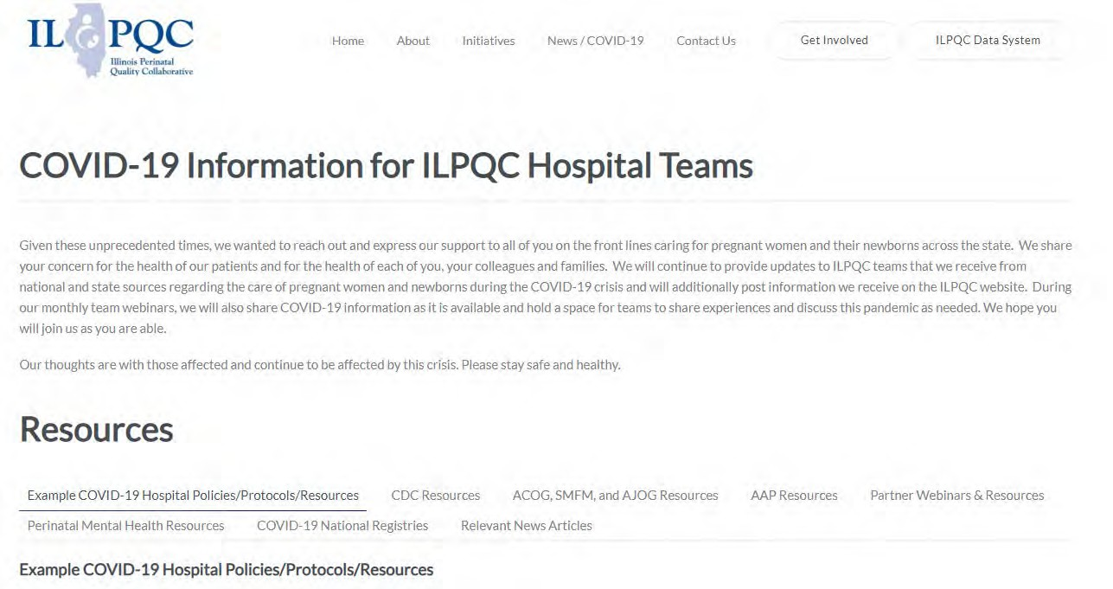
ILPQC COVID-19 Webpage www.ilpqc.org
ILPQC posts national guidelines and OB & Neonatal COVID-19 example hospital protocols & resources
please note dates as guidelines are changing rapidly
https://ilpqc.org/covid-19- information/

Slide 27
Updated OB (ACOG/SMFM) Resources
ACOG: Practice Advisory: Vaccinating Pregnant and Lactating Patients Against COVID-19. (Updated 7.30.21)
ACOG’s COVID-19 Vaccines and Pregnancy: Conversation Guide for Clinicians
SMFM: SMFM Learning: Myth-Busting COVID-19 Vaccines in Pregnancy. (09.10.21)
ACOG: Statement of Strong Medical Consensus for Vaccination of Pregnant Individuals Against COVID-19. (Updated 9.14.21)
ABOG: Statement Regarding Dissemination of COVID-19 Misinformation (9/27/21)
ACOG: Statement on the CDC’s Health Advisory on COVID-19 Vaccination. (9.29.21)
SMFM: Provider Considerations for Engaging in COVID-19 Vaccine Counseling With Pregnant and Lactating Patients. (Updated 10.26.21)
Notes:
ACOG: Statement of Strong Medical Consensus for Vaccination of Pregnant Individuals Against COVID-19. (Updated 9.14.21)
ACOG’s Practice Advisory: COVID-19 Vaccination Considerations for Obstetric-Gynecologic Care
ACOG’s Vaccinating Pregnant Individuals: Eight Key Recommendations for COVID-19 Vaccination Sites
ACOG’s COVID-19 Vaccines and Pregnancy: Conversation Guide for Clinicians
SMFM’s Provider Considerations for Engaging in COVID-19 Vaccine Counseling With Pregnant and Lactating Patients
SMFM’s Covid Vaccination if you are Pregnant or Breastfeeding
TopicsCOVID-19Coronavirus

Slide 28
ACOG President Statement on CDC Health Warning Urging Vaccination for Pregnant People, J. Martin Tucker, MD, FACOG, September 29, 2021
“Despite recommendations from ACOG and the Society for Maternal-Fetal Medicine, as well as other organizations dedicated to maternal health and public health, vaccination rates among pregnant people remain alarmingly low. Unfortunately, obstetrician-gynecologists around the country are witnessing the crisis of unvaccinated pregnant people being hospitalized and dying due to COVID-19 infection. ACOG hopes that the urgent health advisory from the CDC, combined with the existing clear medical consensus in support of vaccination, will encourage pregnant people to choose vaccination.
“Our message cannot be stronger or clearer: please get vaccinated today. Whether you are pregnant, breastfeeding, trying to become pregnant, or plan to get pregnant in the future, vaccination is safe and effective, and is the best way to protect you from severe complications associated with COVID-19 infection. Further, I urge my fellow ACOG members and all maternal health colleagues to strongly, confidently, and clearly recommend COVID-19 vaccination to their pregnant patients.”

Slide 29
ACOG: 9/14/21 Statement of Strong Medical Consensus for Vaccination of Pregnant Individuals Against COVID-19.
“As the leading organizations representing experts in maternal care and public health professionals that advocate and educate about vaccination, we strongly urge all pregnant individuals—along with recently pregnant, planning to become pregnant, lactating and other eligible individuals—to be vaccinated against COVID-19.
“Pregnant individuals are at increased risk of severe COVID-19 infection, including death. With cases rising as a result of the Delta variant, the best way for pregnant individuals to protect themselves against the potential harm from COVID-19 infection is to be vaccinated.
“Data from tens of thousands of reporting individuals have shown that the COVID-19 vaccine is both safe and effective when administered during pregnancy. The same data have been equally reassuring when it comes to infants born to vaccinated individuals. Moreover, COVID-19 vaccines have no impact on fertility.
“Pregnant individuals and those planning to become pregnant should feel confident in choosing vaccination to protect themselves, their infants, their families, and their communities.”

Slide 30
SMFM: Provider Considerations for Engaging in COVID-19 Vaccine Counseling With Pregnant and Lactating Patients (Updated 10.26.21)
SMFM and ACOG recommend that pregnant people, including health care workers, receive a COVID-19 booster shot at least 6 months after their primary series. As with the primary series, the booster dose should be given at any stage during pregnancy and postpartum.

Slide 31
SMFM: Vaccine Booster update 10/26/21
The CDC is currently recommending that for individuals who received a PfizerBioNTech or Moderna COVID-19 vaccine, the following groups are eligible for a booster shot at 6 months or more after their initial series:
• 65 years and older
• Age 18+ who live in long-term care settings
• Age 18+ who have underlying medical conditions
• Age 18+ who work or live in high-risk settings
Pregnancy is included as an underlying medical condition.
For individuals who received the Johnson & Johnson COVID-19 vaccine, booster shots are also recommended for those who are 18 and older and who were vaccinated two or more months ago. Individuals eligible for a booster may choose which vaccine they receive as a booster dose. CDC’s recommendations now allow for a mix and match type dosing for booster shots for people who may have a preference or access for a vaccine type that they did not originally received within their first vaccine series.

Slide 32
Updated Neonatal /AAP Resources
AAP: Supporting Emotional and Behavioral Health during the COVID19 Pandemic. (Updated 7.28.21)
AAP: Post Covid Conditions in Children and Adolescents. (Update 7.28.21)
AAP: Children and COVID-19: State-Level Data Report. (10.28.21)
31

Slide 33
AAP: Children and COVID-19: State-Level Data Report October 28, 2021
Cumulative Number of Child COVID-19 Cases*
6,396,278 total child COVID-19 cases reported, and children represented 16.6% (6,396,278/38,496,700) of all cases
Overall rate: 8,498 cases per 100,000 children in the population
Change in Child COVID-19 Cases*
100,630 child COVID-19 cases were reported the past week from 10/21/21-10/28/21 (6,295,648 to 6,396,278) and children represented 24.2% (100,630/416,059) of the weekly reported cases
Over two weeks, 10/14/21-10/28/21, there was a 4% increase in the cumulated number of child COVID-19 cases since the beginning of the pandemic (218,332 cases added (6,177,946 to 6,396,278))
AAP: Children and COVID-19: State-Level Data Report. (10.28.21)
Illinois Perinatal Quality Collaborative
32
Notes:
Cumulative Number of Child COVID-19 Cases*
6,396,278 total child COVID-19 cases reported, and children represented 16.6% (6,396,278/38,496,700) of all cases
Overall rate: 8,498 cases per 100,000 children in the population
Change in Child COVID-19 Cases*
100,630 child COVID-19 cases were reported the past week from 10/21/21-10/28/21 (6,295,648 to 6,396,278) and children represented 24.2% (100,630/416,059) of the weekly reported cases
Over two weeks, 10/14/21-10/28/21, there was a 4% increase in the cumulated number of child COVID-19 cases since the beginning of the pandemic (218,332 cases added (6,177,946 to 6,396,278))

Slide 34
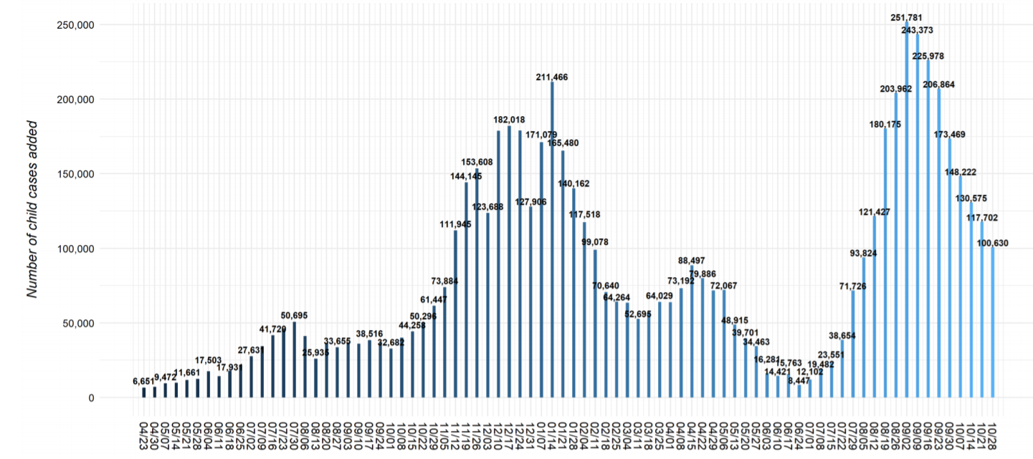
United States: Number of Child COVID- 19 Cases Added in Past Week
10/28/21
Notes:
https://urldefense.com/v3/__https://downloads.aap.org/AAP/PDF/AAP*20and*20CHA*20-*20Children*20and*20COVID-19*20State*20Data*20Report*2010.28*20FINAL.pdf__;JSUlJSUlJSUlJSU!!Dq0X2DkFhyF93HkjWTBQKhk!D-5cLBvIfiAilowD-9iaFSXEv05rxtamH43ejHiNr9camtO54UkH9Gg-63tHO9_EOFBqpED4TA$

Slide 35
Covid-19 Hospitalization Rates in Children in the United States, through October 30, 2021
https://gis.cdc.gov/grasp/COVIDNet/COVID19_3.html

Slide 36
Updated OB/Neo Covid Publications
NEJM - Breakthrough infections in vaccinated healthcare workers. (7.28.21)
Bloomberg: Pregnant, Unvaccinated and Intubated: Case Surge Alarms Doctors. (8.23.21)
AJOG: Monoclonal antibody treatment of symptomatic COVID-19 in pregnancy: initial report. (8.25.21)
NEJM: Resurgence of SARS-CoV-2 Infection in a Highly Vaccinated Health System Workforce. (9.9.21)
NEJM: Receipt of mRNA COVID-19 vaccines preconception and during pregnancy and risk of self-reported spontaneous abortions. (09.8.21)
The Lilly: Pregnancy and coronavirus vaccines: Your questions answered. (9.24.21)
Plos Medicine: Incidence, co-occurrence, and evolution of long-COVID features: A 6-month retrospective cohort study of 273,618 survivors of COVID-19. (09.28.2021)
NHS encourages pregnant women to get COVID-19 vaccine (10.11.21)
JAMA: Short-term and Long-term Rates of Postacute Sequelae of SARS-CoV-2 Infection. (10.13.21)
34

Slide 37
JAMA: Characteristics and Outcomes of Women With COVID-19 Giving Birth at US Academic Centers During the COVID-19 Pandemic. (08.11.21)
499 US Academic medical centers, Among 869 079 women, 18 715 (2.2%) had COVID-19, and 850 364 (97.8%) did not.
Expectant mothers with COVID-19 are 40% more likely to deliver their babies prematurely, according to a study co-authored by UCIrvine Health surgeon Dr. Ninh T. Nguyen,
A COVID-19 infection during pregnancy also poses a five times greater risk for intensive care treatment during childbirth, according to the study published by JAMA Network Open.
"For expectant mothers, it is important to take steps to minimize the risk of COVID-19 infection," said Nguyen, chair of the UCI School of Medicine's Department of Surgery. "Infection at the time of childbirth is associated with higher risk for ICU admission, preterm birth and even death."

Slide 38
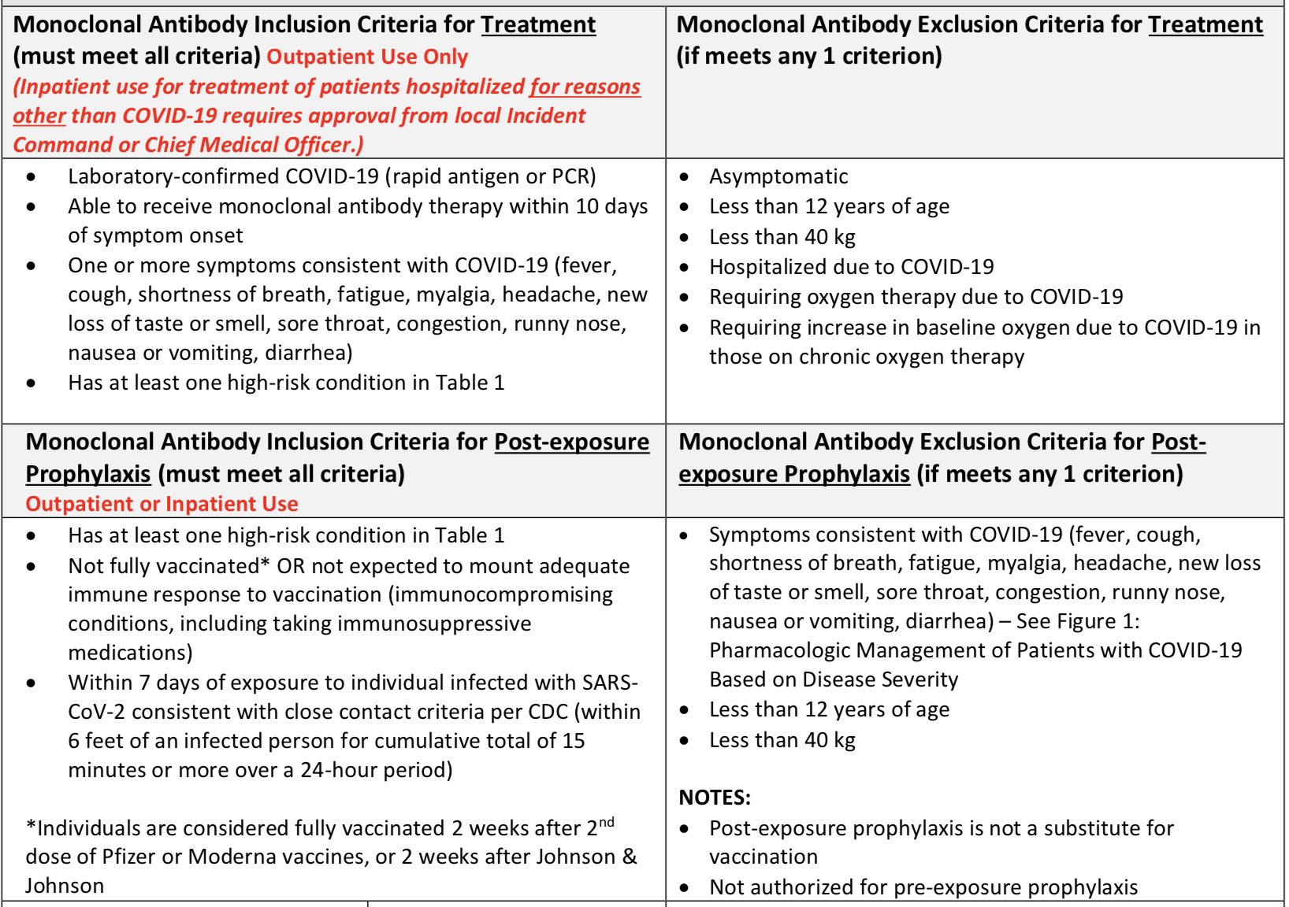
Barnes Jewish BJC monoclonal antibodies protocol
AJOG: Monoclonal antibody treatment of symptomatic COVID-19 in pregnancy: initial report. (8.25.21)

Slide 39
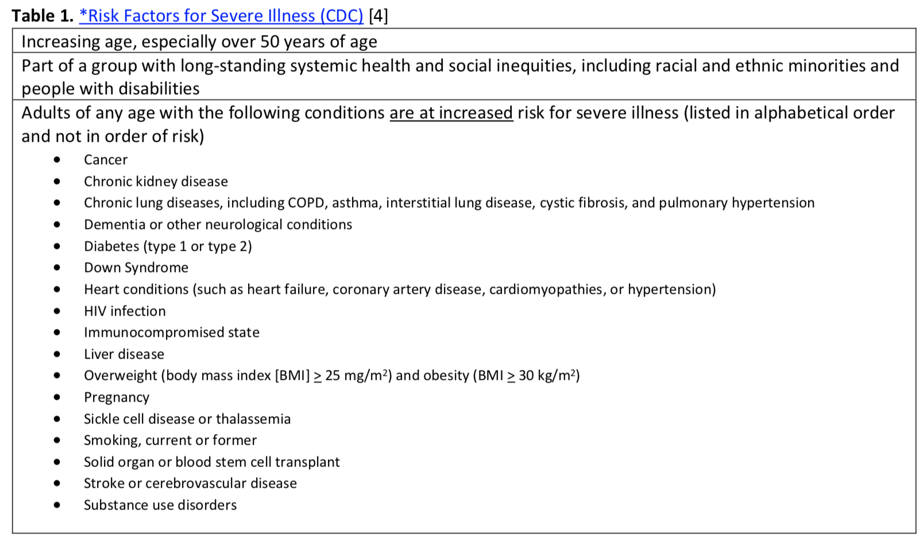

Slide 40
Zauche LH, Wallace B, Smoots AN, et al. Receipt of mRNA COVID-19 vaccines and risk of spontaneous abortions. New Engl J Med Published online September 8, 2021
Among 2,456 pregnant persons who received an mRNA COVID-19 vaccine preconception or prior to 20 weeks' gestation, the cumulative risk of SAB from 6-19 weeks' gestation was 14.1%.
Among recognized pregnancies in high-income countries, 11-16% end in spontaneous abortion (SAB).
Conclusions When compared to the expected range of SABs in recognized pregnancies, these data suggest receipt of an mRNA COVID-19 vaccine preconception or during pregnancy is not associated with an increased risk of SAB. These findings add to accumulating evidence that mRNA COVID-19 vaccines during pregnancy are safe.
NEJM: Receipt of mRNA COVID-19 vaccines preconception and during pregnancy and risk of self-reported spontaneous abortions. (09.8.21)

Slide 41
Plos Medicine: Incidence, co-occurrence, and evolution of long-COVID features: A 6-month retrospective cohort study of 273,618 survivors of COVID-19. (09.28.2021)
Electronic health records (EHRs) data from 81 million patients including 273,618 COVID-19 survivors.
The incidence and co-occurrence within 6 months after COVID-19 diagnosis were calculated for 9 core features of long-COVID:
breathing difficulties/breathlessness, fatigue/malaise,
chest/throat pain, headache, abdominal symptoms,
myalgia, other pain, cognitive symptoms, and anxiety/depression.
Comparison with a propensity score–matched cohort of patients diagnosed with influenza during the same time period

Slide 42
Plos Medicine: Incidence, co-occurrence, and evolution of long-COVID features: A 6-month retrospective cohort study of 273,618 survivors of COVID-19. (09.28.2021)
Among COVID-19 survivors (mean age: 46.3) 57% had one or more long-COVID feature recorded during the whole 6-month period, and 37% between 3 and 6 months.
The incidence of each feature was:
abnormal breathing (18.7%; 7.94% 3-6 month period),
fatigue/malaise (12.82%; 5.87%),
chest/throat pain (12.60%; 5.71%),
headache (8.67%; 4.63%), other pain (11.60%; 7.19%),
abdominal symptoms (15.58%; 8.29%), myalgia (3.24%; 1.54%), cognitive symptoms (7.88%; 3.95%),
and anxiety/depression (22.82%; 15.49%).
All 9 features were more frequently reported after COVID-19 than after influenza (excess incidence of 16.60%, all p < 0.001)

Slide 43
Jama: Short-term and Long-term Rates of Postacute Sequelae of SARS-CoV-2 Infection. (10.13.21)
57 studies with 250 351 survivors of COVID-19 met inclusion criteria. The mean age of survivors was 54.4 years
The median (IQR) proportion of COVID-19 survivors experiencing at least 1 PASC was 54.0% at 1 month (short-term), 55.0% at 2 to 5 months (intermediate-term), and 54.0% at 6 or more months (long-term).
Most prevalent pulmonary sequelae, neurologic disorders, mental health disorders, functional mobility impairments, and general and constitutional symptoms were chest imaging abnormality (62.2%), difficulty concentrating (23.8%), generalized anxiety disorder (29.6%), general functional impairments (44.0%), and fatigue or muscle weakness ( 37.5%), respectively.
Conclusions and relevance: In this systematic review, more than half of COVID-19 survivors experienced PASC 6 months after recovery. The most common PASC involved functional mobility impairments, pulmonary abnormalities, and mental health disorders.

Slide 44
IDPH / HFS / CDC
CDC: New CDC Data: COVID-19 Vaccination Safe for Pregnant People. (8.11.21)
CDC: Receipt of mRNA COVID-19 vaccines preconception and during pregnancy and risk of self-reported spontaneous abortions. (8.9.21)
• CDC: Percent of Pregnant People aged 18-49 years receiving at least one dose of a COVID-19 vaccine during pregnancy. (9.4.21)
CDC: Monitoring Incidence of COVID-19 Cases, Hospitalizations, and Deaths, by Vaccination Status — 13 U.S. Jurisdictions. (9.17.21)
CDC Official Health Advisory : COVID-19 Vaccination for Pregnant People to Prevent Serious Illness, Deaths, and Adverse Pregnancy Outcomes from COVID-19. (9.29.21)
CDC: Expands Eligibility for COVID-19 Booster Shots (10.21.21)
CDC: Recommends Pediatric COVID-19 Vaccine for Children 5 to 11 Years. (11.02.21)
37

Slide 45
CDC: Expands Eligibility for COVID-19 Booster Shots (10.21.21)
For individuals who received a Pfizer-BioNTech or Moderna COVID-19 vaccine, the following groups are eligible for a booster shot at 6 months or more after their initial series:
65 years and older
Age 18+ who live in long-term care settings
Age 18+ who have underlying medical conditions (including pregnant/postpartum)
Age 18+ who work or live in high-risk settings
For the nearly 15 million people who got the Johnson & Johnson COVID-19 vaccine, booster shots are also recommended for those who are 18 and older and who were vaccinated two or more months ago.
Individuals may choose which vaccine they receive as a booster. Some people may have a preference for the vaccine type that they originally received, and others may prefer to get a different booster. CDC’s recommendations now allow for this type of mix and match dosing for booster shots.

Slide 47
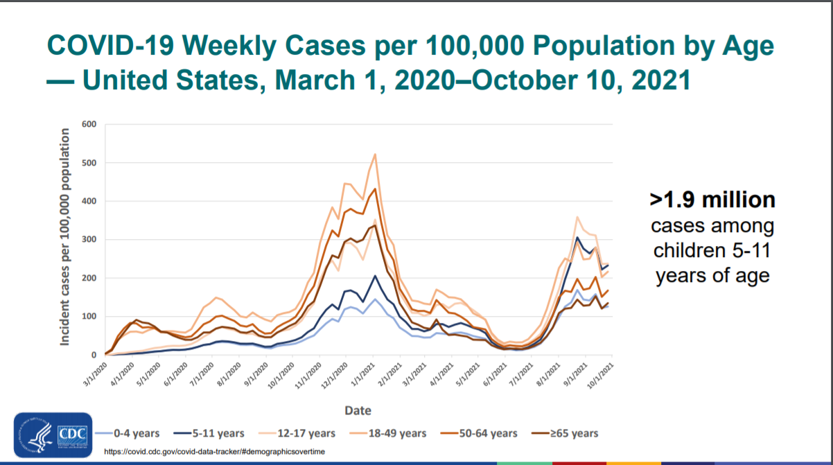

Slide 49
CDC Recommends Pediatric COVID-19 Vaccine for Children 5 to 11 Years (November 2, 2021)
CDC endorsed the ACIP recommendation that children 5 to 11 years old be vaccinated against COVID-19 with the Pfizer pediatric vaccine. Extending vaccination to about 28 million children in the United States in this age group and allows providers to begin vaccinating them as soon as possible.
COVID-19 cases in children can result in hospitalizations, deaths, MIS-C (inflammatory syndromes) and long-term complications, such as “long COVID,” in which symptoms can linger for months.
The spread of the Delta variant resulted in a surge of COVID-19 cases in children throughout the summer. During a 6-week period in late June to mid-August, COVID-19 hospitalizations among children and adolescents increased fivefold.
Similar to what was seen in adult vaccine trials, vaccination was nearly 91 percent effective in preventing COVID-19 among children aged 5-11 years.
Vaccine side effects were mild, self-limiting, and similar to those seen in adults and other vaccines for children. The most common side effect was a sore arm.

Slide 50
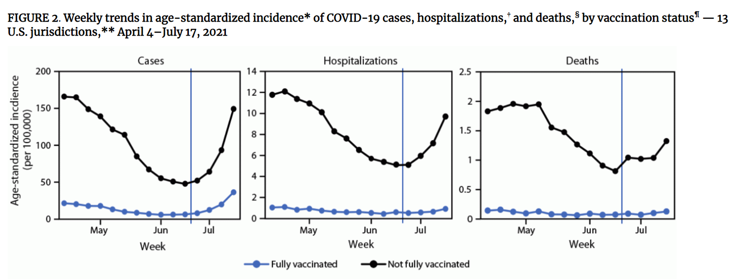
CDC MMWR: Incidence of cases, hospitalizations and deaths by vaccination status noting when > 50% cases Delta variant
CDC MMWR: Monitoring Incidence of COVID-19 Cases, Hospitalizations, and Deaths, by Vaccination Status — 13 U.S. Jurisdictions, April 4–July 17, 2021. (09.17.21)
Notes:
https://www.cdc.gov/mmwr/volumes/70/wr/mm7037e1.htm#F2_down

Slide 51
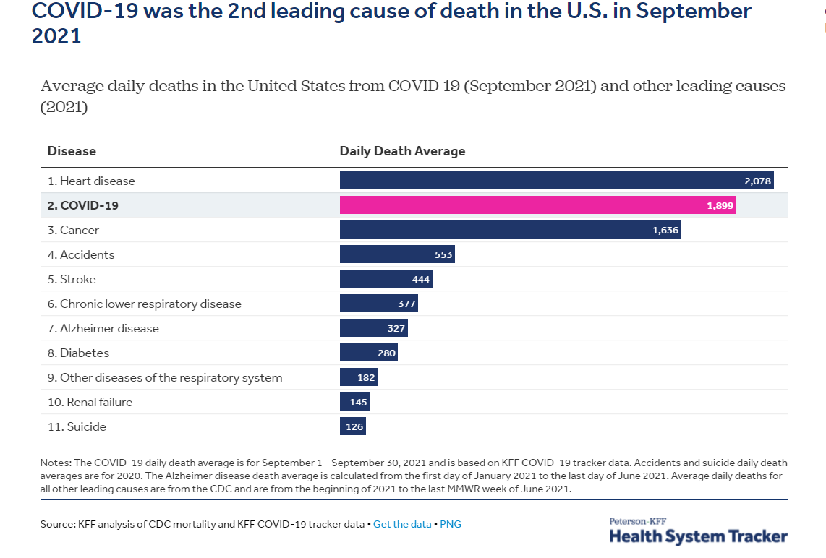

Slide 53
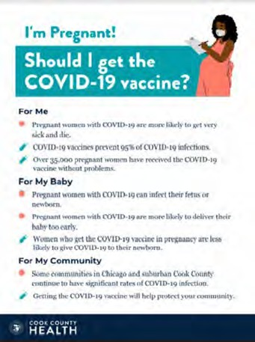
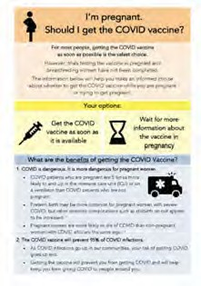
COVID Vaccine
Patient Education Examples
University of Massachusetts Medical School – Baystate: Covid Vaccine Info for Pregnant/Breastfeeding Patients English.
Available in:
Spanish, Nepali, Portuguese, Arabic, Turkish, Somali, Chinese, Vietnamese, Russian (3.17.21)
SMFM Patient Education (English/Spanish): COVID-19 Vaccines and Pregnancy. (3.4.21)
CDC: Safety of COVID-19 Vaccines. Video link. (Updated 6.8. 2021)
Cook County Health: Should I get the COVID-19 vaccine?
Flyer English and Spanish (6.11.21)
CDC: Information about COVID-19 Vaccines for People who Are Pregnant or Breastfeeding. (3.18.21)

Slide 54
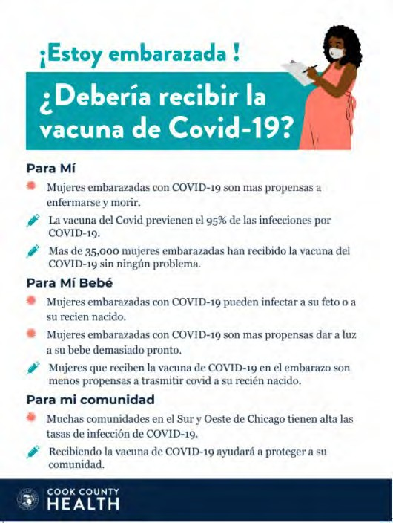
POSTERS

Slide 55
OB Discussion Panel
Discussion of OB Unit Strategies
Helen Cejtin, MD, MPH – Attending Physician, Obstetrics and Gynecology, Cook County Health
Ashish Premkumar, MD – Maternal-Fetal Medicine, John H. Stroger, Jr. Hospital of Cook County
Layan Alrahmani, MD – Maternal Fetal Medicine, Loyola University Medical Center

Slide 56
Neonatal Discussion Panel
Justin Josephsen, MD – Medical Director, St. Mary’s Hospital NICU, Neonatologist Cardinal Glennon Children’s Hospital, St. Louis
Leslie Caldarelli, MD – NICU Director, Prentice Women's Hospital, Chicago

Slide 57
Thanks to our Funders
In kind support:

